Slide 1

MiniProject(19AI701) – Review 3
REHABBOT - AI MENTAL HEALTH THERAPIST
Submitted by:
AKSHAYAA M(212222230009)
2022-2026 Batch
TEAM NO:225
Under the guidance of:
SWEDHA V
Assistant Professor,Department of IT
DEPARTMENT OF ARTIFICIAL INTELLIGENCE AND DATA SCIENCE
SAVEETHA ENGINEERING COLLEGE
(Autonomous Institution – UGC, Govt. of India)
(Affiliated to Anna University, Approved by AICTE - Accredited by NBA & NAAC – ‘A’ Grade - ISO 9001:2015 Certified)
Saveetha Nagar, Thandalam, Chennai-602 105, TamilNadu, INDIA.

Slide 2
Agenda
Introduction
Statement of the Problem
Scope of the project
Methodology
Architectural Diagram
Flow
Algorithm used
Design - Use Case Diagram, Class Diagram
Implementation
Important code segments
Output, Results
Test Cases
Conclusions
Future work
References

Slide 3
Introduction
The "RehabBot" project is an AI-powered web application designed to support individuals facing mental health challenges.
It offers an interactive chatbot for empathetic conversations, helping users navigate their mental health journeys.
Key features include a sleep survey that assesses sleep quality, providing personalized advice to improve sleep and mental well-being.
Additionally, the app has a section for positive affirmations with motivational messages and images to inspire resilience.
With a user-friendly interface, RehabBot aims to create a safe space, promote mental health awareness, and empower users to improve their quality of life.

Slide 4
Statement of the Problem
The "RehabBot" project tackles the urgent need for accessible mental health support, especially in today’s high-stress environment where stigma, cost, and limited access can be major barriers.
It provides an AI-driven platform with an interactive chatbot that offers immediate, personalized support.
Key features include a sleep survey to help users assess and improve sleep quality, along with a section for positive affirmations to boost mental resilience.
RehabBot aims to empower users to manage their mental health, enhance their quality of life, and reduce the stigma around mental health care.

Slide 5
Scope of the project
Scope:​
The "RehabBot" project focuses on providing accessible, AI-driven mental health support through a web-based application.
It offers personalized tools like a chatbot, sleep assessment surveys, and positive affirmations to enhance mental well-being.
Target Audience:​
RehabBot is designed for individuals experiencing mental health challenges, particularly those facing barriers to traditional support such as cost, stigma, or availability
Deliverables:​

Slide 6
Scope of the project
Inclusions:
Customizable chatbot responses to adapt to user needs.
Daily or periodic sleep and mental wellness assessments.
Motivational and mental well-being resources, such as affirmations and coping strategies.
Data-driven insights for users on how sleep patterns and other factors affect mental health.
Exclusions:
Diagnosis: RehabBot is not intended to diagnose any mental health conditions.
Medical Advice: The platform will not provide clinical recommendations, prescriptions, or any form of medical treatment.
Crisis Support: RehabBot is not a substitute for crisis intervention; emergency contacts will be recommended for users in immediate need.

Slide 7
Scope of the project
Data:
User-Provided Data: Information collected from user interactions, such as sleep patterns and responses to surveys.
Privacy & Security: User data will be securely stored, anonymized where possible, and used strictly to enhance user experience and tailor suggestions.
Limitations:
AI Limitations: Chatbot responses may lack the depth and adaptability of a human counselor, especially in complex mental health situations.
Dependency on User Input: The quality of recommendations depends on accurate and honest responses from users.
Resource Constraints: Limited by the scope of data available, particularly in assessing diverse mental health conditions or predicting mental health outcomes.

Slide 8
Methodology
Methodology for RehabBot - AI Mental Health Therapist
Chatbot Framework and User Interaction
RehabBot utilizes Dialogflow for its natural language processing capabilities, allowing it to recognize and respond to specific mental health “intents” like stress management and coping strategies. Each intent is tied to a relevant and empathetic response, enabling RehabBot to engage users with tailored advice and support, fostering a responsive and understanding user experience.
Sleep Survey Design and Implementation
The sleep survey module collects both quantitative (hours slept) and qualitative (perceived sleep quality and consistency) data. It computes a “Sleep Rating” on a 10-point scale based on sleep adequacy, quality, consistency, and pre-sleep stress, giving users a quick overview of their sleep health. Personalized suggestions are offered when ratings fall below a threshold, helping users improve their sleep habits.
Affirmations Section
The affirmations section features visually soothing, high-resolution image cards with positive messages designed to evoke calmness and encourage a positive mindset. This section is passive, requiring no user interaction, creating a serene and uplifting experience for users seeking encouragement.

Slide 9
Methodology
Methodology for RehabBot - AI Mental Health Therapist
D. User Flow and Interaction
The RehabBot interface is simple and user-friendly, with a layout that prominently displays core features: chatbot access, the sleep survey, and affirmations. Users can focus on one feature at a time—chatbot support, sleep survey, or affirmation viewing—ensuring a streamlined, low-cognitive-load experience.
E. Technical Implementation of the Survey Form Reset Function
To protect user privacy, the survey form resets automatically after each session, erasing prior entries. Conditional checks ensure all fields are completed before submission, maintaining data integrity and enhancing the accuracy of the sleep assessment and recommendations.

Slide 10
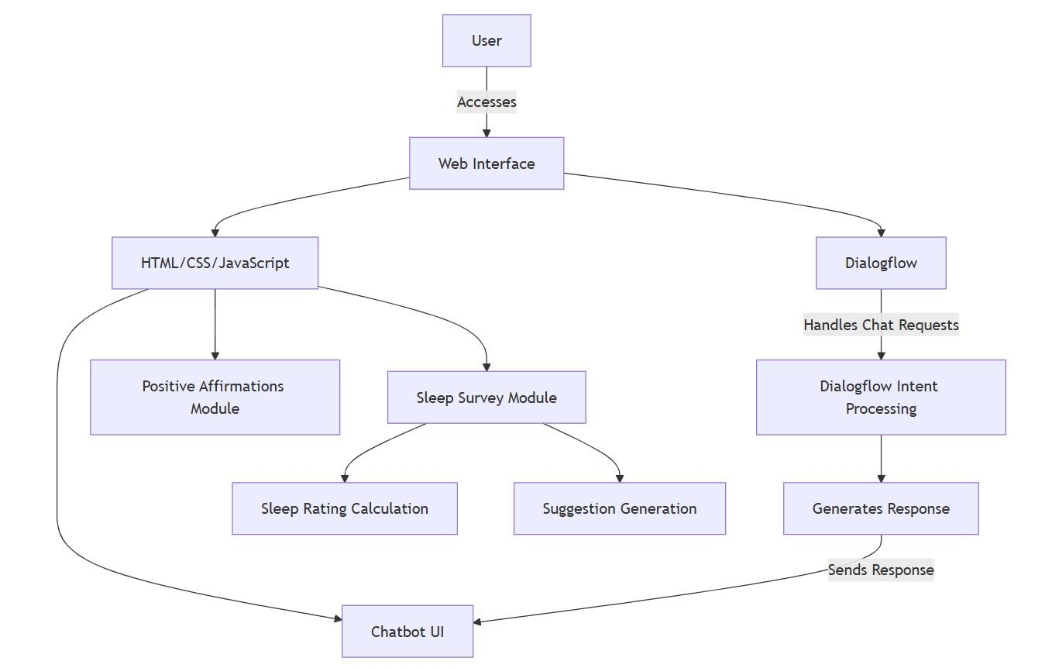
Architecture Diagram/Flow

Slide 11
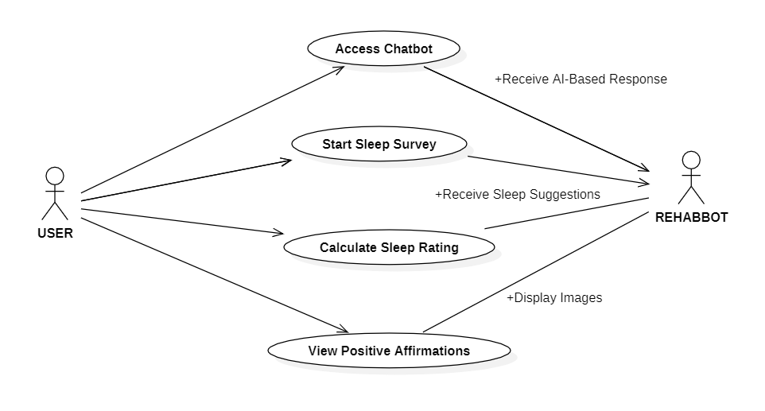
Use Case Diagram
.

Slide 12
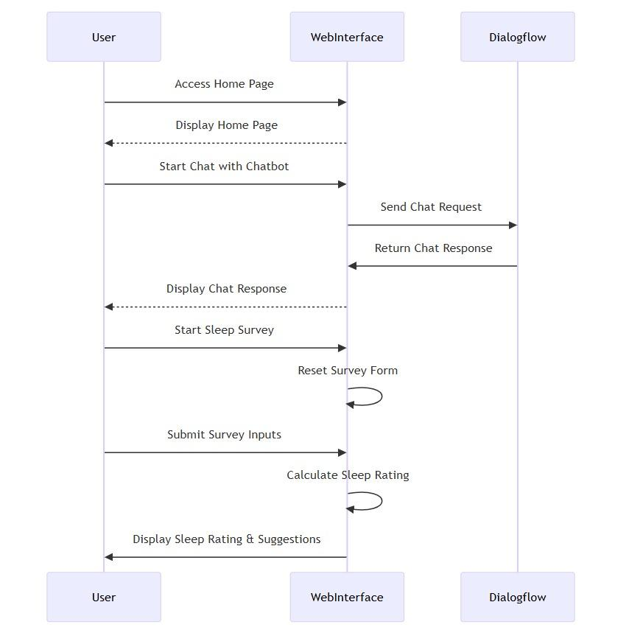
Sequence Diagram

Slide 13
Algorithms used
The project will be using the following algorithms:
The front end is developed using HTML, CSS, and JavaScript to create an interactive user interface for the mental health chatbot.
Users can interact with the chatbot to receive mental health support and positive affirmations.
The chatbot utilizes Dialogflow to handle user intents and provide relevant responses based on the user's queries.
The system also includes analytics to monitor user engagement and improve the chatbot's performance over time.

Slide 14
Algorithms used
Dialogflow:
➢Dialogflow is a natural language processing platform developed by Google that enables developers to create conversational interfaces for applications. It allows for the design and deployment of chatbots and voice assistants capable of understanding user intents and responding intelligently across multiple platforms.
➢Natural Language Understanding (NLU): Dialogflow uses advanced NLU capabilities to understand and process user input in natural language. This allows developers to create conversational interfaces that can interpret user intents and extract relevant entities from the input..

Slide 15
Algorithms used
➢Multi-Platform Support: Dialogflow enables the development of chatbots and voice applications across various platforms, including Google Assistant, Facebook Messenger, Slack, and more. This versatility makes it easy to reach users on their preferred platforms.
➢Integration with Machine Learning: Dialogflow leverages machine learning to improve the accuracy of intent recognition over time. The system learns from user interactions, which enhances its ability to provide relevant and contextually appropriate responses.
➢Easy-to-Use Interface: Dialogflow provides a user-friendly interface for building and managing conversational agents. The visual flow builder and pre-built templates simplify the development process, making it accessible for both beginners and experienced developers.

Slide 16
Hardware and software selection
Hardware Requirements:
Processor: Intel Core i5 or higher
Hard disk: 256 GB SSD (minimum)
RAM: 8 GB (minimum)
Keyboard: Standard 104 keys enhanced
Software Requirements:
Operating system: Windows 10, 11, or Linux (Ubuntu)
Language: HTML, CSS, JAVASCRIPT.

Slide 17
Implementation
For the implementation of the RehabBot project, core technologies include HTML, CSS, and JavaScript for developing the user interface and creating an interactive and accessible web environment. Google Dialogflow was employed to handle the chatbot interactions, allowing for natural language processing to provide mental health support responses. The design emphasizes a user-friendly layout, with a dedicated section for a sleep survey that assesses sleep health through user input. Each component, from the chatbot interactions to the sleep survey, is fully integrated into the website without the need for a backend, allowing users to access mental health tools directly from the web interface.

Slide 18
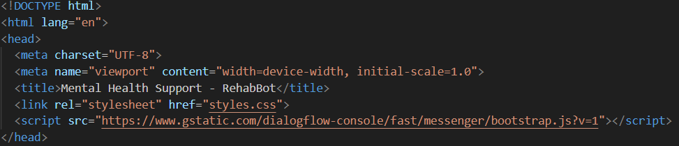
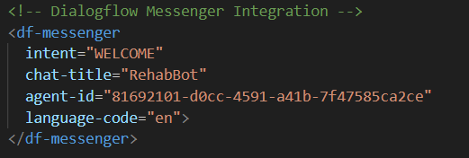
Important Code segments
INTEGRATION OF DIALOGFLOW

Slide 19
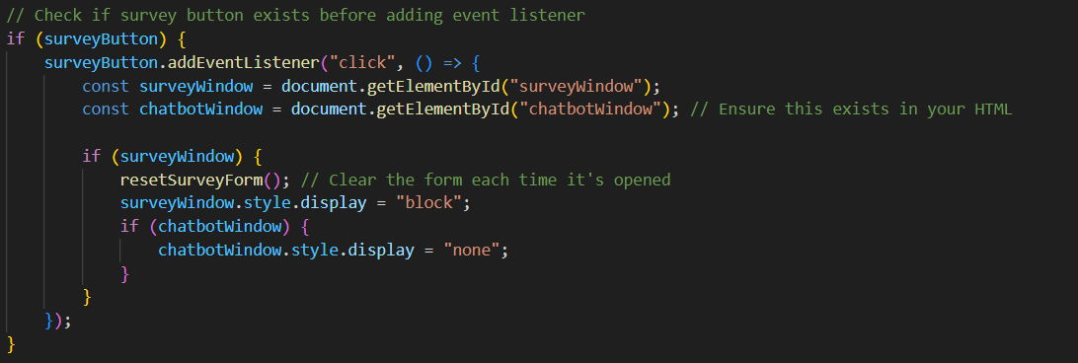
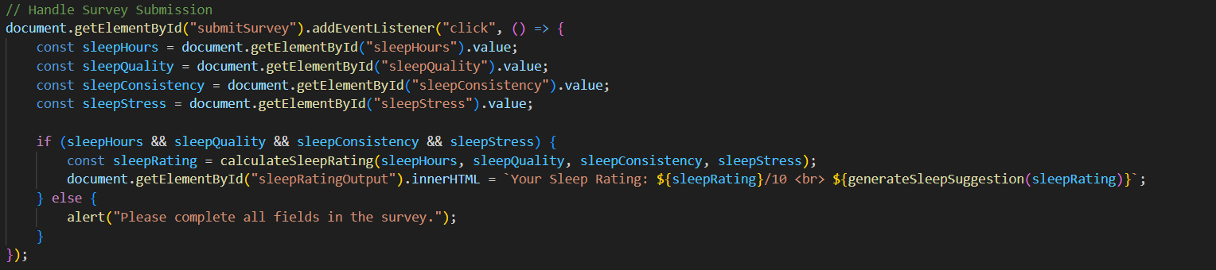
Important Code segments
SLEEP SURVEY BUTTON

Slide 20
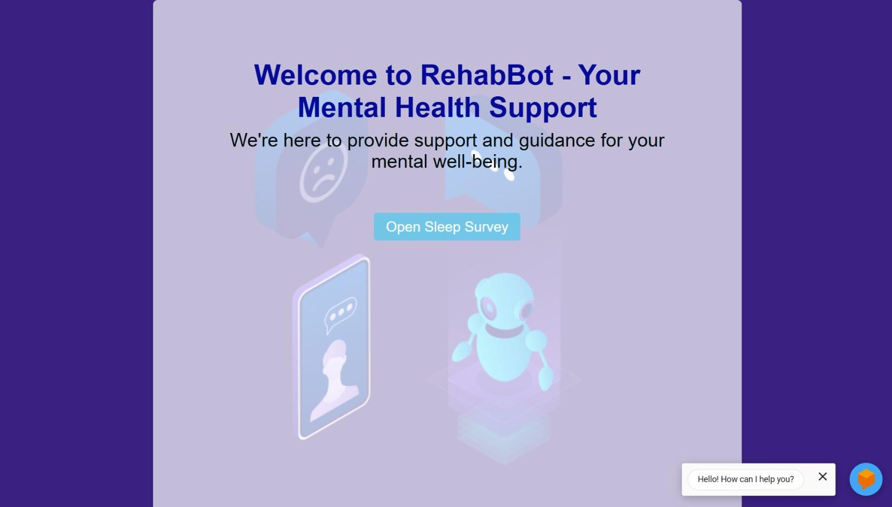
Output
HOME PAGE

Slide 21
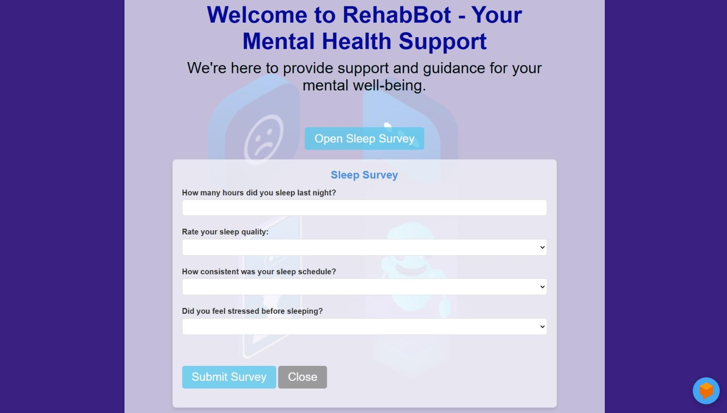
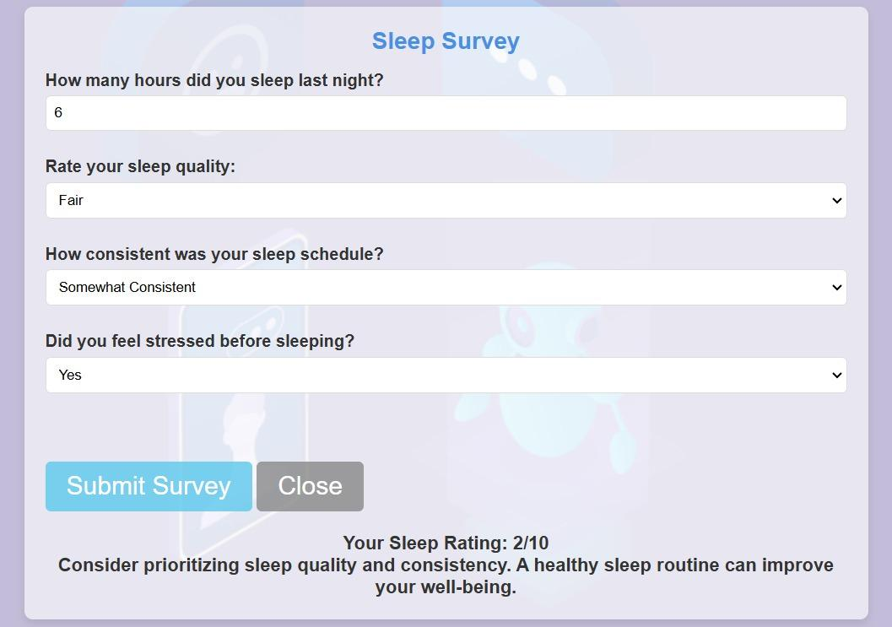
Output
SLEEP SURVEY

Slide 22
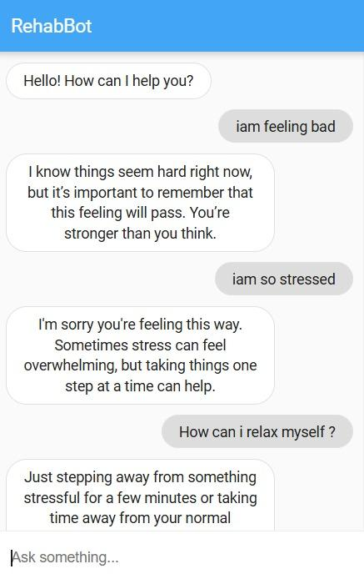
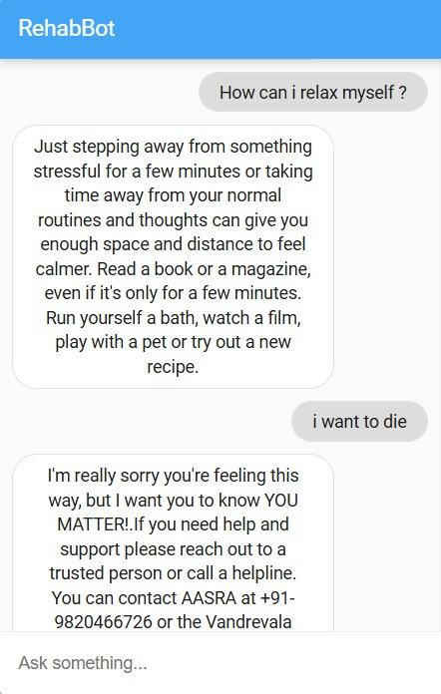
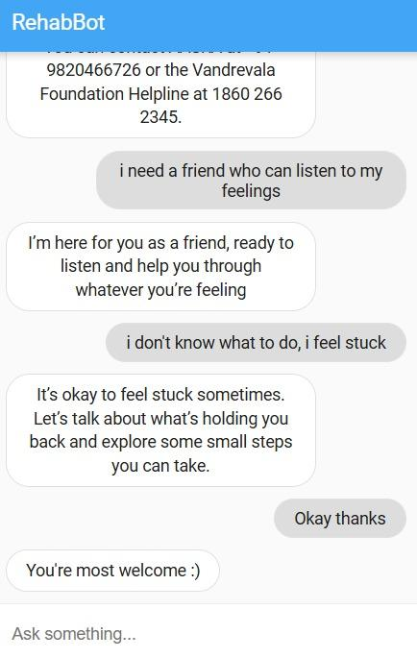
Output
CONVERSATION WITH REHABBOT

Slide 23
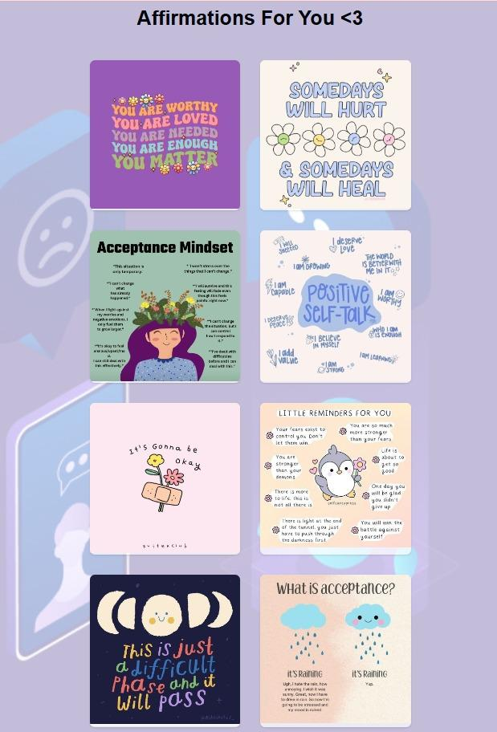
Output
POSITIVE AFFIRMATIONS

Slide 24
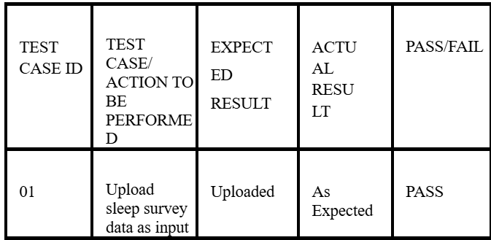
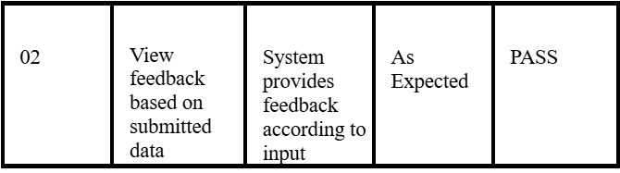
Test Cases
Test Case : 01

Slide 25
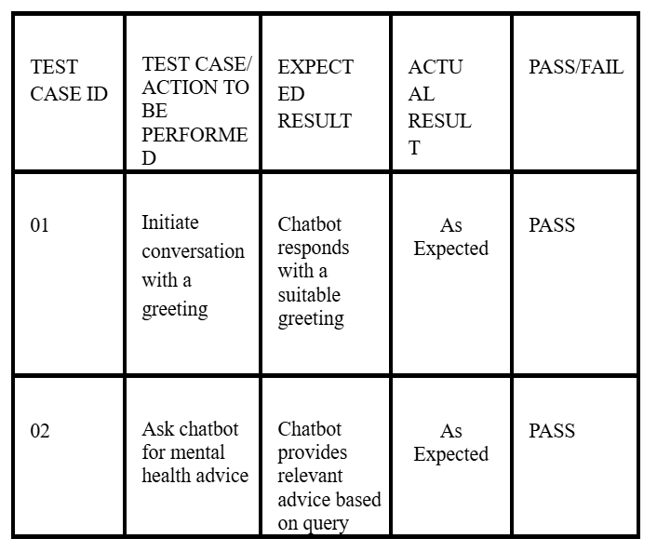
Test Cases
Test Case : 02

Slide 26
Results
Home Page: The homepage offers a welcoming and accessible starting point for users, with intuitive navigation that directs them to RehabBot's core features. This clear structure enhances the onboarding experience.
Chatbot Interaction: The main interface is a conversational AI-driven chatbot designed to offer mental health support. It provides personalized responses powered by a pre-trained Dialogflow model, creating a supportive atmosphere for users to seek guidance. User feedback indicates positive experiences with the chatbot’s conversational flow, reinforcing its role as an accessible mental health resource.
Sleep Survey: This feature allows users to input and monitor their sleep habits by answering questions on sleep duration, quality, consistency, and pre-sleep stress levels. Based on responses, the system calculates a sleep rating and offers personalized suggestions to improve sleep patterns. This feature promotes self-awareness of sleep health, contributing to mental well-being.

Slide 27
Results
Affirmations Section: RehabBot provides visually appealing, motivational affirmations. Users reported finding this feature calming and inspiring, highlighting the affirmations' value in offering positive reinforcement and emotional support.
Performance and Accessibility: RehabBot's integration of Google Dialogflow with HTML, CSS, and JavaScript ensures a smooth, responsive user experience with minimal lag or errors. Cross-browser compatibility was confirmed, and users appreciated the simplicity and clarity of the interface, which enhances accessibility.

Slide 28
Conclusion
Overall, RehabBot met its goal of providing an accessible,web-based mental health support tool.
However, user feedback suggested potential improvements, such as adding more survey customization options or expanding the range of mental health resources.
Additionally, integrating a data-driven backend to store user interaction history would offer more personalized experiences in future iterations.

Slide 29
Future Work
Going forward, we plan to enhance the chatbot's capabilities with advanced natural language processing for deeper engagement and more sophisticated dialogue flows, tailored to individual user needs.

Slide 30
References
[1] Pam, K. T., Nabizadeh, A., & Selek, S. (2022). Artificial Intelligence
and Chatbots in Psychiatry.
[2] Song, I., et al. (2024). The Typing Cure: Experiences with Large
Language Model Chatbots for Mental Health Support.
[3] Roy, K., et al. (2023). Demo: Alleviate: Demonstrating Artificial
Intelligence Enabled Virtual Assistance for Telehealth.
[4] Batyrkhan, O., Omarov, Z., Sergazin, N., & Narynov, A. (2023). AI-
Enabled Chatbots in Mental Health: A Systematic Review.
[5] Dotskovsky, A., Pineda, J., Jacobson, C., Chang, E., Escordeo, D., &
Bunge, S. (2020). Artificial Intelligence Chatbot for Depression:
Descriptive Study.

Slide 31
References
[6] Johanna, H., Sruthi, V., Cagton, R., Tobias, H., Hauser, R., & Max, H.
(2023). Closing the Accessibility Gap to Mental Health Treatment
with a Conversation-AI-Enabled Self-Referral Tool.
[7] Brock, L., et al. (2023). Deep Learning Mental Health Dialogue
System.
[8] Van der Schyff, G., et al. (2023). Providing Self-Led Mental Health
Support Through an AI Chatbot: Leora.
[9] Rathnayaka, R., et al. (2022). A Mental Health Chatbot with
Cognitive Skills for Behavioral Activation Therapy.
[10] Batyrkhan, O., Omarov, Z., Zhandos, A., Zhukmanov, G., Lumar, L.,
& Kuntunova, A. (2023). Artificial Intelligence Enabled Chatbot
Psychologist and Cognitive Behavioral Therapy.

Slide 32
References
[11] Devaram, K. (2022). Emotional Intelligence in AI Chatbots for
Mental Health.
[12] Cho, H., et al. (2023). An Integrative Survey on Mental Health
Conversational Agents.
[13] Dharrao, D., & Gite, S. (2024). TherapyBot: A Chatbot for Mental
Well-being Using Transformers.
[14] Suvarchala, L., & Chandana, P. (2023). NLP-Based Cotton Crop
Advisory: A Dialogflow Powered Chatbot.
[15] Jain, A., & Soni, S. (2023). MarbleBot: A Conversational
Recommender and Assistance Chatbot for Marble Selection Based on
Dialogflow.

Slide 33
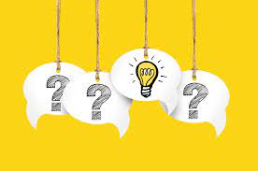
Questions

Slide 34


