Slide 1
PARAMETRIC INSURANCE PLATFORM
ClimateSure
Insurance that pays out when the weather turns
Reactive microservices · Spring Boot 4 · Angular 21
PRESENTED BY
Akshaya Chigullapally
Notes:
Introduce yourself and the project: ClimateSure, a parametric insurance platform where claims are created automatically from measured weather data.

Slide 2








What this presentation covers
AGENDA
01
02
03
04
Business & Requirements
Architecture & Microservices
Frontend – Angular
Backend – Spring Boot
05
06
07
08
Security, Observability & DB
Testing & Quality
Demo, Journeys & Conclusion
Product screenshots

Slide 3


From paperwork-driven claims to event-driven payouts
BUSINESS CONTEXT
Traditional insurance
ClimateSure (parametric)
Customer files a claim and gathers proof
Assessor inspects the loss on site
Weeks of paperwork before a decision
Outcome can be unclear or disputed
A measured index (rainfall, river level, temperature…) is the trigger
Threshold is fixed in the policy when it is bought
Crossing it creates the claim automatically
Approved claims are paid out immediately
Pay on the event, not on the paperwork.
Notes:
Explain parametric insurance: the payout is linked to a measurable event, so customers do not need to prove the loss.

Slide 4






How ClimateSure works, end to end
SOLUTION
1
2
3
4
5
6
Define product
Buy a policy
Pay premium
Measure
Trigger fires
Payout
Admin sets the peril and trigger, e.g. rainfall ≥ 150 mm in 24 h
Customer quotes and applies; underwriter approves; trigger locked in a snapshot
Simulated checkout settles instantly
Live readings per zone; admin records a value for a product
Verified trigger event creates claims for paid, matching policies
Claims officer approves; payout paid at once; claim settled
Example Ravi insures his shop for ₹1,50,000 at 150 mm. Rainfall of 172 mm is recorded in Hyderabad Central → an automatic claim appears, the officer approves it and ₹1,50,000 is paid the same minute.

Slide 5




Functional and non-functional requirements
REQUIREMENTS
Functional — by role
Non-functional
Customer
Browse products, get quotes, apply, pay premiums, track policies, claims and payouts, file manual claims
Reactive & non-blocking end to end
Underwriter
Secure: JWT, roles, gateway-only access
Review policy applications and approve or reject them with reasons
Idempotent: no duplicate claims or payouts
Claims officer
Real-time in-app notifications (SSE)
Review claims, approve an amount (triggers payout), reject or settle
Database per service
Admin
Products & thresholds, zones, perils, pricing rules, users, trigger simulator, payouts
Tested: 75%+ line coverage per service (achieved 79–98%)

Slide 6

Reactive microservices behind one gateway
ARCHITECTURE
Eureka :8761
Auth
Product & Policy
Claims
Service registry
Service :8081
Service :8082
Service :8083
Angular 21 SPA
API Gateway :8080
Browser · NgRx · SSE
JWT filter · routing · CORS
Notification
Trigger
Financial
Service :8085
Service :8087
Service :8088
Service-to-service calls
Database per service
Live updates
REST over @LoadBalanced WebClient, resolved through Eureka, with an internal gateway key
Each service owns an H2 file database, accessed reactively with R2DBC
Notification service streams new notifications to the browser over Server-Sent Events
Notes:
Walk from left to right: the SPA talks only to the gateway; the gateway validates the JWT and routes to services found in Eureka.

Slide 7

Six business services, 143 REST endpoints
MICROSERVICES
Auth
10
Product & Policy
37
Claims
25
Port 8081
endpoints
Port 8082
endpoints
Port 8083
endpoints
Registration, login, JWT access & refresh tokens, profiles, admin user management
Product catalogue, trigger rules & threshold history, applications, underwriting, certificates, renewals
Automatic and manual claims, evidence documents, officer review, timeline
Notification
11
Trigger
31
Financial
29
Port 8085
endpoints
Port 8087
endpoints
Port 8088
endpoints
In-app notifications, unread count, live SSE stream, admin view
Zones, perils, live readings, current measurements, verified trigger events
Pricing rules, quotes, payments, payouts, receipts, ledger, reconciliation
Plus the API Gateway (:8080) and Eureka server (:8761) for routing and discovery.

Slide 8

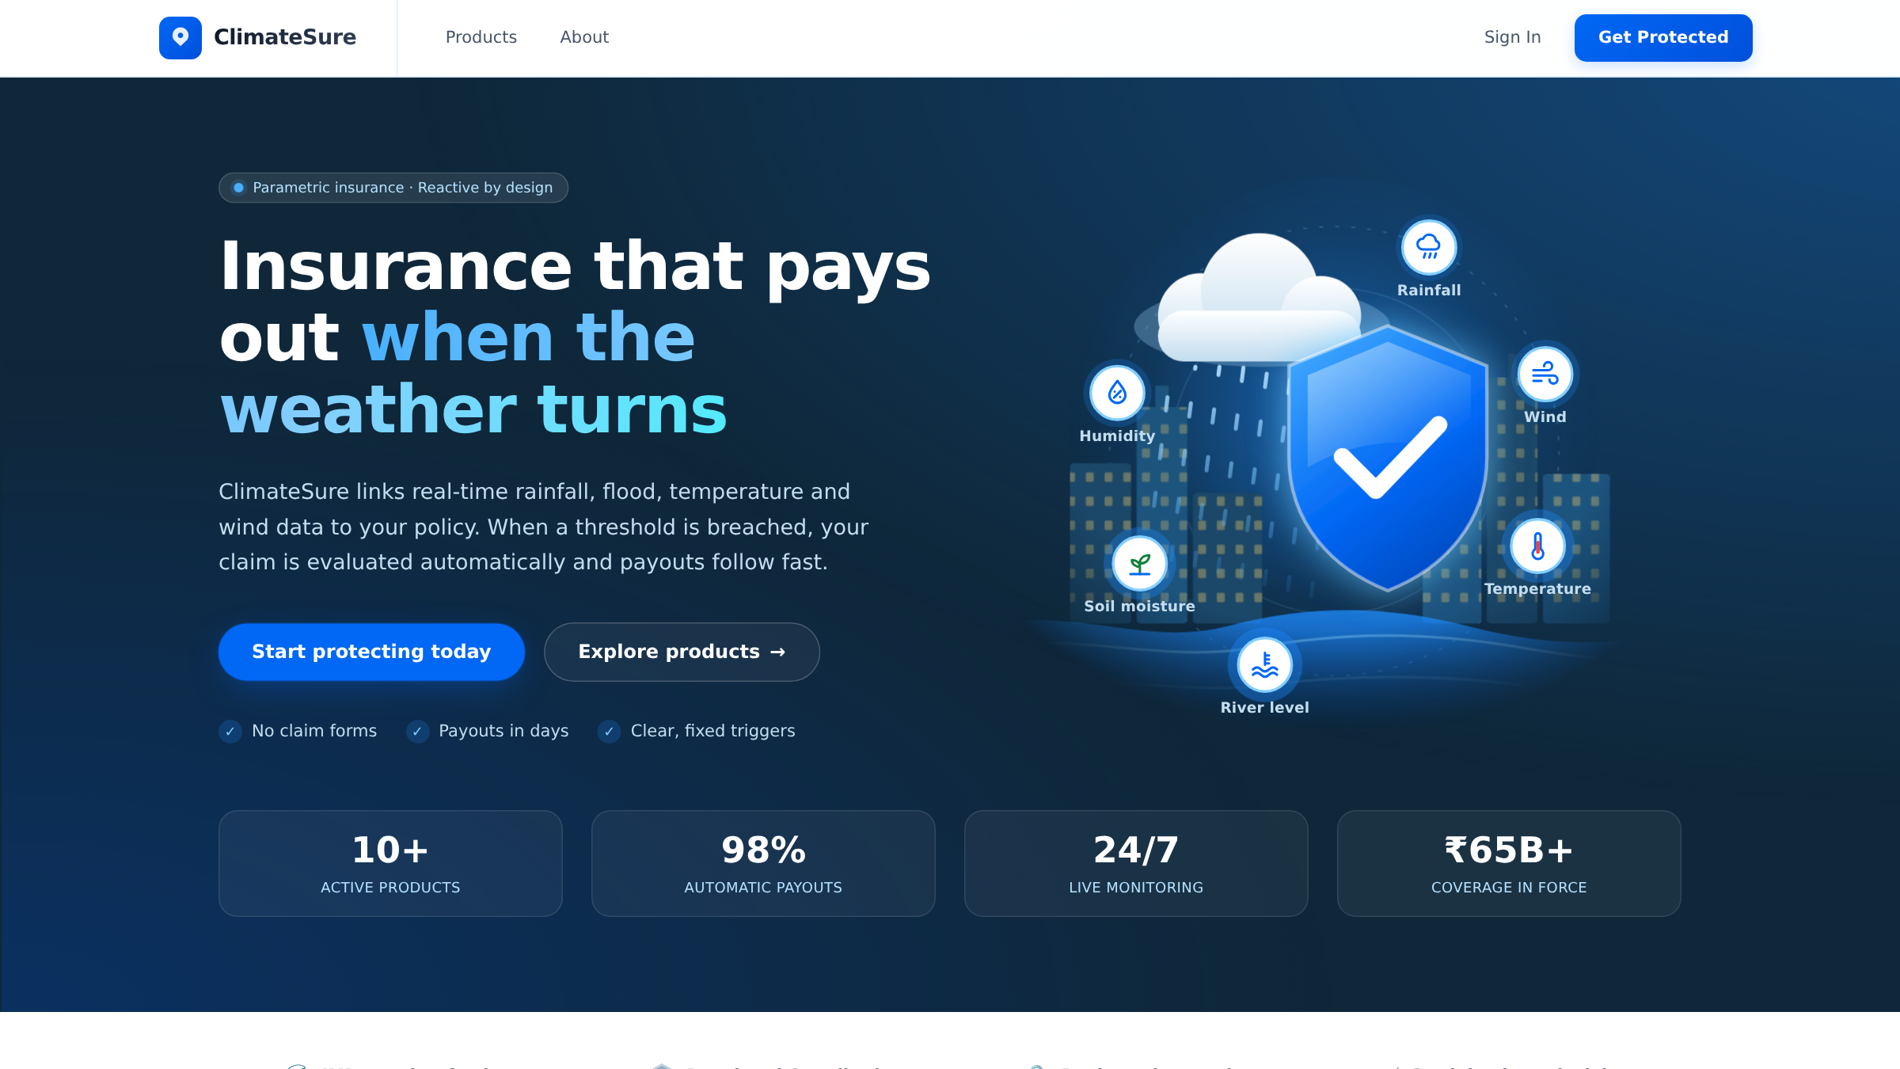



A role-based Angular 21 single-page app
FRONTEND – ANGULAR
Standalone components & lazy routes
5 role layouts: public, customer, underwriter, claims officer, admin
NgRx 21 store, effects & signals
Predictable state for policies, claims, payments and notifications
HTTP interceptors
Attach the JWT; refresh an expired token before sending
Live notifications
EventSource stream → bell, toast and pages that reload themselves
Public landing page
Tailwind CSS 4 & Leaflet
52
124
293
Consistent design system and a live zone map
routes
spec files
unit tests

Slide 9
State management and real-time updates
FRONTEND – ANGULAR
Request flow (NgRx)
Component
Action
Effect
Interceptor
Gateway
Reducer → UI
User clicks Approve, Pay, Apply…
e.g. approvePolicy({ id })
Calls the Angular service
Adds JWT, refreshes if expired
Routes to the service
Selectors and signals re-render
Real-time flow (Server-Sent Events)
Service event
Notification svc
EventSource
NgRx store
Bell & toast
Live pages
Policy approved, claim created, payout paid
Stores it and pushes it on the stream
/api/notifications/me/stream
Adds it to the notifications state
Unread badge and pop-up
Claims and policy pages reload
Result: the customer sees a new automatic claim and its payout without refreshing the page.

Slide 10

Fully reactive Spring Boot 4 services
BACKEND – SPRING BOOT
Router
Functional endpoints (RouterFunction) map paths to handlers
Stack
Java 17
Spring Boot 4.1
Handler
Reads the request, validates DTOs, checks the caller’s role
WebFlux
R2DBC
Spring Cloud Gateway
Eureka
Service
Business rules as Mono / Flux pipelines; calls other services
WebClient
Jakarta Validation
Lombok
JJWT
Repository
Spring Data R2DBC — non-blocking database access
Actuator
Maven
H2 database
One file database per service, schema.sql on start-up
9 scheduled jobs policy expiry & renewals, payout sweep, premium reminders, reconciliation, default pricing, demo weather feed, notification cleanup

Slide 11
From a measurement to a paid claim
BACKEND – CORE FLOW
1
Trigger svc
4
Claims svc
Admin records 172 mm for WEATHER-001 in Hyderabad Central (idempotency key stops duplicates)
Claims service creates one automatic claim per matching policy and notifies the customer
2
Product svc
5
Claims svc
Trigger service loads active policies in that zone, each with its locked trigger snapshot
Claims officer approves an amount; claims service asks Financial for the payout
3
Trigger svc
6
Financial svc
Each paid policy is compared with its own threshold; a VERIFIED trigger event is saved
Payout is paid at once, claim is settled, trigger event marked PROCESSED
Every step publishes an in-app notification, so customer and staff see progress live.

Slide 12

Defence in depth, from browser to database
SECURITY
JWT authentication
Gateway as the only door
Gateway key on every service
HMAC-signed access token (15 min) and refresh token (7 days); passwords hashed with BCrypt
Validates every JWT, strips spoofed identity headers, adds the trusted user id and role
Services reject any call without the internal gateway key header, so they cannot be called directly
Role-based access
Internal endpoints hidden
Safe by design
Customer, underwriter, claims officer, admin — checked in handlers and in Angular route guards
/internal/** APIs are never routed by the gateway; only services call them
Ownership checks, input validation, idempotency keys, and a token refresh before it expires

Slide 13




Visible at runtime, clean at rest
OBSERVABILITY & DATABASE
Observability
Database per service — 28 tables
Actuator health, info, metrics, mappings
Exposed per service and through the gateway
Eureka dashboard
See every registered service instance
Logs per service
Request failures logged with method, path and status
H2 file databases accessed with R2DBC
schema.sql runs on start-up with safe migrations
Idempotency keys on measurements and notifications
Automatic cleanup of old readings and notifications
Consistent error responses
Global error handler returns status, messages and path

Slide 14
870 automated tests across the stack
TESTING & QUALITY
Backend tests per service
577
backend tests
JUnit 5 · Mockito · StepVerifier · WebTestClient
293
frontend tests
Vitest + Angular TestBed, 124 spec files
79–98%
line coverage per service
Measured with JaCoCo on every service
End-to-end checks in a real browser with Playwright before every release

Slide 15
18 mapped journeys across four roles and the system
USER JOURNEYS
Customer
Underwriter
Claims officer
Admin
System
Register, log in, profile
Quote and apply
Pay premium
Track policies & claims
Manual claim with evidence
Live notifications
Review the pending queue
Approve or reject with a reason
Review history
Zone exposure view
Claims queue & live trigger events
Start review
Approve → payout paid
Reject or settle
Products & thresholds
Zones, perils, pricing
Trigger simulator
Users, payments, payouts
Policy expiry & renewal
Payout sweep
Reminders, reconciliation
Demo weather feed

Slide 16
Demo script — one claim, start to finish
LIVE DEMO
1
2
3
4
5
6
Customer
Underwriter
Customer
Admin
System
Claims officer
Ravi applies for WEATHER-001 in Hyderabad Central, ₹1,50,000 cover
Approves the application — Ravi’s bell updates instantly
Pays the premium — the policy is active and covered
Simulates 172 mm of rainfall in the Trigger simulator
Automatic claim appears on Ravi’s claims page with no refresh
Approves ₹1,50,000 — payout paid, claim settled
About two minutes from rainfall to money in the customer’s account — with every step visible live.

Slide 17



What is delivered, and what comes next
CONCLUSION & FUTURE
Future enhancements
Delivered
Real weather & IoT data feeds
End-to-end parametric flow: product → policy → trigger → claim → payout
Live sensor and weather-API readings instead of the demo feed
Real payments & UPI payouts
Six reactive microservices behind a secured gateway
Payment gateway and bank / UPI disbursement
Event streaming with Kafka
Asynchronous events between services
Role-based Angular app with live notifications
PostgreSQL, Docker & Kubernetes
Production database and container deployment
870 automated tests, 79–98% backend line coverage
Tracing & dashboards
OpenTelemetry, Prometheus and Grafana
Simple by design: in-app notifications, instant payments and payouts
Risk-based pricing & mobile app
ML premiums from historical weather; mobile alerts

Slide 18
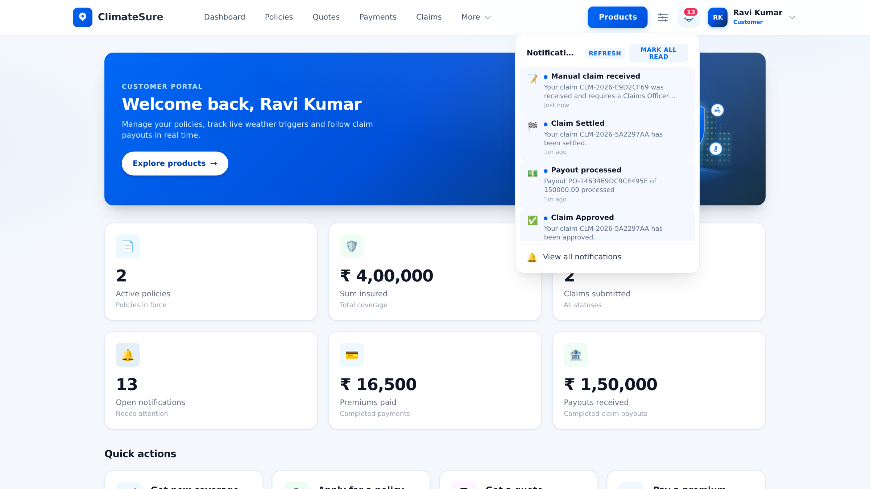


Customer experience
PRODUCT SCREENSHOTS
Public landing page
Customer dashboard with live notifications
Explains parametric cover in one screen and leads visitors to products and sign-up
Policies, cover, premiums and payouts at a glance; every step arrives in the bell instantly

Slide 19
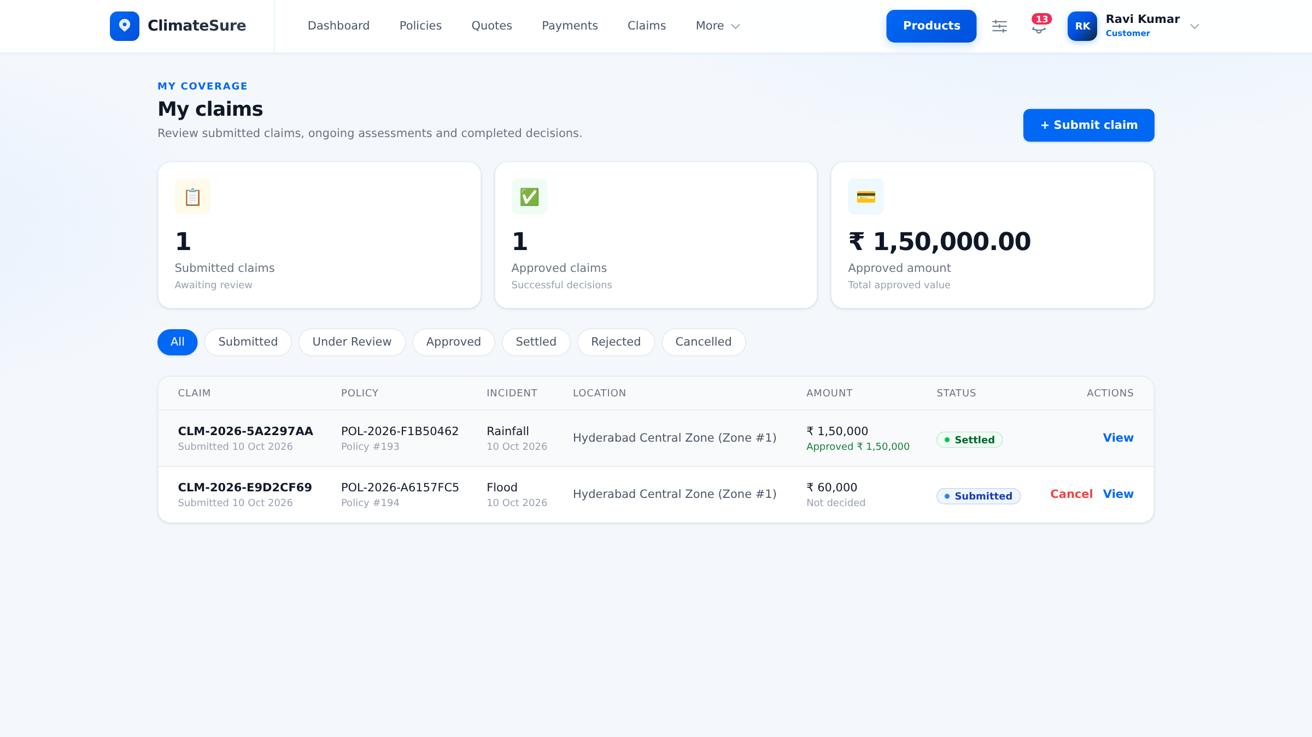
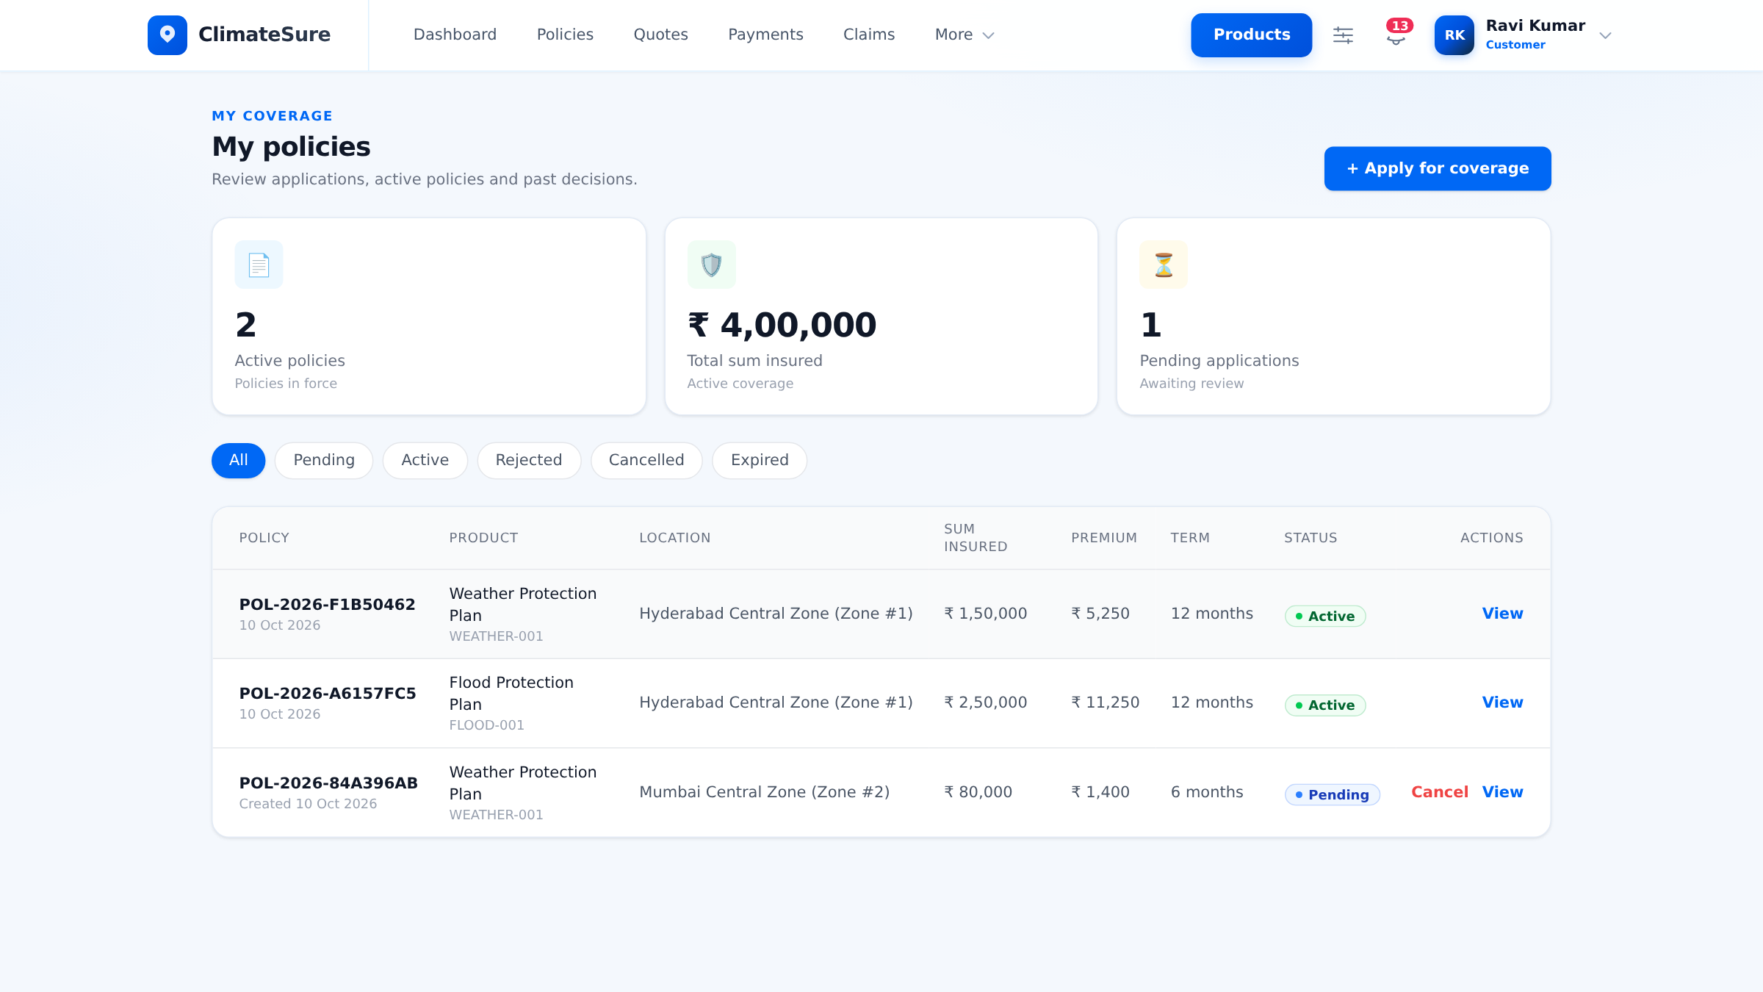
Claims tracked in real time
PRODUCT SCREENSHOTS
My claims
My policies
The automatic claim is settled and paid; a manual claim waits for review — the list updates live
Active and pending policies, each with its trigger locked in when it was bought

Slide 20
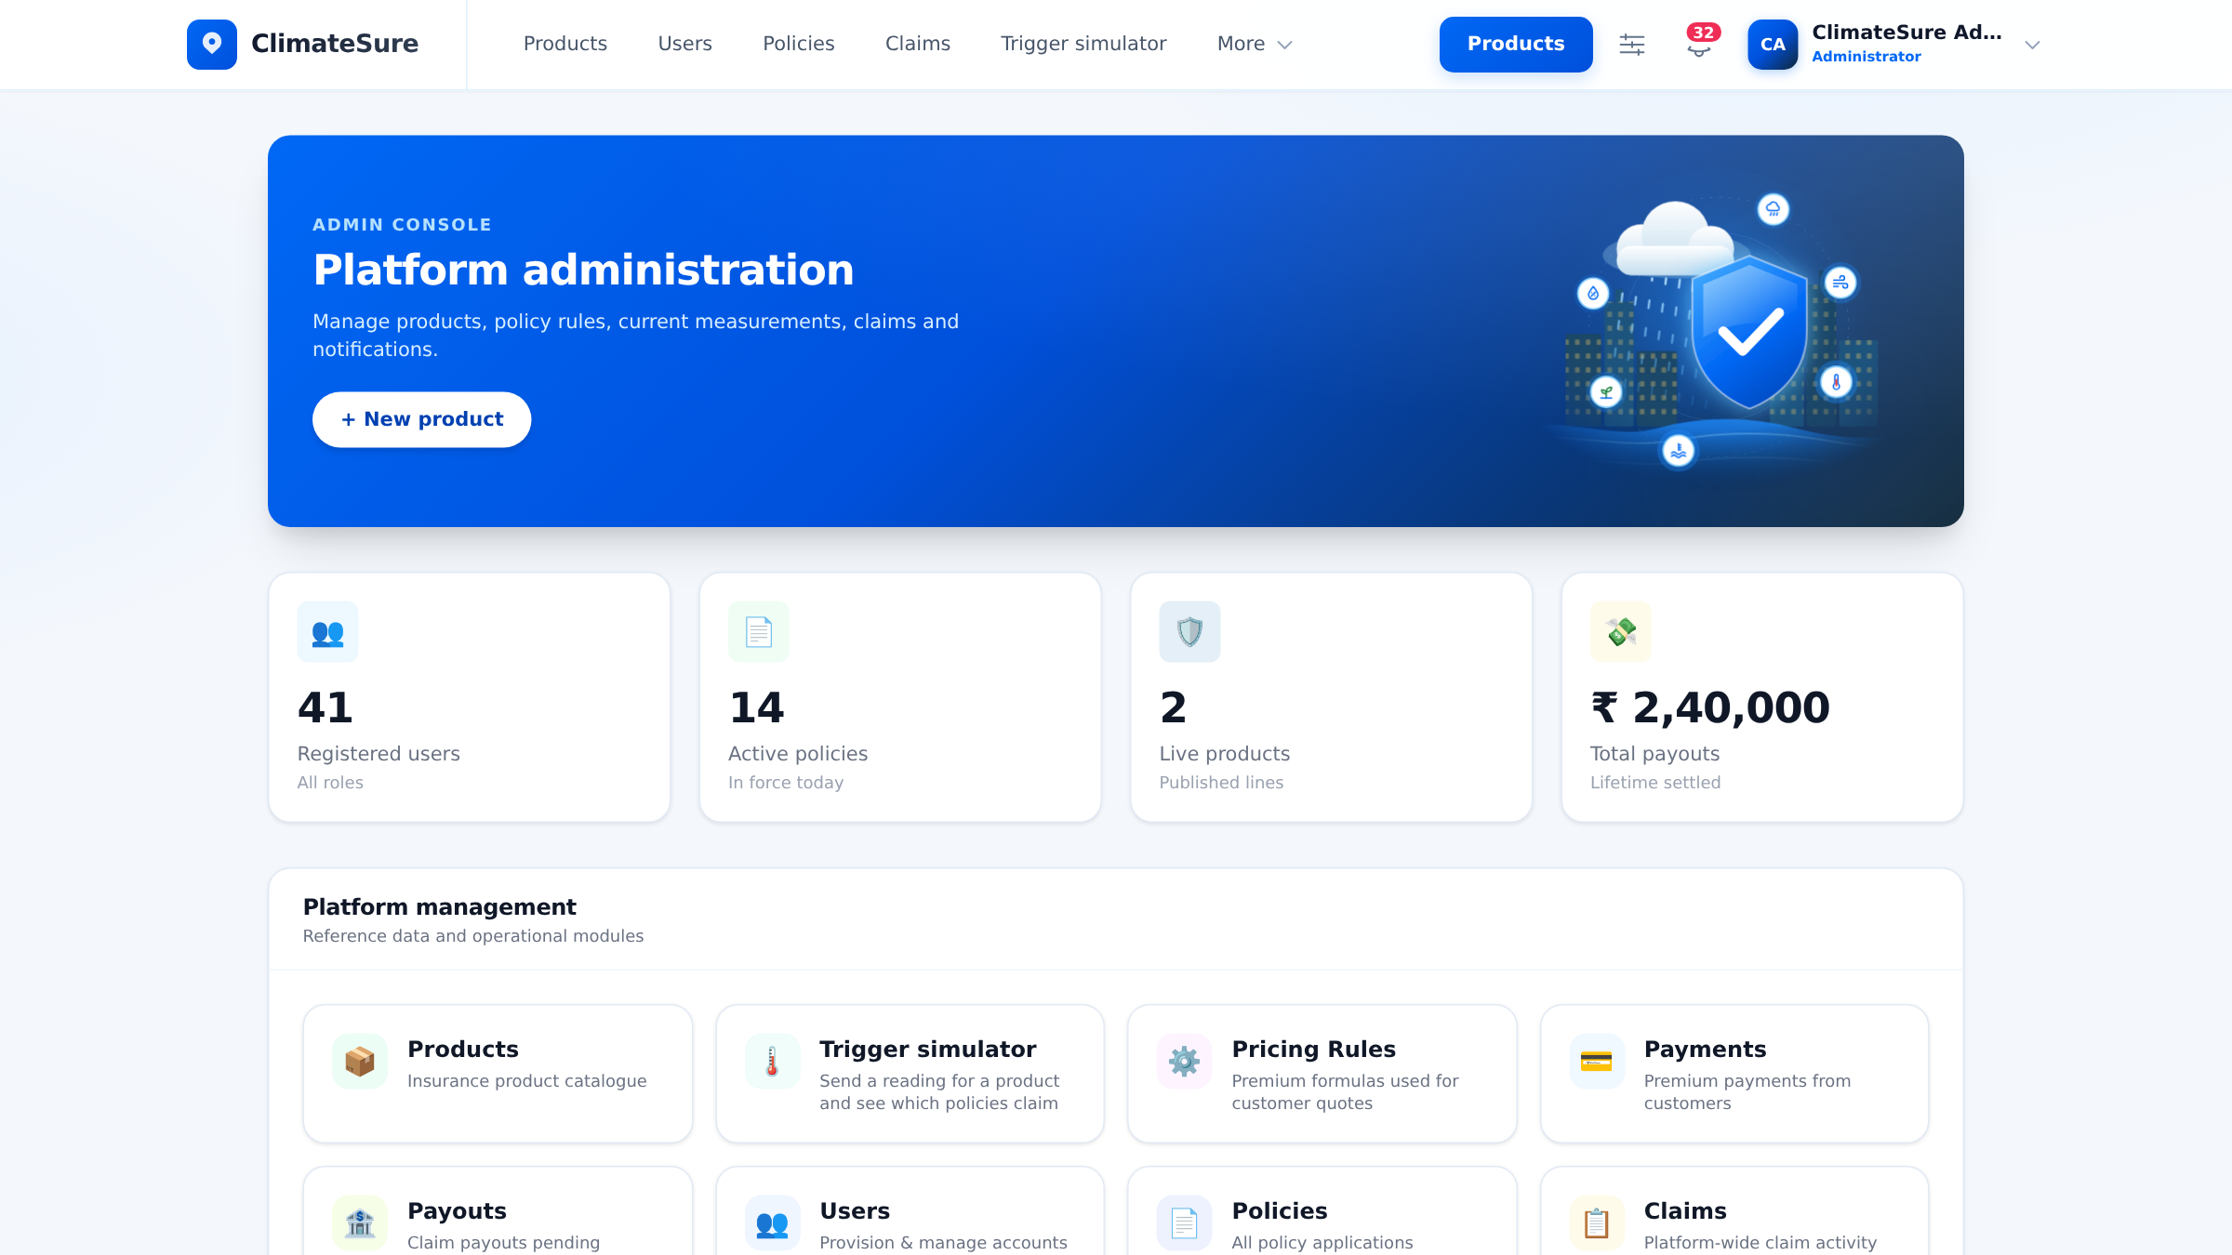
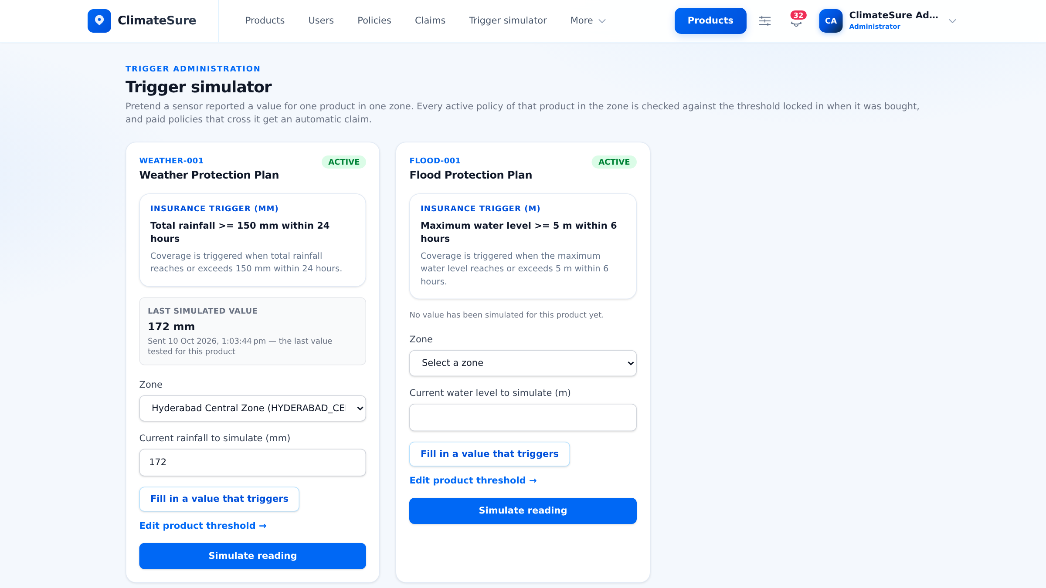
Admin console
PRODUCT SCREENSHOTS
Admin dashboard
Trigger simulator
Platform KPIs and one-click access to products, pricing, payments, payouts and users
Record a reading for a product and zone — matching paid policies get automatic claims

Slide 21
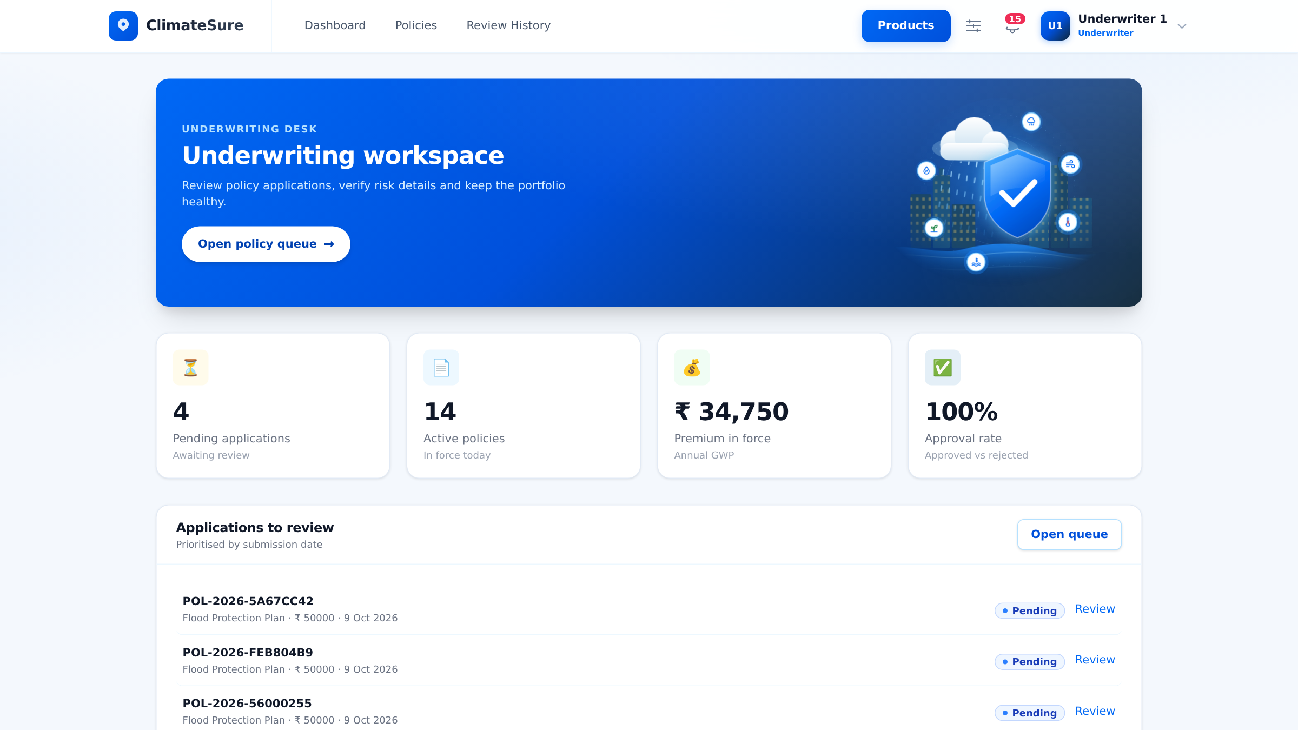
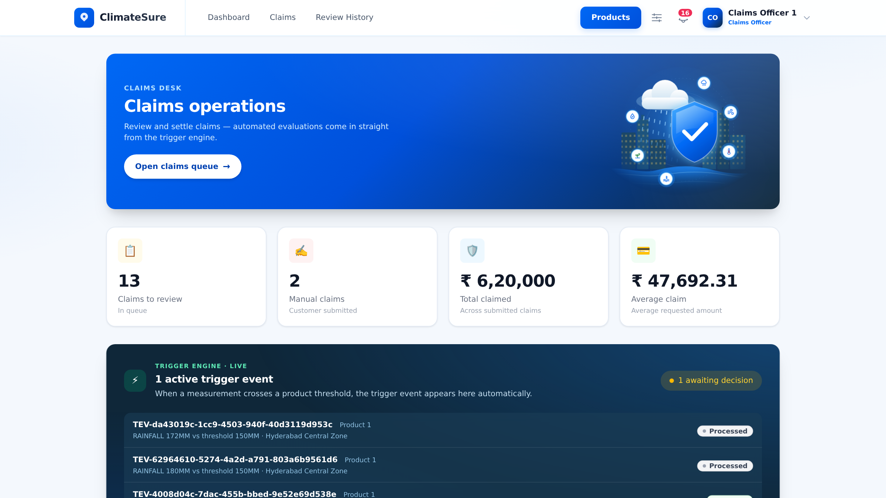
Staff workspaces
PRODUCT SCREENSHOTS
Underwriting workspace
Claims desk
Pending applications, premium in force and approval rate, with the review queue
Claims to review plus a live feed of trigger events from the engine

Slide 22

Thank you
Questions & discussion
Akshaya Chigullapally
ClimateSure — Parametric Insurance Platform

