Slide 1
Sign up Window
Name:
Email Id:
Password:
Sign up

Slide 2
Login Window
Email Id:
Password:
Login
Forgot Password? Sign Up
Password Reset

Slide 3
Password Reset Window
Trouble Logging In?
Enter your email and we'll send you a link to get back into your account.
Email Id:
Reset Password

Slide 4
Selection Page
Logout
Select Requirement
Homepage Promotion
Homepage Teaser
Submit

Slide 5

Homepage Promotion
Logout
Select Country
Select Activation Date
Select Deactivation Date
All
Switzerland
Global
Germany
Submit
Homepage Promotion Dashboard visible here

Slide 6
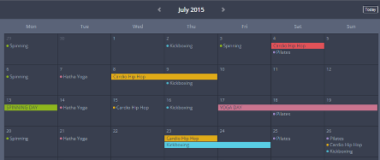
Homepage Promotion Dashboard
Logout
All
Switzerland
Global
Germany

Slide 7
Homepage Teaser
Logout
Select Country
Select Activation Date
Select Deactivation Date
All
Switzerland
Global
Germany
Submit
Homepage Teaser Dashboard visible here

Slide 8
Homepage Teaser Dashboard
Logout
All
Switzerland
Global
Germany

