Slide 1

WEB-BASED CALCULATOR USING HTML, CSS, AND JAVASCRIPT
AKSHAYA DEVI K
43130171
ST-03

Slide 2
Abstract
This project focuses on developing a simple, responsive, and user-friendly calculator using HTML, CSS, and JavaScript.
The calculator performs basic arithmetic operations like addition, subtraction, multiplication, and division.
It replicates the functionality of a standard phone calculator and can be accessed via any web browser.
The project demonstrates the working of frontend technologies and their integration to create an interactive web application.

Slide 3
Existing System
In the existing system, users rely on physical calculators or inbuilt mobile calculator apps.
These systems are not customizable and cannot be accessed through all platforms.
Older web calculators had basic designs without responsive layouts or modern styling.

Slide 4
Proposed System
The proposed system provides a web-based calculator that performs all basic arithmetic operations.
The calculator is built using:
HTML → For structure and layout
CSS → For styling and design
JavaScript → For logic and interactivity
The interface is designed with a grid layout similar to a real calculator, offering a neat, attractive, and responsive design.
Users can perform calculations directly from any device with a browser (desktop, tablet, or phone).

Slide 5
Advantages
Easy to use and understand.
Platform-independent — works on any browser.
Simple user interface with clean design.
No need to install any software.
Fully customizable and extendable (scientific mode can be added).

Slide 6
Disadvantages
Cannot perform advanced scientific calculations
No backend or data storage
Requires a web browser to run.
Works only when the browser supports JavaScript

Slide 7
Hardware Requirements
Internet browser (Chrome, Edge, or Firefox)
Processor: Intel i3 or higher
RAM: 2 GB minimum
Hard Disk: 100 MB free space
Input Device: Keyboard & Mouse
Display: Any standard monitor or screen

Slide 8
Software Requirements
• Operating System: Windows, macOS, or Linux
• Tools: Visual Studio Code or any text editor
• Browser: Google Chrome / Mozilla Firefox
• Languages: HTML, CSS, JavaScript
• Version Control (optional): Git and GitHub

Slide 9
Modules
1. Display Module - Shows input and result
2. Button Module - Contains number and operator buttons
3. Operation Module - Handles arithmetic logic
4. Design Module - Manages layout and styling using CSS

Slide 10
Module Description
• The Display Module updates user input and outputs results dynamically.
• The Button Module captures user clicks and sends values to the script.
• The Operation Module uses JavaScript functions to compute arithmetic operations.
• The Design Module uses CSS Grid for clean, mobile-friendly layout.

Slide 11
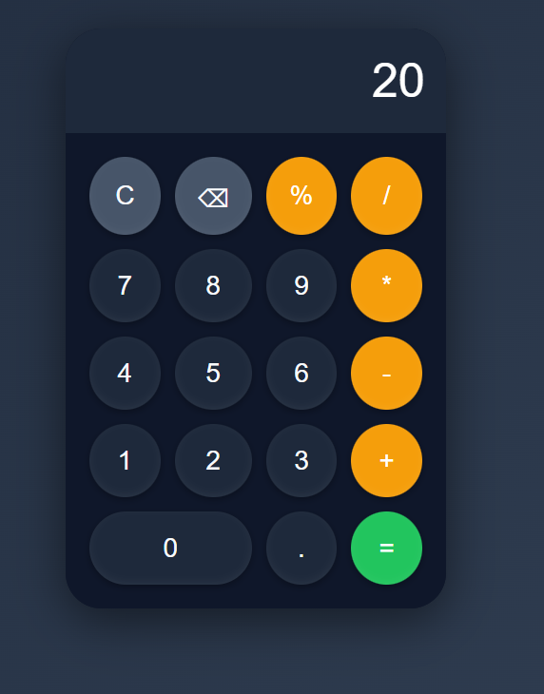
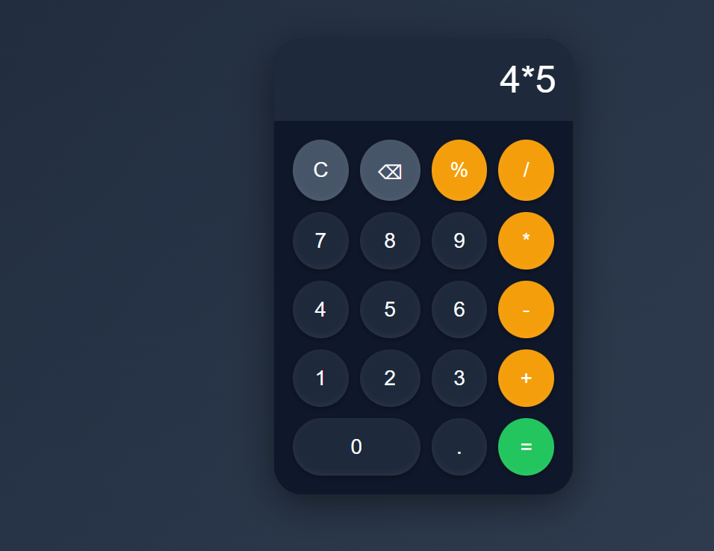
Sample Output (Screenshot)
Screenshot of the interface

Slide 12
Conclusion
This project demonstrates how HTML, CSS, and JavaScript can be combined to build a fully functional web-based calculator. It highlights the importance of front-end development concepts and provides a foundation for learning interactive web design.

