Slide 1

PROPOSAL DEFENSE
AI-Driven Root Cause Analysis and Automated Triage in Micro-service Environments
Akshay Adik
Doctor of Business Administration · Golden Gate University
Chair: Dr. Anil Kumar Vuppala · Sep 2026

Slide 2




ROADMAP
Four Parts
Questions are welcome throughout. Slides 3–14 move quickly — they establish shared context; the discussion should linger on the artefact and evaluation, where the doctoral contribution lives.
Problem & Gap
Methodology
Slides 3–14
Slides 15–18
Artefact
Evaluation & Outcomes
Slides 19–23
Slides 24–28

Slide 3

CONTEXT
What Is a Microservice Environment?
The setting this dissertation operates in, stated in plain terms first.
Aspect | What This Means | Example | Why It Matters
What it is | An app split into many small, independent services | Order · Payment · Inventory | One service failing ≠ whole app down
Who uses it | Organizations operating large, distributed applications | Amazon · Netflix · Uber | Standard pattern in production
Why adopt it | Scalability, independent deploys, flexibility | Docker + Kubernetes | Faster releases, isolated blast radius
What goes wrong | Services depend on each other in chains | Payment fails → order can't complete | The problem this dissertation addresses
This is the environment Artefact operates in — not a hypothetical one. (Soldani & Brogi, 2023; Wang & Qi, 2024)

Slide 4

STAKEHOLDER IMPACT
Who Is Impacted When It Fails?
One failure, four stakeholders, one shared clock: MTTR
Stakeholder | What They See | Immediate Impact | Downstream Cost
Customer | Failed transaction, error page | Lost trust, switches provider | Revenue opportunity lost
SRE / on-call | Alert storm, dashboards | Manual investigation, hours lost | On-call burden, burnout
Dev team | Bug report, postmortem | Debugging & defect fixing | Engineering time diverted
Business / management | SLA breach report | Contractual penalties | Reputation damage
Root-cause analysis speed determines how far down this chain the failure is allowed to run. (Chakraborty et al., 2024; Jin et al., 2024; Bansal et al., 2020)

Slide 5

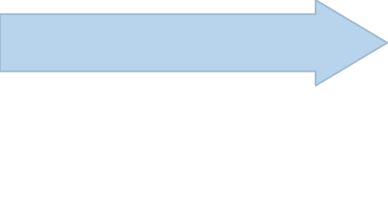
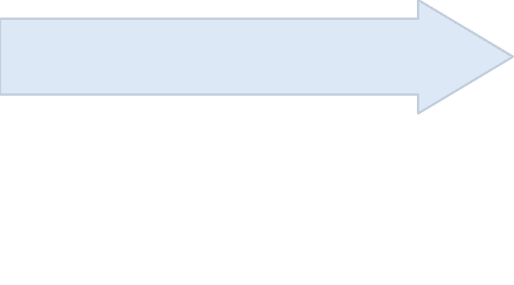


PROBLEM & GAP
Why Microservice RCA Is Hard
Failures cascade — the origin is several hops from the observable symptom.
Many Services
S4 — Payment Service ⚠
Multiple services traversed per user request
Each hop adds latency and an additional failure surface, making end-to-end tracing non-trivial.
S2 → S3 — Order & Auth
S1 — API Gateway
Latency spike — root fault origin
Entry point · request received
Downstream calls initiated
Cascading Hops
Chains and message queues propagate faults across the topology
A single slow dependency ripples upstream, masking the true origin behind layers of secondary symptoms.
S7 — Root Cause
S6 — Inventory Service
Actual fault — several hops from S1
Signature Drift
CI/CD pipeline activity renders fault signatures non-stationary
Frequent deployments shift baseline metrics, meaning yesterday's normal is today's anomaly — invalidating static thresholds.
Blocked · awaiting Payment
Telemetry collection is no longer the bottleneck — causal inference is. CI/CD-driven drift makes fault signatures non-stationary, compounding the challenge of pinpointing origin across distributed service chains. (Soldani & Brogi, 2023; Yu et al., 2023; Wang & Qi, 2024)

Slide 6

PROBLEM & GAP
The Economic Case for Automation
Outage cost and modelled return — from one framework, not two separate arguments.
Per Hour
Primary Metric
CpR Components
Outage cost — Pham et al. 2024
Cost per resolution — what artefact measures directly
Compute · MLOps · Revenue · SLA · Labour
The 5 CpR Components
1
2
3
4
5
Token Cost
Infrastructure Cost
Storage Cost
Human-Minute Cost
Opportunity Cost
LLM inference spend (L-pipe)
Evidence graph · telemetry retention
Cost of delay / downtime during resolution (Sun et al., 2025)
Compute for D-pipe / G-pipe execution
SRE / operator time — HITL, triage (Hwang et al., 2021)
The question is not whether to automate — it is whether automation can be made trustworthy at a cost Artefact will measure, not assume. (Pham et al., 2024; Sun et al., 2025; Bansal et al., 2020; Chen et al., 2023)

Slide 7
PROBLEM & GAP
Why Existing Approaches Fall Short
Four RCA families — none individually adequate
Family | Representatives | Strength | Weakness
Statistical | N-sigma · BIRCH (Pham et al., 2024) | Cheap, scalable | Assumes regularity — no causal reasoning
Classical ML | Random Forest · SVM | Learns from labelled incidents | Concept drift; imbalanced labels
Deep / Graph-ML | GNNs · CHASE hypergraphs (Zhao et al., 2025) | Topology-aware, accurate | Opacity → SRE trust deficit
LLM / Multi-agent | TAMO (2025)· mABC (2024)· Flow-of-Action (2025) | Explanations, generalisation | Cost · hallucination · context limits
Each family is right for a subset of fault classes. None is universally adequate. → Co-deploy paradigms.

Slide 8

PROBLEM & GAP
What the Literature Reviewed
Seven streams, each reviewed to answer one question: where do the variables come from?
Literature Thread | What It Establishes | Limitation | Variable It Produced
RCA & AIOps | How RCA evolved as a paradigm | Manual / fragmented tooling | C1 evaluation rigour
Observability & multimodal | Logs, traces & metrics | Poor cross-modal integration | Multimodal bundle (A-H8)
Statistical & ML | Cheap detection / prediction | Limited causal reasoning | D-pipe floor (A-H3)
Graph / causal methods | Topology & dependency modelling | Limited explainability | Graph-only (A-H6)
GenAI / multi-agent | Reasoning & NL explanation | Hallucination + cost | LLM contribution (A-H1, A-H7)
Hybrid intelligence | Combining modalities | Contribution isolation unclear | Ablation family (A-H1–8)
Economics & business | MTTR, cost, ROI mechanisms | Not integrated into RCA | CpR, MTTR proxies
The literature is not one gap. HELIOS addresses the intersection of these seven — each thread maps to a pre-registered variable.

Slide 9

PROBLEM & GAP
Why Now
LLM cost is itself an operational expense — not merely a research-stage concern.
Non-Zero
100s–1000s
↑ Growing
LLM Diagnosis Cost
Enterprise Incident Rate
Annualised Cost
Usage-dependent — varies by model, tokens, and routing strategy
Incidents per day in large-scale production environments
Increases substantially as multimodal context windows expand
HELIOS (Heuristic Learning for Integrated Observability System) treats LLM cost as architecturally arbitrated — not engineered away post-hoc. (Contribution C6: ORAR cost-aware routing)

Slide 10

PROBLEM & GAP
The Five Methodological Desiderata
None of the surveyed comparators satisfies all five — HELIOS engineered to satisfy them by design.
Desideratum | CHASE | mABC | TAMO | Flow-of-Action | FrugalGPT (2023) | HELIOS
D1 Peer-pipeline co-deployment on identical inputs | ✗ | ◐ | ✗ | ✗ | ✗ | ✓
D2 First-class observability for LLM agent reasoning failures | ✗ | ✗ | ✗ | ✗ | ✗ | ✓
D3 Cost-aware routing with observed accuracy priors | ✗ | ✗ | ✗ | ✗ | ◐ | ✓
D4 Deferred two-stage reward reconciliation | ✗ | ✗ | ✗ | ✗ | ✗ | ✓
D5 Ablation-first variant equivalence at binary level | ✗ | ✗ | ✗ | ✗ | ✗ | ✓
Desiderata are derived from comparator gaps, not from HELIOS.
Architectural commitments — not algorithmic differences — separate HELIOS from each comparator.

Slide 11
PROBLEM & GAP
The Research Gap → The Proposition
No surveyed system meets all five desiderata. So what must a solution provide?
0/5
A Solution Must:
Co-deploy reasoning paradigms on identical inputs
Observe its own reasoning failures, not just the system's
Arbitrate LLM cost architecturally, not post-hoc
Be evaluable mechanism-by-mechanism, not just end-to-end
Desiderata satisfied by any surveyed comparator on the previous slide.
Proposition: a hybrid, ablation-first architecture can satisfy all five jointly — no surveyed comparator satisfies all five at once.
D1 / Peer-pipeline co-deployment
D2 / LLM reasoning observability
5/5
D3 / Cost-aware routing
D4 / Two-stage reward reconciliation
HELIOS Satisfies All 5
The only architecture to meet every desideratum jointly
D5 / Ablation-first variant equivalence

Slide 12
PROBLEM & GAP
Research Questions
Four RQs — separable by inferential layer.
RQ1 — Artefact-Level
RQ2 — Meta-Observability
To what extent do hybrid AI architectures — statistical, graph-based, and generative reasoning as peer pipelines under identical inputs — improve accuracy and reduce cost relative to single-modality baselines?
Operationalisation: B-family (8 hypotheses) + decomposing A-H1, A-H2, A-H3, A-H5.
How can self-telemetry, integrated into the same diagnostic apparatus, enable detection of reasoning failures within the AI system itself?
Operationalisation: E-H6 — exploratory; IOL detection latency.
RQ3 — Per-Mechanism
RQ4 — Human-Interaction
To what extent does each named architectural mechanism (C2–C6) individually contribute to accuracy, cost, and safety, as determined by ablation?
Operationalisation: A-H4, A-H6, A-H7, A-H8 (4 of 8 A-family) + E-H1–E-H5, E-H8–E-H10 — exploratory.
How does explainable output (Chain-of-Evidence) influence SRE interpretation accuracy, decision time, and trust?
Operationalisation: E-H7 — within-subjects user study, n = 24.
A-family splits 4/4 across RQ1 and RQ3 — see Table 15.

Slide 13
PROBLEM & GAP
Pre-Registered Variable Families
26 pre-registered formal tests decompose 4 conceptual hypotheses — not 26 independent hypotheses.
A — Ablation
B — Baseline-Comparison
E — Exploratory
8 variables · Internal mechanism checks
LLM necessity, LLM-only sufficiency, D-pipe floor, G-pipe (graph-only), consensus, routing, hallucination, structural bundle
Confirmatory · Wilcoxon signed-rank · Holm–Bonferroni α = 0.00625
8 variables · External advantage checks
HR@3 (×5), log-MTTR, log-Cost, Avg@5 vs. named baselines
Confirmatory · McNemar exact + Wilcoxon · Holm–Bonferroni α = 0.00625
10 variables · Future pre-registration
Cognitive, routing, FGSV, RRE, IOL, user study, drift/cost, attribution
Point estimates + 95% BCa bootstrap CI · No FWER correction
A and B are corrected separately because they answer different inferential questions. Pre-registered at OSF freeze — not post-hoc α-padding.

Slide 14
PROBLEM & GAP
Conceptual ↔ Formal Hypothesis Mapping
Chapter 1 orients the framework — Chapter 3 binds the falsifiable propositions
Conceptual Hypothesis (§1.8) | Formal Operationalisation (§3.8.1) | Note
H1 — Hybrid AI reduces MTTR | B-H6 + A-H1 · A-H2 · A-H3 | Decomposed by ablation
H2 — Multimodal data improves accuracy | B-H1 … B-H5 + A-H8 | Bundle-level test
H3 — Explainable AI builds operations-team trust | E-H7 | User study, n=24
H4 — Hybrid systems scale better | Out of confirmatory scope | Separate scaling experiment §3.11.5
Two complementary layers — not contradictory. Chapter 3 hypotheses are binding under the deviation log.

Slide 15






METHODOLOGY
Why Design Science Research
The artefact is the contribution — DSR is the framework that demands ablation-first design.
Design
HELIOS construction; iterative refinement; pre-registered ablation evaluation
Relevance
Microservice failure economics; agentic-AI fault classes for which no AIOps framework provides first-class diagnostic support
Rigour
Systematic comparator differentiation; runtime-enforced evaluation rigour as transferable knowledge contribution
DSR is not "no statistics." Hevner et al. (2004), Hevner (2007) and Peffers et al. (2007) treat empirical evaluation as part of DSR. Classification: DSR with embedded controlled quantitative comparison.

Slide 16
METHODOLOGY
Philosophical Stance
Critical realism (Bhaskar, 2008/1975; Mingers, 2004) with pragmatist orientation toward artefact evaluation.
Realist Commitment
Pragmatist Commitment
Microservice failures are produced by real, structural generative mechanisms:
HELIOS is validated by demonstrated utility under a pre-registered protocol.
Falsifiability lives at the contribution level.
Every C1–C6 is ablatable.
Each ablation corresponds to a pre-registered hypothesis.
Fault propagation
Resource cascades
Agent reasoning failures
The underlying mechanism exists independently of our observation.
Telemetry provides only partial access to the mechanism.
RCA is therefore fallible inference.
"A modest epistemic posture appropriate to a doctoral research artefact."

Slide 17
METHODOLOGY
Theoretical Grounding & Business Contribution
DSR sits inside the IS tradition — the business claim is scoped, not asserted.
This dissertation proposes no new management theory. HELIOS's utility claim sits in the IT-business-value tradition — DSR is itself an IS methodology, not a CS borrowing — and organisational adoption is treated as a scoped boundary condition, not a tested construct.
What Is Claimed
What Is Not Claimed
CpR and MTTR (§3.4.2) are technical proxies for organisational outcomes — not the outcomes themselves
A pre-specified ROI model links measured technical outcomes to potential organisational value
DSR (Hevner et al., 2004; Peffers et al., 2007) is an IS-discipline methodology in its own right — not an engineering borrowing
No formal technology-adoption model is tested — adoption is a named limitation (§1.10), not a measured construct
No new management theory is proposed — the contribution is methodological discipline (C1)
Implications are scoped to the SRE / platform-team level, not enterprise strategy
"A bounded business claim, deliberately — an unbounded one would be the real overreach."

Slide 18






METHODOLOGY
C1 — Runtime-Enforced DSR Rigour
Pre-registration is not a reporting convention — it is a runtime invariant this artefact is designed to enforce.
Variant Control Layer
Snapshot Hash Registry
Metric Integrity Gate
Reconciliation Ledger
Variant identity at binary level via content-hashed manifest
Variant identity at the binary level — content-hashed manifest
Input identity across variants; runtime rejection of incomplete cells — no zero-imputation
Two-stage reward correspondence audit
Exclusion Ledger
Deviation Log
Cryptographically signed, append-only — every excluded run logged
Cryptographically signed, append-only — every protocol change recorded
Key Claims
C1 converts DSR evaluation rigour from a reporting convention into a runtime invariant.
Generalisable beyond HELIOS to AIOps research-method practice.
Potentially relevant to DSR research-method practice more broadly.
C1 does not improve diagnostic accuracy directly; it makes falsifiability operationally enforceable.
Potentially transferable to AIOps research-method practice; broader DSR transferability is a future research question.

Slide 19


HELIOS ARTEFACT
HELIOS Architecture
Five layers × five planes — peer pipelines on the same content-hashed snapshot
Five Execution Layers
Five Governance Planes
1
L0 — Telemetry Ingress
Data Plane
P1 metrics · P2 traces · P3 logs · P4 cognitive · P5 business + Privacy + ARM
Telemetry ingress & evidence-graph construction
2
L1 — UEG-C Construction
Reasoning Plane
K-hop pruner · 4 typed edges · Agent-Reasoning-Step nodes
D/G/L peer pipelines — independent, parallel
3
L2 — Peer Reasoning Pipelines
Coordination Plane
D-pipe ║ G-pipe ║ L-pipe — identical inputs, independent outputs
Routing, consensus, Chain-of-Evidence
4
L3 — Coordination & Consensus
Learning Plane
ACP → ORAR → MAHC (μ, σ) → CoE → Narrative
Remediation, reconciliation, online updates
5
L4 — Action & Learning
★ Evaluation Plane — C1
FGSV (KS-gated shadow) → HITL → Reconciliation
Spans all five layers · Enforces variant identity at binary level · Implements C1 apparatus
Incident path: Fault fires → L0 detects → L1 builds causal graph → L2 three pipelines reason in parallel → L3 consensus + CoE → L4 shadow-validated remediation → SRE decision
Structural commitment: Pipelines share no runtime state; any subset can be disabled by feature flag.

Slide 20
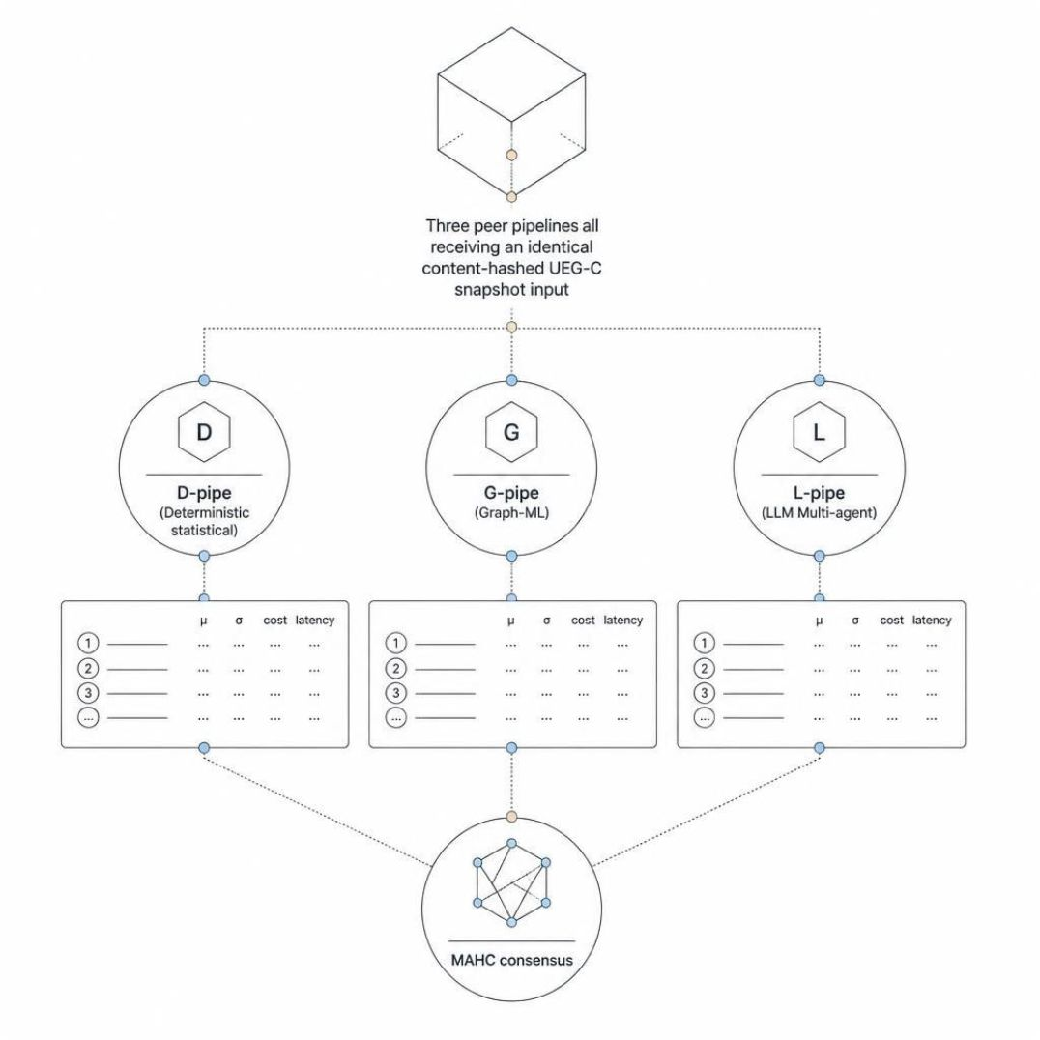


HELIOS ARTEFACT
The Peer-Pipeline Insight
Central novelty — three reasoning paradigms on identical inputs, ablation-first by design.
What Makes This Novel
All three pipelines receive the identical content-hashed UEG-C snapshot, ensuring fair co-evaluation and enabling mechanistic ablation.
What Each Pipeline Passes to MAHC
Pipeline | Output Passed to MAHC
D-pipe — Deterministic | ranked candidates · μ · σ · cost · latency
G-pipe — Graph-ML | ranked candidates · μ · σ · cost · latency
L-pipe — LLM Multi-Agent | ranked candidates · μ · σ · cost · latency
MAHC Fusion | Cost-aware arbitration → consensus ranking
Versus Comparators
mABC
TAMO
Scalar weights — no peer isolation
Single synthesiser — no pipeline separation
Flow-of-Action
CHASE
Sequential cascade — order-dependent bias
Single-mode hypergraph — no multimodal peer reasoning
The novelty is not any single reasoning modality. It is the structural commitment to co-deploy all three under identical inputs with cost-aware arbitration.

Slide 21
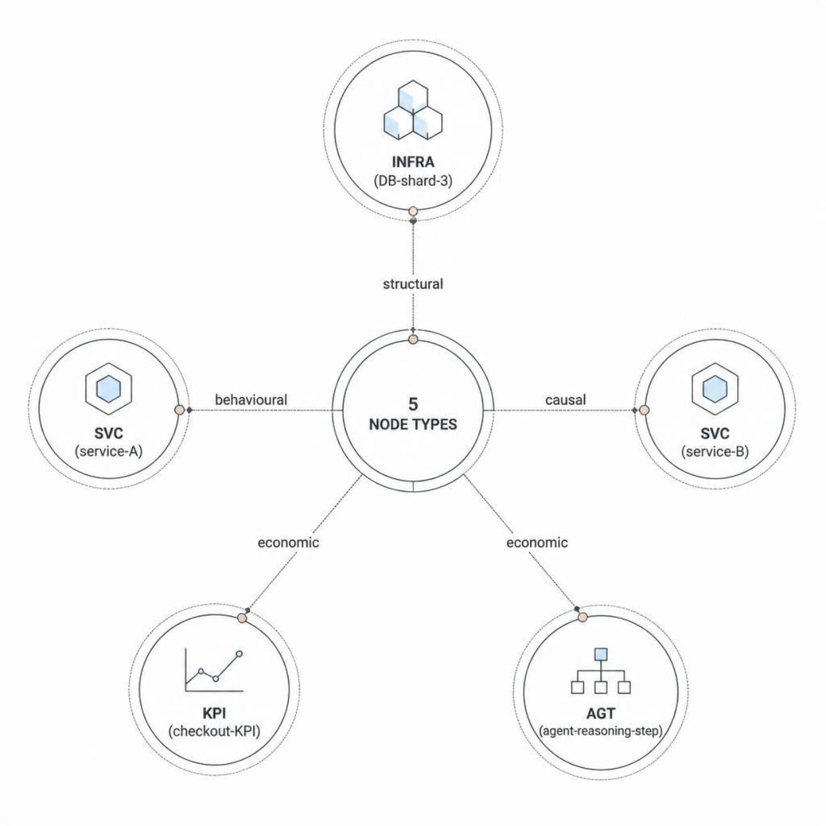
HELIOS ARTEFACT
C2 — UEG-C with Cognitive Nodes
Four typed edge classes admit cross-domain composition queries across infrastructure, service, KPI, and cognitive-agentic tiers.
Structural & Integration Claim → Confirmatory · A-H8
Typed-edge composition rules + Agent-Reasoning-Step nodes + subgraph-aware training discipline (HELIOS-noStructural ablation).
Cognitive-Agentic Claim → Exploratory · E-H1
Tier 4 corpus: n = 12
Confirmatory statistical minimum: 73 faults
Current evidence is therefore underpowered for confirmatory inference.
Path to confirmatory status:
Externally constructed cognitive-agentic fault corpus
Non-AIOpsLab substrate
Disciplined scoping, not a defect.
Structural
Behavioural
Causal
Economic

Slide 22


HELIOS ARTEFACT
Six Contributions
Classified, comparator-anchored, evidentially statused
Contribution | Type | Comparator | Status | Hypotheses
C1 — Runtime-enforced DSR rigour | Methodological-discipline | — | Descriptive | —
C2 — UEG-C with cognitive nodes | Constructs & models | CHASE | Confirmatory + Exploratory | A-H8 / E-H1
C3′ — FGSV: fidelity-gated shadow | Evaluation-infrastructure-discipline | Istio traffic mirroring | Exploratory | E-H4
C4 — MAHC (μ, σ) consensus | Method | mABC | Confirmatory | A-H4 + A-H7
C5 — IOL meta-observability | Architectural-pattern | Prometheus self-scrape · Datadog | Exploratory | E-H6
C6 — ORAR cost-aware routing | Method (cross-field transfer) | FrugalGPT | Confirmatory + Exploratory | A-H5 / E-H5
5 Transferable Design Principles
Pipeline Independence
Ablation-First Design
Bounded Reproducibility
Separation of Diagnosis from Action
The structural commitment that admits causal identifiability across reasoning paradigms — D/G/L share no runtime state.
Every claimed contribution must be feature-flag-toggleable from a single binary.
Protocol-level reproducibility framing for LLM-based research artefacts under explicitly disclosed determinism conditions.
Decision quality and action safety evaluated as distinct constructs.
Failure-as-Covariate Discipline
Every failure mode (sampling downgrade, pipeline unavailability, consensus non-convergence, etc.) becomes a first-class observable — not a silent fallback.
Additional transferable outputs: Asymmetric inferential rule · OSF evaluation template

Slide 23
HELIOS ARTEFACT
Five-Pillar Telemetry Strategy
Canonical three pillars extended with cognitive (P4) and business (P5) signals — all unified under UEG-C with formal composition rules across all five signal classes.
P1 · Metrics
P2 · Traces
P3 · Logs
Canonical
Prometheus · OTEL counters
Canonical
Jaeger · OTEL distributed traces
Canonical
Drain3 templates · LogEDL evidential vacuity
P4 · Cognitive
P5 · Business
Extension
Agent reasoning steps · tool-call schema · goal-drift · loop-depth
Extension
Transaction revenue · SLO penalties · service-class tier
Five-pillar extension is conceptual-architectural — not an ontological claim that P4 / P5 must constitute separate pillars.

Slide 24



EVALUATION
Evaluation Strategy
Pre-registered, ablation-first, controlled comparative experiment.
Corpus
4-Tier Corpus Structure
5 benchmarks · 174-fault confirmatory corpus · AIOpsLab concentration ~76% — scope condition · 4-tier structure · 16,000 ablation runs
Tier 1 — AIOpsLab (Seeded)
1
Multiple seeded replicates per fault · Bulk confirmatory corpus · GLMM sensitivity check for pseudoreplication risk
Baselines
5 priority-ranked AIOps systems · B-H1…B-H5: paired binary HR@3 (McNemar exact) · B-H6 log-MTTR · B-H7 log-Cost · B-H8 Avg@5
2
Tier 2 — AIOpsLab (Parametric)
Parametric extension · Confirmatory · One observation per fault
Primary Metrics
Tier 3 — External Benchmarks
HR@3 — binding accuracy metric · log-MTTR · Cost-per-Resolution (5-component) · Time-to-Triage · Hallucination (H_struct, H_fact)
3
Train-Ticket + DeathStarBench under ChaosBlade injection · External-validity probe, not confirmatory
Statistical Commitments
Tier 4 — Cognitive-Agentic ⚠
Paired Wilcoxon binding · McNemar paired-binary · Holm–Bonferroni separately within A & B families · Min-detectable: Cohen's h ≥ 0.276 → 13 pp HR@3 · BCa bootstrap CI · Pre-registration with deviation log
4
Synthetic NIKA-style faults on AIOpsLab · n=12 · Underpowered (below 73-fault minimum) · E-H1 demoted to exploratory
Static-policy commitment: LinUCB & ACP frozen at the pre-warmed state established prior to OSF freeze — preserves within-pair independence.

Slide 25
EVALUATION
Primary vs. Secondary Data
Secondary data evaluates the artefact — primary data validates the problem and its real-world value.
Data Type | Source | Purpose | Detail
Secondary | AIOpsLab, Train-Ticket, DeathStarBench + 2 more | Technical / quantitative evaluation | 174-fault confirmatory corpus
Primary — Academic | Independent RCA / AIOps researcher | Validate the technical-novelty claim | 5 structured questions
Primary — Business | Industry / business stakeholder | Validate the business-value claim | 5 structured questions
Primary — Practitioner | SRE / microservice on-call engineer | Validate real-world relevance | 5 structured questions
Secondary data evaluates technical performance; primary data provides stakeholder evidence on relevance and perceived value — both are needed.

Slide 26
EVALUATION
Business Evaluation Layer
Technical RCA outcomes map to organisational value after go-live — not a second confirmatory family.
What HELIOS measures | After deployment | Who sees it | Bound
HR@3 / Avg@5 | Fewer wrong first diagnoses; fewer repeat incidents | SRE / Incident commander | A-H1–4,6,8; B-H1–5,8
log-MTTR | Shorter impact; less SLO burn | Service owner / finance | B-H6 (confirmatory)
CpR / log-Cost | Lower incident cost (incl. LLM) | Platform owner / FinOps | A-H5, B-H7
TTT | Faster alert-to-cause hand-off; less on-call queueing | On-call rotation | B-H2 (exploratory)
Interpretation-trust · HITL | Act / escalate / reject | SRE, owner, reviewer | E-H7 user study
H_fact / H_struct | Fluent-but-wrong narrative risk | Risk / change-advisory | A-H7
FGSV + HITL | No unsupervised production write | Engineering leadership | E-H4; Monitor Agent
Lab results may support cheaper / faster / more accurate. They do not invent a firm-level saving. Industrial replication is that last step.

Slide 27
REFERENCES
Theoretical & Methodological Foundations
DSR, philosophy, statistics, and the IT-business-value claim.
Category | Source | What it supports | Year
DSR | Hevner, March, Park & Ram | Design science in IS research | 2004
DSR | Hevner | Three-cycle view of DSR | 2007
DSR method | Peffers et al. | DSR methodology (IS) | 2007
Contribution types | Gregor & Hevner | DSR contribution types | 2013
Philosophy | Mingers | Critical realism in IS | 2004
Routing / cost | Chen, Zaharia & Zou — FrugalGPT | LLM cost cascading (D6) | 2023
Bandits | Li, Chu, Langford & Schapire | LinUCB (DRAR substrate) | 2010
Author–year on slides; full APA 7 list is in the dissertation reference chapter.

Slide 28
REFERENCES
Benchmarks, Comparators & Prior RCA
Datasets and systems that the evaluation and gap analysis rest on.
Category | Source | What it supports | Year
Benchmark | Chen et al. — AIOpsLab | Primary corpus (~76%) | 2025
Benchmark | Gäri et al. — DeathStarBench | Tier 3 external-validity probe | 2019
Benchmark | PetShop; OpsEval | Cross-benchmark probes | 2024 / 2025
Comparator | Zhao et al. — CHASE; Yu et al. — Nezha | Graph / multimodal RCA (D1, C2) | 2025 / 2023
Comparator | TAMO; mABC; Flow-of-Action | LLM / multi-agent RCA families | 2025 / 2024 / 2025
Economics | Pham; Chakraborty; Soldani | Outage cost; failure survey | 2024 / 2024 / 2023
Methods | BARO; Wang & Qi RCA survey | Causal RCA; Ch. 2 synthesis | 2024
Author–year on slides; full APA 7 list is in the dissertation reference chapter.

Slide 29
OUTCOMES
Validity Threats Acknowledged
Each threat is a scope condition explicitly surfaced — not a flaw concealed.
Internal Validity
Construct Validity
Input drift → Snapshot Hash Registry (C1)
Cross-incident learning → STATIC-POLICY freeze
Hallucination → 3-layer (P4 → Sentinel → MAHC)
Threat 8 (pre-warming) — bounded, not dissolved
FAE-Score judges → 3-judge ensemble + 10% human anchor
SRE Likert trust bias → triangulated with HITL counter
Tier 4 NIKA → motivates E-H1 exploratory demotion
External Validity
Statistical Validity
Confirmatory bounded to AIOpsLab + parametric extension
Tiers 3–4 are external-validity probes only
Industrial replication = priority follow-on (§3.11.5)
FWER per family · Min-detectable-effect framing
BCa bootstrap CI per cell
Pre-registration with deviation log as binding instrument
Asymmetric rule for A-H4, A-H8 (rejection = support)

Slide 30
OUTCOMES
Risks, Mitigations & Contributions
Risks acknowledged; contributions stratified across academic, industrial, methodological
Early-Stage Risks → Mitigations
Contributions · Three Layers
Risk | Mitigation
LLM hallucination | P4 telemetry → Cognitive Sentinel → MAHC entropy regulariser → HITL escalation
Data quality / concept drift | Metric integrity gate · Exclusion ledger · ORAR drift mitigation
Scalability beyond 100 services | Explicit scope; 500–5000-service scaling = separate pre-registered experiment
Multimodal integration | UEG-C typed-edge composition · Subgraph-aware training under identical pruning
Evaluation bias / no ground truth | Pre-registered seed register · SHA-256 corpus · Independent-rater protocols
Academic
6 contributions in Gregor & Hevner (2013) taxonomy
5 transferable design principles
Asymmetric inferential rule
Industrial
MTTR & CpR evaluation targets
FGSV + HITL + ARM safety patterns
Runtime-enforcement apparatus
Methodological
Pre-registration as runtime invariant (C1)
Potential transfer to AIOps research-method practice
Broader DSR transferability identified as future research

Slide 31
OUTCOMES
Timeline to Viva
Six milestones — largest schedule risk lies in the confirmatory ablation runs.
Pre-Warming (LinUCB/ACP)
1
(1,200-incident synthetic corpus · freezes routing parameters prior to freeze)
2
OSF Pre-Registration Freeze
Imminent · locks pre-warmed state + protocol
Confirmatory Ablation Runs
3
16,000 runs · static-policy (frozen LinUCB/ACP)
4
Baseline-Comparison Runs
174 × 5 systems
User Study
5
IRB · counterbalanced within-subjects · n = 24
6
Chapter 4 + Viva
ε-probe (200-prompt logit-variance pass) · final submission
Thank you.
I look forward to your questions.
Pre-registration enforced as runtime invariant · Deviation log binding from OSF freeze · Open Science Framework deposit forthcoming

