Slide 1
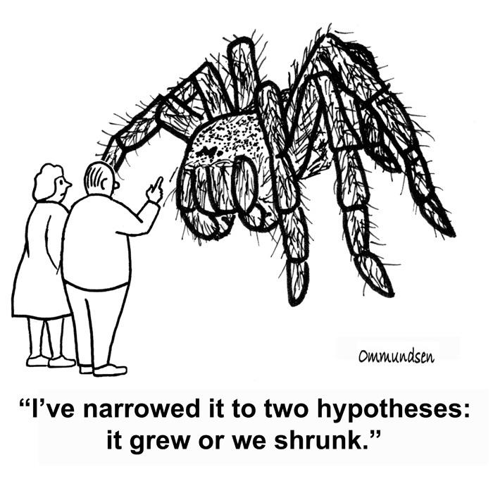
Hypothesis Testing

Slide 2
t-Distribution
Hypothesis tests give a way of using samples to test whether or not statistical claims are likely to be true or not.

Slide 3

Hypothesis testing
A school principal claims
that the students from her
school have an average
score of 7/10 in a English
Proficiency test.
You doubt that claim and take a random sample of 40 students and you find a mean score of 5.5/10, with a sample standard deviation of 1. Can you reject the principal’s claim?

Slide 4
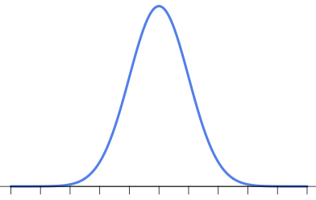
Hypothesis Testing Process
Considering variations in samples, how far away from 7/10
is acceptable to you as expected variation and when do you say “enough is enough; this is too far”?
This Far ?
This Far ?
This Far ?
Claim or Expectation, say, mean score = 7 /10

Slide 5
Step 1: Decide on the hypotheses
Average score on the test is 7/10.
This is called Null Hypothesis and is represented by H0.
In this case, H0 : 𝜇 = 0.7
If Null Hypothesis is rejected based on evidence, an Alternate Hypothesis, H1, needs to be accepted. We always start with the assumption that Null Hypothesis is true.
In this case, H1: 𝜇 < 0.7

Slide 6
Examples of Hypotheses
• Two hypotheses in competition:
– H0 : The NULL hypothesis, usually the most conservative.
– H1 or HA : The ALTERNATIVE hypothesis, the one we are actually interested in.
• Examples of NULL Hypothesis:
– The coin is fair
– The new drug is no better (or worse) than the placebo
• Examples of ALTERNATIVE hypothesis:
– The coin is biased (either towards heads or tails)
– The coin is biased towards heads
– The coin has a probability 0.6 of landing on tails
– The drug is better than the placebo

Slide 7
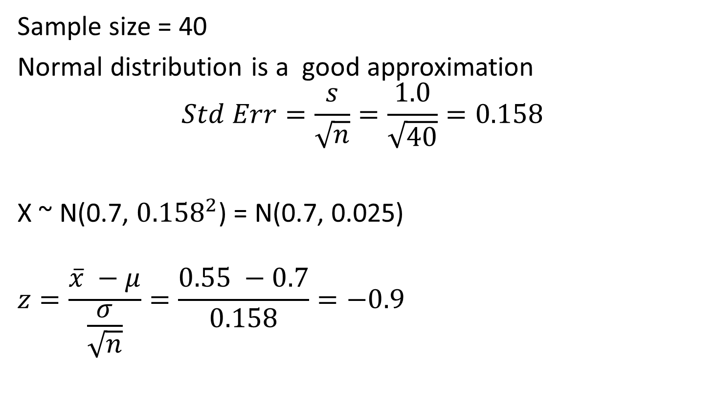
Step 2: Choose your statitics
Sample size = 40
Normal distribution is a good approximation
$$Std Err=\frac{s}{\sqrt{n}}=\frac{1.0}{\sqrt{40}}=0.158$$
X ~ N(0.7, ${0.158}^{2}$) = N(0.7, 0.025)
$$z=\frac{\overline{x} −μ}{\frac{σ}{\sqrt{n}}}=\frac{0.55 −0.7}{0.158}=−0.9$$

Slide 8

Step 3: Specify the significance Level
First, we must decide on the Significance Level, $α$. It is a measure of how unlikely you want the results of the sample to be before you reject the null hypothesis, H0.
This Far ?
This Far ?
This Far ?
Claim or Expectation, say, mean score = 7 /10

Slide 9

Step 4: Determine the critical region
If X represents the sample mean score, the critical region is defined as $P\left(X<c\right)<α$ where $α=5 \%$.
Recall that in a 95% CI, there is a 5% chance that the sample will not contain the population mean. Hence if the sample falls in the critical region, the null hypothesis that 0.7 is the mean score is rejected.
That is the reason 5% or 0.05 is called the Significance Level. In a 99% CI, 0.01 is the Significance Level.
Critical Region

Slide 10

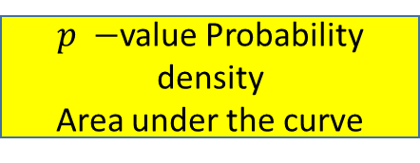
Step 5: Find the $p −$value
p-value is the probability of getting a value up to and including the one in the sample in the direction of the critical region.
It is a way of taking the sample
and working out whether the
result falls within the critical
region of the hypothesis test.
Essentially, this is the value used to determine whether or not to reject the null hypothesis.
$p −$value Probability density
Area under the curve

Slide 11
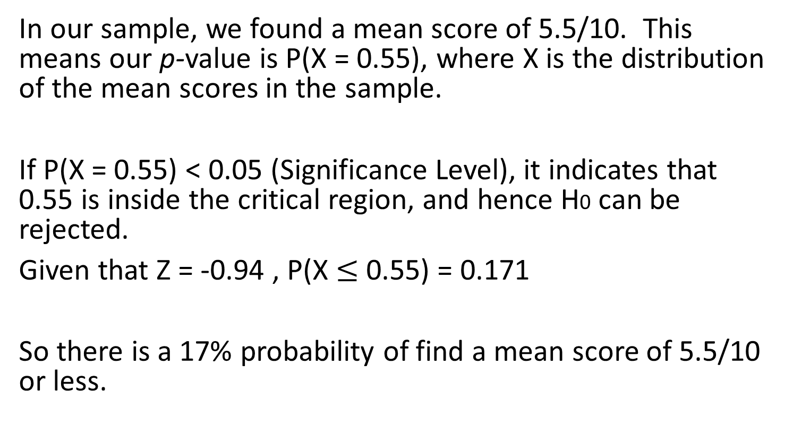

Step 5: Find the $p−$value
In our sample, we found a mean score of 5.5/10. This means our p-value is P(X = 0.55), where X is the distribution of the mean scores in the sample.
If P(X = 0.55) < 0.05 (Significance Level), it indicates that 0.55 is inside the critical region, and hence H0 can be rejected.
Given that Z = -0.94 , P(X $≤$0.55) = 0.171
So there is a 17% probability of find a mean score of 5.5/10 or less.

Slide 12
Step 6: Is the sample result in the critical region ?
Critical Region
17 %

Slide 13
Step 7: Make your decision
There isn’t sufficient evidence to reject the null hypothesis and so, the claims of the principal are accepted.

Slide 14
Would your conclusion be any different if the same average score of 5.5/10 was found from a sample of size 400?

Slide 15

What are the null and alternate hypotheses ?
$$H_{0} :μ=0.7$$
$$H_{1} :μ=0.7$$
What is the test statistics ?
$$Z=\frac{\overline{x} −μ}{\frac{σ}{\sqrt{n}}}= \frac{0.55 −0.7}{\frac{1}{\sqrt{400}}}= −3$$
p-value = P(Z < -3.0) = 0.00135

Slide 16
What is your decision ?
Since the p-value (0.00135) is less than the Significance Level of 0.05, the null hypothesis can be rejected.

Slide 17
Attention Check
In hypothesis testing, do you assume the null hypothesis to be true or false?
If there is sufficient evidence against the null hypothesis, do you accept it or reject it?
Reject it.
True.

Slide 18
Attention Check
If the p-value is less than 0.05 for the above significance level, will you accept or reject the null hypothesis?
Reject it.
Do you need weaker evidence or stronger to reject the null hypothesis if you were testing at the 1% significance level instead of the 5% significance level?
Stronger.

Slide 19





Critical Region Up Close
One-tailed tests
The position of the tail is dependent on H1.
If $H_{1}$ includes a < sign, then the lower tail is used.
If $H_{1}$ includes a > sign, then the upper tail is used.
c
$$α$$
$$100\% − α$$
c
$$100\% − α$$
$$α$$

Slide 20






Critical Region Up Close
Two-tailed tests
Critical region is split over both ends. Both ends contain $\frac{α}{2}$, making a total of $α$.
If $H_{1}$ includes a ≠ sign, then the two-tailed test is used as we then look for a change in parameter, rather than an increase or a decrease.
$$c_{1}$$
$$c_{2}$$
$\frac{α}{2}$
$$100\% − α$$
$\frac{α}{2}$

Slide 21
Critical Region Up Close
For each of the scenarios below, identify what type of test you would require.
• Average test score problem as discussed till now.
One-tailed/Lower-tailed
• If we were checking whether the average is significantly different from 7/10, i.e., H1: 𝜇 ≠0.7.
Two-tailed test
• The coin is biased.
Two-tailed test
• The coin is biased towards heads with probability 0.8.
One-tailed/Upper-tailed

Slide 22

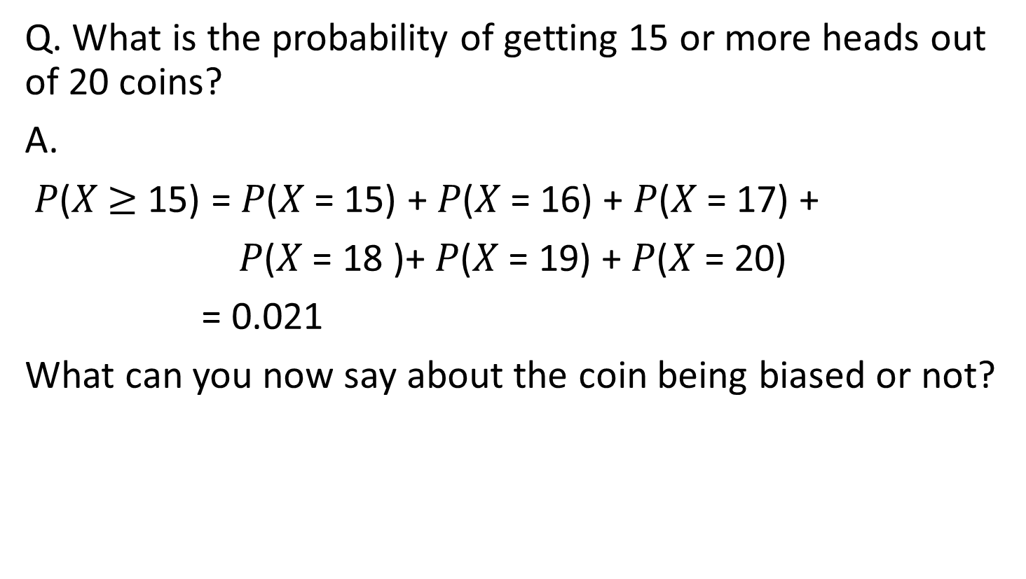

The Missing Link in the Interview
Q. What is the probability of getting 15 or more heads out of 20 coins?
A.
𝑃(𝑋 $≥$ 15) = 𝑃(𝑋 = 15) + 𝑃(𝑋 = 16) + 𝑃(𝑋 = 17) +
𝑃(𝑋 = 18 )+ 𝑃(𝑋 = 19) + 𝑃(𝑋 = 20)
= 0.021
What can you now say about the coin being biased or not?
C = 15
$$100\% − α$$
$$α$$

Slide 23
The hypothesis test doesn’t answer the question
whether the coin is biased or not; it only states
whether the evidence is enough to reject the null
hypothesis or not at the chosen significance level.

Slide 24
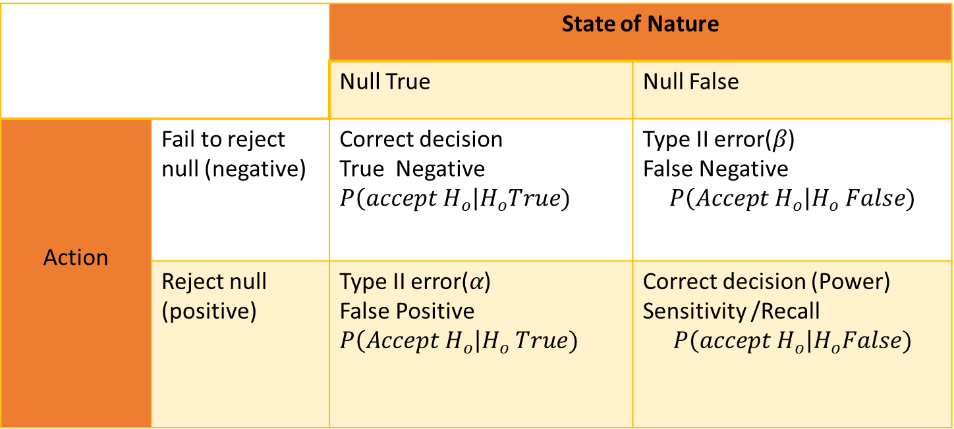
Errors
• Type I: We reject the NULL hypothesis incorrectly
• Type II: We “accept” it incorrectly
 |  | State of Nature
 |  | Null True | Null False
Action | Fail to reject null (negative) | Correct decision True Negative $$P\left(accept H_{o}\right|H_{o}True)$$ | Type II error($β$) False Negative $$P\left(Accept H_{o}\right|H_{o} False)$$
 | Reject null (positive) | Type II error($α$) False Positive $$P\left(Accept H_{o}\right|H_{o} True)$$ | Correct decision (Power) Sensitivity /Recall $$P\left(accept H_{o}\right|H_{o}False)$$

Slide 25
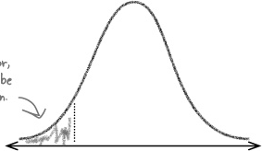

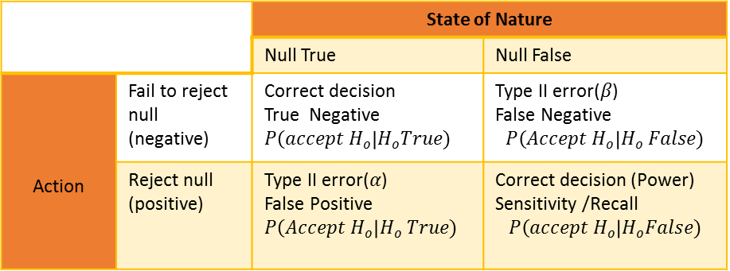
Probability of Getting Type I Error
$$α$$
$$P\left(Type I error\right)=α$$
 |  | State of Nature
 |  | Null True | Null False
Action | Fail to reject null (negative) | Correct decision True Negative $$P\left(accept H_{o}\right|H_{o}True)$$ | Type II error($β$) False Negative $$P\left(Accept H_{o}\right|H_{o} False)$$
 | Reject null (positive) | Type II error($α$) False Positive $$P\left(Accept H_{o}\right|H_{o} True)$$ | Correct decision (Power) Sensitivity /Recall $$P\left(accept H_{o}\right|H_{o}False)$$

Slide 26

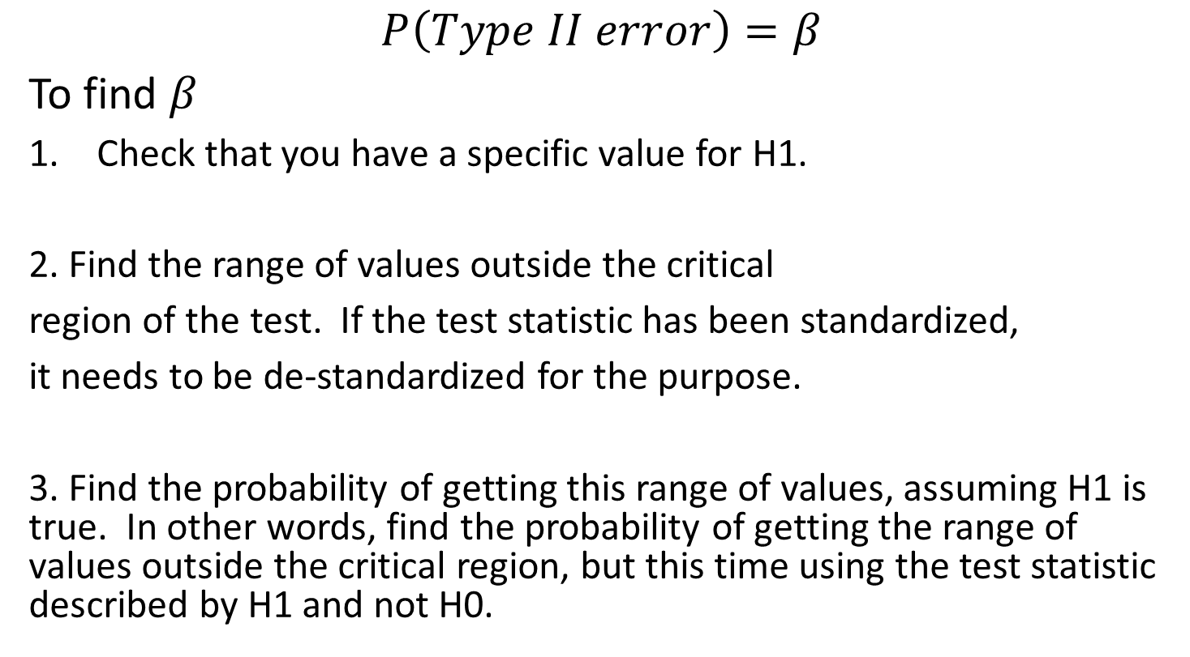
Probability of Getting Type II error
$$P\left(Type II error\right)=β$$
To find $β$
Check that you have a specific value for H1.
2. Find the range of values outside the critical
region of the test. If the test statistic has been standardized,
it needs to be de-standardized for the purpose.
3. Find the probability of getting this range of values, assuming H1 is true. In other words, find the probability of getting the range of values outside the critical region, but this time using the test statistic described by H1 and not H0.

Slide 27
A new miracle drug claims that it cures common cold and it has had a success rate of 90%. You conduct a random sample test with 100 patients and you find that 80 of them are cured.
At 5% significant level, do you reject or accept the claim by the drug company?

Slide 28

What are the null and alternate hypotheses ?
$$H_{o}:p=0.9$$
$$H_{1}:p<0.9$$
What is the test statistics ?
X ~ B(100,0.9)

Slide 29
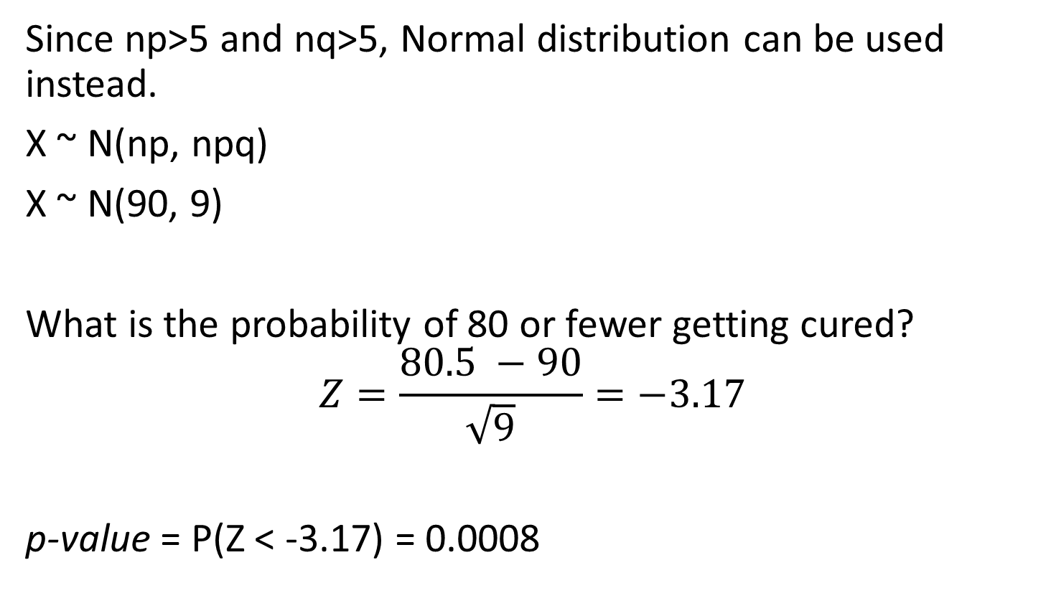
Since np>5 and nq>5, Normal distribution can be used instead.
X ~ N(np, npq)
X ~ N(90, 9)
What is the probability of 80 or fewer getting cured?
$$Z=\frac{80.5 −90}{\sqrt{9}}=−3.17$$
p-value = P(Z < -3.17) = 0.0008

Slide 30
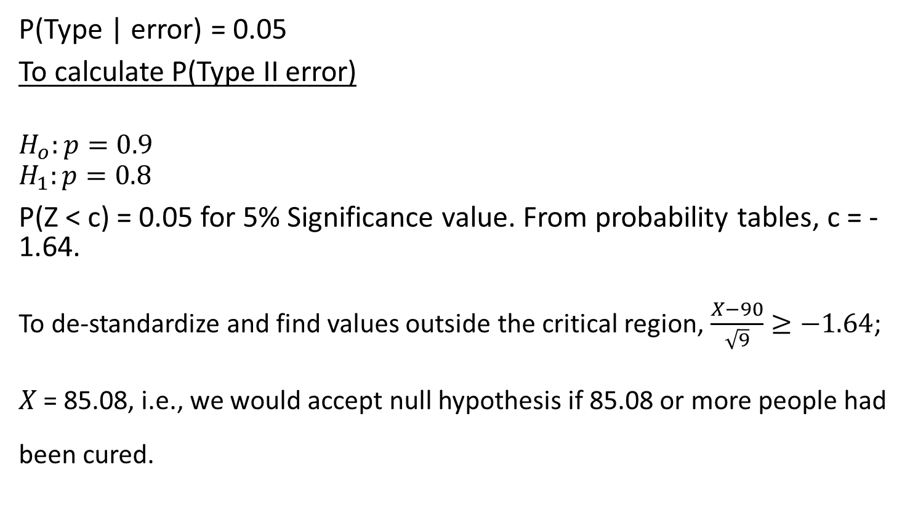
Probabilities of Errors in our Example
P(Type | error) = 0.05
To calculate P(Type II error)
$$H_{o}:p=0.9$$
$$H_{1}:p=0.8$$
P(Z < c) = 0.05 for 5% Significance value. From probability tables, c = -1.64.
To de-standardize and find values outside the critical region, $\frac{X−90}{\sqrt{9}}≥−1.64$;
𝑋 = 85.08, i.e., we would accept null hypothesis if 85.08 or more people had been cured.

Slide 31
Probabilities of Type I and Type II Errors
Type I Error
Type II Error
75
80
85
90
90

Slide 32
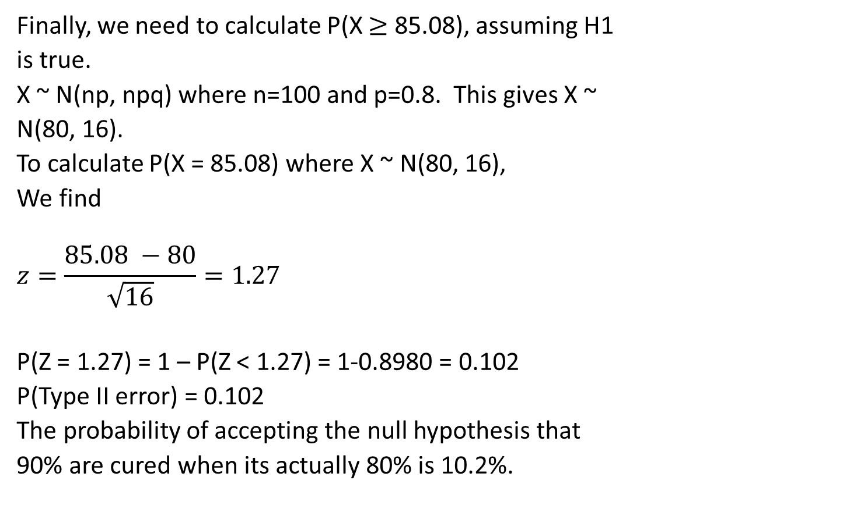
Probabilities of Errors in Our Example
Finally, we need to calculate P(X $≥$ 85.08), assuming H1
is true.
X ~ N(np, npq) where n=100 and p=0.8. This gives X ~
N(80, 16).
To calculate P(X = 85.08) where X ~ N(80, 16),
We find
$$z=\frac{85.08 −80}{\sqrt{16}}=1.27$$
P(Z = 1.27) = 1 – P(Z < 1.27) = 1-0.8980 = 0.102
P(Type II error) = 0.102
The probability of accepting the null hypothesis that
90% are cured when its actually 80% is 10.2%.
75
80
85
90
90

Slide 33
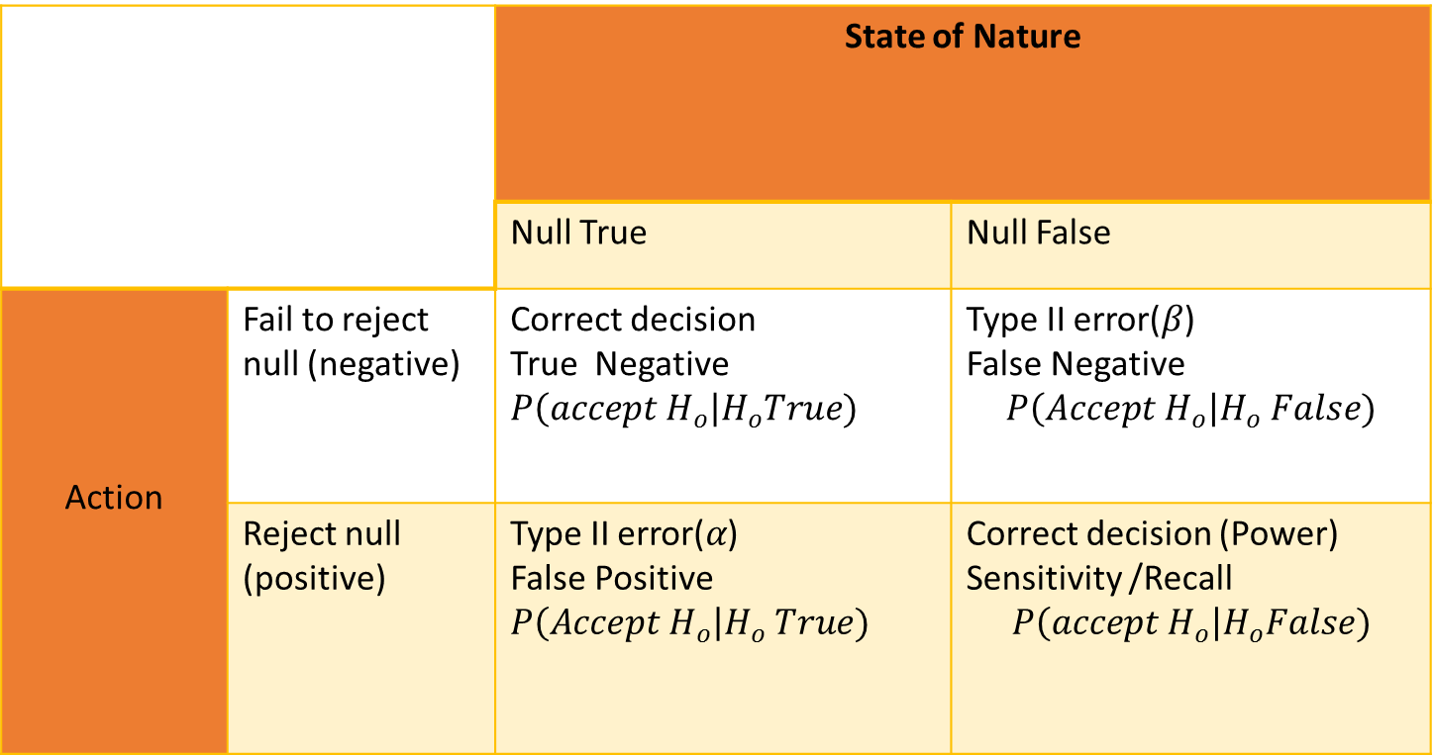
Power of Hypothesis Testing
 |  | State of Nature
 |  | Null True | Null False
Action | Fail to reject null (negative) | Correct decision True Negative $$P\left(accept H_{o}\right|H_{o}True)$$ | Type II error($β$) False Negative $$P\left(Accept H_{o}\right|H_{o} False)$$
 | Reject null (positive) | Type II error($α$) False Positive $$P\left(Accept H_{o}\right|H_{o} True)$$ | Correct decision (Power) Sensitivity /Recall $$P\left(accept H_{o}\right|H_{o}False)$$

Slide 34
Power of Hypothesis Test
We reject null hypothesis correctly
when it is false.
It is actually the opposite of
Type II error, and therefore,
Power = 1 – ß = 1-0.102 = 0.898, i.e.,
the probability that we will make the
correct decision in rejecting the null
hypothesis is 89.8%.
75
80
85
90
90

Slide 35
Hypothesis Testing
A prisoner is on trial and you are on the jury. The jury’s task is to assume that the accused is innocent, but if there is enough evidence, the jury needs to convict him.
In the trial, what is the null hypothesis?
The prisoner is innocent (or not guilty).
What is the alternate hypothesis?
The prisoner is guilty.

Slide 36
Hypothesis Testing
What are the possible ways of the jury coming to an incorrect verdict?
◘ If the prisoner is innocent, and the jury gives a ‘guilty’ verdict.
◘ If the prisoner is guilty, and the jury gives an ‘innocent’ verdict.
Which one is Type I and which one Type II?
First one is Type I because null hypothesis actually was correct but rejected incorrectly.
Second one is Type II because null hypothesis was false but was accepted incorrectly.
What is the Power of the test?
Since it is opposite of Type II, it will be finding the prisoner guilty when the prisoner is actually guilty, i.e., rejecting the null hypothesis correctly.

Slide 37
Common Test Statistics for Inferential Techniques
Inferential techniques (Confidence Intervals and Hypothesis Testing) most commonly use 4 test statistics:
• z
• t
• 𝜒2 (Chi-squared)
• F
Closely related to Sampling Distribution of Means
• Closely related to Sampling Distribution of Variances
• Derived from Normal Distribution

Slide 38
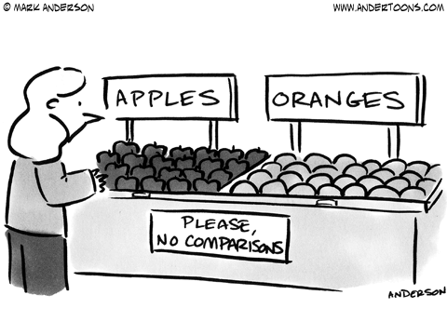
TWO-SAMPLE t-TEST FOR MEANS

Slide 39
• Do two samples come from the same population?
• If they come from different populations, what is the difference in the means of the two populations?
Does the average cost of a two-bedroom flat differ between Bengaluru and Hyderabad? What is the difference?
What is the difference in the strength of steel produced under two different temperatures?
Does the effectiveness of Head & Shoulders anti-dandruff shampoo differ from Pantene anti-dandruff shampoo?
What is the difference in the productivity of men and women on an assembly line under certain conditions?
Does an antibiotic affect the efficacy of another drug being taken by a patient?

Slide 40
Two-sample t-Test
• Paired Data
– You have two sets of data, where there is a natural pairing in the elements. Eg: Blood Pressure - from 30 people – one from before a treatment and other from after treatment
• Unpaired Data
– Comparing apartment costs from two cities
– Two data sets of different length
– No Natural pairing

Slide 41
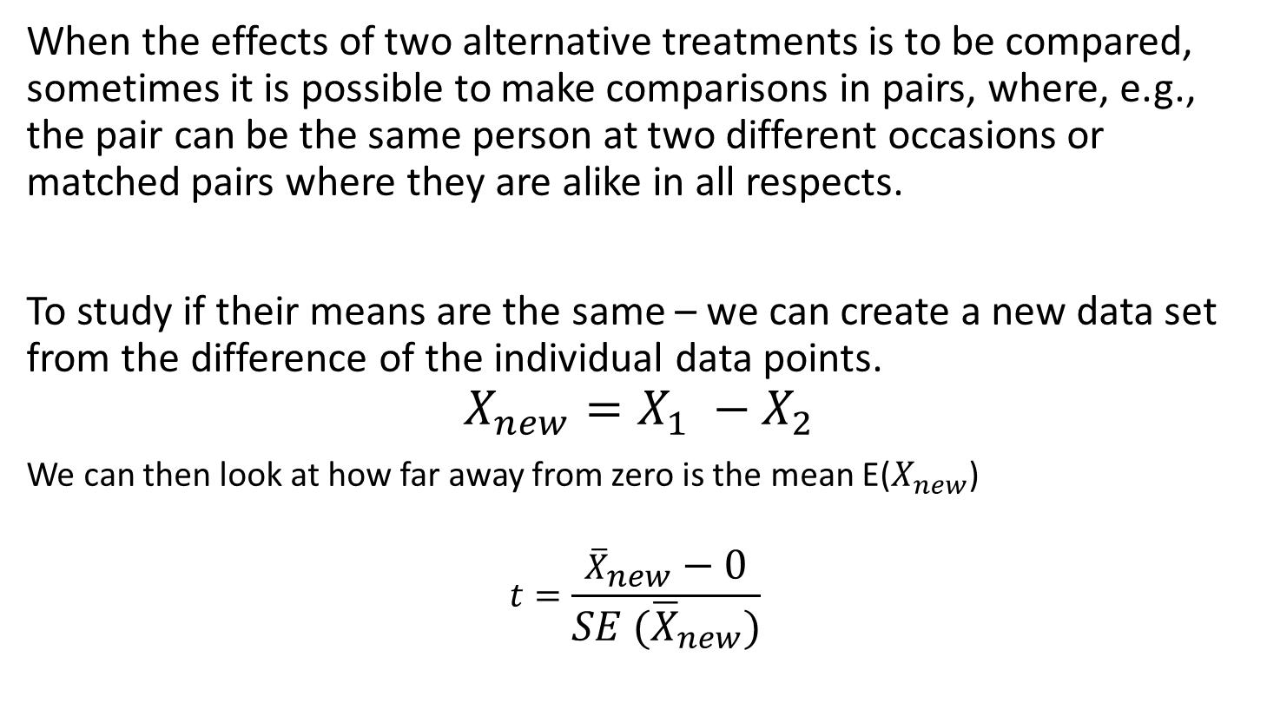
Two-Sample t-Test for Paired Data
When the effects of two alternative treatments is to be compared, sometimes it is possible to make comparisons in pairs, where, e.g., the pair can be the same person at two different occasions or matched pairs where they are alike in all respects.
To study if their means are the same – we can create a new data set from the difference of the individual data points.
$$X_{new}=X_{1} −X_{2}$$
We can then look at how far away from zero is the mean E($X_{new}$)
$$t=\frac{{\overline{X}}_{new}−0}{SE ({\overline{X}}_{new})}$$

Slide 42
Two-Sample t-Test for Paired Data
A Yoga guru suggests that meditation increases concentration. To test this hypothesis, you get 12 volunteers and get them to complete a puzzle and you measure the time taken for completing the puzzle. The next day, you put them through a 30 minute meditation routine and have them complete another puzzle of similar difficulty. The time taken for completion is measured again.
You want to test at 5% Significance Level (or 95% Confidence Level) if the time taken is shorter after meditation.

Slide 43
Yoga Paired Data
Time to Solve the puzzle(min)
Patient
After Yoga(A)
Before Yoga (B)
A-B
1
63
55
8
2
54
62
-8
3
79
108
-29
4
68
77
-9
5
87
83
4
6
84
78
6
7
92
79
13
8
57
94
-37
9
66
69
-3
10
53
66
-13
11
76
72
4
12
63
77
-14
TOTAL
842
920
-78
MEAN
70.17
76.67
-6.5

Slide 44
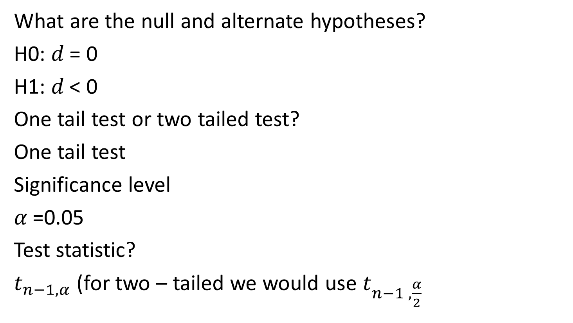
Yoga Paired Data
What are the null and alternate hypotheses?
H0: 𝑑 = 0
H1: 𝑑 < 0
One tail test or two tailed test?
One tail test
Significance level
𝛼 =0.05
Test statistic?
$t_{n−1,α}$ (for two – tailed we would use $t_{n−1 ,\frac{α}{2}}$

Slide 45
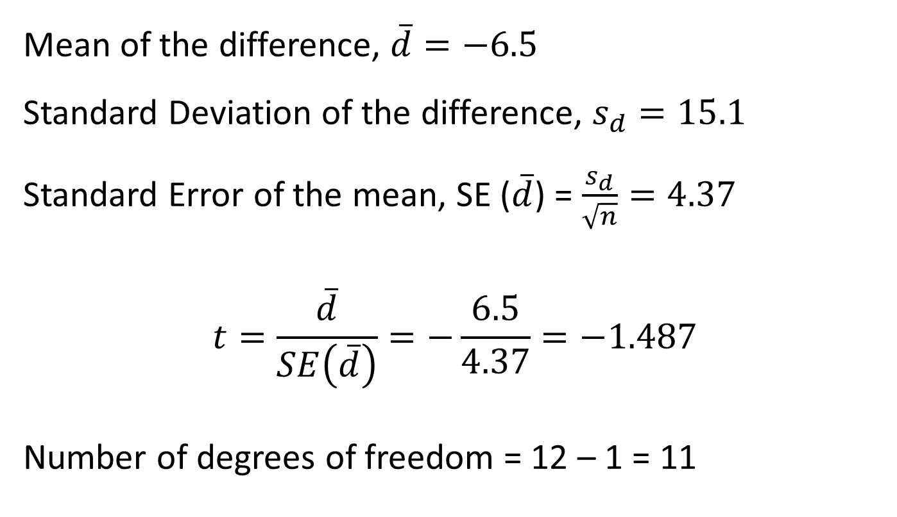
Mean of the difference, $\overline{d}=−6.5$
Standard Deviation of the difference, $s_{d}=15.1$
Standard Error of the mean, SE ($\overline{d}$) = $\frac{s_{d}}{\sqrt{n}}=4.37$
$$t=\frac{\overline{d}}{SE\left(\overline{d}\right)}=−\frac{6.5}{4.37}=−1.487$$
Number of degrees of freedom = 12 – 1 = 11

Slide 46
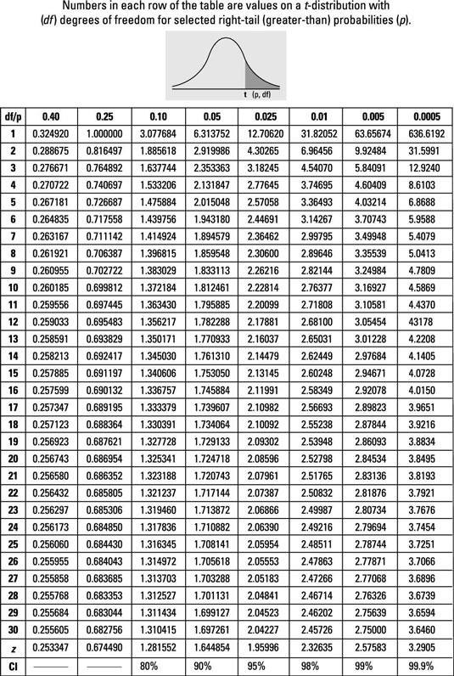

Two-Sample t-Test for Paired Data
t = -1.487
$t_{11,0.05}=1.795885$
Comparing the
absolute t-value,
we cannot reject the
Null hypothesis that
the mean completion
time is the same.

Slide 47
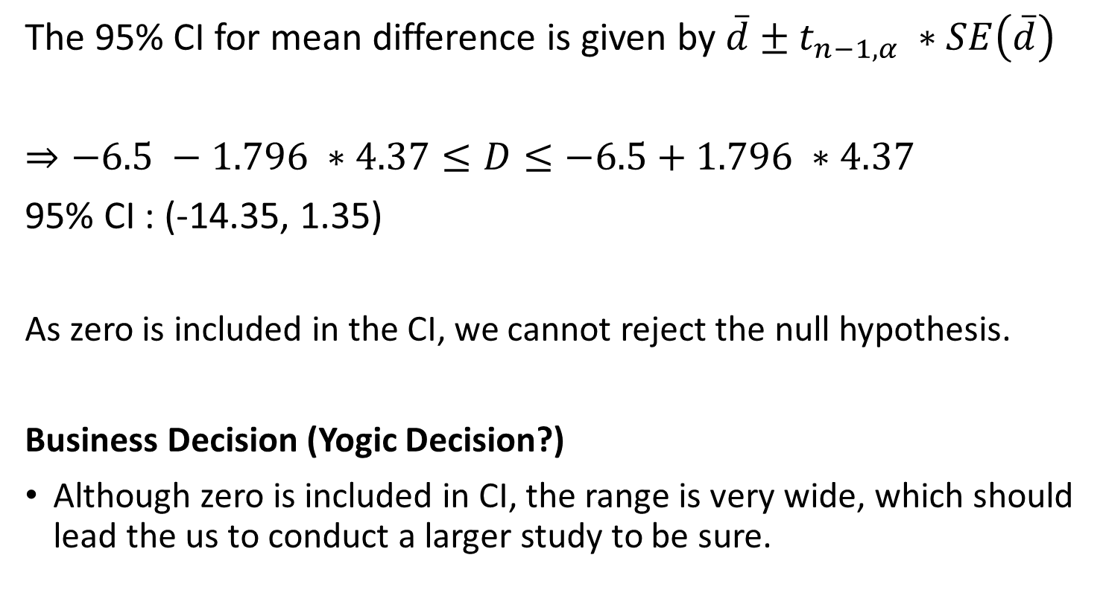
Two-Sample t-Test for Paired Data
The 95% CI for mean difference is given by $\overline{d}±t_{n−1,α} ∗SE\left(\overline{d}\right)$
$⇒−6.5 −1.796 ∗4.37≤D≤−6.5+1.796 ∗4.37$
95% CI : (-14.35, 1.35)
As zero is included in the CI, we cannot reject the null hypothesis.
Business Decision (Yogic Decision?)
Although zero is included in CI, the range is very wide, which should lead the us to conduct a larger study to be sure.

Slide 48
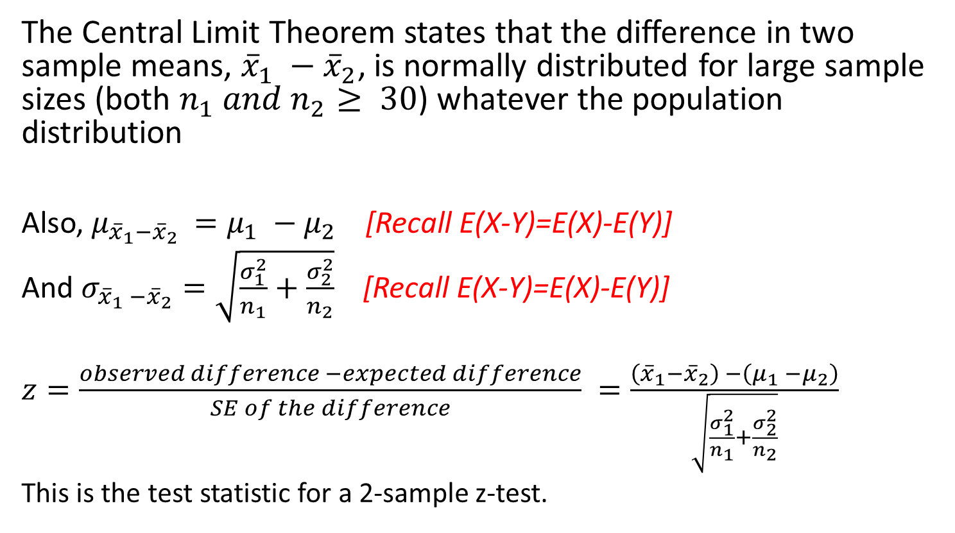
Two sample t-Test: unpaired data
The Central Limit Theorem states that the difference in two sample means, ${\overline{x}}_{1} −{\overline{x}}_{2}$, is normally distributed for large sample sizes (both $n_{1} and n_{2}≥ 30$) whatever the population distribution
Also, $μ_{{\overline{x}}_{1}−{\overline{x}}_{2} }=μ_{1} −μ_{2}$ [Recall E(X-Y)=E(X)-E(Y)]
And $σ_{{\overline{x}}_{1} −{\overline{x}}_{2}}=\sqrt{\frac{σ_{1}^{2}}{n_{1}}+\frac{σ_{2}^{2}}{n_{2}}}$ [Recall E(X-Y)=E(X)-E(Y)]
$z=\frac{observed difference −expected difference}{SE of the difference} =\frac{\left({\overline{x}}_{1}−{\overline{x}}_{2}\right) −\left(μ_{1} −μ_{2}\right)}{\sqrt{\frac{σ_{1}^{2}}{n_{1}}+\frac{σ_{2}^{2}}{n_{2}}}}$
This is the test statistic for a 2-sample z-test.

Slide 49
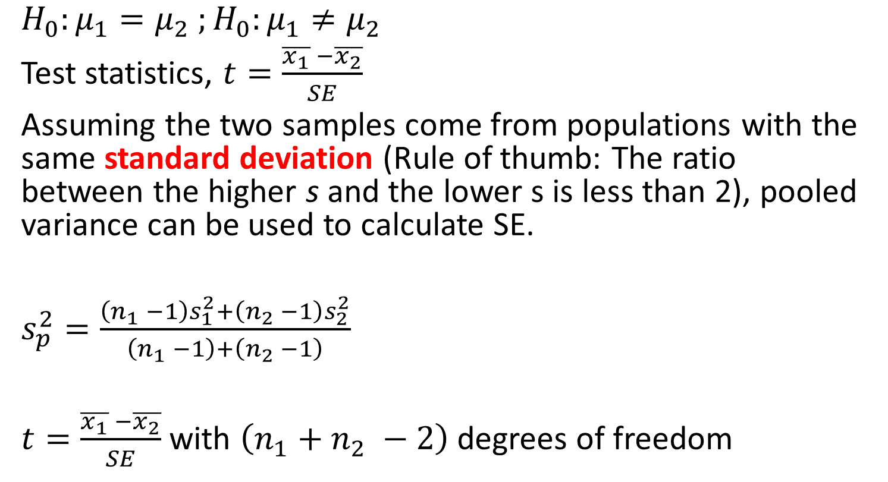
Two-Sample t-Test for Unpaired Data
$H_{0}:μ_{1}=μ_{2} ;H_{0}:μ_{1}≠μ_{2}$
Test statistics, $t=\frac{\overline{x_{1}} −\overline{x_{2}}}{SE}$
Assuming the two samples come from populations with the same standard deviation (Rule of thumb: The ratio between the higher s and the lower s is less than 2), pooled variance can be used to calculate SE.
$s_{p}^{2}=\frac{\left(n_{1} −1\right)s_{1}^{2}+\left(n_{2} −1\right)s_{2}^{2}}{\left(n_{1} −1\right)+\left(n_{2} −1\right)}$
$t=\frac{\overline{x_{1}} −\overline{x_{2}}}{SE}$ with $\left(n_{1}+n_{2} −2\right)$degrees of freedom

Slide 50

Insomnia Treatment
A statistics professor claims that his lectures can cure insomnia. You want to test the claim. You collect 30 patients with sleeping trouble and divide them into 2 groups of 15 each.
The control group were asked to follow their usual routine while the other group was exposed to 1-hour of his lecture on t-distribution shortly after dinner. The time taken to sleep was measured for each group.

Slide 51


Two sample t-test
Time taken to sleep (hr)
Treated Subjects
Control Subjects
0.81 0.56 0.46
1.15 1.15 0.92
1.06 0.45 0.43
1.28 0.72 0.67
0.43 0.88 0.37
1.00 0.79 0.76
0.54 0.73 0.73
0.95 0.67 0.82
0.68 0.43 0.93
1.06 1.21 0.82
$n_{2}=15$
$\overline{x_{2}}=0.633$
$s_{2}=0.216$
$s_{2}^{2}=0.0467$
$n_{2}=15$
$\overline{x_{2}}=0.931$
$s_{2}=0.202$
$s_{2}^{2}=0.0408$

Slide 52
Hypothesis Testing
What is the null hypothesis?
𝐻0 : 𝜇1- 𝜇2 = 0 (The lecture has no impact)
What is the alternative hypothesis?
𝐻1 : 𝜇1- 𝜇2 ≠ 0
Is it a one-tailed test or a two-tailed test?
Two-tailed
What could be a possible hypothesis for a one-tailed test?
The lecture helps people sleep better.

Slide 53
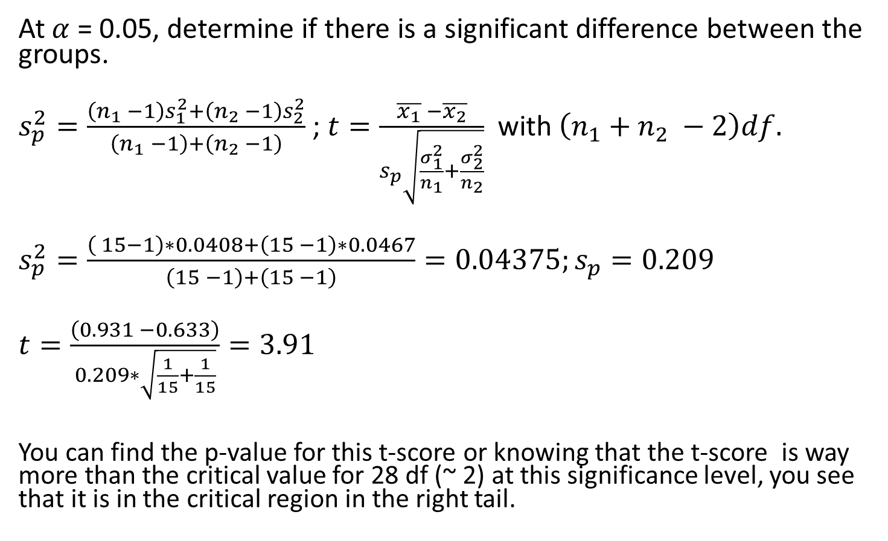
Two sample t-test
At $α$ = 0.05, determine if there is a significant difference between the groups.
$s_{p}^{2}=\frac{\left(n_{1} −1\right)s_{1}^{2}+\left(n_{2} −1\right)s_{2}^{2}}{\left(n_{1} −1\right)+\left(n_{2} −1\right)}$ ; $t=\frac{\overline{x_{1}} −\overline{x_{2}}}{s_{p}\sqrt{\frac{σ_{1}^{2}}{n_{1}}+\frac{σ_{2}^{2}}{n_{2}}}}$ with $\left(n_{1}+n_{2} −2\right)df.$
$s_{p}^{2}=\frac{\left( 15−1\right)∗0.0408+\left(15 −1\right)∗0.0467}{\left(15 −1\right)+\left(15 −1\right)}=0.04375;s_{p}=0.209$
$t=\frac{\left(0.931 −0.633\right)}{0.209∗\sqrt{\frac{1}{15}+\frac{1}{15}}}=3.91$
You can find the p-value for this t-score or knowing that the t-score is way more than the critical value for 28 df (~ 2) at this significance level, you see that it is in the critical region in the right tail.

Slide 54
Hypothesis Testing
Will you reject the null hypothesis or fail to do so?
Reject. That means lecture does affect the time-to-sleep.
Does it increase or decrease the time to sleep and by how much?
As the treated patients slept in shorter time (0.633 hr) compared to the control group (0.931 hr), the lecture reduces the time to sleep by 0.298 hr.

Slide 55
Reference
INSOFE: www.insofe.edu.in

