Slide 1
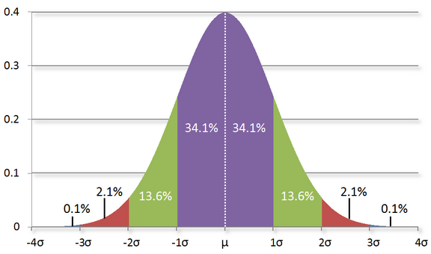
Distribution

Slide 2
Bernouli Distribution

Slide 3
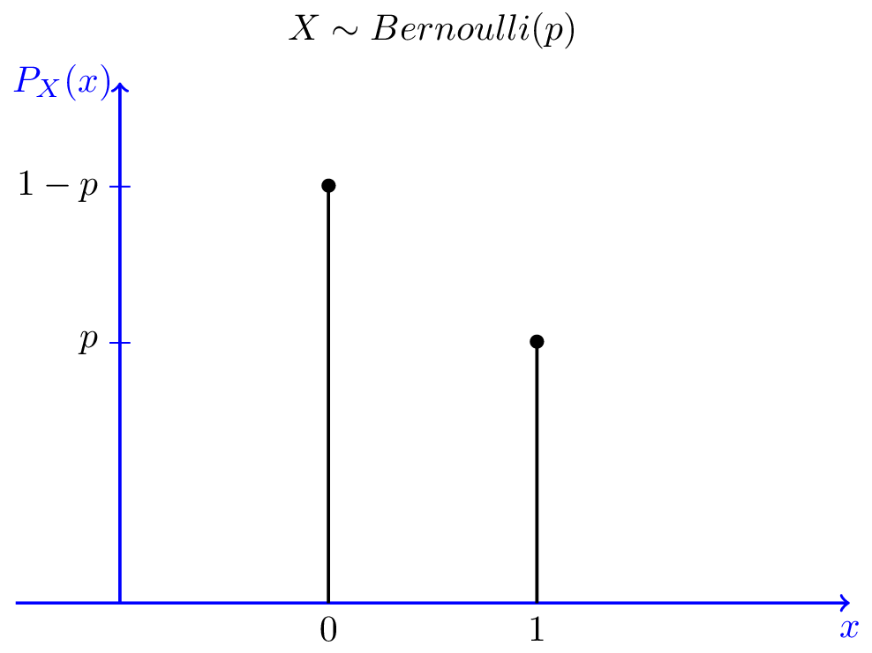
Bernouli
There are two possibilities (pass or fail) with probability p of success and q = 1-p of failure..
Expectation : p
Variance : pq

Slide 4

Bernouli
$$Expectation, E\left(x\right)= \sum{x_{i} P(x_{i})}$$
= 1 * p + 0 * q
= p
$$Variance, Var= \sum{{{(x}_{i} − μ)}^{2} P(x_{i})}$$
= ${{(1}_{ } −p)}^{2} ∗p+{{(0}_{ } −p)}^{2} ∗(1−p)$
= $p \left(1−p\right)$
= pq

Slide 5
Geometric Distribution
Number of independent and identical Bernoulli trails needed to get ONE success.
Eg. Number of attempts before I pass the exam

Slide 6
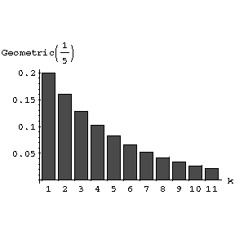
Geometric Distribution
You run a series of independent trail.
There can be either a success or failure for each trail, and the probability of success is the same for each trail.
How many trails are needed in order to get the first successful outcome.

Slide 7
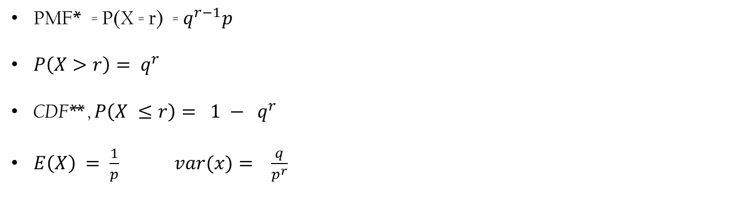
Geometric Distribution
PMF* = P(X = r) = $q^{r−1}p$
$P\left(X>r\right)= q^{r}$
CDF** , $P\left(X ≤r\right)= 1 − q^{r}$
$E\left(X\right) = \frac{1}{p} var(x)= \frac{q}{p^{r}}$
PMF : Probaility Mass Funciton
CDF : Cumulative Distribution Function

Slide 8
Binomial Distribution

Slide 9
Binomial Experiment
The process consists of a sequence of n trials.
Only two exclusive outcomes are possible in each trail. One outcome is called “Success” and other a “failure”.
The probability of a success denotes p , does not change from trail to trail. The probability of failure is 1-p and is also fixed from trail to trail.
The trails are independent; the outcome of previous trail not influence future trail.

Slide 10
Binomial Variable
Let’s consider a coin P(H) = 0.6
P(T) = 0.4
X = # of heads after 10 flip of my coin
Made up of independent trails
Each trail can be classified as either success or failure
Probability of success on each trail is constant

Slide 11

Binomial distribution
X = # of heads after flipping coin 4 times
Possible outcomes = 2 * 2 * 2 * 2 = 16
P(X = 0) = $\frac{C_{0 }^{4}}{32 }=\frac{1}{32}$
P(X = 1) = $\frac{C_{1 }^{4}}{32 } =\frac{5}{32}$
P(X = 2) = $\frac{C_{2 }^{4}}{32 } =\frac{6}{32}$

Slide 12
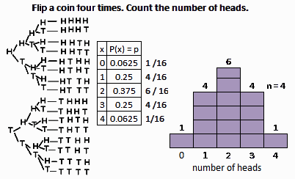
Binomial distribution

Slide 13
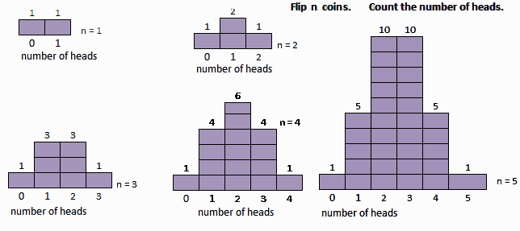
Binomial distribution

Slide 14
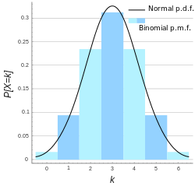
Binomial distribution

Slide 15
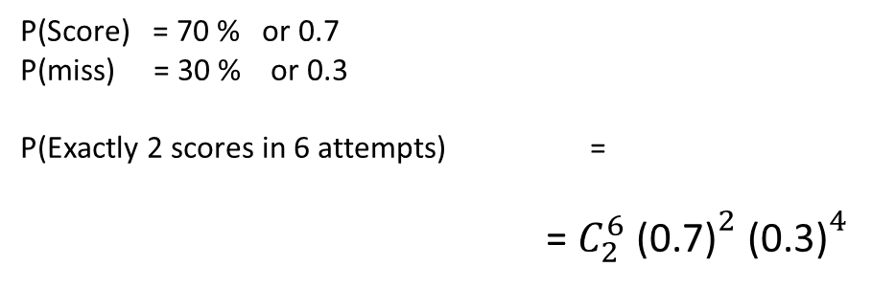
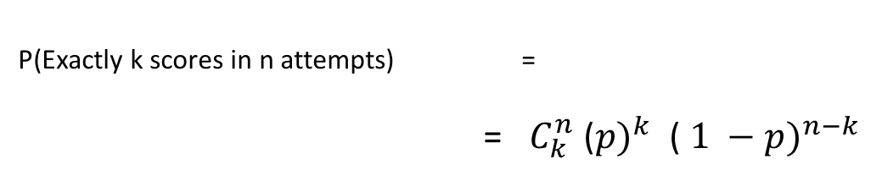
Binomial Probability example
P(Score) = 70 % or 0.7
P(miss) = 30 % or 0.3
P(Exactly 2 scores in 6 attempts) =
= $C_{2}^{6} {\text{(0.7)}}^{2}$ ${\text{(0.3)}}^{4}$
P(Exactly k scores in n attempts) =
= $C_{k}^{n} {\text{(}p)}^{k}$ ${\text{(} 1 −p)}^{n−k}$

Slide 16
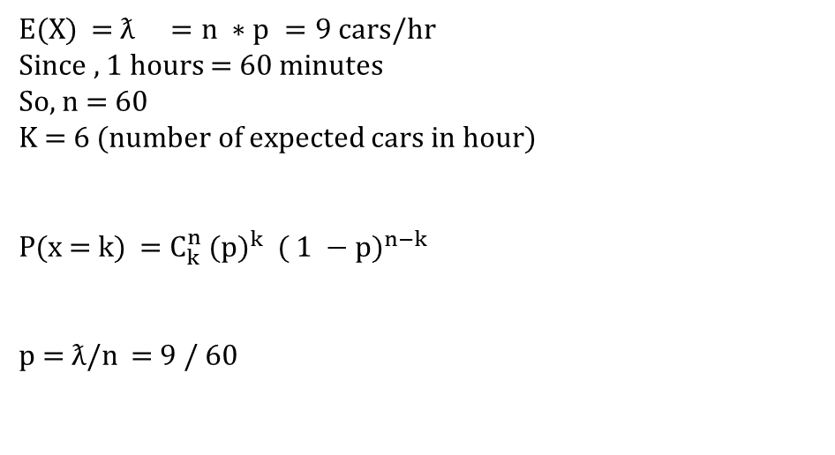
Question
In this area it is expected that 9 cars are passing in a hours. What is the probability that there are exactly 6 cars are passing in this hour
E(X) = $ƛ =n ∗p =9 cars/hr$
Since , 1 hours = 60 minutes
So, n = 60
K = 6 (number of expected cars in hour)
P(x = k) = $C_{k}^{n} {\text{(}p)}^{k}$ ${\text{(} 1 −p)}^{n−k}$
p = $ƛ$/n = 9 / 60

Slide 17

Question
In this area it is expected that 9 cars are passing in a hours. What is the probability that there are exactly 6 cars are passing in this hour
p = $ƛ$/n = 9 / 60
1 – p = 51 / 60
Therefore, probability of exactly 6 cars are passing in an hours is
P(x = 6) = $C_{6}^{60} {\text{(}\frac{9}{60} )}^{6}$ ${\text{(}\frac{51}{60} )}^{54}$
n = 3600 (no. of seconds in an hour)

Slide 18
Poisson Distribution

Slide 19

Poisson
E(X) = $ƛ =n ∗p$
P(X = k ) = $\lim_{n→∞}{C_{k}^{n} {\text{(}p)}^{k} {\text{(} 1 −p)}^{n−k}}$
= $\frac{ƛ^{k}}{k !}{e }^{−ƛ}$
$ƛ$ = 9 cars pass
P(X = 2)

Slide 20

Question
Q. Probability that a cars will not pass in 6 min
= $\frac{ƛ^{k}}{k !}{e }^{−ƛ}$
For 1st second:
P (x = 0) = $\frac{ƛ^{0}}{0!}{e }^{−ƛ}={e }^{−ƛ}$ ( for 1 sec)
For n second:
Probability that a cars will pass for n sec.
$={e }^{−nƛ}$

Slide 21

Exponential Distribution
Q. Probability that a cars will pass in n sec
1 - ${e }^{−nƛ}$
CDF = 1 - ${e }^{−nƛ } , n≥0$
PDF= ${ƛe }^{−nƛ } , n≥0$

Slide 22
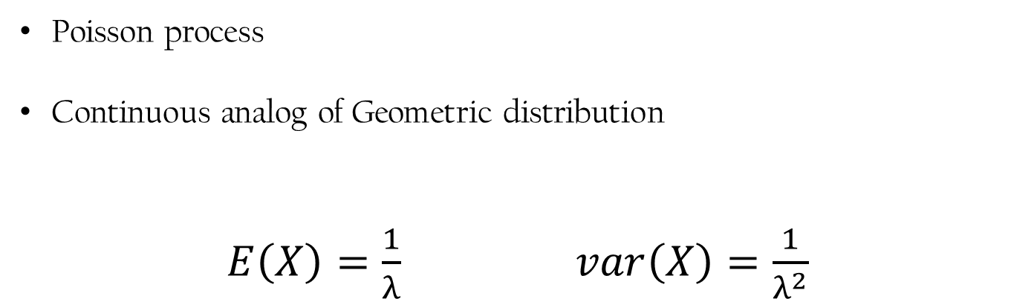
Exponential Distribution
Poisson process
Continuous analog of Geometric distribution
$E\left(X\right)=\frac{1}{λ}$ $var\left(X\right)=\frac{1}{λ^{2}}$

