Slide 1

Machine Learning

Slide 2
Statistics for Decision Modelling (Machine Learning)

Slide 3
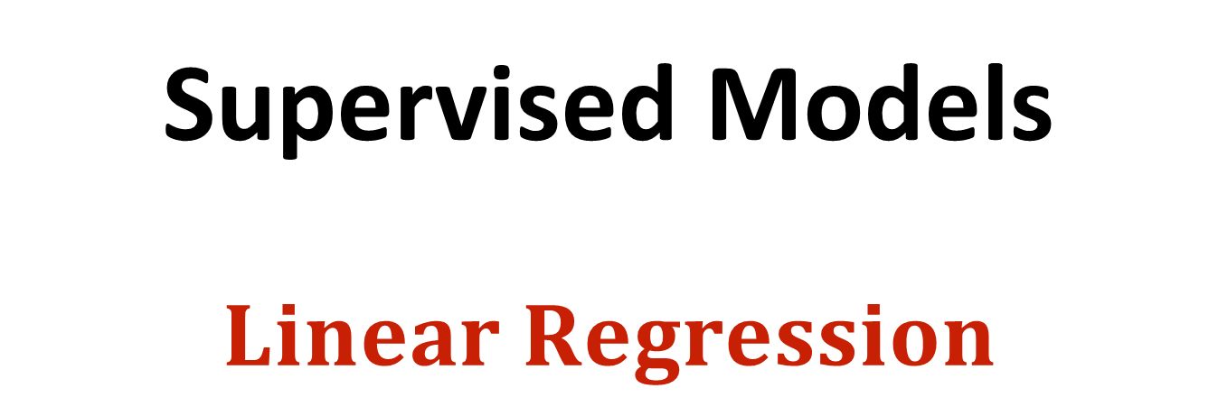
Supervised Models $$Linear Regression$$

Slide 4
Why Model Building ?
In any business, there are some easy-to-measure metrics
- Age, Gender, Income, Education level etc.
and a difficult-to-measure metric
- Amount of loan to give; Will she buy or not; How many days a patient will stay in the hospital etc.,
• Regression enables you to compute the latter form the former

Slide 5
Simplest Learning Models
Linear Regression: Measuring the relation between two or more analog variables (class variable is numeric)
Logistics Regression: A classification model (class variable is categorical)

Slide 6
Simple Linear Regression

Slide 7
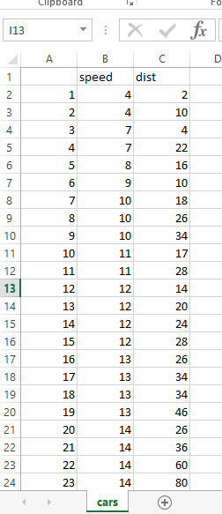
Speed vs Stopping distance
The “cars” dataset contains 50 pairs of data points of Speed(mph) vs stopping distance(ft). That were collected in 1920

Slide 8
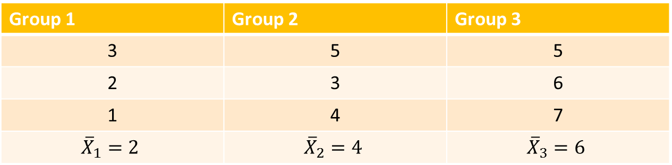
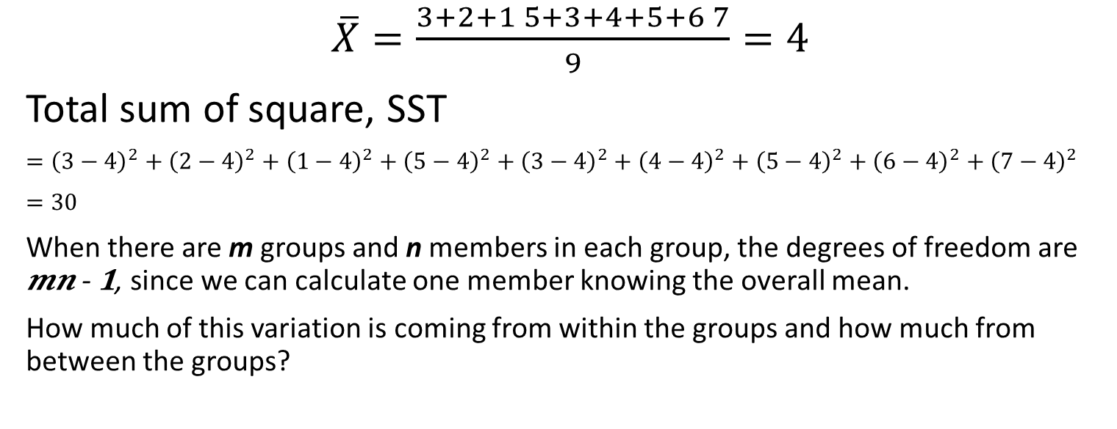
Group 1 | Group 2 | Group 3
3 | 5 | 5
2 | 3 | 6
1 | 4 | 7
$${\overline{X}}_{1}=2$$ | $${\overline{X}}_{2}=4$$ | $${\overline{X}}_{3}=6$$
$\overline{X}=\frac{3+2+1 5+3+4+5+6 7}{9}=4$
Total sum of square, SST
$={\left(3−4\right)}^{2}+{\left(2−4\right)}^{2}+{\left(1−4\right)}^{2}+{\left(5−4\right)}^{2}+{\left(3−4\right)}^{2}+{\left(4−4\right)}^{2}+{\left(5−4\right)}^{2}+{\left(6−4\right)}^{2}+{\left(7−4\right)}^{2}$
$=30$
When there are m groups and n members in each group, the degrees of freedom are 𝒎𝒏 - 𝟏, since we can calculate one member knowing the overall mean.
How much of this variation is coming from within the groups and how much from between the groups?

Slide 9

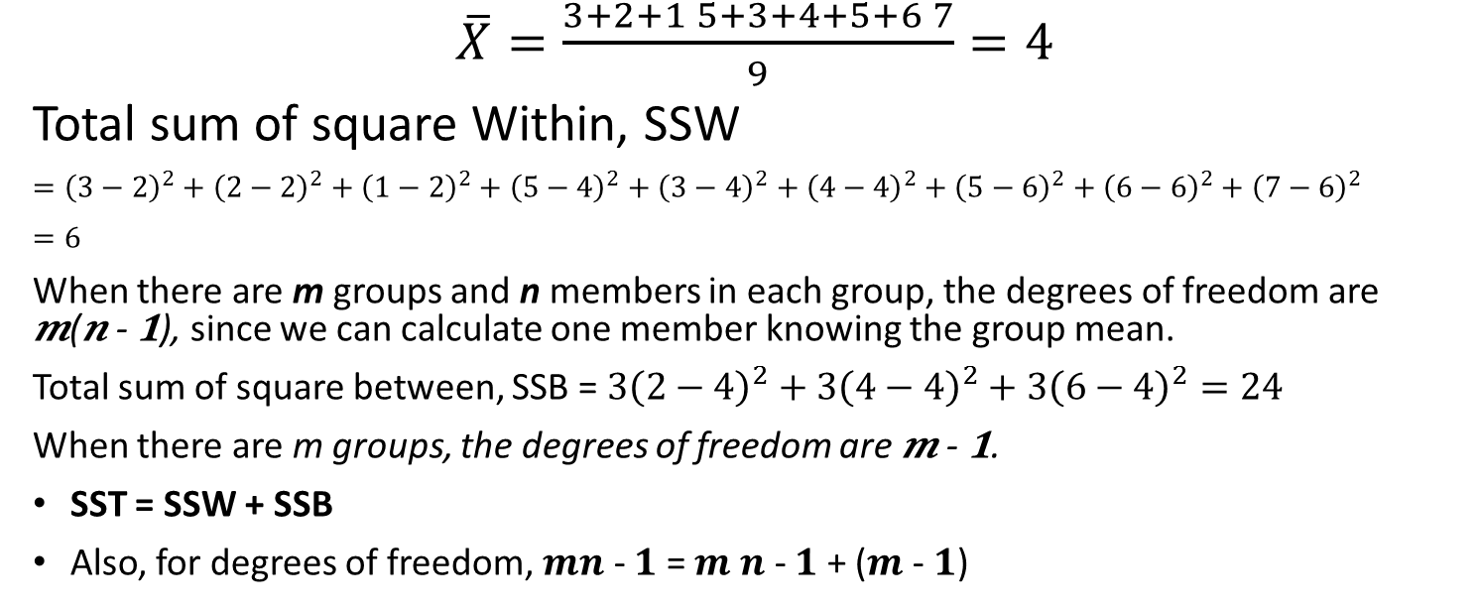
Group 1 | Group 2 | Group 3
3 | 5 | 5
2 | 3 | 6
1 | 4 | 7
$${\overline{X}}_{1}=2$$ | $${\overline{X}}_{2}=4$$ | $${\overline{X}}_{3}=6$$
$\overline{X}=\frac{3+2+1 5+3+4+5+6 7}{9}=4$
Total sum of square Within, SSW
$={\left(3−2\right)}^{2}+{\left(2−2\right)}^{2}+{\left(1−2\right)}^{2}+{\left(5−4\right)}^{2}+{\left(3−4\right)}^{2}+{\left(4−4\right)}^{2}+{\left(5−6\right)}^{2}+{\left(6−6\right)}^{2}+{\left(7−6\right)}^{2}$
$=6$
When there are m groups and n members in each group, the degrees of freedom are 𝒎(𝒏 - 𝟏), since we can calculate one member knowing the group mean.
Total sum of square between, SSB = $3{\left(2−4\right)}^{2}+3{\left(4−4\right)}^{2}+3{\left(6−4\right)}^{2}=24$
When there are m groups, the degrees of freedom are 𝒎 - 𝟏.
SST = SSW + SSB
Also, for degrees of freedom, 𝒎𝒏 - 𝟏 = 𝒎 𝒏 - 𝟏 + (𝒎 - 𝟏)

Slide 10
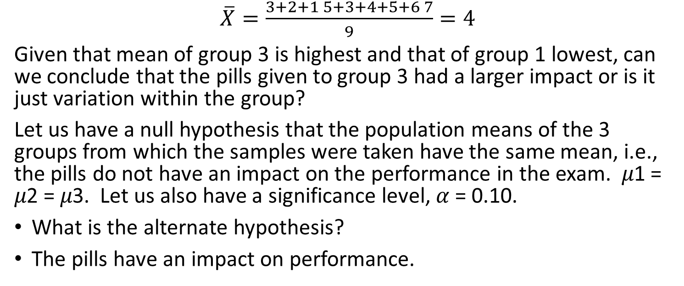
Group 1 | Group 2 | Group 3
3 | 5 | 5
2 | 3 | 6
1 | 4 | 7
$${\overline{X}}_{1}=2$$ | $${\overline{X}}_{2}=4$$ | $${\overline{X}}_{3}=6$$
$\overline{X}=\frac{3+2+1 5+3+4+5+6 7}{9}=4$
Given that mean of group 3 is highest and that of group 1 lowest, can we conclude that the pills given to group 3 had a larger impact or is it just variation within the group?
Let us have a null hypothesis that the population means of the 3 groups from which the samples were taken have the same mean, i.e., the pills do not have an impact on the performance in the exam. 𝜇1 = 𝜇2 = 𝜇3. Let us also have a significance level, 𝛼 = 0.10.
What is the alternate hypothesis?
The pills have an impact on performance.

Slide 11
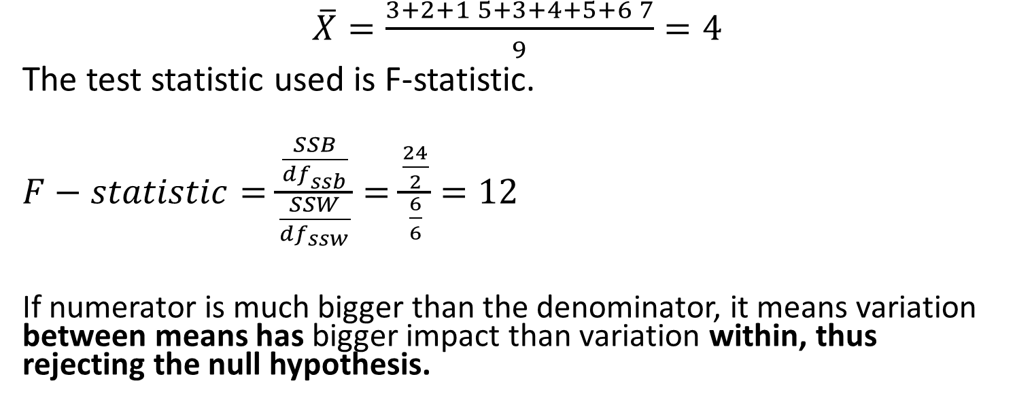
Group 1 | Group 2 | Group 3
3 | 5 | 5
2 | 3 | 6
1 | 4 | 7
$${\overline{X}}_{1}=2$$ | $${\overline{X}}_{2}=4$$ | $${\overline{X}}_{3}=6$$
$\overline{X}=\frac{3+2+1 5+3+4+5+6 7}{9}=4$
The test statistic used is F-statistic.
$F−statistic=\frac{\frac{SSB}{{df}_{ssb}}}{\frac{SSW}{{df}_{ssw}}}=\frac{\frac{24}{2}}{\frac{6}{6}}=12$
If numerator is much bigger than the denominator, it means variation between means has bigger impact than variation within, thus rejecting the null hypothesis.

Slide 12
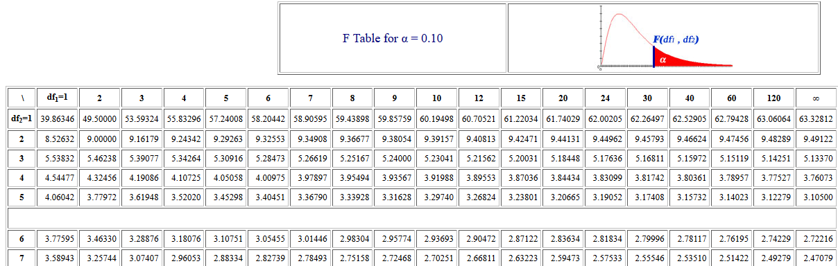
The df are 2 for numerator and 6 for denominator.
Fc, the critical F-statistic, therefore, is 3.46330. 12 is way higher than this and hence we reject the null hypothesis. That means the pills do have an impact on the performance.

Slide 13
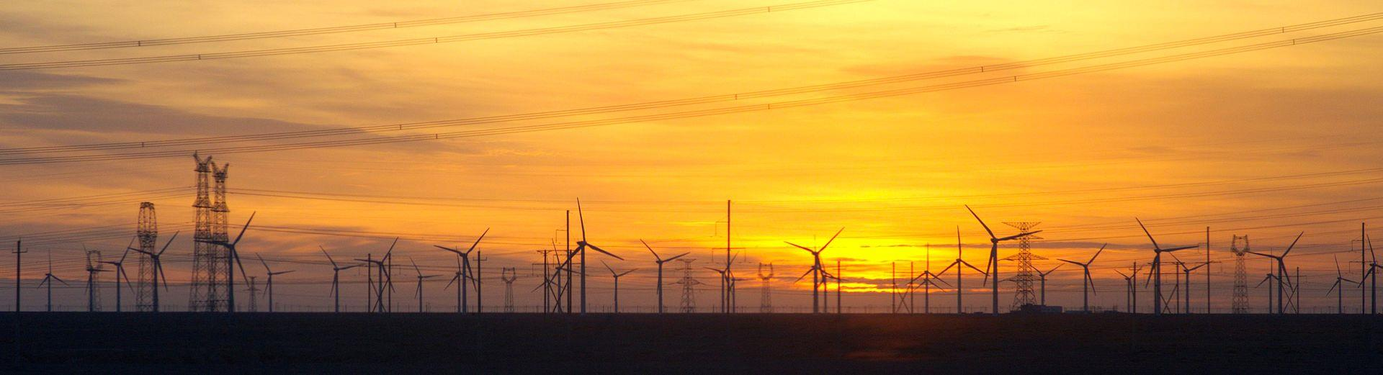
ANOTHER EXAMPLE
A wind turbine manufacturer is testing 3 different designs of the turbines. It picks 3 different sites in the same district to install each model of the turbine. The mean power output (MW) over the day is measured for 9 consecutive days in each of the sites.
We want to understand if the differences are due to within-group differences or between-group differences.

Slide 14
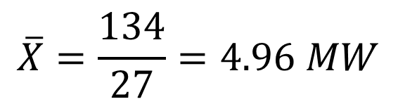
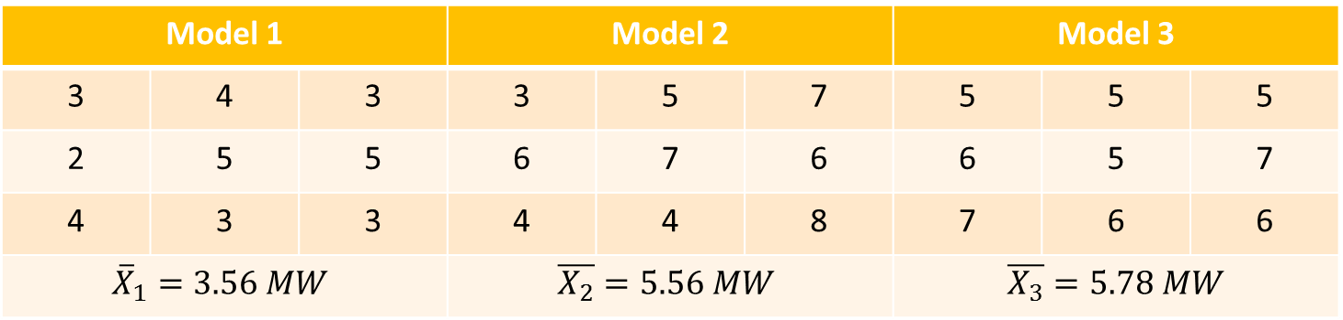
Model 1 |  |  | Model 2 |  |  | Model 3
3 | 4 | 3 | 3 | 5 | 7 | 5 | 5 | 5
2 | 5 | 5 | 6 | 7 | 6 | 6 | 5 | 7
4 | 3 | 3 | 4 | 4 | 8 | 7 | 6 | 6
$${\overline{X}}_{1}=3.56 MW$$ |  |  | $$\overline{X_{2}}=5.56 MW$$ |  |  | $\overline{X_{3}}=5.78 MW$
$$\overline{X}=\frac{134}{27}=4.96 MW$$
Total Sum of Squares, SST = 62.96
Total Sum of Squares Within, SSW = 36.00
Total Sum of Squares Between, SSB = 26.96

Slide 15
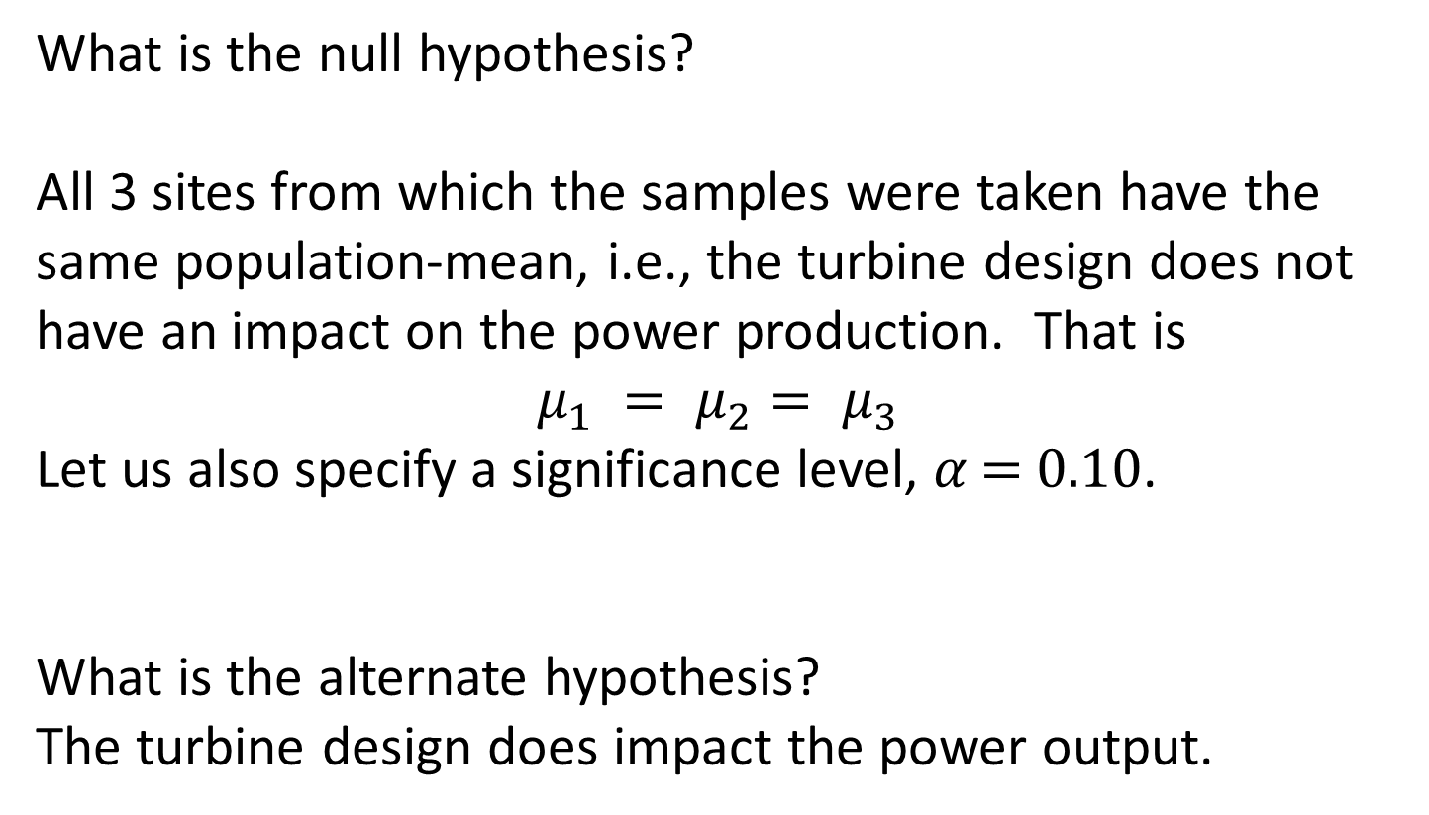
What is the null hypothesis?
All 3 sites from which the samples were taken have the same population-mean, i.e., the turbine design does not have an impact on the power production. That is
$$μ_{1} = μ_{2}= μ_{3}$$
Let us also specify a significance level, 𝛼 = 0.10.
What is the alternate hypothesis?
The turbine design does impact the power output.

Slide 16
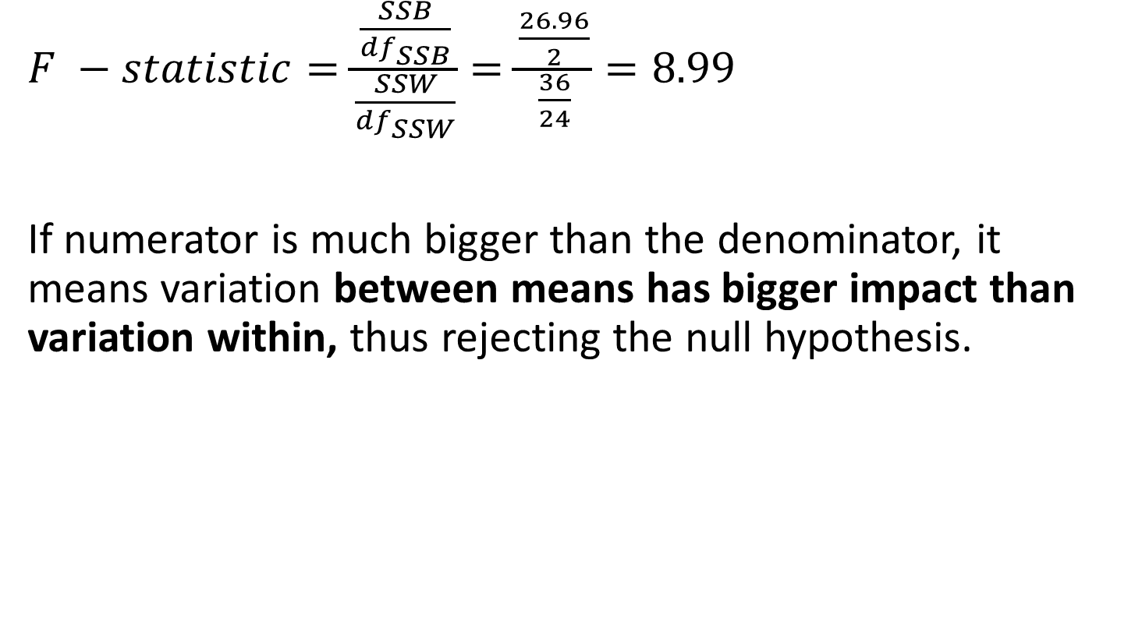
Compute the statistics
$F −statistic=\frac{\frac{SSB}{df_{SSB}}}{\frac{SSW}{df_{SSW}}}=\frac{\frac{26.96}{2}}{\frac{36}{24}}=8.99$
If numerator is much bigger than the denominator, it means variation between means has bigger impact than variation within, thus rejecting the null hypothesis.

Slide 17
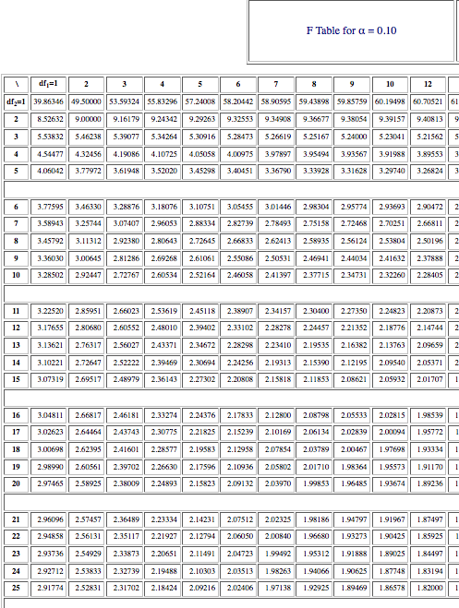
The df are 2 for numerator and 24 for
denominator.
Fc, the critical F-statistic, therefore, is
2.53833.
Our F=8.99 is way higher than this and
hence we reject the null hypothesis.
That means the turbine design does
have an impact on the power
production.

Slide 18
Anova: Single Factor
SUMMARY
Groups
Count
Sum
Average
Variance
Group1
9
32
3.55556
1.027778
Group2
9
50
5.55556
2.777778
Group3
9
52
5.77778
0.694444
ANOVA
Source of Variation
SS
df
MS
F
P-value
F crit
Between Groups
26.963
2
13.4815
8.987654
0.0012
2.5383
Within Groups
36
24
1.5
Total
62.963
26

Slide 19

Tree Diagram Taxonomy of Inferential Techniques
Confidence Intervals
(Estimation)
1 Independent
Variable
Two-way
ANOVA
Means
One-way
ANOVA
2
^{z for p}1^{-p}2
$χ$2
𝜒
z
^{z for p}1^{-p}2
F for 𝜎1 2 − 𝜎2 2
z
z
Paired t-test
z
t
t
t for Diff
^{z for µ}1^{-µ}2
^{t for µ}1^{-µ}2
^{z for µ}1^{-µ}2
^{t for µ}1^{-µ}2

Slide 20
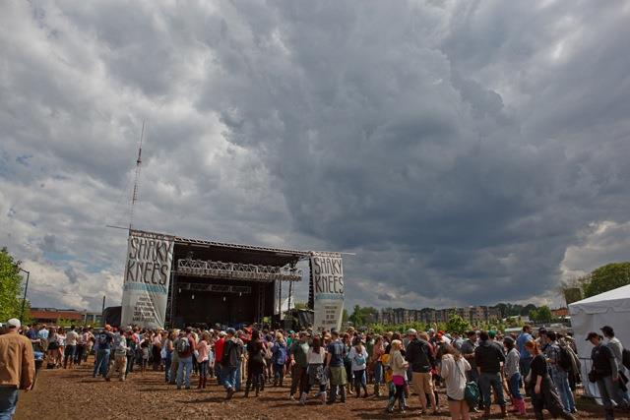
Sunshine (hours) | 1.9 | 2.5 | 3.2 | 3.8 | 4.7 | 5.5 | 5.9 | 7.2
Concert attendance (100s) | 22 | 33 | 30 | 42 | 38 | 49 | 42 | 55
• The band makes a loss if less than 3500 people attend.
• Based on predicted hours of sunshine, can we predict ticket sales?
• Are sunshine and concert attendance correlated?

Slide 21
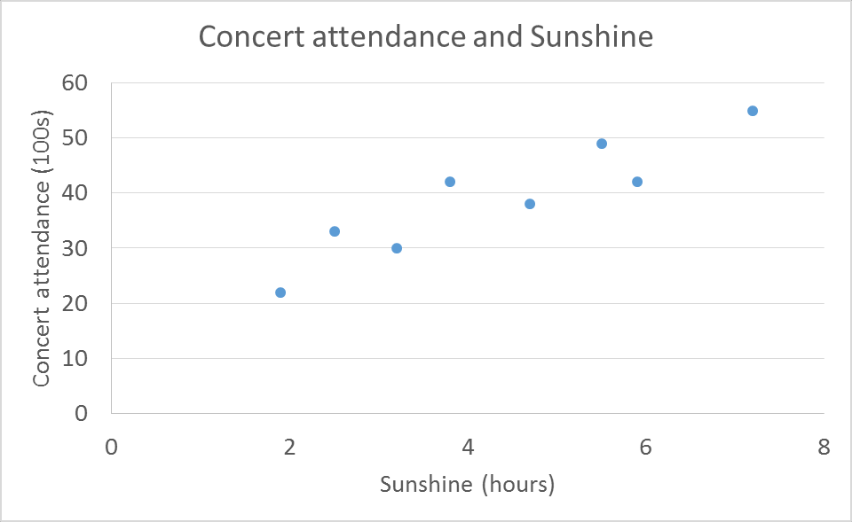
Sunshine (hours) | 1.9 | 2.5 | 3.2 | 3.8 | 4.7 | 5.5 | 5.9 | 7.2
Concert attendance (100s) | 22 | 33 | 30 | 42 | 38 | 49 | 42 | 55
• Independent variable (explanatory) – Sunshine – Plotted on X-axis
• Dependent variable (response) – Concert attendance – Plotted on Y-axis

Slide 22


• Hours of sunshine and concert attendance are correlated, i.e., in general, longer sunshine hours indicate higher attendance.
Positive
Linear
Negative Linear
Correlation
No
Correlation
Correlation

Slide 23
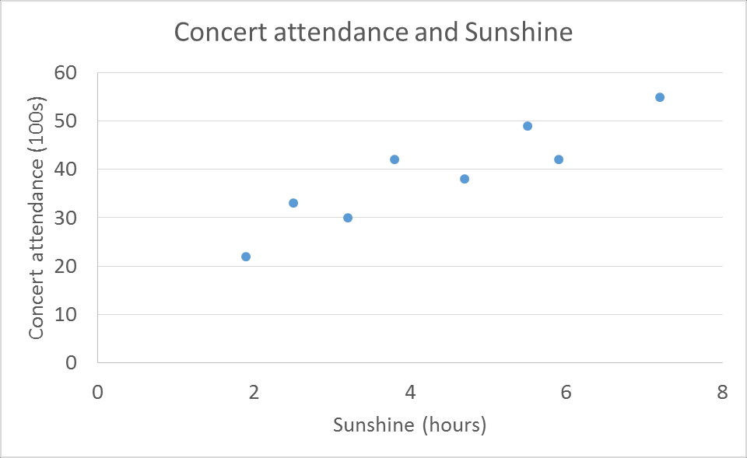
We
need
to
find
the
equation
of
the
line.
y
=
a
+
bx
s
b
a

Slide 24
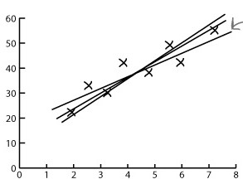
Sunshine (hours) | 1.9 | 2.5 | 3.2 | 3.8 | 4.7 | 5.5 | 5.9 | 7.2
Concert attendance (100s) | 22 | 33 | 30 | 42 | 38 | 49 | 42 | 55
• Line of the best fit

Slide 25
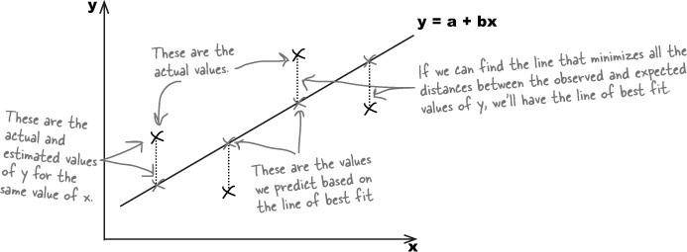
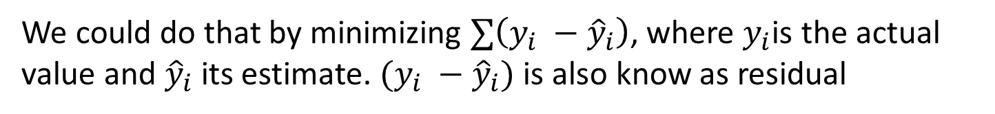
We need to minimize errors
We could do that by minimizing $∑\left(y_{i} −{\hat{y}}_{i}\right)$, where $y_{i}$is the actual value and ${\hat{y}}_{i}$its estimate. $(y_{i} −{\hat{y}}_{i})$ is also know as residual

Slide 26
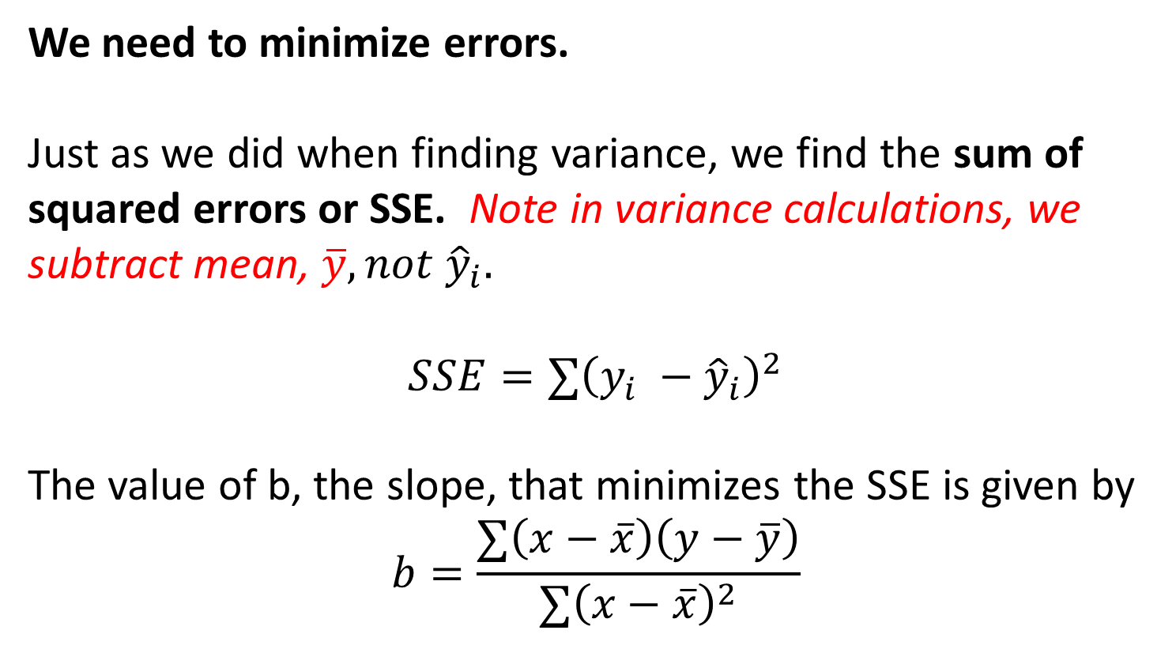
We need to minimize errors.
Just as we did when finding variance, we find the sum of squared errors or SSE. Note in variance calculations, we subtract mean, $\overline{y}, not {\hat{y}}_{i}$.
$$SSE=∑{\left(y_{i} −{\hat{y}}_{i}\right)}^{2}$$
The value of b, the slope, that minimizes the SSE is given by
$$b=\frac{∑\left(x−\overline{x}\right)\left(y−\overline{y}\right)}{∑{\left(x−\overline{x}\right)}^{2}}$$

Slide 27
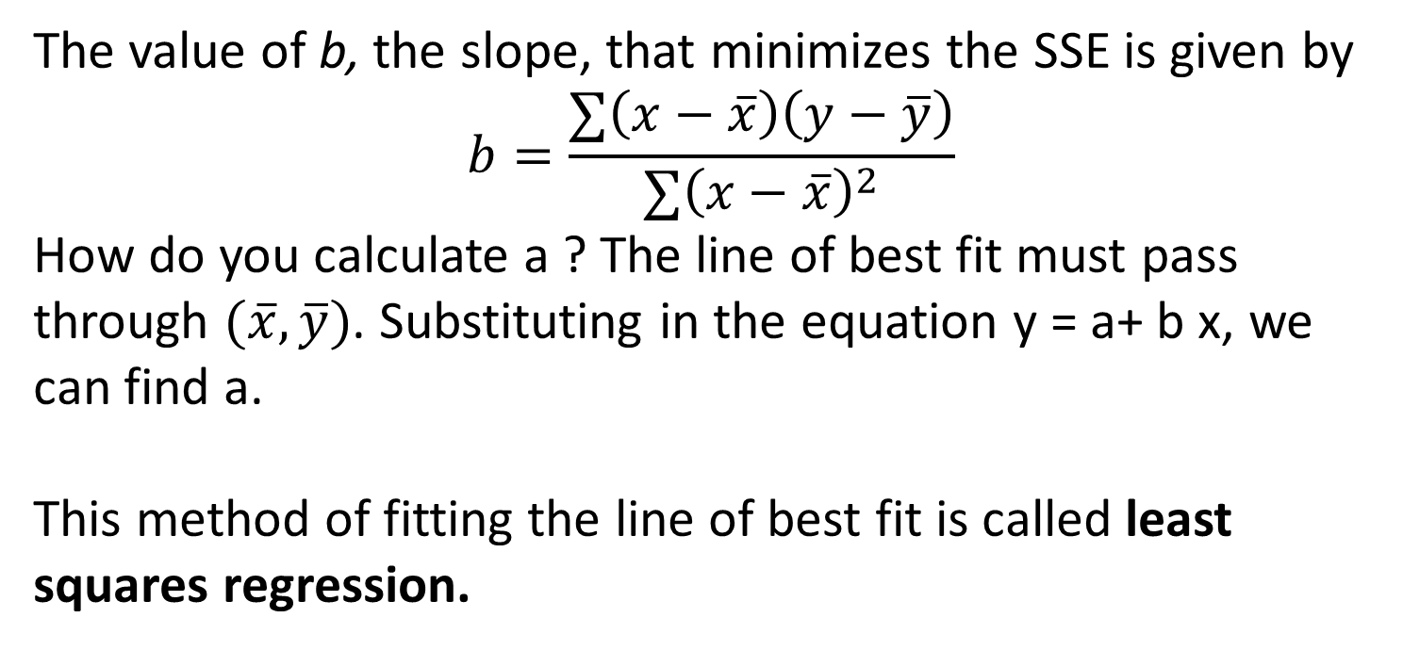
The value of b, the slope, that minimizes the SSE is given by
$$b=\frac{∑\left(x−\overline{x}\right)\left(y−\overline{y}\right)}{∑{\left(x−\overline{x}\right)}^{2}}$$
How do you calculate a ? The line of best fit must pass through $(\overline{x}, \overline{y})$. Substituting in the equation y = a+ b x, we can find a.
This method of fitting the line of best fit is called least squares regression.

Slide 28

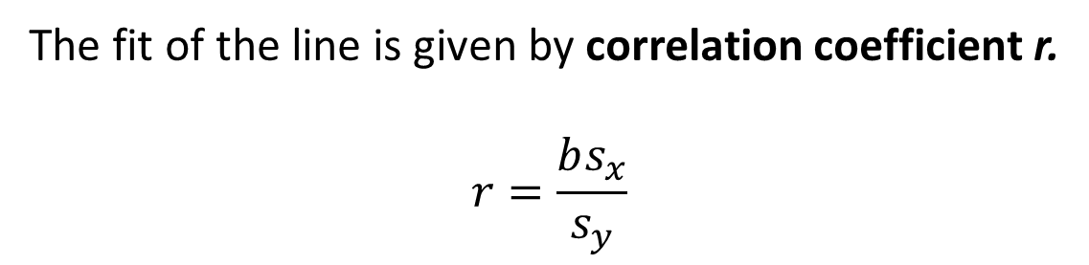
But how do you know how good this fitted line is ?
Perfect Linear
Correlation
No Linear Correlation
The fit of the line is given by correlation coefficient r.
$$r=\frac{bs_{x}}{s_{y}}$$

Slide 29
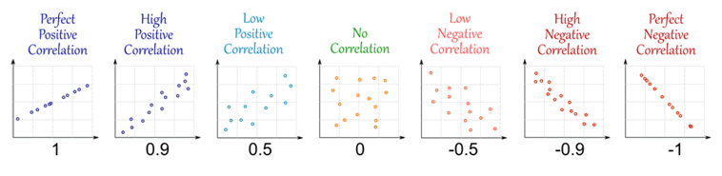
Correlation Coefficient
Correlation coefficient, r, is a number between -1 and 1 and tells us how well a regression line fits the data.
It gives the strength and direction of the relationship between two variables.

Slide 30
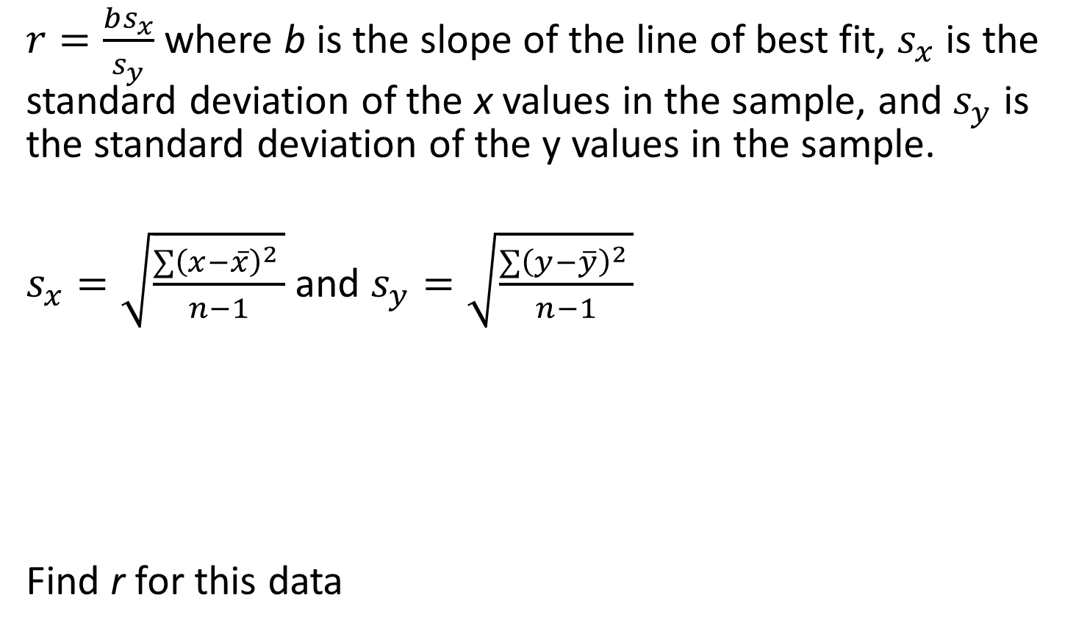
Correlation Coefficient
$r=\frac{bs_{x}}{s_{y}}$ where b is the slope of the line of best fit, $s_{x}$ is the standard deviation of the x values in the sample, and $s_{y}$ is the standard deviation of the y values in the sample.
$s_{x}=\sqrt{\frac{∑{\left(x−\overline{x}\right)}^{2 }}{n−1}}$ and $s_{y}=\sqrt{\frac{∑{\left(y−\overline{y}\right)}^{2 }}{n−1}}$
Find r for this data
Sunshine (hours) | 1.9 | 2.5 | 3.2 | 3.8 | 4.7 | 5.5 | 5.9 | 7.2
Concert attendance (100s) | 22 | 33 | 30 | 42 | 38 | 49 | 42 | 55

Slide 31
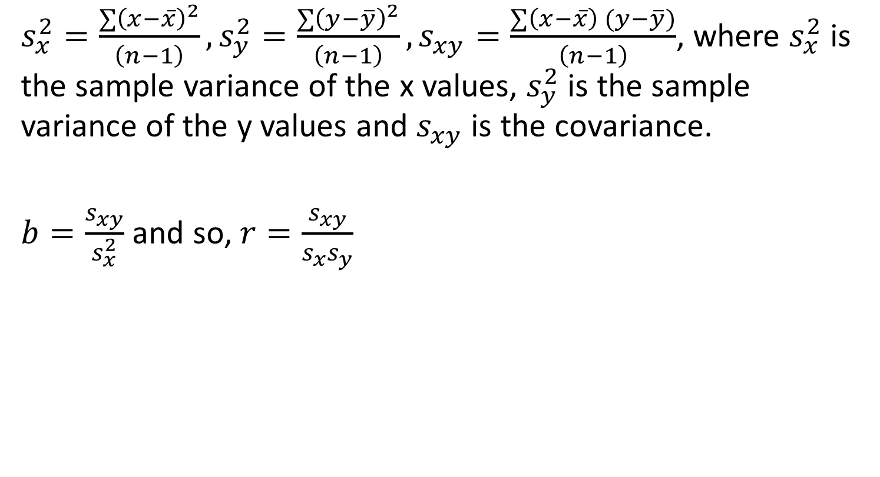
Correlation Coefficient and Covariance
$s_{x}^{2}=\frac{∑{\left(x−\overline{x}\right)}^{2}}{\left(n−1\right)},s_{y}^{2}=\frac{∑{\left(y−\overline{y}\right)}^{2}}{\left(n−1\right)},s_{xy}^{ }=\frac{∑{\left(x−\overline{x}\right)}^{ }(y−\overline{y})}{\left(n−1\right)}$, where $s_{x}^{2}$is the sample variance of the x values, $s_{y}^{2}$ is the sample variance of the y values and $s_{xy}$ is the covariance.
$b=\frac{s_{xy}}{s_{x}^{2}}$ and so, $r=\frac{s_{xy}}{s_{x}s_{y}}$

Slide 32
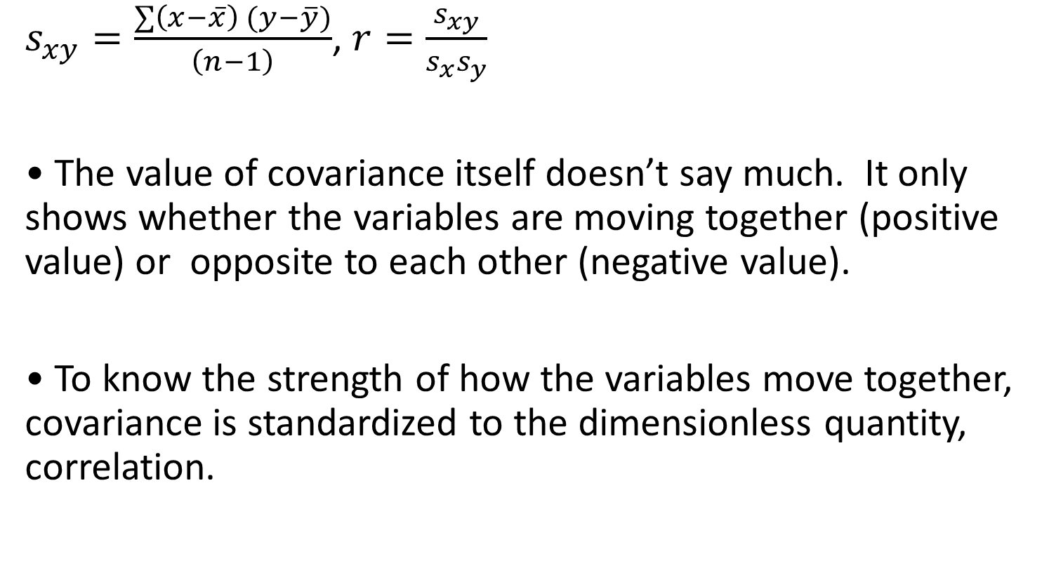
Covariance and Correlation
$s_{xy}^{ }=\frac{∑{\left(x−\overline{x}\right)}^{ }(y−\overline{y})}{\left(n−1\right)}$, $r=\frac{s_{xy}}{s_{x}s_{y}}$
• The value of covariance itself doesn’t say much. It only shows whether the variables are moving together (positive value) or opposite to each other (negative value).
• To know the strength of how the variables move together, covariance is standardized to the dimensionless quantity, correlation.

Slide 33
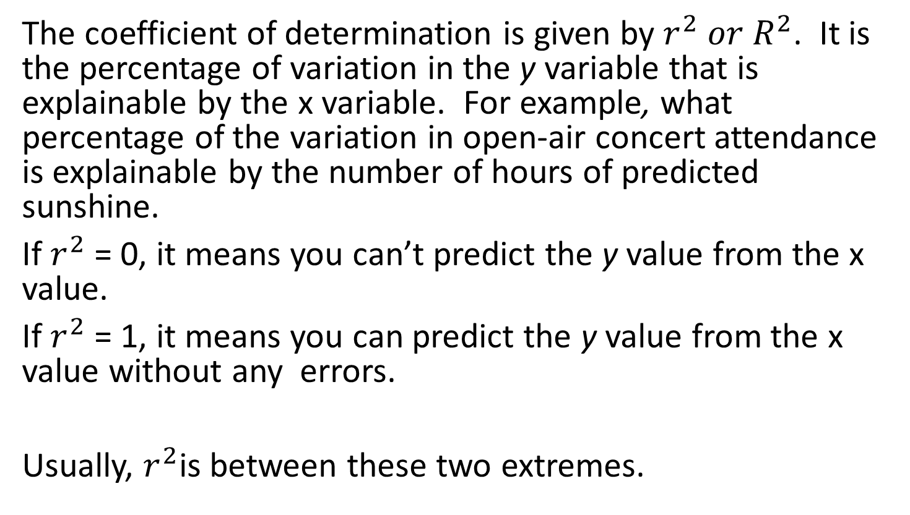
Coefficient of Determination
The coefficient of determination is given by $r^{2} or R^{2}$. It is the percentage of variation in the y variable that is explainable by the x variable. For example, what percentage of the variation in open-air concert attendance is explainable by the number of hours of predicted sunshine.
If $r^{2}$ = 0, it means you can’t predict the y value from the x value.
If $r^{2}$ = 1, it means you can predict the y value from the x value without any errors.
Usually, $r^{2}$is between these two extremes.

Slide 34
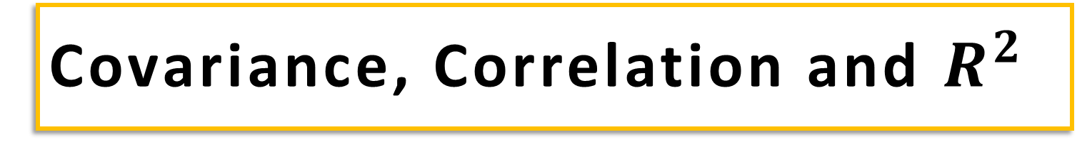
Covariance, Correlation and $R^{2}$
How do the interest rates of federal funds and the commodities futures index co-vary and correlate?
Month | Interest Rate | Futures Index
1 | 7.43 | 221
2 | 7.48 | 222
3 | 8.00 | 226
4 | 7.75 | 225
5 | 7.60 | 224
6 | 7.63 | 223
7 | 7.68 | 223
8 | 7.67 | 226
9 | 7.59 | 226
10 | 8.07 | 235
11 | 8.03 | 233
12 | 8.00 | 241

Slide 35
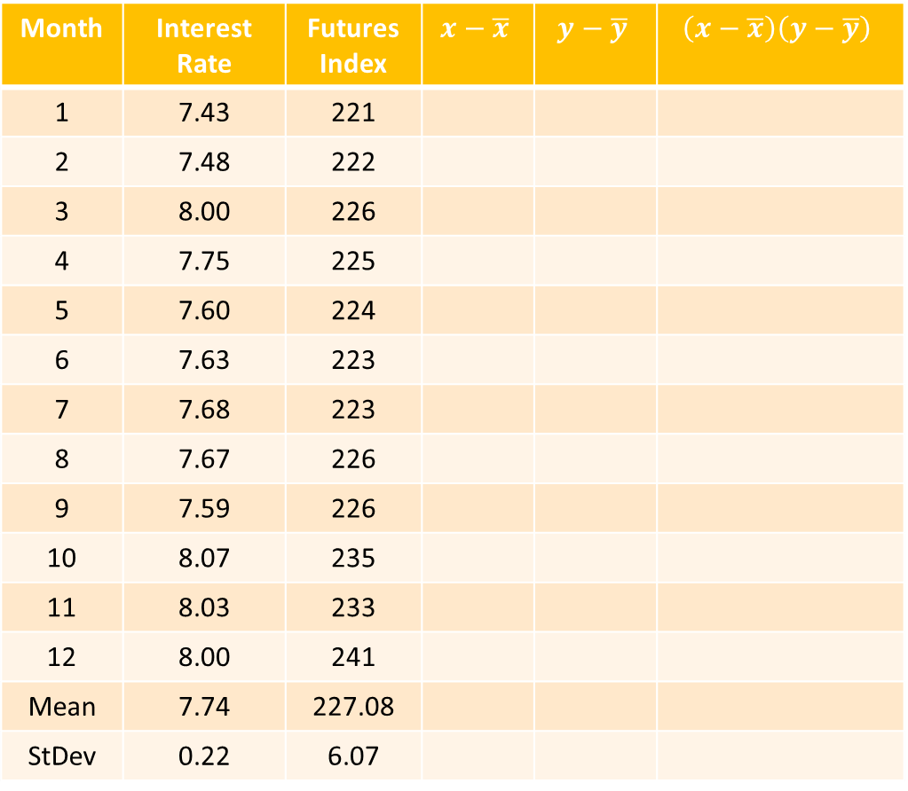

Covariance, Correlation and $R^{2}$
Month | Interest Rate | Futures Index | $$x−\overline{x}$$ | $$y−\overline{y}$$ | $$\left(x−\overline{x}\right)\left(y−\overline{y}\right)$$
1 | 7.43 | 221
2 | 7.48 | 222
3 | 8.00 | 226
4 | 7.75 | 225
5 | 7.60 | 224
6 | 7.63 | 223
7 | 7.68 | 223
8 | 7.67 | 226
9 | 7.59 | 226
10 | 8.07 | 235
11 | 8.03 | 233
12 | 8.00 | 241
Mean | 7.74 | 227.08
StDev | 0.22 | 6.07
$Cov=\frac{12.216}{11}=1.11$
$$r=\frac{1.11}{0.22∗6.07 }$$
$=0.815$
$R^{2}={0.815}^{2}=0.665$

Slide 36
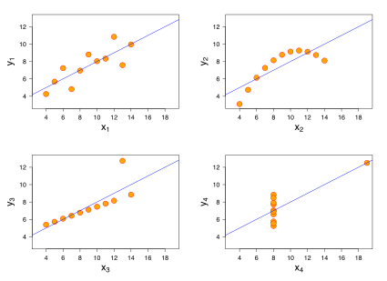
Anscombe’s
Quartet
Anscombe's quartet
Property
Value
I
II
III
IV
Mean of x in each case
9 (exact)
x
y
x
y
x
y
x
y
Sample variance of x in each case
11 (exact)
10
8.04
10
9.1
10
7.46
8
6.6
Mean of y in each case
7.50 (to 2 decimal places)
8
6.95
8
8.1
8
6.77
8
5.8
Sample variance of y in each case
4.122 or 4.127 (to 3 decimal places)
13
7.58
13
8.7
13
12.7
8
7.7
Correlation between x and y in each case
0.816 (to 3 decimal places)
9
8.81
9
8.8
9
7.11
8
8.8
Linear regression line in each case
y = 3.00 + 0.500x (to 2 and 3
decimal places, respectively)
11
8.33
11
9.3
11
7.81
8
8.5
14
9.96
14
8.1
14
8.84
8
7
6
7.24
6
6.1
6
6.08
8
5.3
4
4.26
4
3.1
4
5.39
19
13
12
10.8
12
9.1
12
8.15
8
5.6
7
4.82
7
7.3
7
6.42
8
7.9
5
5.68
5
4.7
5
5.73
8
6.9

Slide 37
Reference
INSOFE: www.insofe.edu.in

Slide 38
THE STORY

Slide 39
We started by looking at various types of data (Categorical/Numerical) and we sought methods to describe the central tendency of the data. We discussed Mean, Median and
Mode.
We realized to understand the data better, along with the central tendency,
We need to understand the spread. We looked at Range, Interquartile Range, Variance and Standard Deviation.
We discussed Box and Whisker plots as a way to represent both central-tendency and the spread in the data.

Slide 40
We moved on to basic Probability theory and described rules of
probabilities using Venn Diagrams. We talked about conditional
probabilities and that led to Bayes Theorem.
We then looked at some of the commonly occurring Probability
Distributions and their properties, and looked at the expected
values, their variance and the probabilities of various possible
outcomes.
Then we saw how the Sampling Distributions of Means tend to
normal distribution irrespective of how the population is
distributed and learned how to describe populations based on
available sample data.

Slide 41
We then looked at Confidence Intervals to properly describe the conclusions about populations based on samples.
Then we studied Hypothesis Tests as an alternative inferential technique to prove our claims. Of course, there are errors in these tests too.

Slide 42
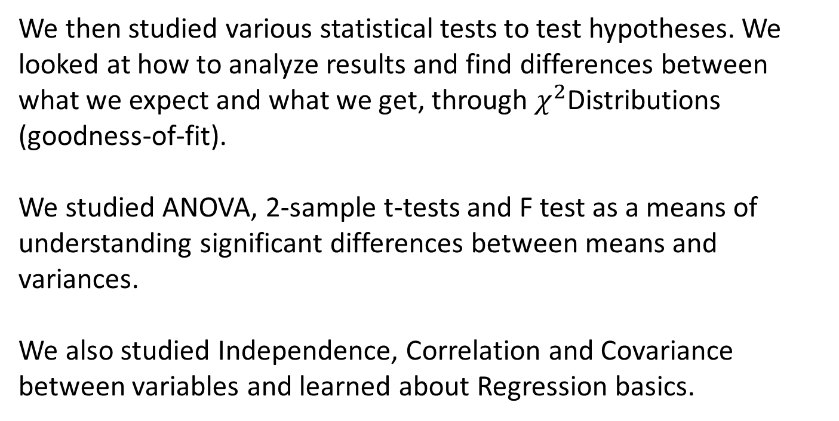
We then studied various statistical tests to test hypotheses. We looked at how to analyze results and find differences between
what we expect and what we get, through $χ^{2}$Distributions
(goodness-of-fit).
We studied ANOVA, 2-sample t-tests and F test as a means of
understanding significant differences between means and
variances.
We also studied Independence, Correlation and Covariance
between variables and learned about Regression basics.

Slide 43
Reference
Head First Statistics

