Slide 1
TIME SERIES FORECASTING

Slide 2
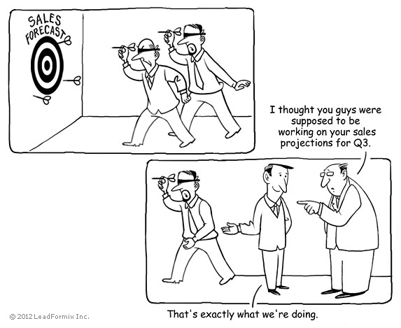
Prediction is very difficult,
especially if it’s about the future

Slide 3
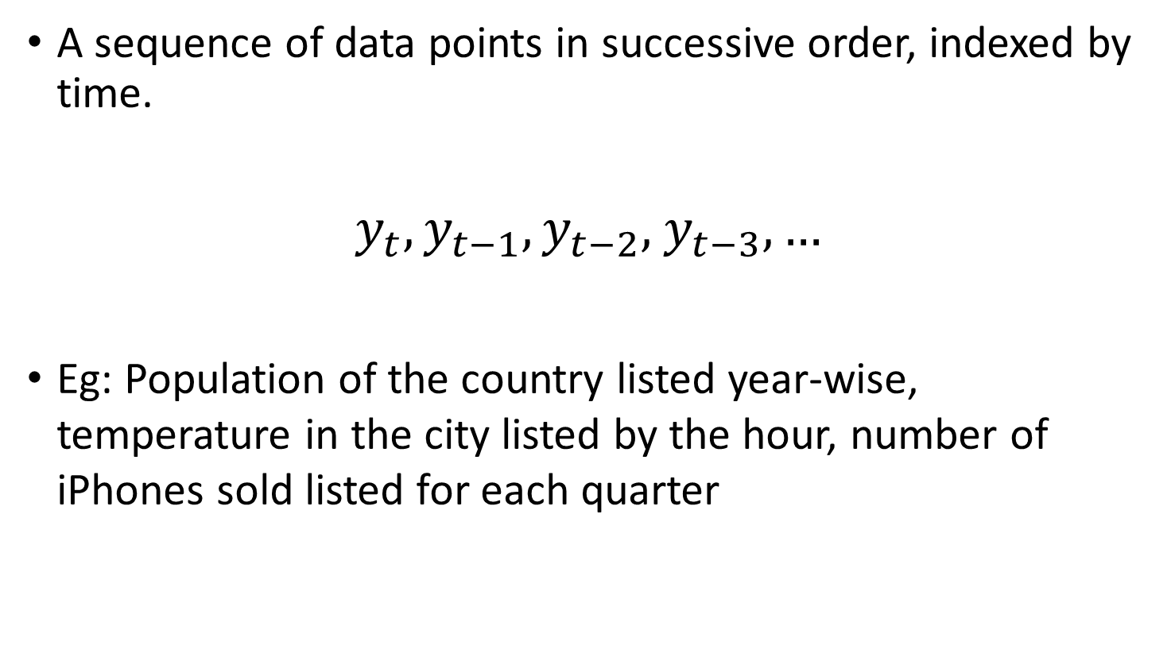
What is Time Series data ?
A sequence of data points in successive order, indexed by time.
$y_{t}, y_{t−1},y_{t−2},$ $y_{t−3}, …$
Eg: Population of the country listed year-wise, temperature in the city listed by the hour, number of iPhones sold listed for each quarter

Slide 4
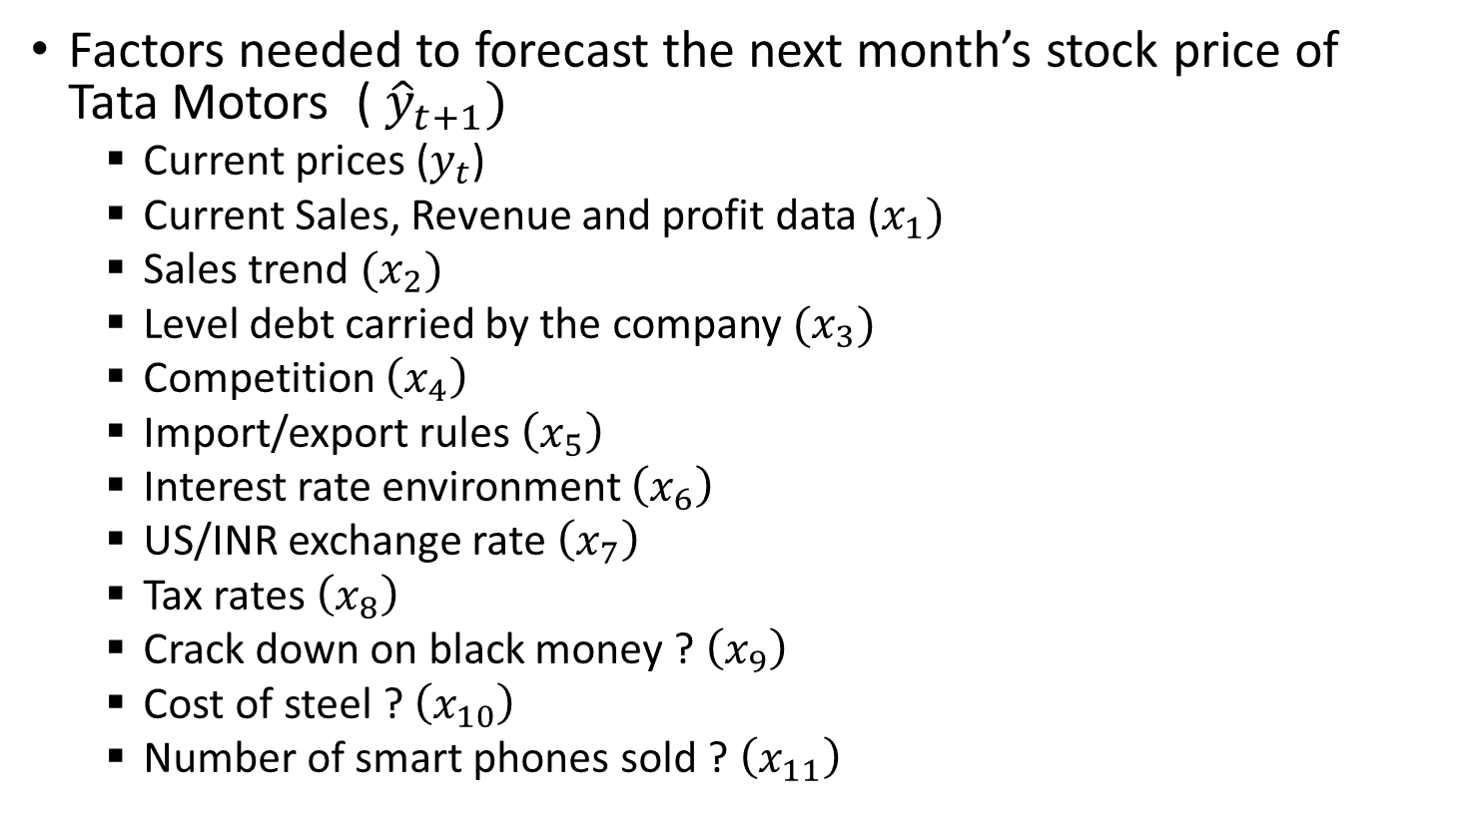
Forecasting
Factors needed to forecast the next month’s stock price of Tata Motors ( ${\hat{y}}_{t+1})$
Current prices ($y_{t}$)
Current Sales, Revenue and profit data ($x_{1})$
Sales trend $(x_{2})$
Level debt carried by the company $(x_{3})$
Competition $\left(x_{4}\right)$
Import/export rules $\left(x_{5}\right)$
Interest rate environment $\left(x_{6}\right)$
US/INR exchange rate $\left(x_{7}\right)$
Tax rates $\left(x_{8}\right)$
Crack down on black money ? $\left(x_{9}\right)$
Cost of steel ? $\left(x_{10}\right)$
Number of smart phones sold ? $\left(x_{11}\right)$

Slide 5
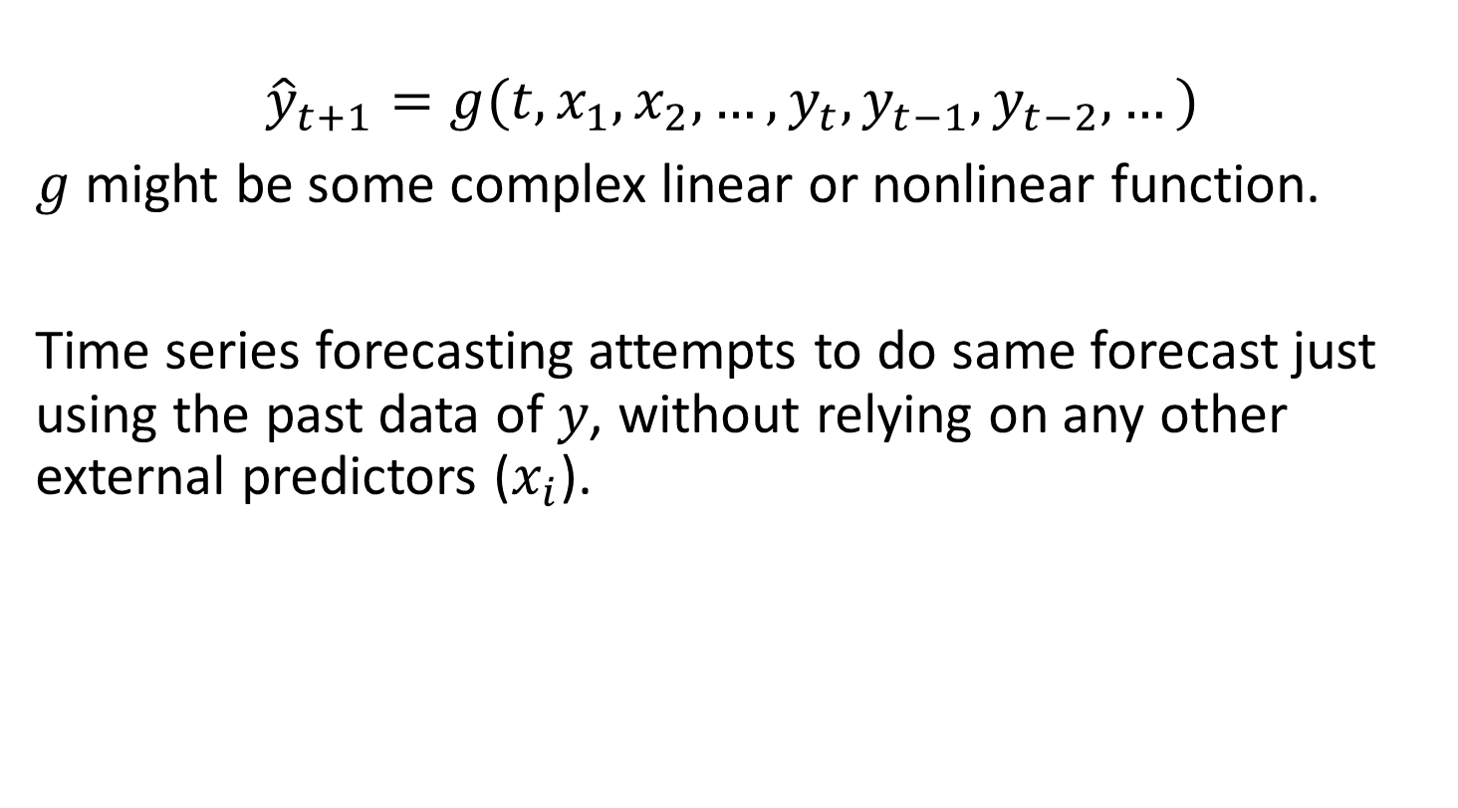
Forecasting
$${\hat{y}}_{t+1}=g(t,x_{1},x_{2},…,y_{t}, y_{t−1},y_{t−2}, …)$$
$g$ might be some complex linear or nonlinear function.
Time series forecasting attempts to do same forecast just using the past data of 𝑦, without relying on any other external predictors ($x_{i}$).

Slide 6

Typical Time Series
${\hat{y}}_{t+1}=g\left(t, y_{t}, y_{t−1},y_{t−2}, …\right)$
$f$ can be linear or nonlinear function

Slide 7
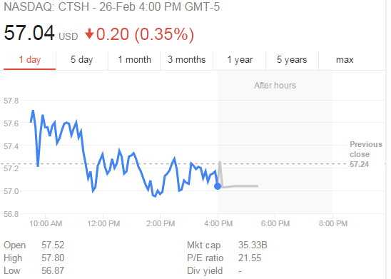
Why Time Series forecasting
Causal independent variables are
– Unknown to us
– Not available
– Might not fit the data well
– Difficult to forecast

Slide 8
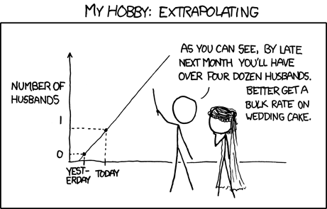
FORECASTING THROUGH TREND ANALYSIS

Slide 9

Regression with time
$${\hat{y}}_{t+1}=f(t)$$

Slide 10
Regression on Time
• Use when trend is the most pronounced
• ACF decays exponentially and PACF has very few spikes

Slide 11
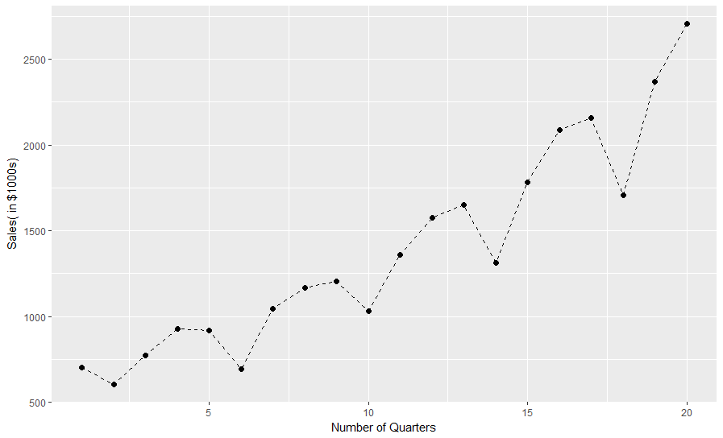
Seasonality

Slide 12
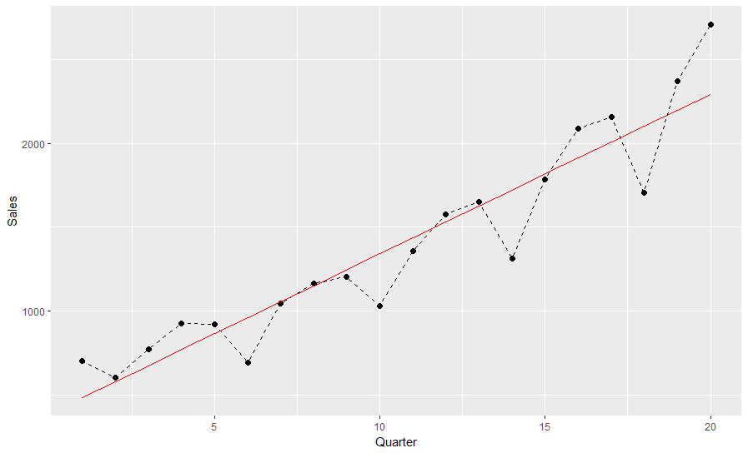
Regression Analysis – Linear fit

Slide 13
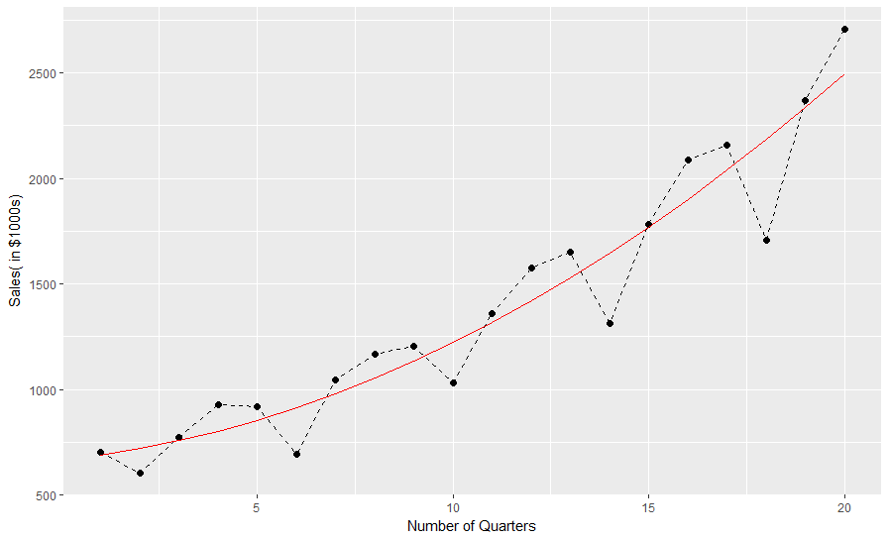
Quadratic Trend

Slide 14
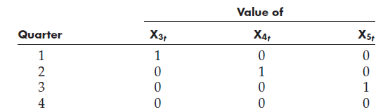

Seasonal Regression Models
$$Y_{t}=β_{0}+β_{1}X_{1}+β_{2}X_{2}+β_{3}X_{3}+β_{4}X_{4}+β_{5}X_{5}+ε_{t}$$
Where,$X_{1t}=t$ and $X_{2t}=t^{2}$

Slide 15
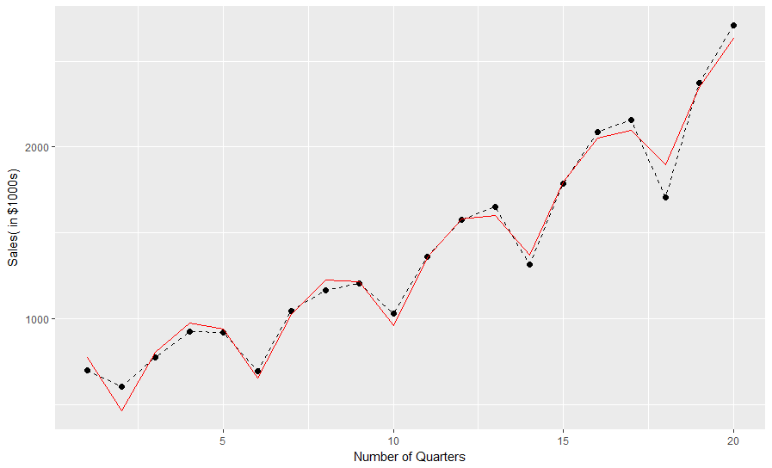
Seasonal Regression Models

Slide 16
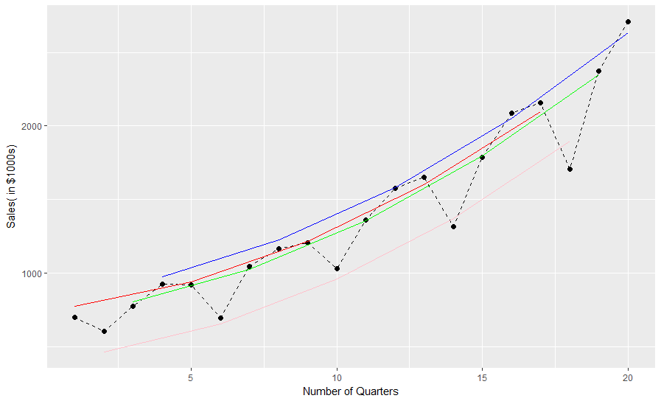
Quadratic fit with seasonality
Plotting the fitted data-points separately for each quarter, shows how R manages to do such a good fit. Its basically fitting a quadratic line for each quarter with a different intercept.

Slide 17
Seasonal Regression Models

Slide 18
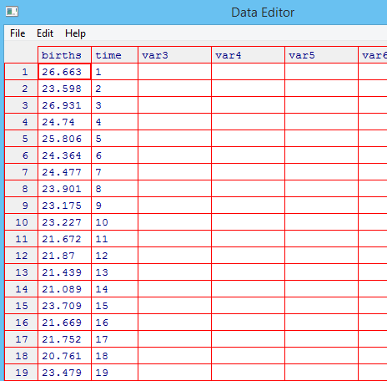
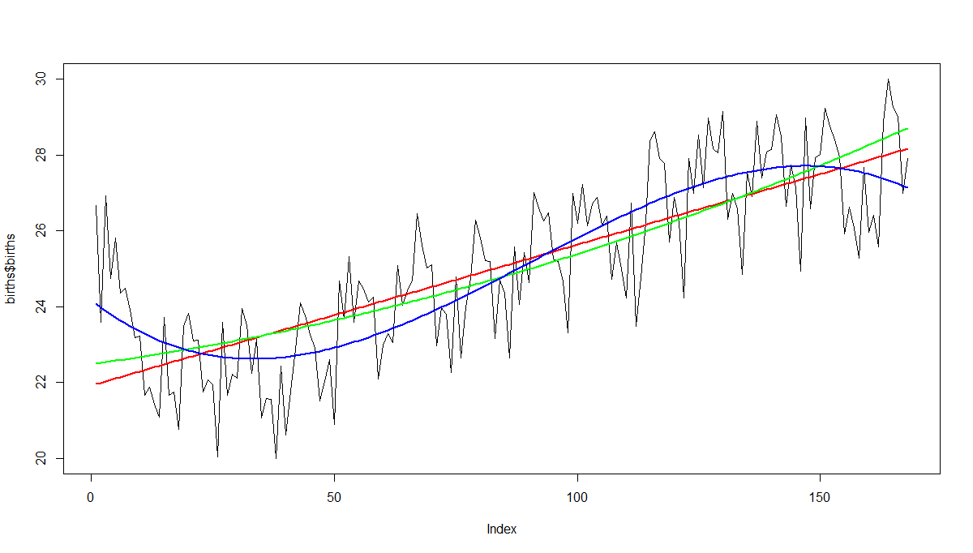
Seasonal Regression Models - Births

Slide 19
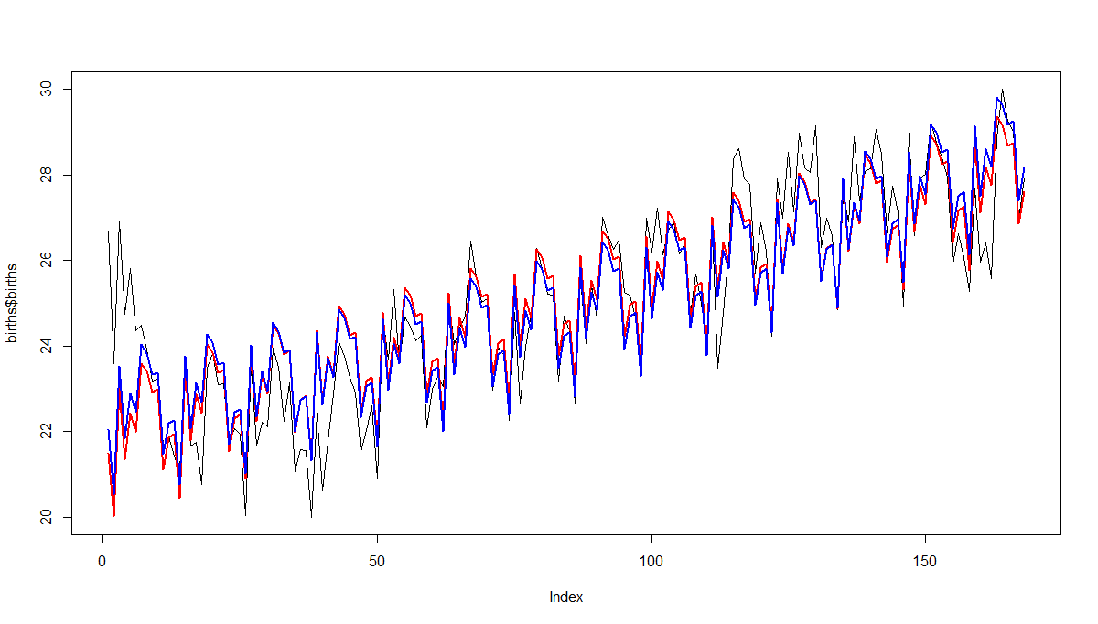
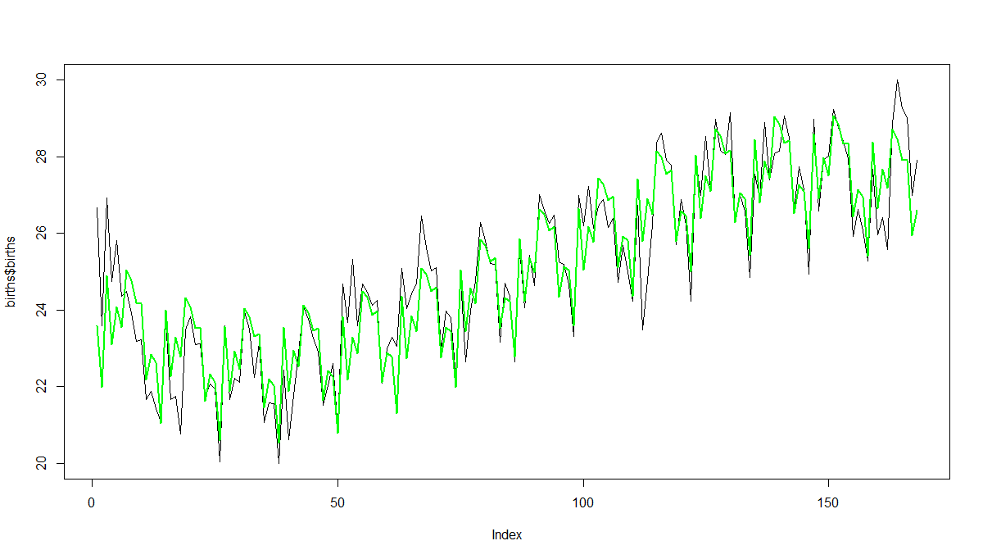
Seasonal Regression Models - Births

Slide 20
Another Crude Way of Incorporating Seasonality
• Take the trend prediction and actual prediction.
• Depending on additive or multiplicative model compute the deviation and map it as seasonality effect for each prediction.
• Take averages of the seasonality value. Use this to make future predictions.

Slide 21
Case
Year
Quarter
Time variable
(this is created)
Revenues (in
$M)
2008
I
1
10.2
II
2
12.4
III
3
14.8
IV
4
15
2009
I
5
11.2
II
6
14.3
III
7
18.4
IV
8
18

Slide 22
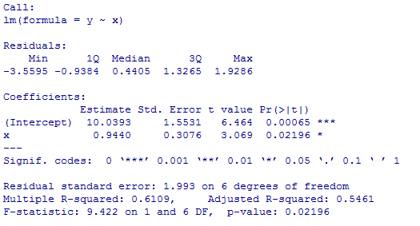
What is the Regression equation?
𝑦 = 10.0393 + 0.9440𝑥

Slide 23
Seasonality: Multiplicative
Time
Observed values
TSI* (assuming no
impact of cyclicality)
Predicted values
(per the regression)
T*
SI* = TSI/T
1
10.2
10.983
0.929
2
12.4
11.927
1.040
3
14.8
12.871
1.150
4
15.0
13.815
1.086
5
11.2
14.759
0.759
6
14.3
15.703
0.911
7
18.4
16.647
1.105
8
18.0
17.591
1.023
* T: Trend;
S: Seasonal; I: Irregular

Slide 24
Quarterly Seasonality
Time
Average seasonality factor
Q1
^{0.844} = ^{0. 9 29 + 0 . 759}
2
Q2
0.975
Q3
1.127
Q4
1.054
Time
Observed values
TSI* (assuming no impact of cyclicality)
Predicted values (per
(per the regression)
SI* = TSI/T
1
10.2
10.983
0.929
2
12.4
11.927
1.040
3
14.8
12.871
1.150
4
15.0
13.815
1.086
5
11.2
14.759
0.759
6
14.3
15.703
0.911
7
18.4
16.647
1.105
8
18.0
17.591
1.023

Slide 25

Computations
• Trend $Y_{9}$ =10.039 + 0.944(9) = 18.535
• Corrected for seasonality and
randomness: 18.535 * 0.844 = 15.643

Slide 26
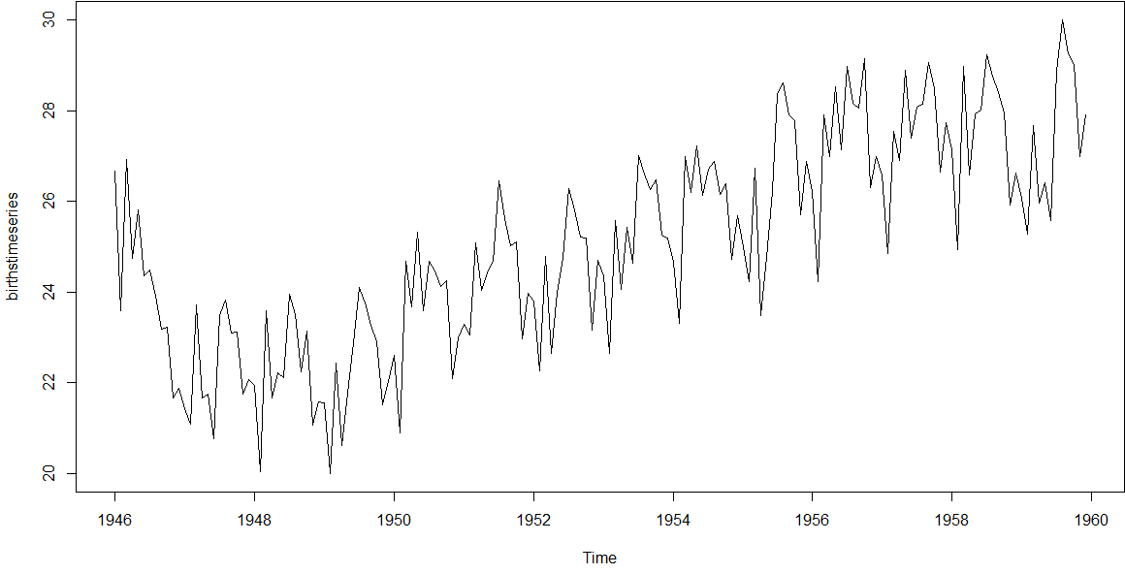
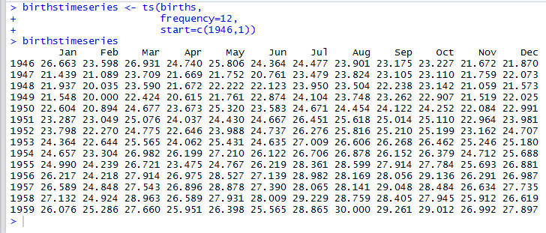
Births in NY

Slide 27
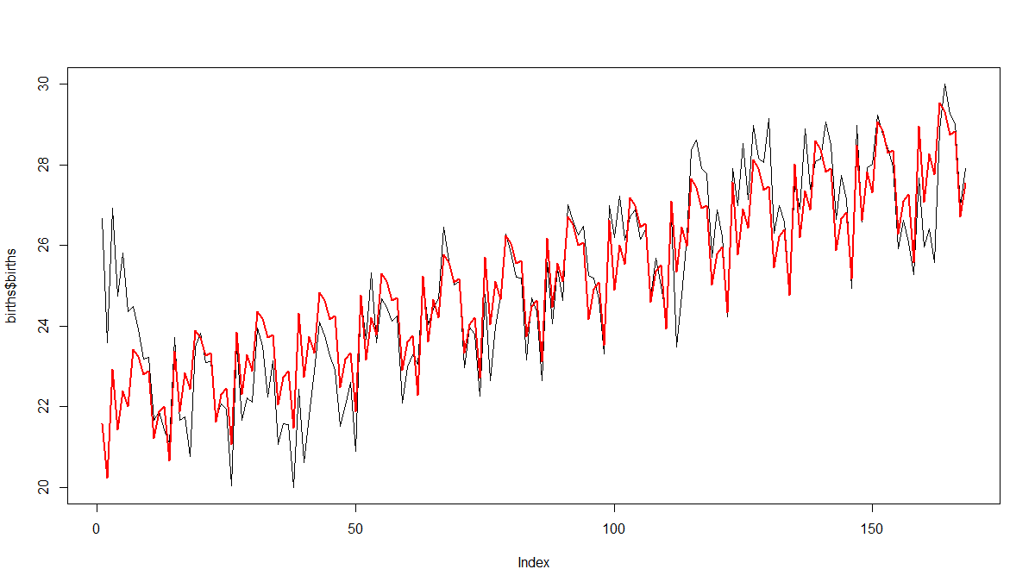
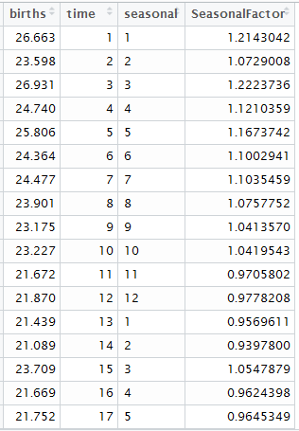
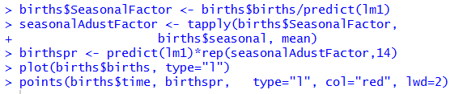
Seasonality: Multiplicative

Slide 28
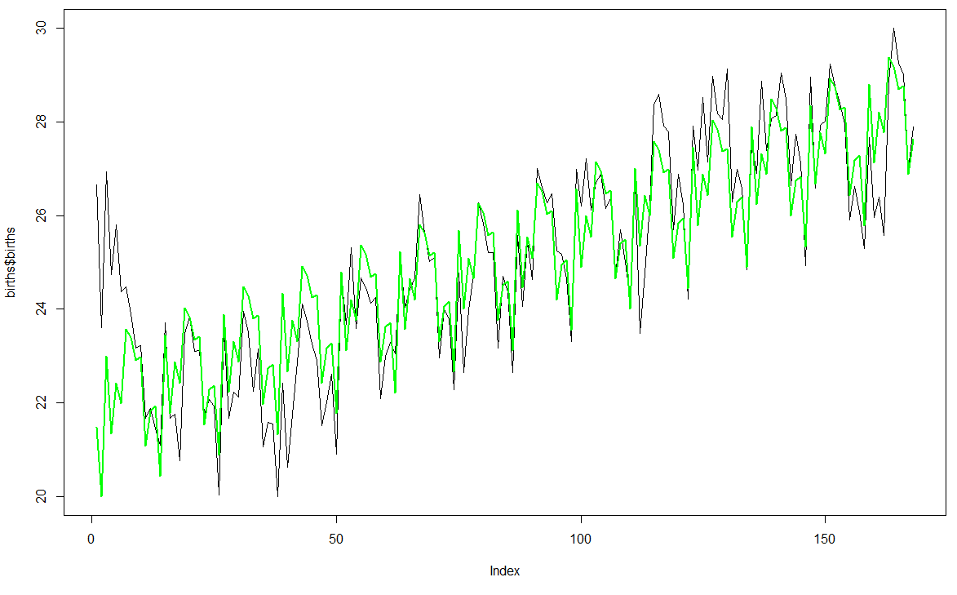
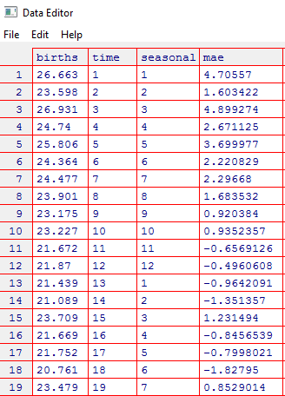
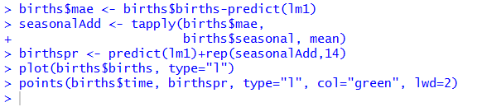
Seasonality: Additive

Slide 29
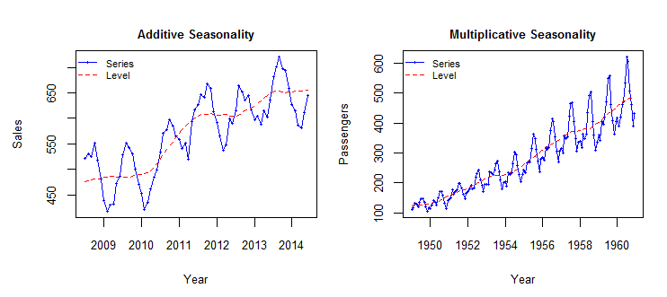
Additive or Multiplicative
Source: http://www.forsoc.net/2014/11/11/can-you-identify-additive-and-multiplicative-seasonality/

Slide 30
Goodness of Fit
• MSE (Mean square error)
• MAE (Mean absolute error)
• RMSE (Root mean square error)
• MAPE (Mean absolute percent error)
• NMSE (Normalized mean square error)
• NMAE (Normalized mean absolute error)
• NMAPE (Normalized mean absolute percent error)

Slide 31
Issues with Regressing on Time
• It is too much of a curve fit for a statistician to sleep well!
• If there is no trend or if seasonality and fluctuations are more important than trend, then the coefficients behave weirdly

Slide 32
TIME SEREIS: AUTO REGRESSIVE METHODS

Slide 33

Auto Regressive Methods
$${\hat{y}}_{t+1}=f\left(y_{t}, y_{t−1},y_{t−2}, …\right)$$

Slide 34
Identifying Techniques for Different Processes
• We use different techniques for different processes
– Random stationary
– Seasonal
– Trend
• First we need to identify them

Slide 35
AUTOCORRELATION AND PARTIAL AUTOCORELATION

Slide 36
Time Series Descriptive Statistics
• In descriptive statistics covered earlier (central tendencies, measures of variability, skewness, kurtosis, distributions, correlations, etc.), the order of observations in the data was of no consequence.
• In time series descriptive statistics, order of observations is of primary importance and so autocorrelations, etc. play a vital role in identifying the models and their characteristics.

Slide 37
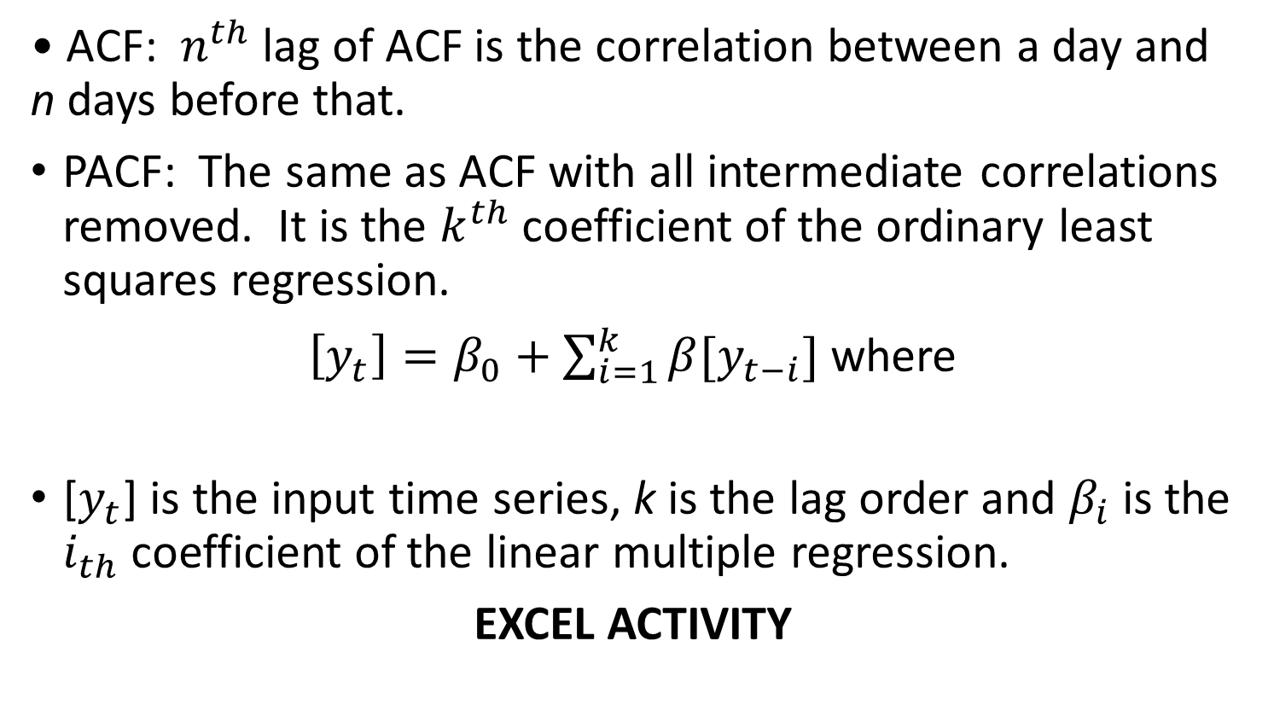
Autocorrelation (ACF) and Partial ACF (PACF)
• ACF: $n^{th}$ lag of ACF is the correlation between a day and n days before that.
PACF: The same as ACF with all intermediate correlations removed. It is the $k^{th}$ coefficient of the ordinary least squares regression.
$\left[y_{t}\right]=β_{0}+\sum_{i=1}^{k}{β[y_{t−i}]}$ where
[$y_{t}$] is the input time series, k is the lag order and $β_{i}$is the $i_{th}$ coefficient of the linear multiple regression.
EXCEL ACTIVITY

Slide 38
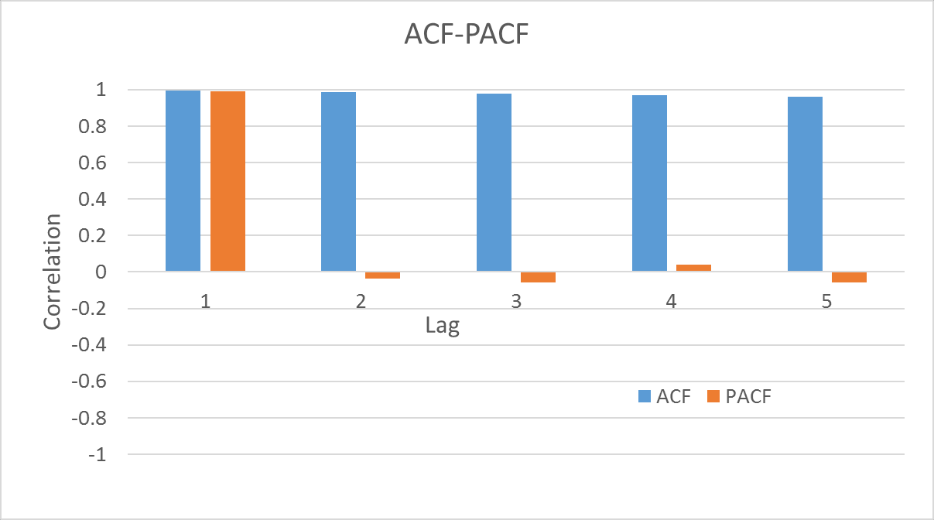
Autocorrelation (ACF) and Partial ACF (PACF)

Slide 39
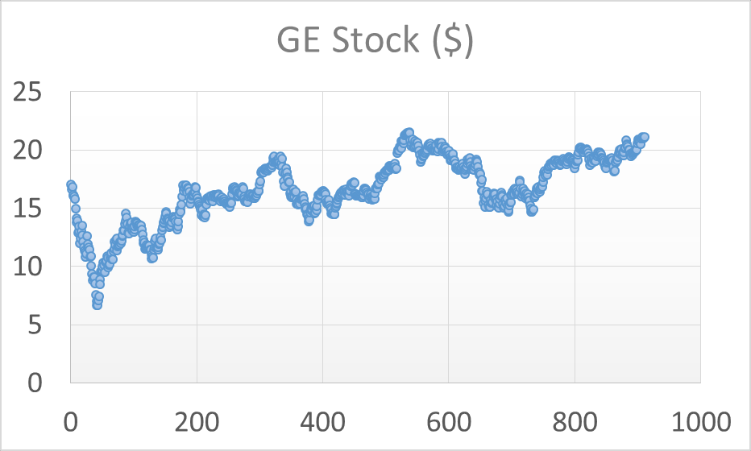
Components of Time Series
Trend
Seasonality
Random component

Slide 40
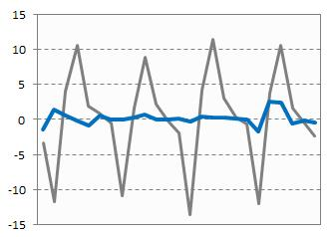
Seasonality

Slide 41
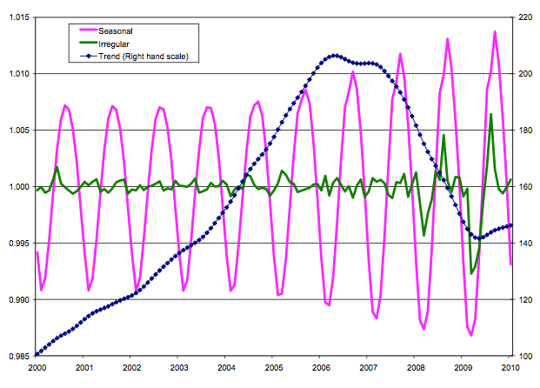
Trend, Seasonality and Randomness

Slide 42
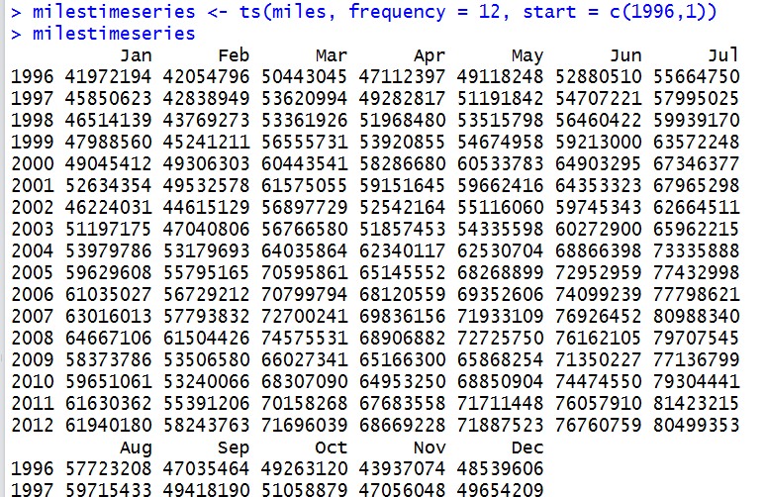
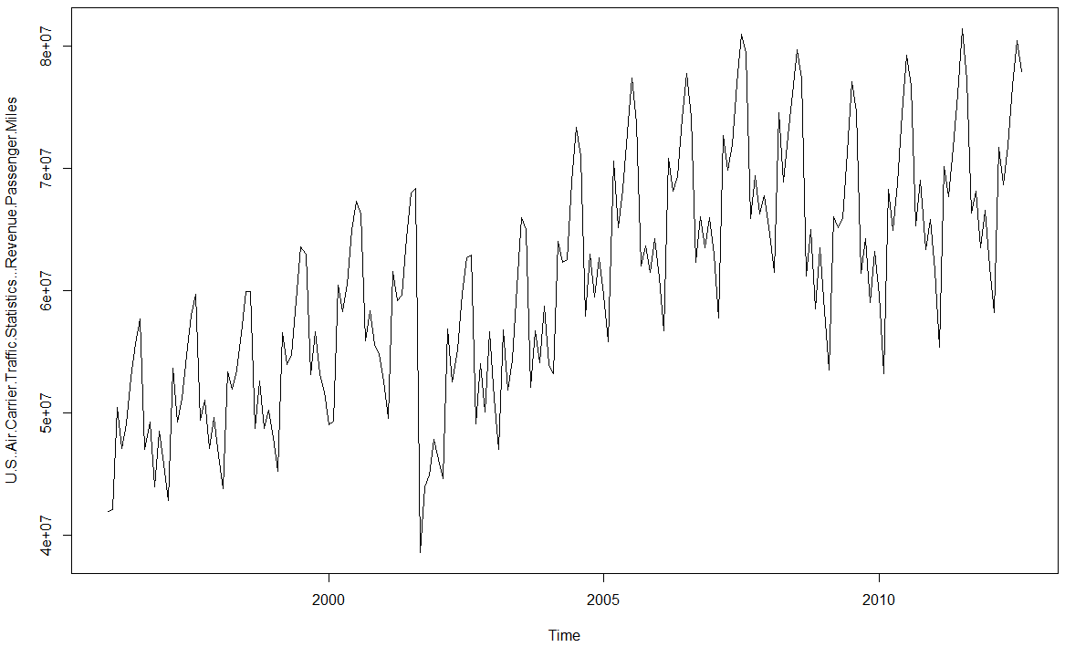
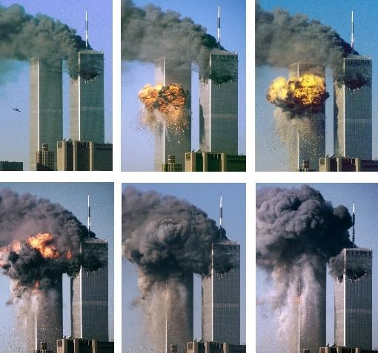
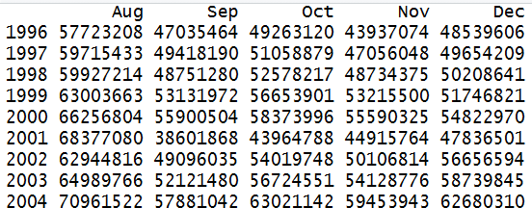
US Air Carrier Traffic – Revenue Passenger Miles (‘000) RPM
Data sources:
http://www.bts.gov/xml/air_traffic/src/index.xml
and https://datamarket.com/data/set/281x/us-aircarrier-traffic-statistics-revenue-passenger-miles

Slide 43
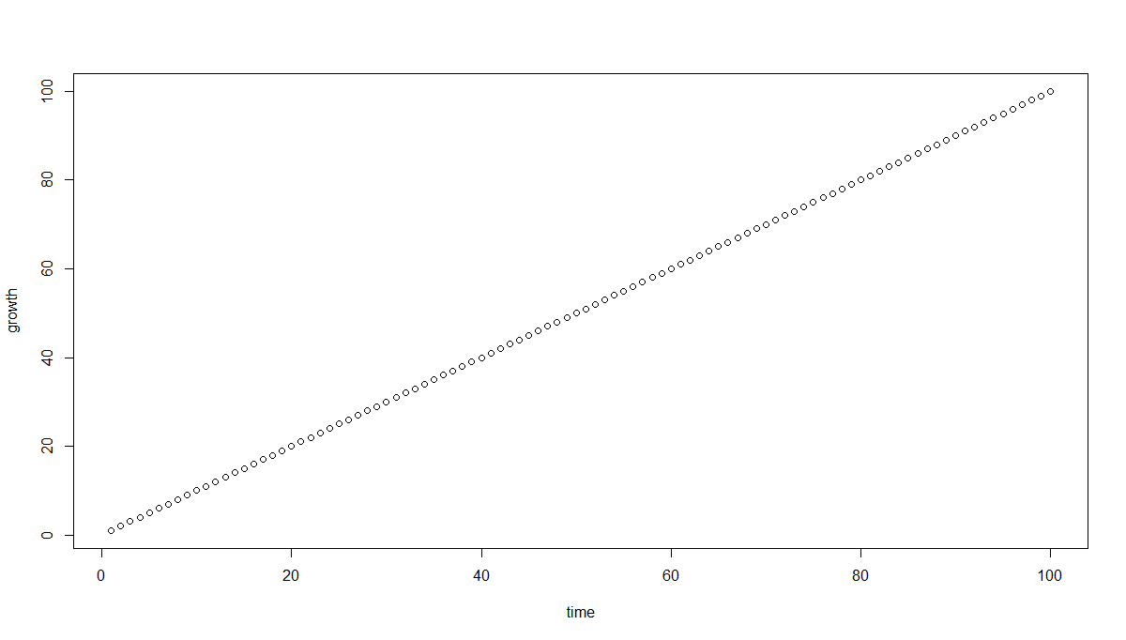
ACF and PACF – Idealized Trend

Slide 44
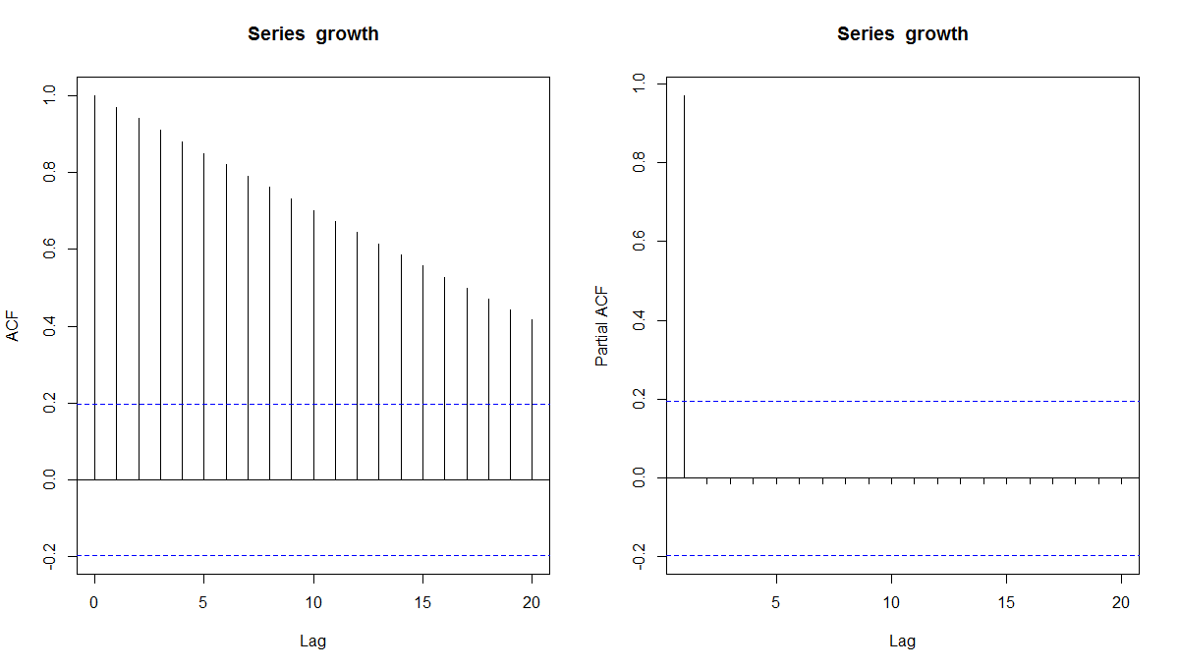
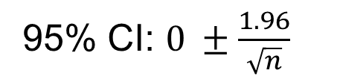
ACF and PACF – Idealized Trend
95% CI: $0 ±\frac{1.96}{\sqrt{n}}$
• ACF is a bar chart of correlation coefficients of the time series and its lags.
• PACF is a plot of the partial correlation coefficients of the time series and its lags.

Slide 45
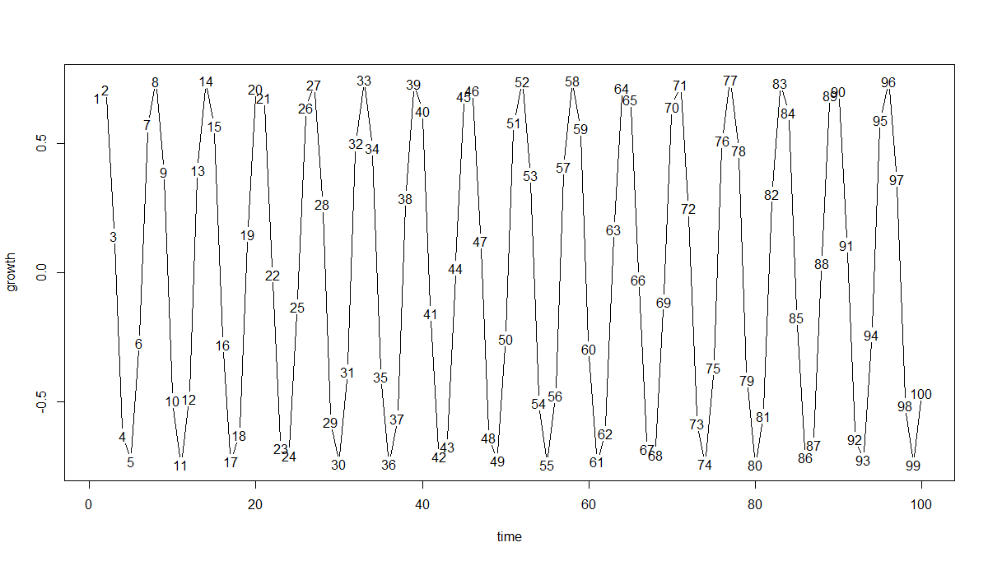
ACF and PACF – Idealized Seasonality

Slide 46
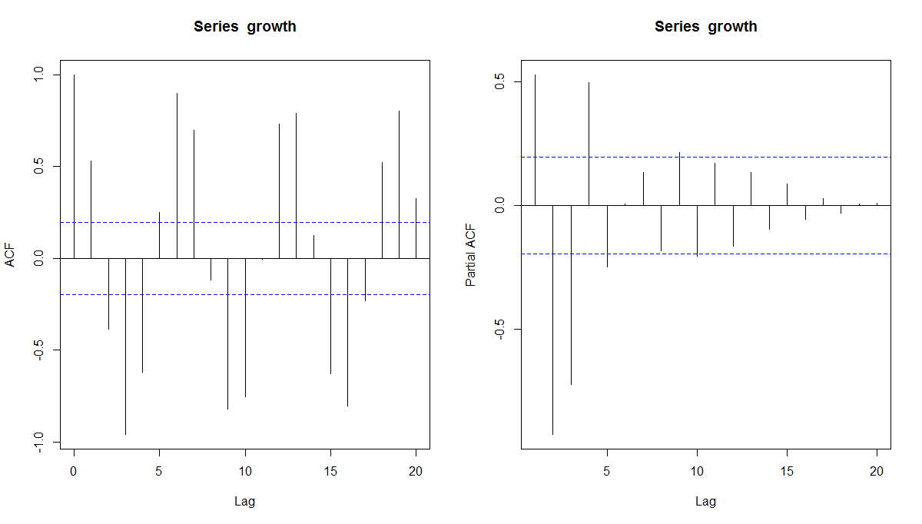
ACF and PACF – Idealized Seasonality

Slide 47
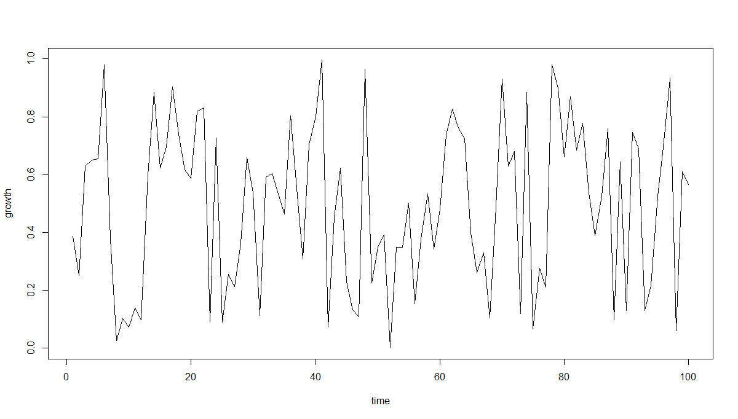
ACF and PACF – Idealized Randomness

Slide 48
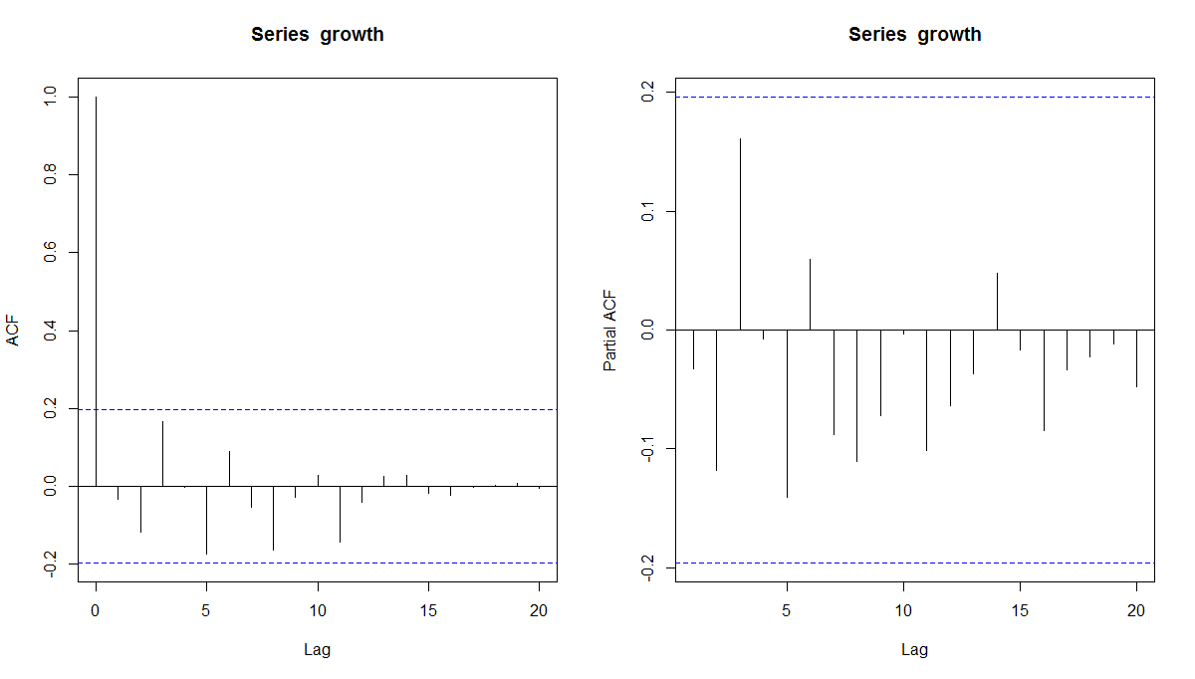
ACF and PACF – Idealized Randomness

Slide 49
ACF and PACF – Idealized Trend, Seasonality and Randomness
• Ideal Trend: Decreasing ACF and 1 or 2 lags of PACF
• Ideal Seasonality: Cyclicality in ACF and a few lags of PACF with some positive and some negative
• Ideal Random: A spike may or may not be present; even if present, magnitude will be small

Slide 50
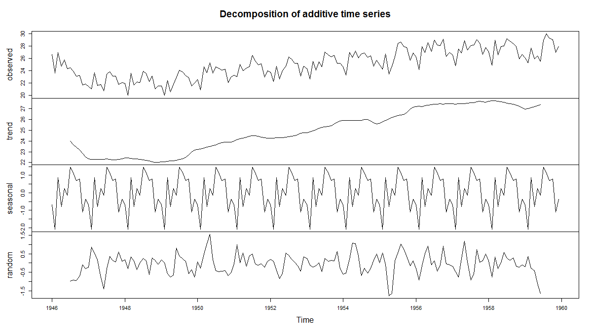
ACF and PACF (Real-world): Decomposing Time Series into the 3 Components –Births in NY

