Slide 1
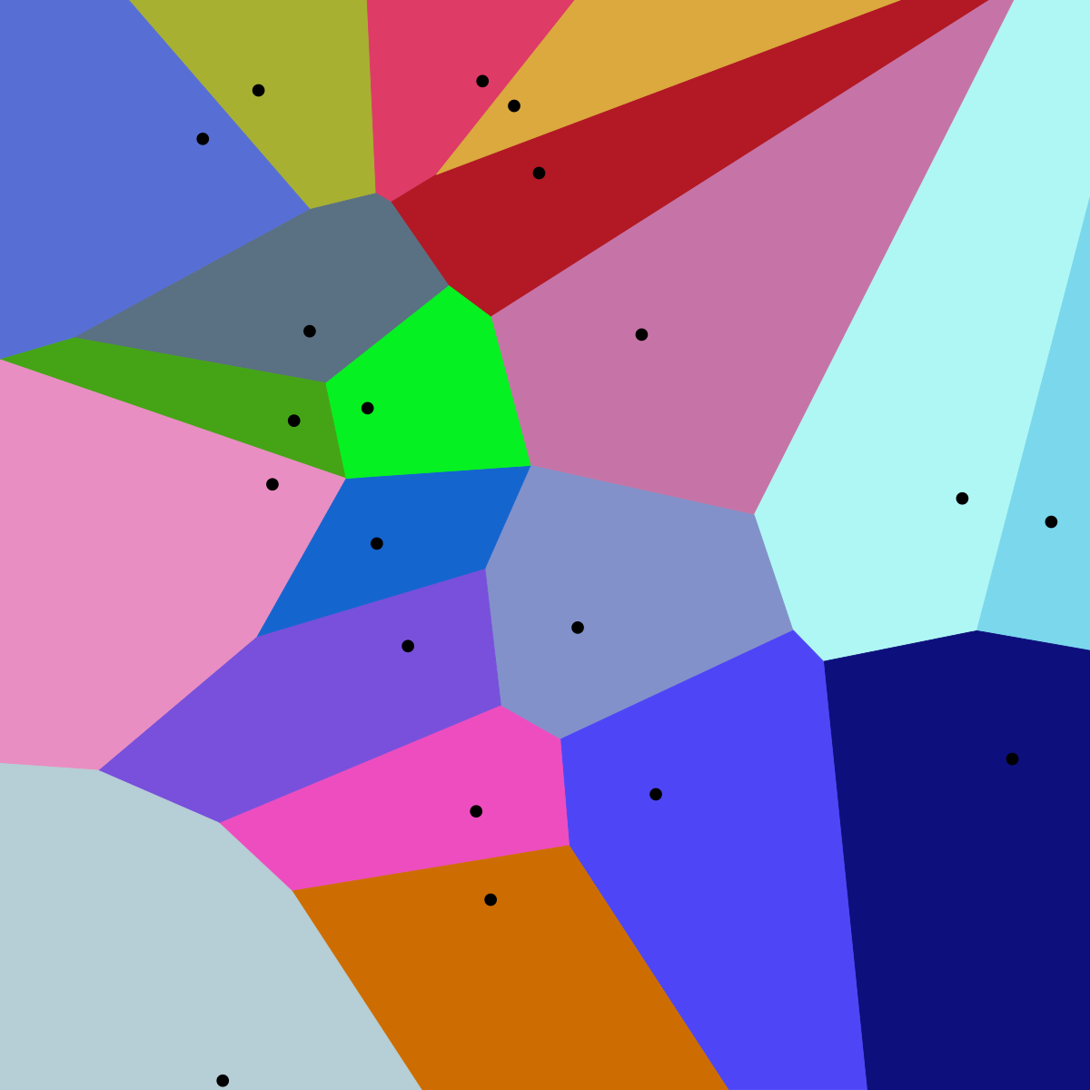
K Nearest Neighbor

Slide 2
Instance Based Learning
• Also known as “Lazy Learning”
• Store the given training data and don’t learn any model
• During query time, retrieve a set of “similar” instances from the training data and use them to classify/predict the new instance
• Essentially construct only local approximations to the target function
• There is no global model learnt to perform well across all instances

Slide 3
K-NN (K-Nearest Neighbors)
• One of the most basic forms of instance learning
• K-NN Algorithm for Classification
Training method:
Save the training examples
At prediction time:
Find the k training examples (x1,y1),…(xk,yk) that are closest to the test example x
Predict the most frequent class among those yi’s.

Slide 4
K-NN - Classification
• One of the most basic forms of instance learning
• K-NN Algorithm for Classification
Training method:
Save the training examples
At prediction time:
Find the k training examples (x1,y1),…(xk,yk) that are closest to the test example x
Predict the most frequent class among those yi’s.

Slide 5
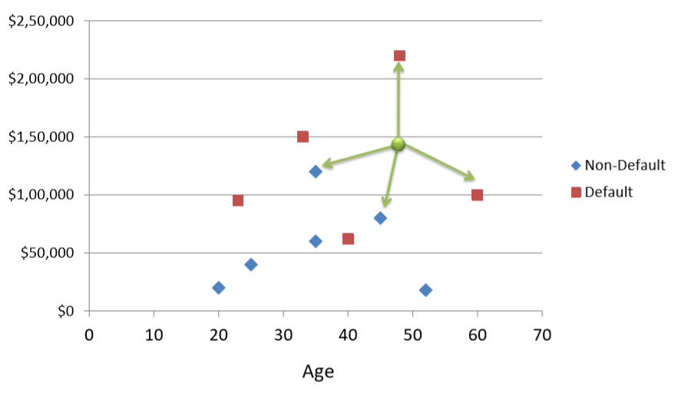
K-NN - Classification

Slide 6
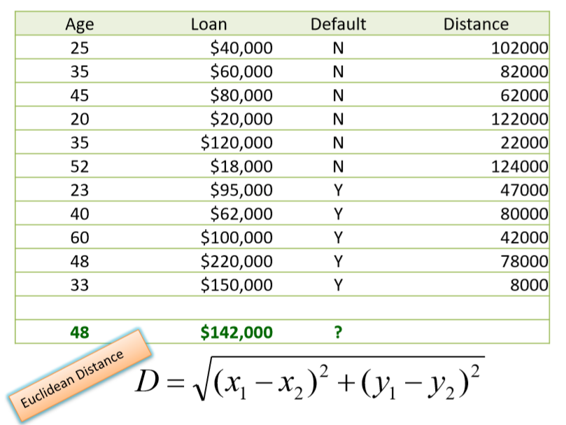
K-NN – Classification (Contd..)

Slide 7
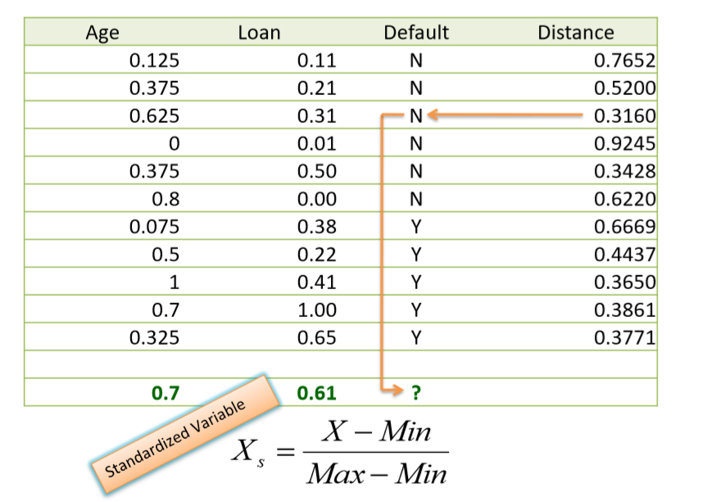
K-NN – Classification (Contd ..)

Slide 8
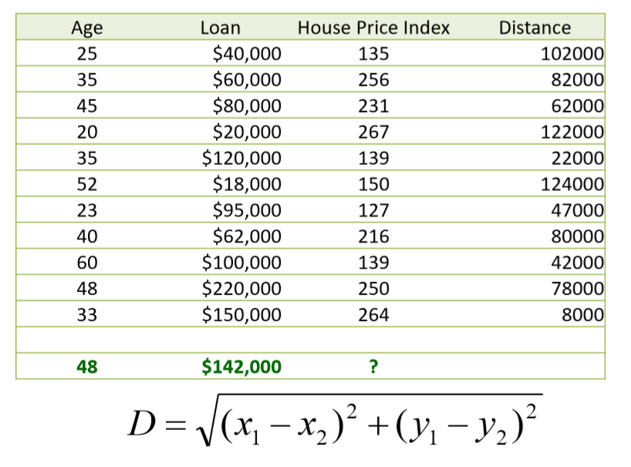
K-NN - Regression

Slide 9
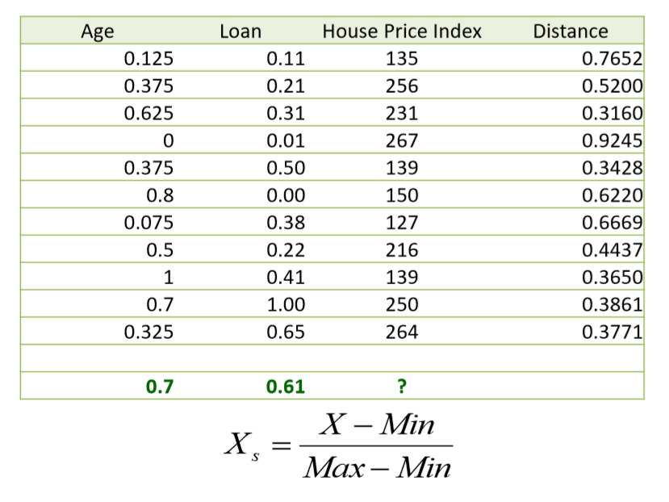
K-NN Regression (Contd..)

Slide 10
K-NN Decision Boundaries
Voronoi Diagrams

Slide 11
How to determine a good value of “K”
• Usually tuned using a validation set
• Start with k=1 and test the error rate on validation set
• Repeat with k=k+2
• Choose the value of k which has minimum error rate on validation set
• Note: Odd values of k chosen to avoid ties

Slide 12
Improving K-NN
• Weighting examples from the neighborhood
• Measuring “closeness”
• Finding “close” examples in a large training set quickly

Slide 13
Reference

