Slide 1

SPARK FUNDS INVESTMENT ANALYSIS
Presented By: Akshay Aithal

Slide 2
Project Abstract
Business Objective
Data Analysis Goals
Checkpoints
Identify the suitable investment type
Identify the top 3 English speaking countries
Identify the best sectors where most investors are investing
Investment analysis in the seed, angel, venture and equity
Country analysis where have been most heavily invested in the past
Sector analysis for understanding the distribution in 8 main sectors
Points to be noted
Spark Funds only wants to invest between 5 to 15 million USD per round of investment
It wants to invest only in English-Speaking countries
Consider a country to be English speaking only if English is one of the official language
Checkpoint 1 – Data Cleaning
Checkpoint 2 – Funding Type Analysis
Checkpoint 3 – Country Analysis
Checkpoint 4 – Sector Analysis 1
Checkpoint 5 – Sector Analysis 2
Checkpoint 6 – Plots and Visualizations

Slide 3
Problem Solving Methodology
Collect data from different sources
Load Companies.txt
Data Cleaning
Use proper encoding techniques
Handling missing, null values
Data Transformation
Data Analysis &
Plotting
Do exploratory data analysis
Data Collection
Load Rounds2.csv
Load mapping.csv
Manipulation of Date and Strings
Transform data to do analysis and visualizations
Merge or concat various data frames
Filter, extract and arrangement of data
Grouping n summarizing of data
Investment type analysis
Top Country analysis
Main Sector analysis
Use Matplotlib n Seaborn to constructs different types of plots

Slide 4
Funding Type Analysis
Spark funds wants to choose one of these four investment types (venture, private equity, seed and angel) for each potential investment they will make.
Calculate most representative value of the investment amount for each of the funding types
1. We have to extract data where funding round type is venture, private equity, seed and angel
2. Extract the data from the master frame and check info of master frame
3. Apply grouping on the data on the behalf of funding round type and take out the mean of raised amount USD.
4. Spark fund want to invest between the 5 to 15 Million USD per investment round so after this we got VENTURE as a funding type which is most suitable for the company
Funding round type | Raised amount USD
private equity | 73938486.3
venture | 11724222.7
angel | 971573.9
seed | 747827.9

Slide 5
Country Analysis
Spark funds wants to invest in countries with the highest amount of funding for the VENTURE investment type
It wants to invest in only English speaking countries.
Consider a country to be English speaking only if English is one of the official languages in that country
1. Fetch the list of English-speaking countries from the given link:
https://en.wikipedia.org/wiki/List_of_territorial_entities_where_English_is_an_official_language
2. Drop the unnecessary columns from the table and rename the columns and split the data to get official languages and store all the clean data in countries frame
3. Extract the data from the master frame across all sectors for the chosen investment type i.e. venture
4. Merge your master frame with countries frame to get countries with official language as English
5. Apply grouping on your data on the behalf of country code and apply sum on raised amount usd you will get the data with top 9 countries
Country Code | Raised Amount USD
USA | 420068029342
GBR | 20072813004
IND | 14261508718
CAN | 9482217668
SGP | 2793917856
IRL | 1669285543
AUS | 1319028698
NZL | 448316383
ZAF | 233713106

Slide 6



Sector Analysis
Main Sector | No. of Investments | Sum of Investments
Cleantech / Semiconductors | 7857 | 118834869645
Others | 8310 | 82796823598
Social, Finance, Analytics, Advertising | 7246 | 86331402349.0
Spark Funds aim is to find out the most heavily invested main sectors in each of the 3 countries and for the best funding type and investment range between 5-15 M USD
1. Extract the data from the frame of top 3 countries and check for the % of null data
2. Extract first string before the vertical bar will be considered the primary sector (Business Rule.)
3. Using the mapping.csv file to map each primary sector with its main sector
4. Merge the mapped data frame with our master frame3. Using the mapping.csv file to map each primary sector with its main sector
5. Create 3 separate data frames for each of the three countries containing the observations of venture type in between 5-15 M. Apply grouping and get top sectors for all the countries
Main Sector | No. of Investments | Sum of Investments
Cleantech / Semiconductors | 437 | 5052849729.0
Others | 516 | 4492219646
Social, Finance, Analytics, Advertising | 421 | 3773328672.0
Main Sector | No. of Investments | Sum of Investments
Social, Finance, Analytics, Advertising | 147 | 1578804920
News, Search and Messaging | 130 | 1739579948.0
Others | 184 | 6329507440.0

Slide 7
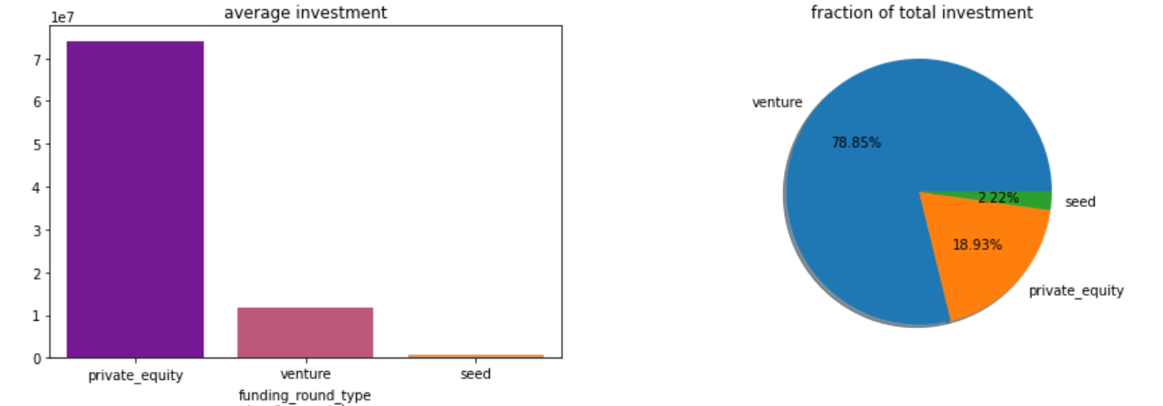
Plot 1: A plot showing the fraction of total investment (globally) in venture, seed and private equity and the average amount of investment in each funding type
Venture type has attracted 590 B USD Worldwide
78.8 % of funding by Venture type
Average of 13.4 M USD per investment
the range of funding preferred by Spark Funds is 5 to 15 million USD.
78.8 % of funding in venture type
Average of 11.75 M USD per investment

Slide 8
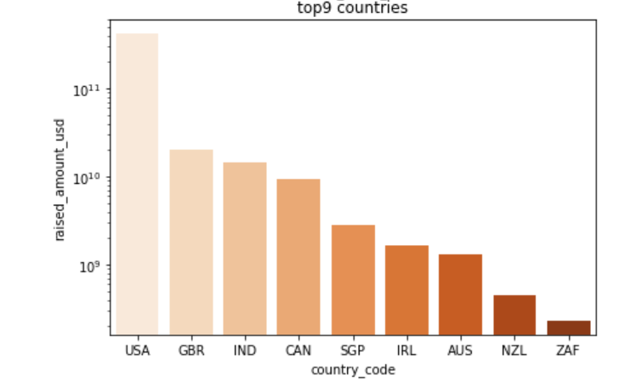
Plot 2: A plot showing the top 9 countries against the total amount of investments of funding type FT (i.e. VENTURE)
Top three English speaking country invested by venture fund type
USA is the best country for venture
investment
$ 420068 M
GBR is second best country for venture
investment
$ 20072 M
IND is the third best country for venture
Investment
$ 14261 M

Slide 9
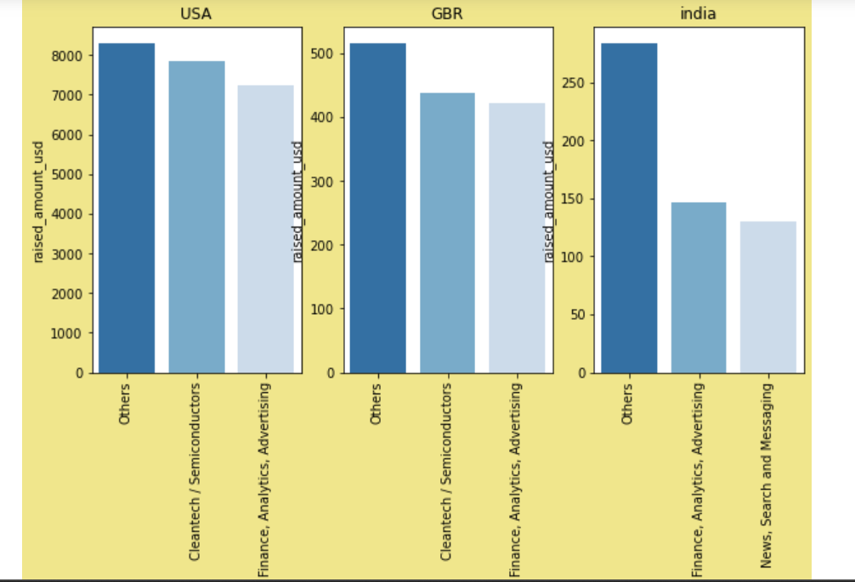
Plot 3 : A plot showing the number of investments in the top 3 sectors of the top 3 countries
Count of total investments in top 3 sectors of the top 3 countries
Others
Social, Finance, Analysis and Advertising
Cleantech / Semiconductors
Others
2. Social, Finance, Analysis and Advertising
3.Cleantech / Semiconductors
Others
News, Search and Messaging
Entertainment

Slide 10
Project Conclusions
Investment Type Goal
The funding type which is best suited to Sparks Fund is VENTURE
Top Countries Goal
Top 3 English speaking countries which has been the most heavily invested in the past is: United States of America, Great Britain and India
Main Sector Goal
Best sectors where distribution of investments are high are Others sectors including Semiconductors and many more
Its average funding globally is between 5 to 15 Million USD per round of investment
78.8 % of funding is raised by venture globally
Attracts around 590 B USD worldwide
Alone in USA the venture fund invested is around 422510.84 M USD
Also these countries have English as their official language
GBR invested 20245.63 M USD in venture
IND invested 14391.86 M USD in venture
Others, Cleantech / Semiconductors and Social, Finance, Analytics, Advertising for USA
Others, Cleantech / Semiconductors and Social, Finance, Analytics, Advertising for GBR
Others, News Search and Messaging and Entertainment for IND

