Slide 1
Evaluating Uncertainty-Aware PSO-Tuned SVM Selection
Small medical datasets | Nested cross-validation | Saved-results analysis
Research question: does penalizing variability in inner-fold loss change outer-fold performance or the inner-to-outer loss gap?
The evidence is mixed and descriptive; superiority is not assumed.
01

Slide 2
Motivation and objective
- Cross-validation estimates vary with the particular training/validation folds.
- Mean-only search may select candidates with unstable fold losses.
- We test whether the sample SD of inner-fold loss adds useful selection information.
Objective: compare outer-fold performance and generalization-gap behavior, not to presume overtuning mitigation or clinical utility.
02

Slide 3
Four methods: keep the distinction explicit
M1 Standard PSO: minimize mean inner-fold loss during fitness, best updates, and selection.
M2 Post-hoc selection: choose mean loss + lambda x sample SD from the M1 candidate pool; swarm path unchanged.
M3 UA-PSO: penalized loss is used during fitness and personal/global-best updates; each lambda has its own search trajectory.
M4 Random search: equal-budget uniform samples, selected by mean inner loss.
Lambda = 0 is the standard PSO objective; lambda = 0.25, 0.5, 1, 2 are sensitivity values.
03

Slide 4
Datasets and preprocessing
Datasets: Wisconsin Diagnostic Breast Cancer (569 rows), Pima Indians Diabetes (768), Cleveland Heart Disease (303).
Four configurations: median imputation; mean imputation; PCA (95% variance) after median imputation; five-component TruncatedSVD after median imputation.
Target mappings and missing-value handling follow the saved repository protocol. All preprocessing is fitted within each training partition. Exact local Pima CSV provenance and licenses remain unresolved.
04

Slide 5
Nested evaluation and search budget
Nested stratified 5-fold outer x 5-fold inner CV; RBF-SVM.
Search: log10(C), log10(gamma) in [-3, 3]. Final v2 and multi-seed runs: 8 particles x 6 iterations = 48 candidate evaluations/search.
Seeds 42, 43, 44; matched splits and starting positions for lambda comparisons. SVD random state is explicitly recorded per run in the final seeded experiment.
Outer-test labels are reserved for evaluation. Calibration uses outer-training inner OOF scores only.
05

Slide 6
One-seed v2: four-method descriptive means
Averages over the saved 60 dataset/configuration/fold rows per method. Historical v2 SVD was unseeded.
Method ROC-AUC Bal. Acc. Sens. Spec. F1
M1 Standard PSO 0.9109 0.8262 0.7321 0.9204 0.7697
M2 Post-hoc UA 0.9113 0.8233 0.7257 0.9209 0.7629
M3 UA-PSO, lambda=1 0.9123 0.8286 0.7341 0.9230 0.7683
M4 Random search 0.9105 0.8109 0.6952 0.9266 0.7312
Single-seed context only; not pooled with the final seeded sensitivity analysis.
06

Slide 7
Three-seed M1 vs M3 at lambda=1
Paired average M3 - M1 across saved matched observations:
ROC-AUC -0.0003 | Balanced accuracy -0.0061 | Sensitivity -0.0147
Specificity +0.0025 | F1 -0.0152
Direction varied by dataset and preprocessing. The comparison does not support consistent M3 improvement.
07

Slide 8
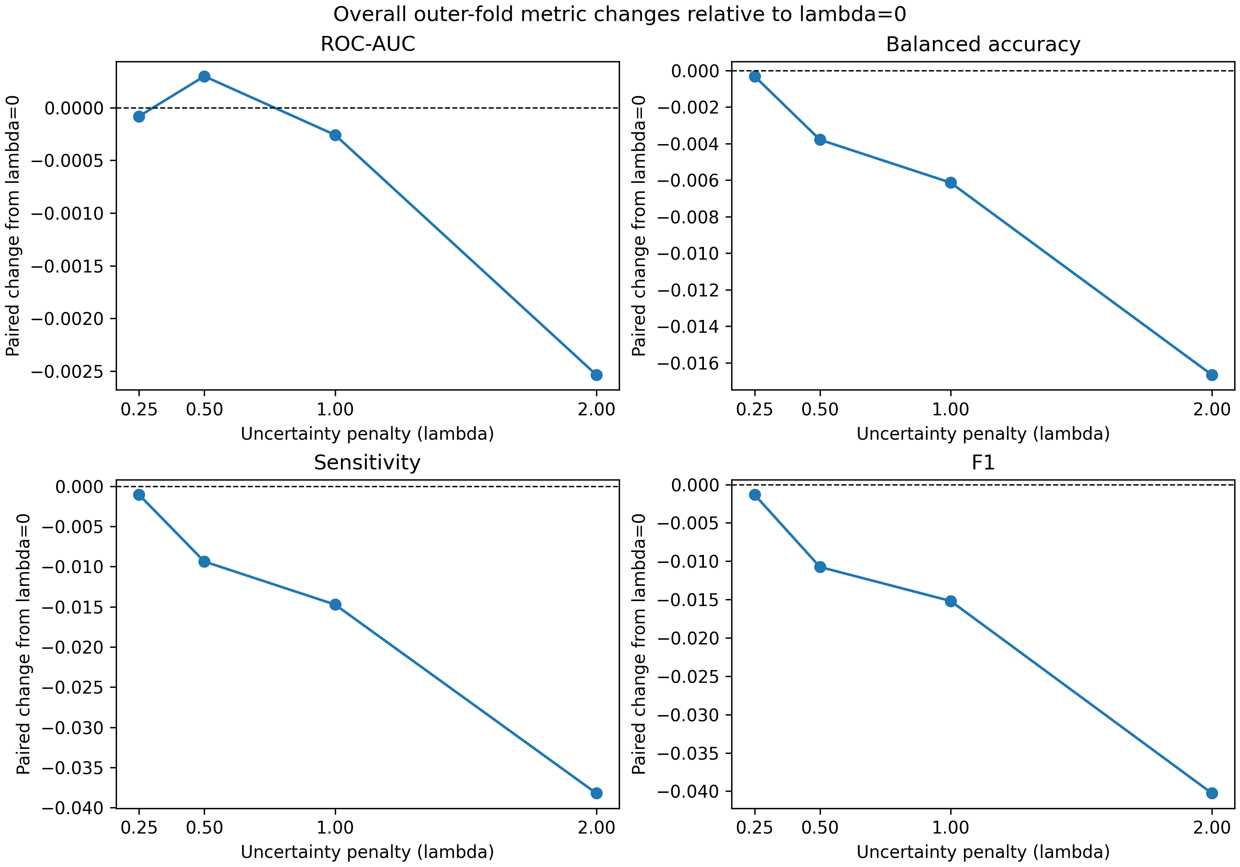
Five-lambda sensitivity: average changes from lambda=0
Paired differences are first computed by seed, dataset, preprocessing, and outer fold; descriptive means shown here.
Lambda ROC-AUC Bal. Acc. Sens. Spec. F1
0.25 -0.0001 -0.0003 -0.0011 +0.0004 -0.0013
0.50 +0.0003 -0.0038 -0.0094 +0.0018 -0.0108
1.00 -0.0003 -0.0061 -0.0147 +0.0025 -0.0152
2.00 -0.0025 -0.0167 -0.0382 +0.0049 -0.0403
These average changes conceal dataset- and pipeline-specific variation.
08

Slide 9
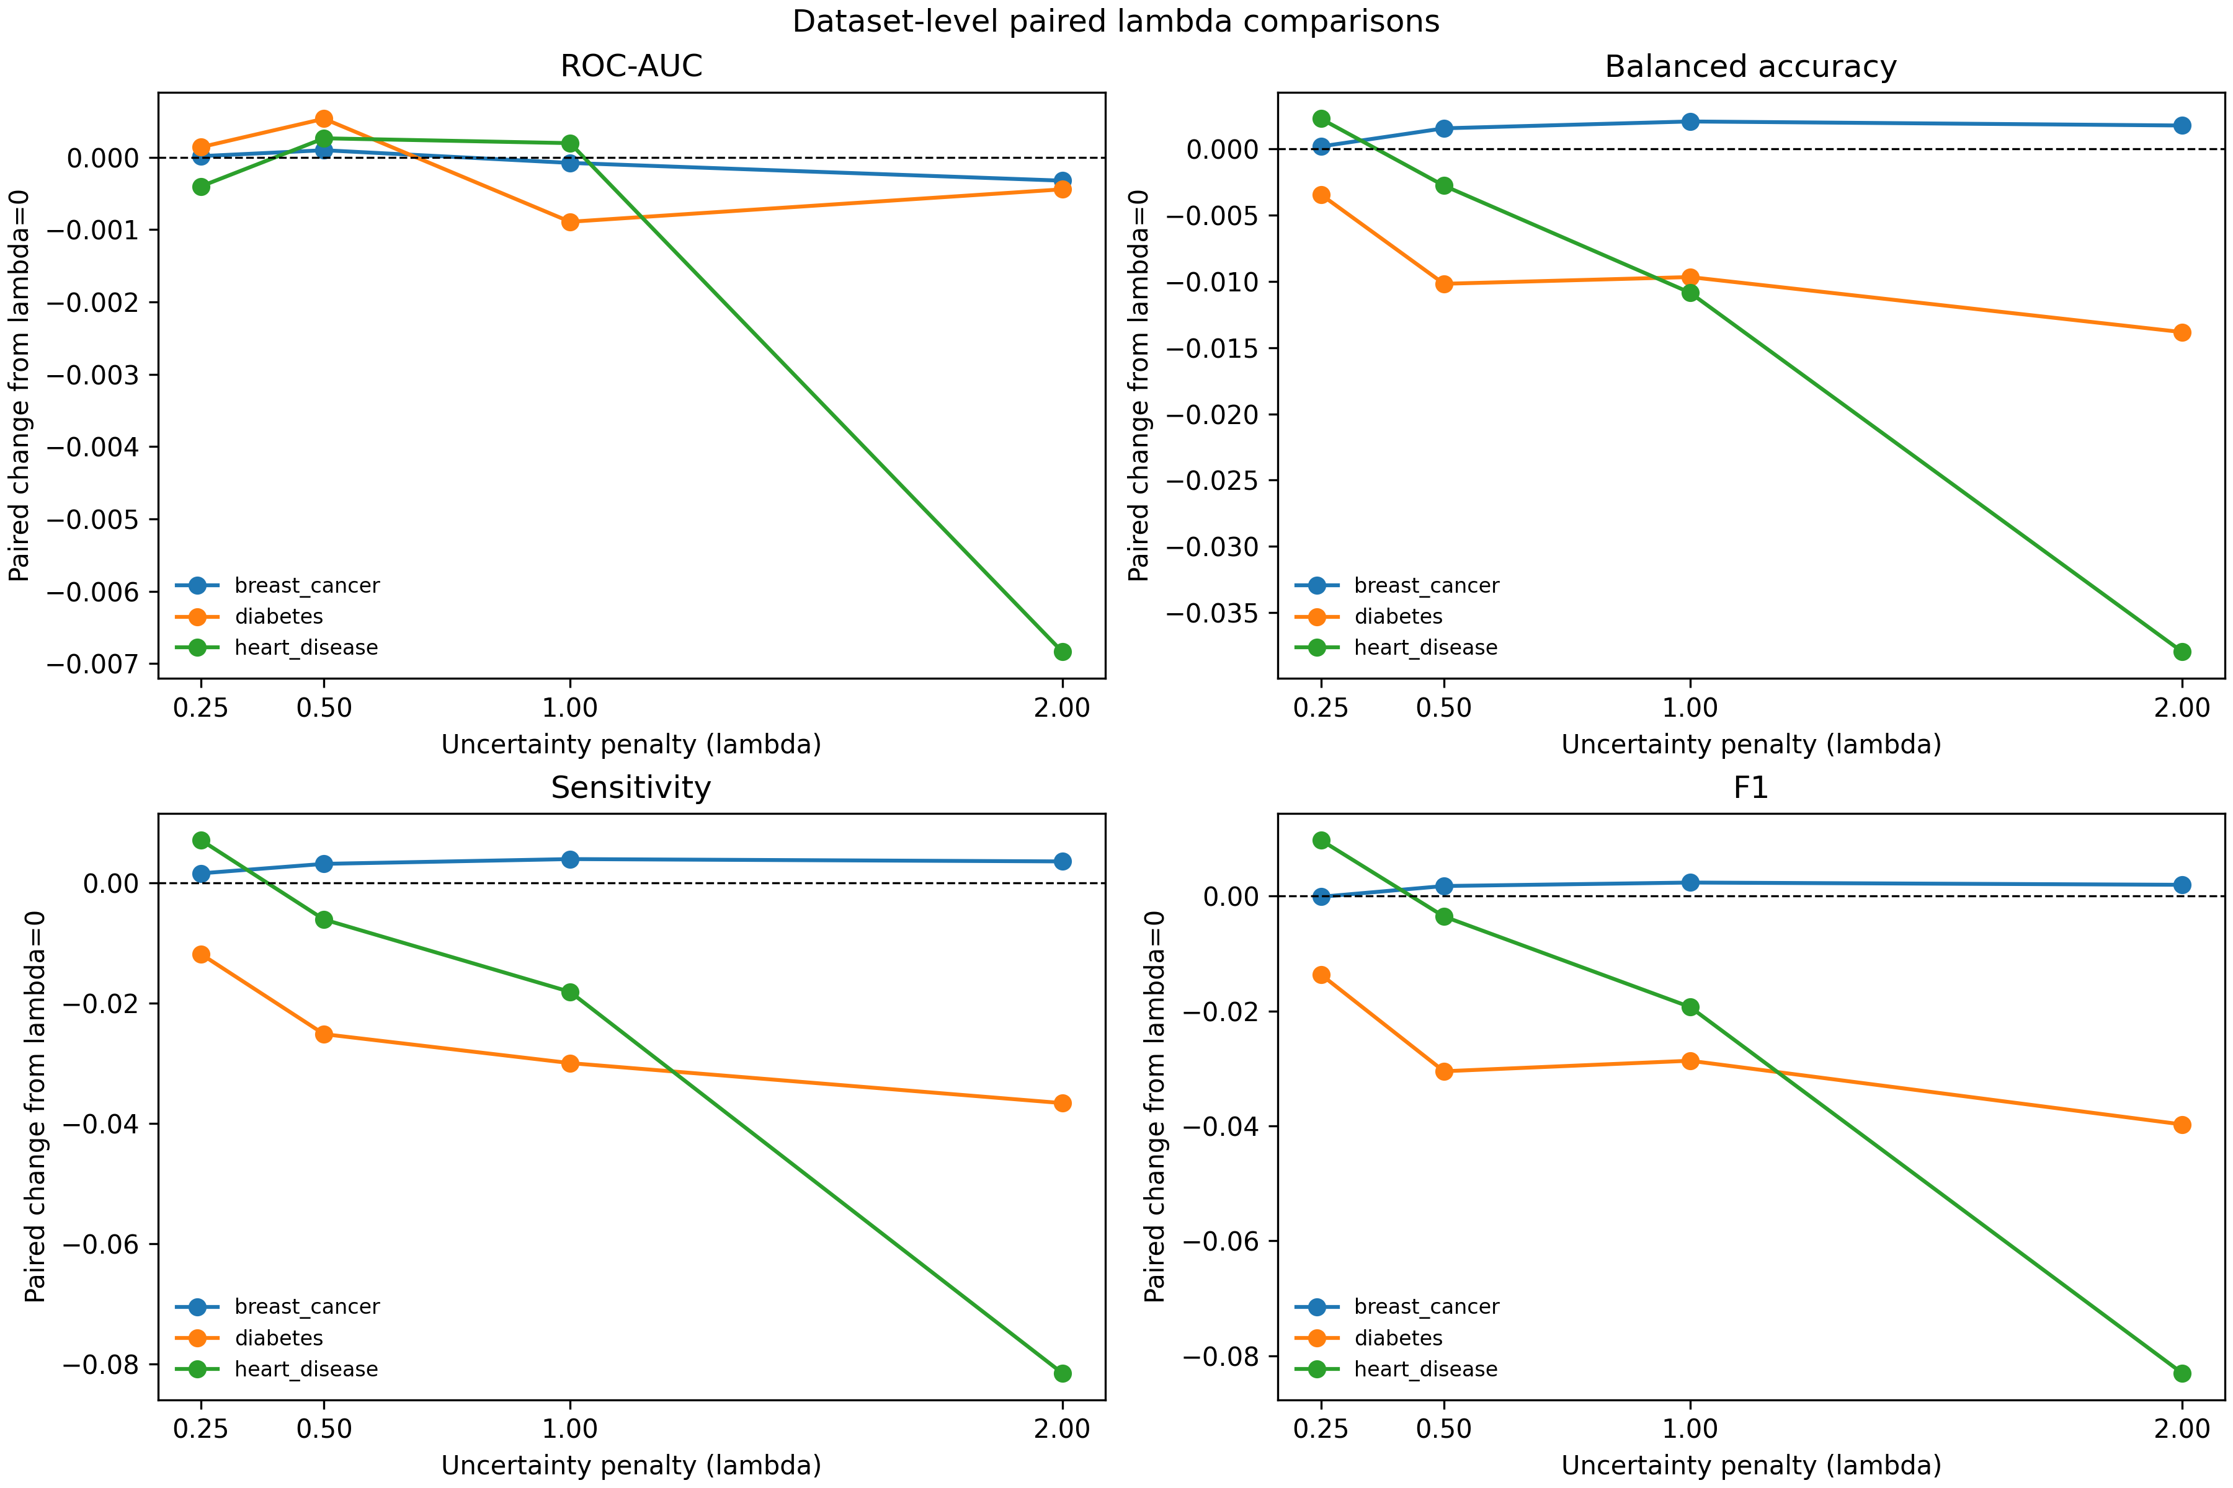
Dataset-level sensitivity is heterogeneous
At lambda=1 (mean paired change from lambda=0):
Breast Cancer: small gains in balanced accuracy (+0.0021), sensitivity (+0.0039), F1 (+0.0024); near-zero AUC/gap change.
Diabetes: balanced accuracy -0.0097, sensitivity -0.0300, F1 -0.0287; specificity +0.0107.
Heart Disease: balanced accuracy -0.0108, sensitivity -0.0181, F1 -0.0193; AUC +0.0002.
Preprocessing-specific effects also differ; no single lambda is established as best.
09

Slide 10
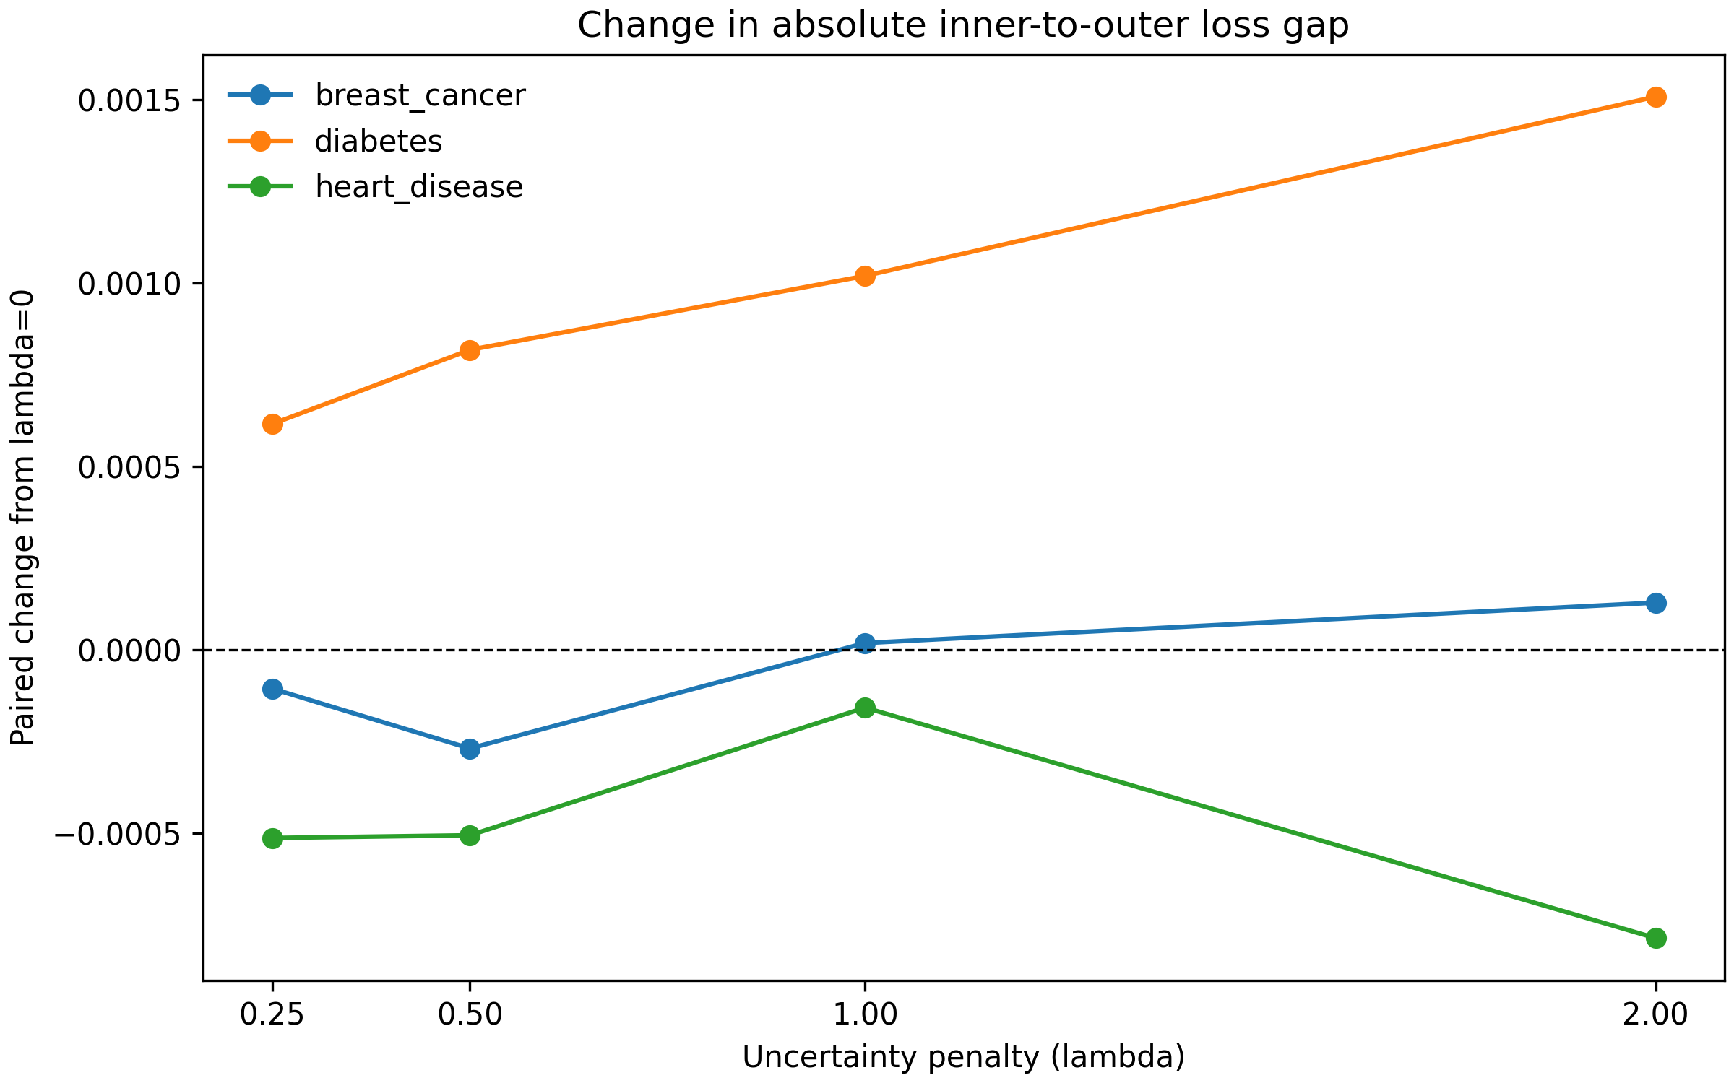
Generalization gap: no consistent reduction
Signed gap = (1 - outer ROC-AUC) - selected mean inner loss. Absolute gap is a descriptive discrepancy, not proof of overtuning.
For M3 vs M1 at lambda=1, absolute gap was smaller in 71/180 matched rows, larger in 75, and equal in 34.
Lambda-level changes also vary by dataset and remain close to zero in aggregate.
10

Slide 11
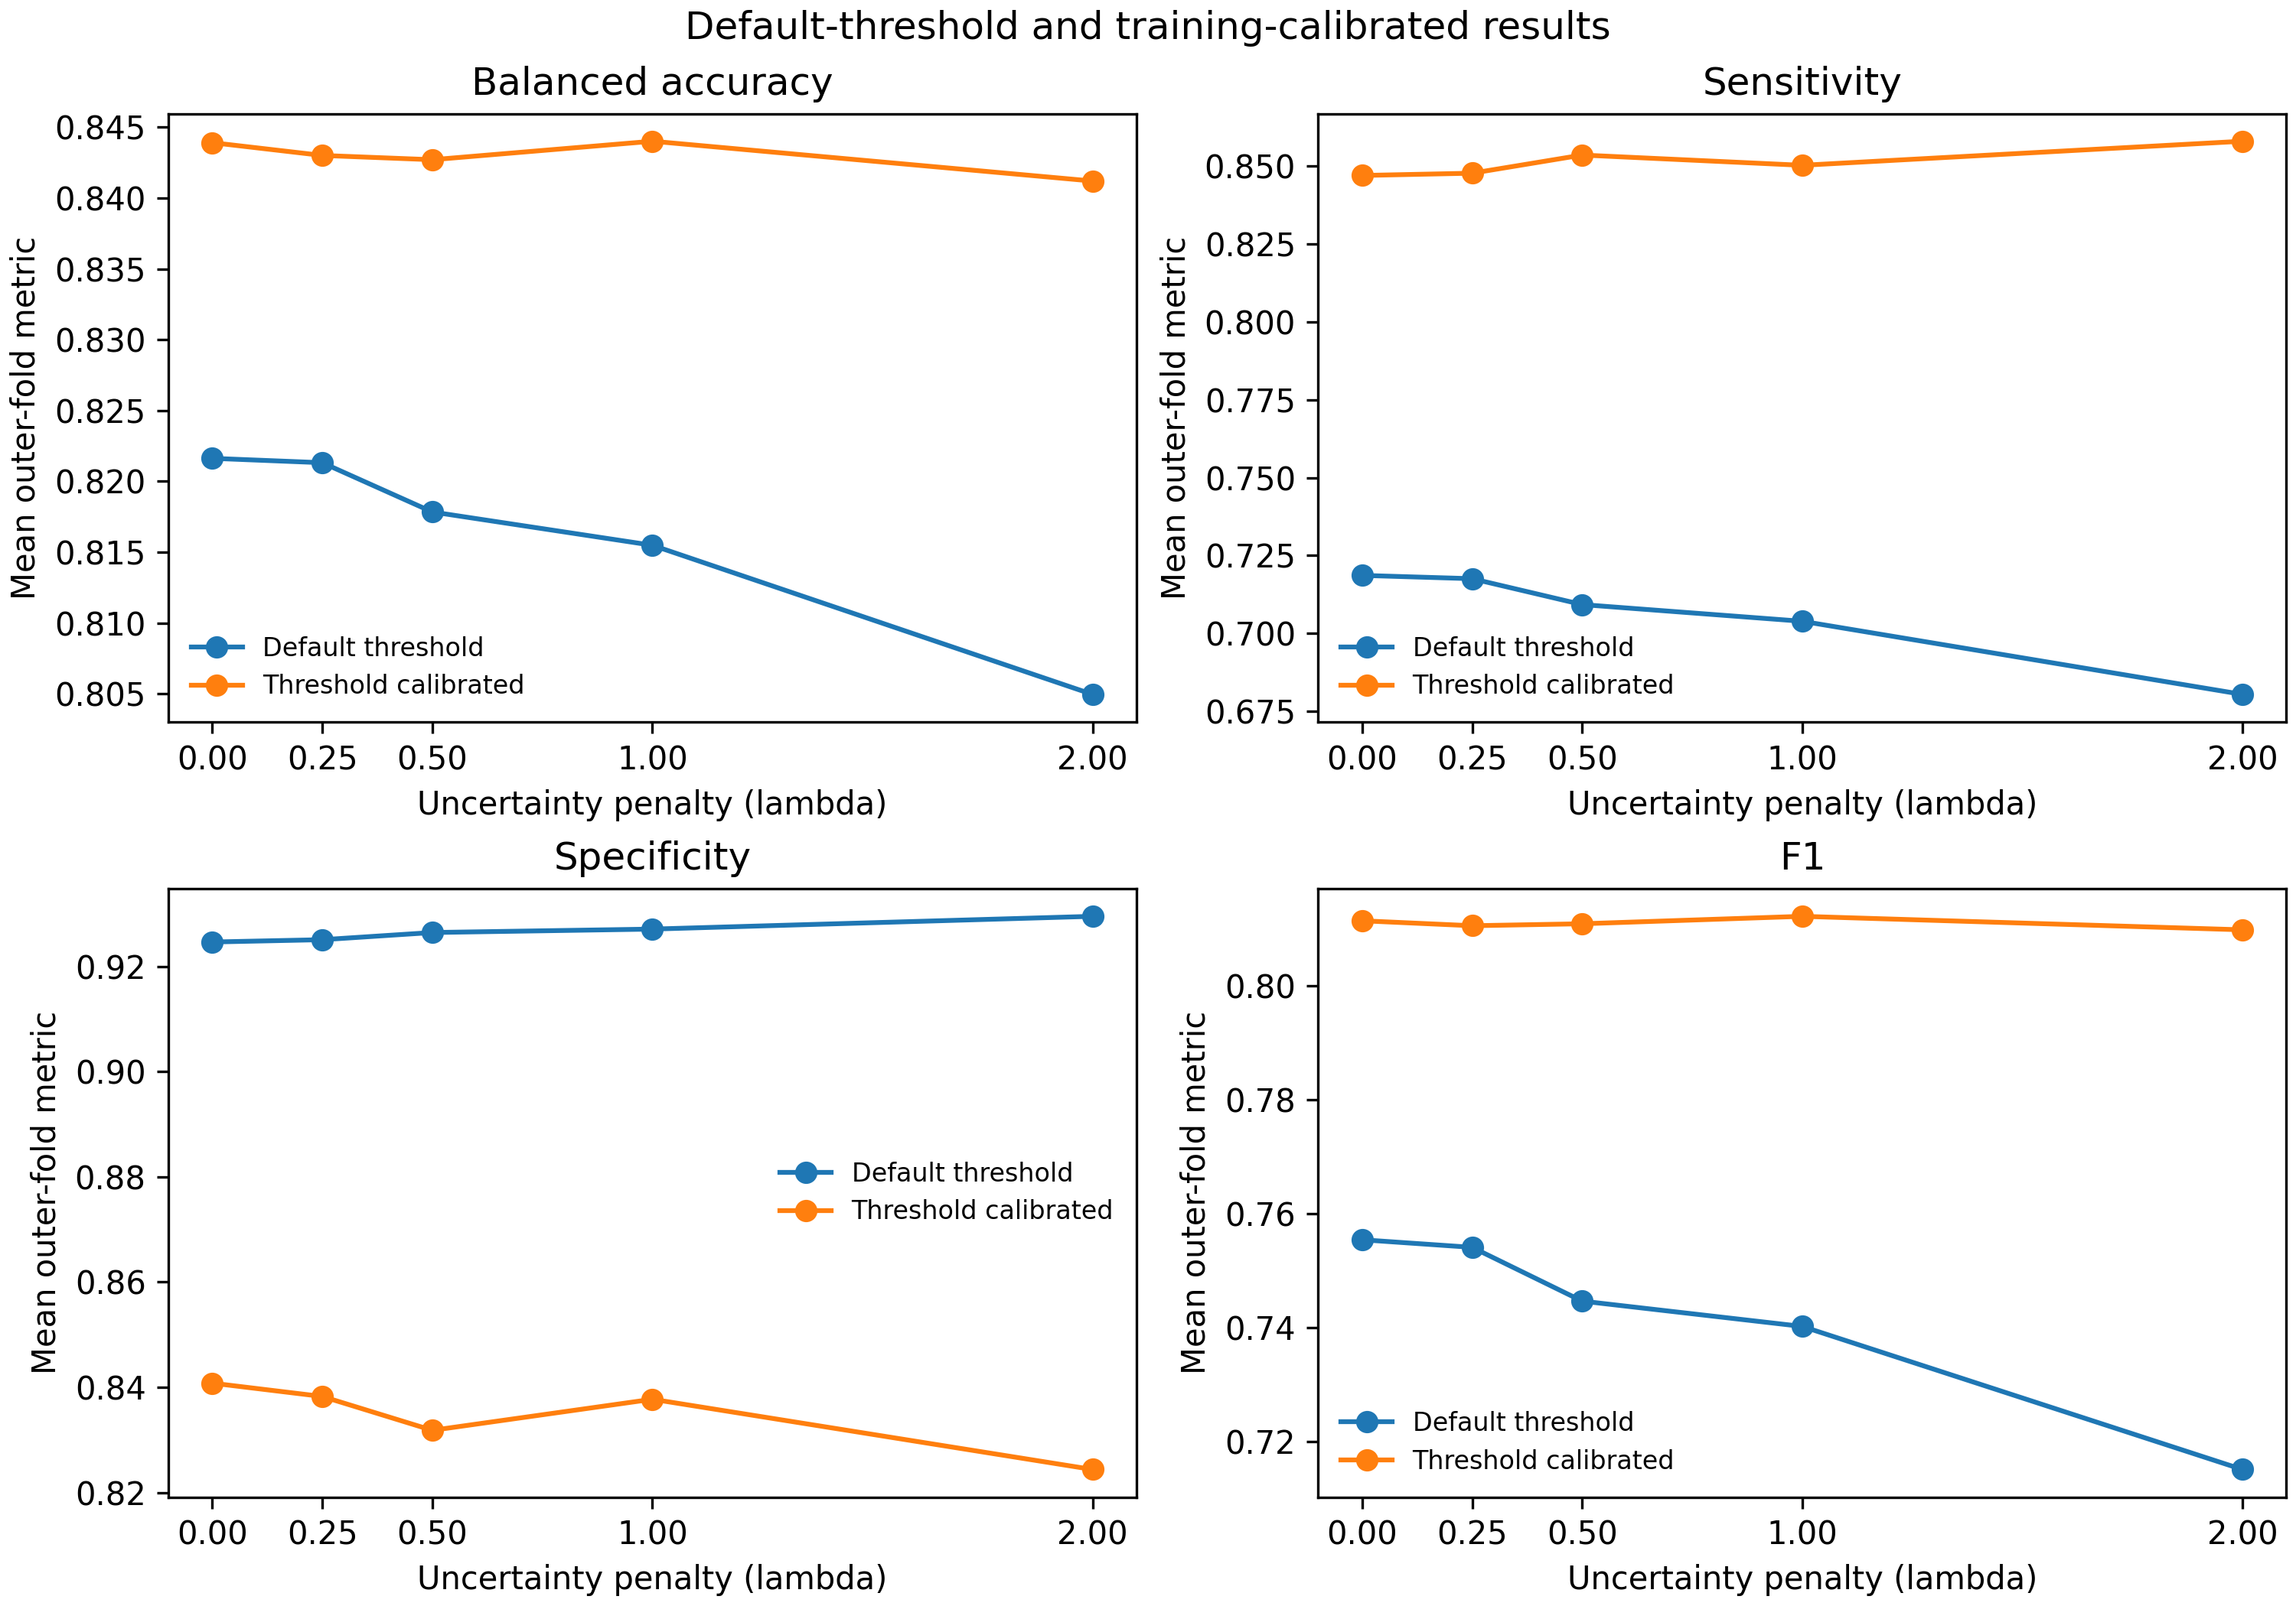
Default and calibrated metrics are separate
Default-threshold metrics use SVC predictions. Calibrated thresholds maximize inner-OOF balanced accuracy within outer training data, then apply to the untouched outer test fold.
ROC-AUC uses continuous decision scores. Calibration has a possible score-scale mismatch after refitting on all outer-training rows.
11

Slide 12
Limitations and conclusion
- Three datasets and three seeds do not establish population or seed robustness.
- Outer folds overlap; no significance test is claimed.
- Historical v2 TruncatedSVD used random_state=None; saved outputs were not regenerated.
- Exact Pima CSV provenance and dataset redistribution terms remain unresolved.
- No external validation, clinical benefit, or established overtuning mitigation.
Conclusion: uncertainty-aware PSO changes candidate search behavior, but measured effects are mixed. Independent, provenance-verified validation is the next step.
12

Slide 13
Selected verified references
Wolberg, Mangasarian & Street (1993), Nuclear feature extraction for breast tumor diagnosis; UCI WDBC dataset 17.
Smith et al. (1988), Using the ADAP learning algorithm to forecast diabetes mellitus.
Detrano et al. (1989), International application of a new probability algorithm for coronary artery disease; UCI Heart Disease dataset 45.
Cortes & Vapnik (1995), Support-vector networks.
Kennedy & Eberhart (1995), Particle swarm optimization.
Stone (1974), Cross-validatory choice and assessment of statistical predictions.
Pedregosa et al. (2011), Scikit-learn: Machine Learning in Python.
Full citation details and dataset links are in docs/references.md. Local Pima file provenance is not established.
13

