Slide 1
FinanceFlash Currency Analysis
Analysis Report

Slide 2
Decision Table
Date | Closing Price | Decision
Feb 26, 2024 | 89.9024 | NEUTRAL
Feb 23, 2024 | 89.611 | NEUTRAL
Feb 22, 2024 | 89.675 | NEUTRAL
Feb 21, 2024 | 89.478 | NEUTRAL
Feb 20, 2024 | 89.403 | NEUTRAL
Feb 19, 2024 | 89.378 | NEUTRAL
Feb 16, 2024 | 89.357 | NEUTRAL
Feb 15, 2024 | 89.036 | NEUTRAL
Feb 14, 2024 | 88.862 | NEUTRAL
Feb 13, 2024 | 89.31 | NEUTRAL
Feb 12, 2024 | 89.444 | NEUTRAL
Feb 09, 2024 | 89.278 | NEUTRAL
Feb 08, 2024 | 89.401 | NEUTRAL
Feb 07, 2024 | 89.261 | NEUTRAL
Feb 06, 2024 | 89.121 | NEUTRAL
Feb 05, 2024 | 89.2182 | NEUTRAL
Feb 02, 2024 | 90.084 | NEUTRAL
Feb 01, 2024 | 89.618 | NEUTRAL
Jan 31, 2024 | 90.049 | NEUTRAL
Jan 30, 2024 | 90.025 | NEUTRAL
Jan 29, 2024 | 90.124 | NEUTRAL
Jan 26, 2024 | 90.1 | NEUTRAL
Jan 25, 2024 | 90.346 | NEUTRAL
Jan 24, 2024 | 90.283 | NEUTRAL
Jan 23, 2024 | 90.306 | NEUTRAL
Jan 22, 2024 | 89.4372 | NEUTRAL
Jan 19, 2024 | 90.386 | NEUTRAL
Jan 18, 2024 | 90.442 | NEUTRAL
Jan 17, 2024 | 90.313 | NEUTRAL
Jan 16, 2024 | 90.648 | NEUTRAL
Jan 15, 2024 | 90.663 | NEUTRAL
Jan 12, 2024 | 91.144 | NEUTRAL
Jan 11, 2024 | 91.041 | NEUTRAL
Jan 10, 2024 | 90.803 | NEUTRAL
Jan 09, 2024 | 90.858 | NEUTRAL
Jan 08, 2024 | 89.7557 | NEUTRAL
Jan 05, 2024 | 91.036 | NEUTRAL
Jan 04, 2024 | 90.98 | NEUTRAL
Jan 03, 2024 | 91.058 | BUY
Jan 02, 2024 | 91.142 | BUY
Jan 01, 2024 | 91.79 | NEUTRAL
Dec 29, 2023 | 91.897 | BUY
Dec 28, 2023 | 92.415 | NEUTRAL
Dec 27, 2023 | 90.6702 | SELL
Dec 26, 2023 | 90.6702 | SELL
Dec 25, 2023 | 90.6702 | SELL
Dec 22, 2023 | 91.317 | BUY
Dec 21, 2023 | 90.959 | SELL
Dec 20, 2023 | 91.149 | BUY
Dec 19, 2023 | 90.674 | SELL
Dec 18, 2023 | 90.0414 | SELL
Dec 15, 2023 | 91.487 | BUY
Dec 14, 2023 | 90.557 | SELL
Dec 13, 2023 | 89.968 | SELL
Dec 12, 2023 | 89.63 | SELL
Dec 11, 2023 | 88.9095 | NEUTRAL
Dec 08, 2023 | 89.872 | SELL
Dec 07, 2023 | 89.667 | SELL
Dec 06, 2023 | 89.862 | SELL
Dec 05, 2023 | 90.302 | SELL
Dec 04, 2023 | 89.747 | SELL
Dec 01, 2023 | 90.651 | BUY
Nov 30, 2023 | 91.214 | BUY
Nov 29, 2023 | 91.563 | BUY
Nov 28, 2023 | 91.196 | BUY
Nov 27, 2023 | 91.098 | BUY
Nov 24, 2023 | 90.803 | BUY
Nov 23, 2023 | 90.883 | BUY
Nov 22, 2023 | 90.826 | BUY
Nov 21, 2023 | 91.118 | BUY
Nov 20, 2023 | 89.4732 | SELL
Nov 17, 2023 | 90.131 | SELL
Nov 16, 2023 | 90.126 | SELL
Nov 15, 2023 | 90.166 | SELL
Nov 14, 2023 | 88.94 | SELL
Nov 13, 2023 | 87.9352 | NEUTRAL
Nov 10, 2023 | 88.738 | SELL
Nov 09, 2023 | 89.05 | SELL
Nov 08, 2023 | 88.95 | SELL
Nov 07, 2023 | 89.122 | SELL
Nov 06, 2023 | 89.109 | SELL
Nov 03, 2023 | 88.294 | SELL
Nov 02, 2023 | 88.047 | SELL
Nov 01, 2023 | 87.983 | SELL
Oct 31, 2023 | 88.286 | SELL
Oct 30, 2023 | 86.858 | NEUTRAL
Oct 26, 2023 | 87.9 | SELL
Oct 25, 2023 | 87.942 | SELL
Oct 24, 2023 | 87.858 | SELL
Oct 23, 2023 | 88.484 | SELL
Oct 22, 2023 | 88.042 | SELL
Oct 19, 2023 | 87.901 | SELL
Oct 18, 2023 | 87.642 | SELL
Oct 17, 2023 | 87.948 | SELL
Oct 16, 2023 | 87.749 | SELL
Oct 15, 2023 | 86.5582 | NEUTRAL
Oct 12, 2023 | 87.646 | SELL
Oct 11, 2023 | 88.319 | BUY
Oct 10, 2023 | 88.198 | BUY
Oct 09, 2023 | 88.013 | BUY

Slide 3
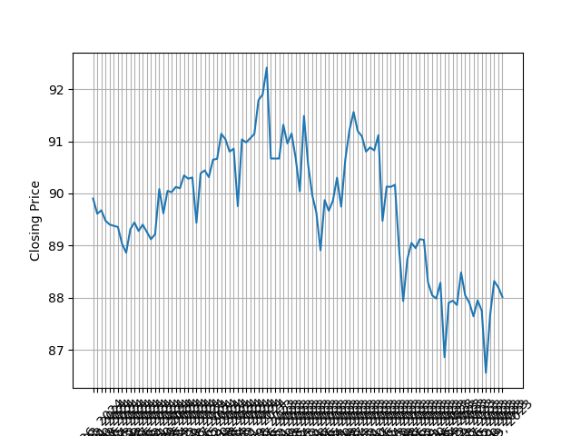
Closing Price Trend

