Slide 1
Capstone Project: Automated an E-Commerce Website (Bstackdemo)
Under the Guidance of Vaishali Mam.
Presented By:
Akshay Alladi

Slide 2
Contents:
Introduction
Overview of Modules Tested
Functionalities Tested
Defects
Challenges & Experience

Slide 3
INTRODUCTION
Bstackdemo is a sample e-commerce platform created by BrowserStack to demonstrate and practice automation testing on modern web applications.
It provides functionalities like product browsing, sorting, adding items to cart, and completing checkout, making it an ideal practice site for test automation.
Purpose: To automate test cases using Cucumber (BDD framework) integrated with Selenium WebDriver.
This approach enables writing test scenarios in plain English (Gherkin) for better collaboration between business and technical teams while ensuring maintainable and scalable test automation.

Slide 4
OVERVIEW OF MODULES TESTED
Login & Logout Module
Functionalities Tested:
Verified Login & Logout functionalities.

Slide 5
Search Module
Functionalities Tested:
Searched for products by name, brand, and category.
Filtered search results by price, brand, and other attributes.
Verified the "No results found" message for invalid searches.
Ensured the search handles special characters.

Slide 6
Add to Cart Module
Functionalities Tested:
Adding single and multiple products to the shopping cart.
Updating the quantity of items in the cart.
Removing items from the cart.
Ensuring the cart total updates correctly.
Verifying that the cart contents remains same after a page refresh/login.

Slide 7
Wishlist Module
Functionalities Tested:
Preventing guest users from adding to the Wishlist (prompting login).
Adding a product to the Wishlist.
Removing an item from the Wishlist.
Moving an item directly from the Wishlist to the shopping cart.
Ensuring the Wishlist is saved to the user's account and after logout/login.

Slide 8
Offers Module
Functionalities Tested:
Verified that offer banners redirect to the correct pages and that promotional codes can be successfully applied in the cart.
Vendors Module
Functionalities Tested:
Ensured the A-Z brand list loads correctly and that clicking a brand name properly filters to show only its products.
Orders Module
Functionalities Tested:
Verified that users can view their past orders with correct details (items, amounts, statuses); validated order tracking, cancellations, returns/refunds, and related notifications.

Slide 9
DEFECTS
While running testcases for search module, search results are not accurate, So I created a defect report on those defects

Slide 10
Defect Identifier :- SRCH_01
Defect summary: When searching for unrelated items like “car spare parts”, it shows random products results instead of displaying “No Results Found”.
Test Id : TC_001
Test case name : TC_invalidSearchResults
Module name : Search module
Reproducible :
Severity : Medium
Priority : Medium
Raised by : Akshay
Assigned to : Development Lead
Date of assignment :
Status : Open
Snap shots :
Fixed by :
Date of fixing :

Slide 11
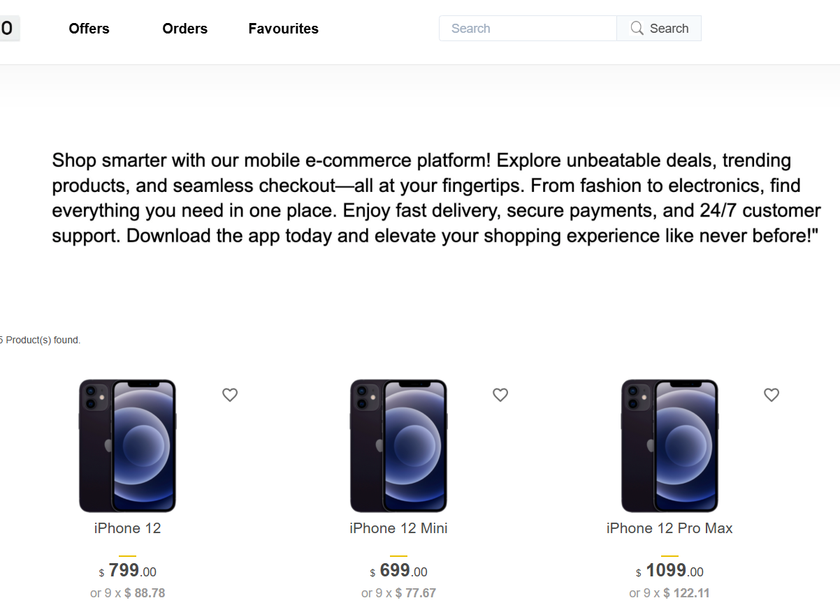

Slide 12
Defect Identifier :- SRCH_02
Defect summary: Searching for “Phones under 1100” shows products priced both below and above 500.
Test Id : TC_002
Test case name : TC_incorrect_Results
Module name : Search module
Reproducible :
Severity : Medium
Priority : Low
Raised by : Akshay
Assigned to : Development Lead
Date of assignment :
Status : Open
Snap shots :
Fixed by :
Date of fixing :

Slide 13
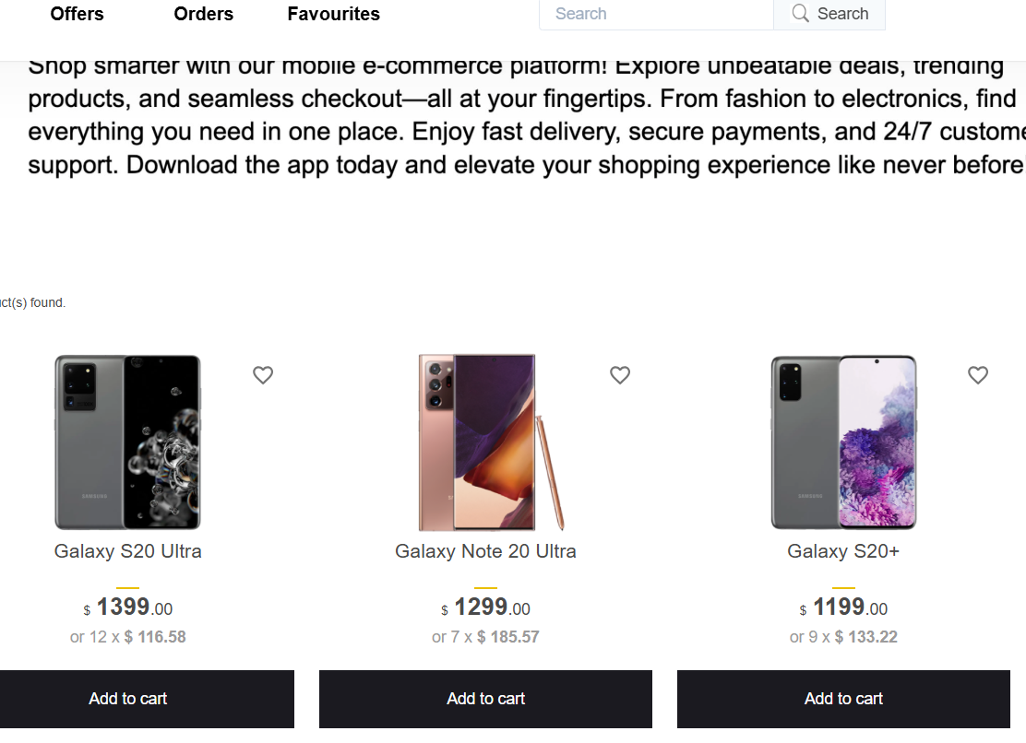

Slide 14
Challenges & Experience
Challenges:
I have ensured test data covered a wide range of products, brands, and prices.
Rechecking defects that only occurred on specific devices or browsers.
Experience:
Handling all modules myself gave me complete end-to-end testing exposure.
Gained experience in automating web applications using Cucumber (BDD) with Selenium WebDriver, writing test scenarios in Gherkin and mapping them to step definitions.
In-depth testing helped me uncover critical usability issues and improve collaboration between business and technical teams.

Slide 15
THANK YOU!

