Slide 1
Twilearn Internship Project
Budget Sales Analytics
AKSHAYA . L

Slide 2
OBJECTIVE
The objective of this project is to create a comprehensive dashboard that provides a clear overview of the "Domain Sale" process. which should extract and present various information related to the sales, budget, and variance of the domain sale process. Additionally, the dashboard should enable stakeholders to compare sales and budgets with various attributes.

Slide 3
PROJECT DETAILS
Project Title | Budget Sales Analytics
Technology | Data Science
Domain | Retail and Sales
Project Difficulty Level | Advanced
Programming Language Used | Python

Slide 4
DATA INFORMATION
➢ The Dataset was taken from Twilearn’s Provided Project
Description Document.
➢ The data was a combination of numerical and Categorical
values.
➢ I used Pandas, NumPy, Matplotlib, Seaborn and Plotly libraries

Slide 5
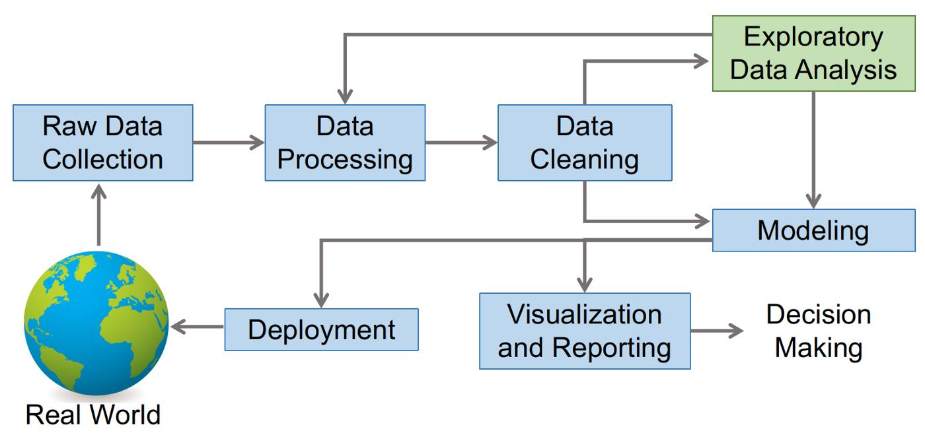
ARCHITECTURE

Slide 6
Key Performance Indicators (KPIs)
Key indicators displaying a summary of the Budget Sales Analysis and its relationship with
Different Metrics :
1. Customer Distribution by Age, Marital Status, Total Children
2. Customer and Sales Relation
3. Sales and Customer Distribution based on Countries and Commute Distance
4. Category and Sub-Category wise Distribution of Sales
5. Customers and Sales Distribution by Education, Occupation
6. Yearly Income of Customers and Sales
7. Profit and Budget Analys

Slide 7
THANKYOU

