Slide 1

Data Science Project-SpaceX
Akshay A
12-07-2024

Slide 2
Outline
Executive Summary
Introduction
Methodology
Results
Conclusion

Slide 3
Executive Summary
Methodologies
Data Collection through API
Data Collection with Web Scrapping
Data Wrangling
EDA with SQL
EDA with Data Visualization
Machine Learning Prediction
Results
EDA results
Predictive Analytics result

Slide 4
Introduction
•Project background and context
Space X advertises Falcon 9 rocket launches on its website with a cost of 62 million dollars;
other providers cost upward of 165 million dollars each, much of the savings is because
Space X can reuse the first stage. Therefore, if we can determine if the first stage will land,
we can determine the cost of a launch. This information can be used if an alternate company
wants to bid against space X for a rocket launch. This goal of the project is to create a
machine learning pipeline to predict if the first stage will land successfully.
•Problems you want to find answers
What factors determine if the rocket will land successfully?
The interaction amongst various features that determine the success rate of a successful Landing.
What operating conditions needs to be in place to ensure a successful landing program.

Slide 5
Methodology
Summary
• Data collection methodology:
• Data was collected using SpaceX API and web scraping from Wikipedia.
• Perform data wrangling
• One-hot encoding was applied to categorical features
• Perform exploratory data analysis (EDA) using visualization and SQL
• Perform interactive visual analytics using Folium and Plotly Dash
• Perform predictive analysis using classification models
• How to build, tune, evaluate classification models

Slide 6
Data Collection
The data was collected using various methods:
- Data collection was done using get request to the SpaceX API.
- Next, we decoded the response content as a Json using .json() function call and turn it
into a pandas dataframe using .json_normalize().
- We then cleaned the data, checked for missing values and fill in missing values where
necessary.
- In addition, we performed web scraping from Wikipedia for Falcon 9 launch records with BeautifulSoup.
- The objective was to extract the launch records as HTML table, parse the table and
convert it to a pandas dataframe for future analysis

Slide 7
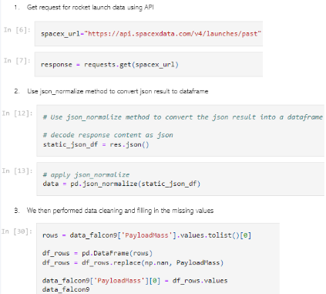
Data Collection – SpaceX API
We used the get request to the SpaceX API to collect data, clean the requested data and did some basic data wrangling and formatting.

Slide 8
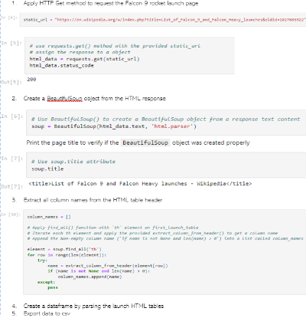
Data Collection - Scraping
We applied web scrapping to webscrap Falcon 9 launch recordswith BeautifulSoup
We parsed the table and converted it into a pandas dataframe.

Slide 9
Data Wrangling
•We performed exploratory data analysis
and determined the training labels.
•We calculated the number of launches at
each site, and the number and occurrence
of each orbits
• We created landing outcome label from
outcome column and exported the results
to csv.

Slide 10
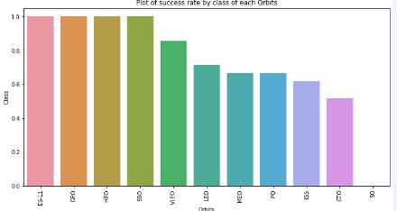
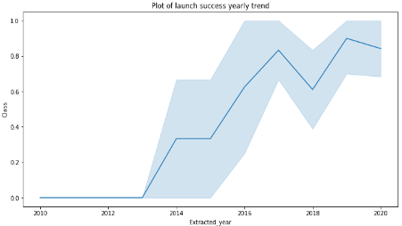
EDA with Data Visualization
We explored the data by visualizing the relationship between flight number and launch Site, payload and launch site, success rate of each orbit type, flight number and orbit type, the launch success yearly trend.

Slide 11
EDA with SQL
We loaded the SpaceX dataset into a PostgreSQL database without leaving
the jupyter notebook.
• We applied EDA with SQL to get insight from the data. We wrote queries to
find out for instance:
- The names of unique launch sites in the space mission.
- The total payload mass carried by boosters launched by NASA (CRS)
- The average payload mass carried by booster version F9 v1.1
- The total number of successful and failure mission outcomes
- The failed landing outcomes in drone ship, their booster version and launch site names.

Slide 12
Build an Interactive Map with Folium
• We marked all launch sites, and added map objects such as markers, circles, lines to mark the success or failure of launches for each site on the folium map.
• We assigned the feature launch outcomes (failure or success) to class 0 and 1.i.e., 0 for failure, and 1 for success.
• Using the color-labeled marker clusters, we identified which launch sites have relatively high success rate.
• We calculated the distances between a launch site to its proximities. We answered
some question for instance:
- Are launch sites near railways, highways and coastlines.
- Do launch sites keep certain distance away from cities.

Slide 13
Predictive Analysis (Classification)
• We loaded the data using numpy and pandas, transformed the data, split our data into training and testing.
• We built different machine learning models and tune different
hyperparameters using GridSearchCV.
• We used accuracy as the metric for our model, improved the model using feature engineering and algorithm tuning.
• We found the best performing classification model.

Slide 14
Results
• Exploratory data analysis results
• Interactive analytics demo in screenshots
• Predictive analysis results

Slide 15
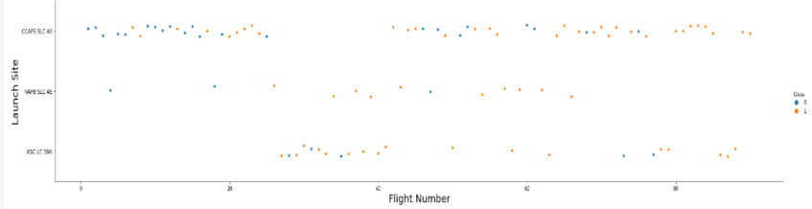
Flight Number vs. Launch Site
we found that the larger the flight amount at a launch site, the greater
the success rate at a launch site

Slide 16
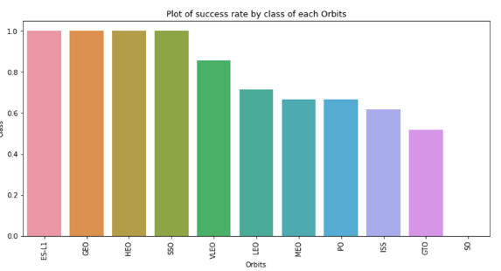
Success Rate vs. Orbit Type
• From the plot, we can see that ES-L1, GEO, HEO, SSO,
VLEO had the most success rate.

Slide 17
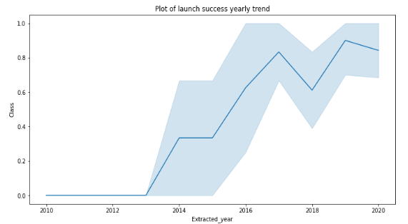
Launch Success Yearly Trend
• From the plot, we can observe that success rate
since 2013 kept on increasing till 2020.

Slide 18
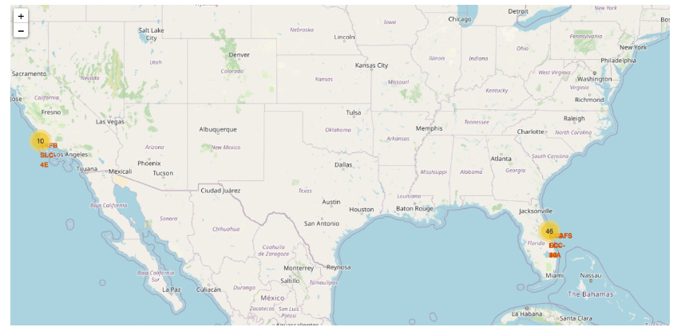
All launch sites global map markers

Slide 19
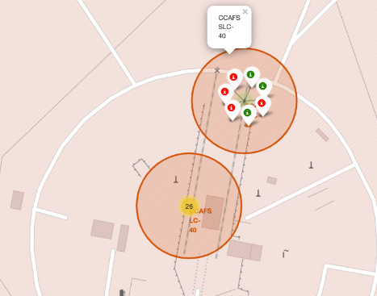
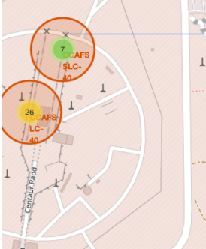
Markers showing launch sites with color labels

Slide 20
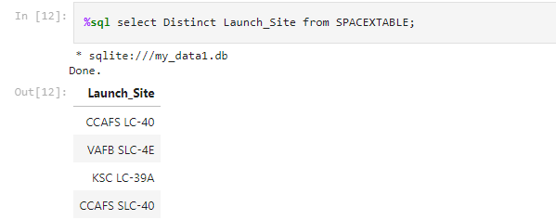
All launch site name
We used the key word DISTINCT to show only unique
launch sites from the SpaceX data.

Slide 21
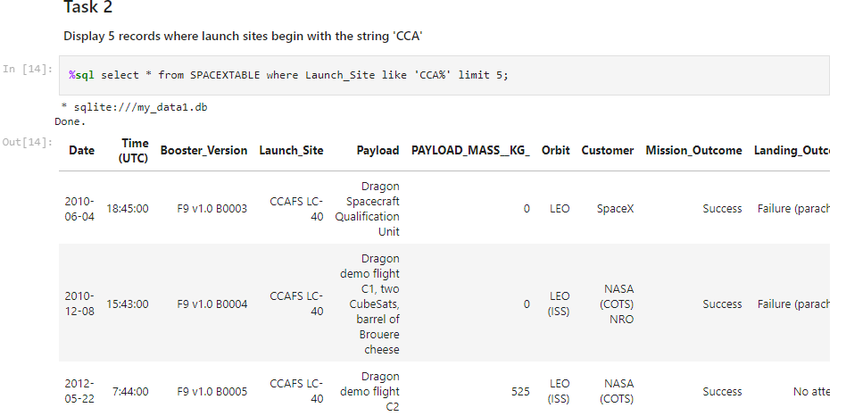
Launch Site Names Begin with 'CCA'
We used the query below to display 5 records where launch sites begin with `CCA`

Slide 22
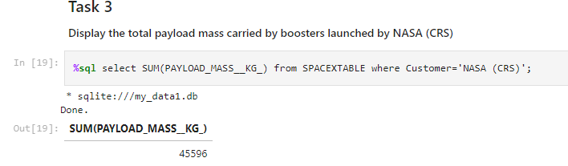
Total Payload Mass
• We calculated the total payload carried by boosters from NASA using the query below:

Slide 23
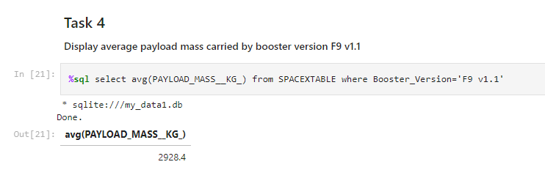
Average Payload Mass by F9 v1.1
We calculated the average payload mass carried by booster version F9 v1.1 as 2928.4

Slide 24
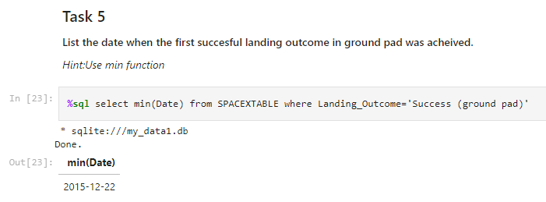
First Successful Ground Landing Date
We observed that the dates of the first successful landing outcome on ground pad was 22nd December 2015

Slide 25
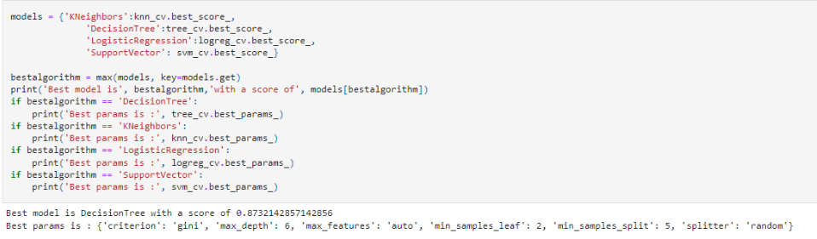
Classification Accuracy
The decision tree classifier is the model with the highest classification accuracy

Slide 26
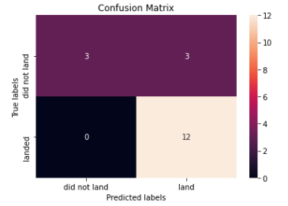
Confusion Matrix
The confusion matrix for the decision tree
classifier shows that the classifier can
distinguish between the different classes.
The major problem is the false positives .i.e.,
unsuccessful landing marked as successful
landing by the classifier.

Slide 27
Conclusions
We can conclude that:
• The larger the flight amount at a launch site, the greater the success rate at a launch site.
• Launch success rate started to increase in 2013 till 2020.
• Orbits ES-L1, GEO, HEO, SSO, VLEO had the most success rate.
• KSC LC-39A had the most successful launches of any sites.
• The Decision tree classifier is the best machine learning algorithm for this task.

Slide 28
Thank you

