Slide 1
IBM University Engagement Project Submission
“Exploring the Power of Agentic AI with IBM Granite and LangFlow”

Slide 2

Project Tile – AI-Powered Telecom Training Assistant
Domain of Project – Education
Student Name | Recent Passport Photo | Email ID | Mobile number [WhatsApp]
AKSHAYA N R |  | akshayar719@gmail.com | 6238608788

Slide 3
Problem Statement -
The Challenge
Telecommunication concepts such as networking, OSI model, optical fiber communication, and 5G technology are often spread across textbooks, lecture notes, and technical documents. Students spend significant time searching for reliable information and may struggle to understand complex concepts. Traditional learning methods do not provide personalized guidance or instant explanations.
Objective
Develop an AI-Powered Telecom Training Assistant using IBM watsonx.ai, IBM Granite Models, LangFlow, and Retrieval-Augmented Generation (RAG) that:
Explains telecom concepts in simple language.
Answers questions using uploaded telecom documents.
Summarizes technical topics.
Generates quizzes for self-assessment.
Provides accurate, document-based responses.
Supports interactive learning for students and professionals.

Slide 4
Proposed Solution -
The proposed AI-Powered Telecom Training Assistant is a Retrieval-Augmented Generation (RAG) based intelligent learning system built using IBM watsonx.ai, IBM Granite Models, LangFlow, and IBM Cloud.
The system retrieves relevant information from uploaded telecommunication documents such as OSI Model, Optical Fiber Communication, and 5G Technology. It uses a vector database to search document embeddings and IBM Granite Models to generate accurate, context-aware responses.
The assistant can:
Answer telecom-related questions.
Explain technical concepts.
Summarize uploaded documents.
Generate quizzes.
Support interactive learning through conversational AI.
This solution provides a reliable and efficient learning platform while ensuring responses are based only on the uploaded knowledge base.

Slide 5
Technology Used
LangFlow
Visual platform for designing and orchestrating AI workflows.
IBM Granite Models
Provides natural language understanding, reasoning, summarization, and question answering.
IBM watsonx.ai
Used for AI model deployment and inference.
IBM Cloud
Provides secure and scalable cloud infrastructure.
Retrieval-Augmented Generation (RAG)
Retrieves relevant information from uploaded telecom documents before generating responses.
Vector Database (FAISS/ChromaDB)
Stores document embeddings for semantic search.
PDF Knowledge Base
Contains telecom learning materials including OSI Model, Optical Fiber Communication, and 5G Technology

Slide 6
Langflow component Used -
Chat Input Accepts user questions related to telecommunication
IBM watsonx AI Agent Processes user queries using IBM Granite Models.
IBM Granite 4.0 Model Generates intelligent, context-aware responses.
Knowledge Base Stores telecom PDF documents for retrieval.
Retriever (RAG) Retrieves relevant document chunks.
Chat Output Displays accurate explanations and answers.

Slide 7

Role of Agentic AI in the solution
Agentic AI enables the Telecom Training Assistant to function as an intelligent educational companion rather than a simple chatbot. It coordinates multiple tasks such as understanding user intent, retrieving relevant knowledge, reasoning over the retrieved information, and generating meaningful responses
.
Unlike conventional AI systems that rely only on pre-trained knowledge, the assistant uses Retrieval-Augmented Generation to access uploaded telecom documents before producing an answer. This improves the accuracy and relevance of responses while reducing incorrect or hallucinated information.
The assistant can explain technical concepts, summarize documents, generate quizzes, and provide personalized learning assistance based on the user's queries. Agentic AI continuously improves the interaction by combining retrieval, reasoning, and response generation into a single intelligent workflow, making learning more effective and engaging.

Slide 8
Novelty and Uniqueness
The AI-Powered Telecom Training Assistant introduces a modern approach to technical education by combining Retrieval-Augmented Generation with IBM Granite Models. Unlike traditional chatbots, it retrieves information directly from uploaded telecom documents before generating responses, ensuring high accuracy and reliability.
The system explains complex topics in simple language, generates quizzes for self-assessment, summarizes lengthy documents, and supports conversational learning. It is easy to update by uploading new learning materials, making it scalable for future technologies such as IoT and 6G.
The use of IBM watsonx.ai, LangFlow, semantic search, and vector databases creates an intelligent learning platform that provides personalized and document-based educational support.

Slide 9
Git Hub Link
Repository Name: AI-Powered-Telecom-Training-Assistant
Github URL https://github.com/akshayanr2005/AI-Powered-Telecom-Training-Assistant
·
·
·

Slide 10
Future Scope
The AI-Powered Telecom Training Assistant can be extended with several advanced features in the future. Voice-based interaction can enable hands-free learning using speech recognition and text-to-speech technologies. Multilingual support can make the system accessible to students from different linguistic backgrounds.
The assistant can be integrated with networking simulators to provide practical demonstrations alongside theoretical explanations. Future versions may include personalized learning recommendations, adaptive quizzes, progress tracking, and AI-generated study plans.
Support for emerging technologies such as Internet of Things (IoT), Software Defined Networking (SDN), Cloud Networking, and 6G Communication can further enhance the assistant and make it a comprehensive learning platform for telecommunication education.
·
·
·

Slide 11
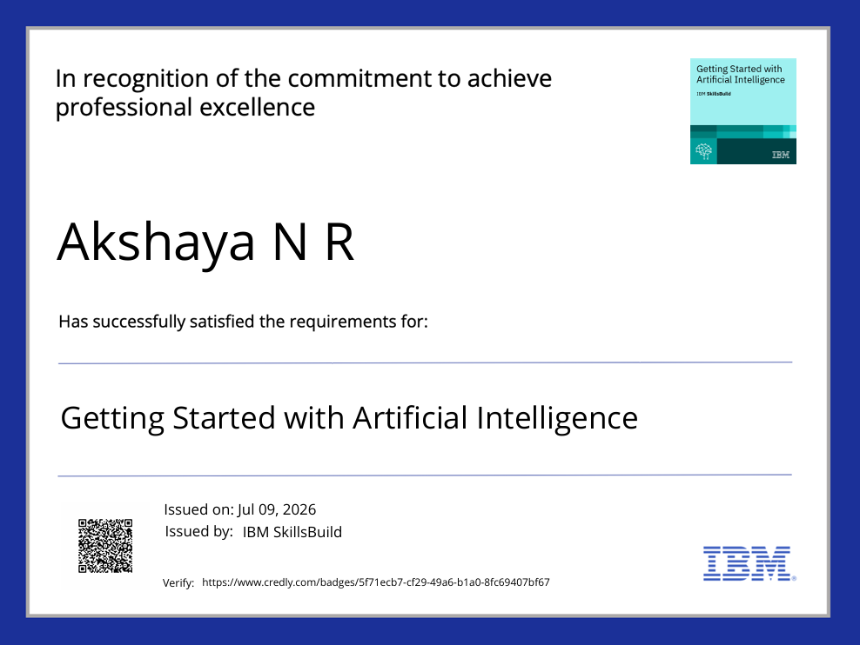
Certificates Earned:

Slide 12
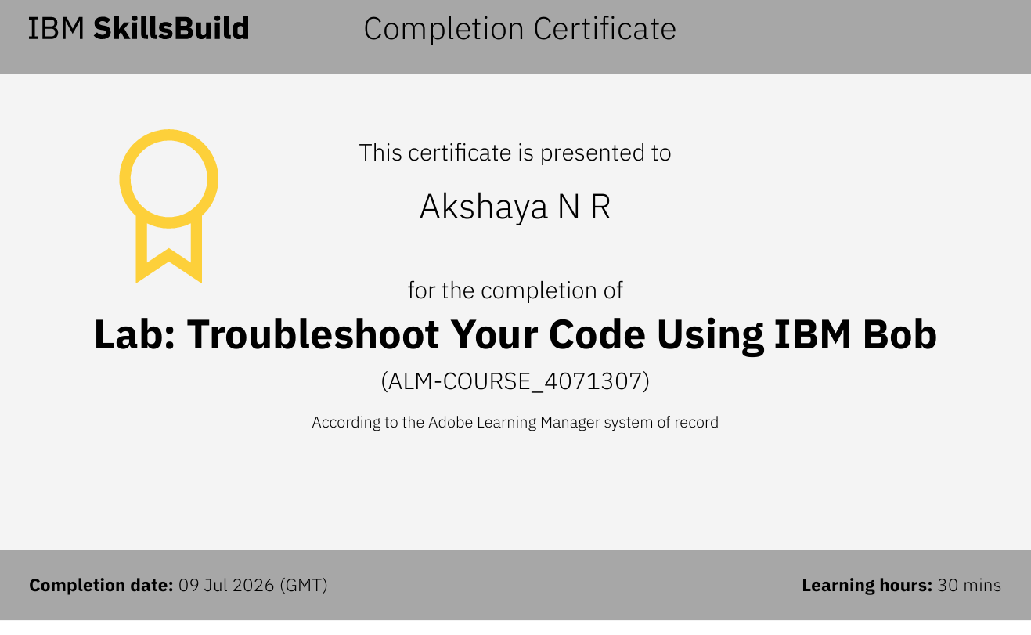
Certificates Earned:​

Slide 13


