Slide 1
MRA- Market Basket Analysis Milestone 2
By
Akshaya Parthasarathy
DSBA July-E_2020

Slide 2
Table of Content
Executive Summary
Initial Data Analysis
Overview - Exploratory data analysis
Market Basket Analysis
Offers and Recommendations
Summary and Limitations

Slide 3
Executive Summary
This project conduct an analysis of Point of Sales(POS) data for providing recommendations through which the grocery store can increase its revenue by popular combo offers and discounts for customers.
In the dataset, there are 20,641 data rows of transactional records containing details of products purchased in 1139 orders. Data is collected from 2018-2020 for the months January to September. There are 37 different products available which has been grouped into 8 product categories.
This study applies Market Basket Analysis (MBA) to look into the relationships through these transactions of product combinations. The result suggests that poultry, dinner rolls are the popular items of all. Customers who buy dinner rolls, spaghetti sauce tend to buy poultry. There are 24 association rules based on products and 30 association rules based on product category. With these rules, the grocery store could use cross-selling, up-selling or bundling of products to increase the sales.
More recommendations are described in the last section of the report.
Problem statement
Data Analysis
Market Basket Analysis

Slide 4
Initial and Exploratory Data Analysis
Given dataset contains 20,641 rows and 3 columns (date, order id and products).
Dataset does not contain any null or duplicate values.
Data is collected from 2018 January to 2020 February. There is a gap of three months (fourth quarter) for both the years 2018 and 2019.
There are 37 different products offered by the grocery stores. These items have been grouped into 8 product categories namely dairy, meat/eggs, bakery, toiletries/cleaning, dry food grocery, kitchen extras, fruits/frozen items and bottled items. The product categories are mainly for analysis purposes. Association rules are based on individual products.
Out of 1139 orders, all the products are present in at least 32% of the orders among which poultry product is present in 42% of the orders.
Average of total products per order is 18. The highest product count per order is 34 (order ids: 1071, 1013, 957, 226) while the lowest product count is 3 (order ids: 1139,408).
Insights are derived from initial analysis of the dataset using KNIME and tableau for visualisations.

Slide 5
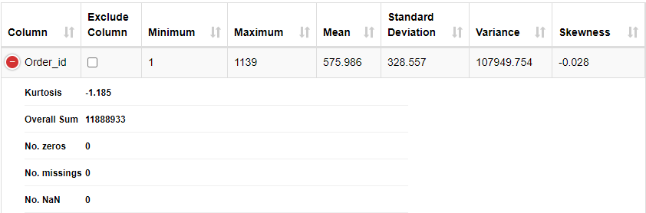
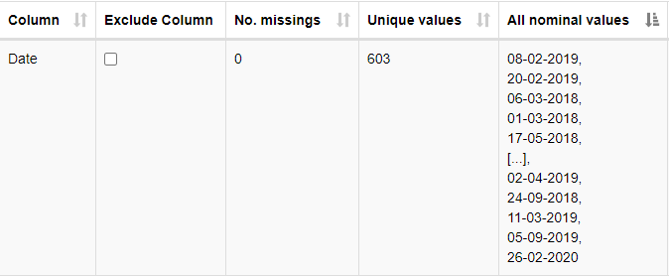
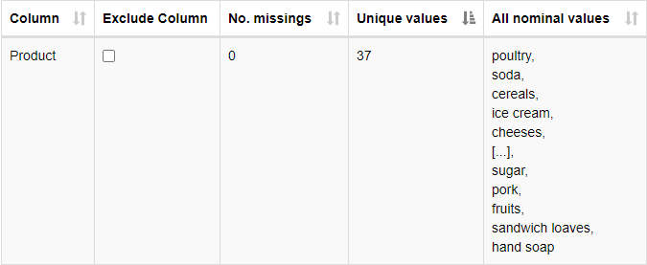
Information of the dataset and Univariate analysis:
Dataset does not contain any null or duplicate values or missing values.
As we can see that there are a total of 1139 individual orders placed.

Slide 6
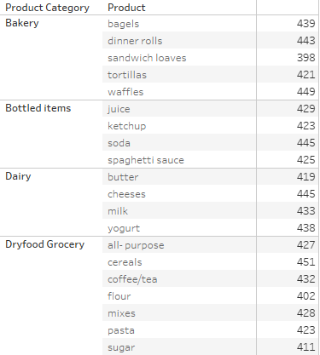
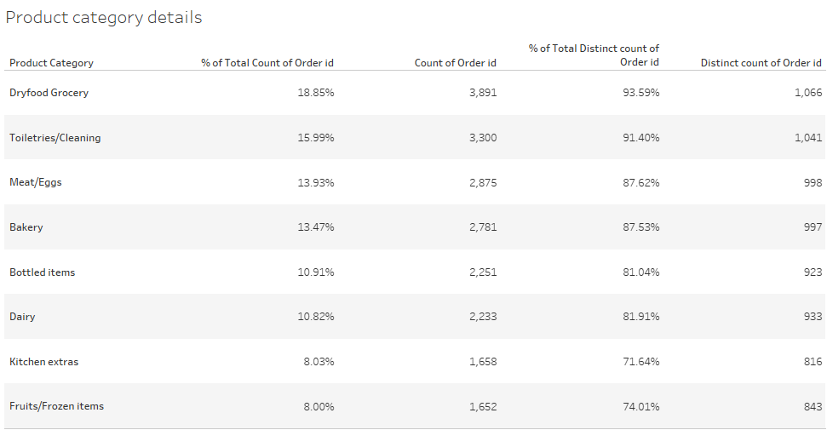
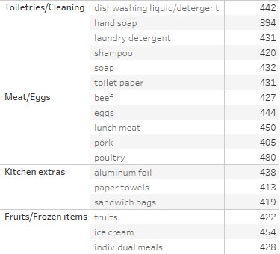
The entire product list has been divided into 8 group as shown above.
As we can see that dry food groceries consists of 7 items in total hence the high contribution among order count. And most of the products have been in at least 400 of the orders placed, hence we can say that the grocery story has a steady outgoing of all products. There is not one product which stands out in terms of highest/lowest bought ones.
Because of this non distinction and to promote the products as well, Association rules will be best fit in order to group the products and come up with combo offers.
Poultry is found to be the hit of the store. Handmade soaps are a little behind. This can be used when association rules are performed.

Slide 7
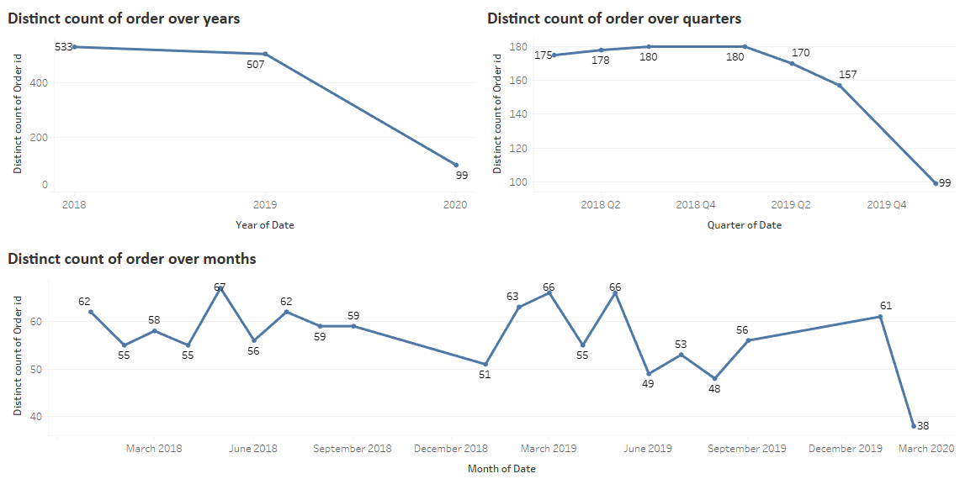
Since we have data for effectively two years only (2018,2019), count of orders over two years will not give a quantifiable output to identify trends present in the data. But we can see that orders count have reduced from 2018 to 2019, from 533 orders to 507 orders.
While looking at the quarterly plot, we can observe that orders being placed has significantly decreased for the third quarter of 2019 which constitutes to the overall decrease in orders for 2019.
For both the years 2018 and 2019, fourth quarter data is not present. Maybe because of the holidays or inventory of stock.

Slide 8
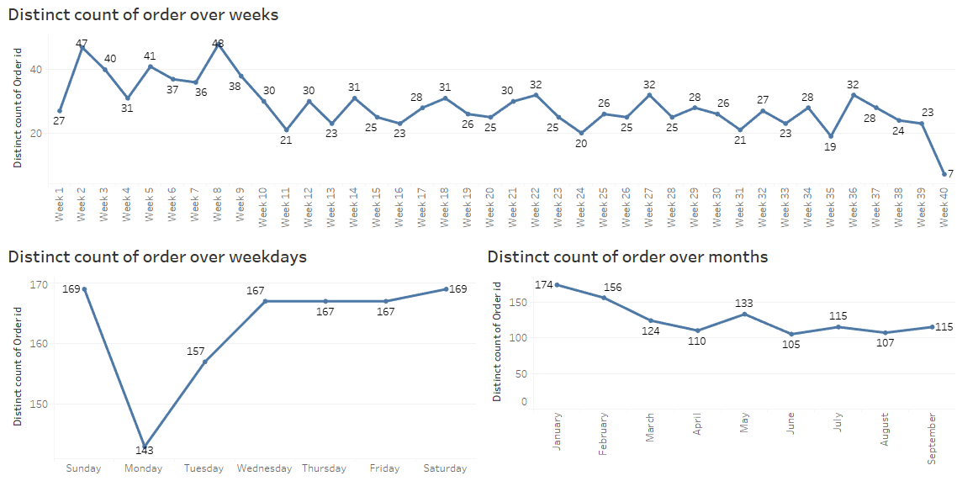
Initial weeks of the year are having slightly higher distinct count of orders is due to the dataset structure. We have data for the first two months of 2020 which gives the boost to these months and weeks correspondingly than other months. Other that that there is no visible trend observed in the dataset.
However, we can see that Monday sees the least number of orders than order days of the week. Weekends have a little more orders than compared to rest of the weekdays. Choosing to give the offers and recommendations on weekends would be a good strategy to move forward.

Slide 9
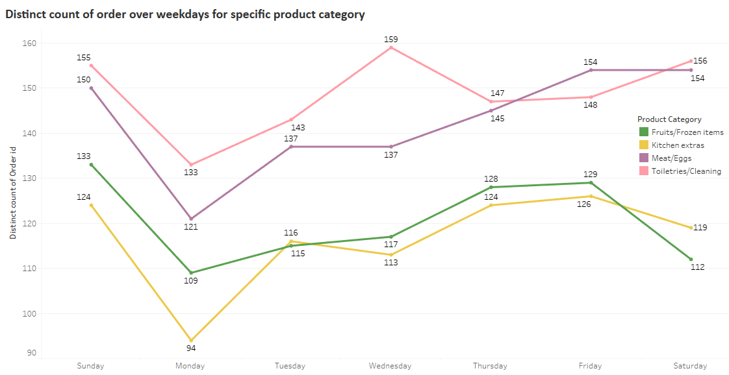
Fruits/Frozen items and Kitchen extras category has highest number of orders on Thursday, Friday and Sunday.
Meat/Eggs category is on Friday, Saturday and Sunday.
Toiletries/Cleaning category has highest number of orders on Wednesday, Saturday and Sunday.
Monday seems to have the lowest order numbers for all the categories.
Introducing combos and offers on these specific days with the corresponding items could give a boost to the sales of products in the store.

Slide 10
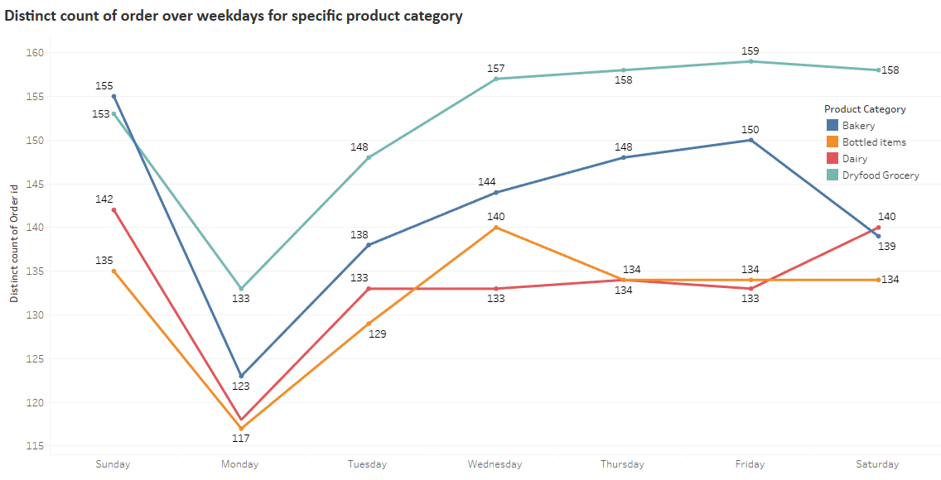
Bakery category sees highest sales on Friday and Sunday.
Bottled items are on Wednesday.
Dairy products are bought maximum during Saturday and Sunday.
For dry food grocery items, other than Monday, all other days has no major change in number of orders places. Since these are staple items, combining other category with this items can be a good offer.

Slide 11
Market Basket Analysis
Market Basket Analysis is a process that looks for relationships among entities and objects that frequently appear together. For the purpose of customer centricity, MBA examines collections of items to identify affinity that are relevant within the point-of-sale transactions.
Grocery store can use this affinity grouping of multiple products as an indication that customers are predisposed to buy certain sets of products at the same time.
The first step in Market basket analysis is to infer association rules, which expresses products that are frequently purchased together. Using this method in our problem would help the store to discover buying habits and developing marketing insights such as cross-selling/up selling. Customers may be willing to buy more when certain products are bundled together.
Using association rules strategy, next product the customer purchases or how to bundle the products to create combo offers can be interpreted using support, confident and lift.
Association rule is basically expressed as, X → Y
Support – It is the percentage of transactions that comprise all of the items in a dataset. The more the support value the more frequently the product occurs. High support values are preferred for ample amount of future transactions.
Confidence - It is the probability that a transaction that contains the items on the left hand side(X) also contains the item on the right hand side(Y). The more the confidence value, the greater the likelihood that the product on the right hand side will be purchased.
Lift - Lift is the ratio of Confidence to Support. It is the probability of all of the products in a rule occurring together by the product of the probabilities of the items on the left and right hand side occurring as if there was no association between them.
Association rule analysis is done using KNIME.

Slide 12
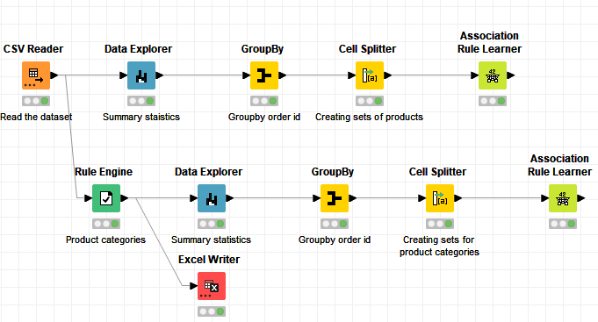
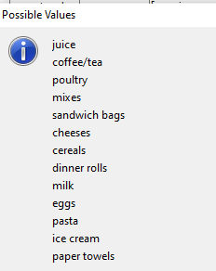

KNIME WORKFLOW
Consequent items for recommendations:
Support and confidence level used for creating Association rules
For a rule to be considered and to make meaning business decisions, both support and confidence are important. A minimum support value of 5% and minimum confidence of 60% is chosen initially to come up with combos from the transactions.
This gave us a set of 24 rules.

Slide 13
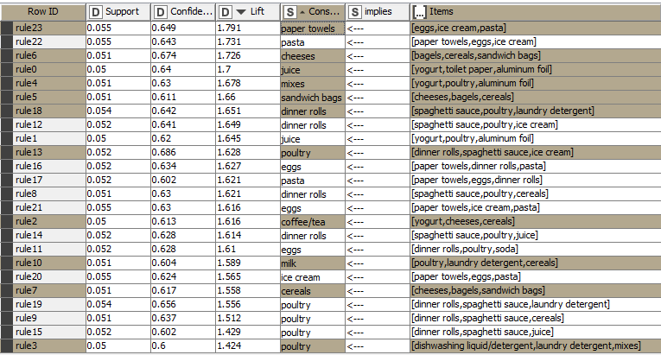
This table allows us to view the rules ascending or descending based on lift, confidence and support.
We could see that in rule index 23, lift for ‘eggs, ice cream, pasta’ and ‘paper towels’ is 1.791, which suggests that people who buy one item is likely to purchase the other compared to picking customers at random to provide offers. There are several trivial rules which are found with high confidence, support and lift – but the products are reversed. Hence including one rule alone is recommended.
Poultry, dinner rolls are some of the most popular item which has been bought with almost all combinations. An interesting one to note is the combination of ‘dishwashing liquid/detergent’ and poultry.

Slide 14
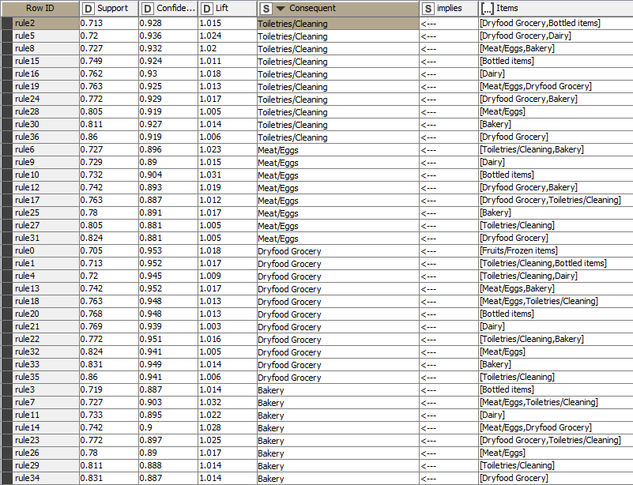
Association rules for product category
Association rules for the product category has been created with a minimum support of 70% and confidence of 85%. Since the products are grouped together, minimum support of a product category is 70% as all the orders contain at least one product under a particular category.
This has been done to come up with combo offers for particular category and to set up offer days in which these categories can be sold for a discount rate.
There are four category of products which has resulted as an output from the association rules created.

Slide 15
Offers and Recommendations
It will be productive to run promotional and marketing campaigns with the help of the associative rules. Based on the prediction of the next product, customers can be given additional offers by bundling the products together for a lesser price and customize the products based on the association rules. Examples:
Dinner rolls, spaghetti sauce and poultry can be bundled and offered in a combo. Since customers who sets out to buy either one of these will end up buying all three because of the offer.
Eggs, ice cream, pasta and paper towel has a good lift. Customer buying the first three tend to buy the fourth item as well. In this case, offering paper towel at a discounted rate if the customer has at least one of the items already in the basket could give a boost.
Yogurt and juice combo offer – buying one item at half rate when other one is purchased.
There is an interesting association rule which came up, that is dishwashing liquid/laundry detergent implies poultry. This can be incorporated by giving a coupon for poultry or any of the popular product for those customers who got the toiletries. This might induce the customer to buy immediately or at a later point.
There are some offers which can be given product category wise. Examples:
Toiletries/Cleaning category products can be sold under ‘Buy two Get one free’ on days in which their sales are high, in this case Wednesday. By doing so, we will be attracting the customers urging to go for the second product.
Same goes with Meat/Eggs category, giving a discounted offer on eggs when customers has meat products purchased on Saturday/Sunday.
Bakery and Dairy category has a stronger relation which can be used to provide offers.

Slide 16
Summary
This report reveals insights about the customers and orders which can contribute in revenue maximization is used properly. The discovery of supplementary or complementary products can lead to promotional or cross selling opportunities.
Here, we have reduced the less frequent items by setting minimum threshold for support and confidence. Graphs are used to depict the pattern on products bought by the customers. With more data and price details, we will be able to easily identify which association rules are more active. However, generated insights can be used as a starting point for the grocery store to plan their marketing strategies.
Limitations
Dataset consists of only order id and product details, even thought that is good enough to start off with for initial grouping of products and identifying combinations. More product wise details like price, brand could help to come up with interesting and unique offers.
Thresholds for support and confidence doesn’t have any specific criteria to decide. Chosen values are based on personal knowledge of the domain.

Slide 17
Conclusion
In conclusion, the marketing recommendations are not only for poultry, dinner roles or toiletries. This could be applied for all association rules. The analysis could go more in detail if there are some more attributes of the product given which could increase the effectiveness of solving the problem.

