Slide 1
MRA- Automobile Sales Segmentation
By
Akshaya Parthasarathy
DSBA July-E_2020

Slide 2
Table of Content
Executive Summary
Initial Data Analysis
Sales overview – Exploratory data analysis
Customer Segmentation using RFM
Inferences
Segment Recommendations

Slide 3
Executive Summary
This project aims to find the underlying buying patterns of customers based on past 3 years of transaction data and hence recommend customized marketing strategies for different segments.
In the dataset, there are 2747 data rows of customer records for the past three years. There are 89 unique customers spread across 19 countries.
The report applied RFM analysis for the automobile sales part manufacturing data, scoring each customer based on recency – how recent did a customer visit a store, frequency – how often did the customer ordered, and monetary – how much did the customer order (price each * quantity ordered). Combining these three scores as RFM could provide a mapping and help us understand customers in different aspects.
Problem statement
Data Analysis
RFM Analysis

Slide 4
Initial and Exploratory Data Analysis
Given dataset contains 2747 rows and 20 columns.
Dataset does not contain any null or duplicate values.
Out of 7 numerical variables, three are of importance (sales, quantity ordered and price each) and they contain outliers. (No treatment for outlier is performed since we are focused on segmentation)
There are 7 different product lines offered by the company. Among these product lines major chunk of orders are for parts related to domestic vehicles (cars and motorcycles)
89 unique customers have placed ordered in which Euro Shopping channel is the highest.
Sales of automobile parts are spread across the globe.
Maximum orders are placed by the customers in USA which are dispersed across cities. Looking at city wise orders Madrid is the highest.
Insights are derived from initial analysis of the dataset using python and tableau for visualisations.

Slide 5
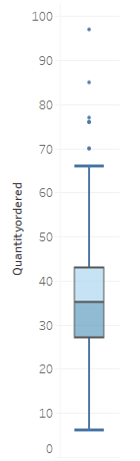
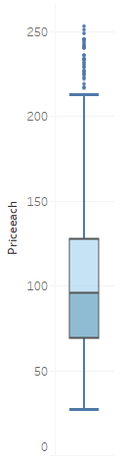
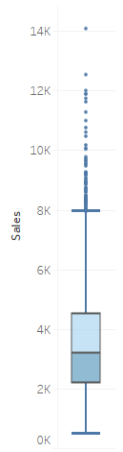
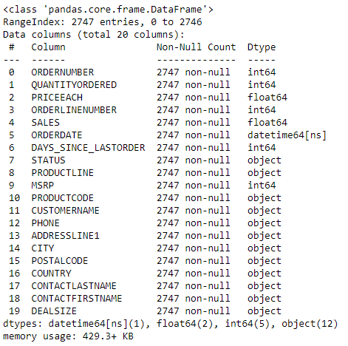
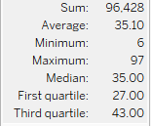
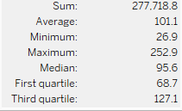
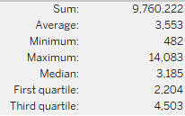
Information of the dataset:
Univariate analysis:
Out of 7 numerical variables, three are of importance (sales, quantity ordered and price each) and they contain outliers. (No treatment for outlier is performed since we are focusing on segmentation)

Slide 6
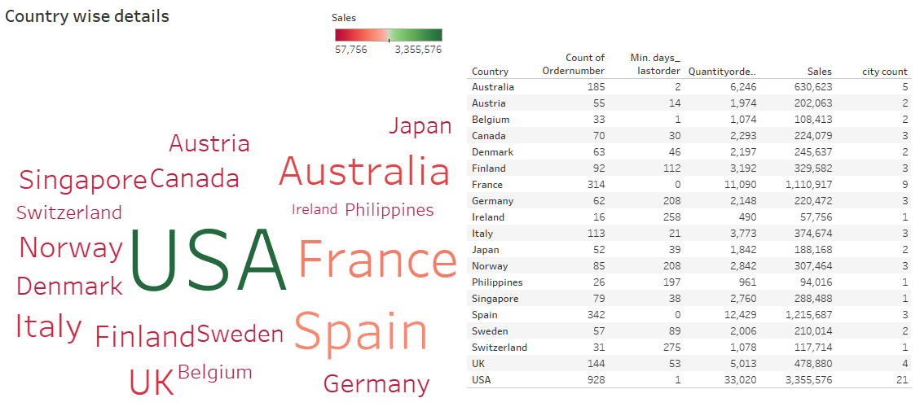
Left side word map shows the countries which has placed orders. Color shows the sum of sales and size shows the count of orders.
Country wise table contains count of orders, min days since last order, sum of quantity ordered, total sales and total number of city in that particular country.
USA has given highest sales followed by Spain and France.
Spain and France has ordered recently followed by USA and Belgium.

Slide 7
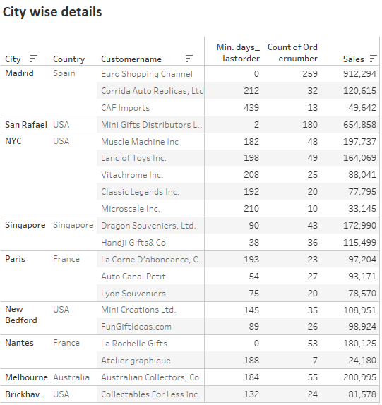
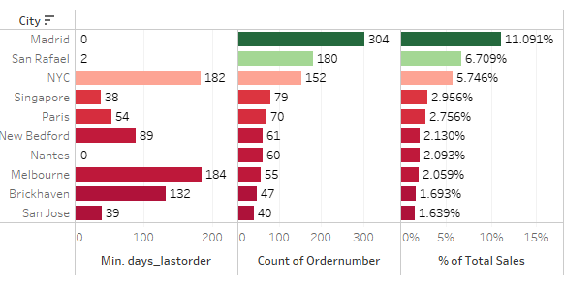
Both the plots are showing top 10 cities based on sales.
Madrid’s share of total sales is 11.09% with 304 orders.
Euro Shopping Channel happens to be the highest contributor among the customers present in Spain and it has purchased recently.
Even though USA has comparatively more number of orders and highest sales totally, it is dispersed across 21 cities. On the other hand, Spain has only 3 cities in which products are being bought.

Slide 8
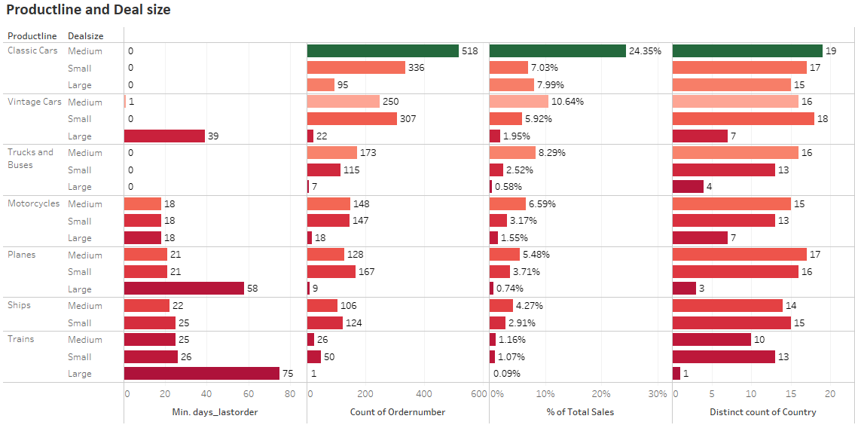
All the countries buy parts for Classic Cars product line and medium size which resonates with the highest % of total sales, number of orders and the recency.
On the other hand, Large Train parts has been ordered by only one country that too not recently. Hence, we can say that easy moving parts are the ones which are used by domestic vehicles (like cars and motorcycles) whereas parts related to heavy duty automobiles are less frequently bought and also does not contribute much to the total sales of the company.
Even among cars, Classic cars, Trucks and buses have been purchased recently rather than large vintage cars.

Slide 9
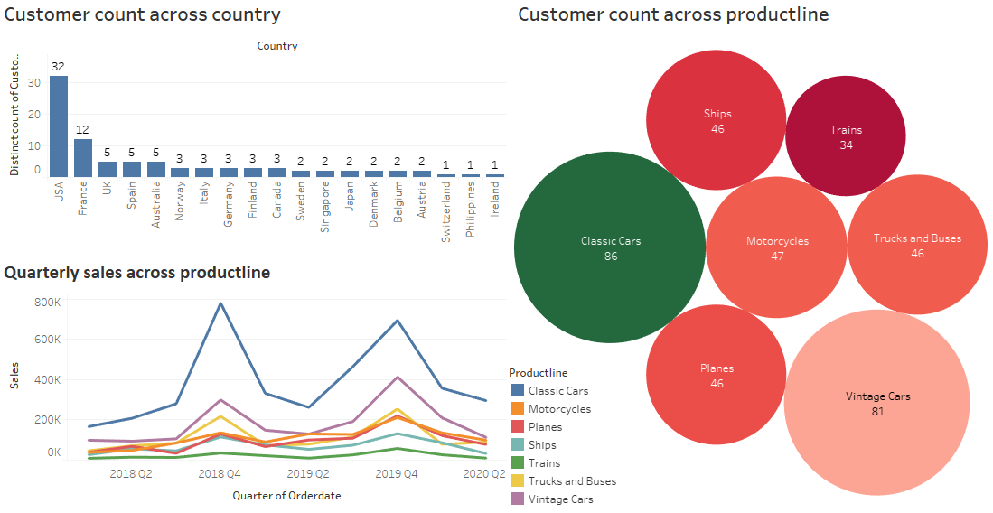
There are 32 customers in USA alone whereas Switzerland, Philippines and Ireland have only 1 customer each.
Out of 89 customers, 86 customers orders parts for Classic cars.
Second plot gives an idea about which product lines generates the highest sales, evidently it is Classic cars, rest of the product lines does not contribute as high as above.

Slide 10
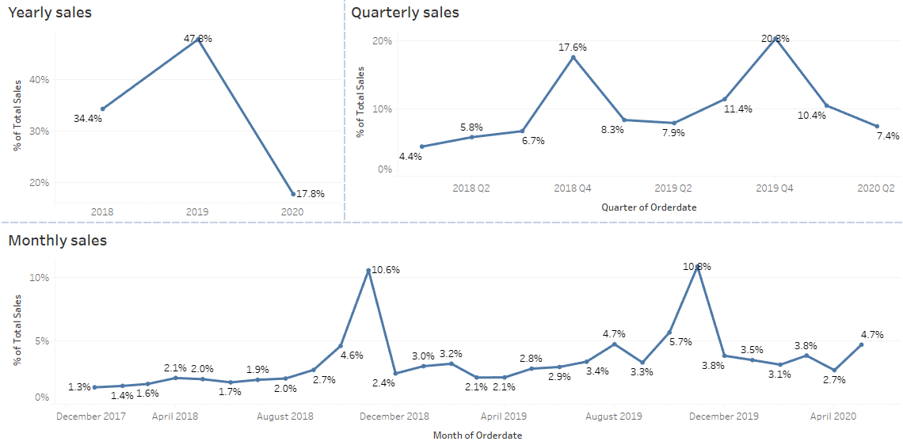
Dataset contains transaction data starting from January 2018 till May 2020. Hence considering the data till January of 2020 in order to have two entire cycle.
Yearly sales shows an increase in trend from 2018 to 2019. Since data for 2020 ends in May, we cannot be certain about the increasing trend.
Quarterly sales shows a pattern present. Increase in sales in observed in fourth quarter of each year and that increase is little higher in 2019 showing multiplicative seasonality at a very small rate.
Monthly sales shows a peak in November with the sales going up to 10.6% in 2018 and 10.8% in 2019. If the trend and seasonality continues we can see a peak in November of 2020 as well.

Slide 11
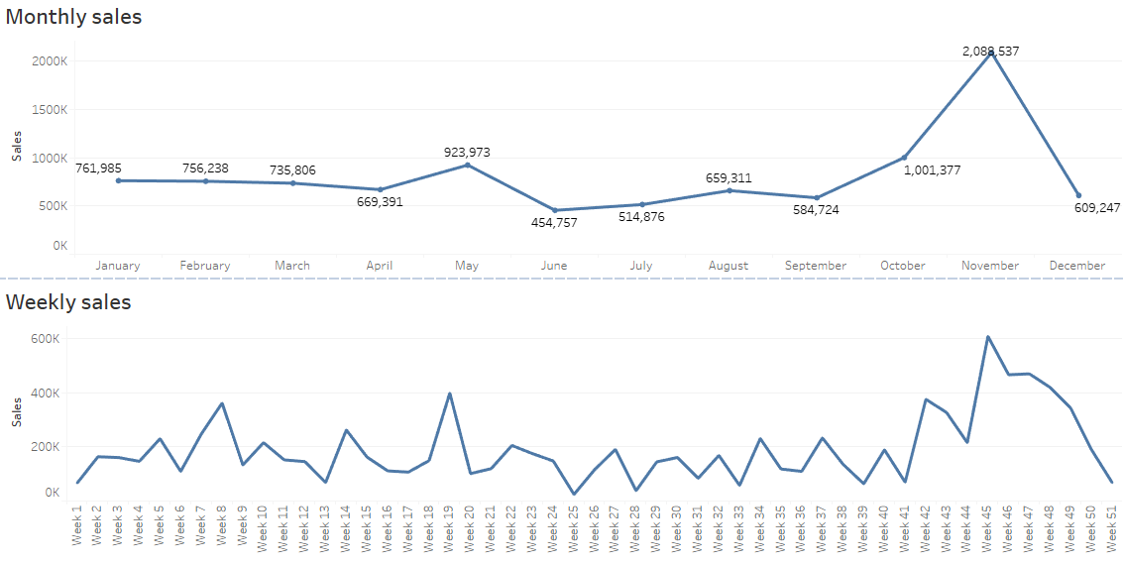
These two are discrete plots of monthly and weekly sales.
As we can see November month has the highest total sales and specifically week 45.

Slide 12
Customer Segmentation using RFM
Three key assumptions for RFM analysis:
Customers who have purchased from manufacturing company recently are more likely to make a purchase in the near future – Recency.
Frequent buyers are more likely to make another purchase than less frequent buyers – Frequency.
Big spenders are more likely to spend more money in the future than low spenders – Monetary.
This report is based on RFM key assumptions to identify customer segments according to RFM scores and characterize their purchasing behaviours.
Analysis variables that are set are – Recency, Frequency, Monetary, RFM score(concatenated values). Each variable divides the data into four quantiles (0-0.25, 0.25-0.5, 0.5-0.75, 0.75-1).
Four bins are created Bin1, Bin2, Bin3, Bin4 and assigned a value of 1,2,3,4 respectively.
For recency, days are calculated using max(order date). 4 being the recent purchased order and 1 being the farthest purchased order.
Frequency is the number of orders placed. 4 for highest count of orders and 1 for lowest count.
Monetary value is the sum product of quantity ordered and price each. Customers with high sales has a monetary value of 4, while customers with low sales has a monetary value of 1.
RFM score is the concatenated value. 444 represents best customers with high recency, frequency and monetary. 111 denotes to gone customers with low RFM.
RFM analysis is done using KNIME.

Slide 13
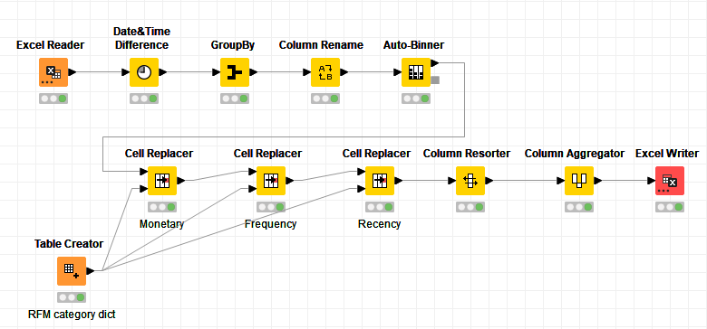
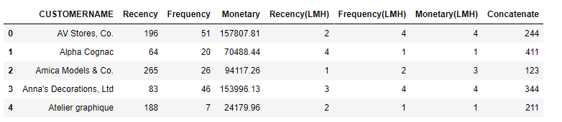
KNIME WORKFLOW
Dataset is grouped by Customer name. There are a total of 89 unique customers.
Recency, Frequency and Monetary columns have been created by binning the customers into four bins.
For Frequency and Monetary, Bin1 – 1, Bin2 – 2, Bin3 – 3 and Bin4 – 4.
For Recency, Bin1 – 4, Bin2 – 3, Bin3 – 2 and Bin4 – 1.
RFM score is found out by concatenating the above values and grouped according to the assumptions which were made initially.
Output head

Slide 14
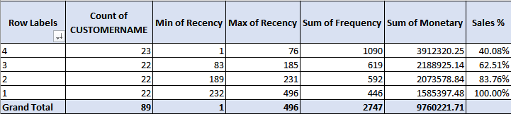
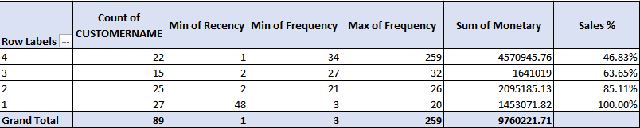
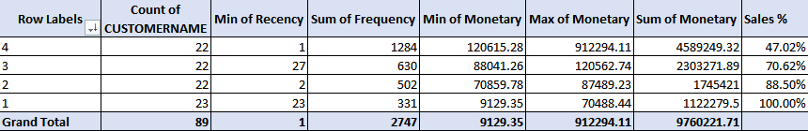
Summary statistics of Recency bins
The dataset is into four quantiles more equally when recency or monetary is set as an analysis variable than frequency.
One fourth of the customers have purchased from the company within three months with a total sales value of 40% and have placed maximum orders.
Customers who have not placed a lot of orders are not the recent ones and they only contribute to 15% of total sales.
Three fourth of the customers corresponds to 88.5% of total sales.
Summary statistics of Frequency bins
Summary statistics of Monetary bins

Slide 15
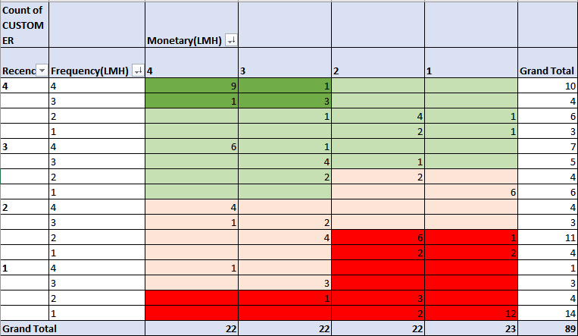
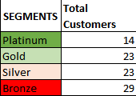
Segments from the output
Tabular column is constructed by using Pivot table from Excel and four segments have been created based on the RFM values.

Slide 16
Segments Description and Recommendations
Platinum
These are the top customers who are current, frequent and generate huge sales. Focusing on value added offers through product recommendations of previous orders.
Gold
Gold represents active and emerging customers who either generate continuous sales or place lots of orders. Consider rewarding these customers with free shipping benefits, premium offers on luxury products and cross/up-selling.
Silver
This represents unsteady customers or at-risk customers who are non current but partly place lots of orders or generate huge sales. Focus on creating loyalty and offering incentives tied to specific threshold on the sales.
Bronze
These are potential lost customers or inactive customers who churned as they are non current, rare and not contributing to sales. Focusing on these customers will be a strain on the resources since they are long gone and the purchase might have been just one time.

Slide 17
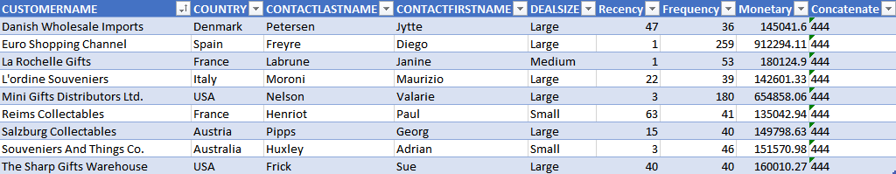
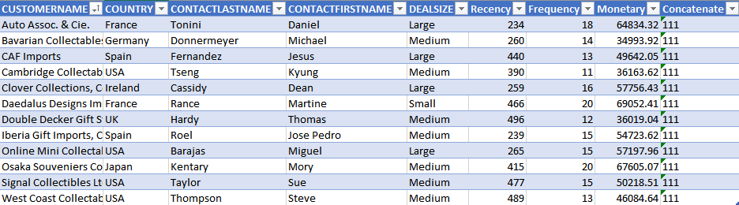
Identifying customers
Best customers
Highly engaged customers who have bought most recently, most often and generated the most sales. Typically customers having 444 RFM score.
Lost customers
Customers who did not purchase recently. They leave for a variety of reasons depending on the price deals, new product launches. Typically these are the customers who have least RFM score, 111.

Slide 18
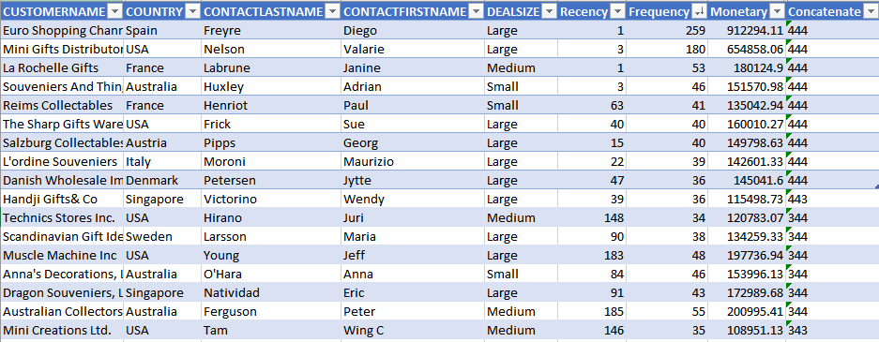
Loyal customers
Customers who places more orders. They belong to platinum and gold segments who have frequency value of 4.

Slide 19
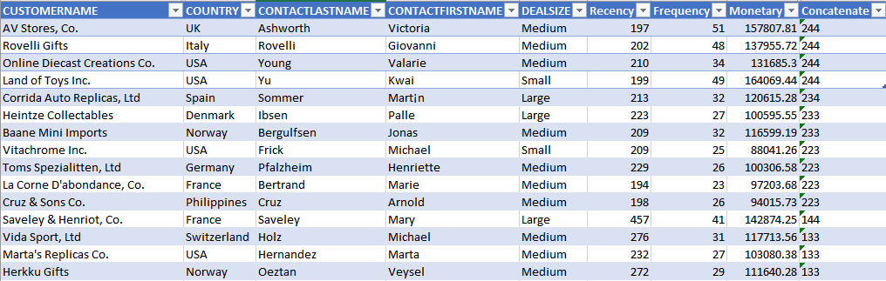
Customers on the verge of churning
Customers who belong to silver segment with recency less than 3, frequency can be 1-4, monetary value greater than 2. These are the customers who have not ordered recently, but their monetary value is high and number of orders are more than average.

Slide 20
Conclusion
In conclusion, the analysis result from the RFM is a base mapping for future response testing of customer migrations among the RFM cells. RFM scores can be analysed over time with the recommendation results. This would eliminate the non-responsive customers and improve marketing campaigns.

