Slide 1
STENOGRAPHY- HIDING A TEXT IN IMAGE
CAPSTONE PROJECT
Presented By: Name : DODLE AKSHAYA Dept: CSM Email: dodleakshaya123@gmail.com AICTE ID : STU664366d688b881715693270 College Name: MALLA REDDY ENGINEERING COLLEGE FOR WOMEN

Slide 2
OUTLINE
Problem Statement
System Development Approach
Algorithm & Deployment (Step by Step Procedure)
Result
Conclusion
References

Slide 3
Problem Statement
The increasing need for secure and discreet digital communication presents a challenge. Traditional encryption often highlights the presence of sensitive data, inviting unwanted attention. This project tackles the issue of covert communication through steganography. Our aim is to develop a method to conceal text within digital images, making the hidden message imperceptible. This approach provides plausible deniability, as communication appears as a normal image, reducing interception risks.

Slide 4
System Approach
This section outlines the strategy for developing and implementing the text steganography solution System Requirements: Encode/decode text in RCB images. Imperceptible messages, P NG
compatibility, message delimiter Libraries: Pillow (image manipulation), Numpy(numerical operations) Technology Used : Python

Slide 5
Algorithm & Deployment
This project uses Least Significant Bit (LSB) steganography to embed text in RGB images.
Step-by-Step Procedure:
Image Loading: Open image, get width/height.
Text to Binary: Convert text to 8 but binary , appenf a 16 bit delimiter. Capacity Check: Verify image size can hold the binary message. Message Embedding : Modify LSB of each R, G, B pixel component (odd for ‘1’, even for ‘0’).
Image Saving : Save the modified image Message Extraction: Read LSBs from R, G, B components until the delimiter is found. Binary to Text: Convert extracted binary back to readable text. Deployment: Encode : cacher_texte_dans_image('input.png', 'message', 'output.png’) Decode: decoder_texte_dans_image('output.png')

Slide 6

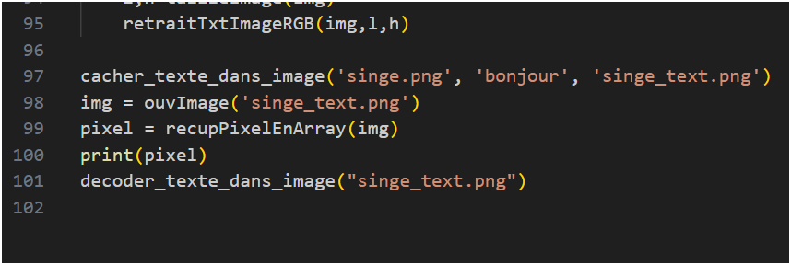
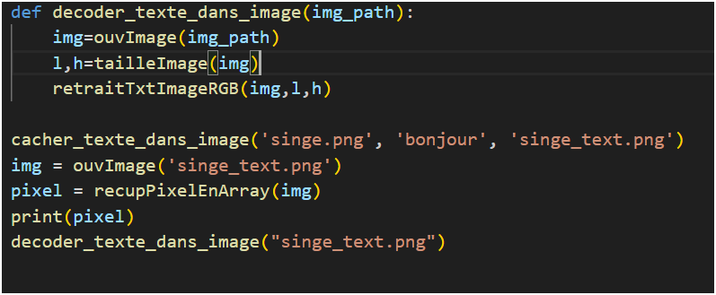
Result
1. Original image 2. Encoding Code Snippet 3. Encoded Image Output 4. Encoded Image Output

Slide 7
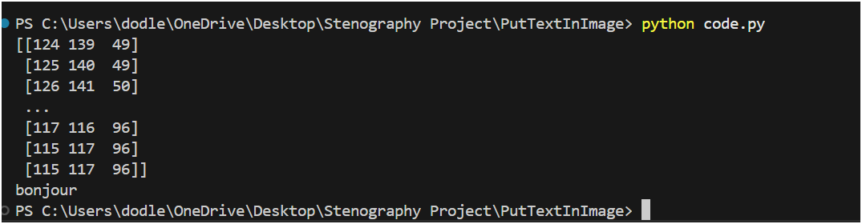
Result
5. Terminal Output of Decoded Message

Slide 8
Conclusion
This project successfully implemented a text steganography system utilizing the Least Significant Bit (LSB) method. The core functionality involved imperceptibly hiding text messages within RGB images, ensuring the visual integrity of the cover image was maintained throughout the process. During implementation, challenges were encountered regarding image capacity limits, particularly with larger text messages, and the ongoing effort to maintain perfect imperceptibility when embedding significant amounts of data. Moving forward, potential improvements include incorporating adaptive LSB techniques for enhanced robustness, adding an encryption layer for the message before embedding, developing a user-friendly graphical interface (GUI), and expanding support for a wider array of image formats.

Slide 9
References
Solanki, J. (2018). A Survey on Least Significant Bit (LSB) Steganography and its Limitations. Cox, I. J., Miller, M. L., & Bloom, J. A. (2007). Digital Watermarking and Steganography.
Pyton Pillow Documentation: : https://pillow.readthedocs.io/en/stable/ Numpy Documentation: https://numpy.org/doc/ ..

Slide 10
THANK YOU

