Slide 1
Chapter 16
Practical Database Design and Tuning

Slide 2
Chapter Outline
1. Physical Database Design in Relational Databases
2. An Overview of Database Tuning in Relational Systems

Slide 3
1. Physical Database Design in Relational Databases(1)
Factors that Influence Physical Database Design: A. Analyzing the database queries and transactions
For each query, the following information is needed.
The files that will be accessed by the query;
The attributes on which any selection conditions for the query are specified;
The attributes on which any join conditions or conditions to link multiple tables or objects for the query are specified;
The attributes whose values will be retrieved by the query.
Note: the attributes listed in items 2 and 3 above are candidates for definition of access structures.

Slide 4
Physical Database Design in Relational Databases(2)
Factors that Influence Physical Database Design (contd.): A. Analyzing the database queries and transactions (contd.)
For each update transaction or operation, the following information is needed.
The files that will be updated;
The type of operation on each file (insert, update or delete);
The attributes on which selection conditions for a delete or update operation are specified;
The attributes whose values will be changed by an update operation.
Note: the attributes listed in items 3 above are candidates for definition of access structures. However, the attributes listed in item 4 are candidates for avoiding an access structure.

Slide 5
Physical Database Design in Relational Databases(3)
Factors that Influence Physical Database Design (contd.): B. Analyzing the expected frequency of invocation of queries and transactions
The expected frequency information, along with the attribute information collected on each query and transaction, is used to compile a cumulative list of expected frequency of use for all the queries and transactions.
It is expressed as the expected frequency of using each attribute in each file as a selection attribute or join attribute, over all the queries and transactions.
80-20 rule
20% of the data is accessed 80% of the time

Slide 6
Physical Database Design in Relational Databases(4)
Factors that Influence Physical Database Design (contd.) C. Analyzing the time constraints of queries and transactions
Performance constraints place further priorities on the attributes that are candidates for access paths.
The selection attributes used by queries and transactions with time constraints become higher-priority candidates for primary access structure.

Slide 7
Physical Database Design in Relational Databases(4)
Factors that Influence Physical Database Design (contd.) D. Analyzing the expected frequencies of update operations
A minimum number of access paths should be specified for a file that is updated frequently.

Slide 8
Physical Database Design in Relational Databases(4)
Factors that Influence Physical Database Design (contd.) E. Analyzing the uniqueness constraints on attributes
Access paths should be specified on all candidate key attributes — or set of attributes — that are either the primary key or constrained to be unique.

Slide 9
Physical Database Design in Relational Databases(5)
Physical Database Design Decisions
Design decisions about indexing
Whether to index an attribute?
What attribute or attributes to index on?
Whether to set up a clustered index?
Whether to use a hash index over a tree index?
Whether to use dynamic hashing for the file?

Slide 10
Physical Database Design in Relational Databases(6)
Physical Database Design Decisions (contd.)
Denormalization as a design decision for speeding up queries
The goal of normalization is to separate the logically related attributes into tables to minimize redundancy and thereby avoid the update anomalies that cause an extra processing overheard to maintain consistency of the database.
The goal of denormalization is to improve the performance of frequently occurring queries and transactions. (Typically the designer adds to a table attributes that are needed for answering queries or producing reports so that a join with another table is avoided.)
Trade off between update and query performance

Slide 11
2. An Overview of Database Tuning in Relational Systems (1)
Tuning:
The process of continuing to revise/adjust the physical database design by monitoring resource utilization as well as internal DBMS processing to reveal bottlenecks such as contention for the same data or devices.
Goal:
To make application run faster
To lower the response time of queries/transactions
To improve the overall throughput of transactions

Slide 12
An Overview of Database Tuning in Relational Systems (2)
Statistics internally collected in DBMSs:
Size of individual tables
Number of distinct values in a column
The number of times a particular query or transaction is submitted/executed in an interval of time
The times required for different phases of query and transaction processing
Statistics obtained from monitoring:
Storage statistics
I/O and device performance statistics
Query/transaction processing statistics
Locking/logging related statistics
Index statistic

Slide 13
An Overview of Database Tuning in Relational Systems (3)
Problems to be considered in tuning:
How to avoid excessive lock contention?
How to minimize overhead of logging and unnecessary dumping of data?
How to optimize buffer size and scheduling of processes?
How to allocate resources such as disks, RAM and processes for most efficient utilization?

Slide 14
An Overview of Database Tuning in Relational Systems (4)
Tuning Indexes
Reasons to tuning indexes
Certain queries may take too long to run for lack of an index;
Certain indexes may not get utilized at all;
Certain indexes may be causing excessive overhead because the index is on an attribute that undergoes frequent changes
Options to tuning indexes
Drop or/and build new indexes
Change a non-clustered index to a clustered index (and vice versa)
Rebuilding the index

Slide 15
An Overview of Database Tuning in Relational Systems (5)
Tuning the Database Design
Dynamically changed processing requirements need to be addressed by making changes to the conceptual schema if necessary and to reflect those changes into the logical schema and physical design.

Slide 16
An Overview of Database Tuning in Relational Systems (6)
Tuning the Database Design (contd.)
Possible changes to the database design
Existing tables may be joined (denormalized) because certain attributes from two or more tables are frequently needed together.
For the given set of tables, there may be alternative design choices, all of which achieve 3NF or BCNF. One may be replaced by the other.
A relation of the form R(K, A, B, C, D, …) that is in BCNF can be stored into multiple tables that are also in BCNF by replicating the key K in each table.
Attribute(s) from one table may be repeated in another even though this creates redundancy and potential anomalies.
Apply horizontal partitioning as well as vertical partitioning if necessary.

Slide 17
An Overview of Database Tuning in Relational Systems (7)
Tuning Queries
Indications for tuning queries
A query issues too many disk accesses
The query plan shows that relevant indexes are not being used.

Slide 18
An Overview of Database Tuning in Relational Systems (8)
Tuning Queries (contd.): Typical instances for query tuning
In some situations involving using of correlated queries, temporaries are useful.
If multiple options for join condition are possible, choose one that uses a clustering index and avoid those that contain string comparisons.
The order of tables in the FROM clause may affect the join processing.
Some query optimizers perform worse on nested queries compared to their equivalent un-nested counterparts.
Many applications are based on views that define the data of interest to those applications. Sometimes these views become an overkill.

Slide 19
An Overview of Database Tuning in Relational Systems (8)
Tuning Queries (contd.): Typical instances for query tuning
In some situations involving using of correlated queries, temporaries are useful.
If multiple options for join condition are possible, choose one that uses a clustering index and avoid those that contain string comparisons.
The order of tables in the FROM clause may affect the join processing.
Some query optimizers perform worse on nested queries compared to their equivalent un-nested counterparts.
Many applications are based on views that define the data of interest to those applications. Sometimes these views become an overkill.

Slide 20
An Overview of Database Tuning in Relational Systems (10)
Additional Query Tuning Guidelines
A query with multiple selection conditions that are connected via OR may not be prompting the query optimizer to use any index. Such a query may be split up and expressed as a union of queries, each with a condition on an attribute that causes an index to be used.
Apply the following transformations
NOT condition may be transformed into a positive expression.
Embedded SELECT blocks may be replaced by joins.
If an equality join is set up between two tables, the range predicate on the joining attribute set up in one table may be repeated for the other table
WHERE conditions may be rewritten to utilize the indexes on multiple columns.

Slide 21
Summary
Physical Database Design in Relational Databases
Database Tuning in Relational Systems

Slide 22
26.2 Temporal Database Concepts
Temporal databases require some aspect of time when organizing information
Healthcare
Insurance
Reservation systems
Scientific databases
Time considered as ordered sequence of points
Granularity determined by the application

Slide 23
Temporal Database Concepts (cont’d.)
Chronon
Term used to describe minimal granularity of a particular application
Reference point for measuring specific time events
Various calendars
SQL2 temporal data types
DATE, TIME, TIMESTAMP, INTERVAL, PERIOD

Slide 24
Temporal Database Concepts (cont’d.)
Point events or facts
Typically associated with a single time point
Time series data
Duration events or facts
Associated with specific time period
Time period represented by start and end points
Valid time
True in the real world

Slide 25
Temporal Database Concepts (cont’d.)
Transaction time
Value of the system clock when information is valid in the system
User-defined time
Bitemporal database
Uses valid time and transaction time
Valid time relations
Used to represent history of changes

Slide 26
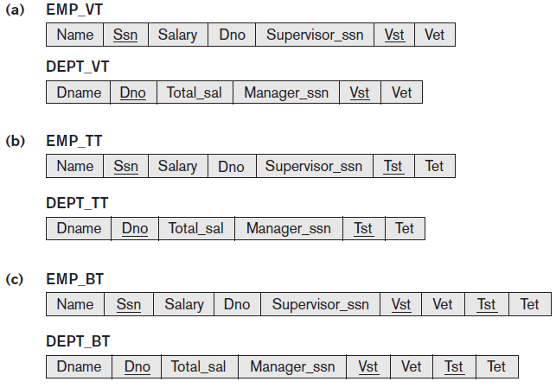
Temporal Database Concepts (cont’d.)
Figure 26.7 Different types of temporal relational databases (a) Valid time database schema (b) Transaction time database schema (c) Bitemporal database schema

Slide 27
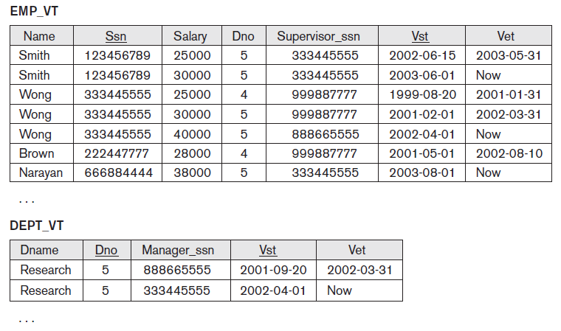
Temporal Database Concepts (cont’d.)
Figure 26.8 Some tuple versions in the valid time relations EMP_VT and DEPT_VT

Slide 28
Temporal Database Concepts (cont’d.)
Types of updates
Proactive
Retroactive
Simultaneous
Timestamp recorded whenever change is applied to database
Bitemporal relations
Application requires both valid time and transaction time

Slide 29
Temporal Database Concepts (cont’d.)
Implementation considerations
Store all tuples in the same table
Create two tables: one for currently valid information and one for the rest
Vertically partition temporal relation attributes into separate relations
New tuple created whenever any attribute updated
Append-only database
Keeps complete record of changes and corrections

Slide 30
Temporal Database Concepts (cont’d.)
Attribute versioning
Simple complex object used to store all temporal changes of the object
Time-varying attribute
Values versioned over time by adding temporal periods to the attribute
Non-time-varying attribute
Values do not change over time

Slide 31
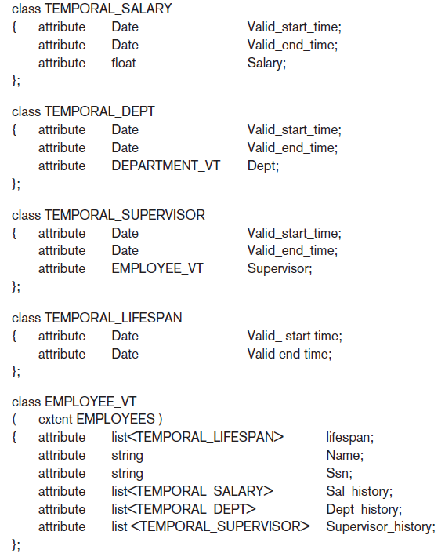
Figure 26.10 Possible ODL schema for a temporal valid time EMPLOYEE_VT object class using attribute versioning

Slide 32
Temporal Database Concepts (cont’d.)
TSQL2 language
Extends SQL for querying valid time and transaction time tables
Used to specify whether a relation is temporal or nontemporal
Temporal database query conditions may involve time and attributes
Pure time condition involves only time
Attribute and time conditions

Slide 33
Temporal Database Concepts (cont’d.)
CREATE TABLE statement
Extended with optional AS clause
Allows users to declare different temporal options
Examples:
AS VALID STATE<GRANULARITY> (valid time relation with valid time period)
AS TRANSACTION (transaction time relation with transaction time period)
Keywords STATE and EVENT
Specify whether a time period or point is associated with valid time dimension

Slide 34
Temporal Database Concepts (cont’d.)
Time series data
Often used in financial, sales, and economics applications
Special type of valid event data
Event’s time points predetermined according to fixed calendar
Managed using specialized time series management systems
Supported by some commercial DBMS packages

Slide 35
Value of SDBMS
Traditional (non-spatial) database management systems provide:
Persistence across failures
Allows concurrent access to data
Scalability to search queries on very large datasets which do not fit inside main memories of computers
Efficient for non-spatial queries, but not for spatial queries
Non-spatial queries:
List the names of all bookstore with more than ten thousand titles.
List the names of ten customers, in terms of sales, in the year 2001
Spatial Queries:
List the names of all bookstores with ten miles of Minneapolis
List all customers who live in Tennessee and its adjoining states

Slide 36
Value of SDBMS – Spatial Data Examples
Examples of non-spatial data
Names, phone numbers, email addresses of people
Examples of Spatial data
Census Data
NASA satellites imagery - terabytes of data per day
Weather and Climate Data
Rivers, Farms, ecological impact
Medical Imaging
Exercise: Identify spatial and non-spatial data items in
A phone book
A cookbook with recipes

Slide 37
Value of SDBMS – Users, Application Domains
Many important application domains have spatial data and queries. Some Examples follow:
Army Field Commander: Has there been any significant enemy troop movement since last night?
Insurance Risk Manager: Which homes are most likely to be affected in the next great flood on the Mississippi?
Medical Doctor: Based on this patient's MRI, have we treated somebody with a similar condition ?
Molecular Biologist:Is the topology of the amino acid biosynthesis gene in the genome found in any other sequence feature map in the database ?
Astronomer:Find all blue galaxies within 2 arcmin of quasars.
Exercise: List two ways you have used spatial data. Which software did you use to manipulate spatial data?

Slide 38
What is a SDBMS ?
A SDBMS is a software module that
can work with an underlying DBMS
supports spatial data models, spatial abstract data types (ADTs) and a query language from which these ADTs are callable
supports spatial indexing, efficient algorithms for processing spatial operations, and domain specific rules for query optimization
Example: Oracle Spatial data cartridge, ESRI SDE
can work with Oracle 8i DBMS
Has spatial data types (e.g. polygon), operations (e.g. overlap) callable from SQL3 query language
Has spatial indices, e.g. R-trees

Slide 39
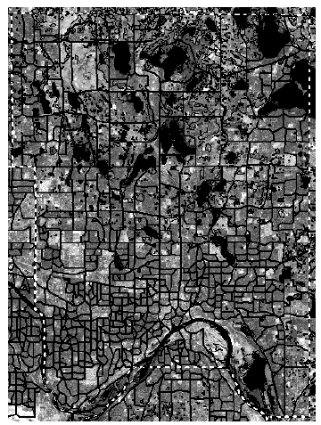
SDBMS Example
Consider a spatial dataset with:
County boundary (dashed white line)
Census block - name, area, population, boundary (dark line)
Water bodies (dark polygons)
Satellite Imagery (gray scale pixels)
Storage in a SDBMS table:
create table census_blocks (
name string,
area float,
population number,
boundary polygon );
Fig 1.2

Slide 40
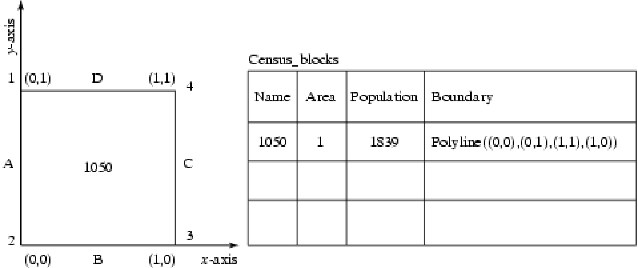
Modeling Spatial Data in Traditional DBMS
A row in the table census_blocks (Figure 1.3)
Question: Is Polyline datatype supported in DBMS?
Figure 1.3

Slide 41
Spatial Data Types and Traditional Databases
Traditional relational DBMS
Support simple data types, e.g. number, strings, date
Modeling Spatial data types is tedious
Example: Figure 1.4 shows modeling of polygon using numbers
Three new tables: polygon, edge, points
Note: Polygon is a polyline where last point and first point are same
A simple unit sqaure represented as 16 rows across 3 tables
Simple spatial operators, e.g. area(), require joining tables
Tedious and computationally inefficient
Question. Name post-relational database management systems which facilitate modeling of spatial data types, e.g. polygon.

Slide 42
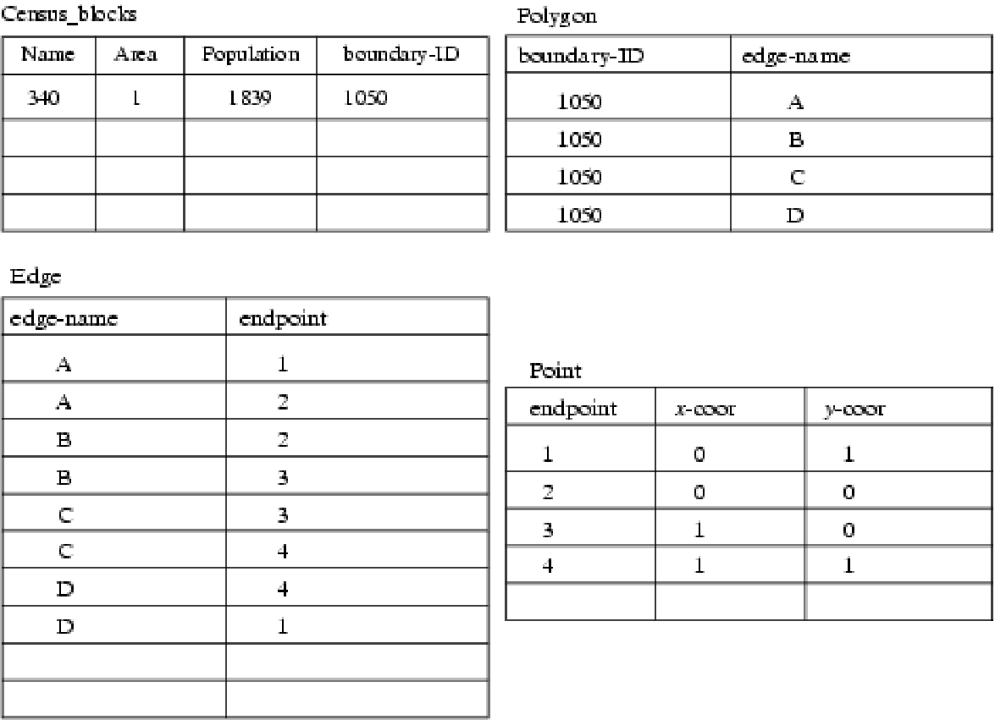
Mapping “census_table” into a Relational Database
Fig 1.4

Slide 43
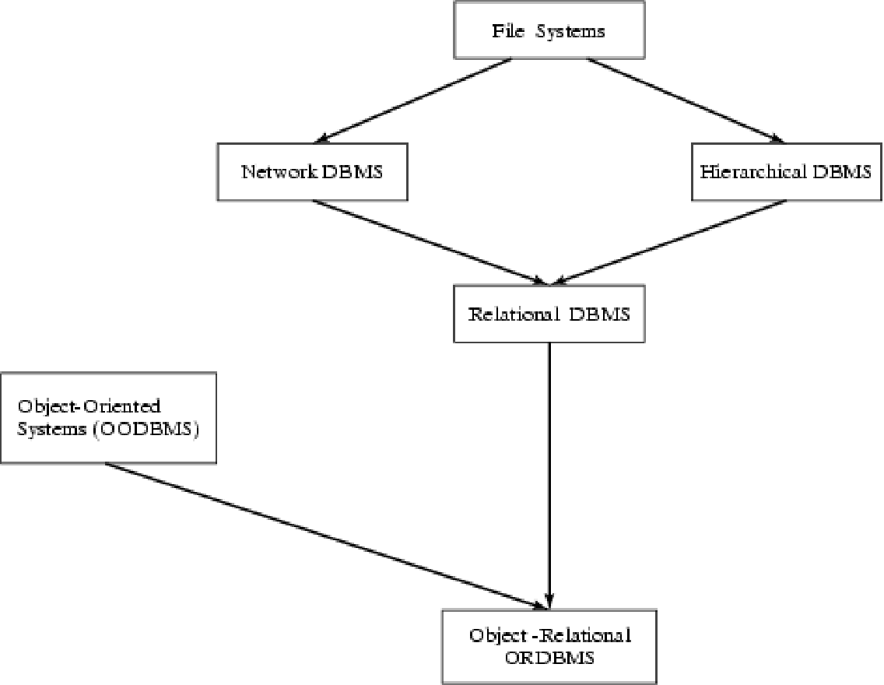
Evolution of DBMS technology
Fig 1.5

Slide 44
Spatial Data Types and Post-relational Databases
Post-relational DBMS
Support user defined abstract data types
Spatial data types (e.g. polygon) can be added
Choice of post-relational DBMS
Object oriented (OO) DBMS
Object relational (OR) DBMS
A spatial database is a collection of spatial data types, operators, indices, processing strategies, etc. and can work with many post-relational DBMS as well as programming languages like Java, Visual Basic etc.

Slide 45
26.3 Spatial Database Concepts
Spatial databases support information about objects in multidimensional space
Examples: cartographic databases, geographic information systems, weather information databases
Spatial relationships among the objects are important
Optimized to query data such as points, lines, and polygons
Spatial queries

Slide 46
Spatial Database Concepts (cont’d.)
Measurement operations
Used to measure global properties of single objects
Spatial analysis operations
Uncover spatial relationships within and among mapped data layers
Flow analysis operations
Help determine shortest path between two points

Slide 47
Spatial Database Concepts (cont’d.)
Location analysis
Determine whether given set of points and lines lie within a given polygon
Digital terrain analysis
Used to build three-dimensional models

Slide 48
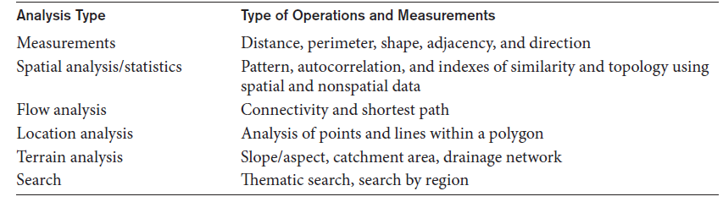
Spatial Database Concepts (cont’d.)
Table 26.1 Common types of analysis for spatial data

Slide 49
Spatial Database Concepts (cont’d.)
Spatial data types
Map data
Geographic or spatial features of objects in a map
Attribute data
Descriptive data associated with map features
Image data
Satellite images
Models of spatial information
Field models
Object models

Slide 50
Spatial Database Concepts (cont’d.)
Spatial operator categories
Topological operators
Properties do not change when topological transformations applied
Projective operators
Express concavity/convexity of objects
Metric operators
Specifically describe object’s geometry
Dynamic spatial operators
Create, destroy, and update

Slide 51
Spatial Database Concepts (cont’d.)
Spatial queries
Range queries
Example: find all hospitals with the Metropolitan Atlanta city area
Nearest neighbor queries
Example: find police car nearest location of a crime
Spatial joins or overlays
Example: find all homes within two miles of a lake

Slide 52
Spatial Database Concepts (cont’d.)
Spatial data indexing
Grid files
R-trees
Spatial join index
Spatial data mining techniques
Spatial classification
Spatial association
Spatial clustering

Slide 53
Chapter 20
Concepts for Object Databases

Slide 54
Chapter Outline
1 Overview of O-O Concepts
2 O-O Identity, Object Structure and Type Constructors
3 Encapsulation of Operations, Methods and Persistence
4 Type and Class Hierarchies and Inheritance
5 Complex Objects
6 Other O-O Concepts
7 Summary & Current Status

Slide 55
Introduction
Traditional Data Models:
Hierarchical
Network (since mid-60’s)
Relational (since 1970 and commercially since 1982)
Object Oriented (OO) Data Models since mid-90’s
Reasons for creation of Object Oriented Databases
Need for more complex applications
Need for additional data modeling features
Increased use of object-oriented programming languages
Commercial OO Database products –
Several in the 1990’s, but did not make much impact on mainstream data management

Slide 56
History of OO Models and Systems (contd.)
Experimental Systems:
Orion at MCC
IRIS at H-P labs
Open-OODB at T.I.
ODE at ATT Bell labs
Postgres - Montage - Illustra at UC/B
Encore/Observer at Brown

Slide 57
History of OO Models and Systems (contd.)
Commercial OO Database products:
Ontos
Gemstone
O2 ( -> Ardent)
Objectivity
Objectstore ( -> Excelon)
Versant
Poet
Jasmine (Fujitsu – GM)

Slide 58
20.1 Overview of Object-Oriented Concepts(1)
Main Claim:
OO databases try to maintain a direct correspondence between real-world and database objects so that objects do not lose their integrity and identity and can easily be identified and operated upon
Object:
Two components:
state (value) and behavior (operations)
Similar to program variable in programming language, except that it will typically have a complex data structure as well as specific operations defined by the programmer

Slide 59
Overview of Object-Oriented Concepts (2)
In OO databases, objects may have an object structure of arbitrary complexity in order to contain all of the necessary information that describes the object.
In contrast, in traditional database systems, information about a complex object is often scattered over many relations or records, leading to loss of direct correspondence between a real-world object and its database representation.

Slide 60
Overview of Object-Oriented Concepts (3)
The internal structure of an object in OOPLs includes the specification of instance variables, which hold the values that define the internal state of the object.
An instance variable is similar to the concept of an attribute, except that instance variables may be encapsulated within the object and thus are not necessarily visible to external users

Slide 61
Overview of Object-Oriented Concepts (4)
Some OO models insist that all operations a user can apply to an object must be predefined. This forces a complete encapsulation of objects.
To encourage encapsulation, an operation is defined in two parts:
signature or interface of the operation, specifies the operation name and arguments (or parameters).
method or body, specifies the implementation of the operation.

Slide 62
Overview of Object-Oriented Concepts (5)
Operations can be invoked by passing a message to an object, which includes the operation name and the parameters.
The object then executes the method for that operation.
This encapsulation permits modification of the internal structure of an object, as well as the implementation of its operations, without the need to disturb the external programs that invoke these operations

Slide 63
Overview of Object-Oriented Concepts (6)
Some OO systems provide capabilities for dealing with multiple versions of the same object (a feature that is essential in design and engineering applications).
For example, an old version of an object that represents a tested and verified design should be retained until the new version is tested and verified:
very crucial for designs in manufacturing process control, architecture , software systems …..

Slide 64
Overview of Object-Oriented Concepts (7)
Operator polymorphism:
This refers to an operation’s ability to be applied to different types of objects; in such a situation, an operation name may refer to several distinct implementations, depending on the type of objects it is applied to.
This feature is also called operator overloading

Slide 65
20.2 Object Identity, Object Structure, and Type Constructors (1)
Unique Identity:
An OO database system provides a unique identity to each independent object stored in the database.
This unique identity is typically implemented via a unique, system-generated object identifier, or OID
The main property required of an OID is that it be immutable
Specifically, the OID value of a particular object should not change.
This preserves the identity of the real-world object being represented.

Slide 66
Object Identity, Object Structure, and Type Constructors (2)
Type Constructors:
In OO databases, the state (current value) of a complex object may be constructed from other objects (or other values) by using certain type constructors.
The three most basic constructors are atom, tuple, and set.
Other commonly used constructors include list, bag, and array.
The atom constructor is used to represent all basic atomic values, such as integers, real numbers, character strings, Booleans, and any other basic data types that the system supports directly.

Slide 67
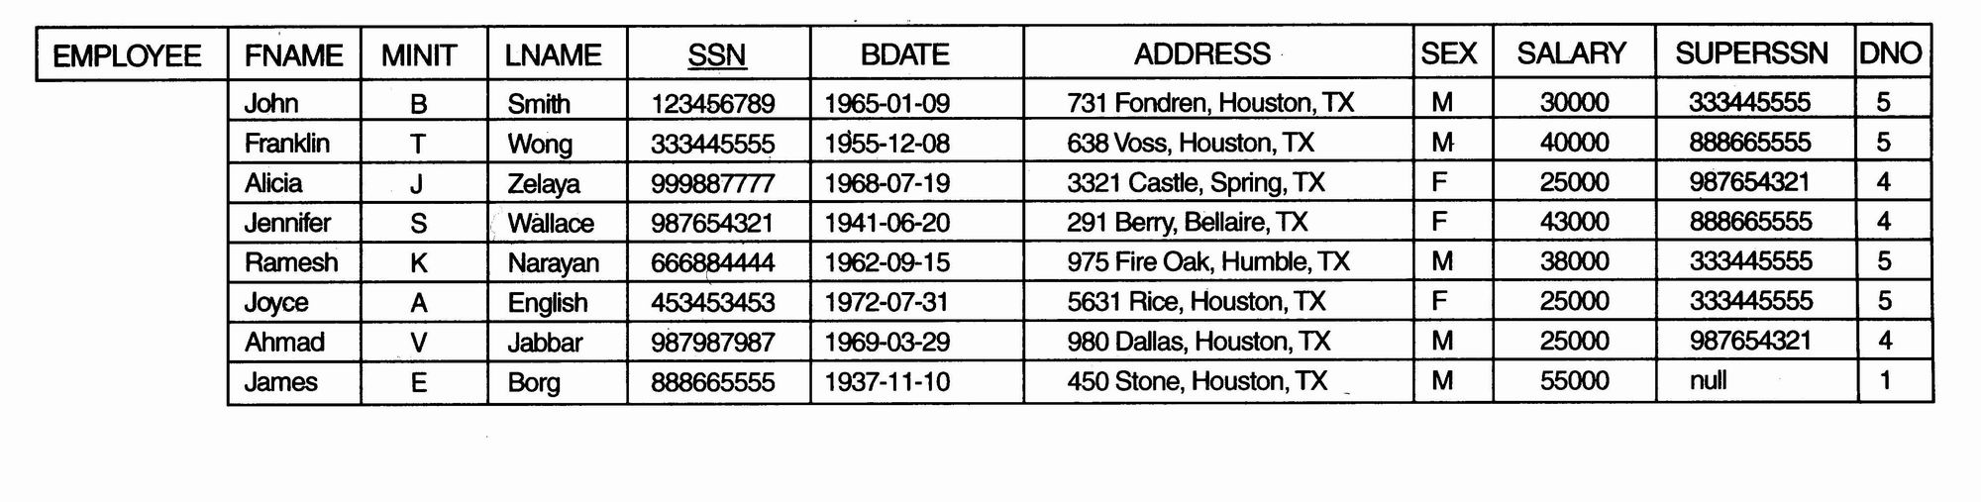
Object Identity, Object Structure, and Type Constructors (3)
Example 1
One possible relational database state corresponding to COMPANY schema

Slide 68
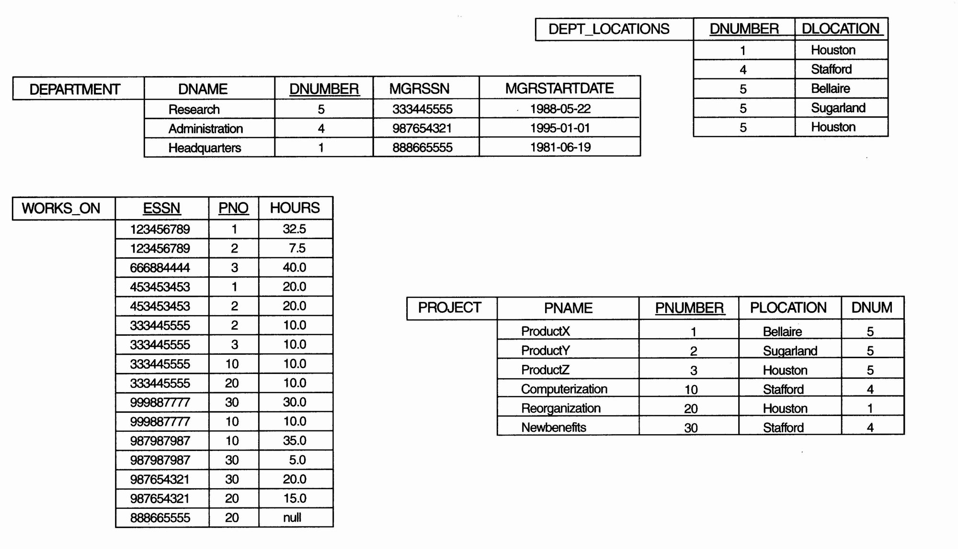
Object Identity, Object Structure, and Type Constructors (4)
Example 1 (contd.):

Slide 69
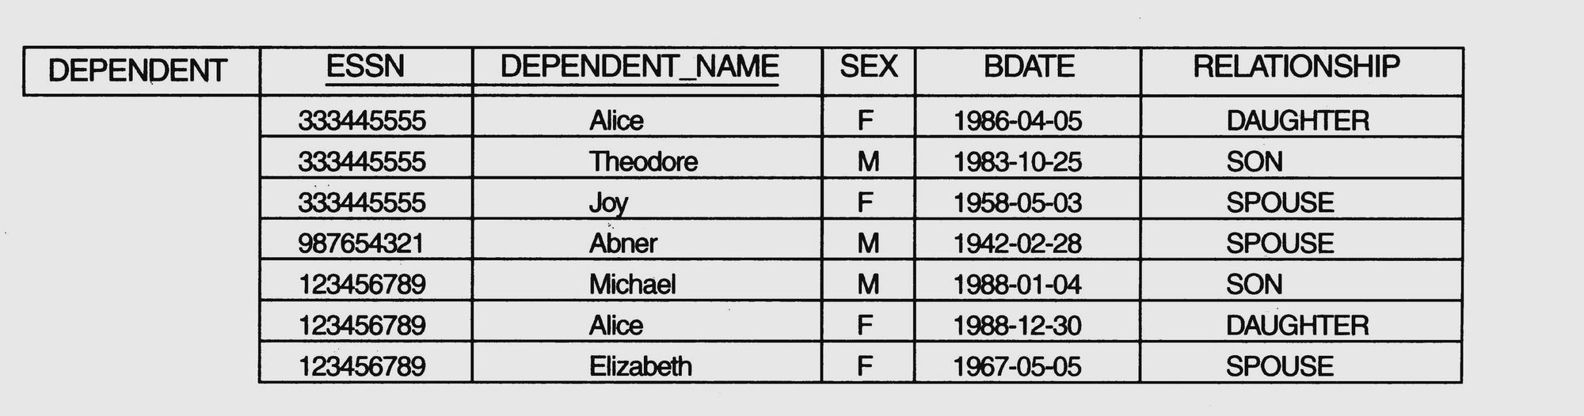
Object Identity, Object Structure, and Type Constructors (5)
Example 1 (contd.)

Slide 70
Object Identity, Object Structure, and Type Constructors (6)
Example 1 (contd.)
We use i₁, i₂, i₃, . . . to stand for unique system-generated object identifiers. Consider the following objects:
o₁ = (i₁, atom, ‘Houston’)
o₂ = (i₂, atom, ‘Bellaire’)
o₃ = (i₃, atom, ‘Sugarland’)
o₄ = (i₄, atom, 5)
o₅ = (i₅, atom, ‘Research’)
o₆ = (i₆, atom, ‘1988-05-22’)
o₇ = (i₇, set, {i1, i2, i3})

Slide 71
Object Identity, Object Structure, and Type Constructors (7)
Example 1(contd.)
o₈ = (i₈, tuple, <dname:i₅, dnumber:i₄, mgr:i₉, locations:i₇, employees:i₁₀, projects:i₁₁>)
o₉ = (i₉, tuple, <manager:i₁2, manager_start_date:i₆>)
o₁₀ = (i₁₀, set, {i₁₂, i₁₃, i₁₄})
o₁₁ = (i₁₁, set {i₁₅, i₁₆, i₁₇})
o₁₂ = (i₁₂, tuple, <fname:i₁₈, minit:i₁₉, lname:i₂₀, ssn:i₂₁, . . ., salary:i₂₆, supervi­sor:i₂₇, dept:i₈>)
. . .

Slide 72
Object Identity, Object Structure, and Type Constructors (8)
Example 1 (contd.)
The first six objects listed in this example represent atomic values.
Object seven is a set-valued object that represents the set of locations for department 5; the set refers to the atomic objects with values {‘Houston’, ‘Bellaire’, ‘Sugarland’}.
Object 8 is a tuple-valued object that represents department 5 itself, and has the attributes DNAME, DNUMBER, MGR, LOCATIONS, and so on.

Slide 73
Object Identity, Object Structure, and Type Constructors (9)
Example 2:
This example illustrates the difference between the two definitions for comparing object states for equality.
o₁ = (i₁, tuple, <a₁:i₄, a₂:i₆>)
o₂ = (i₂, tuple, <a₁:i₅, a₂:i₆>)
o₃ = (i₃, tuple, <a₁:i₄, a₂:i₆>)
o₄ = (i₄, atom, 10)
o₅ = (i₅, atom, 10)
o₆ = (i₆, atom, 20)

Slide 74
Object Identity, Object Structure, and Type Constructors (10)
Example 2 (contd.):
In this example, The objects o1 and o2 have equal states, since their states at the atomic level are the same but the values are reached through distinct objects o4 and o5.
However, the states of objects o1 and o3 are identical, even though the objects themselves are not because they have distinct OIDs.
Similarly, although the states of o4 and o5 are identical, the actual objects o4 and o5 are equal but not identical, because they have distinct OIDs.

Slide 75
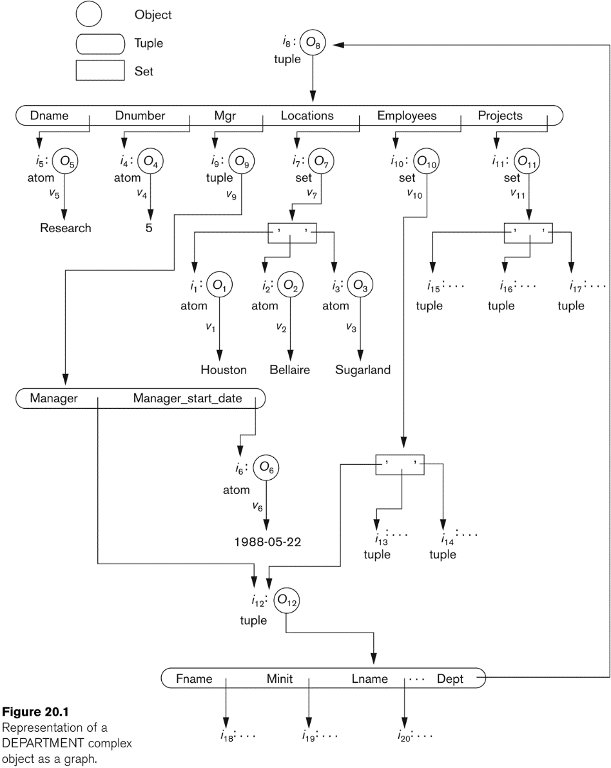
Object Identity, Object Structure, and Type Constructors (11)

Slide 76
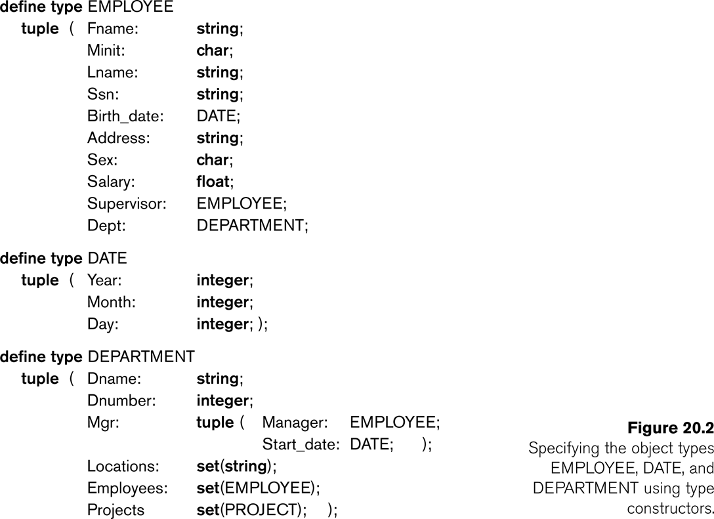
Object Identity, Object Structure, and Type Constructors (12)

Slide 77
20.3 Encapsulation of Operations, Methods, and Persistence (1)
Encapsulation
One of the main characteristics of OO languages and systems
Related to the concepts of abstract data types and information hiding in programming languages

Slide 78
Encapsulation of Operations, Methods, and Persistence (2)
Specifying Object Behavior via Class Operations:
The main idea is to define the behavior of a type of object based on the operations that can be externally applied to objects of that type.
In general, the implementation of an operation can be specified in a general-purpose programming language that provides flexibility and power in defining the operations.

Slide 79
Encapsulation of Operations, Methods, and Persistence (3)
Specifying Object Behavior via Class Operations (contd.):
For database applications, the requirement that all objects be completely encapsulated is too stringent.
One way of relaxing this requirement is to divide the structure of an object into visible and hidden attributes (instance variables).

Slide 80
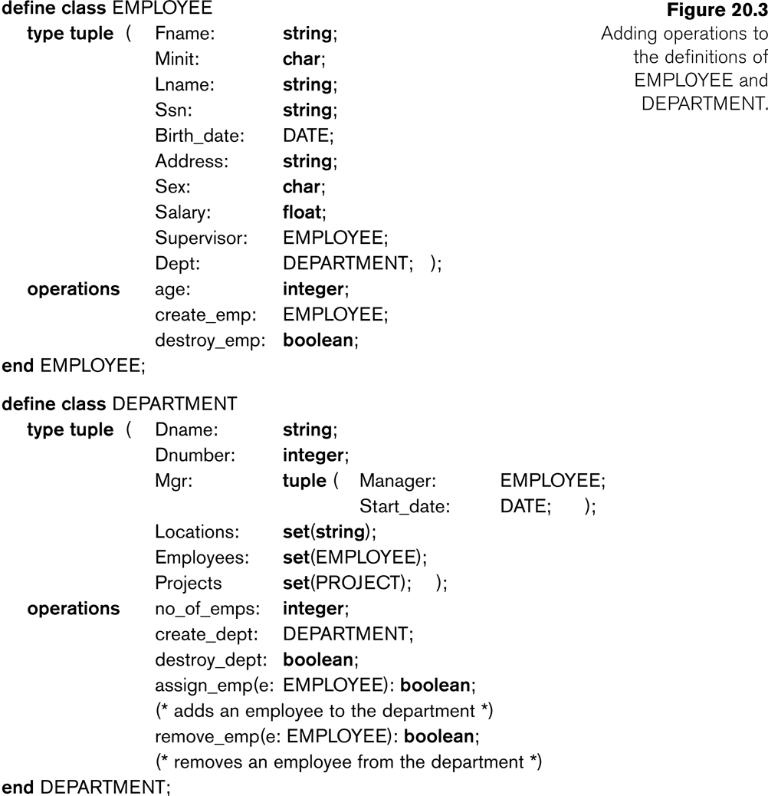
Encapsulation of Operations, Methods, and Persistence (4)

Slide 81
Encapsulation of Operations, Methods, and Persistence (5)
Specifying Object Persistence via Naming and Reachability:
Naming Mechanism:
Assign an object a unique persistent name through which it can be retrieved by this and other programs.
Reachability Mechanism:
Make the object reachable from some persistent object.
An object B is said to be reachable from an object A if a sequence of references in the object graph lead from object A to object B.

Slide 82
Encapsulation of Operations, Methods, and Persistence (6)
Specifying Object Persistence via Naming and Reachability (contd.):
In traditional database models such as relational model or EER model, all objects are assumed to be persistent.
In OO approach, a class declaration specifies only the type and operations for a class of objects. The user must separately define a persistent object of type set (DepartmentSet) or list (DepartmentList) whose value is the collection of references to all persistent DEPARTMENT objects

Slide 83
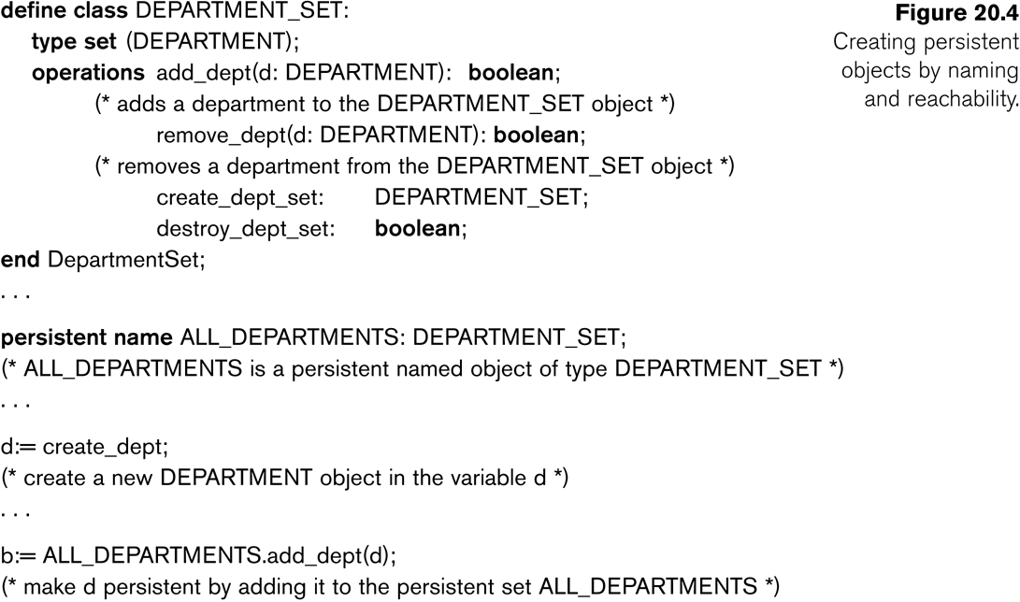
Encapsulation of Operations, Methods, and Persistence (7)

Slide 84
20.4 Type and Class Hierarchies and Inheritance (1)
Type (class) Hierarchy
A type in its simplest form can be defined by giving it a type name and then listing the names of its visible (public) functions
When specifying a type in this section, we use the following format, which does not specify arguments of functions, to simplify the discussion:
TYPE_NAME: function, function, . . . , function
Example:
PERSON: Name, Address, Birthdate, Age, SSN

Slide 85
Type and Class Hierarchies and Inheritance (2)
Subtype:
When the designer or user must create a new type that is similar but not identical to an already defined type
Supertype:
It inherits all the functions of the subtype

Slide 86
Type and Class Hierarchies and Inheritance (3)
Example (1):
PERSON: Name, Address, Birthdate, Age, SSN
EMPLOYEE: Name, Address, Birthdate, Age, SSN, Salary, HireDate, Seniority
STUDENT: Name, Address, Birthdate, Age, SSN, Major, GPA
OR:
EMPLOYEE subtype-of PERSON: Salary, HireDate, Seniority
STUDENT subtype-of PERSON: Major, GPA

Slide 87
Type and Class Hierarchies and Inheritance (4)
Example (2):
Consider a type that describes objects in plane geometry, which may be defined as follows:
GEOMETRY_OBJECT: Shape, Area, ReferencePoint
Now suppose that we want to define a number of subtypes for the GEOMETRY_OBJECT type, as follows:
RECTANGLE subtype-of GEOMETRY_OBJECT: Width, Height
TRIANGLE subtype-of GEOMETRY_OBJECT: Side1, Side2, Angle
CIRCLE subtype-of GEOMETRY_OBJECT: Radius

Slide 88
Type and Class Hierarchies and Inheritance (5)
Example (2) (contd.):
An alternative way of declaring these three subtypes is to specify the value of the Shape attribute as a condition that must be satisfied for objects of each subtype:
RECTANGLE subtype-of GEOMETRY_OBJECT (Shape=‘rectangle’): Width, Height
TRIANGLE subtype-of GEOMETRY_OBJECT (Shape=‘triangle’): Side1, Side2, Angle
CIRCLE subtype-of GEOMETRY_OBJECT (Shape=‘circle’): Radius

Slide 89
Type and Class Hierarchies and Inheritance (6)
Extents:
In most OO databases, the collection of objects in an extent has the same type or class.
However, since the majority of OO databases support types, we assume that extents are collections of objects of the same type for the remainder of this section.
Persistent Collection:
This holds a collection of objects that is stored permanently in the database and hence can be accessed and shared by multiple programs
Transient Collection:
This exists temporarily during the execution of a program but is not kept when the program terminates

Slide 90
20.5 Complex Objects (1)
Unstructured complex object:
These is provided by a DBMS and permits the storage and retrieval of large objects that are needed by the database application.
Typical examples of such objects are bitmap images and long text strings (such as documents); they are also known as binary large objects, or BLOBs for short.
This has been the standard way by which Relational DBMSs have dealt with supporting complex objects, leaving the operations on those objects outside the RDBMS.

Slide 91
Complex Objects (2)
Structured complex object:
This differs from an unstructured complex object in that the object’s structure is defined by repeated application of the type constructors provided by the OODBMS.
Hence, the object structure is defined and known to the OODBMS.
The OODBMS also defines methods or operations on it.

Slide 92
20.6 Other Objected-Oriented Concepts (1)
Polymorphism (Operator Overloading):
This concept allows the same operator name or symbol to be bound to two or more different implementations of the operator, depending on the type of objects to which the operator is applied
For example + can be:
Addition in integers
Concatenation in strings (of characters)

Slide 93
Other Objected-Oriented Concepts (2)
Multiple Inheritance and Selective Inheritance
Multiple inheritance in a type hierarchy occurs when a certain subtype T is a subtype of two (or more) types and hence inherits the functions (attributes and methods) of both supertypes.
For example, we may create a subtype ENGINEERING_MANAGER that is a subtype of both MANAGER and ENGINEER.
This leads to the creation of a type lattice rather than a type hierarchy.

Slide 94
Other Objected-Oriented Concepts (3)
Versions and Configurations
Many database applications that use OO systems require the existence of several versions of the same object
There may be more than two versions of an object.
Configuration:
A configuration of the complex object is a collection consisting of one version of each module arranged in such a way that the module versions in the configuration are compatible and together form a valid version of the complex object.

Slide 95
20.7 Summary (1)
Object identity:
Objects have unique identities that are independent of their attribute values.
Type constructors:
Complex object structures can be constructed by recursively applying a set of basic constructors, such as tuple, set, list, and bag.
Encapsulation of operations:
Both the object structure and the operations that can be applied to objects are included in the object class definitions.

Slide 96
Summary (2)
Programming language compatibility:
Both persistent and transient objects are handled uniformly. Objects are made persistent by being attached to a persistent collection.
Type hierarchies and inheritance:
Object types can be specified by using a type hierarchy, which allows the inheritance of both attributes and methods of previously defined types.
Extents:
All persistent objects of a particular type can be stored in an extent. Extents corresponding to a type hierarchy have set/subset constraints enforced on them.

Slide 97
Summary (3)
Support for complex objects:
Both structured and unstructured complex objects can be stored and manipulated.
Polymorphism and operator overloading:
Operations and method names can be overloaded to apply to different object types with different implementations.
Versioning:
Some OO systems provide support for maintaining several versions of the same object.

Slide 98
Current Status
OODB market growing very slowly these days.
O-O ideas are being used in a large number of applications, without explicitly using the OODB platform to store data.
Growth:
O-O tools for modeling and analysis, O-O Programming Languages like Java and C++
Compromise Solution Proposed:
Object Relational DB Management (Informix Universal Server, Oracle 10i, IBM’s UDB, DB2/II …)

Slide 99
CHAPTER 24
NOSQL Databases
and Big Data Storage Systems

Slide 100
Introduction
NOSQL
Not only SQL
SQL systems offer many features (not everyone will use) and restrictive
Most NOSQL systems are distributed databases or distributed storage systems
Focus on semi-structured data storage, high performance, availability, data replication, and scalability

Slide 101
Introduction (cont’d.)
NOSQL systems focus on storage of “big data”
Typical applications that use NOSQL
Social media
Web links
User profiles
Marketing and sales
Posts and tweets
Road maps and spatial data
Email

Slide 102
24.1 Introduction to NOSQL Systems
BigTable
Google’s proprietary NOSQL system
Column-based or wide column store
DynamoDB (Amazon)
Key-value data store
Cassandra (Facebook)
Uses concepts from both key-value store and column-based systems

Slide 103
Introduction to NOSQL Systems (cont’d.)
MongoDB and CouchDB
Document stores
Neo4J and GraphBase
Graph-based NOSQL systems
OrientDB
Combines several concepts
Database systems classified on the object model
Or native XML model

Slide 104
Introduction to NOSQL Systems (cont’d.)
NOSQL characteristics related to distributed databases and distributed systems
Scalability
Availability, replication, and eventual consistency
Replication models
Master-slave
Master-master
Sharding of files
High performance data access

Slide 105
Introduction to NOSQL Systems (cont’d.)
NOSQL characteristics related to data models and query languages
Schema not required
Less powerful query languages
Versioning

Slide 106
Introduction to NOSQL Systems (cont’d.)
Categories of NOSQL systems
Document-based NOSQL systems
NOSQL key-value stores
Column-based or wide column NOSQL systems
Graph-based NOSQL systems
Hybrid NOSQL systems
Object databases
XML databases

Slide 107
24.2 The CAP Theorem
Various levels of consistency among replicated data items
Enforcing serializabilty the strongest form of consistency
High overhead – can reduce read/write operation performance
CAP theorem
Consistency, availability, and partition tolerance
Not possible to guarantee all three simultaneously
In distributed system with data replication

Slide 108
The CAP Theorem (cont’d.)
Designer can choose two of three to guarantee
Weaker consistency level is often acceptable in NOSQL distributed data store
Guaranteeing availability and partition tolerance more important
Eventual consistency often adopted

Slide 109
24.3 Document-Based NOSQL Systems and MongoDB
Document stores
Collections of similar documents
Individual documents resemble complex objects or XML documents
Documents are self-describing
Can have different data elements
Documents can be specified in various formats
XML
JSON

Slide 110
MongoDB Data Model
Documents stored in binary JSON (BSON) format
Individual documents stored in a collection
Example command
First parameter specifies name of the collection
Collection options include limits on size and number of documents
Each document in collection has unique ObjectID field called _id

Slide 111
MongoDB Data Model (cont’d.)
A collection does not have a schema
Structure of the data fields in documents chosen based on how documents will be accessed
User can choose normalized or denormalized design
Document creation using insert operation
Document deletion using remove operation

Slide 112
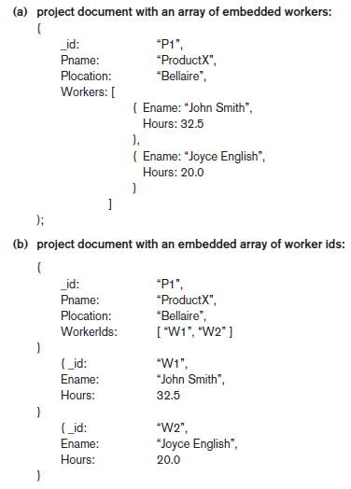
Figure 24.1 (continues)
Example of simple documents in MongoDB (a) Denormalized document design with embedded subdocuments (b) Embedded array of document references

Slide 113
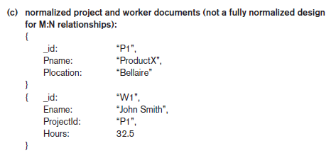
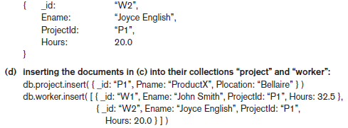
Figure 24.1 (cont’d.) Example of simple documents in MongoDB (c) Normalized documents (d) Inserting the documents in Figure 24.1(c) into their collections

Slide 114
MongoDB Distributed Systems Characteristics
Two-phase commit method
Used to ensure atomicity and consistency of multidocument transactions
Replication in MongoDB
Concept of replica set to create multiple copies on different nodes
Variation of master-slave approach
Primary copy, secondary copy, and arbiter
Arbiter participates in elections to select new primary if needed

Slide 115
MongoDB Distributed Systems Characteristics (cont’d.)
Replication in MongoDB (cont’d.)
All write operations applied to the primary copy and propagated to the secondaries
User can choose read preference
Read requests can be processed at any replica
Sharding in MongoDB
Horizontal partitioning divides the documents into disjoint partitions (shards)
Allows adding more nodes as needed
Shards stored on different nodes to achieve load balancing

Slide 116
MongoDB Distributed Systems Characteristics (cont’d.)
Sharding in MongoDB (cont’d.)
Partitioning field (shard key) must exist in every document in the collection
Must have an index
Range partitioning
Creates chunks by specifying a range of key values
Works best with range queries
Hash partitioning
Partitioning based on the hash values of each shard key

Slide 117
24.4 NOSQL Key-Value Stores
Key-value stores focus on high performance, availability, and scalability
Can store structured, unstructured, or semi-structured data
Key: unique identifier associated with a data item
Used for fast retrieval
Value: the data item itself
Can be string or array of bytes
Application interprets the structure
No query language

Slide 118
DynamoDB Overview
DynamoDB part of Amazon’s Web Services/SDK platforms
Proprietary
Table holds a collection of self-describing items
Item consists of attribute-value pairs
Attribute values can be single or multi-valued
Primary key used to locate items within a table
Can be single attribute or pair of attributes

Slide 119
Voldemort Key-Value Distributed Data Store
Voldemort: open source key-value system similar to DynamoDB
Voldemort features
Simple basic operations (get, put, and delete)
High-level formatted data values
Consistent hashing for distributing (key, value) pairs
Consistency and versioning
Concurrent writes allowed
Each write associated with a vector clock

Slide 120
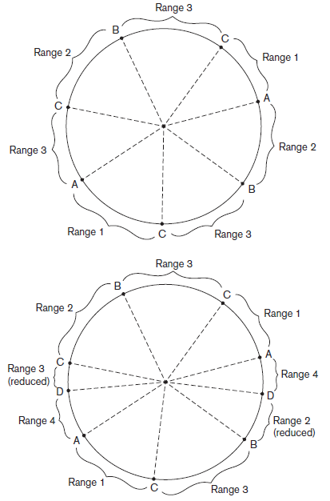
Figure 24.2 Example of consistent hashing (a) Ring having three nodes A, B, and C, with C having greater capacity. The h(K) values that map to the circle points in range 1 have their (k, v) items stored in node A, range 2 in node B, range 3 in node C (b) Adding a node D to the ring. Items in range 4 are moved to the node D from node B (range 2 is reduced) and node C (range 3 is reduced)

Slide 121
Examples of Other Key-Value Stores
Oracle key-value store
Oracle NOSQL Database
Redis key-value cache and store
Caches data in main memory to improve performance
Offers master-slave replication and high availability
Offers persistence by backing up cache to disk
Apache Cassandra
Offers features from several NOSQL categories
Used by Facebook and others

Slide 122
24.5 Column-Based or Wide Column NOSQL Systems
BigTable: Google’s distributed storage system for big data
Used in Gmail
Uses Google File System for data storage and distribution
Apache Hbase a similar, open source system
Uses Hadoop Distributed File System (HDFS) for data storage
Can also use Amazon’s Simple Storage System (S3)

Slide 123
Hbase Data Model and Versioning
Data organization concepts
Namespaces
Tables
Column families
Column qualifiers
Columns
Rows
Data cells
Data is self-describing

Slide 124
Hbase Data Model and Versioning (cont’d.)
HBase stores multiple versions of data items
Timestamp associated with each version
Each row in a table has a unique row key
Table associated with one or more column families
Column qualifiers can be dynamically specified as new table rows are created and inserted
Namespace is collection of tables
Cell holds a basic data item

Slide 125
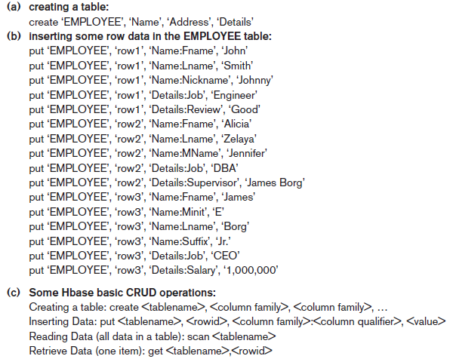
Figure 24.3 Examples in Hbase (a) Creating a table called EMPLOYEE with three column families: Name, Address, and Details (b) Inserting some in the EMPLOYEE table; different rows can have different self-describing column qualifiers (Fname, Lname, Nickname, Mname, Minit, Suffix, … for column family Name; Job, Review, Supervisor, Salary for column family Details). (c) Some CRUD operations of Hbase

Slide 126
Hbase Crud Operations
Provides only low-level CRUD (create, read, update, delete) operations
Application programs implement more complex operations
Create
Creates a new table and specifies one or more column families associated with the table
Put
Inserts new data or new versions of existing data items

Slide 127
Hbase Crud Operations (cont’d.)
Get
Retrieves data associated with a single row
Scan
Retrieves all the rows

Slide 128
Hbase Storage and Distributed System Concepts
Each Hbase table divided into several regions
Each region holds a range of the row keys in the table
Row keys must be lexicographically ordered
Each region has several stores
Column families are assigned to stores
Regions assigned to region servers for storage
Master server responsible for monitoring the region servers
Hbase uses Apache Zookeeper and HDFS

Slide 129
24.6 NOSQL Graph Databases and Neo4j
Graph databases
Data represented as a graph
Collection of vertices (nodes) and edges
Possible to store data associated with both individual nodes and individual edges
Neo4j
Open source system
Uses concepts of nodes and relationships

Slide 130
Neo4j (cont’d.)
Nodes can have labels
Zero, one, or several
Both nodes and relationships can have properties
Each relationship has a start node, end node, and a relationship type
Properties specified using a map pattern
Somewhat similar to ER/EER concepts

Slide 131
Neo4j (cont’d.)
Creating nodes in Neo4j
CREATE command
Part of high-level declarative query language Cypher
Node label can be specified when node is created
Properties are enclosed in curly brackets

Slide 132
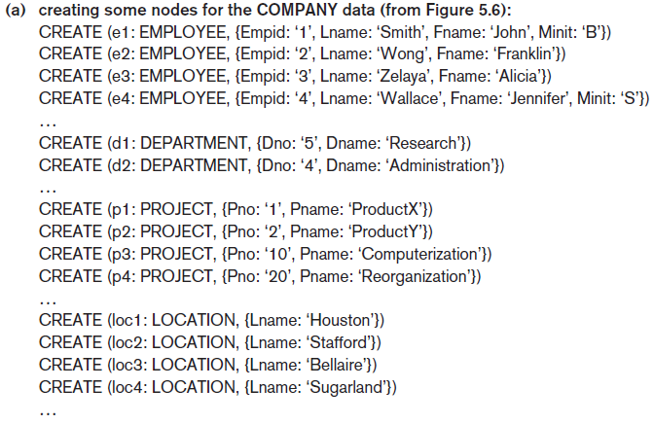
Neo4j (cont’d.)
Figure 24.4 Examples in Neo4j using the Cypher language (a) Creating some nodes

Slide 133
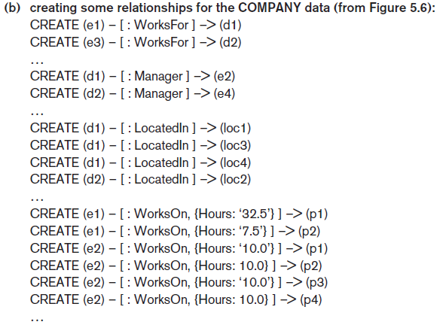
Neo4j (cont’d.)
Figure 24.4 (cont’d.) Examples in Neo4j using the Cypher language (b) Creating some relationships

Slide 134
Neo4j (cont’d.)
Path
Traversal of part of the graph
Typically used as part of a query to specify a pattern
Schema optional in Neo4j
Indexing and node identifiers
Users can create for the collection of nodes that have a particular label
One or more properties can be indexed

Slide 135
The Cypher Query Language of Neo4j
Cypher query made up of clauses
Result from one clause can be the input to the next clause in the query

Slide 136
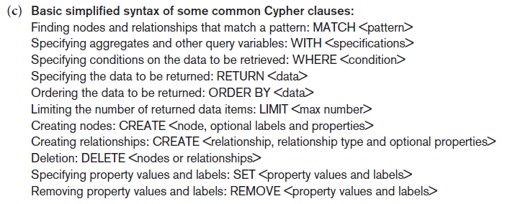
The Cypher Query Language of Neo4j (cont’d.)
Figure 24.4 (cont’d.) Examples in Neo4j using the Cypher language (c) Basic syntax of Cypher queries

Slide 137
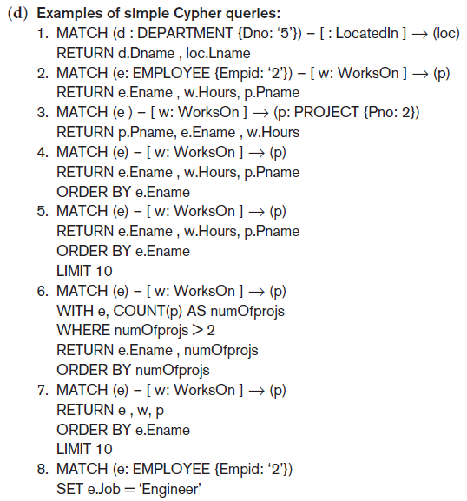
The Cypher Query Language of Neo4j (cont’d.)
Figure 24.4 (cont’d.) Examples in Neo4j using the Cypher language (d) Examples of Cypher queries

Slide 138
Neo4j Interfaces and Distributed System Characteristics
Enterprise edition versus community edition
Enterprise edition supports caching, clustering of data, and locking
Graph visualization interface
Subset of nodes and edges in a database graph can be displayed as a graph
Used to visualize query results
Master-slave replication
Caching
Logical logs

Slide 139
24.7 Summary
NOSQL systems focus on storage of “big data”
General categories
Document-based
Key-value stores
Column-based
Graph-based
Some systems use techniques spanning two or more categories
Consistency paradigms
CAP theorem

