Slide 1
Deep learning

Slide 2
Model comparisons
ConvNets |  | Accuracy | parameters
AlexNet | 2012
GoogleNet | 2014 | 74,8% | 6,8 M
SENet | 2017 | 82.7% | 145M
GPipe | 2018 | 84,3% | 557M
ConvNets
Model compression | 2012
SqueezeNets | 2016
MobileNets | 2017
ShuffleNets | 2018
Neural architecture search | 2019
Model scaling
ResNet | Depth layers
WideResNet,MobileNets | Netweork width(#channels)

Slide 3
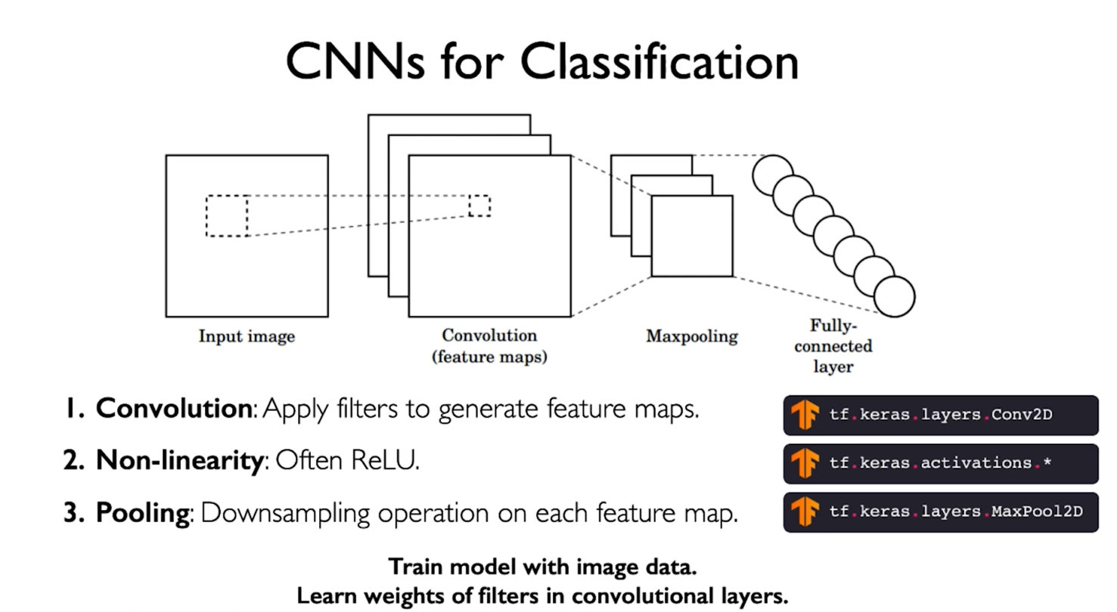

Slide 4
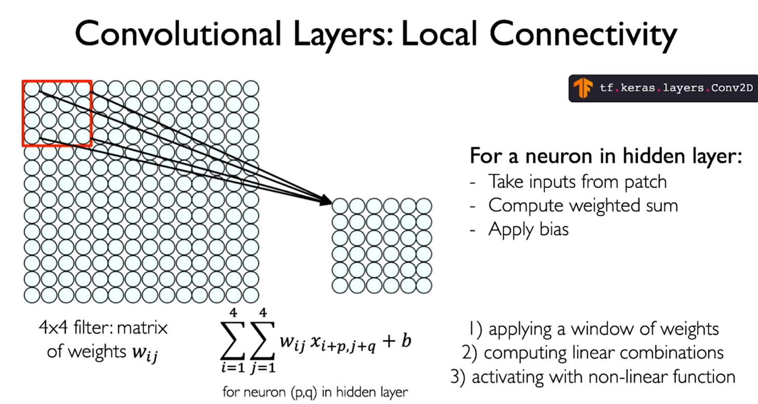
CNN 1st

Slide 5
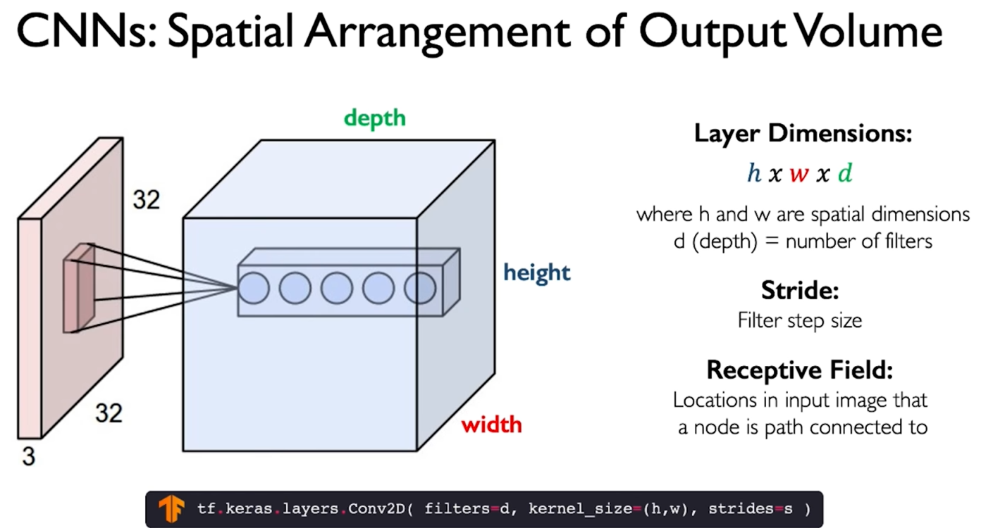
CNN

Slide 6
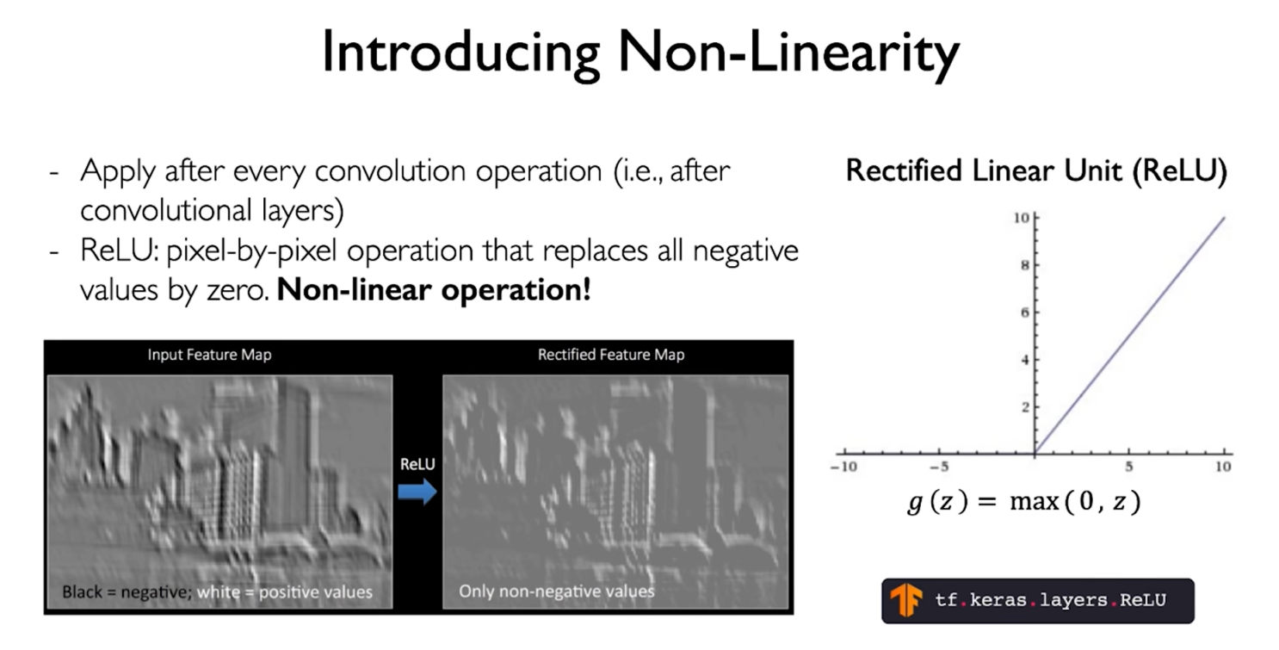
CNN

Slide 7
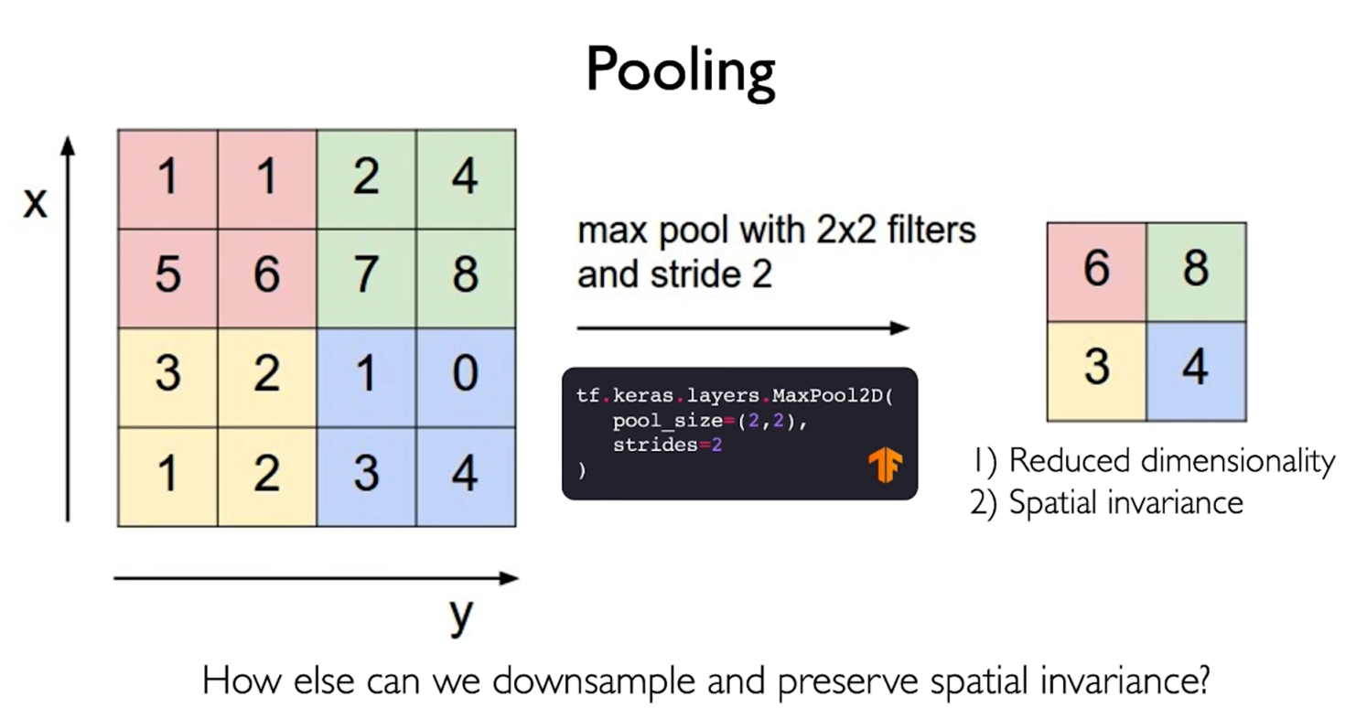
CNN

Slide 8
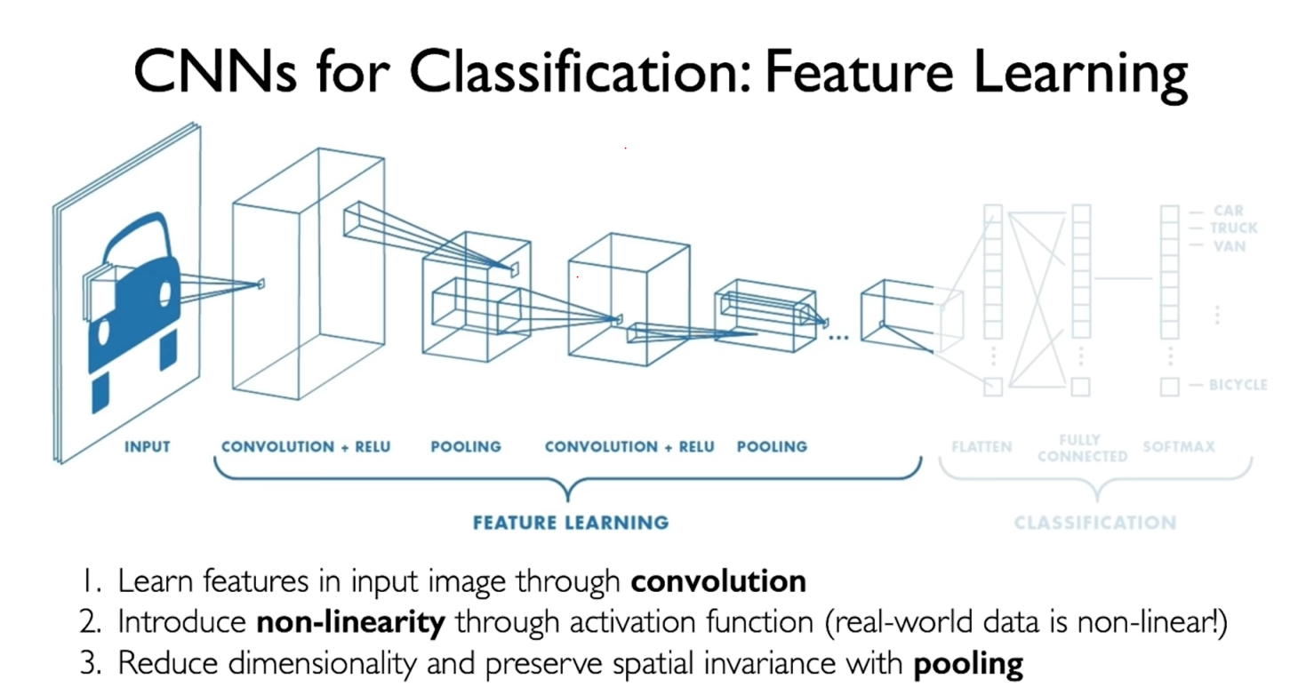
CNN for classification

Slide 9
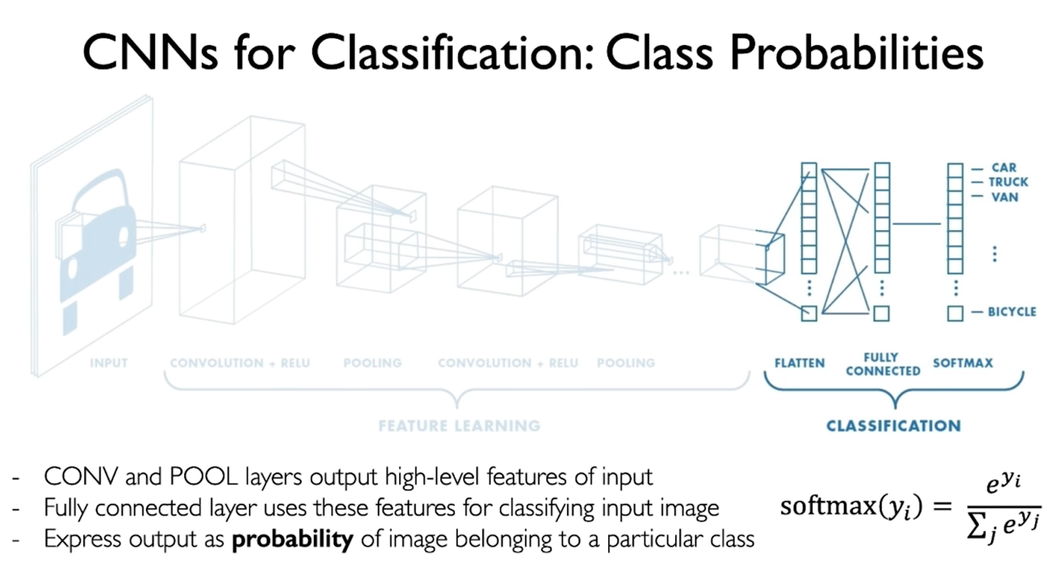
CNN for classification

Slide 10
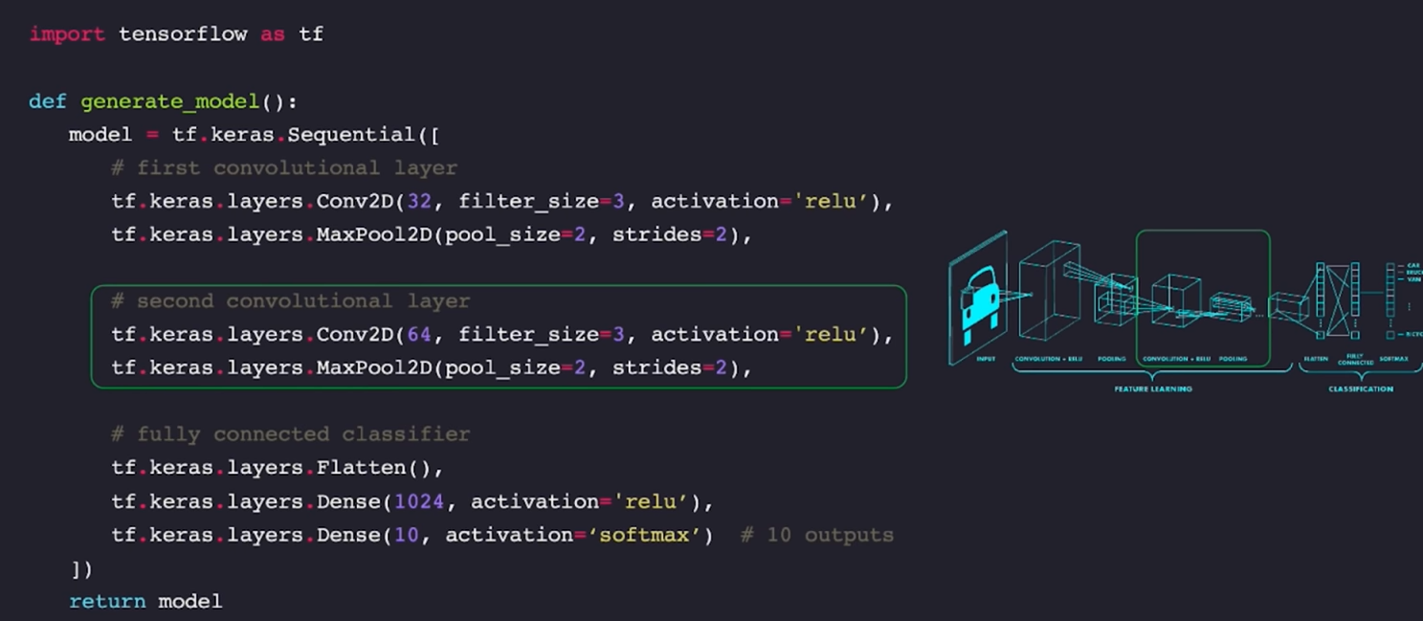
Code

Slide 11
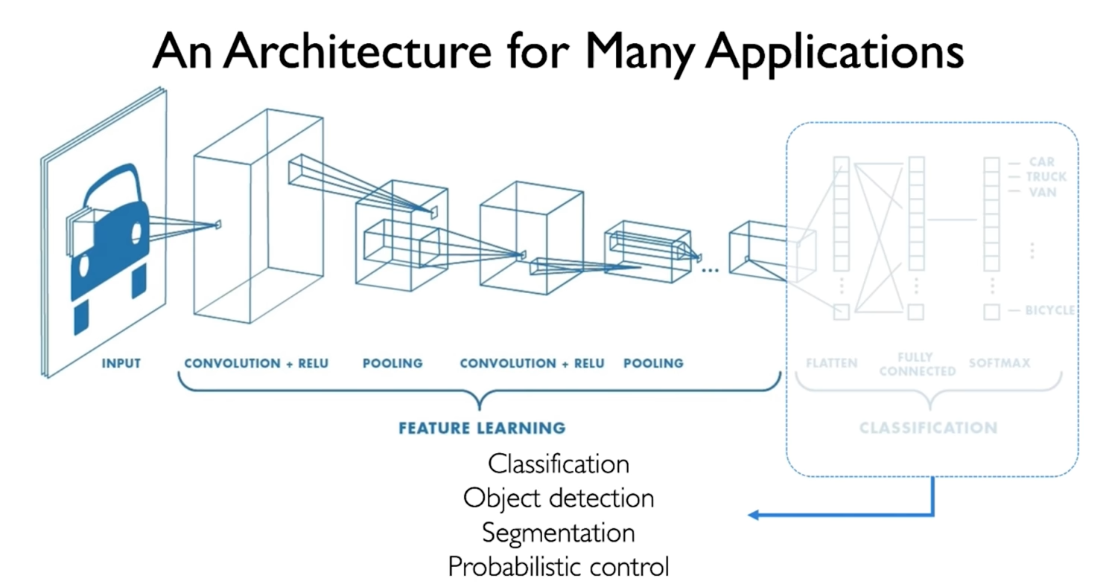
Object detection – multi localizing + multi classification

Slide 12
Xi <Hi, Wi, Ci> input tensor
Yi Output tensor
Multiple stages, Layer in each stage same config
ResNet -> 5 stages
Fi(Xi), <Hi, Wi, Ci>

Slide 13
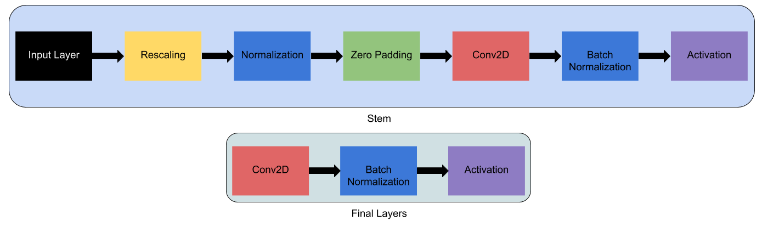
EfficientNet
Conv2D

Slide 14
Bidirectional GRU
Conv2D

Slide 15
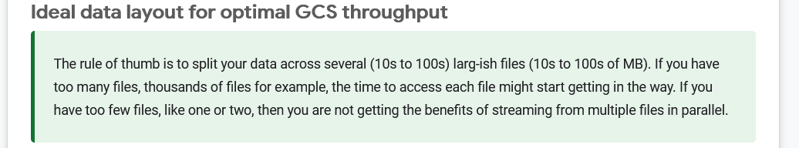
TPU

