Slide 1
CLOUD ROBOTICS
Presented by
AKSHAY KUMAR
B.TECH 3rd YEAR (B)
DEPARTMENT OF COMPUTER SCIENCE AND ENGINEERING
Ideal Institute of Technology Ghaziabad [U.P.]
Dr. A.P.J ABDUL KALAM TECHNICAL UNIVERSITY
March-2013
March-2013
15/03/2013
Cloud Robotics

Slide 2
WHAT IS ROBOT?
A robot is an autonomous system which exists in the physical world, can sense its environment, and can act on it to achieve some goals.

Slide 3
TYPES OF ROBOT
STRUCTURED ROBOTS
UNSTRUCTURED ROBOTS
TELEOPERATED ROBOT SYSTEM
MULTI ROBOT SYSTEM
15/03/2013
Cloud Robotics

Slide 4
STRUCTURED ROBOTS
15/03/2013
Cloud Robotics

Slide 5
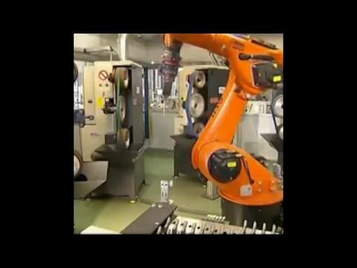
KUKA AUTOMATION COMPANY OF GERMANY (VIDEO)
15/03/2013
Cloud Robotics

Slide 6
UNSTRUCTURED ROBOTS
15/03/2013
Cloud Robotics

Slide 7
TELEOPERATED SYSTEMS
15/03/2013
Cloud Robotics

Slide 8
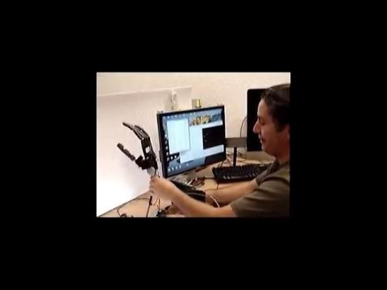
ROBOTIC ARM MIMICKING THE MOVEMENTS OF HUMAN HAND (VIDEO)
15/03/2013
Cloud Robotics

Slide 9
MULTI ROBOT SYSTEMS
15/03/2013
Cloud Robotics

Slide 10
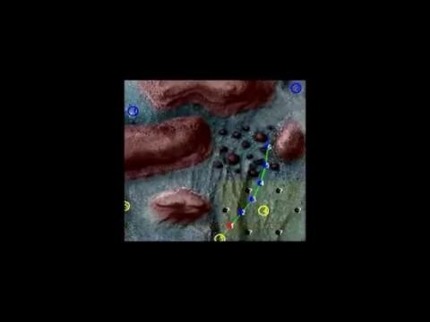
RESCUE OPERATION PERFORMED BY ROBOTS (VIDEO)
15/03/2013
Cloud Robotics

Slide 11
LIMITATIONS OF ROBOT
15/03/2013
Cloud Robotics

Slide 12
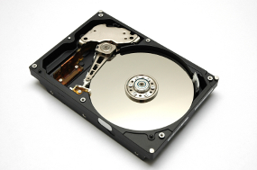
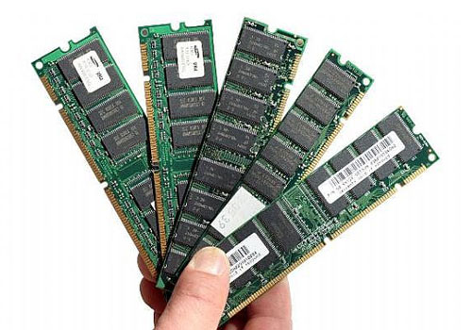
SECONDARY STORAGE
PRIMARY STORAGE
15/03/2013
Cloud Robotics

Slide 13
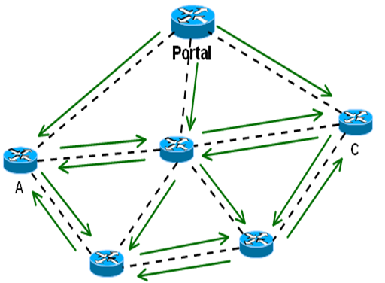
PROACTIVE ROUTING
high computation
large memory
15/03/2013
Cloud Robotics

Slide 14
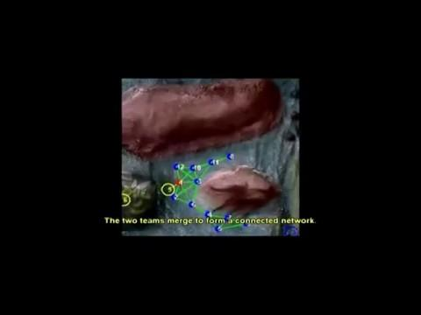
DYNAMIC ROUTING (VIDEO)
Dynamic topology
High latency
15/03/2013
Cloud Robotics

Slide 15
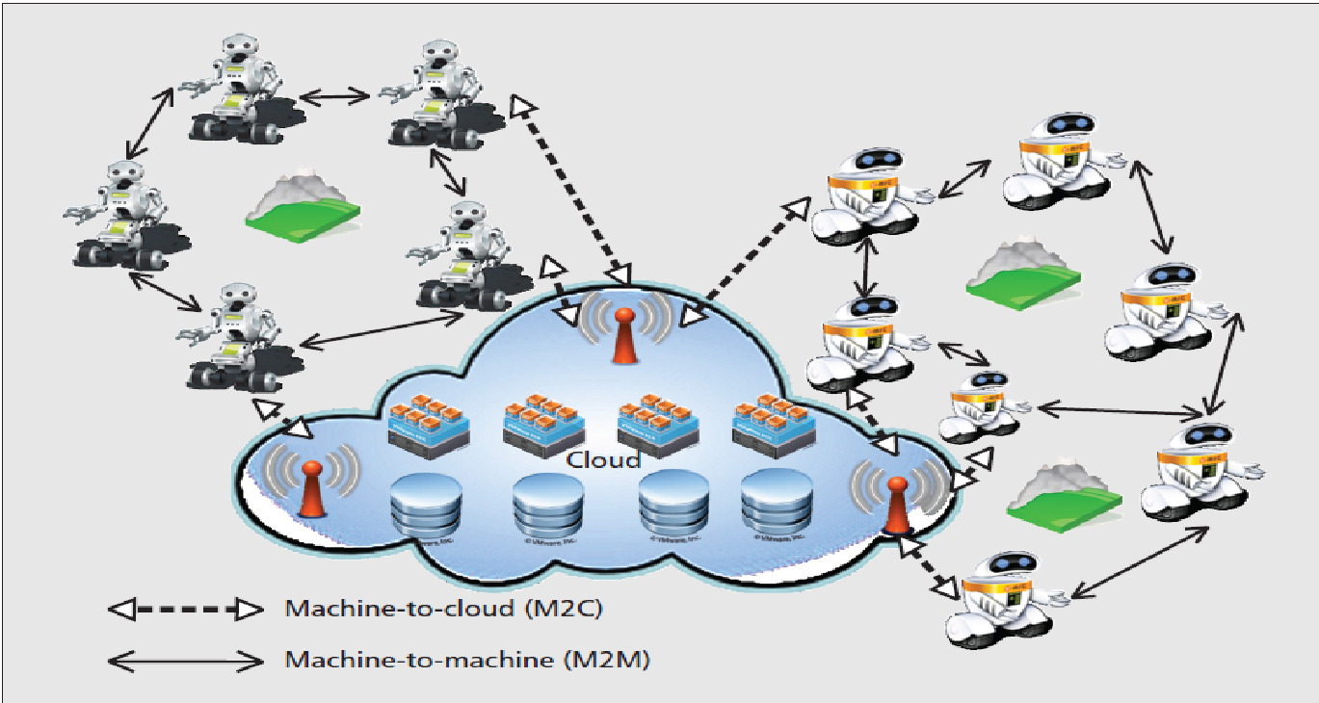
CLOUD ROBOTICS
15/03/2013
Cloud Robotics

Slide 16
SMART PHONE ROBOT
SENSORS MOBILITY
MICROPHONE MOTORS
SPEAKER EFFECTORS
GYROSCOPE CONTROLLERS
MEMORY MEMORY
PROCESSOR PROCESSOR
ACTUATORS
15/03/2013
Cloud Robotics

Slide 17
GOOGLE PROVIDING SOME SERVICES SUCH AS
15/03/2013
Cloud Robotics

Slide 18
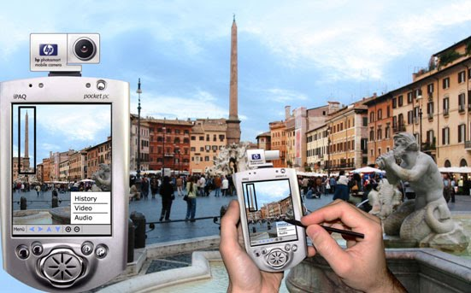
OBJECT RECOGNITION
15/03/2013
Cloud Robotics

Slide 19
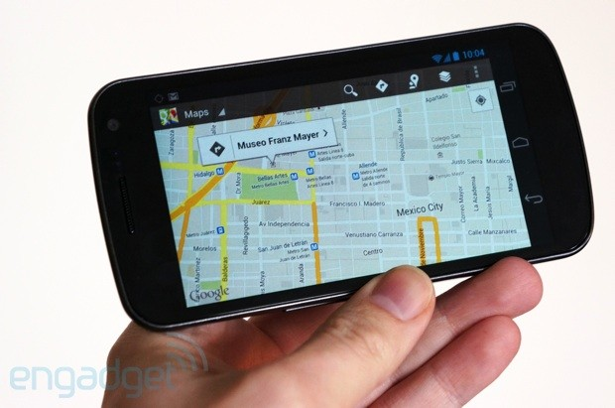
MAPPING AND NAVIGATION
15/03/2013
Cloud Robotics

Slide 20
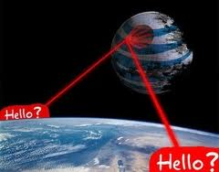
VOICE SERVICES
15/03/2013
Cloud Robotics

Slide 21
ADVANTAGES OF CLOUD ENABLED ROBOTS
AFFORDABLE ROBOTS
SCALABLE MEMORY
SCALABLE PROCESSOR
15/03/2013
Cloud Robotics

Slide 22
ROS
(ROBOT OPERATING SYSTEM)
ROS provides libraries and tools to help software developers to create robot applications.
ROS is written in C++, JAVA, PYTHON.
It provides hardware abstraction, device drivers, libraries, visualizers, message-passing, package management, and more.
ROS is open source.
ROS is made by Willow Garage.
15/03/2013
Cloud Robotics

Slide 23
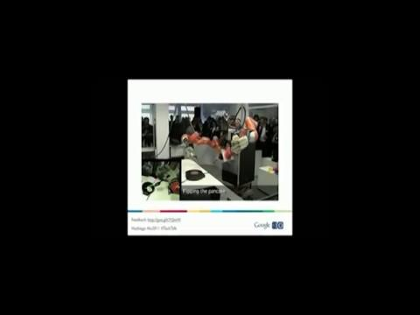
ROS ENABLED ROBOTS (VIDEO)
15/03/2013
Cloud Robotics

Slide 24
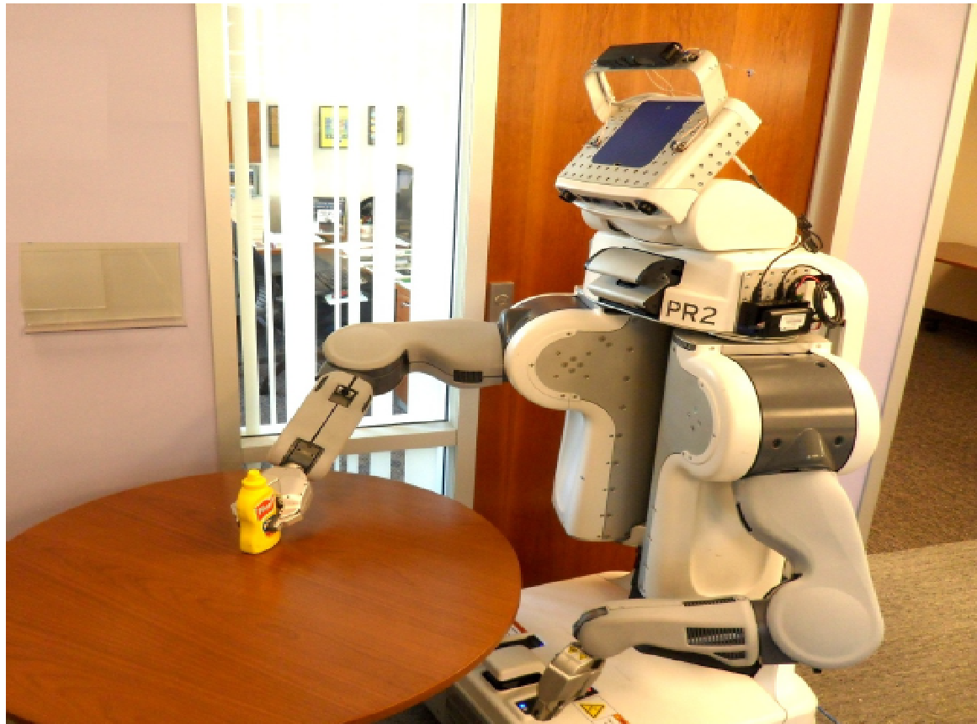
PR2
SPECIFICATIONS:
COSTS $400,000
2 SERVERS(8 CORE I7)
2X(24 G.B RAM)
7 CAMERAS(2X STEREOS)
2XLASER RANGE FINDERS
2X4 DOF ARMS,3DOF WRIST
OMNIDIRECTIONAL BASE
15/03/2013
Cloud Robotics

Slide 25
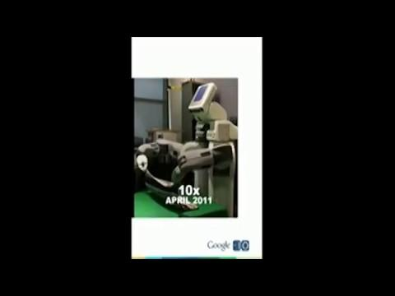
PR2 WORKING IN UNSTRUCTURED ENVIRONMENT (VIDEO)
15/03/2013
Cloud Robotics

Slide 26
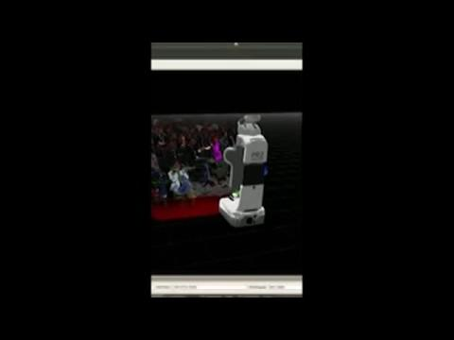
PR2 HAVING 3D SENSOR (VIDEO)
15/03/2013
Cloud Robotics

Slide 27
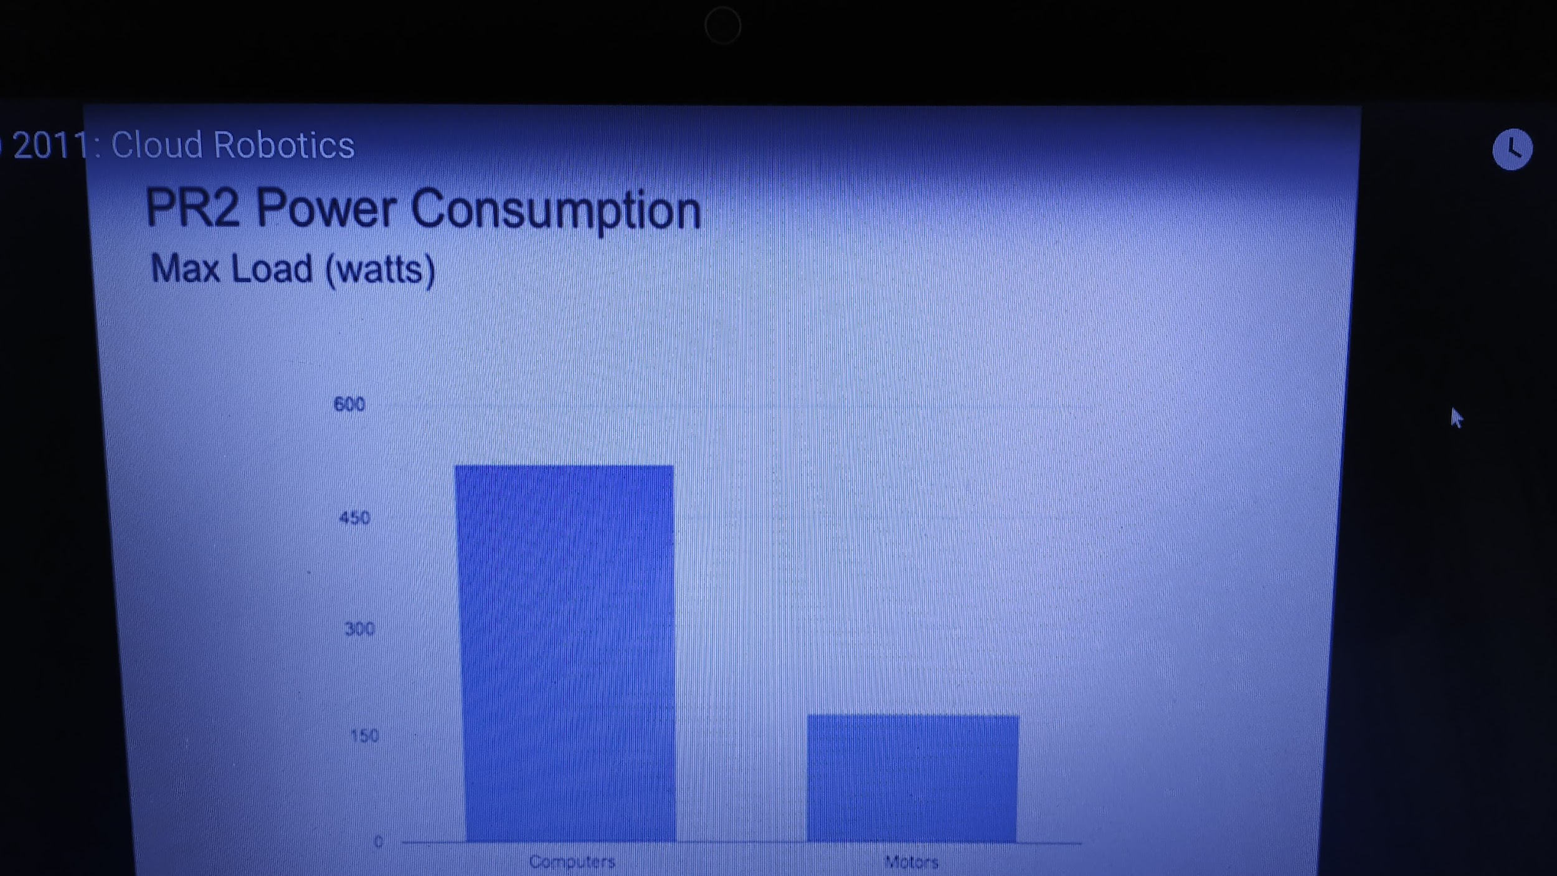
PR2 POWER CONSUMPTION
MAX LOAD(WATT)
15/03/2013
Cloud Robotics

Slide 28
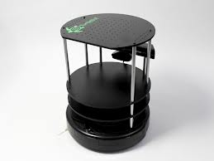
ROS ENABLED HARDWARE
TURTLEBOT
Explore your house on its own
Build 3D pictures
Bring you food
Comes with an open-source SDK based on ROS
Advanced capabilities like mapping and navigation
15/03/2013
Cloud Robotics

Slide 29
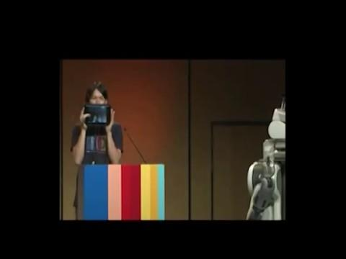
ROS ON ANDROID (VIDEO)
ROS framework written in pure java called ROS JAVA
Android compatible
Open source
15/03/2013
Cloud Robotics

Slide 30
CONCLUSION
We are basically offloading the task from robot to the cloud in terms of memory and processing.
As we have the google services on the smart phone in the similar manner these services are transferred to the robots.
PR2 robot is performing such services in terms of object recognition with the help of google goggle server.
If we remove the servers from the PR2 then we are doubling the battery life of PR2 for 4 to 5 hours.
ROS on Android gives us the service in which we can control the robot from our smart phone.
15/03/2013
Cloud Robotics

Slide 31
REFERENCES
[1] Google Cloud Storage. http://cloud.google.com/
products/cloud-storage.html.
[2] Google Goggles. http://www.google.com/mobile/
goggles/.
[3] PCL: The Point Cloud Library. http://pointclouds.org.
[4] Willow Garage PR2. http://www.willowgarage.com/
pages/pr2/overview.
15/03/2013
Cloud Robotics

Slide 32
THANK YOU
15/03/2013
Cloud Robotics

