Slide 1
Object Detection
YOLO, DARKNET
BY ENGG_TECH

Slide 2
INTRODUCTION:
Hey, Youtube!!
In this tutorial, we are going to learn about Object Detection and we can train our own custom model.
We are going to use Darknet and YOLO.
In later part of video/tutorial we going to setup a full-fleshed environment for training..
Purpose of making of this video is to Guide programmers, how step by step and easily we can do custom object detection. As when I performed, I found many difficulties and lots of errors, so in this video we will discuss how to tackle such errors and how to build an Object detection model.
So Keep Watching…

Slide 3
SYSTEM REQUIREMENTS:
For Object Detection, Minimum requirements and recommended are listed below:
Specifications: | Minimum | Recommended
RAM | 8GB | 16 OR 32 GB
CPU | 4 CORES | 6 OR 8 CORES
GPU | NIVIDIA 1650 (If not GPU, then don’t worry, we can still train) | NIVIDIA 1080ti 11GB
INTERNET CONNECTION | REQUIRED | REQUIRED
OPERATING SYSTEM | WINDOWS OR LINUX | LINUX
If in your computer, Nividia Graphics is not installed, then don’t worry we will use online GPU which will be free of cost.

Slide 4
INDEX
WE WILL SETUP OUR ENVIRONMENT:
If you are using Linux then it will not be much difficult. And if you are using Windows Operating System then we need to download and install some tools set up our environment.. And also, this setup will be very easy, just follow the steps…
Then, we will download Image and label it. Also, we are going to download some repository, some pre-defined weights.
After this, we will modify come pre-downloaded config files which is very easy.
Later on, we create 2-3 files only in which each file will be of 4-5 lines only.
And, Boom, that’s it. Then we will train our model and we will use trained model to predict the images.

Slide 5
Setting Up The Environment.
Basically, we need to download DARKNET repository and sun the files. But before that we need to run MAKEFILE(present in DARKNET repository, don’t worry we will discuss this later on.).
Now, if you are using Linux then you can skip this part and can run MAKEFILE command(How to do? ➔ Discussed after Windows tools installation).
If you are using Windows then you must follow these simple steps in order to run MAKEFILE command.
Windows:( Make Sure during Installation, Internet connect is on.)
1. You need to download Git and install it.
While installing, check Additional icons, On desktop,Git Bash, Git GUI and keep default check as it is.
2. You need to download Cygwin and install it.
See next slide…

Slide 6
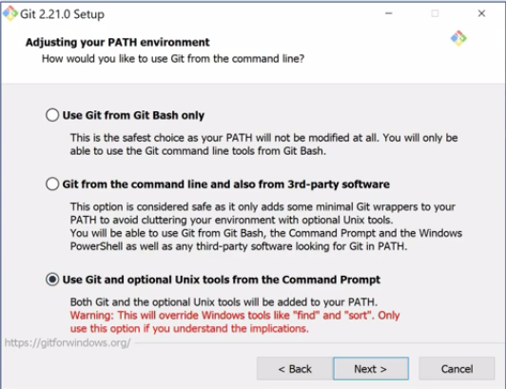
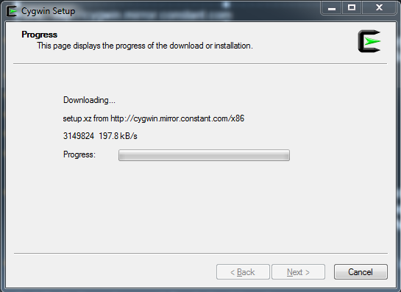
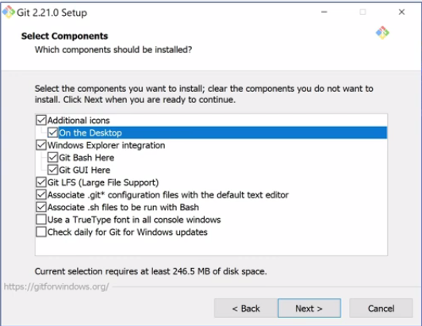
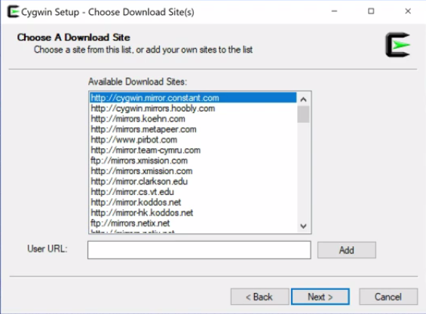
Screenshots:
To check, whether Git is installed or not, type git in cmd.

Slide 7
Continue…(Cygwin installation)
URL: http://cygwin.mirror.constant.com
On clicking next-next you will end with one window named as Cygwin setup select packages. Now here we need to select some packages. So search for:
1. make ➔ Devel ➔ select make(change skip to install)
2. ssh ➔ Net ➔ install whole Net
3. ssl ➔ Python, select whole package to install
4. gcc-core ➔ Devel ➔ gcc-core(select install)
4. vim ➔ Editors ➔ Select Vim(latest version)
Now all packages are selected, now click next and sit back for some time. The installation might time some time depends on your internet connection speed. In my case it took around 2 hours. So, just relax, have some coffee.
After downloading, click on next, check “create icon on desktop” and ”add icon to start menu” and finish.
And that’s it, environment for darknet is setup.

Slide 8
Download Githubs…
Now, to go for object detection, we need to download some github repositories:
1. Darknet Repository by AlexeyAB➔ https://github.com/AlexeyAB/darknet
2. labelImg ➔ https://github.com/tzutalin/labelImg
3. XmltoTxt by Isabek ➔ https://github.com/Isabek/XmlToTxt
4. My Github repository.
➔https://github.com/hmgtech/Requirents-For-Darknet
5. We need to download one pre-defined weights:
darknet53.conv.74 its about 154 MB
Link:➔ https://pjreddie.com/media/files/darknet53.conv.74

Slide 9
After Downloading…
Extract darknet repository only. Extract it in C: drive to better convenient.
After extracting, open Cygwin64 Terminal(from desktop or start menu)
Change the directory of terminal to C:\darknet.
If you are using GPU:
Then modify MAKEFILE(in C:\darknet folder) accordingly:
GPU=1
CUDNN=1
OPENCV=1
Above are starting lines of makefile.
And type “make”
It will run MAKEFILE and install all necessary files.
Make sure to install CUDA and OPENCV if you are using GPU.

Slide 10

Now, Lets Collect Images.
There is one Google extension named as “Download All images” and icon shown as zip.
Now, open search any thing in Google Chorme and go to images section and just click this extension, it will download all your images in zip file and you only need to extract it.
You can also use Google image dataset for image downloading…
Demo is shown in next slide.
Link of repo: https://github.com/theAIGuysCode/OIDv4_ToolKit

Slide 11
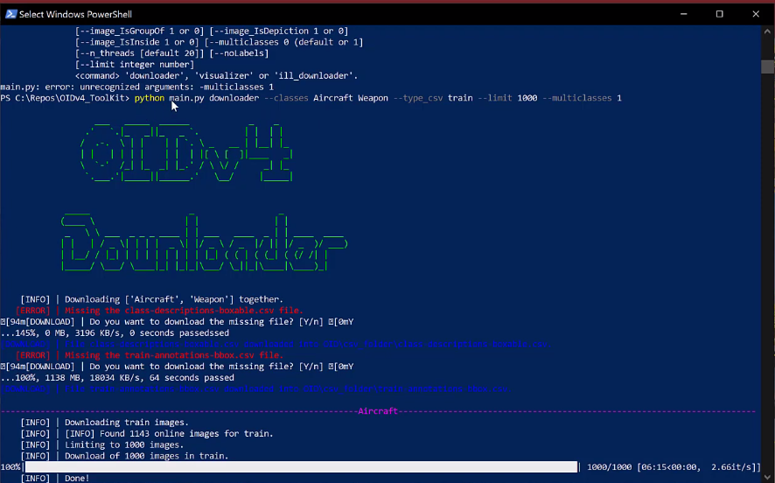

Slide 12


After Downloading the images:
We need to label it. To label, we have already download one repository named as “labelImg”. Just extract it. Before that, you need to install pyqts and lxml libraries for user-interface. In cmd type:
pip install pyqt5
pip install lxml
Now ready to run labelImg. Make sure you are in labelImg folder. Open cmd there. And type “python labelImg.py”, and boom, it will open up a window.
To save label in .xml type
To save label in .txt type

Slide 13
Label image problem:
Suppose u have to download 8 different classes namely, cat, dog, lion, tiger, bike, truck, car and train. If you are the only person who is going to label then it will become tedious job, but as you are alone, you have to do all this task and in this case you can use yolo which will direct create label in txt form. And you consider as, 0 index for cat, 1 index for dog, 2 index for lion, 3 index for tiger, 4 index for bike and so on..
But, if you are have a team of 4 members then it is obvious that you are going to distribute the work and suppose each member will get 2 classes. Suppose, Member A get cat and dog, Member B get lion and tiger, Member C get bike and truck, and you will get car and train.
Here, when Member A will go for label the image, then by default labelImg will assign 0 for cat and 1 for dog.
Same thing for Member B also, LabelImg will assign 0 for lion and 1 for tiger. And it will repeat for Member C and with you also.

Slide 14
Continue Problem…
At the time, when Member A, B and C submit their work(images with label in txt extension) then, you will receive multiple classes name for same index and hence your model will turn up in a mess...
Member A: Member B: Member C: You:
So, to overcome this problem, you can give images to your team members, and ask them to label it in .xml file. Get all images from them, Now u are the one who will decide which index will be given to which class and storing classes in text file and just run xmlTotxt converter. It will convert all xml to txt file at once. This is safe, secure method with 0% error.
Classes | Index
Cat | 0
Dog | 1
Classes | Index
Lion | 0
Tiger | 1
Classes | Index
Bike | 0
Truck | 1
Classes | Index
Car | 0
Train | 1

Slide 15
Libraries need to be install:
pip install pillow
pip install numpy
pip install matplotlib
pip install opencv-python
pip install tensorflow
pip install keras
pip install contextlib2
pip install pandas
pip install Cython
pip install jupyter

Slide 16
After labeling the image:
Copy images and labels
Go to data folder in darknef folder(C:\darknet) and make a new folder and name it as obj.
Now, inside obj folder, paste images and labels.
Now go to cfg folder in (Darknet folder)➔ look for yolov3.cfg. Make copy of it at same place and rename copied file as yolov3-custom.
Open this yolov3-custom file in any editor. I prefer Sublime. Now make changes accordingly…

Slide 17
Changes in yolov3-custom.cfg
Comment below lines(Line: 2 to 5):
# Testing
# batch=1
# subdivisions=1
# Training
Uncomment(Line: 6 and 7):
batch=64
subdivisions=16
Now, go to subdivisions (i.e., Line: 7), replace according to ur GPUs.
If subdivisions=16 and gives CUDA error while training, then change it to 32 ie, subdivisions=32, if still it gives error then change to 64 and so on.

Slide 18
Continue…
Now, search for max_batches on (Line:20). Change it accordingly:
it depends on number of your classes.
max_batches = classes * 2000
➔If you have 3 classes, then max_batches = 6000 (3*2000)
➔If you have 4 classes, then max_batches = 8000 (4*2000)
➔If you have 1 classes, then max_batches = 4000. (4000 because, minimum max_batches should be set at 4000 for better training)
Now, just below max_batches, steps are there, it also be changed accordingly:
if max_batches = 6000 then
steps = 4800, 5400
4800 because➔80% of max_batches
5400 because➔90% of max_batches

Slide 19
Continue…
Now, search for yolo. And u will [yolo]. In that, you will find classes:80.
Change this classes to number of your classes. Eg, classes = 4
And above this [yolo] layer, you will find a [conventional] layer. In this, you will find a filters attribute:255. Change it accordingly.
filters = (classes+5)*3
➔If classes = 4; then filters = 27 (4+5)*3
➔If classes = 1; then filters = 18 (1+5)*3
Now, this we have to modify all [yolo] and [conventional] layer. So just repeat this steps. (it will be repeated 3 times only).
After this, one small thing is left, that is, random. Search for random, and change accordingly.
random = 1➔ It resizes images while training and doesnow overfit.(I prefer this.)
random = 0➔ it will not resizes and No problem of out of memory. (can be risky)

Slide 20
That’s it. SAVE yolov3-custom.cfg file.
Now go to data folder in Darknet folder.
Create a file named as obj.names
Obj.names will contain all classes name inside it. Example:
queen
ten
ace
king
nine
jack
Now, create another file names as obj .data. This file contain number of classes, train images path, valid images path, names, and a bachup folder path. Example:
classes = 6
train = data/train.txt
valid = data/test.txt
names = data/obj.names
backup = backup/

Slide 21
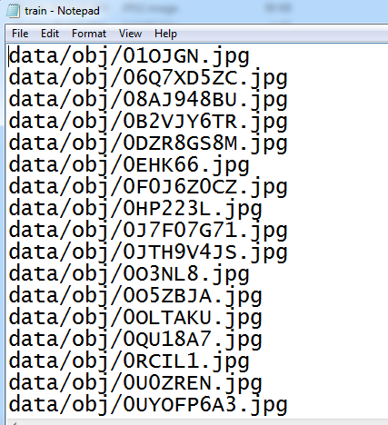
Modifications:
Create a backup folder in darknet folder to store all weights while traning.
Now we need to create a train.txt file in data folder which will contain path of all images.
Tedious Job?
For generation for this train.txt please refer my github repository.
After generating train.txt file, generate manually test.txt in same folder and cut-paste some lines from train.txt to test.txt.

Slide 22
Quick Recap:
We have download images and labelled it.
We make changes in MAKEFILE as per GPU and CPU
We modify yolov3-custom.cfg file.
We Created obj.names, obj,data and train.txt and test.txt in Data folder.
Copied images and labels in obj folder of Data folder.

Slide 23
Hurray!!
Now we are ready to train our model.
Now go to darknet folder and open cmd(or Cygwin) and run:
For cmd: darknet detector train data/obj.data cfg/yolov3-custom.cfg darknet53.conv.74
For Cygwin: ./darknet detector train data/obj.data cfg/yolov3-custom.cfg darknet53.conv.74
Now, Suppose if you don’t have GPU, or having but low space GPU, then we can use Google Colab for training.
If you followed my whole tutorial step by step then we don’t want to do that work again.

Slide 24
Google Colab:
If you are going to use google colab, then it Is best practice to upload all your data images, labels, and pre-trained(darknet53.conv.74) weights on your drive.
This is because, Google colab allows us to use its GPU for 12 hours only, and after it log off to us and colab store our data temporary. It will remove all our uploaded data from its Virtual Machine(VM).
And also, if while training some error occurs then it might happen that colab gets shut down and all your uploaded images and pre-trainded get lost.
I will sugest you to upload only images, labels and weights. If your uploading your files to drive then, you have to mount drive in colab,

Slide 25
Google Colab:
Open Colab, Change the runtime to GPU from edit menu and Runtime menu.
Clone Darknet: !git clone https://github.com/AlexeyAB/darknet
It will not take any your internet data.
Run this command to change makefile:
%cd darknet
!sed -i 's/OPENCV=0/OPENCV=1/' Makefile
!sed -i 's/GPU=0/GPU=1/' Makefile
!sed -i 's/CUDNN=0/CUDNN=1/' Makefile
Verify Nividia of google colab:
# verify CUDA
!/usr/local/cuda/bin/nvcc --version

Slide 26
Make command in google colab:
# make darknet (build)
!make
After make import darknet53.conv.74 weights to Virtual Machine of colab by copying it from drive or you can manually upload it.
!cp <path-file to copy from drive> <destination>
Or to download:
!wget http://pjreddie.com/media/files/darknet53.conv.74
Now, we need to upload our modified files to colab VM.
Yolov3-custom.cfg to darknet/cgf folder
Obj.names to darknet/data folder
Obj.data to darknet/data folder
Train.txt and test.txt to darknet/data folder
Images and labels to darknet/data/obj folder

Slide 27
Train On COLAB:
Now just sit and tight your seat belts, we are almost done. We are going to train our model on colab.
Run this command:
!./darknet detector train data/obj.data cfg/yolov3 custom.cfg darknet53.conv.74 -dont_show
NOTE: Colab Cloud Service kicks you off it's VMs if you are idle for too long (30-90 mins).
To overcome this problem copy this command and paste in your console web brower.
function ClickConnect(){ console.log("Working"); document.querySelector("colab-toolbar-button#connect").click() } setInterval(ClickConnect,60000)

Slide 28
Thank You!!
Subscribe, for more such tutorials
Share
Any Doubt, Please let me know in Comment Box.

