Slide 1
Big Data Project: Group 2
Jesina Ahmed
Punya Anand
Garima Goswami
Akshaya Sivakumar
Mohnish Tirumalasetti
Notes:
Overview and Objective workflow
prediction for future risky driver
business questions regression in R/python slide outlier handling slide
1 slide for each short conclusion summary

Slide 2
Overview:
The Fleet Manager for Az National Trucking (ANT) follows compliance guidelines and risk management practices as dictated by the Federal Motor Carrier Safety Administration (FMCSA).
With 310 drivers traveling through many states and even several countries in North America, the ANT would like to impose more stringent rules regarding to certain risk factors as warranted by telematics data or business exigencies, within bounds of legal permissibility. Ultimately, we would like to enhance safety within the trucking industry.
Objective of the project:
Our objective is to grasp an understanding of the risk factors associated with commercial truck operations through data visualizations and various types of data analysis using Tableau.

Slide 3








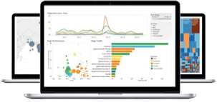
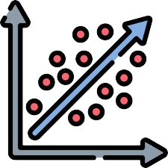

Project Workflow
Create additional tables: trucks_mileage, avg_mileage, driver_mileage, and riskfactor
START: Download Tableau, essential Tableau drivers, and
and files from eLearning
Create table for geolocation, trucks, and trucks_mg files in Hive using DDL
Verify tables are in default database, then import data into the created tables
Move files to HDFS default location
Populate riskfactor table using the provided PIG script
Establish a connection for HDFS in Tableau
Import data from Cloudera server and establish relationship between the tables and combine the data
Integrate tableau with R using Rserve library
Use Exploratory Data Analysis to create dashboards and other visualizations for business questions
Use Regressional Analysis and create a regression model to predict the risk factor

Slide 4
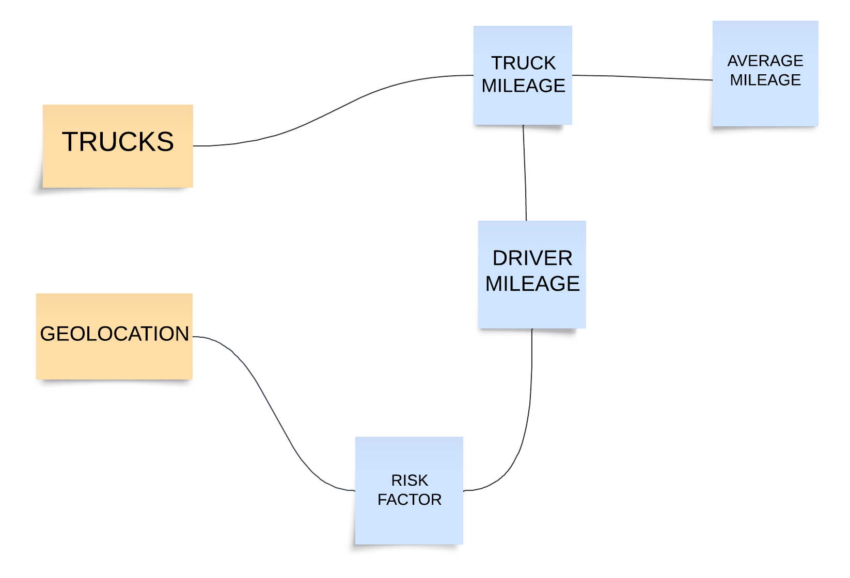
Relational Database/Dataset
Key Risk Factor Thresholds
Mileage
Speed
Other thresholds based on regulatory mandates, business imperatives, and telematic data observations
Truck Driver Risk Factor Cases
In this phase, the "Mileage/Speed risk factor threshold is employed to assess individual driver' risk levels.

Slide 5
Business Questions
Which are the cities where drivers have been found to be having higher speeds and what is the average speed of vehicles in the cities?
What is the actual count of cases of non-normal events causing the risk for the company?
Who are the drivers with the highest risk factors? (The firm needs to know this to keep check on such drivers)
Are there particular truck models attributing more to the risk? Does the risk arise from any particular truck model being driven by the drivers.
How do the risk factors and events in different cities correlate with the total miles driven by truck drivers, and how can this information be used to improve fleet safety and efficiency?

Slide 6
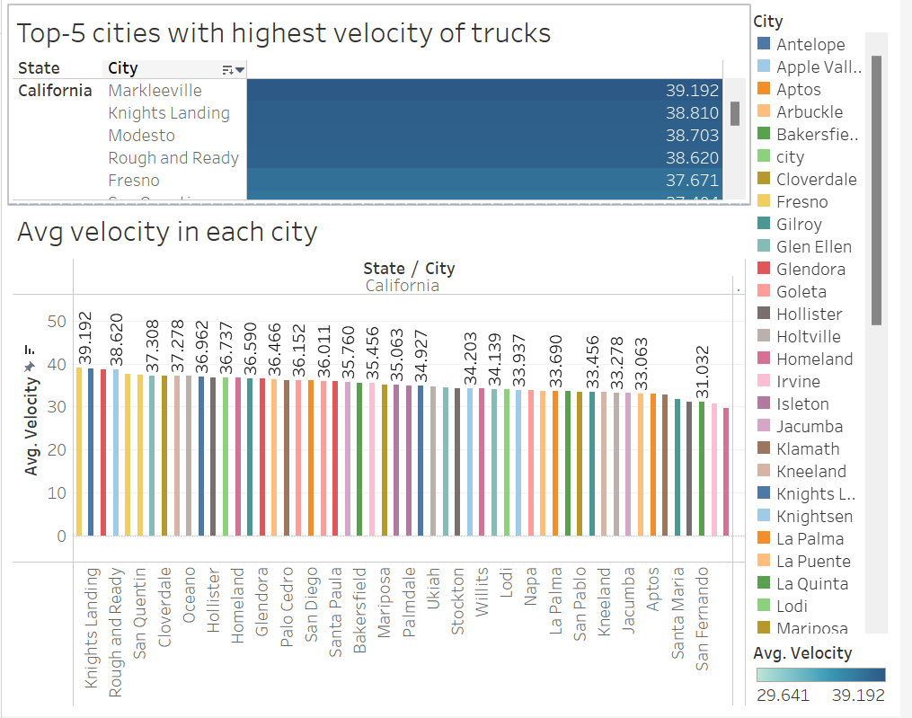
Question 1: The cities where drivers have been found to have higher speed than the average
Velocity > 37 mph found in cities
Markleeville
Knights Landing
Modesto
Rough & Ready
Fresno
Notes:
This slide covers the top-5 highest velocity trucks with significantly higher risk factors
We can recommend imposing speeding controls of trucks to their respective avg. velocities to reduce accidents

Slide 7
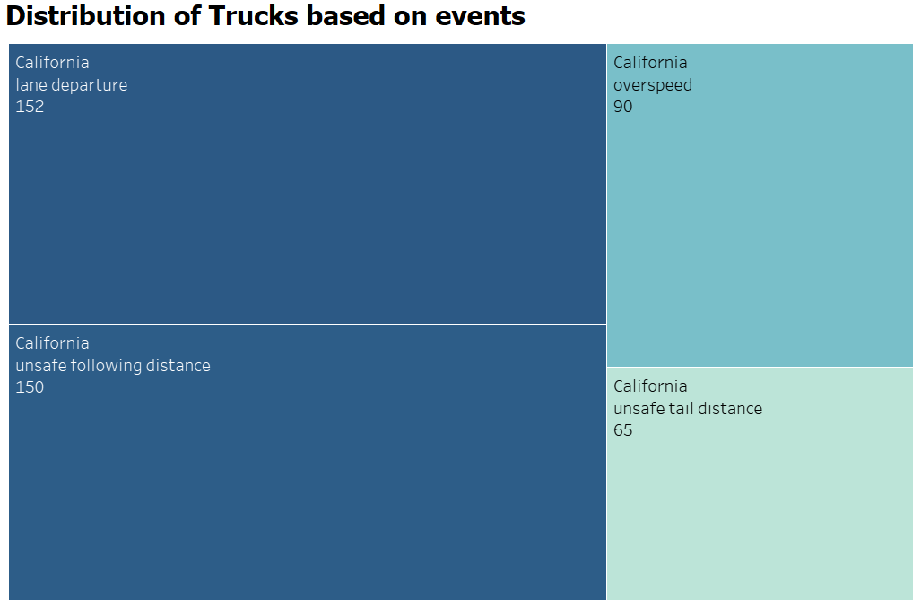
Question 2: The count of various cases of non-normal events : It was found that Lane departure cases were prominent among all the events causing risk

Slide 8
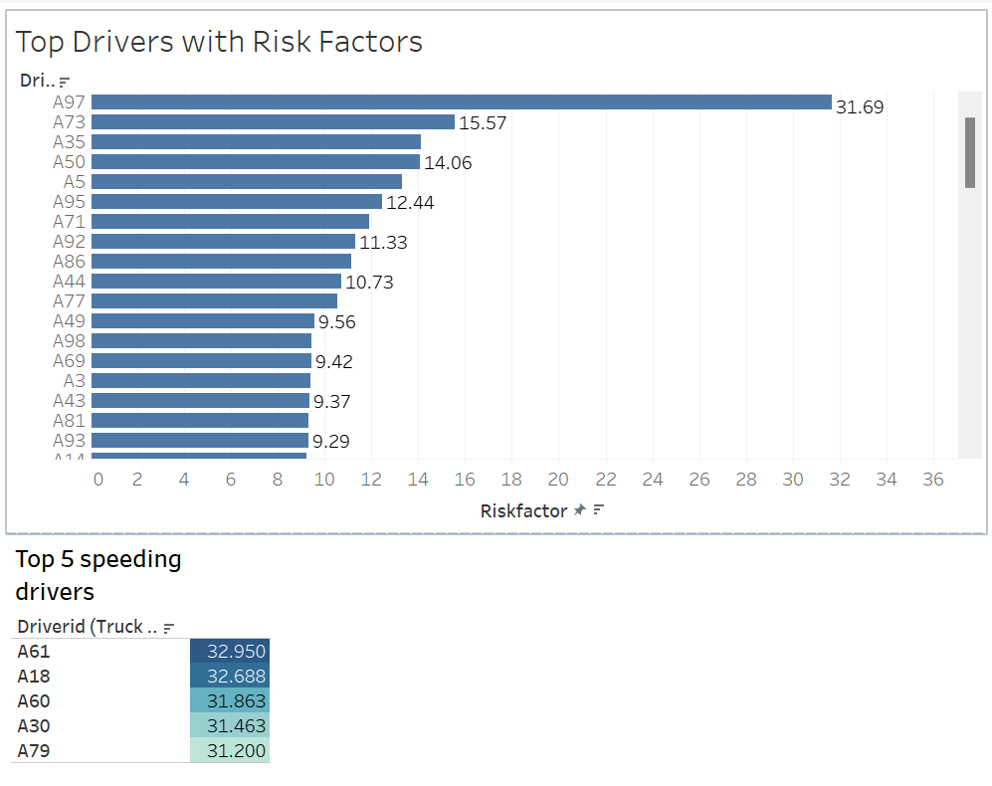
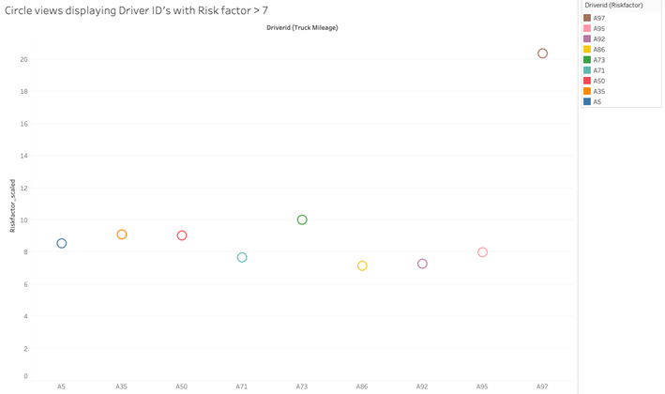
Top 5 risky drivers: A97, A73, A35, A50, A5
Question 3: Drivers contributing to highest no. of events i.e risky drivers?
When Focusing on Driver IDs with Risk
Factor > 7
A97 proves to be the outlier however with a Risk factor of 20.35

Slide 9
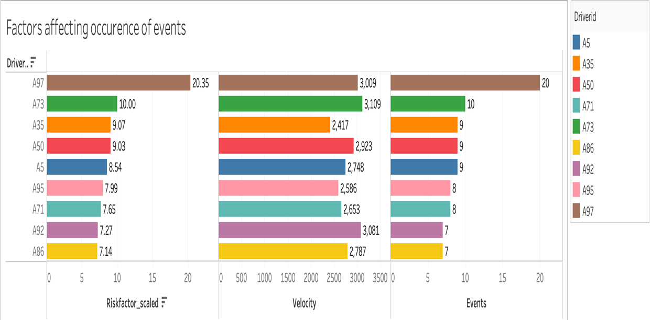
Question 4: Drivers contributing to highest no. of events (contd.)
Driver IDs with risk factor > 7 have been presented above
The speed (velocity) of the vehicle is a significant contributing factor to lane departure incidents.
Following A97, it is evident that Driver ID A73 requires particular attention to effectively reduce accidents.
Notes:
Continuing with our investigation, we aim to identify the driver responsible for the most events and explore the factors influencing lane departure occurrences. Lane departure incidents are often linked to high-speed driving. Hence, we've introduced a velocity factor to monitor driving behavior and implement appropriate measures.
Upon analyzing the graph, we find that, except for the outlier A97 driver ID, A73 holds the second-highest risk factor. Interestingly, upon closer observation, we notice that A73 also exhibits the highest velocity among all drivers. Therefore, it is crucial to closely monitor the driving behavior of A73 to reduce the number of events and enhance risk management. By doing so, we can work towards improving overall safety and mitigating potential costs associated with risks.

Slide 10
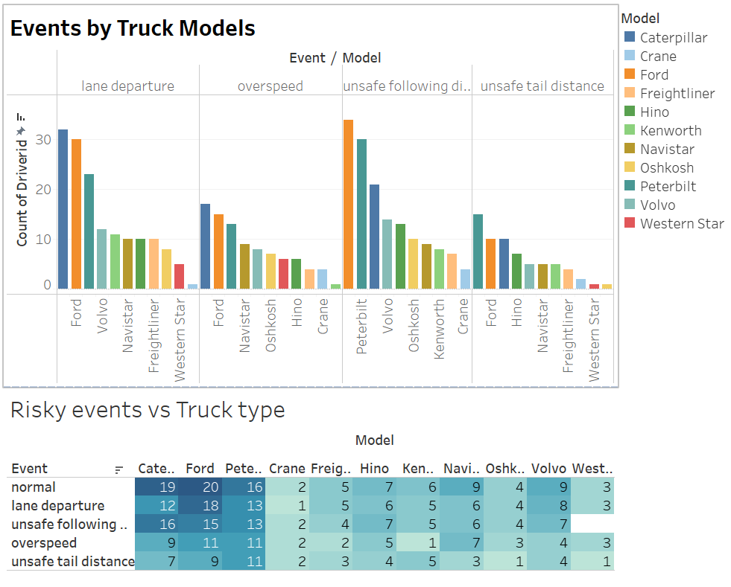
Drivers driving the truck models: Ford, Caterpillar & Peterbilt found causing more issues falling under issues.

Slide 11
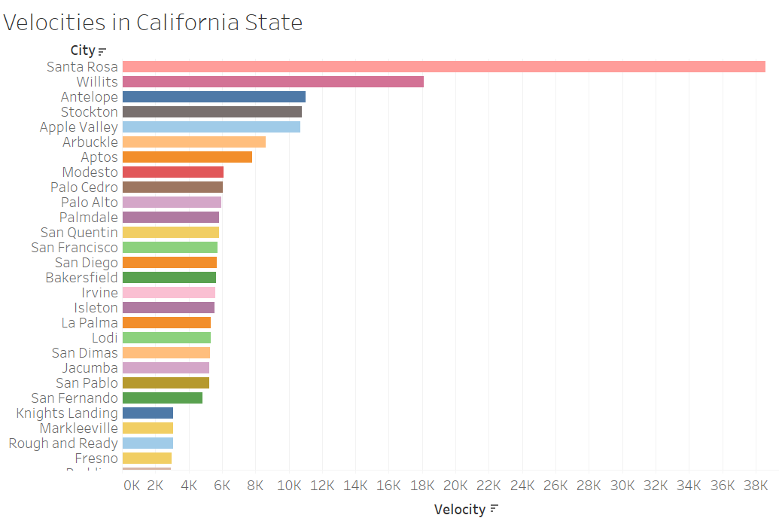
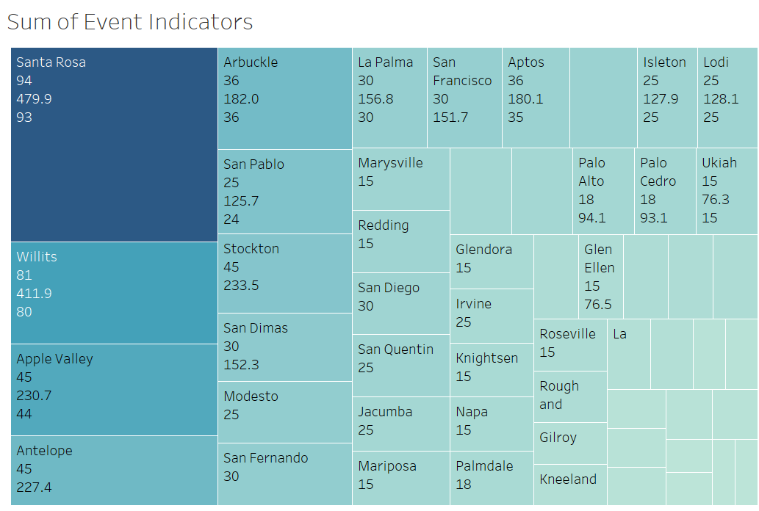
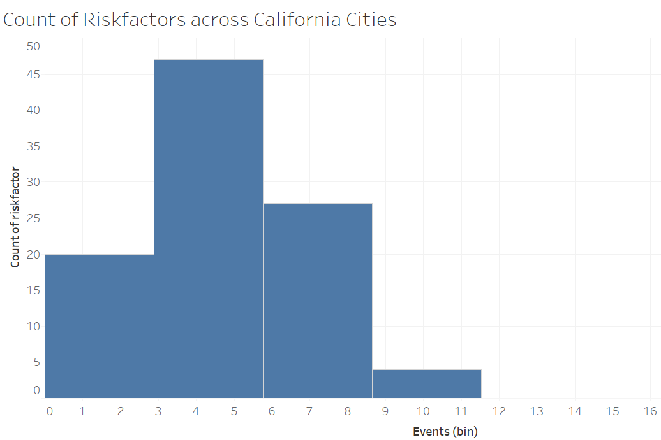
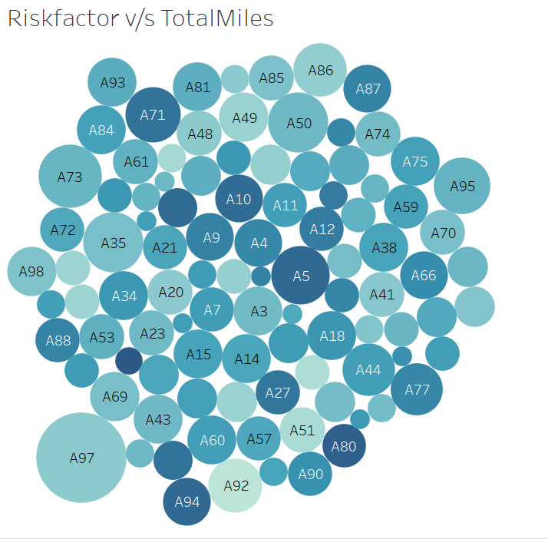
Notes:
Velocities Across
California in Decreasing Order

Slide 12
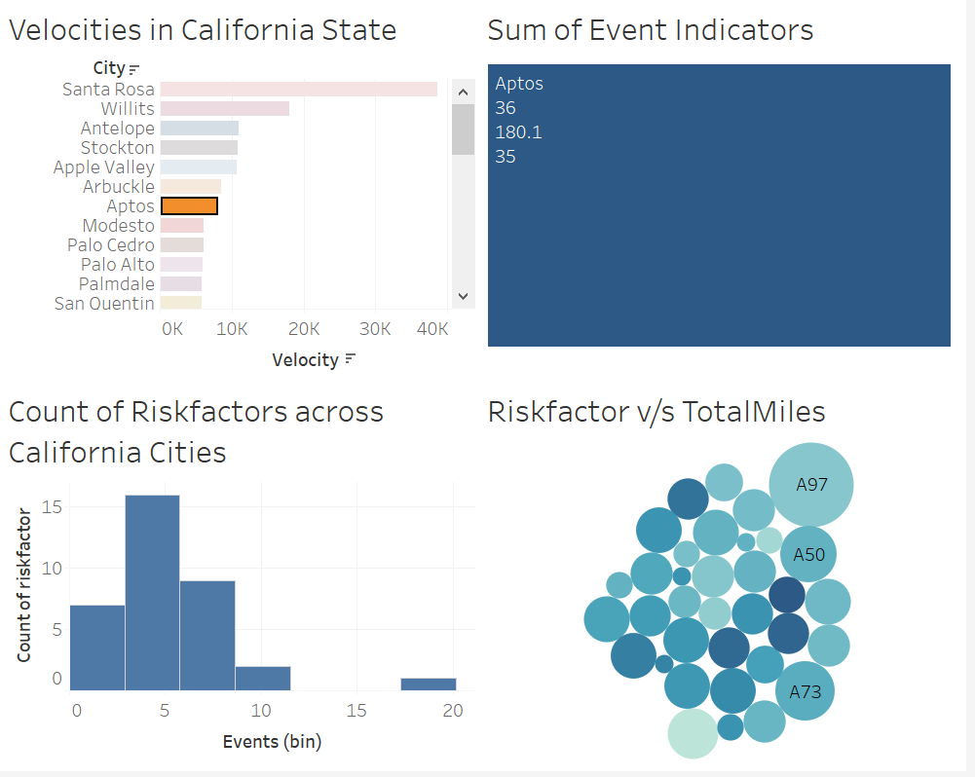
Question 5: How do the risk factors and events in different cities correlate with the total miles driven by truck drivers, and how can this information be used to improve fleet safety and efficiency?

Slide 13
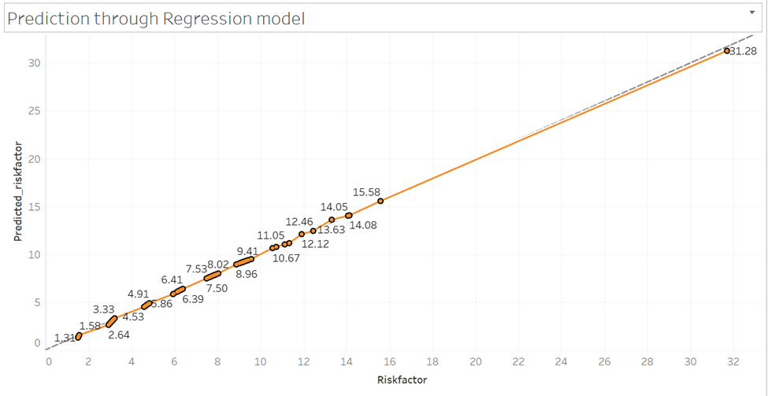
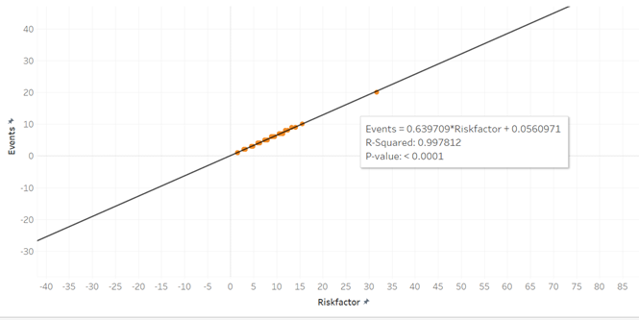
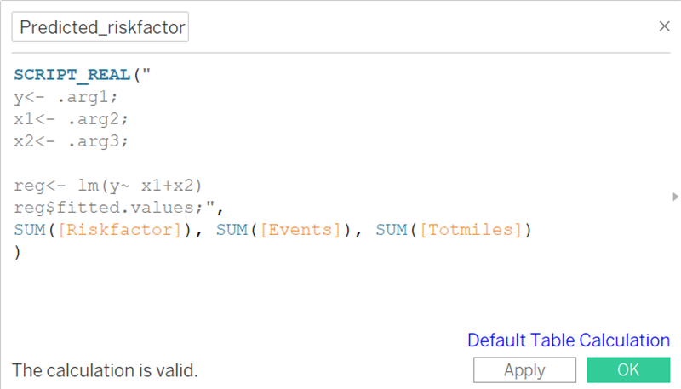
R-integration with Tableau
Simple Linear Regression Model
Linear Regression Model with additional parameters

Slide 14
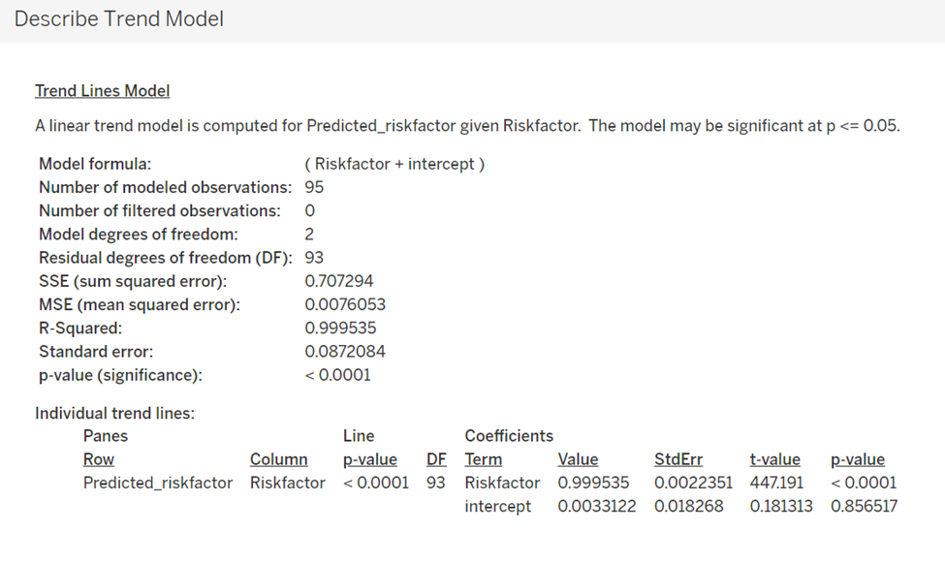
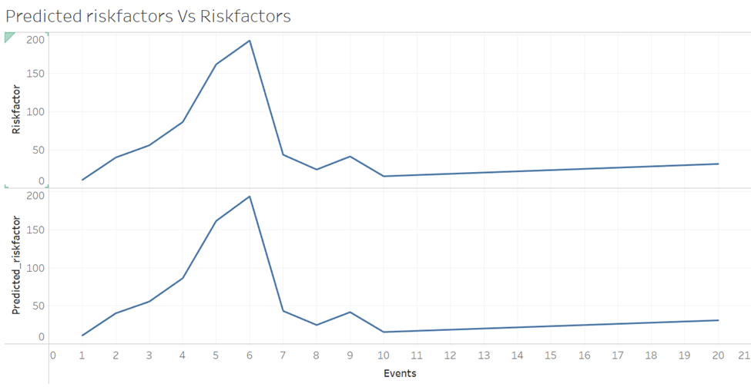
Our model's fit and Accuracy

Slide 15
Challenges
Importing the dataset from Cloudera VM
Integration with R: Compatibility & Configurations
Connecting with EC2 for Mac Systems
Domain knowledge
Notes:
There are two major challenges that we have , the first one is integrating with R for MAC users. While integrating , we faced compatibility and configuration issues as Setting up R integration in Tableau for Mac might be more challenging compared to Windows. Also, Managing R packages and their dependencies might be different on Mac than on Windows. Ensuring that the required R packages are installed and accessible to Tableau can be a challenge. Security and permissions issues such as On macOS, security settings may prevent Tableau from executing R scripts by default. Users might need to grant appropriate permissions or modify security settings to allow Tableau to interact with R.

Slide 16
Conclusion (Action items)
Implement stringent speed regulations for vehicles, especially in cities prone to unsafe events.
Implement strict regulations for drivers with higher risk factors and frequent speeding violations.
Conduct further analysis on Ford, Caterpillar, and Peterbilt models, which are linked to numerous lane departure and unsafe following events.
Total events and miles traveled are key contributors to driver risk, by leveraging a regression model based on historical data.
Notes:
1.Top 3 Trucks Contributing to Accidents: The analysis indicates that Ford, Peterbilt, and Caterpillar are the top three truck manufacturers that contribute the most to accidents. These trucks may warrant special attention in terms of safety measures and regulations.
2.Ford Has the Highest Risk Factor: Among the identified truck manufacturers, Ford stands out with the highest risk factor. This suggests that Ford trucks might have a higher likelihood of being involved in accidents compared to the others.
3.Santa Rosa Leads in Lane Departure Events: The data reveals that Santa Rosa has the highest number of lane departure events, indicating a potential area of concern in terms of road safety and lane adherence.
4.A97 Identified as an Outlier: A97 is identified as an outlier in the dataset. This could imply that it exhibits significantly different behavior or characteristics compared to other data points, warranting further investigation.
5.Focus on A35 after A97: Following A97, A35 is suggested to be the next area of focus to improve event statistics. This indicates that A35 might have notable safety issues that need attention to reduce accidents or events.
6.Correlation Between Events and Risk Factor: The analysis shows that there is a positive correlation between the number of events (e.g., lane departure events) and the risk factor. This means that as the number of events increases, the risk factor also tends to increase, suggesting a potential relationship between these variables.
_________________________________________
Implement stringent speed regulations for vehicles, especially in cities prone to unsafe events : Analysis shows a strong correlation between higher vehicle speeds and the occurrence of major unsafe events in these areas. To enhance safety, we recommend enforcing a maximum speed limit of 40 MPH in populated areas
Implement strict regulations for drivers with higher risk factors and frequent speeding violations. Specifically, target drivers A97, A73, A50, and A5. Notify these drivers of their issues to mitigate accident risks and enhance overall safety.
Conduct further analysis on Ford, Caterpillar, and Peterbilt models, which are linked to numerous lane departure and unsafe following events. Investigate factors like vehicle size, motor, and shipment type to understand the underlying causes of these riskier events.
Total events and miles traveled are key contributors to driver risk. By leveraging a regression model based on historical data, we can accurately predict the live risk factor for any driver, enabling targeted monitoring and restrictions to enhance safety.

Slide 17
Thank you!

