Slide 1



Charting New Horizons: Empowering Hotel Ananda’s Performance With Powerful Strategic Insights
Bdm project
Bdm project
Charting New Horizons: Empowering Hotel Ananda’s Performance With Powerful Strategic Insights
AKSHAYA V
22ds3000012@ds.study.iitm.ac.in
Done by:
AKSHAYA V 22ds3000012@ds.study.iitm.ac.in

Slide 2

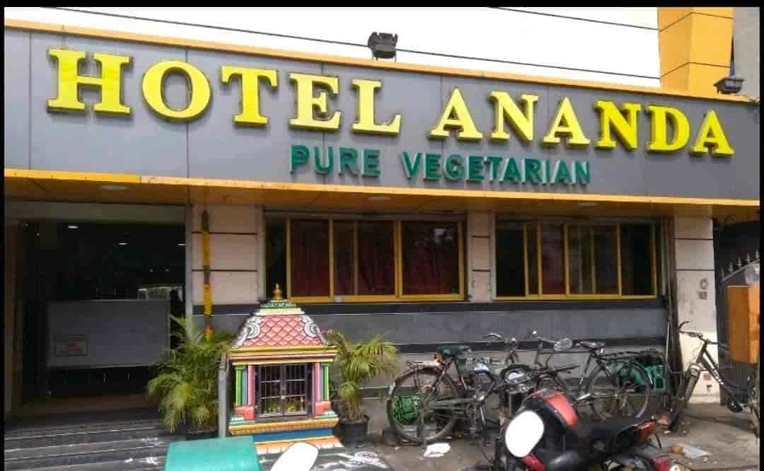
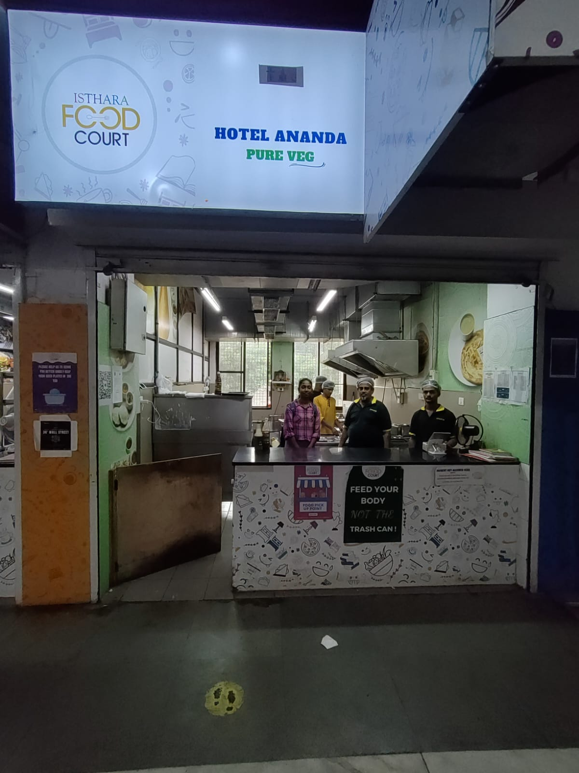
BACKGROUND & HISTORY OF HOTEL ANANDA
Hotel Ananda was founded in 1989 in Teynampet, Chennai, and has since flourished into a chain of seven branches across the city. Notably, one of these branches is situated within the IITM Himalayas food court, serving as the data collection hub for insights.
The hotel has earned a reputation for delivering authentic South Indian cuisine. Its core values center around affordability and fostering meaningful customer interactions, forming the cornerstone of its service approach.
(i) Hotel Ananda – Teynampet branch
(ii) Hotel Ananda – IITM Branch

Slide 3
PROBLEM STATEMENT
PROBLEM STATEMENT – 1
When do sales peak for optimized inventory planning?
PROBLEM STATEMENT – 2
Methods to boost the sales of the lowest-selling dishes
Following a routine of preparing dishes with consistent quantities of raw materials daily can lead to issues.
This approach can result in overutilization and eventual unavailability of certain dishes on some days. Conversely, on other days, excessive preparation may lead to dish wastage due to their limited shelf life.
Therefore, by observing the timing and way customers place orders, valuable insights can be gained to aid in comprehending customer behaviors and planning resources more effectively.
Certain dishes excel while others face challenges in attracting customers. Analyzing both high and low performers leads to effective solutions.
These solutions minimize waste of less popular dishes and ensure constant availability of customer favorites throughout the day. By optimizing this balance, we enhance resource efficiency and customer satisfaction simultaneously.
Through careful assessment, we can strike a harmonious equilibrium between reducing waste and meeting customer demand.

Slide 4




PROCESS
Step No. | Steps | Platform used
1 | Data Collection
2 | Data cleaning & Preprocessing
3 | Data analysis
4 | Data visualization
5 | Recommendations | -

Slide 5
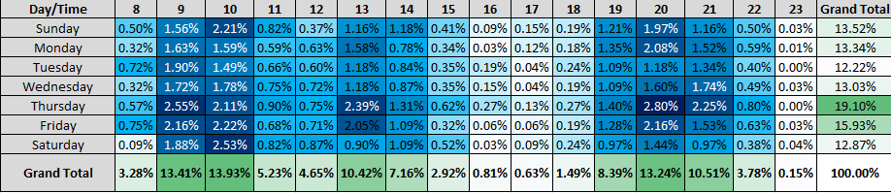
TEMPORAL ANALYSIS
Higher orders
The analysis of the heatmap notably highlights a surge in order activity, prominently concentrated on Thursdays, and notably peaking during morning hours.
Considering the specific campus environment at IIT, it's plausible that the reduced order frequency during weekends can be attributed to students potentially venturing out or returning home.
Implementing a strategic approach, such as bolstering inventory for Thursdays and Fridays, while adopting a more conservative stance over weekends, has the potential to curtail unnecessary food wastage and enhance overall operational efficiency.

Slide 6
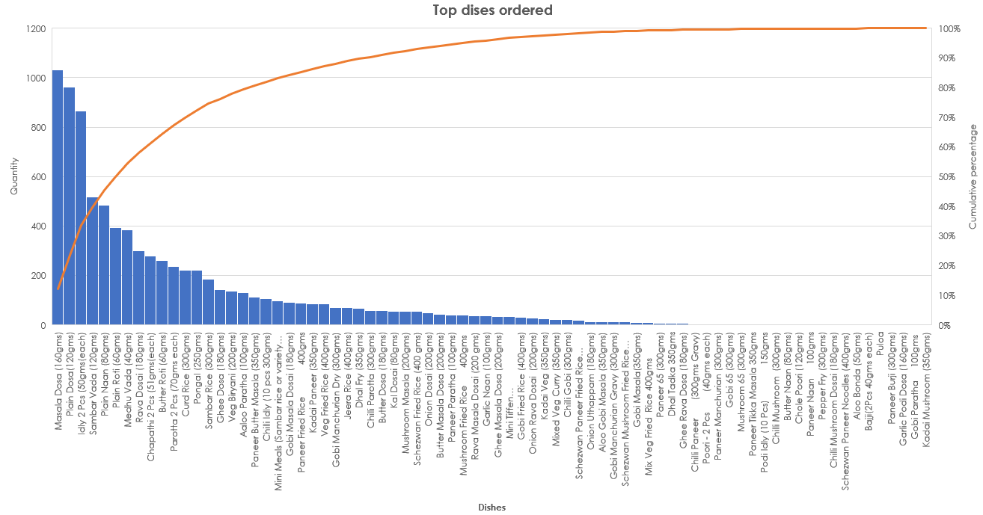
DISHES ANALYSIS
Top dishes ordered
A comprehensive assessment of dish performance reveals a significant insight using the Pareto principle: a mere 15 dishes drive 80% of total orders.
To maximize this revelation's potential, a dynamic approach involves thoughtfully pairing top-selling and less-popular dishes to create enticing combos.

Slide 7
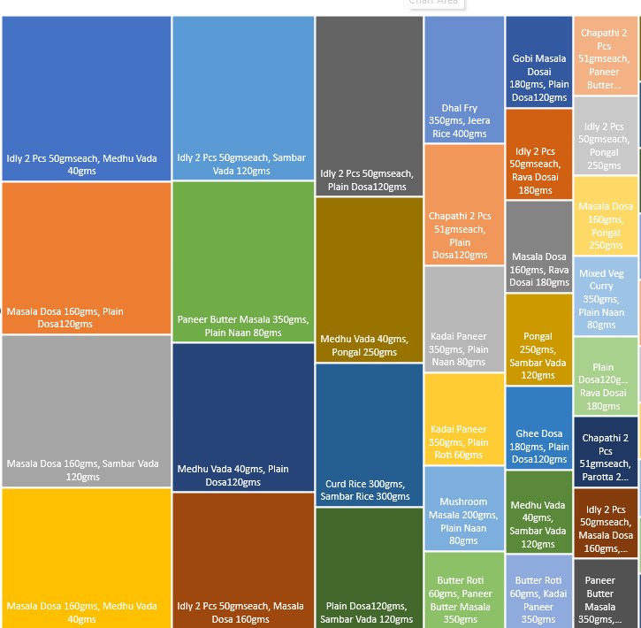
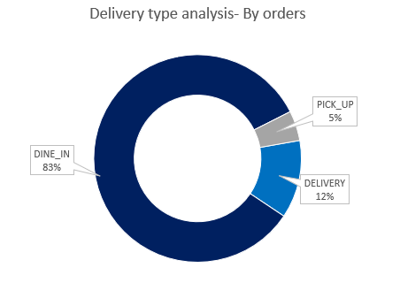
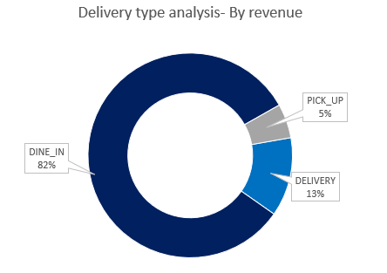
ADDITIONAL INSIGHTS
DELIVERY TYPE ANALYSIS
TOP COMBINATION OF DISHES
The preference for in-person dining experiences over take-home or pick-up services is widely observable.
Directing efforts towards elevating the dine-in experience opens a multitude of avenues to captivate and maintain a loyal customer base. This includes refining ambiance, refining service quality, and incorporating engaging activities, all of which collectively contribute to a holistic and memorable dining occasion.
Despite the hotel offering North Indian & Chinese menu, it's noteworthy that the most preferred dishes revolve around the South Indian selection.
Future strategies could involve creating special meal deals or bundles based on the identified popular dish combinations, introducing targeted promotions to encourage customers to explore these preferred options

Slide 8
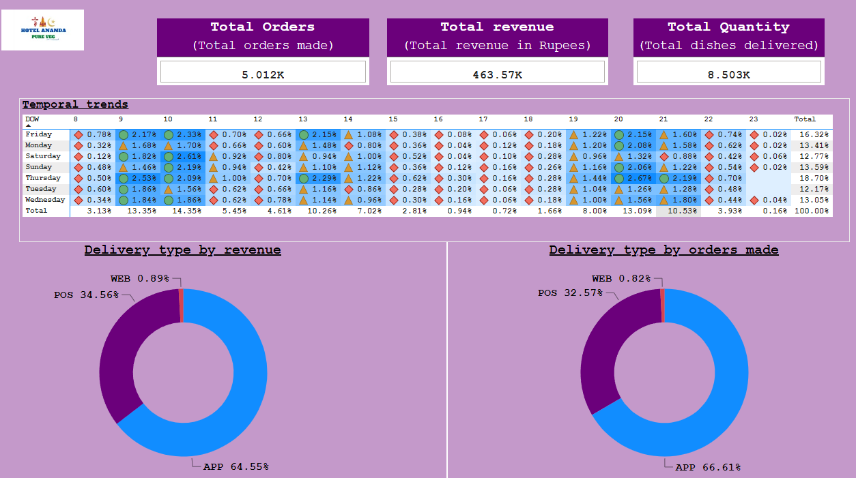
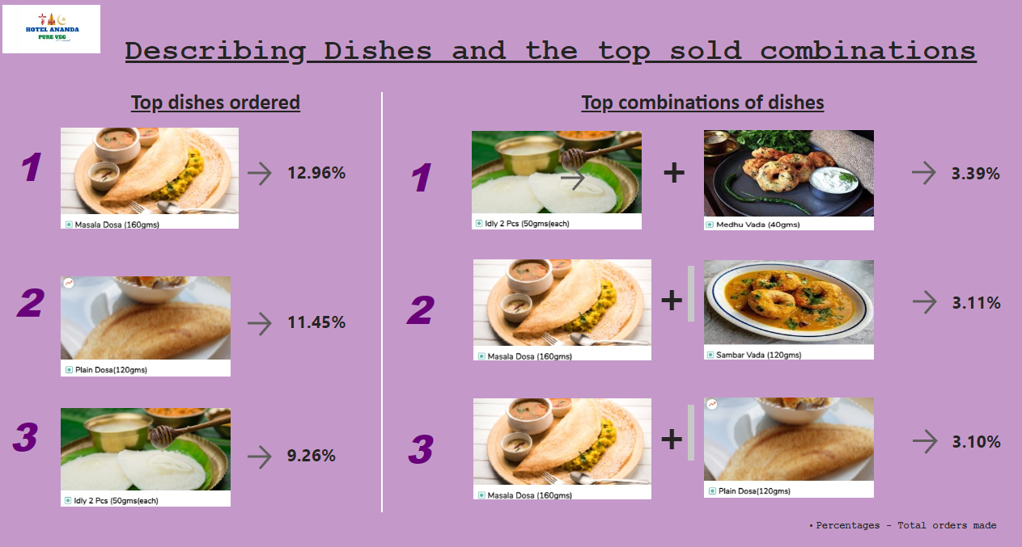
POWER BI DASHBOARD
The initial page offers a comprehensive overview of sales data, including order statistics and revenue figures, while also presenting insights into temporal trends and the performance of different delivery types.
Page 2 delves deeper into the orders placed. This page is divided into two sections: on the left, it presents the top individually ordered dishes, while on the right, it highlights the most popular combinations of dishes. To enhance clarity, understanding, and readability, images were employed instead of other visualizations
(i) Page 1
(ii) Page 2

Slide 9
HOW TO PROCEED FURTHER
Blend high-performing and low-performing dishes
Begin digital ads, conquer competitors.
Modifying the inventory control
The restaurant could introduce introductory offers for the novel combos. Such promotions serve the dual purpose of enticing customers to explore a diverse range of dishes while maximizing sales potential. This strategic pricing strategy, coupled with the harmonious fusion of top and least selling dishes, holds the potential to captivate a wider audience and elevate the overall dining experience
Hotel Anandas has untapped potential in its offerings of North Indian and Chinese cuisines, which often go unnoticed. To attract a larger customer base, digital marketing efforts and promotional offers can be introduced, shedding light on these lesser-known dishes and driving more user engagement.
Rather than acquiring a consistent quantity of raw materials for daily cooking, a more effective approach would involve procuring larger amounts of raw materials on high-demand days such as Thursdays, while scaling down purchases on lower-demand days like Tuesdays. This strategy ensures that raw materials remain fresh and minimizes dish wastage, optimizing resource utilization

Slide 10
IMPORTANT LINKS AND REFERRENCES
Excel sales data link
Colab notebook link
Proposal document link
Mid term submission link
Final document link

