Slide 1


K.RAMAKRISHNAN COLLEGE OF ENGINEERING
(AUTONOMOUS)
SPORTS SYSTEMS FOR TEAMS AND ATHELETES
Presented by,
Name : AKSHAYA V
Register No. : 8115U24AM004
Roll No. : AM2404
Year : II /CSE(AIML)
Date of Review : 19.02.2026

Slide 2
PRESENTATION OVERVIEW
Objective
Problem Analysis
System Architecture
Methodology
Dataset Used
Modules
Implementation
Conclusion
Future Scope

Slide 3
OBJECTIVE
To design and develop a database system for managing sports teams and athletes
To store and organize data related to teams, players, coaches, and events
To demonstrate relationships using SQL (Primary Key, Foreign Key, JOIN)
To provide efficient data retrieval using queries
To improve data accuracy and reduce redundancy

Slide 4
PROBLEM ANALYSIS
Manual management of sports data is time-consuming and error-prone
Difficulty in tracking athletes, teams, and events efficiently
Lack of structured storage leads to data redundancy
Hard to generate reports like team performance or player count
Need for a centralized database system.

Slide 5
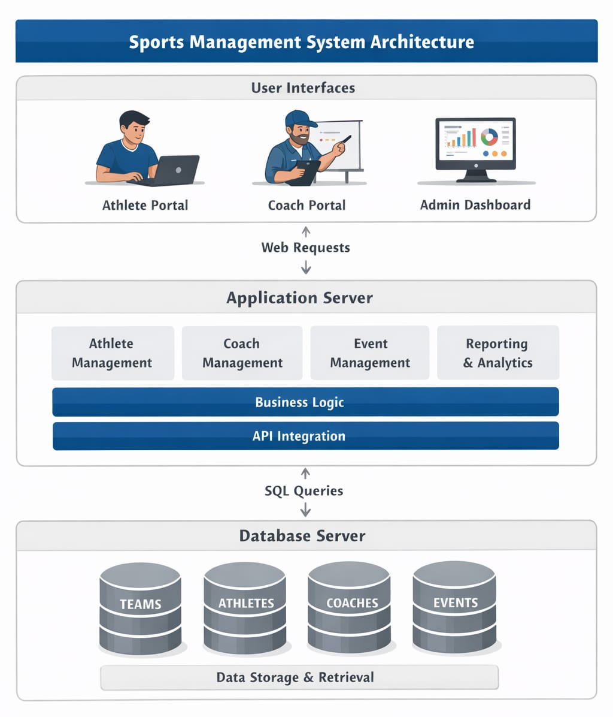
SYSTEM ARCHITECTURE
.

Slide 6
METHODOLOGY
The project begins with analyzing requirements for managing sports teams, athletes, coaches, and events.
An ER diagram is designed to represent entities and relationships in the system.
The database schema is created using SQL with proper primary and foreign key constraints.
Sample data is inserted into tables to simulate real-world scenarios.
SQL queries such as SELECT, JOIN, and GROUP BY are executed to test and retrieve meaningful outputs.
.

Slide 7
DATASET USED
The Sample dataset created manually for demonstration Includes:
Team details (team_id, team_name)
Athlete details (name, age, team_id)
Coach details (coach_name, team_id)
Event details (event_name, date)
Though small in size, the dataset is sufficient to test SQL queries and demonstrate database functionality.
Data is small but sufficient to test relationships
.

Slide 8
MODULES
The Team Management Module handles creation and storage of team details such as team ID and team name.
The Athlete Management Module manages athlete information including name, age, and team association.
The Coach Management Module stores coach details and assigns them to respective teams.
The Event Management Module maintains event data such as event name, date, and participating teams.
The Query Processing Module performs SQL operations like JOIN and GROUP BY to retrieve meaningful information.

Slide 9
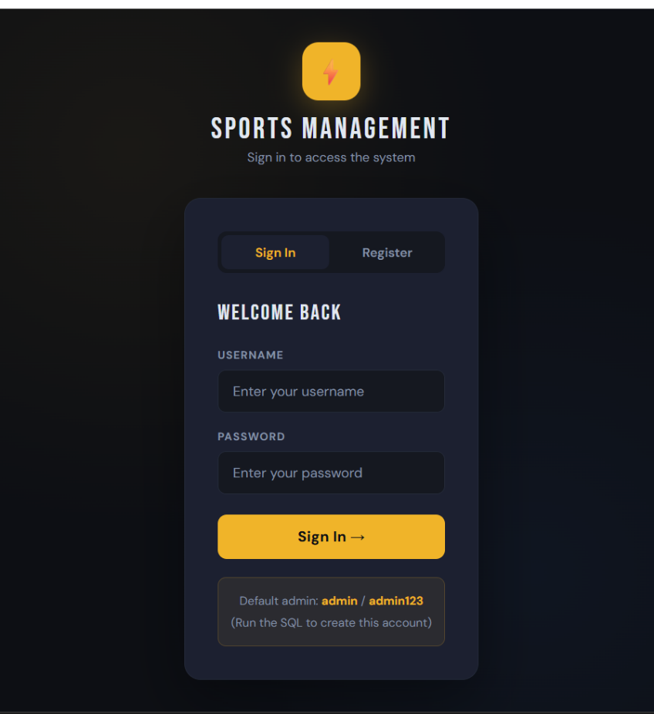
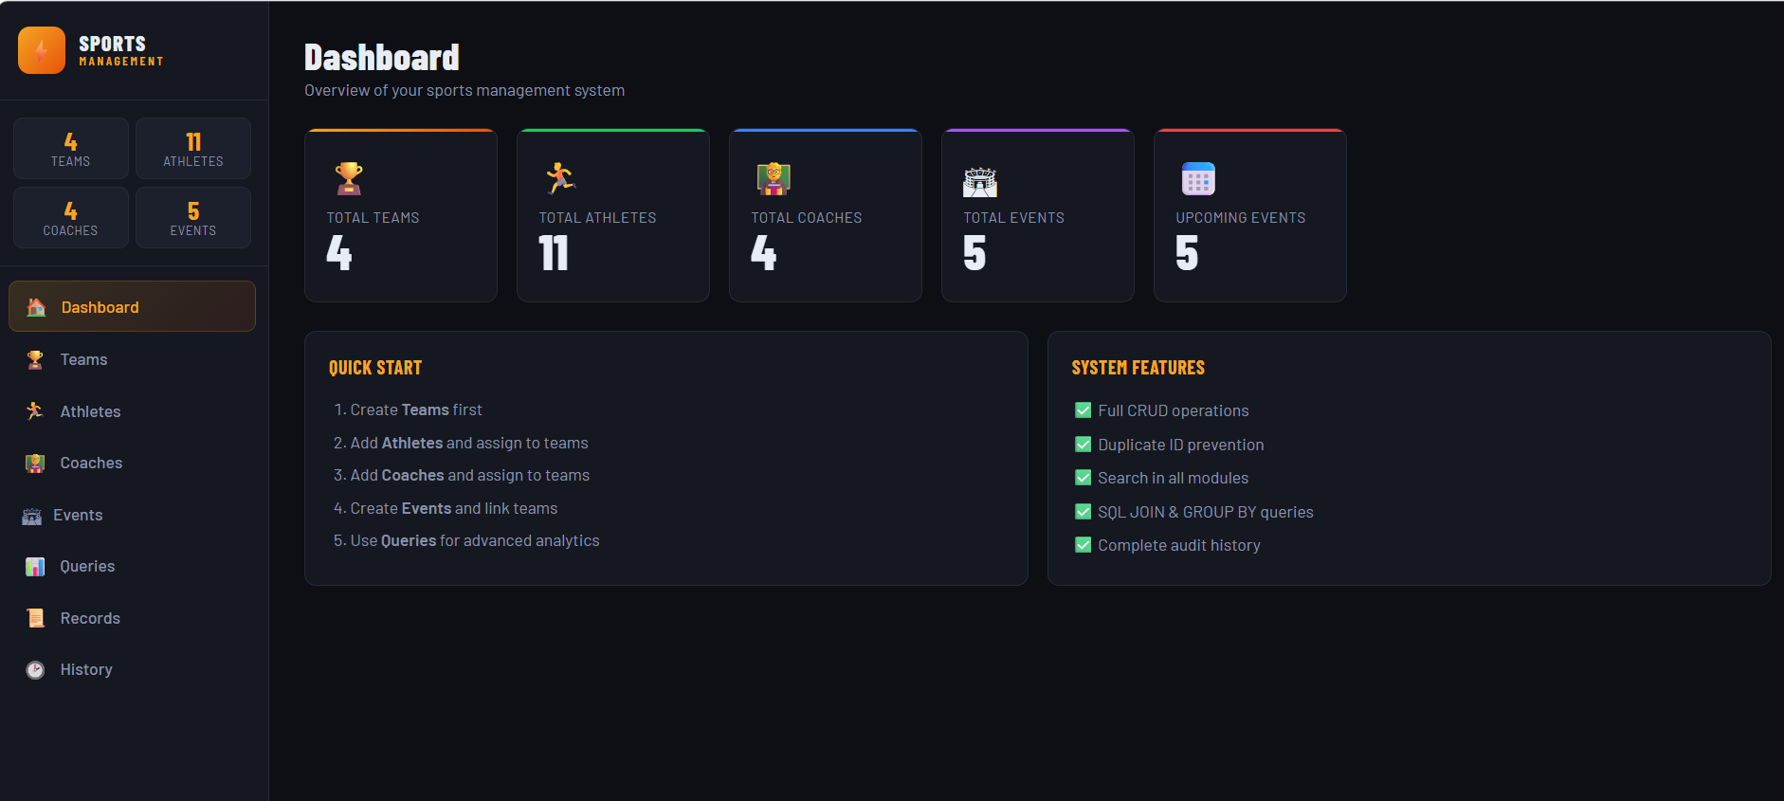

IMPLEMENTATION

Slide 10
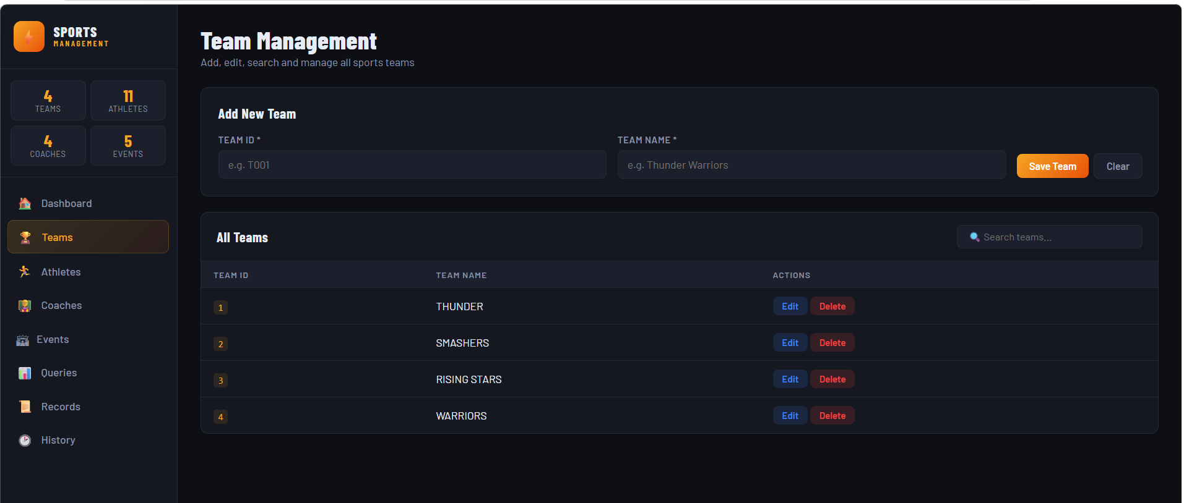
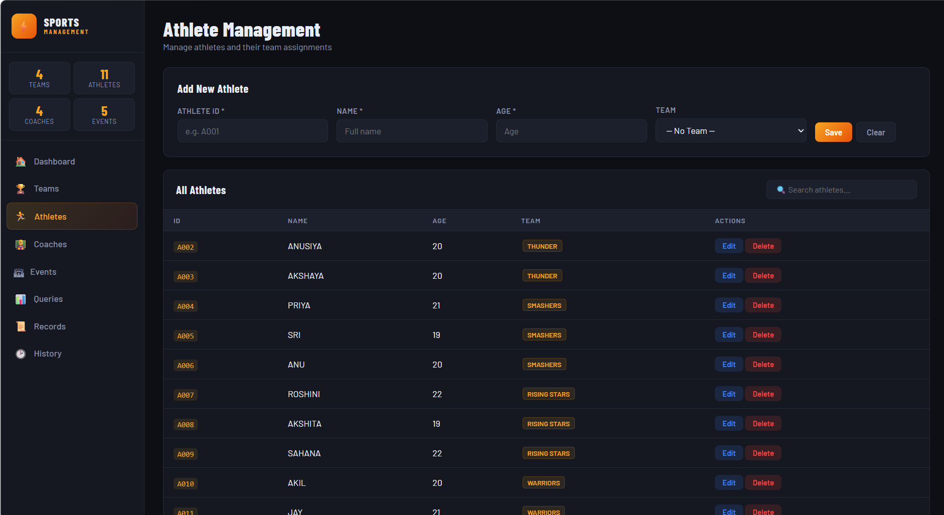
IMPLEMENTATION

Slide 11
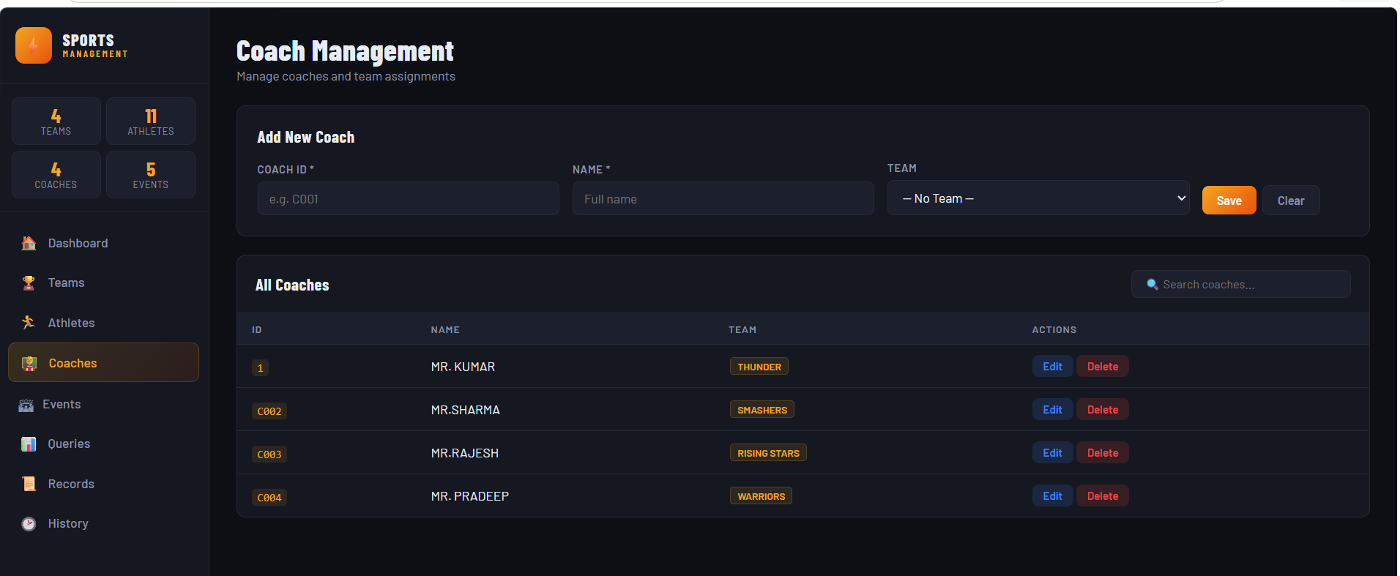
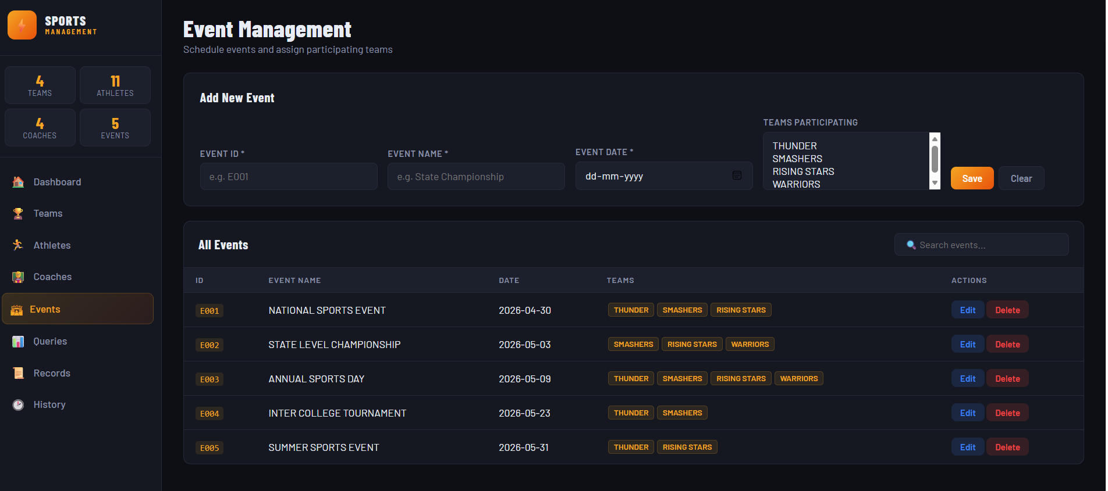
IMPLEMENTATION

Slide 12
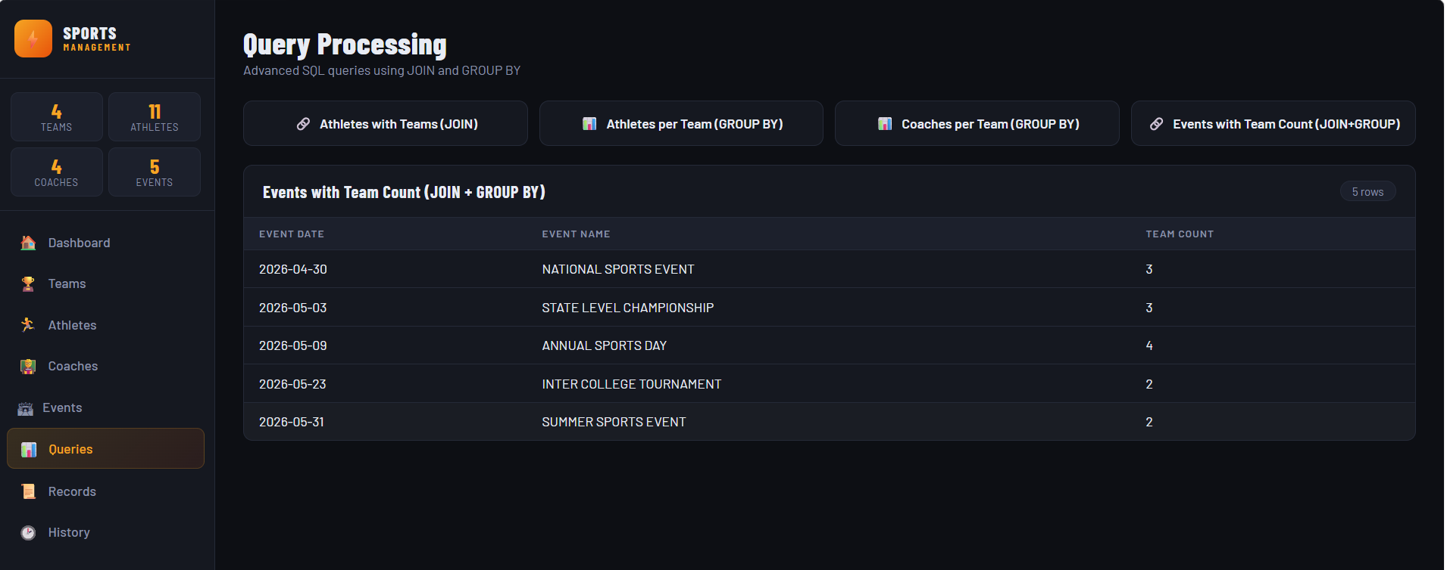
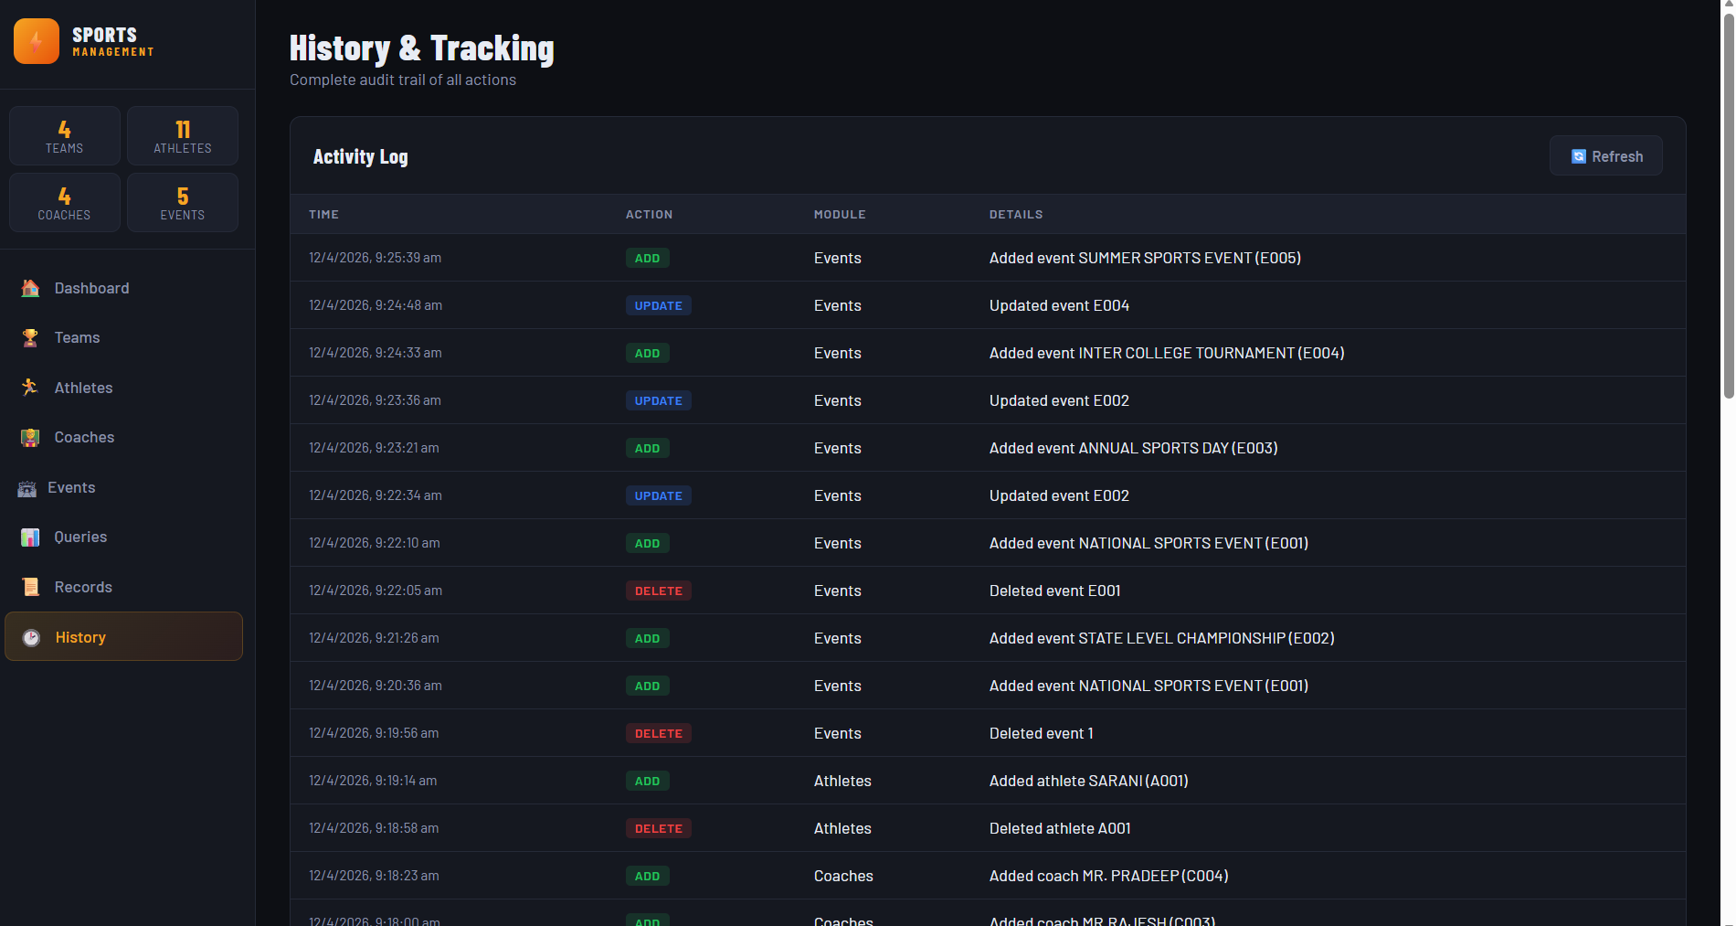
IMPLEMENTATION

Slide 13
CONCLUSION
The project successfully developed a structured database system for managing sports teams, athletes, coaches, and events.
It demonstrated effective use of SQL concepts such as primary keys, foreign keys, JOIN operations, and aggregation.
The system reduces data redundancy and improves accuracy through proper relational design.
Overall, the project shows how database systems can efficiently manage and retrieve sports-related data.

Slide 14
FUTURE SCOPE
The system can be enhanced by developing a user-friendly web or mobile interface for easier access.
Real-time data integration can be added to manage live sports events and updates.
Advanced analytics can be implemented to track player performance and team statistics.
The database can be expanded to include additional modules like match scheduling, sponsorship, and rankings.

Slide 15


