Slide 1


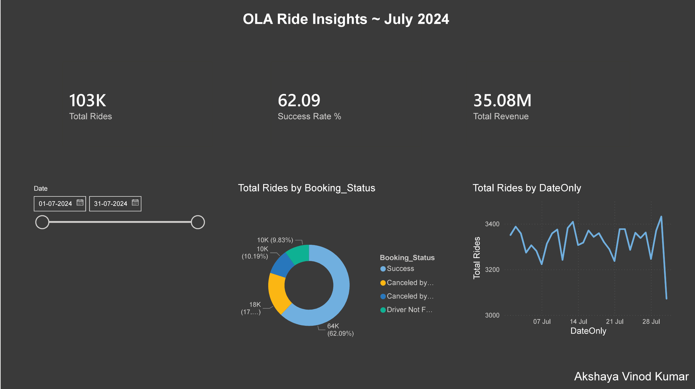





Overall
Vehicle Type
Revenue
Cancellation
Ratings

Slide 2
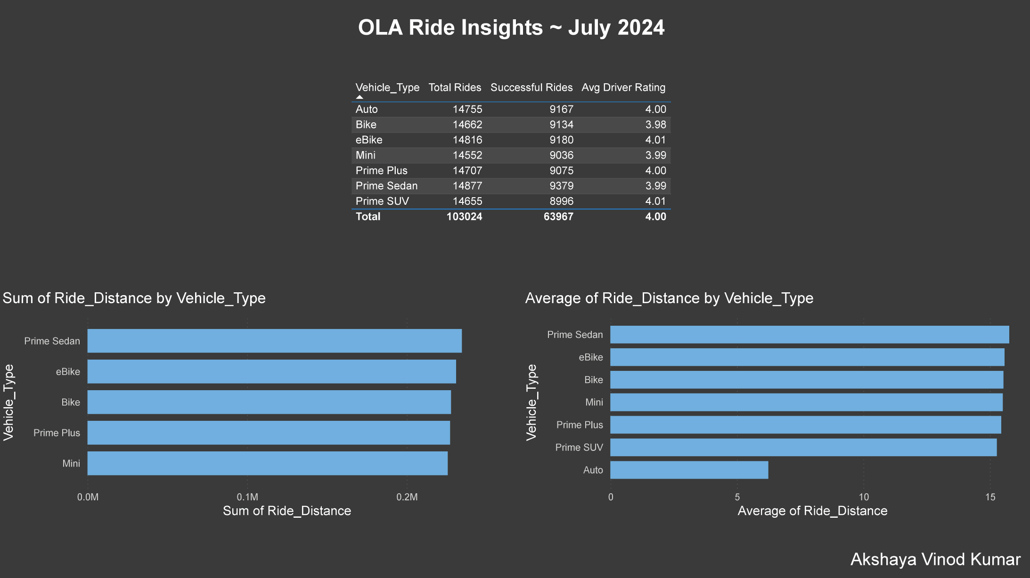


Overall
Vehicle Type
Revenue
Cancellation
Ratings

Slide 3







Vehicle Type | Total Booking Value | Success Booking Value | Avg. Distance Travelled | Total Distance Travelled
Prime Sedan | ₹ 82,98,612 | ₹ 52,24,050 | 15.76 km | 2,34,535 km
Prime SUV | ₹ 79,33,330 | ₹ 48,76,815 | 15.27 km | 2,23,848 km
Prime Plus | ₹ 80,50,889 | ₹ 50,15,165 | 15.45 km | 2,27,186 km
Mini | ₹ 79,90,996 | ₹ 48,85,961 | 15.51 km | 2,25,703 km
Auto | ₹ 80,92,210 | ₹ 50,51,846 | 6.24 km | 92,043 km
Bike | ₹ 79,87,054 | ₹ 49,71,968 | 15.53 km | 2,27,746 km
E-Bike | ₹ 81,81,523 | ₹ 50,54,662 | 15.58 km | 2,30,842 km
Overall
Vehicle Type
Revenue
Cancellation
Ratings

Slide 4
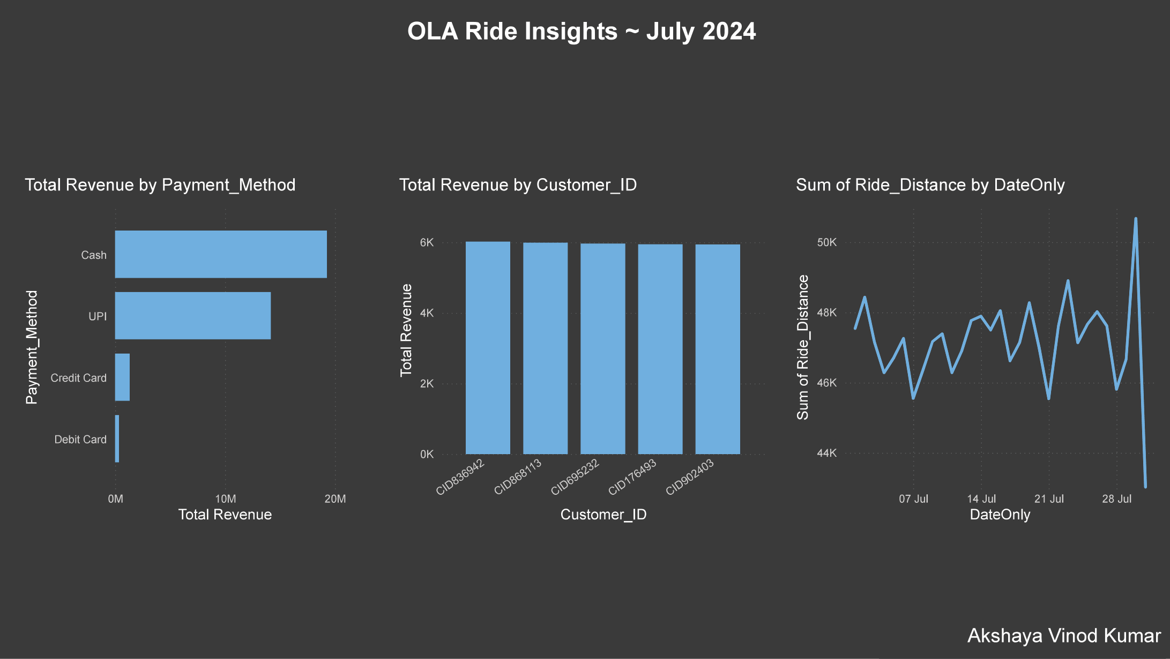

Overall
Vehicle Type
Revenue
Cancellation
Ratings

Slide 5
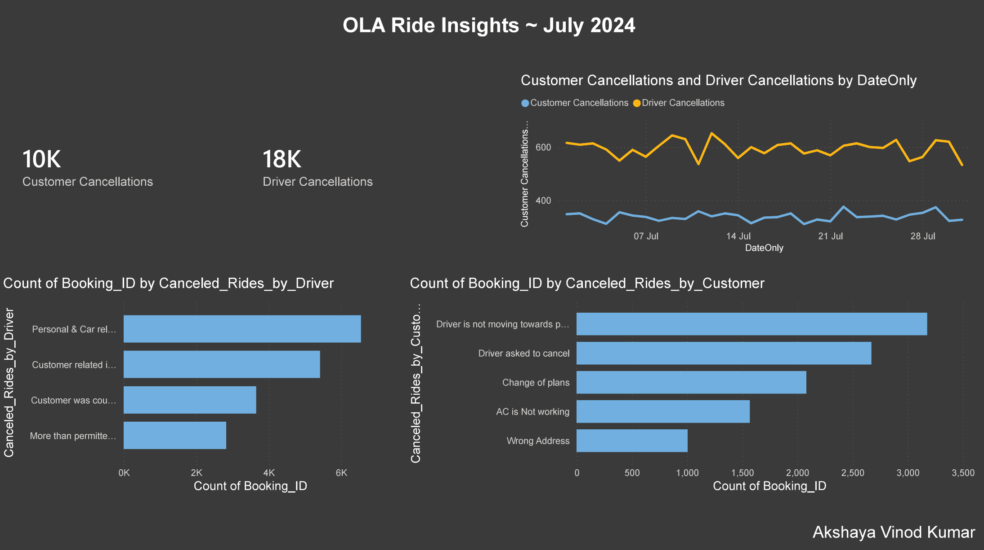

Overall
Vehicle Type
Revenue
Cancellation
Ratings

Slide 6
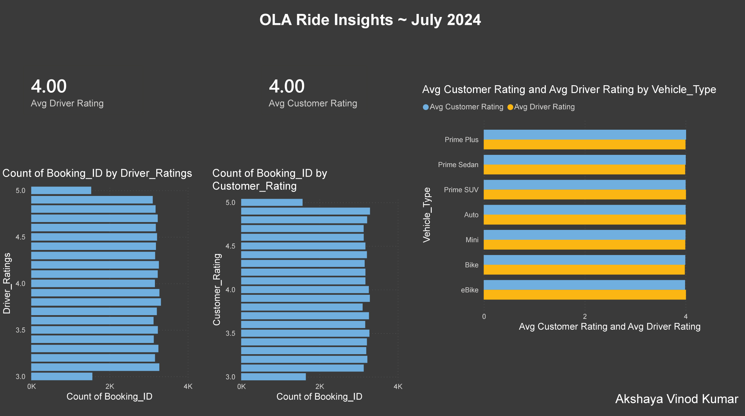

Overall
Vehicle Type
Revenue
Cancellation
Ratings

Slide 7
⭐
Driver Ratings:
Overall
Prime Sedan | Prime SUV | Prime Plus | Mini | Auto | Bike | E-Bike
3.99 | 4.01 | 4.00 | 3.99 | 4.00 | 3.98 | 4.01
Vehicle Type
Revenue
Customer Ratings:
Cancellation
Prime Sedan | Prime SUV | Prime Plus | Mini | Auto | Bike | E-Bike
4.00 | 4.00 | 4.01 | 4.00 | 4.00 | 3.99 | 3.99
Ratings

