Slide 1

Customer Shopping Behavior Analysis
Uncovering insights from 3,900 transactions across product categories — spending patterns, customer segments, and subscription behavior to guide strategic business decisions.

Slide 2
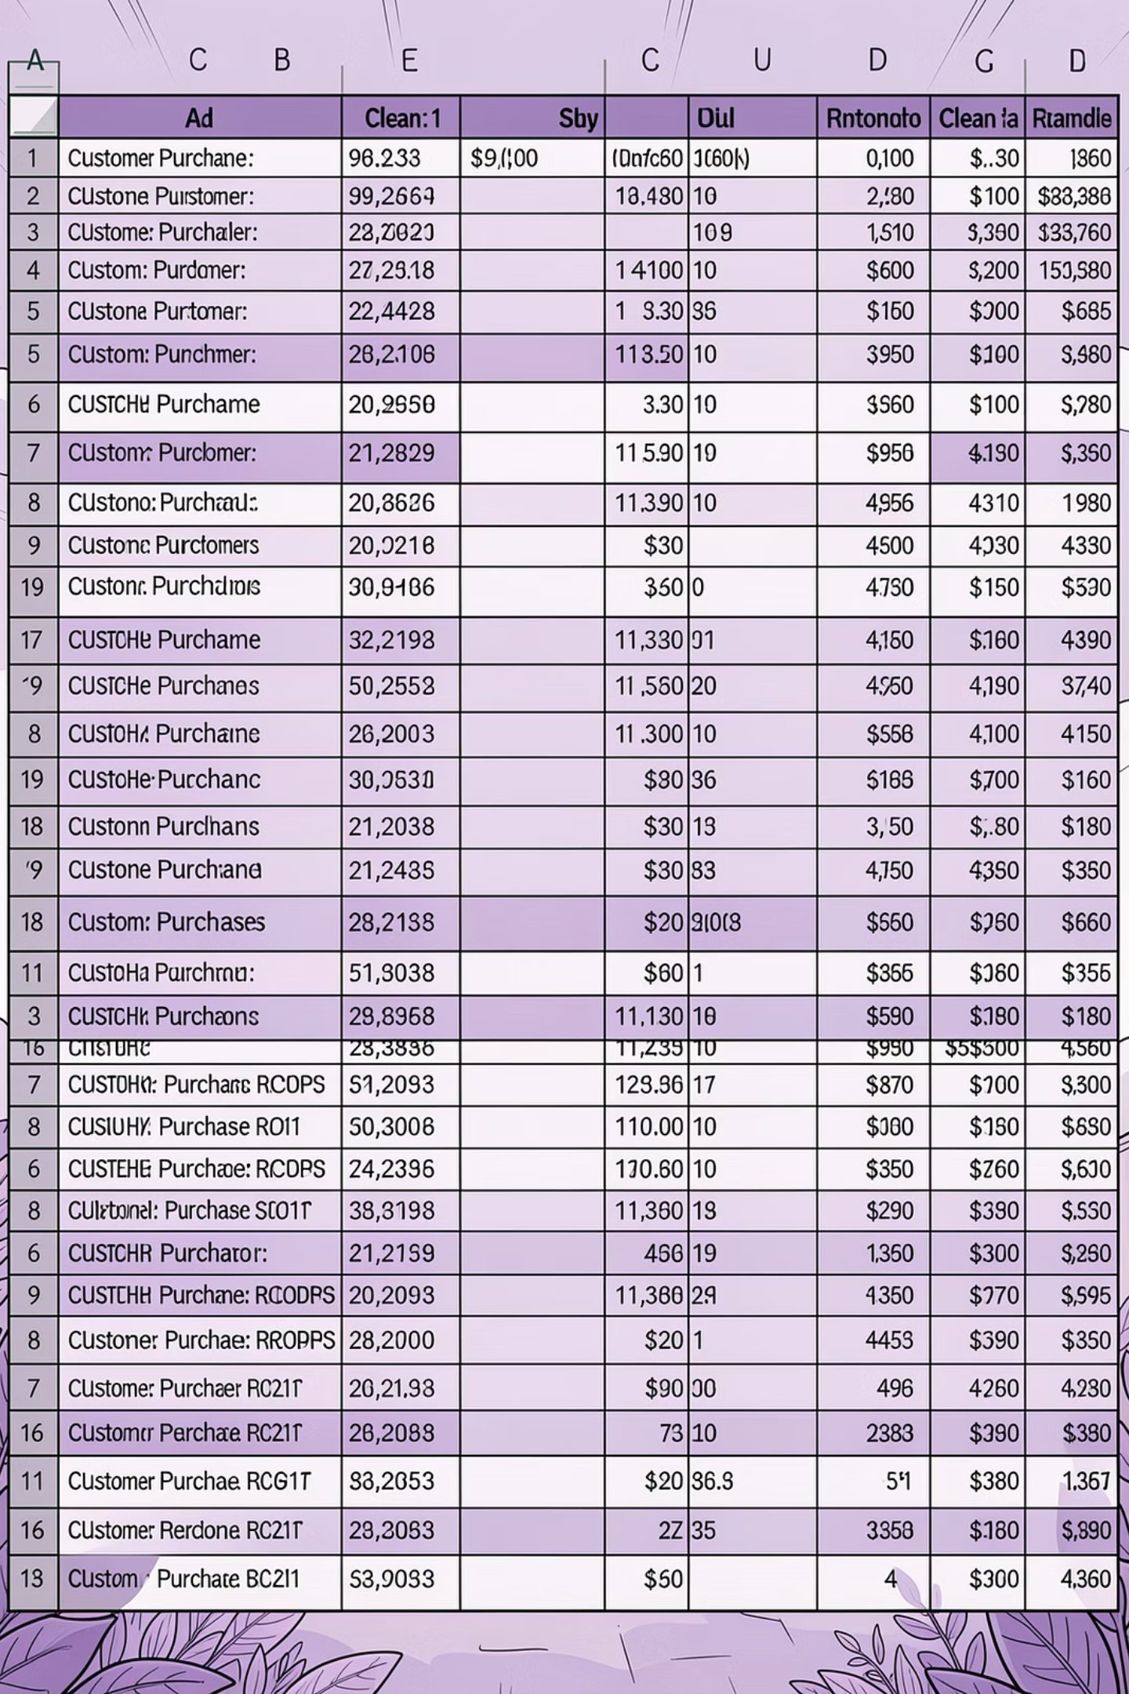
Dataset at a Glance
3,900
18
Transactions
Features
37
Missing Values
Review Rating column only
Key features include customer demographics, purchase details, shopping behavior, and subscription status across 50 locations.

Slide 3

DATA PREPARATION
Exploratory Data Analysis in Python
Handle Missing
Standardize & Engineer
Validate & Load
Load Data
Columns were renamed to snake_case for readability. The promo_code_used column was dropped after confirming redundancy with discount_applied. The cleaned DataFrame was loaded into PostgreSQL for SQL analysis.

Slide 4
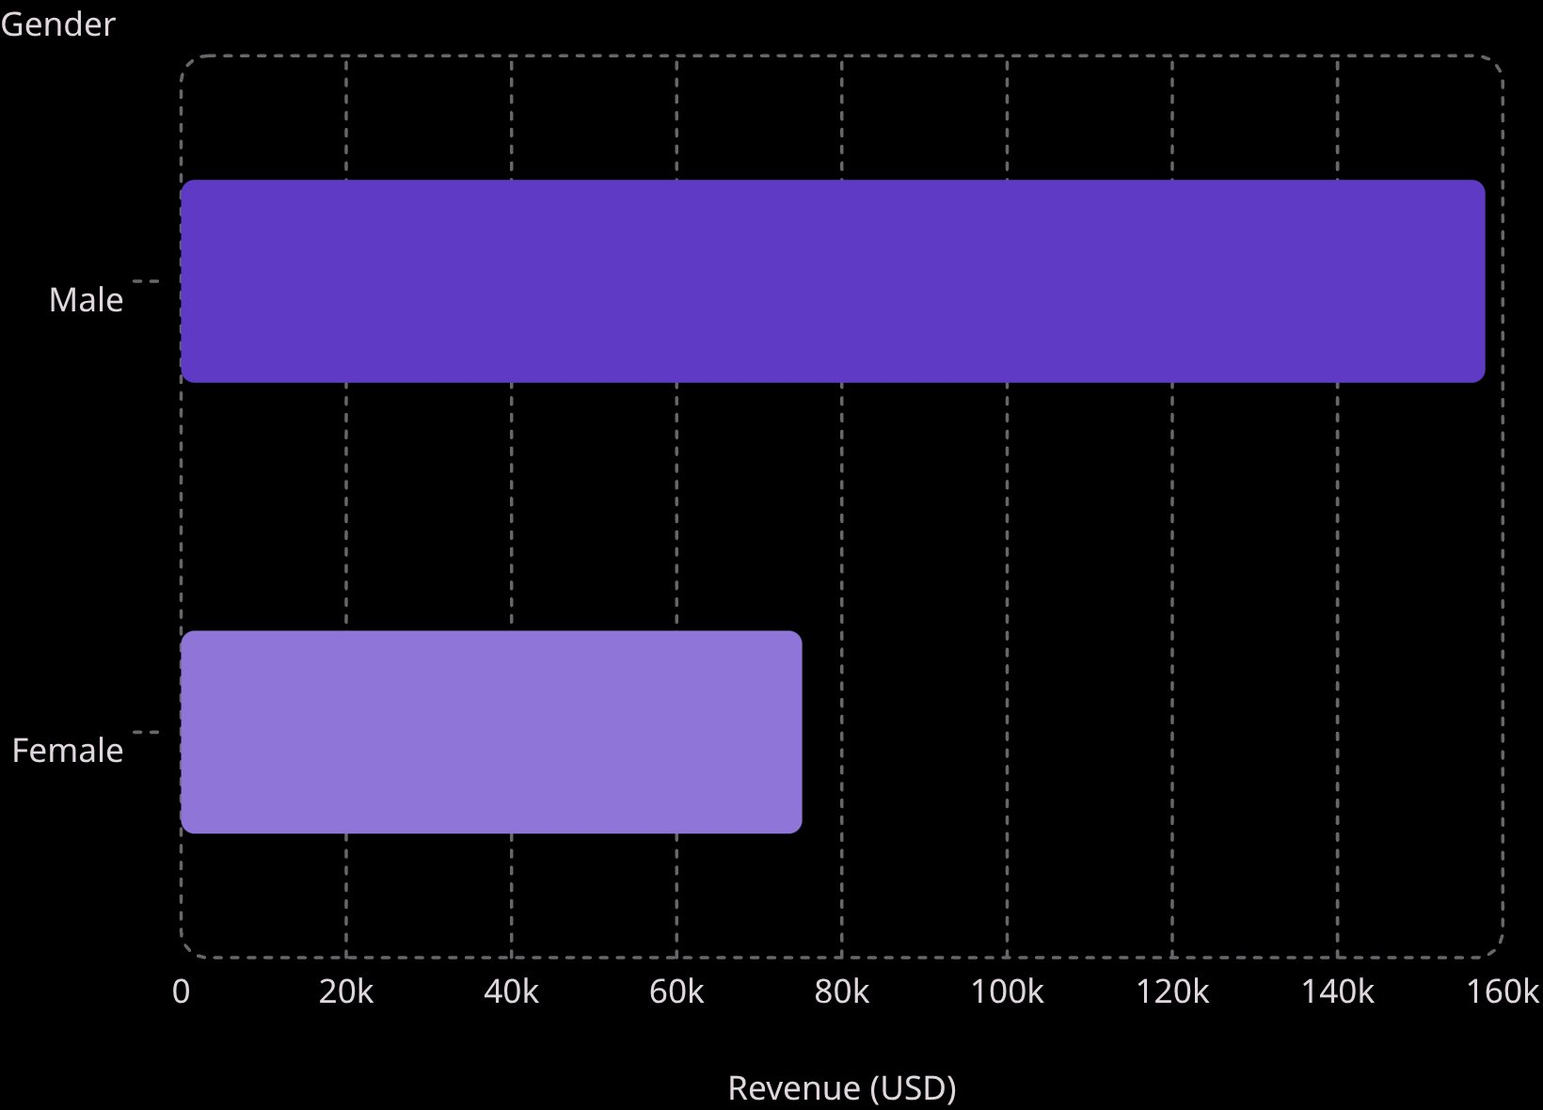
SQL ANALYSIS
Revenue & Spending Insights
Key Findings
Male customers generated over 2× the revenue of female customers
839 high-spending discount users spent above average despite using discounts
Express shipping averaged $60.48 vs. $58.46 for Standard

Slide 5
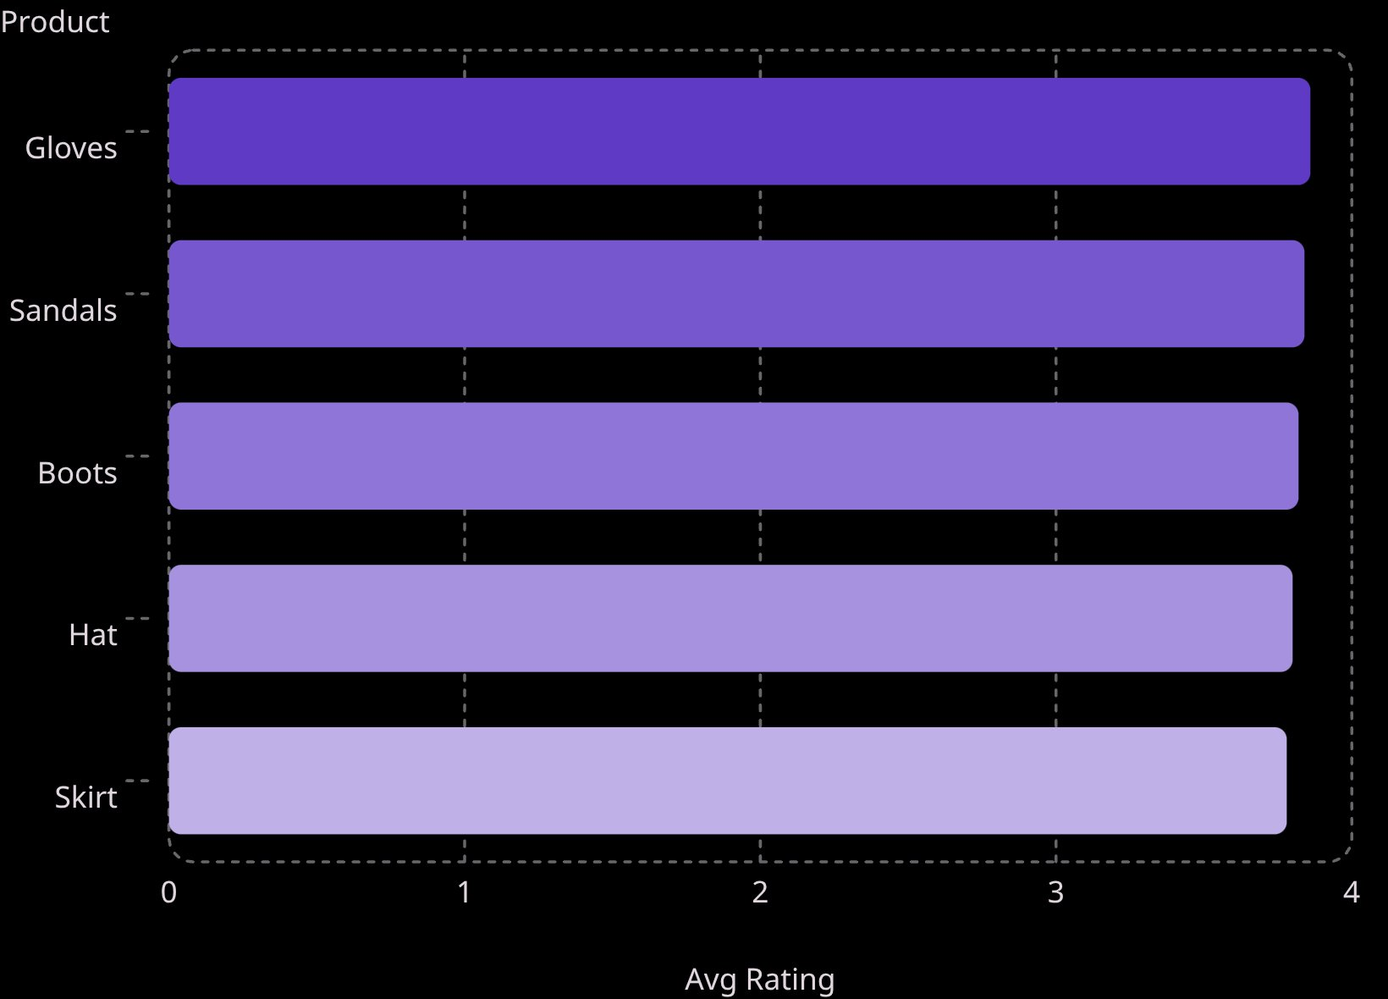
SQL ANALYSIS
Product Ratings & Discount Dependence
Top Rated Products
Overall average review rating: 3.75
Most Discount-Dependent Products
Hat — 50.00% discounted purchases
Sneakers — 49.66%
Coat — 49.07%
Sweater — 48.17%
Pants — 47.37%

Slide 6
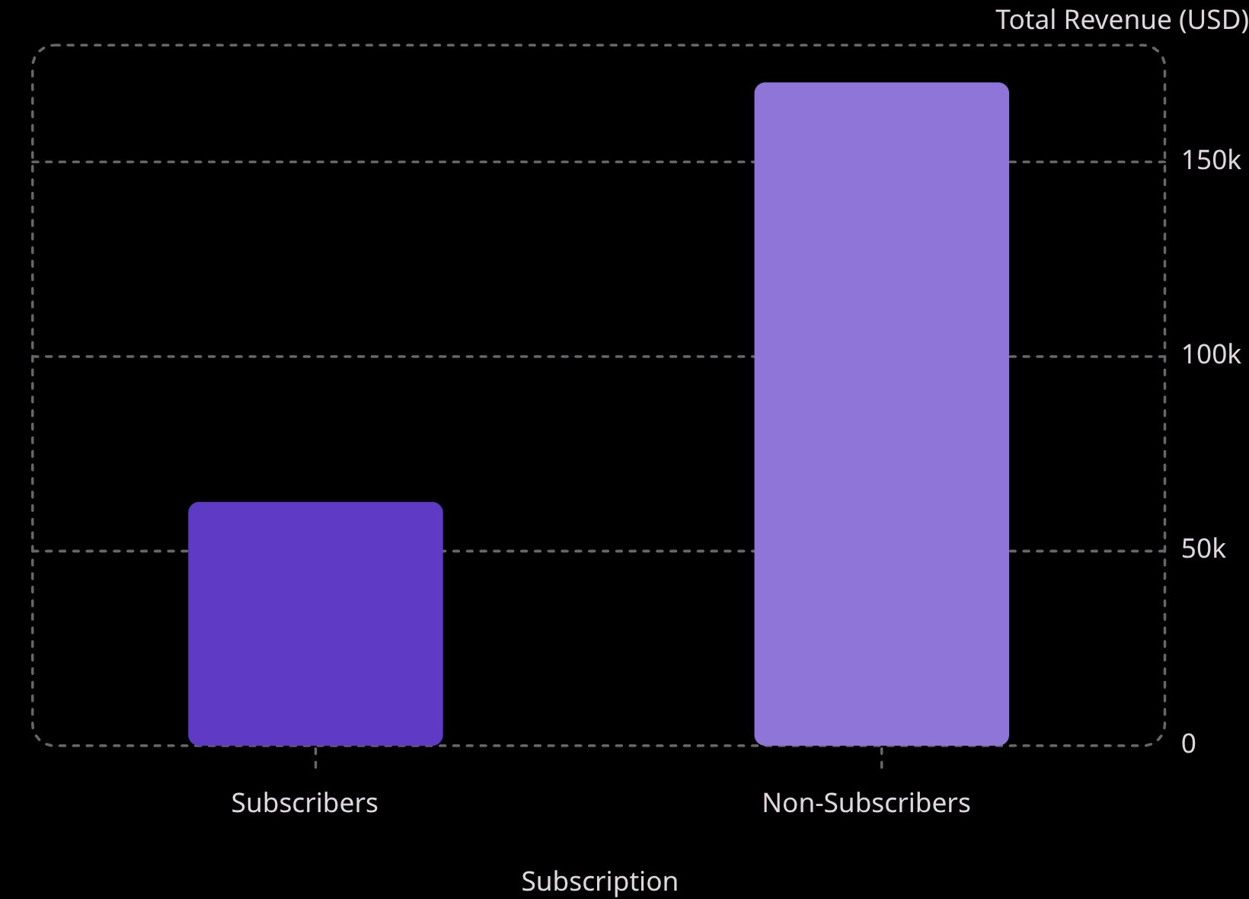

SQL ANALYSIS
Subscribers vs. Non-Subscribers
Subscription Breakdown
27% of customers subscribe, yet they contribute only ~27% of total revenue.
Average spend is nearly identical: $59.49 (subscribers) vs. $59.87 (non-subscribers).
Of 958 repeat buyers (>5 purchases), only a portion subscribe — a clear growth opportunity.

Slide 7
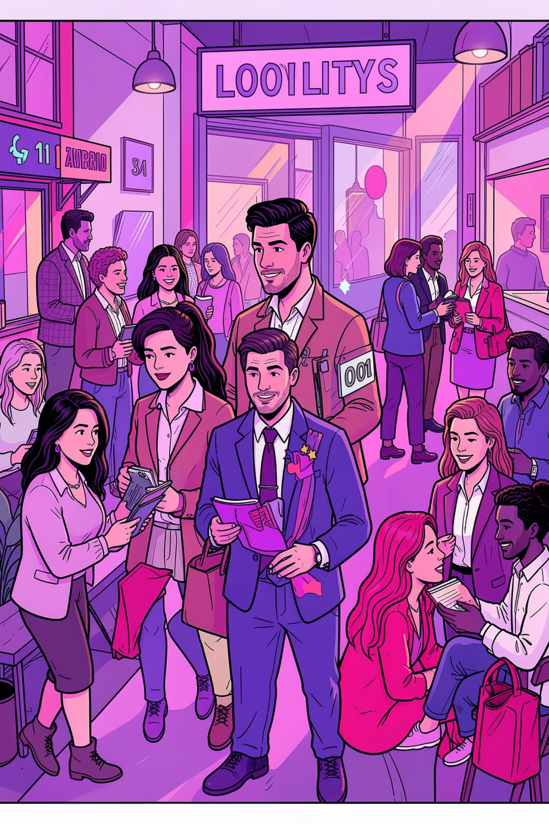
CUSTOMER SEGMENTATION
Loyal, Returning & New Customers
🏆 Loyal
🔁 Returning
3,116 customers — the dominant segment, representing the core revenue base
701 customers — strong candidates for loyalty program upgrades
🌱 New
83 customers — smallest segment, highest growth potential

Slide 8
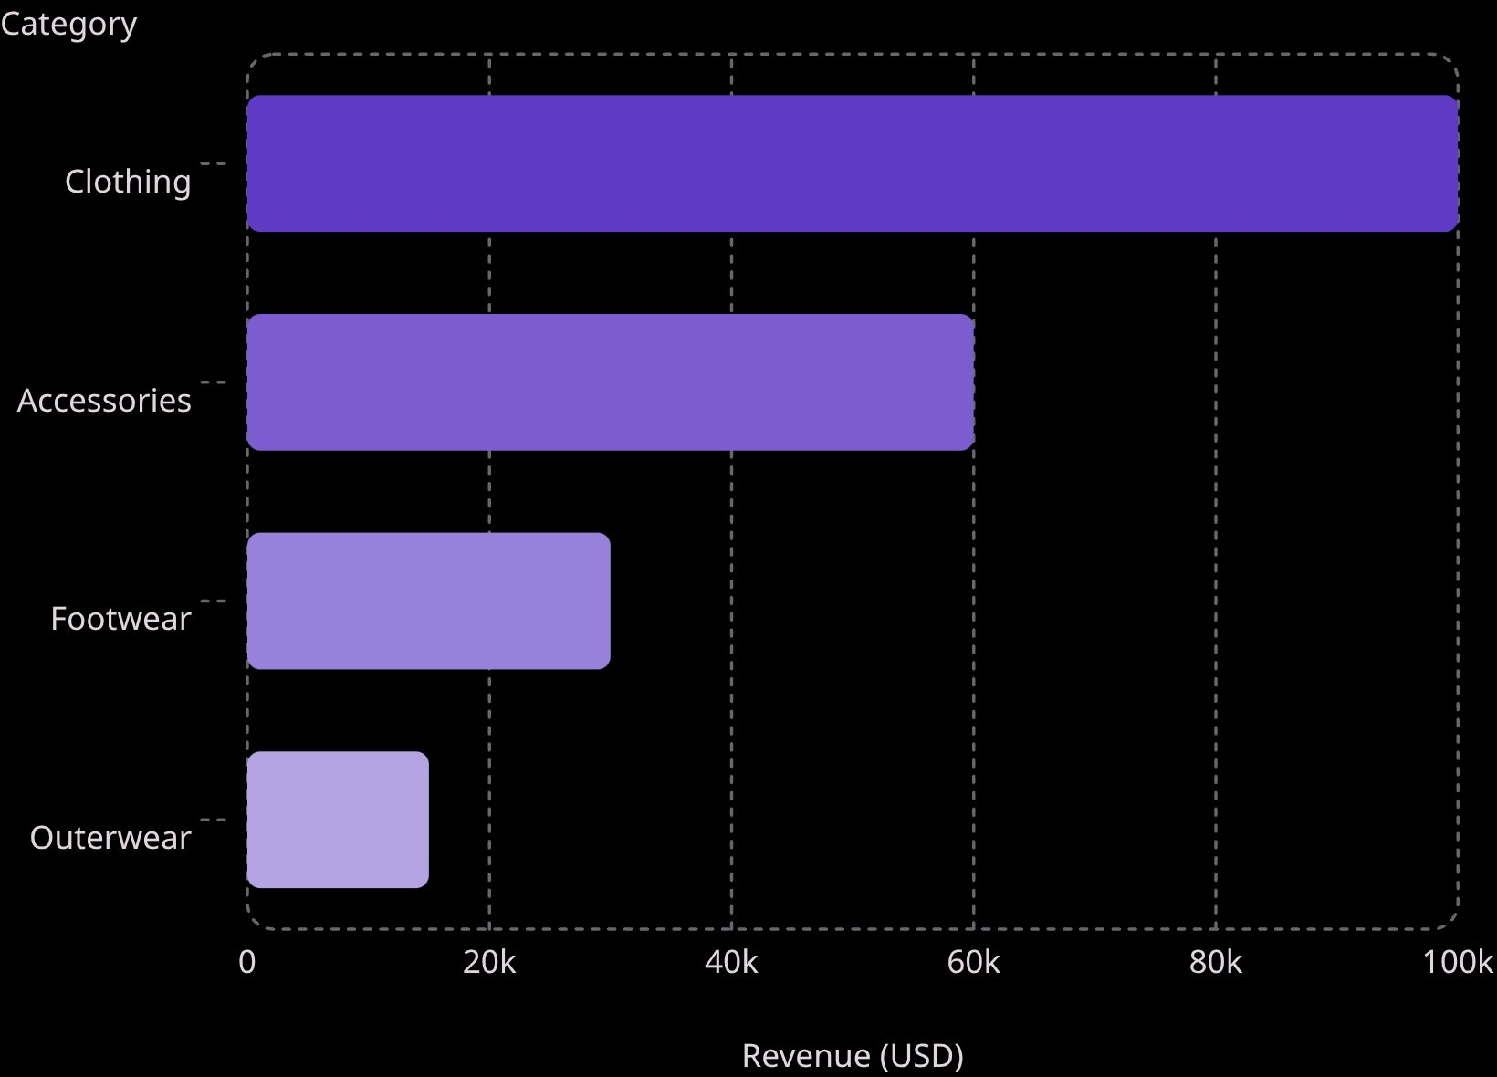
CATEGORY ANALYSIS
Top Products by Category
Top Products per Category
Accessories: Jewelry (171), Sunglasses (161), Belt (161)
Clothing: Blouse (171), Pants (171), Shirt (169)
Footwear: Sandals (160), Shoes (150), Sneakers (145)
Outerwear: Jacket (163), Coat (161)

Slide 9
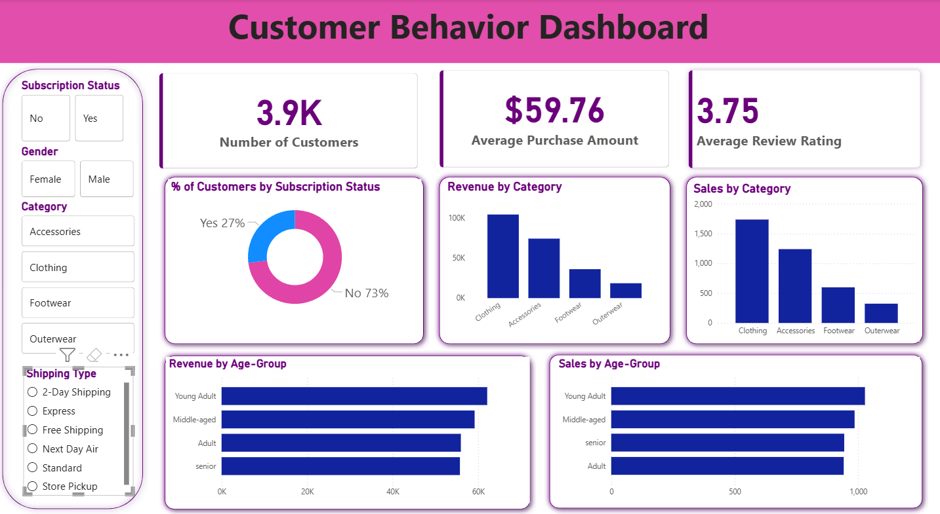
POWER BI DASHBOARD
Interactive Dashboard Overview
Key Metrics
3.9K customers
$59.76 avg. purchase
3.75 avg. review rating
Filters
Subscription Status, Gender, Category, Shipping Type
Revenue by Age Group
Young Adult: ~$55K
Middle-aged: ~$50K
Adult: ~$45K
Senior: ~$40K

Slide 10
RECOMMENDATIONS
Strategic Business Recommendations
Boost Subscriptions
Promote exclusive benefits to convert high-frequency non-subscribers
Customer Loyalty Programs
Reward repeat buyers to move them into the "Loyal" segment
Review Discount Policy
Balance sales boosts with margin control on discount-heavy products
Product Positioning
Highlight top-rated and best-selling products in campaigns
Targeted Marketing
Focus on high-revenue age groups and express-shipping users

