Slide 1
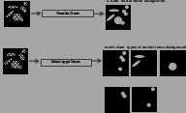
vanilla Unet
2 class: nuclei vs background
multi-type Unet
multi class: multi-nuclei vs background
example of types can be: - different sizes - 'white nucleus' on black background, black nucleus' on white background,
- discounnected, connected - etc ...

Slide 2
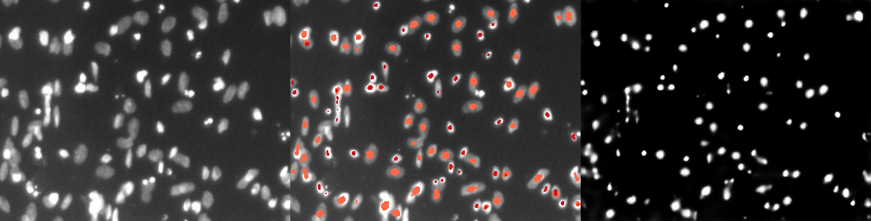
proof of concept: - unet to detect center of nuclei - unet out 4 class probabilities p1,p2,p3,p4, each correspond to different nuclei size
still detect, but low confidence
pi >0.5, each i is denoted by color (red is smallest, pale-orange is largest size)
p = p1+p2+p3+p4

Slide 3
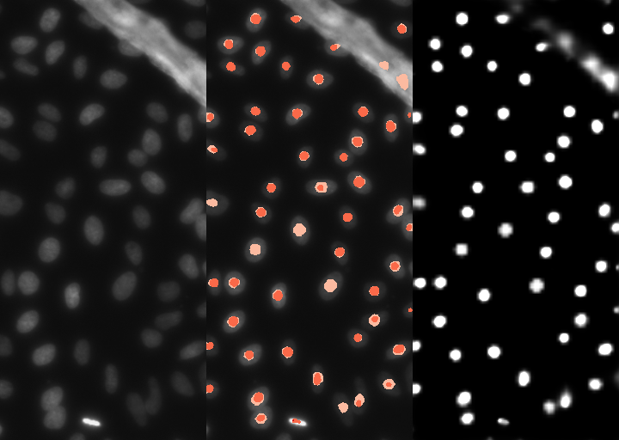

Slide 4
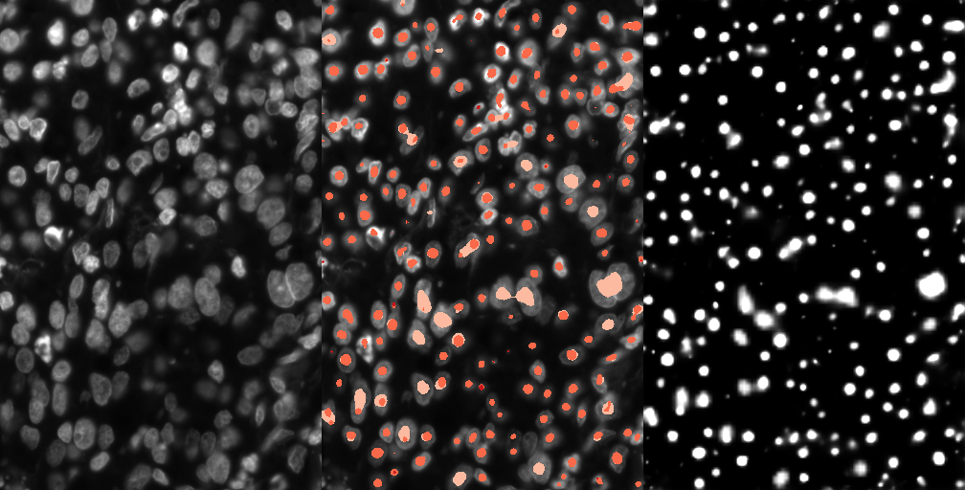
larger size is wrong but smaller size is correct

Slide 5
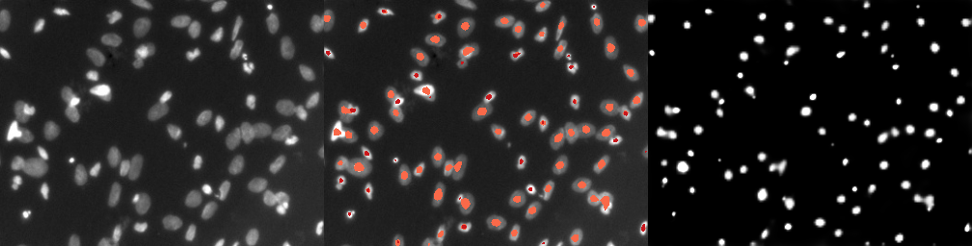

Slide 6
