Slide 1

Complaint Management System

Slide 2
Index
Case Type Category wise Sub-Category wise Region wise Office wise LOS wise SBU wise Sub-SBU wise Gender of Complainant Gender of Respondent Designation of Complainant Designation of Respondent Mode of Complaint Ageing/Case Closure

Slide 3
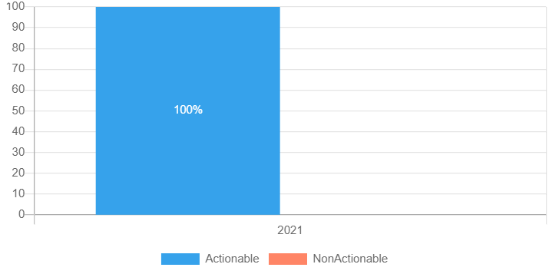
Case Type

Slide 4
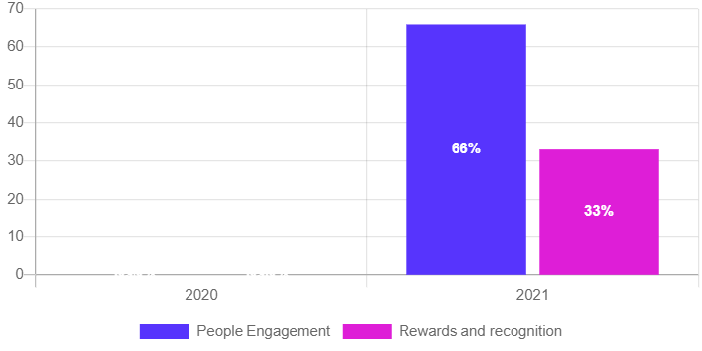
Category wise

Slide 5
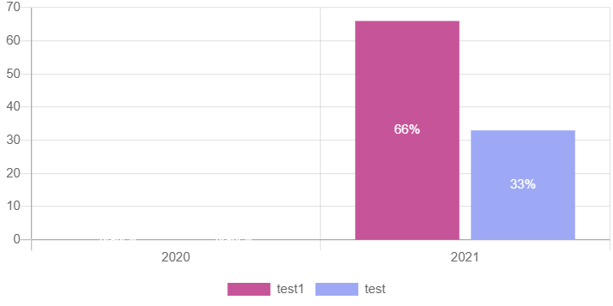
Sub-Category wise

Slide 6
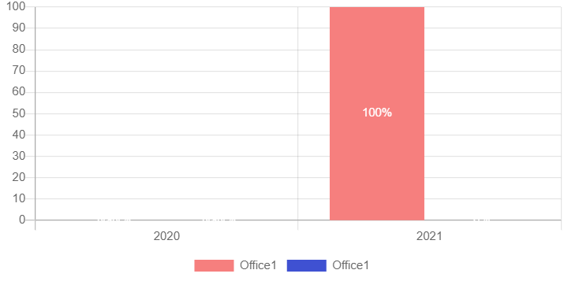
Region wise

Slide 7
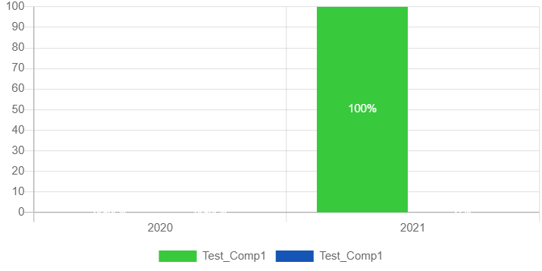
Office wise

Slide 8
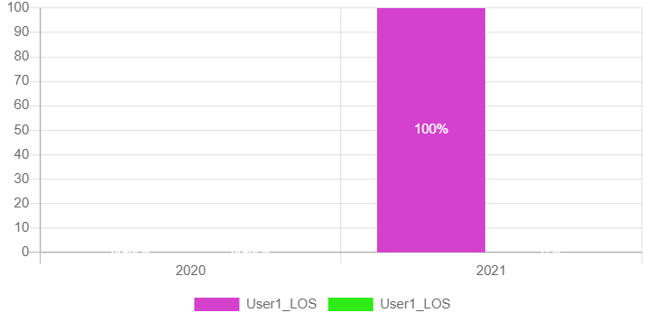
LOS wise

Slide 9
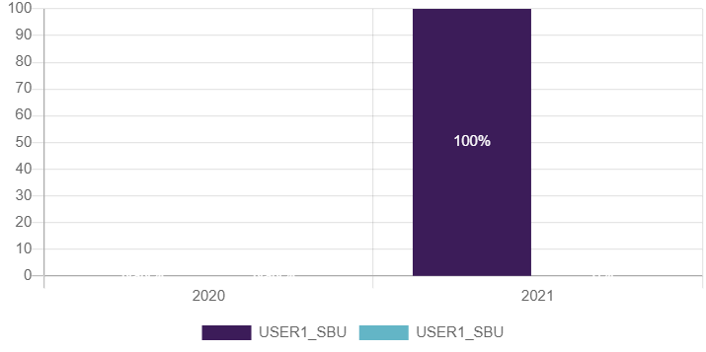
SBU wise

Slide 10
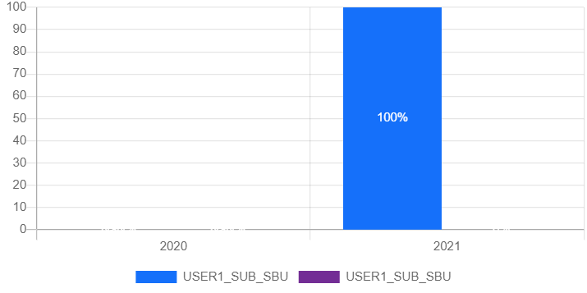
Sub-SBU wise

Slide 11
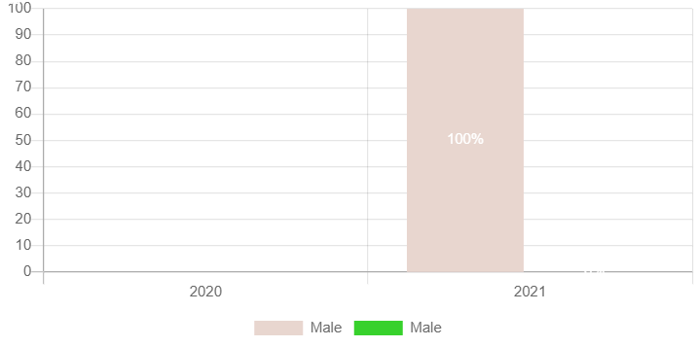
Gender of Complainant

Slide 12
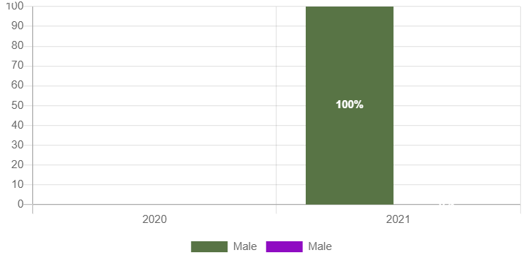
Gender of Respondent

Slide 13
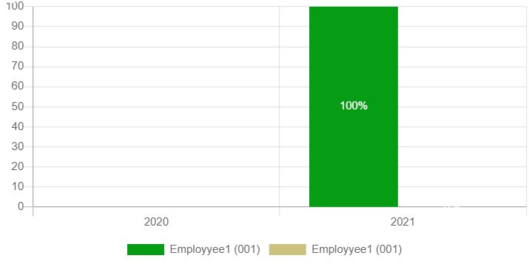
Designation of Complainant

Slide 14
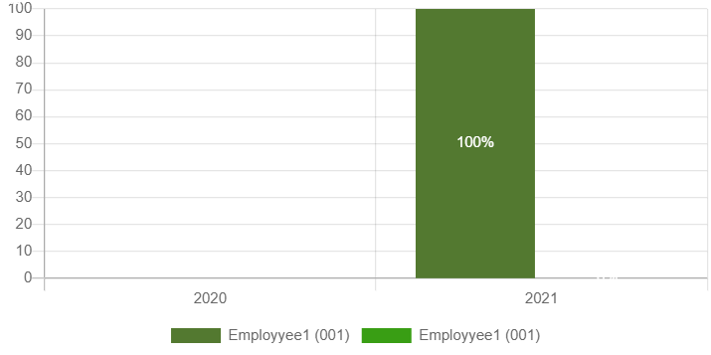
Designation of Respondent

Slide 15
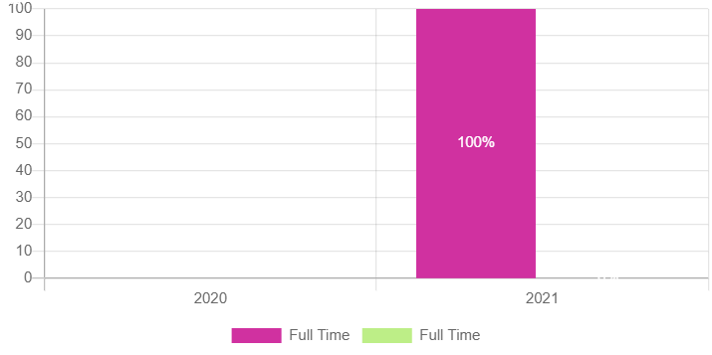
Mode of Complaint

Slide 16
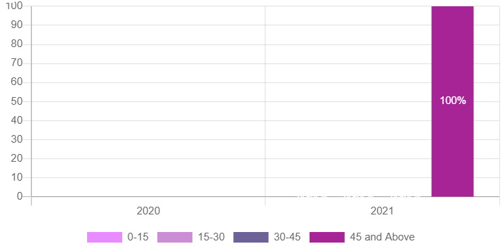
Ageing/Case Closure

