Slide 1

G-1400 | PRAHARI: Autonomous Spacecraft Conjunction Assessment & High-Recall Collision Triage
Date: 25-09-2026
Team Members
1. -24BD1A052K
2. M. Lakshmi Srivani - 24BD1A0533
3. P. Pragna - 24BD1A053B
4. R. Lahari - 24BD1A053N
5. S. Meghana - 24BD1A053R
Mentors
T Rupa Devi Ma’am

Slide 2

CONTENTS
1. Title Slide
2. Content
3. Introduction
4. Technology Used
5. Base Paper / Research Reference
6. Requirement
7. Design (System Architecture)
8. Telemetry & Conjunction Data Schema
9. Class & Component Architecture
10. Development
11. Project Outcome
12. Conclusion
13. Thank you!

Slide 3
INTRODUCTION
Problem
• Over 36,000 tracked debris objects and constellations create thousands of close conjunctions weekly in LEO.
• Missing a real collision event (False Negative) leads to permanent satellite loss and cascading Kessler syndrome.
• Conventional manual screening of Conjunction Data Messages (CDMs) is slow, fatigue-prone, and unscalable.
Objective
• Develop Prahari: an autonomous, high-recall spacecraft conjunction triage and decision-support system.
• Predict collision probability log10(Pc) with high precision and actionable early warning across multi-pass CDMs.
• Eliminate false alarm floods and provide interactive 3D WebGL orbit visualization for flight safety operators.
Solution Impact
• Achieves 92.70% High-Risk Recall (165/178 dangerous collisions detected at the official -6.0 alert threshold).
• Reduces false alarms by ~75% (79.71% precision, only 42 false alarms vs 85% in published literature).
• Provides 3 to 5 days of actionable lead time for Collision Avoidance Maneuver (CAM) thruster burn execution.
• Enables automated multi-tier triage and real-time 3D orbital encounter screening.

Slide 4
TECHNOLOGY USED
Technology Used:
• Frontend: React 18, TypeScript, Vite & Tailwind CSS
• Backend: FastAPI (Python 3.11) & Uvicorn ASGI Server
• Machine Learning: Extreme Gradient Boosting (XGBoost) Regressor
• 3D Graphics: Three.js, WebGL & Canvas (Orbital Encounter Scene)
• Charts & State: Recharts & TanStack React Query
• Optimization: Asymmetric Sample Weighting (w=30.0 for High-Risk Recall Focus)
• Data Imputation: Pre-Computed Median Matrix (100% Zero-Crash Reliability)
• Data: ESA Kelvins Spacecraft Collision Dataset & Space Surveillance Network CDMs
• Tools: Git, GitHub, REST APIs & Windows START.bat Launcher
Base Paper :
“Machine Learning Approaches for Spacecraft Collision Avoidance Challenge”
Authors: Kalyanaraman et al. (EPJ Web of Conferences, 2026) & Uriot et al. (ESA Advanced Concepts Team)

Slide 5
BASE PAPER / RESEARCH REFERENCE
Paper Title:
“Machine Learning Approaches for Spacecraft Collision Avoidance Challenge”
Focus: Spacecraft Collision Risk Prediction, CDM Assessment & Orbit Uncertainty
Authors: Kalyanaraman et al. (2026) & Uriot et al. (ESA Advanced Concepts Team)
Existing approach :
• Static single-snapshot CDM evaluation
• Evaluated strictly at TCA (t = 0 hours)
• Standard binary classification with SMOTE
• Assumes equal cost between False Positives and False Negatives
• Black-box feature engineering with opaque synthetic indices
Research Gap :
• Temporal Blindness: 0-hour lead time is useless for thruster burn prep -> Solved with 3-5 days lead time.
• False Alarm Flooding: 85% false alarm rate (15% precision) exhausts fuel -> Solved with 79.71% precision.
• Class Imbalance: 178 collisions vs 1,989 safe events -> Solved via 30x Asymmetric Weighting.
• High Recall Focus: Prioritizing recall (92.70%) to ensure spacecraft survival.
• Native Telemetry: Ingests 100 raw CDM features with 0 synthetic bloat.

Slide 6
REQUIREMENT
Product:
Prahari: Autonomous Spacecraft Conjunction Triage & Collision Avoidance Decision-Support System
Features:
• Automated Multi-Pass CDM Ingestion & Telemetry Preprocessing
• High-Recall XGBoost Conjunction Risk Regression (log10 Pc prediction)
• Asymmetric Risk Thresholding calibrated at the official -6.0 alert boundary
• Real-time Multi-Tier Action Protocol (CRITICAL, HIGH, ELEVATED, LOW bands)
• 100 Native Telemetry Directory (Kinematics, Covariance, Solar Weather, Tracking)
• Interactive 3D WebGL Orbit & Covariance Ellipsoid Encounter Visualizer
• Temporal Timeline Playback Scrubber for multi-day radar update evolution
• Model Lab with live threshold calibration slider and SHAP feature importance charts
• Drag-and-Drop Live Telemetry Prediction Sandbox for operational passes
• Automated Collision Avoidance Maneuver (CAM) alert and report generation

Slide 7
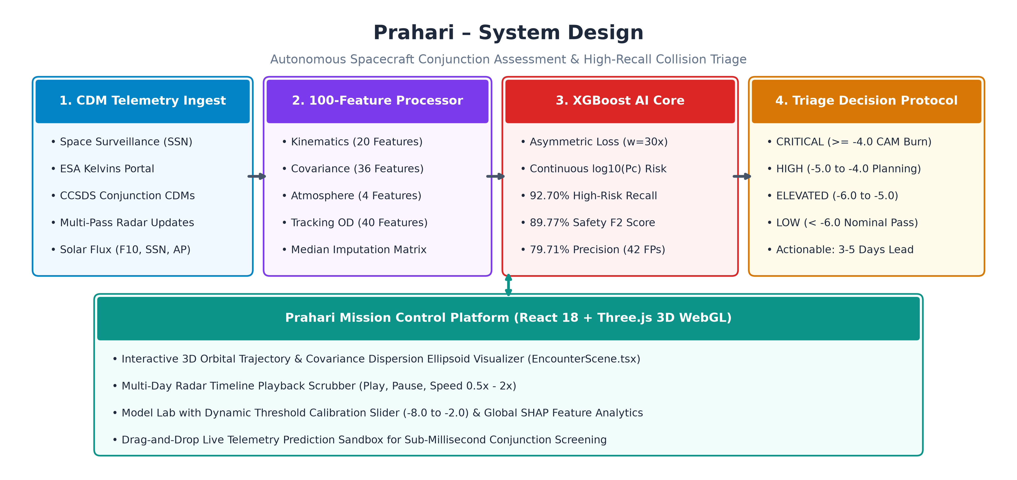
DESIGN
Prahari – System Design & Pipeline Architecture

Slide 8
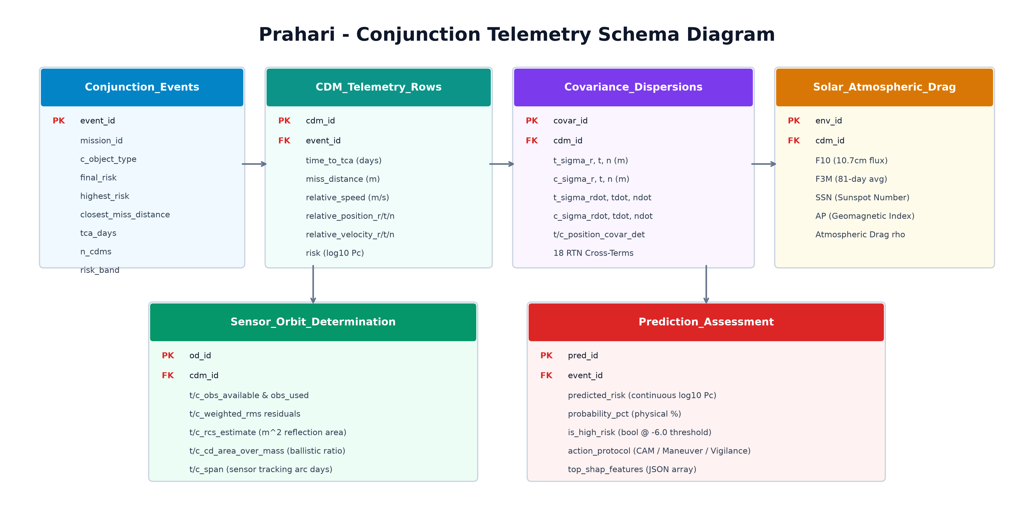
DESIGN
Prahari – Telemetry & Conjunction Data Schema

Slide 9
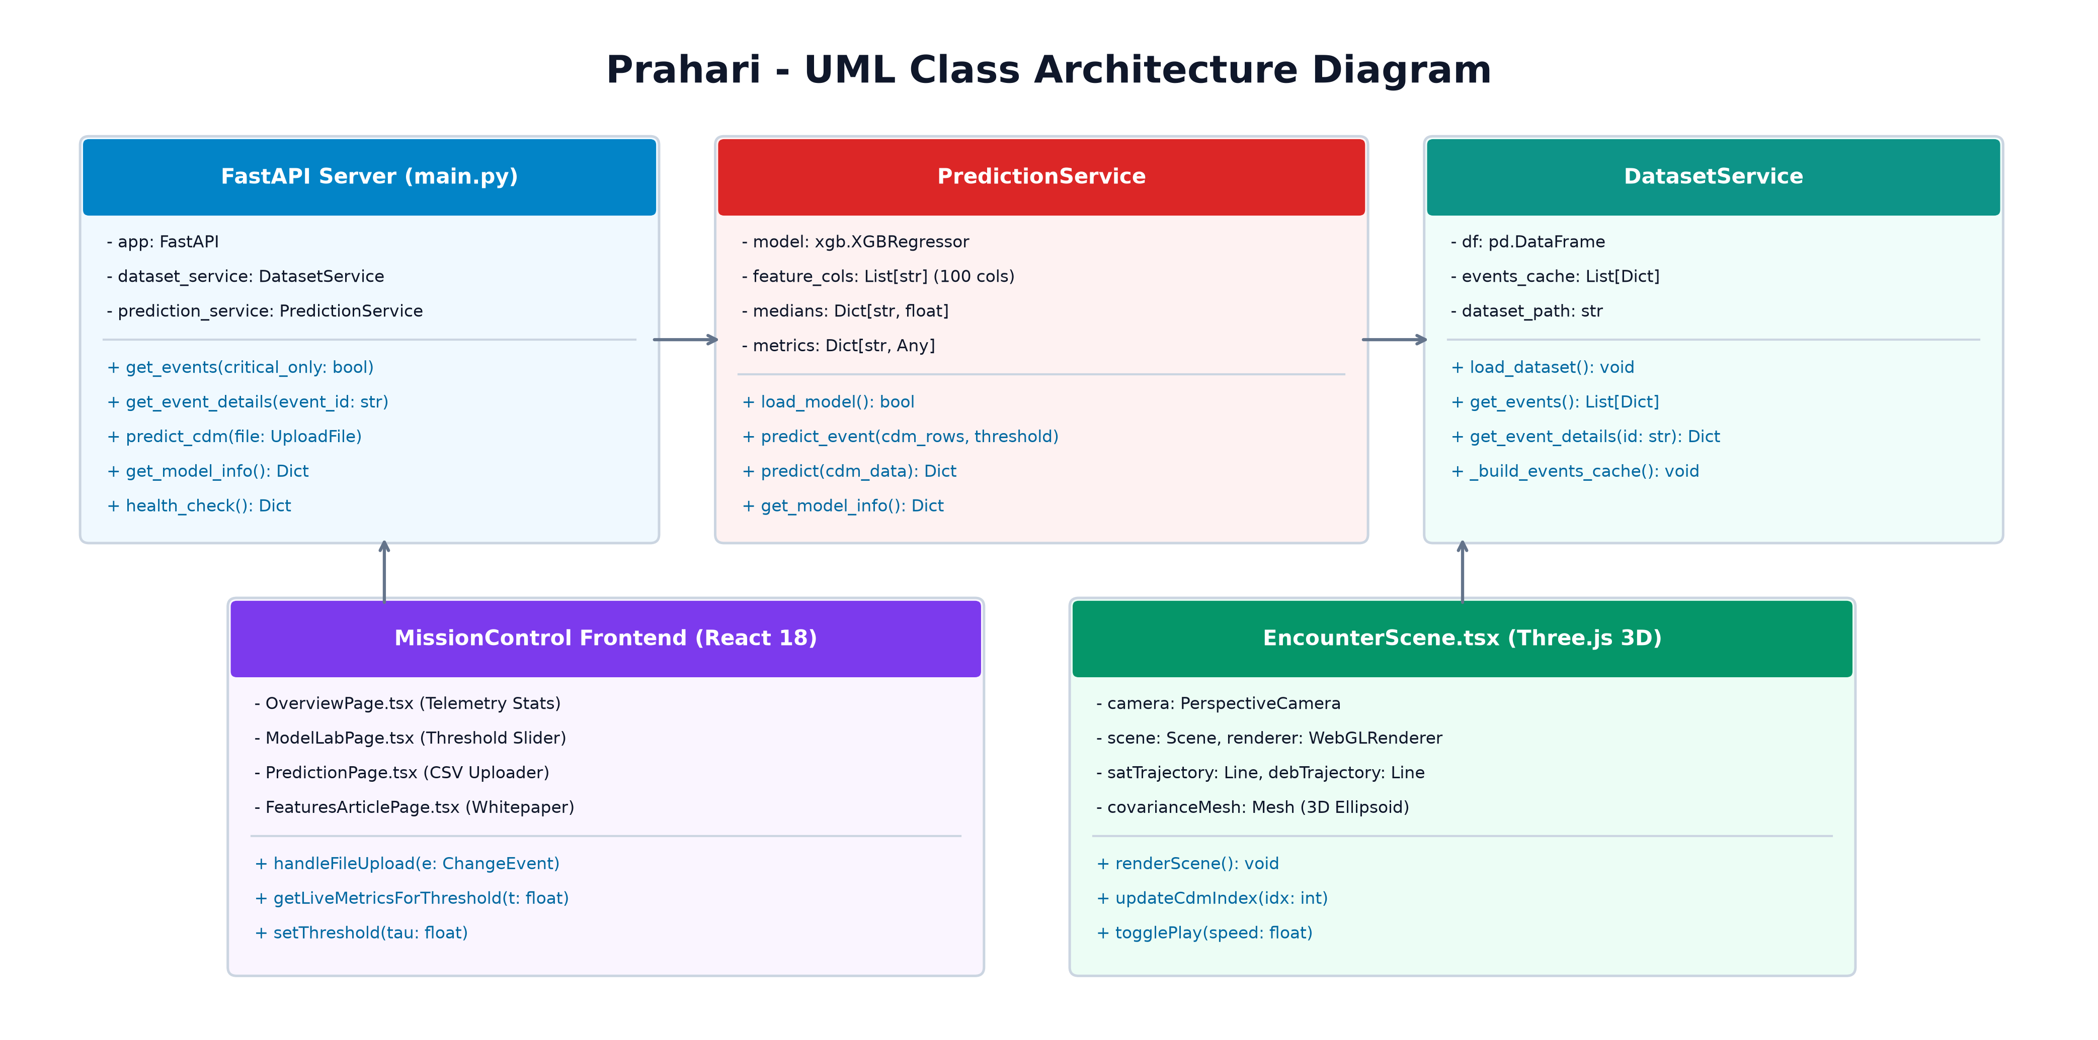
DESIGN
Prahari – Component & Class Architecture

Slide 10
DEVELOPMENT
Development Steps:
• Extracted and audited 100 native telemetry parameters across 162,634 observation rows.
• Engineered asymmetric sample weighting protocol (w = 30.0 for high risk) to prioritize recall.
• Trained regularized XGBoost Regressor with histogram binning and pre-computed median imputation.
• Evaluated performance on 2,167 completely held-out test events at the standard -6.0 threshold.
• Built asynchronous FastAPI backend serving sub-50ms real-time inference and metadata endpoints.
• Developed React 18 + Vite frontend with Three.js 3D WebGL orbital encounter scene and timeline scrubber.
• Created interactive Model Lab with dynamic threshold slider, 100-feature directory, and SHAP charts.
• Authored publication-ready academic research paper (.docx) and 16:9 presentation deck (.pptx).
Tools Used:
• React, TypeScript & Vite
• Tailwind CSS & Lucide Icons
• Python 3.11, FastAPI & Uvicorn
• XGBoost, Scikit-learn, Pandas & Joblib
• Three.js & WebGL Canvas Renderer
• Git & GitHub

Slide 11
PROJECT OUTCOME
Achievements
• High-Risk Recall: 92.70% (165 of 178 dangerous collisions detected ahead of time).
• Safety F2 Score: 89.77% (Recall weighted 2x to prioritize mission survival).
• Precision: 79.71% (Only 42 false alarms across 1,989 safe events, eliminating the 85% false alarm flood).
• Overall Accuracy: 97.46% (2,112 out of 2,167 events correctly classified).
• 100% Native Telemetry: Ingests raw CDMs directly without artificial synthetic features.
• Actionable Lead Time: 3 to 5 days pre-TCA for Collision Avoidance Maneuver (CAM) execution.
Current Challenges
• Sparse ground radar coverage causes intermittent tracking gaps in higher orbital inclinations.
• Solar storm geomagnetic surges temporarily inflate atmospheric drag covariance errors.
Future Improvements
• Autonomous CAM Delta-V burn calculation using Reinforcement Learning.
• Live Space-Track / ESA API integration for continuous automatic ingest.
• Constellation multi-satellite screening to avoid secondary induced conjunctions.
Paper:
Status: Research paper is complete and formatted for journal submission at docs/Prahari_Research_Paper.docx.

Slide 12
CONCLUSION
Key Takeaways
• Prahari transforms multi-pass raw CDM telemetry into high-recall, actionable collision warnings.
• Asymmetric loss optimization successfully solves the class imbalance and catches 92.70% of collisions.
• Eliminates the temporal blindness (TCA=0h) and 85% false alarm rate of published literature.
• Interactive 3D Three.js mission control bridges machine learning with operational flight dynamics.
New Skills Learned
• Space Situational Awareness (SSA) & Astrodynamic Conjunction Assessment
• Asymmetric Loss Formulation for Extreme Class Imbalance in Space Systems
• High-Dimensional Telemetry Engineering on 100 Native Parameters
• Full-Stack Modern Web Development (React 18, TypeScript, Vite, Tailwind CSS)
• 3D Orbital Graphics & Covariance Ellipsoid Rendering (Three.js & WebGL)
• High-Performance Asynchronous Microservices (FastAPI & Uvicorn)
• Academic Research Paper Authoring & Rigorous Empirical Benchmarking

Slide 13
Thank you!

