Slide 1
Covid-19 Detection Using Deep Learning of Chest X-Ray Images
ET4207 – Major Project AY 2020-21
Group members: Gr No.
1)Akshay Bharati (1710352)
2)Shrikant Karhale (1710362)
3)Pranav Kulkarni (1710726)
4)Dyanand Haral (1710756)
5)Abhinandan Patil (1710725)
Under Guidance of
Prof. Bhorge Sir
Faculty Dept E&TC

Slide 2
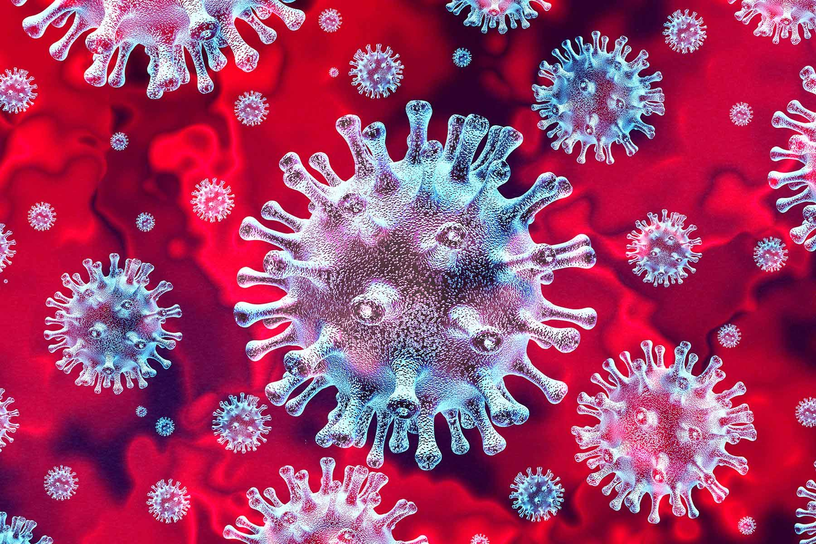
Introduction
What is Corona Virus?
Spread of Corona Virus
Symptoms
Affect on body parts
Our idea about this Project

Slide 3
Limitation of Current Covid-19 Test
Different values of the sensitivity of RT-PCR tests to COVID-19 have been reported in different parts of the globe.
According to one analysis with 51 people in China, up to 29% of people with the coronavirus tested negative
If the sensitivity of one RT-PCR test kit is 90%.
If that is so, about 200,000 COVID-19 patients could have been wrongly diagnosed among the more than 20 million tests worldwide.

Slide 4
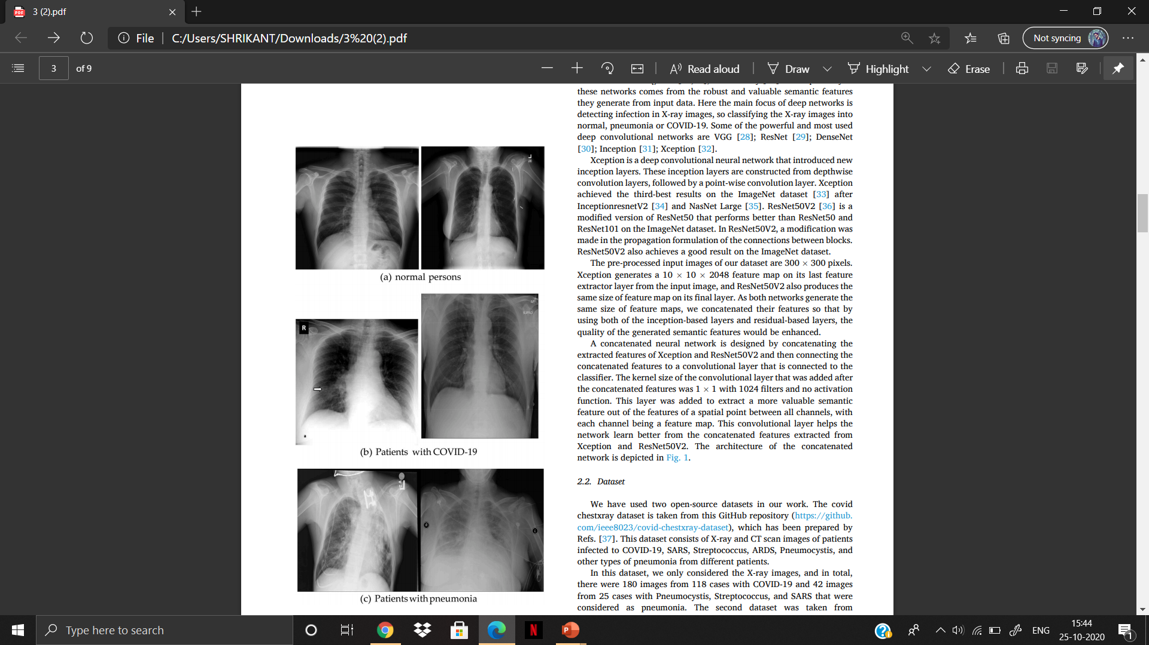
Dataset
Dataset
Covid-19 Chest X-Ray Dataset
Rsna Pneumonia Detection Challenge
Normal 8851
Images
Pneumonia 6012
Images
Covid-19 468
Images
Pneumonia 38
Images

Slide 5
Dataset Division
Dataset Division
Training Set
Validation Set
Test Set
1) 2000 Normal &
1600 Pneumonia from rsna Detection Challenge.
1) 300 Normal & 300 Pneumonia from rsna pneumonia Dataset
1) 6851 Normal Images
2) 359 Covid-19 Images from Covid Chest X-Ray Dataset
2) 50 Images From Covid-19 Chest X-Ray Dataset
2) 109 Covid-19 Images
3) 4420 Pneumonia Images

Slide 6
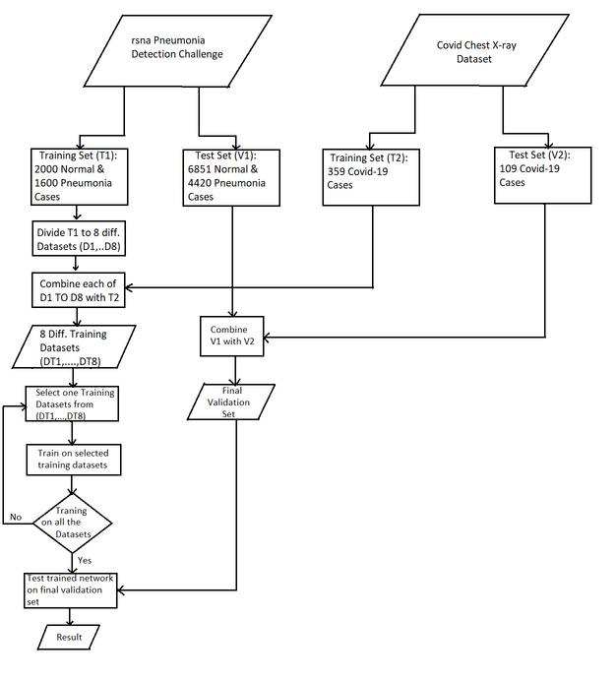
Flowchart

Slide 7
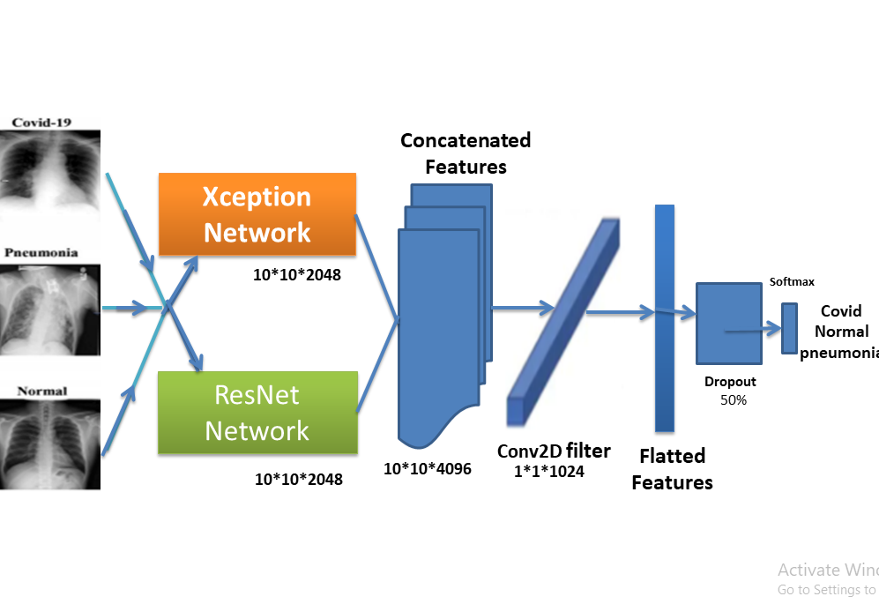
Architecture of Concatenated network

Slide 8
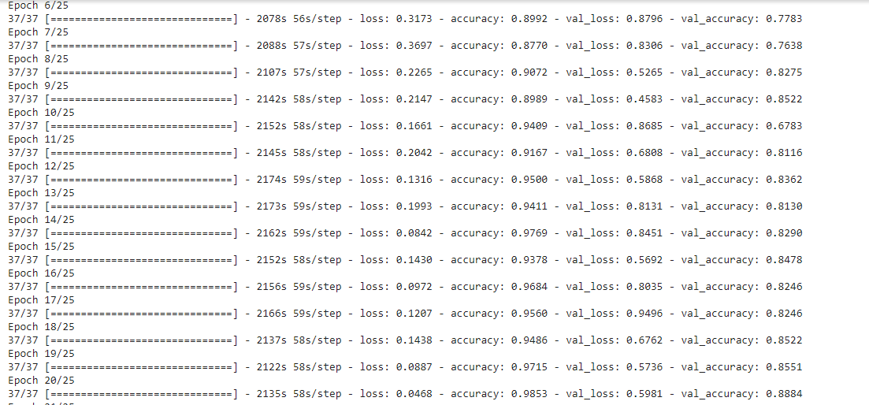
Training and Validation Accuracy
Average Training accuracy of 94% and Validation accuracy Of 88% achieved

Slide 9
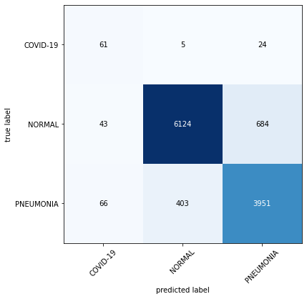
Testing Results
Covid-19: 90
Normal: 6851
pneumonia: 4420
Confusion Matrix

Slide 10
Conclusion and Future Scope
In this project we presented a CNN based on state of the art pretrained models like Xception and ResNetV50.
We classified the images into three classes i.e Normal Pneumonia and COVID-19 and presented how to train the model when the
dataset is imbalanaced.
Instead of building a CNN from scratch,we used Transfer Learning for extracting feature maps from Xception snd ResNetV50 so that
the model accuracy is increased.
The final accuracy we obtained on the test set was 88.84% .
The model accuracy can surely be improved by using more COVID-19 images and by fine-tuning the model hyperparameters.
Today healthcare sector is continuously evolving,thanks to the rapid advancements in deep learning.AI driven diagnostic process will definitely be widely
used in the upcoming years in the medical sector.
As we fine-tune our model to obtain a accuracy of more than 95% ,we hope our model can be useful in the medical field.

Slide 11
REFERENCES
Lakshmanaprabu S, Mohanty SN, Shankar K, Arunkumar N, Ramirez G. Optimal deep learning model for classification of lung cancer on ct images. Future Generat Comput Syst.
Rahimzadeh M, Attar A, et al. Sperm detection and tracking in phase-contrast microscopy image sequences using deep learning and modified csr-dcf. 2020.
McIntosh K. Coronavirus disease 2019 (COVID-19): epidemi- ology, virology, clinical features, diagnosis, and prevention.
Jiang F, Deng L, Zhang L, Cai Y, Cheung CW, Xia Z. Review of the clinical characteristics of coronavirus disease 2019 (covid-19).
Gozes O, Frid-Adar M, Greenspan H, Browning PD, Zhang H, Ji W, Bernheim A, Siegel E. Rapid ai development cycle for the coronavirus (covid-19) pandemic: initial results for automated detection & patient monitoring using deep learning ct image analysis.
Wang S, Kang B, Ma J, Zeng X, Xiao M, Guo J, Cai M, Yang J, Li Y, Meng X, et al. A deep learning algorithm using ct images to screen for corona virus disease (covid19).

Slide 12
Thanks...

