Slide 1

ANZ BANK
Exploratory Data Analysis
BY: AKSHAY BHAT

Slide 2
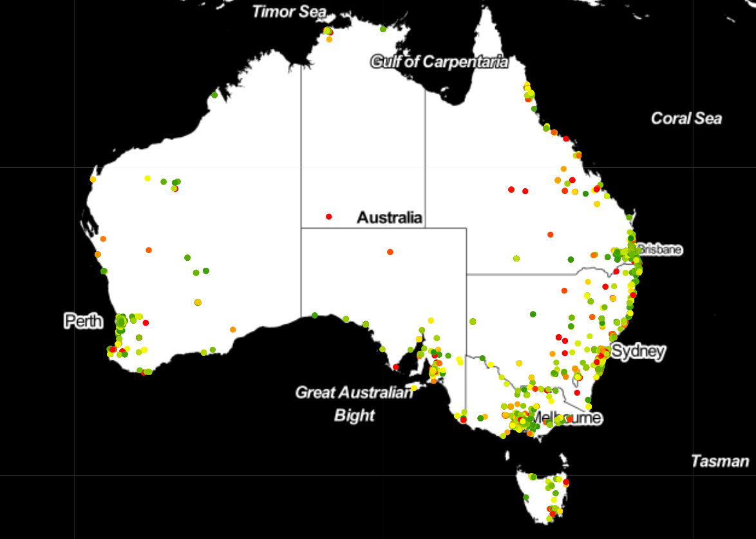
MERCHANT BASE ANALYSIS[TRANSACTION POINT]
Most of the transactions have taken place in the East coast.

Slide 3
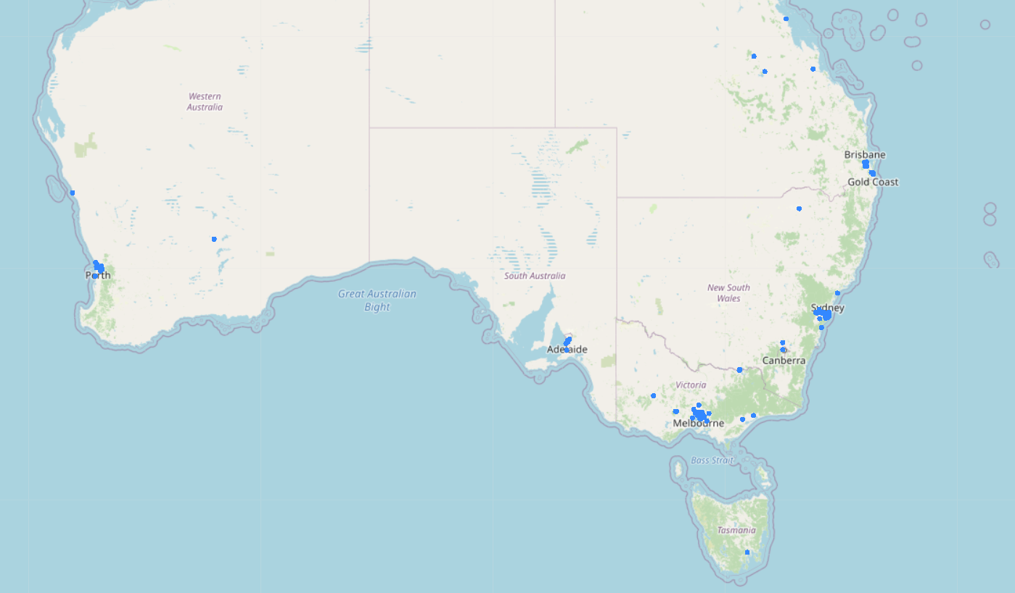
CUSTOMER BASE ANALYSIS
-Most of the customers are from Melbourne and Sydney.
- One outlier was found outside Australia.

Slide 4
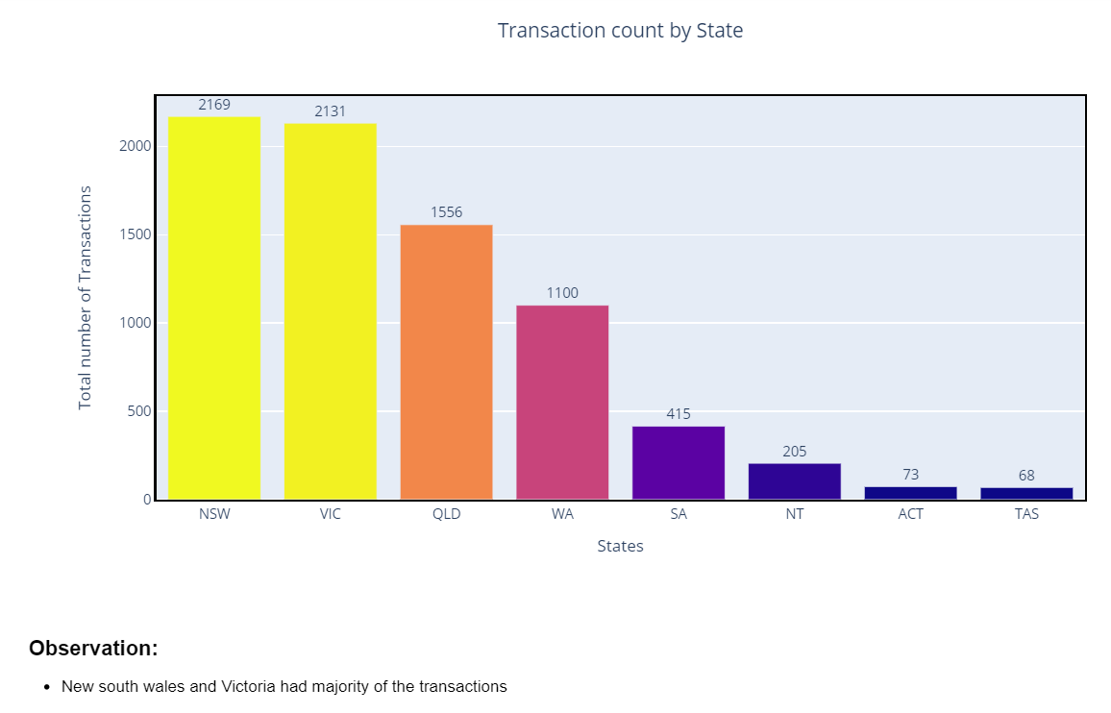
STATE v/s TRANSACTION ANALYSIS

Slide 5
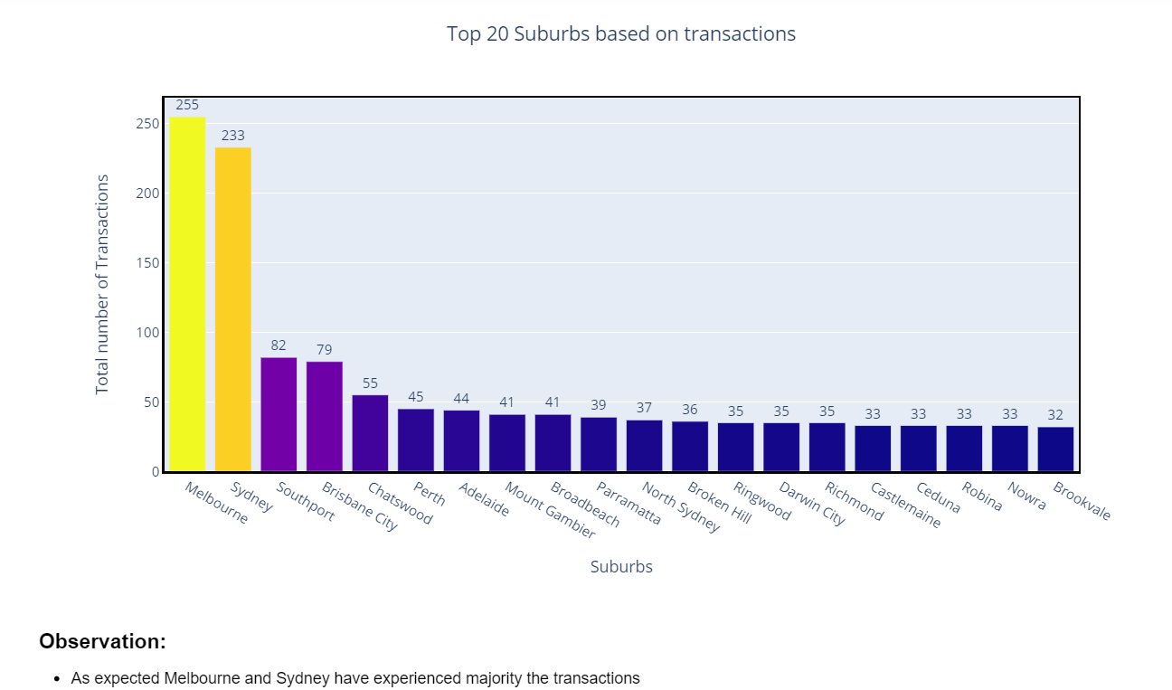
SUBURB v/s TRANSACTION

Slide 6
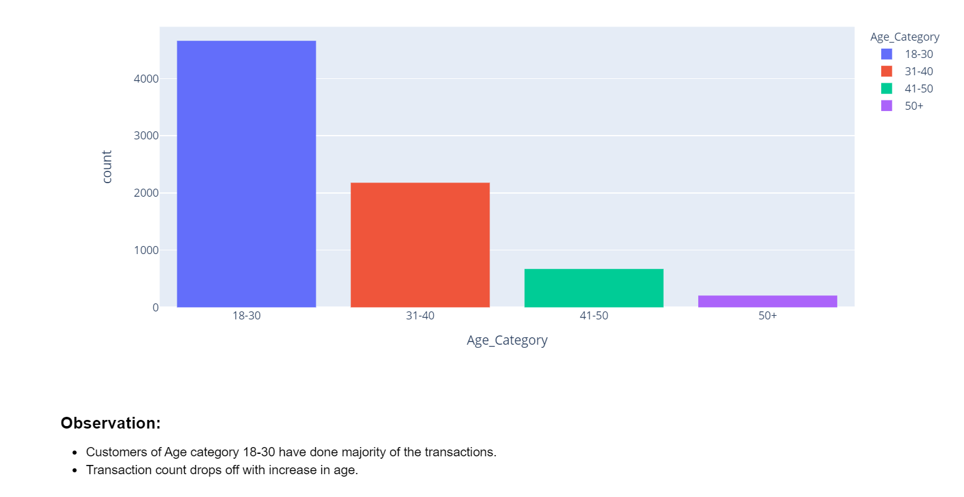
AGE CATEGORY v/s TRANSACTION

Slide 7
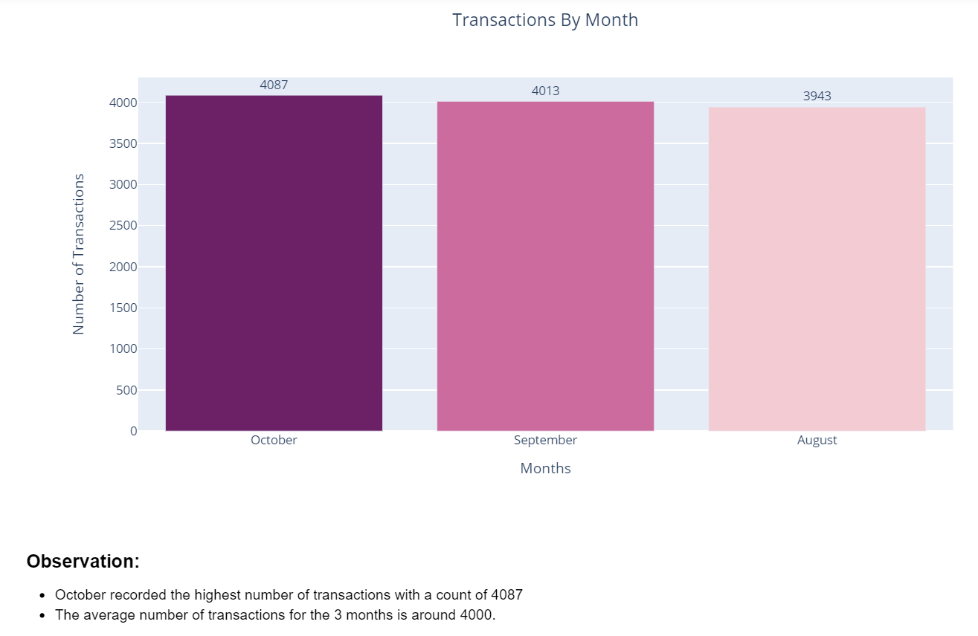
MONTH v/s TRANSACTION

Slide 8
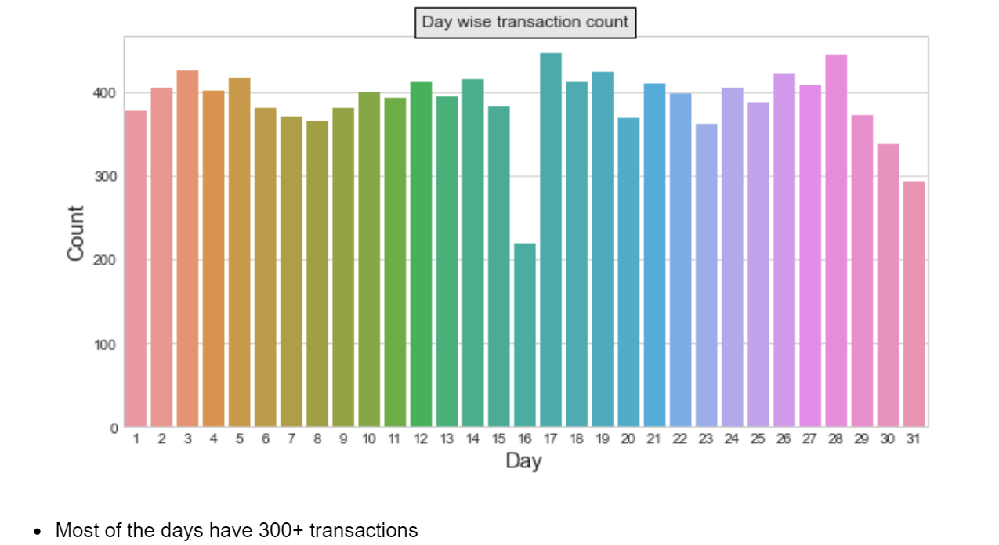
DAY v/s TRANSACTION

Slide 9
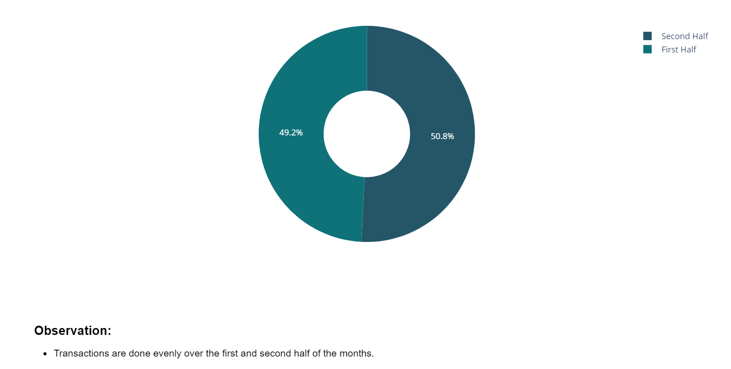
DATE CATEGORY v/s TRANSACTION

Slide 10
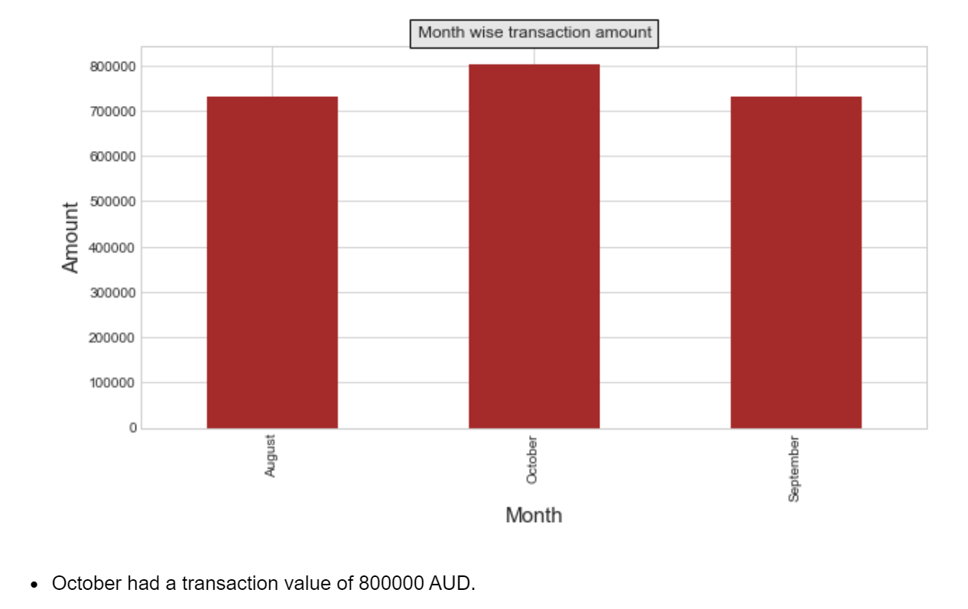
MONTH v/s TRANSACTION AMOUNT

Slide 11
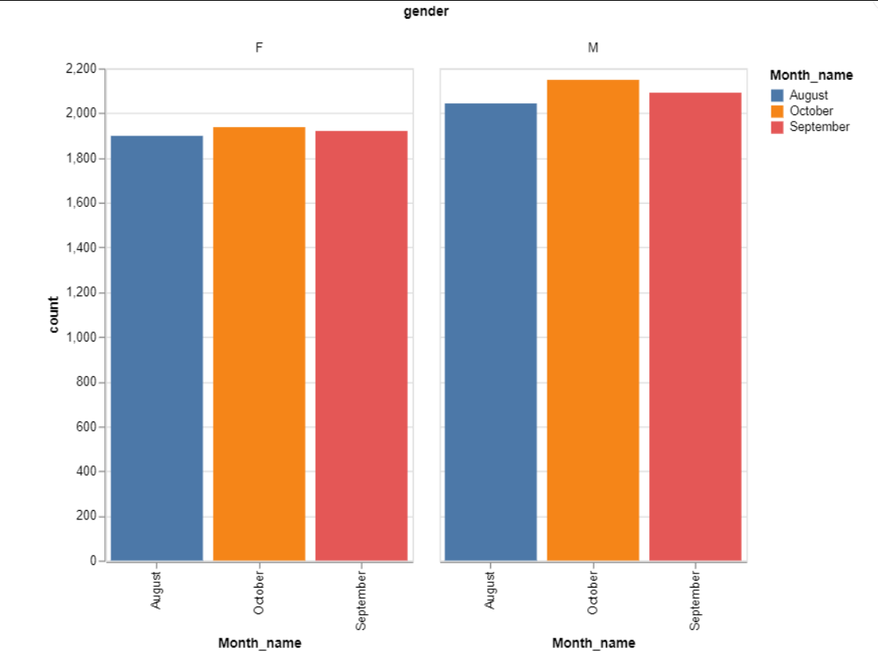
MONTH, GENDER AND TRANSACTION

Slide 12
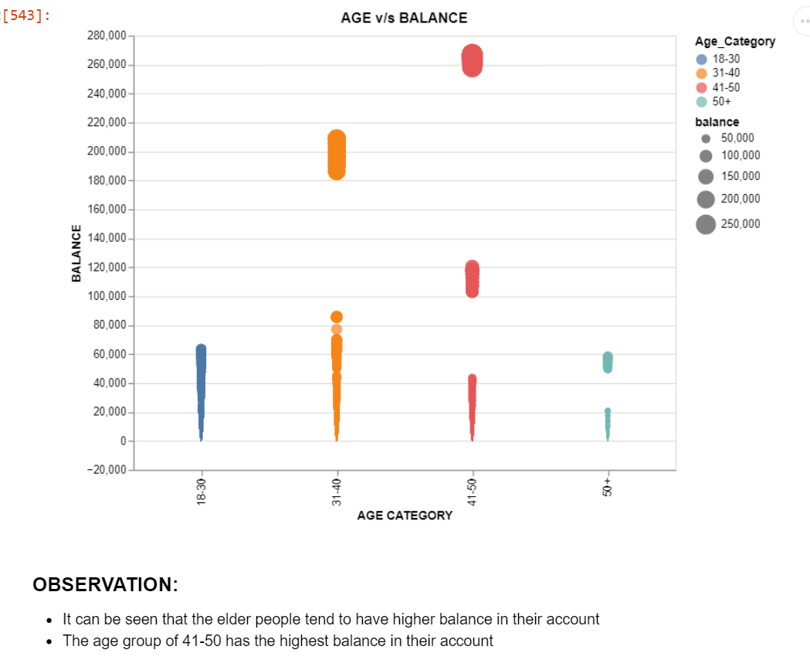
AGE v/s BALANCE

Slide 13
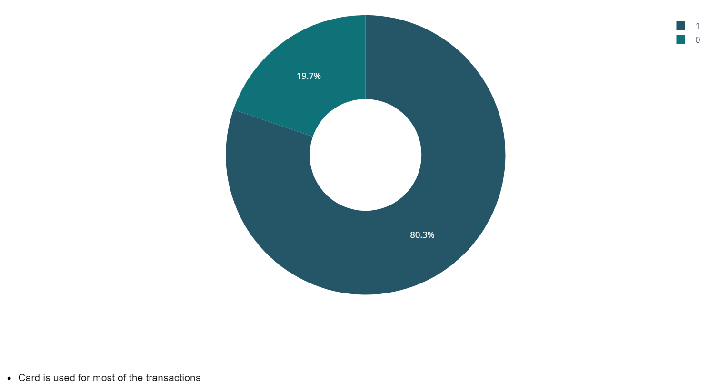
AGE v/s BALANCE

