Slide 1
Hotel_Booking_Analysis
Akshayakumara B S

Slide 2
OUTLINE:
PROBLEM STATEMENT
DATA SUMMARY & CLEANING
PROJECT ANALYSIS
CONCLUSION

Slide 3
PROBLEM STATEMENTS

Slide 4
PROBLEM STATEMENTS:
Which type of hotel is more preferable by customers (overall) ?
Which type of hotel is more preferable by customers to stay night ?
In which year did guests visit most of both types of hotels?
In which month did guests visit most of both types of hotels?
In which weekday did guests visit most of both types of hotels?
From which Market segment did guests visit most of both types of hotels?
Which type of customer visits the most throughout the year?
Both types of hotels are visited more by guests from which country? Mention the top 10
Which hotel has the customer made the most special request?
Monthly ADR report for the analysis of price and revenue?
Hotel wise as well how long customer will prefer to stay in both type hotels?
Is booking cancelation affected by 'lead_time' or 'waiting_period' ?

Slide 5
DATA SUMMARY & CLEANING

Slide 6
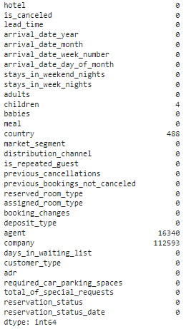
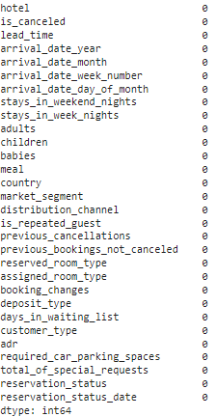
DATA SUMMARY & CLEANING:
Before Cleaning
After Cleaning
In this hotel booking capstone project table some columns have null values, those two columns have lots of null values ​​in their rows so those two columns are dropped. (‘lead’,’agent’)

Slide 7
ANALYSIS

Slide 8
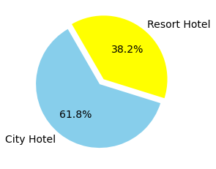
Which type of hotel is more preferable by customers (overall) ?
If we consider overall customers preference about the hotels most of them preferred (61.8%) city hotel only, and least of them preferred (38.2%) Resort hotel

Slide 9
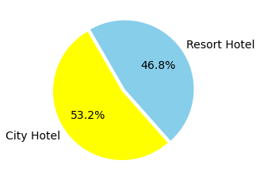
Which type of hotel is more preferable by customers to stay night ??
If we consider overall customers preference about the hotels for night stay most of them preferred (53.2%) city hotel only, and least of them preferred (46.8%) Resort hotel

Slide 10
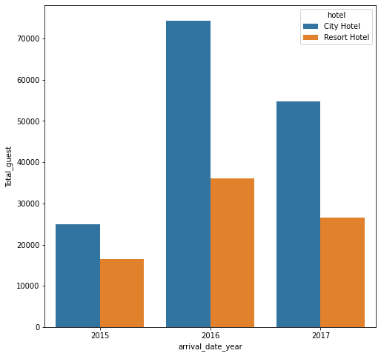
In which year did guests visit most of both types of hotels?
As shown in the graph (Total Guest Vs Arrival_Date_Year) most visited both types of hotels in 2016

Slide 11
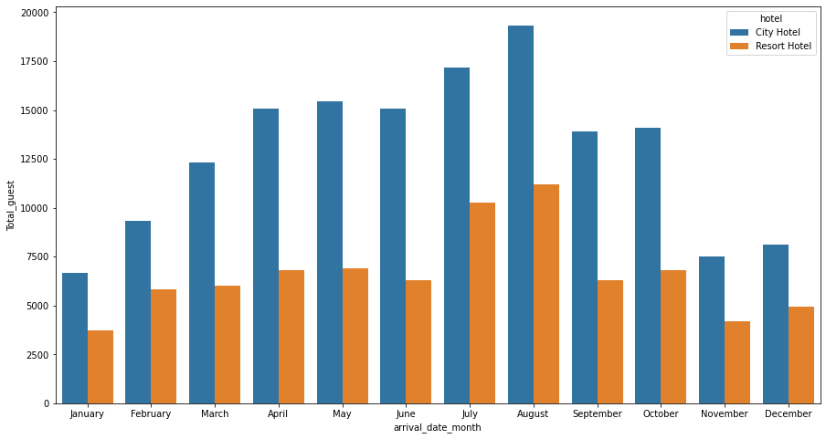
In which month did guests visit most of both types of hotels?
The 'August' is busiest month followed by 'july' as well January and November are the months when the number of guests is less and the prices (As 2.9) are also lower during that time so it is a good time to book both city and resort hotels.

Slide 12
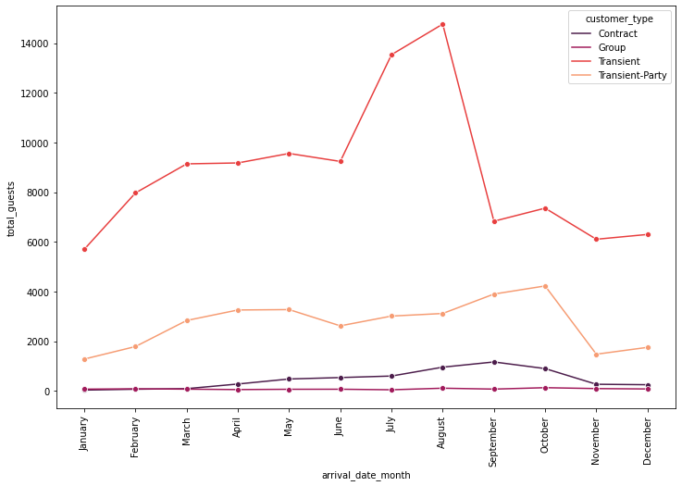
Which type of customer visits the most throughout the year?
The Group type guests are very low during the whole year.
There is a peak season for Transient-Party guests in October.
There is a very clear peak season for Transient guests between July and August.
Contract guests numbers are very low during the first half of the year.
There is a very clear that the peak season for Transient guests between July and August

Slide 13
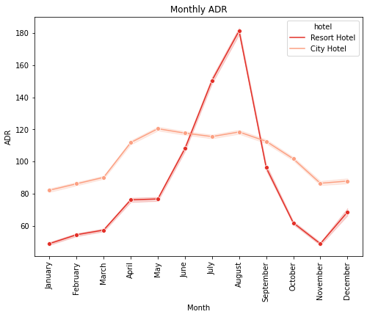
Monthly ADR report for the analysis of price and revnue?
prices for the rooms as well avg revenue for hotel increases a lot during the peak season between July and August.
The best time to book the hotels for lowest price in during the time of January and November.
We can observe there that monthly ADR of a Resort Hotel during the time between July and August is very high even compare to city hotel so better to offer the room in reasonable price to attract the customers

Slide 14
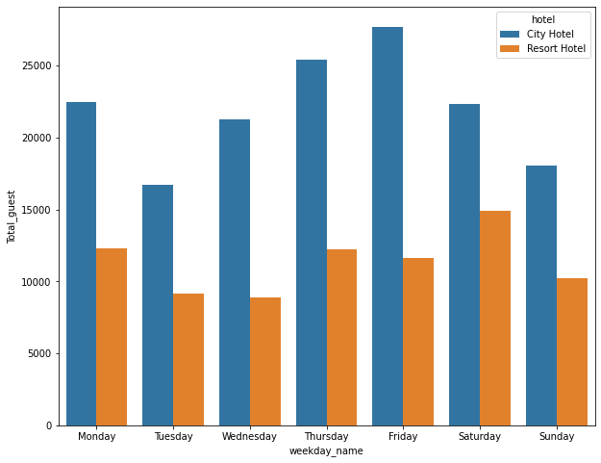
In which weekday did guests visit most of both types of hotels?
‘Friday’ is the most busiest weekday throughout the year so better to book ‘Tuesday’ and ‘Sunday’ as those days have the least number of guests compared to the rest.

Slide 15
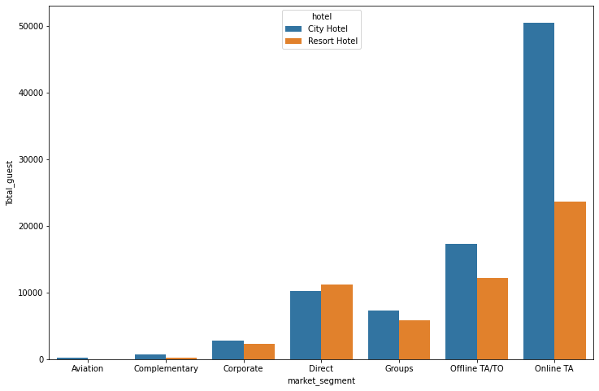
From which Market segment did guests visit most of both types of hotels?
Most of the customers stayed in both types of hotels from online travel agencies.
If we consider the area of ​​direct market segment, customers prefer resort hotel over city hotel, while airline segment has less number of guests. Hence attractive discount rates should be offered to those who have fewer guests here

Slide 16

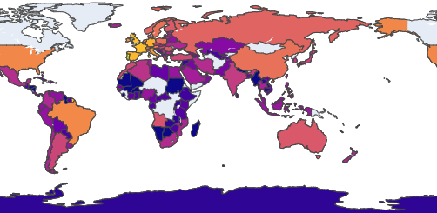
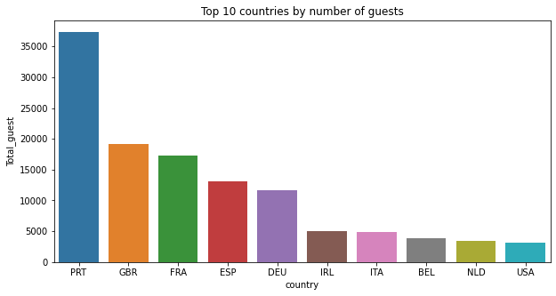
Both types of hotels are visited more by guests from which country? Mention the top 10
Most of the customers from Portugal and also visited from European countries

Slide 17
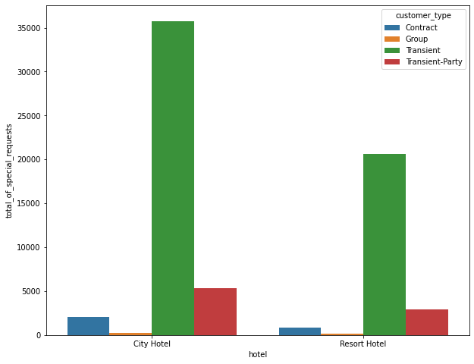
Which hotel has the customer made the most special request?
Transient type customers have more special request for both types of hotels especially city hotels.
City Hotel has the ability to accommodate special requests as shown in the picture

Slide 18
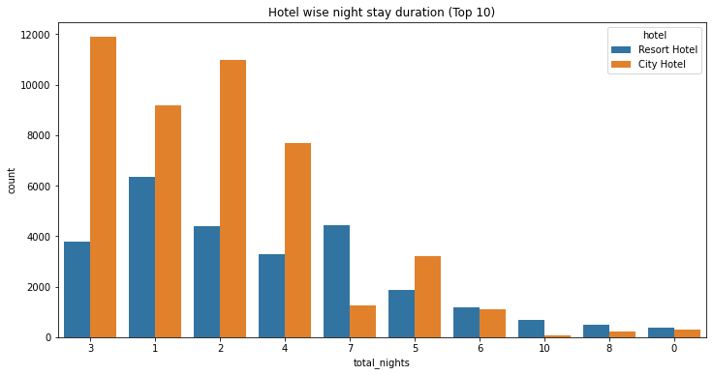
Hotel wise as well how long customer will prefer to stay in both type hotels?
Customers prefer to stay in resort hotel for single day and city hotel for 2-3 days

Slide 19
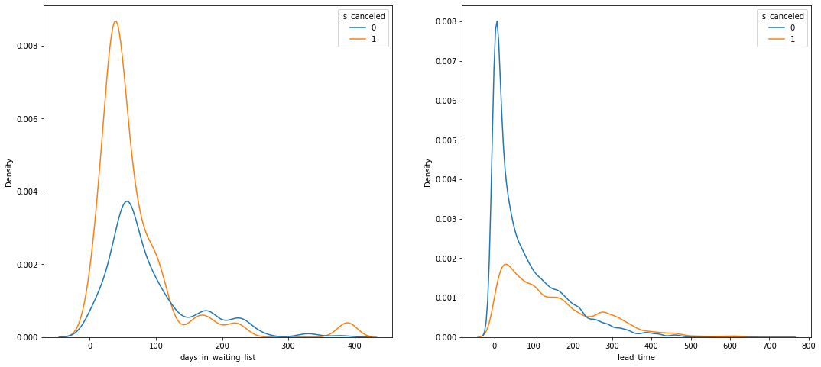
Is booking cancelation affected by 'lead_time' or 'waiting_period' ?
Here we can note that most of the canceled bookings have a waiting period of less than 150 days while most of the non-cancelled bookings also have a waiting period of less than 150 days. So this shows that waiting period has no effect on cancellation of bookings.
Also, lead time has no effect on cancellation of bookings, as both cancellation and non-cancellation curves are similar for lead time.

Slide 20
THE END

