Slide 1
Project Report On Library Management System
Presentated By,
Akshay Chavan
Trainee Testing
(VFISLK)

Slide 2
Contents
Introduction
Software Testing
STLC
Test Strategy
Test Case Planning
Test Case Design
White Box Testing
Black Box Testing
Execution and Error Reporting
Defect Life Cycle
Library Management System
Number of scenarios
Reports

Slide 3
Introduction

Slide 4
Software Testing
“Testing is a process of executing a program or system with a intent of finding errors ” by Myers 1979.
“Testing is any activity aimed at evaluating an attribute or capacity of a program or system and determining that it meets its required results” by Hetzel 1983
Identifying defects is the main aim of software testing which is useful in achieving quality. This will ensure to avoid any kind of disastrous situations due to software failure, which may lead to huge damage.

Slide 5
STLC- Software Testing Life Cycle
Test Strategy
Test Planning
Test Design
Test Development
Test Execution
Evaluations
Defect Tracking

Slide 6
Test Strategy
The Test Strategy is a concise statement of how to meet the objective of testing effectively in limited time by optimal use of resources.
Need of Test Strategy – How to meet the objective of software testing
Clarify expectations with the user
How the testing team will work on activities and results
Describe approach to all testing phases
Verification and Validation
Test Strategy Approach
Test Strategy for each testing phase
Unit Testing
Integration Testing
System Testing
User Acceptance Testing
Debugging
Test Strategy Document

Slide 7
Test Planning
Test Planning – Process Cycle - PDCA
Plan [P] – Device a Plan
Do[D] – Execute
Check[C]- Check
Action
90 % of all defects are caused by process problems.
The test process must be designed to provide as much value as possible in the time available.

Slide 8
Test Planning
Pre- Planning Activities
Success Criteria/ Acceptance Criteria
Test Objective
Assumptions
Entrance /Exit Criteria
Test Planning Activities
Test Plan
Requirement and Traceability
Scheduling
Staffing
Approach
Test check procedure
Post- Planning Activities
Change Management
Versioning

Slide 9
Test Case Design
“A set of test inputs executions conditions and expected results developed for a particular objective such as to exercise a particular program path or to verify compliance with a specific requirement.”
Need of Test Case Design
Classification of Test Case Design
Test Case Design
White Box Testing
Black Box Testing
Static
Dynamic
Reviews
Informal
Formal
Semi Formal
Formal
Walk Through
Technical Review
Fagan Inspection
Desk Check
1.Control/Coverage
2. Basis Path
3. Loop Testing
4. Data Flow Testing
1.ECP 2. BVA
3. DT 4.STD
5.OA 6.All Pairs

Slide 10
BBT- Black Box Testing
Need of Black Box Testing (Why ?)
Helps in Functionality validation of the system under test
Any incomplete or inconsistent requirements can be identified and addressed
Done based on the end user perspective
Handle both valid and invalid inputs
When to do Black Box Testing (When ?)
System Testing
User Acceptance Testing
Techniques (How ?)
Equivalence Class Partitioning
Boundary Value Analysis
Decision Table
State Transition Diagram
Orthogonal Arrays
All Pairs

Slide 11
White Box Testing
Need of White Box Testing (Why ?)
Detecting special case logical errors.
Uncovering incorrect programming assumptions.
Debugging code.
Finding random typographical errors.
When to do WBT (When ?)
Unit Testing
Integration Testing
Techniques (How ?)
Static
Desk Checking
Code Walkthrough
Formal Inspection
Structural
Control flow/ Converge Testing
Basis path Testing
Loop Testing
Data Flow Testing

Slide 12
Test Execution
The process of executing all or a selected number of test cases and observing the result
Test Cases
Test Data
Test Environment
Previous Defect Information
Software to be tested
Execute Testes
Test Plan & Strategy
Testing Status & Results
Test Incident Reports
Test Log

Slide 13
Levels of Testing
Unit Testing

Slide 14
Error Reporting
Testers reports errors when they find variation of software product or its components with specific and standards.
If the test results executed from test case or test script matches the expected outcome then the test case is pass. Otherwise it’s a Fail and reported.
Reporting Error contains
Log/Update error
Details include test cycle id, severity, tester details.
Analyze Reported Error
Process related
Product related
Severity related
Severity-Wise
Origin-Phase Wise
Class Wise
Cause Wise

Slide 15
Defect Life Cycle
A software error is a defect (bug), flow, mistake, failure, or failure in a computer program that prevent it from behaving as intended.
Most defect arise from mistake and flows made by people n either a program’s source code or its design and few are caused by compiler producing incorrect code.
Where does Defect Occur ?

Slide 16
Defect Life Cycle
Submit Defect
Update
Review verify and quality
More Info
Defer
Assign
Duplicate/
Invalid
In-Work
Fix/Change
Cancel
Validate
Close

Slide 17
LMS-Library Management System
Make Entry
Book Entry
Magazine/ News paper Entry
Make Entry
Student Entry
Staff Entry
Deposit
Deposit book from student and staff
History of book issue
Issue
Settings
Number of days and books to be issued
Fine Calculations
Issue books and magazine to student
Issue books and magazine to staff

Slide 18
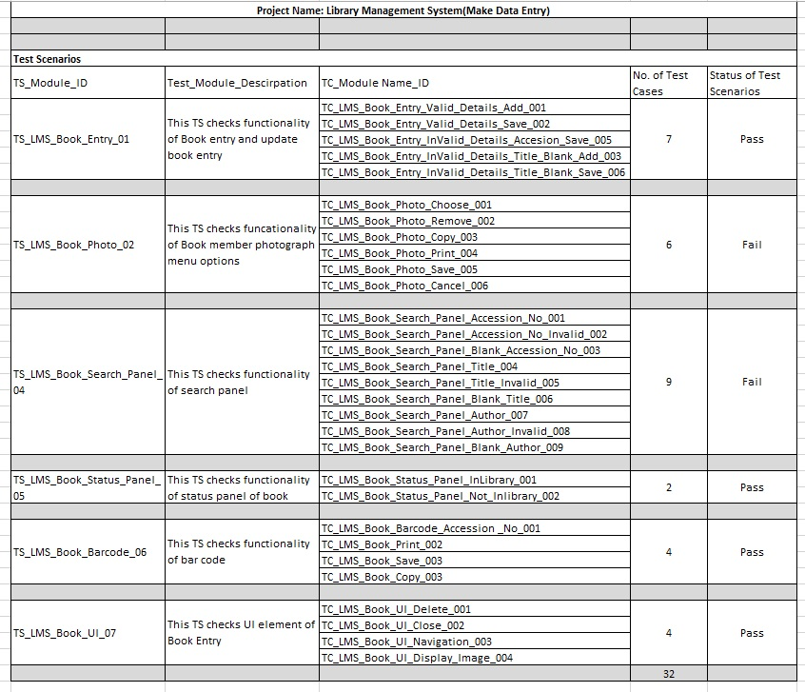
Test Scenarios

Slide 19
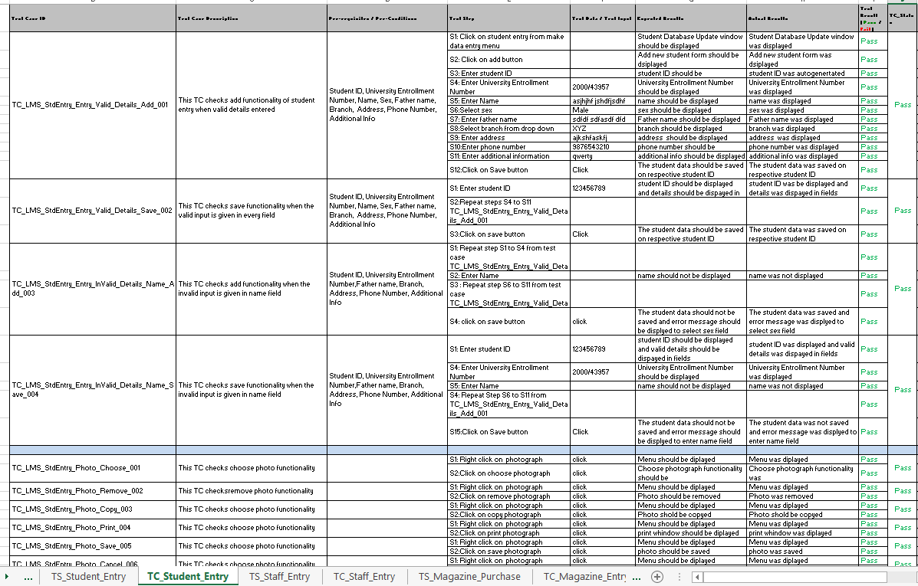
Test Cases

Slide 20
Report
Sr. No. | Module Name | No. of Test Scenarios | No. of Test Cases | No. of Defects
1 | Make Data Entry | 21 | 86 | 8
2 | Issue/Deposit | 6 | 25 | 4
3 | View Report | 4 | 6 | 0
4 | Setting | 7 | 25 | 6
5 | Search | 2 | 9 | 1

Slide 21
Test Scenarios, Test Cases and Execution

Slide 22
DDR- Defect Distribution Report

Slide 23
Testing Status
Module Name | Total Tests | Complete | Complete % | Success | Success %
Make Data Entry | 86 | 86 | 100 | 78 | 91
Issue/Deposit | 25 | 25 | 100 | 21 | 84
View Report | 6 | 6 | 100 | 6 | 100
Setting | 25 | 25 | 100 | 19 | 68
Search | 9 | 9 | 100 | 8 | 88

Slide 24
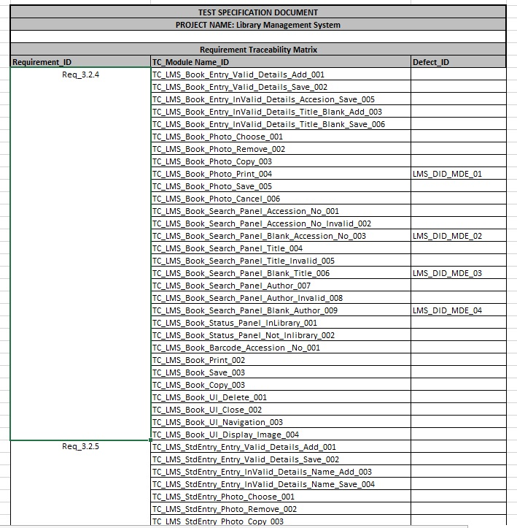
RTM

