Slide 1

NetDevOps Engineer Everyday Skills
IOS XE Guest Shell, RESTCONF, Spark and ServiceNow
Gabriel Zapodeanu
Technology Solutions Architect, Cisco Systems
@zapodeanu gzapodea@cisco.com github.com/gzapodea

Slide 2

Gabriel Zapodeanu
Technology Solutions Architect, Cisco Systems
Gabriel Zapodeanu is a Network Programmability Technology Solutions Architect. He is presently part of the Architecture and Engineering team, Cisco Global Partner Organization.
His work is focused on infrastructure programmability, partner enablement programs, APIs use case development across various technologies, as well as learning and certifications programs.
Notes:
My background is network engineer

Slide 3
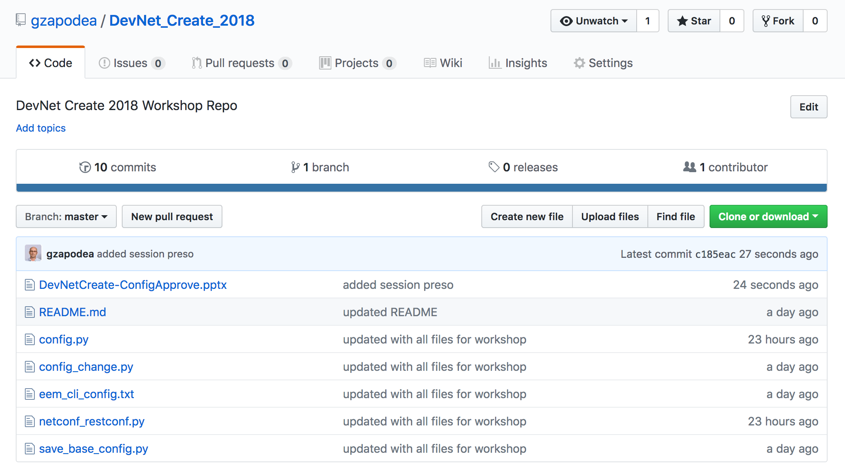
Session Presentation and Code
https://github.com/gzapodea/DevNet_Create_2018

Slide 4
NetDevOps
IOS XE Guest Shell Configuration
Device Management Using:
Python CLI
NETCONF
RESTCONF
Embedded Event Manager
ConfigApprove - ChatOps Use Case
ConfigApprove Roadmap
Agenda

Slide 5
Workshop Requirements
DevNet account – you have this, use your CCO account
Webex Teams account – you have this
GitHub account – http://github.com
ServiceNow developer account (optional)
DevNet CSR1000V sandbox –reserved by you here: https://developer.cisco.com/site/sandbox/ - IOS XE Programmability NETCONF-RESTCONF-YANG
VPN client

Slide 6
What is NetDevOps?
Networking + Dev Ops
DevOps values of automation and scalability applied to network infrastructure
Starts with network automation
Requires Networking and Programming skills

Slide 7
IOS XE Guest Shell Configuration

Slide 8
Acronym Decoder / Technical Terms
GS - Guest Shell
IOX - Virtualization Manager
DNS - Domain Name System
sudo - Super User Do
PIP - Tool for installing and managing Python packages (Pip Installs Packages)
YUM - (Yellowdog Updater Modified) open source package management tool
CentOS - Linux distribution derived from RHEL
Bash - Bourne Again Shell, the Linux standard shell
PNP - Plug and Play
CAF - Cisco Application Hosting Framework
ZTP - Zero Touch Provisioning

Slide 9



Guest Shell Application
Linux Shell Environment On Your Device
Maintains IOS XE system integrity
Isolated User Space
Fault Isolation
Resource Isolation
On-box rapid prototyping
Device-level API Integration
Scripting (Python)
Linux Commands
Application Hosting
Integrates into your Linux workflow
Integrated with IOS XE
Linux applications
Guest Shell
Open Application Container
API
Network OS

Slide 10
IOS XE Guest Shell Overview
Guest Shell is a decoupled and secure environment running within a Linux Container (LXC)
From within the Guest Shell the network admin has the following capabilities:
Access to the network over Linux network interfaces
Access to /bootflash
Device management using CLI, NETCONF and RESTCONF
The ability to install and run Linux applications
The ability to install and run on-box Python Scripts

Slide 11
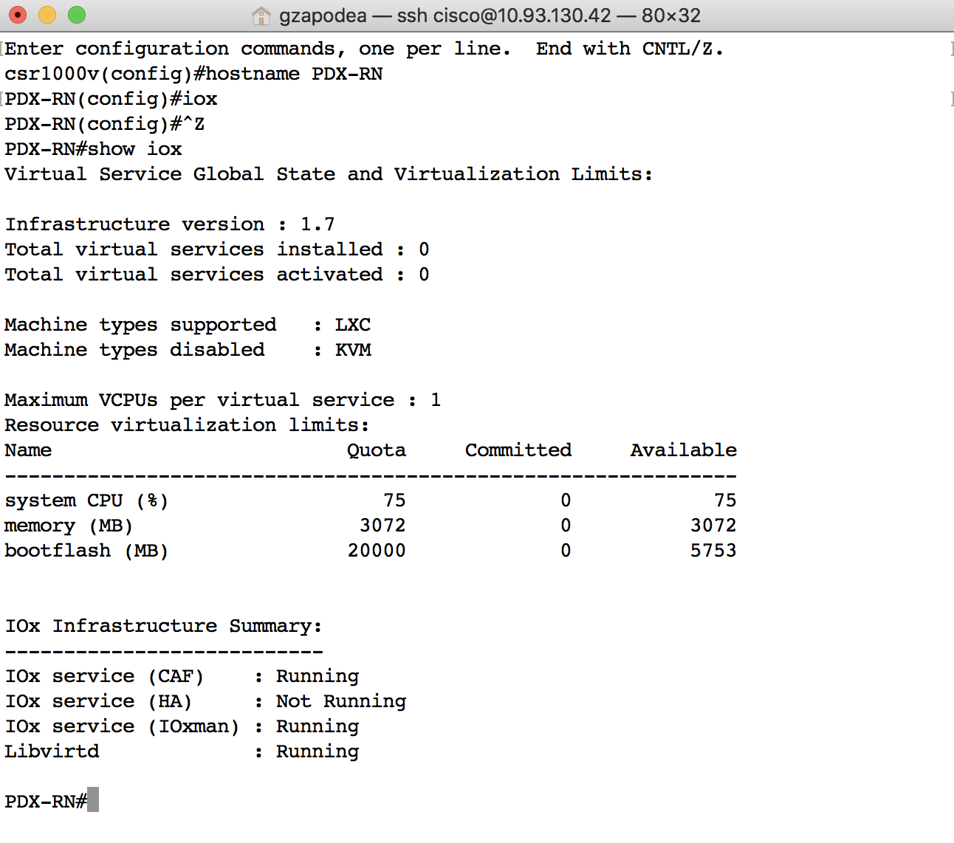
Configure IOX
Use the provided instructions to connect to your sandbox
ssh to your CSR1000V router (10.10.20.48)
Change the device name to something to identify you
Enter the command iox in config mode
IOX is the manager that handles guest shell and others apps
It will take a couple of minutes for the IOX services to start running
Verify IOX operations with the command show iox

Slide 12
Guest Shell Networking
Guest Shell network access using:
management interface/ management vrf – Switches, Routers
VirtualPortGroup (VPG) for platforms without a management port
We are going to use the VPG mode to set up Guest Shell networking
The guest shell container will use the VPG to communicate with the IOS XE CSR and the Internet
NAT
LAN
Internet
GigabitEthernet1
10.10.20.48
VirtualPortGroup0
10.1.1.1
eth0
10.1.1.2
IOS XE
Guest Shell
Container
CSR 1000v
Notes:
Which Ip will be used to access the CSR from Guest Shell

Slide 13
Guest Shell Networking - continued
Configure your CSR1000V with these commands:
aaa new-model
aaa authentication login default local
aaa authorization exec default local
ip name-server 208.67.222.222
interface VirtualPortGroup0
ip address 10.1.1.1 255.255.255.0
description used_for_GS_access
ip nat inside
interface GigabitEthernet1
ip nat outside
ip access-list standard GS_NAT_ACL
permit 10.1.1.0 0.0.0.255
ip nat inside source list GS_NAT_ACL interface GigabitEthernet1 overload
Interface GigabitEthernet 1 is connected to the Internet for external access
Need a VirtualPortGroup interface with static ip address
NAT set up between VPG and the GigabitEthernet 1

Slide 14
Guest Shell Configuration
Enable Guest Shell and verify connectivity from IOS XE:
PDX-RN(config)#app-hosting appid guestshell
PDX-RN(config-app-hosting)#vnic gateway1 virtualportgroup 0 guest-interface 0 guest-ipaddress 10.1.1.2 netmask 255.255.255.0 gateway 10.1.1.1 name-server 208.67.222.222
PDX-RN#guestshell enable
Interface will be selected if configured in app-hosting
Please wait for completion
Guestshell enabled successfully
PDX-RN#show app-hosting list
App id State
------------------------------------------------------
guestshell RUNNING
PDX-RN#guestshell run ping 10.1.1.1
PING 10.1.1.1 (10.1.1.1) 56(84) bytes of data.
64 bytes from 10.1.1.1: icmp_seq=1 ttl=255 time=0.527 ms
PDX-RN#guestshell ?
destroy Disable and uninstall the guest shell service package
disable Disable the guest shell service package
enable Enable the guest shell service
run Execute/run program in the guest shell

Slide 15
Guest Shell Configuration - continued
Verify connectivity from Guest Shell to IOS XE and Internet
PDX-RN#guestshell run bash
[guestshell@guestshell ~]$ cat /etc/resolv.conf
nameserver 208.67.222.222
[guestshell@guestshell ~]$ ping 10.1.1.1
PING 10.1.1.1 (10.1.1.1) 56(84) bytes of data.64 bytes from 10.1.1.1:
icmp_seq=1 ttl=255 time=0.568 ms64 bytes from 10.1.1.1:
icmp_seq=2 ttl=255 time=0.407 ms64 bytes from 10.1.1.1:
icmp_seq=3 ttl=255 time=0.467 ms64 bytes from 10.1.1.1:
^C
[guestshell@guestshell ~]$ ping 10.10.20.254
64 bytes from 10.10.20.254: icmp_seq=1 ttl=255 time=0.790 ms
64 bytes from 10.10.20.254: icmp_seq=2 ttl=255 time=0.880 ms
64 bytes from 10.10.20.254: icmp_seq=3 ttl=255 time=0.740 ms
^C
[guestshell@guestshell ~]$

Slide 16
Guest Shell Troubleshooting
If not successful verify:
VirtualPortGroup and NAT Configuration
Guest Shell Configuration
Add a DNS configuration to the /etc/resolv.conf
PDX-RN#show run interface VirtualPortGroup 0
interface VirtualPortGroup0
ip address 10.1.1.1 255.255.255.0
ip nat inside
PDX-RN#show ip nat statistics
Total active translations: 0 (0 static, 0 dynamic; 0 extended)
Outside interfaces:
GigabitEthernet1
Inside interfaces:
VirtualPortGroup0
Hits: 14768 Misses: 86
PDX-RN#guestshell run sudo ifconfig
eth0: flags=4163<UP,BROADCAST,RUNNING,MULTICAST>. mtu 1500
inet 10.1.1.2 netmask 255.255.255.0 broadcast 10.1.1.255
inet6 fe80::5054:ddff:fed0:1dbf prefixlen 64
ether 52:54:dd:d0:1d:bf txqueuelen 1000 (Ethernet)
RX packets 10012 bytes 12216093 (11.6 MiB)
RX errors 0 dropped 0 overruns 0 frame 0
TX packets 5593 bytes 383829 (374.8 KiB)
TX errors 0 dropped 0 overruns 0 carrier 0 collisions 0
PDX-RN#guestshell run cat /etc/resolv.conf
nameserver 208.67.222.222

Slide 17
Install Python Packages
PDX-RN#guestshell run bash
[guestshell@guestshell ~]$ sudo -E pip install --upgrade pip
[guestshell@guestshell ~]$ sudo -E pip install requests
[guestshell@guestshell ~]$ sudo -E pip install requests[security]
[guestshell@guestshell ~]$ sudo pip list
DEPRECATION: The default format will switch to columns in the future. You can use --format=(legacy|columns) (or define a format=(legacy|columns) in your pip.conf under the [list] section) to disable this warning.
…
cryptography (2.2.2)
pip (9.0.3)
requests (2.18.4)
…
[guestshell@guestshell ~]$ exit
Notes:
PIP List is abbreviated

Slide 18
Install Git on Guest Shell
Install Git on CentOs (GS): sudo yum install git
If the command completes without errors, you had git downloaded and installed.
To double-check that it is working correctly, try running Git's built-in version check
git --version - git version 1.8.3.1
Set-up Git with your info:
git config --global user.name "Your GitHub Username "
git config --global user.email "you@example.com"
git config --global credential.helper "cache --timeout 3600"
Verify Git Config - git config --list
Additional packages:
sudo yum install curl-devel
sudo yum update -y nss curl libcurl
(May be required for git clone/pull operations)
Reference: https://www.digitalocean.com/community/tutorials/how-to-install-git-on-centos-7

Slide 19
Clone the Code Repo
PDX-RN#guestshell run bash
[guestshell@guestshell ~]$ cd /bootflash
[guestshell@guestshell bootflash]$ sudo -E git clone 'https://github.com/gzapodea/DevNet_Create_2018.git'
Cloning into 'DevNet_Create_2018'...
remote: Counting objects: 22, done.
remote: Compressing objects: 100% (14/14), done.
remote: Total 22 (delta 5), reused 17 (delta 5), pack-reused 0
Unpacking objects: 100% (22/22), done.
[guestshell@guestshell bootflash]$ ls /bootflash/DevNet_Create_2018
README.md config_change.py netconf_restconf.pyconfig.py
eem_cli_config.txt save_base_config.py
[guestshell@guestshell bootflash]$ exit

Slide 20
Guest Shell – Other Resources
File operations IOS XE:
mkdir flash:/path/to/folder
delete /force /recursive flash:/path/to/folder
dir flash:
more flash:/path/to/file (display content of file)
File operations Guest Shell (sometimes sudo is required)
mkdir /bootflash/path/to/folder
rm -rf /bootflash/path/to/folder
ls /bootflash/
cat /bootflash/path/to/file (display the content of file)
Verify the IOS XE Programmability Guide for additional configurations (for example proxy configurations) and troubleshooting options

Slide 21
Device Management Using: - Python CLI - NETCONF - RESTCONF

Slide 22
Python CLI Module
Allows the user’s Python scripts to run IOS CLI commands on the host device
Interactive Python Prompt
guestshell run python
Python Script
guestshell run python /flash/path/to/file.py

Slide 23
Device Management from Guest Shell Using the Interactive Python Prompt
PDX-RN#guestshell run python
Python 2.7.5 (default, Jun 17 2014, 18:11:42)
[GCC 4.8.2 20140120 (Red Hat 4.8.2-16)] on linux2
Type "help", "copyright", "credits" or "license" for more information.
>>> import cli
>>> from cli import cli
>>> output = cli("show run | in hostname")
>>> print output
hostname PDX-RN
>>> print(cli("show interface Gi1"))
GigabitEthernet1 is up, line protocol is up
Hardware is CSR vNIC, address is 0050.56ac.232f (bia 0050.56ac.232f)
Description: DON'T TOUCH ME
Internet address is 10.10.20.48/24
MTU 1500 bytes, BW 1000000 Kbit/sec, DLY 10 usec,
reliability 255/255, txload 1/255, rxload 1/255 Encapsulation ARPA, loopback not set
…
>>> exit()
Notes:
Look at the first few lines of code, and the last one. I can write a small python code to collect the info I want.

Slide 24
NETCONF and RESTCONF
Options to program network devices:
NETCONF - Network Configuration Protocol
RESTCONF - REST-like access to the YANG Data Model
gRPC - open-source universal RPC framework, started by Google
NETCONF
RESTCONF
gRPC
YANG Data Models
Open
Native
Configuration and Operation
Device Features
SNMP
Interface
BGP
QoS
ACL
…
Notes:
This is a reference to understand there is much more that NETCONF, RESTCONF and gRPC.
gRPC and NETCONF support notifications
GRPC / GNMI - designed for generic client/server communication, By default gRPC uses protocol buffers, Google’s mature open source mechanism for serializing structured data (although it can be used with other data formats such as JSON)
In gRPC a client application can directly call methods on a server application on a different machine as if it was a local object, making it easier for you to create distributed applications and services. As in many RPC systems, gRPC is based around the idea of defining a service, specifying the methods that can be called remotely with their parameters and return types. On the server side, the server implements this interface and runs a gRPC server to handle client calls. On the client side, the client has a stub (referred to as just a client in some languages) that provides the same methods as the server.

Slide 25
Protocol Summary
Standardization | RFC 6241 | RFC 8040 | Open Initiative
Encoding | XML | XML / JSON | JSON / GPB
Session-layer Service (RPC) Support | ✓ | ✓ | ✓
Connection Oriented | ✓ | ✗ | ✓
Session Security | SSH / SOAP | HTTPS | HTTPS
NETCONF
RESTCONF
gRPC
Notes:
How Many prefer NETCONF/XML vs RESTCONF/JSON?
RESTconf: GET, PUT, POST, DELETE
NETCONF: GET, EDIT, COPY, DELETE
GRPC / GNMI - designed for generic client/server communication
In gRPC a client application can directly call methods on a server application on a different machine as if it was a local object, making it easier for you to create distributed applications and services. As in many RPC systems, gRPC is based around the idea of defining a service, specifying the methods that can be called remotely with their parameters and return types. On the server side, the server implements this interface and runs a gRPC server to handle client calls. On the client side, the client has a stub (referred to as just a client in some languages) that provides the same methods as the server.
By default gRPC uses protocol buffers, Google’s mature open source mechanism for serializing structured data (although it can be used with other data formats such as JSON)

Slide 26


NETCONF and/or RESTCONF ?
<rpc-reply message-id="urn:uuid:50bf9d6e-7e5c-4182-ae6b-972a055ceef7" xmlns="urn:ietf:params:xml:ns:netconf:base:1.0" xmlns:nc="urn:ietf:params:xml:ns:netconf:base:1.0">
<data>
<interfaces-state xmlns="urn:ietf:params:xml:ns:yang:ietf-interfaces">
<interface>
<name>GigabitEthernet1</name>
<admin-status>up</admin-status>
<oper-status>up</oper-status>
<phys-address>00:0c:29:6c:81:06</phys-address>
<speed>1024000000</speed>
<statistics>
<in-octets>5432293472</in-octets>
<in-unicast-pkts>28518075</in-unicast-pkts>
……………
<out-octets>2901845514</out-octets>
<out-unicast-pkts>18850398</out-unicast-pkts>
</statistics>
</interface>
</interfaces-state>
</data></rpc-reply>
{
"ietf-interfaces:interface": {
"name": "GigabitEthernet1",
"admin-status": "up",
"oper-status": "up",
"last-change": "2018-01-17T21:49:17.000387+00:00",
"phys-address": "00:0c:29:6c:81:06",
"speed": 1024000000,
"statistics": {
"in-octets": 5425386232,
"in-unicast-pkts": 28489134,
……………
"out-octets": 2899535736,
"out-unicast-pkts": 18844784
}
}
}
YANG Data Models
Notes:
Both protocols provide to us the same operational data

Slide 27
Device Management from Guest Shell Using RESTCONF
PDX-RN#guestshell run bash
[guestshell@guestshell ~]$ cd /bootflash/DevNet_Create_2018/
[guestshell@guestshell DevNet_Create_2018]$ python netconf_restconf.py
https://10.10.20.48/restconf/data/interfaces-state/interface=GigabitEthernet1
{ "speed" : 1024000000 ,
"statistics" : {
"out-octets" : 1744814 ,
"out-unicast-pkts" : 21961 ,
"in-unicast-pkts" : 40599 ,
"out-broadcast-pkts" : 0 ,
"in-octets" : 47467395 } ,
"name" : "GigabitEthernet1" ,
"oper-status" : "up" ,
"phys-address" : "00:50:56:ac:23:2f" ,
"type" : "iana-if-type:ethernetCsmacd" ,
"last-change" : "2018-04-07T23:53:44.000208+00:00" ,
"admin-status" : "up" ,
"if-index" : 0
}
Device Hostname via RESTCONF: PDX-RN
[guestshell@guestshell DevNet_Create_2018]$ exit
Read and execute the file
netconf_restconf.py

Slide 28
Python CLI or RESTCONF ?
PDX-RN#guestshell run python
>>> print(cli("show interface Gi1"))
GigabitEthernet1 is up, line protocol is up
Hardware is CSR vNIC, address is 0050.56ac.22c3 (bia 0050.56ac.22c3)
Description: DON'T TOUCH ME
Internet address is 10.10.20.48/24
Full Duplex, 1000Mbps, link type is auto, media type RJ45
Last clearing of "show interface" counters never
5 minute input rate 100000 bits/sec, 3 packets/sec
5 minute output rate 1000 bits/sec, 2 packets/sec
40897 packets input, 49324086 bytes, 0 no buffer
Received 0 broadcasts (0 IP multicasts)
21486 packets output, 1658940 bytes, 0 underruns
>>>
Unstructured Data
[guestshell@guestshell DevNet_Create_2018]$ python netconf_restconf.py
{
"speed" : 1024000000 ,
"statistics" : {
"out-octets" : 1744814 ,
"out-unicast-pkts" : 21961 ,
"in-unicast-pkts" : 40599 ,
"out-broadcast-pkts" : 0 ,
"in-octets" : 47467395 } ,
"name" : "GigabitEthernet1" ,
"oper-status" : "up" ,
"phys-address" : "00:50:56:ac:23:2f" ,
"type" : "iana-if-type:ethernetCsmacd" ,
"last-change" : "2018-04-07T23:53:44.000208+00:00" ,
"admin-status" : "up" ,
"if-index" : 0
}
Structured Data
There is a need to know both

Slide 29
Embedded Event Manager

Slide 30
EEM Python Policies
Offers the ability to monitor events and take action when the monitored events occur or when a threshold is reached
Embedded Event Manager (EEM) uses software programs known as event detectors to determine when an EEM event occurs
Embedded Event Manager (EEM) policies support Python scripts
Configured EEM policies run within the Guest Shell

Slide 31
EEM Configuration
Configure EEM on your device the commands from the eem_cli_config.txt file
PDX-RN#copy run start
Destination filename [startup-config]?
Building configuration...
[OK]
PDX-RN#configure terminal
Enter configuration commands, one per line. End with CNTL/Z.
PDX-RN(config)#event manager applet config_change
PDX-RN(config-applet)# event syslog pattern "SYS-5-CONFIG_I"
PDX-RN(config-applet)# action 0 cli command "enable"
PDX-RN(config-applet)# action 1 cli command "guestshell run python /bootflash/DevNet_Create_2018/config_change.py"
PDX-RN(config-applet)# action 2 cli command "end"
PDX-RN(config-applet)# action 3 cli command "exit"
PDX-RN(config-applet)#^Z
PDX-RN#show run | b event
event manager applet config_change
event syslog pattern "SYS-5-CONFIG_I”
action 0 cli command "enable”
action 1 cli command "guestshell run python /bootflash/DevNet_Create_2018/config_change.py” ….
event detector

Slide 32
ChatOps Use Case ConfigApprove

Slide 33
ConfigApprove Workflow
User makes IOS XE device configuration change
Syslog triggers EEM Python script execution in Guest Shell
The config_change.py script will:
Detect if the configuration changed and what changed
Collect the device hostname using RESTCONF
Identify the user that made the change using Python CLI
Create Spark room using REST APIs, invite Approver to room, post the above information to ask for approval
If changes approved, save new configuration as baseline
If not approved or no response, rollback to the previous baseline configuration
Close the Spark room in 30 seconds
Create ServiceNow incident to record all of the above information

Slide 34
Prepare to Execute 1st Time the App
PDX-RN#wri mem
PDX-RN#guestshell run bash
[guestshell@guestshell ~]$ cd /bootflash/
[guestshell@guestshell bootflash]$ mkdir CONFIG_FILES
[guestshell@guestshell bootflash]$ ls
CONFIG_FILES
DevNet_Create_2018
…
[guestshell@guestshell bootflash]$ cd DevNet_Create_2018
Read and execute the initialize script:
[guestshell@guestshell DevNet_Create_2018]$ python save_base_config.py

Slide 35
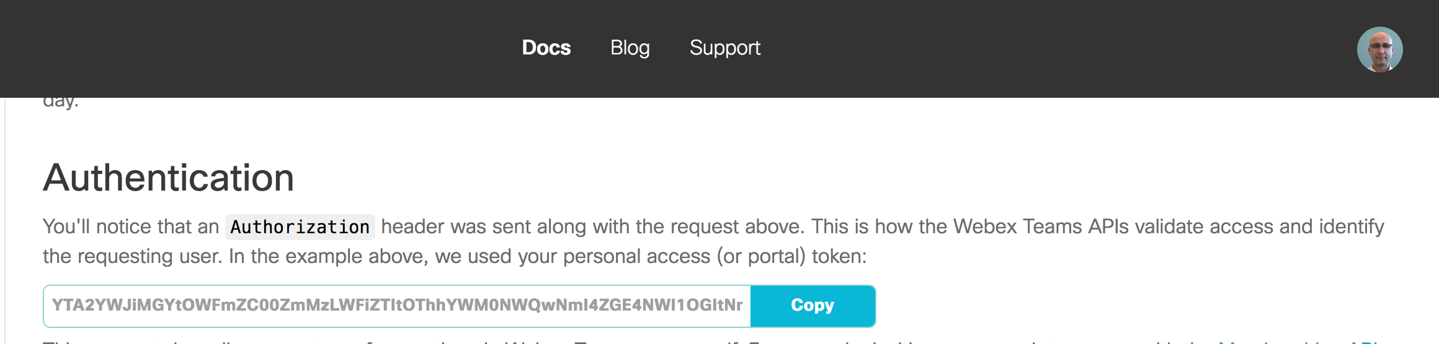
Edit Configuration File
edit the config.py file located /bootflash/DevNet…
sudo vi config.py
# developed by Gabi Zapodeanu, TSA, GPO, Cisco Systems # This file contains the Spark Auth, ServiceNow Dev account info, router info SPARK_URL = 'https://api.ciscospark.com/v1' SPARK_AUTH = 'Bearer ' + 'your Spark Token' SPARK_ROOM = 'Config Change Alert' + 'your name' SPARK_MEMBER = 'gzapodea@cisco.com' SNOW_URL = 'https://dev48476.service-now.com/api/now' SNOW_USER = ‘user' SNOW_PASS = ‘password' SNOW_INSTANCE = 'dev48476' HOST = ‘10.10.20.48' USER = 'cisco' PASS = 'cisco_1234!'
Find your Spark Token from http://developer.webex.com

Slide 36
Verification
Guest Shell commands:
[guestshell@guestshell]$ cd /bootflash
[guestshell@guestshell bootflash]$ ls
CONFIG_FILES
DevNet_Create_2018
[guestshell@guestshell bootflash]$ ls CONFIG_FILES/
base-config
[guestshell@guestshell bootflash]$ cat DevNet_Create_2018/config.py
# developed by Gabi Zapodeanu, TSA, GPO, Cisco Systems
# This file contains the Spark Auth, ServiceNow Dev account info, router info
SPARK_URL = 'https://api.ciscospark.com/v1’
SPARK_AUTH = 'Bearer ' + 'NzRiZGU0M2UtOWJjNy00MzQwLWE4MjUtO…’
SPARK_ROOM = 'Config Change Alert' + 'GabiZ’
SPARK_MEMBER = 'gzapodea@cisco.com’
…
exit

Slide 37
Let’s Have Some Fun!
Make some configurations changes
PDX-RN#term mon
PDX-RN#conf t
Enter configuration commands, one per line. End with CNTL/Z.
PDX-RN(config)#interface loopback2018
*Apr 8 23:36:57.410: %LINEPROTO-5-UPDOWN: Line protocol on Interface Loopback2018, changed state to up
PDX-RN(config-if)#description DevNet Create
PDX-RN(config-if)#end
PDX-RN#
*Apr 8 23:37:08.859: %SYS-5-CONFIG_I: Configured from console by cisco on vty2 (192.168.5.1)

Slide 38
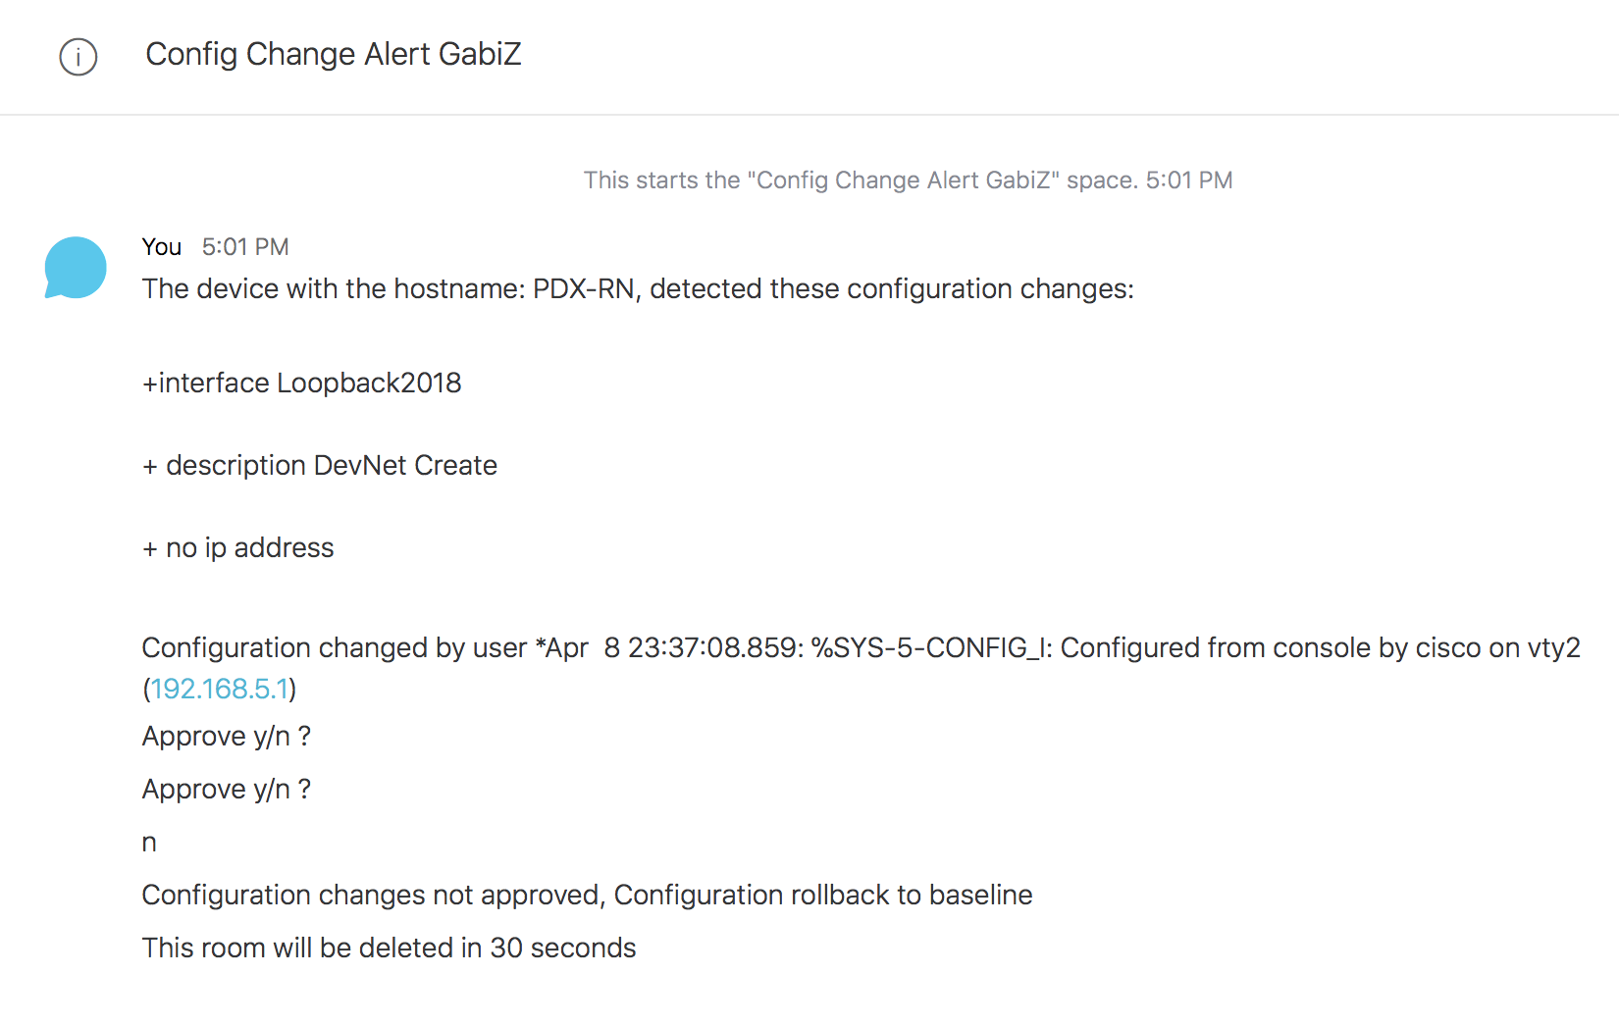
Spark Room

Slide 39
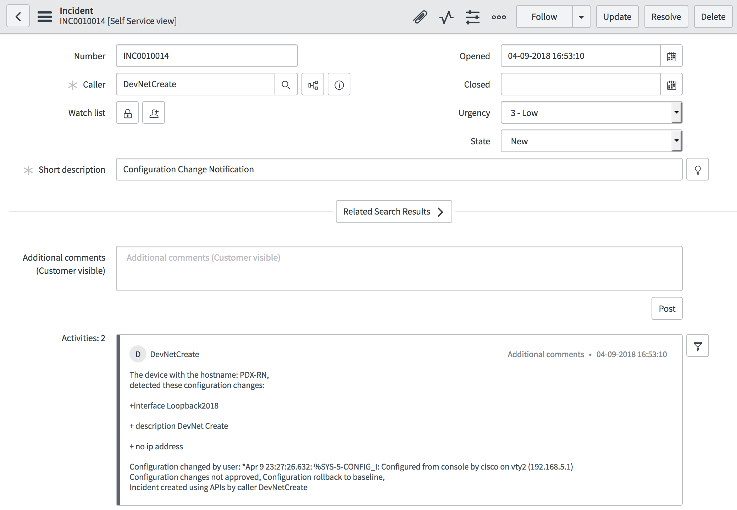
ServiceNow

Slide 40
ConfigApprove Roadmap

Slide 41
ConfigApprove Roadmap
Integration with DNA Center
Identify physical location of device
Trigger DNA C device sync if configuration approved
Business rule integrations:
”No configuration changes during business hours”
Rollback changes if configuration does not pass validations:
”No duplicate IP addresses”
Automatic code sync with github
Voice/text notifications

Slide 42
Questions

Slide 43
Thank You

