Slide 1
Integrated Cache Miss Predictor with Confidence Estimation
Sneha Gorantala
Akshay Sawant

Slide 2
Presentation Outline
Introduction
Problem
Importance of the Problem
Previous Work
Simple History Table Predictor
Address-based History Table Predictor
Results
Conclusions
Insight Gained

Slide 3
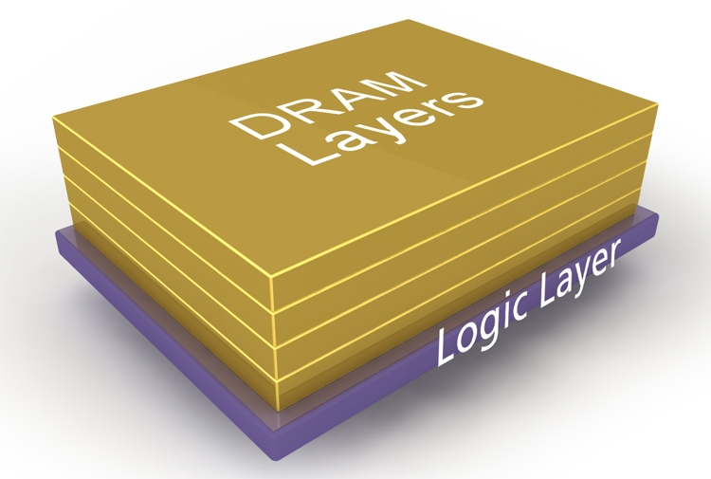
Stacked DRAM as a Cache
Why?
Improved performance
Reduced energy
Problem:
Latency is only 50% lower than that of main memory
Misses cause increased latency, poor performance

Slide 4
Proposed Solution
Predict which accesses will be a miss in DRAM cache
Directly access main memory for those with a miss prediction, saving the latency associated with DRAM cache lookup

Slide 5
Importance of this Problem
If misses can be predicted in advance, there can be a lot of saving in latency
Faster cache system can reduce the performance gap between processors and memory
DRAM caches can become more widely accepted

Slide 6
Previous Work
Map-g
Map-g: 3-bit counter that is incremented if an access is a hit, decremented if miss (predict hit if MSB = 1)
Achieved 82.5% accuracy
Dual-grain filter
Coarse-grain filter: keeps track of what’s in the DRAM cache on a page level basis
Fine-grain filter: keeps track of which blocks of the page are cached
Achieved 85% accuracy in prediction, 158 KB overhead

Slide 7
Initial Developments
Started work on one level cache using own, validated simulator
Implemented: “Simple History Table”
- idea: predict if the access will be a hit or miss based on previous accesses

Slide 8
Simple History Table (SHT) Predictor
Table of four elements is used to keep track of the last four accesses (0 for miss, 1 for hit)
Introduces just 4 bits of overhead
Hit is predicted if at least two of the last four were hits

Slide 9
Implementation Details
Pointer = 0
Access
1
2
3
4
5
Accesses:
Hit
Miss
Hit
Hit
Miss
0
0
Pointer
1
1
0
Pointer
Access: Hit / Miss?
2
1
Pointer
3
1
Pointer
Hit
Miss
Put 1 in the table
Put 0 in the table
Prediction:
Hit Miss
Counter:
0 1 2 3
Increment pointer

Slide 10
Further Development: Integrated Solution
Created a 3-level cache simulator
Last level represents the DRAM cache
If miss is predicted, lookup in that level should be bypassed and lookup should take place in the next level
Created separate table for reads and writes as the access patterns lower level were different (writes were mostly writebacks)

Slide 11
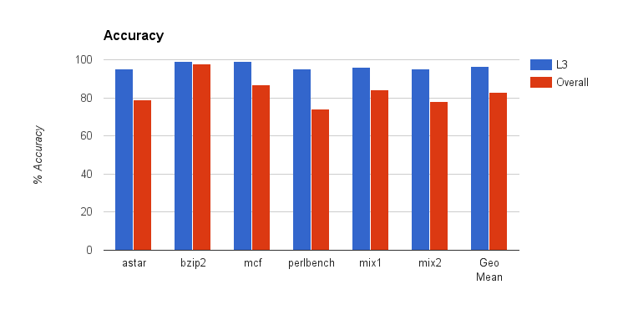
Results for SHT on 3-level Cache

Slide 12
Taking it further..
Prediction with the notion of confidence
New method: Address-based HT
-idea: to assign a level of confidence for different counter values, which helps
make more accurate predictions

Slide 13
Address-based History Table
Array of SHT’s based on hash values of the address
Storage overhead = 512 rows * 4 bits * 5 tables ~ 1KB (0.3425% overhead)
Implementation:
-Address is hashed
-If hit, 1 is placed in the pointer location and if miss, 0 is placed
-Then the pointer is incremented

Slide 14
Implementation
Pointer
Address
Hash Function

Slide 15
Address-Based History Table Prediction
To check if an access is present, the address is hashed and the value of the corresponding counter is checked
If the counter value = 0, prediction is that the block is definitely not present (confidence interval of 0-20%)
Counter value of 1: 20-40% confidence
Counter value of 2: 40-60% confidence
Counter value of 3: 60-80% confidence
Counter value of 4: 80-100% confidence

Slide 16
Notion of Confidence
Observation: Most access for L3 fall in either 0-20% confidence or 80-100% as shown by the results below:
Confidence | Astar | Mix1 | Mix2
80-100 | 42.6752% | 53.1621% | 47.9858%
60-80 | 1.5844% | 2.4534% | 2.4711%
40-60 | 3.2545% | 2.6547% | 3.6128%
20-40 | 5.9752% | 4.3107% | 5.6907%
0-20 | 46.5107% | 37.4191% | 40.2396%

Slide 17
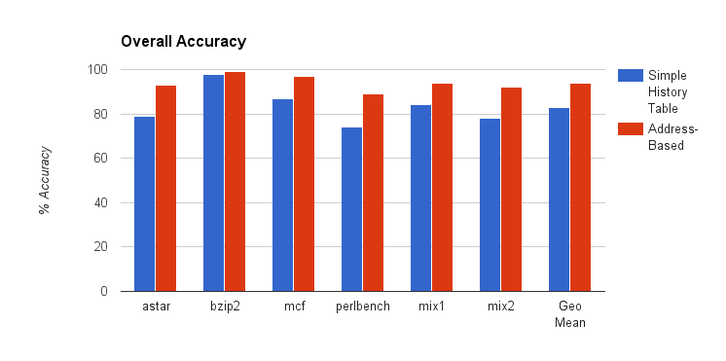
Results

Slide 18
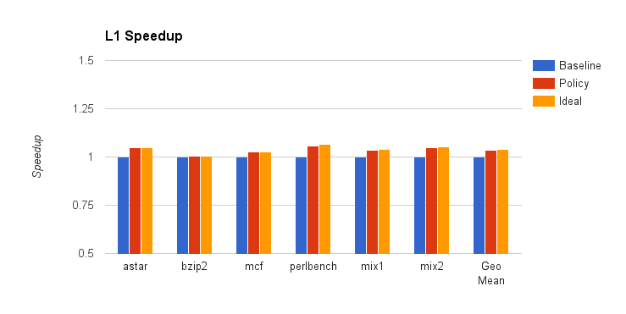
L1 Speedup

Slide 19
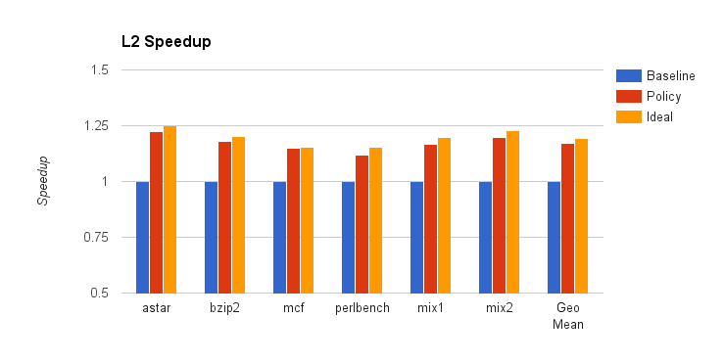
L2 Speedup

Slide 20
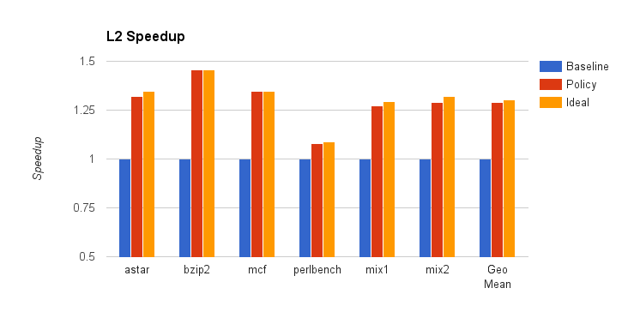
L3 Speedup

Slide 21
Conclusions
Our work shows that significant speedup for DRAM cache can be gained from accurate prediction (speedup = 1.2892 vs. ideal speedup = 1.3030)
Speedup can also be gained for the overall cache system (speedup = 1.0513 vs. ideal = 1.0553)

Slide 22
Insight Gained
With accurate prediction and the notion of confidence, DRAM latency can be masked
When confidence is 0-20%, DRAM lookup can be bypassed and main memory can be directly accessed
When confidence is between 20-80%, perform parallel lookup in DRAM cache and main memory
When 80-100%, perform serial lookup in DRAM cache and then main memory
Notion of confidence significantly improves trade-offs between performance, bandwidth, and energy

Slide 23
THANK YOU!
Questions?

