Slide 1
Intuit Craft Demonstration
All Time High Score Gaming Leaderboard Design
By Akshay Gaikwad
July 24, 2024

Slide 2
01
Introduction
02
Problem Statement
03
Assumptions
CONTENTS
04
Back of Envelope
05
Design Overview
06
API Interfaces

Slide 3
07
Schema / Data Models
08
Class Diagrams
09
Code Overview
CONTENTS
10
High Level Design
11
Future Scope
12
Q&A

Slide 4
13
Appendix
CONTENTS
14
Thank You Page

Slide 5
Introduction
PART 01
Professional Journey

Slide 6
Introduction
A passionate and enthusiastic SDE with 5 years of robust background in backend development in in fintech, payments and social media domains.
A graduate in Information Technoilogy from NIT Kurukshetra, 2019 batch.
Passionate about problem-solving, data structures and designing systems.
My expertise spans over Java, SpringBoot, Microservices, Sql, NoSql DBs, Kafka, AWS, Docker, CI/CDs and associated technologies.
Currently working as an SDE III at Jiraaf, leading a team that has designed and implemented high-performance investment workflows from scratch.
Previously, at
Kachow - I designed the social module in the social trading platform.
Morgan Stanley - Contributed to significant projects that streamlined client onboarding globally.
Prudential - Engineered a highly extensible payment gateways integration platform, significantly reducing transaction completion times and payment gateway onboarding times across South East Asia Pacific.

Slide 7
Problem Statement
PART 02

Slide 8
Problem Statement
You are part of a team, building a gaming service. You are responsible for implementing the module that
keeps track of the all time top scores. As players complete a game, the game service will publish the
player’s score to a topic (you can replace the topic with a flat file). You are expected to code a service
that when invoked will return the top 5 scores and the names of the players who attained that score.
You can use any database that you want.
Instructions to the candidate:
1. We are interested in your approach to the problem. It is alright if you don’t have a beautiful PPT
2. We would like to see working code and at least a few key unit tests.
Ensure is your code is organized well and is production grade

Slide 9
Assumptions
PART 03

Slide 10
Assumptions
The data published by game-service is always valid i.e. registered users, valid score and game details. So no futher validations needed.
The codependent infrastructure for the leaderboard service already exists like a relational database for the user details, user caches. etc.
The size of the leaderboard is configurable but fixed once the application is live.
Scores are assumed integers, avoiding complexities of comparing 2 decimals, precisions for now.
Current design assumes only All Time High Score leaderboard with real-time or near real-time with eventual consistency.
All the APIs exposed are used internally by say a gateway service and no API is exposed publicly eliminating the need of authentication & authorization.
The memory requirements and throughput for now is within the range of a single vertically scaled server range.

Slide 11
Back of Envelope
PART 04
Rough calculation estimates

Slide 12
Back of the Envelope Calculations
Total number of active users in the system : 50 million
Total DAU : Assuming 20% users use the app daily, so 10 million
Assuming a player plays 5 games per day.
So 10*5 = 50 million games per day. Assuming even distribution, hence 5*(10^7)/24*60*60 ~ 600 write QPS.
Assuming 2x peak load, the max QPS ~ 1200 write QPS.
Assuming each user’s client device refreshes every 500 milliseconds, read QPS ~ 2400.
Redis cache Simple GET Operations: Redis can handle up to 300,000 to 500,000.
ZINCRBY Write Throughput: Typically, Redis can handle around 20,000 to 50,000 ZINCRBY operations per second
Storage requirements - GameDetails(String userId, int score, String gameId, String date). So, 30 bytes * 10 million per day. Very high write throughput and lots of incoming data to store in real time.

Slide 13
Design Overview
PART 05

Slide 14
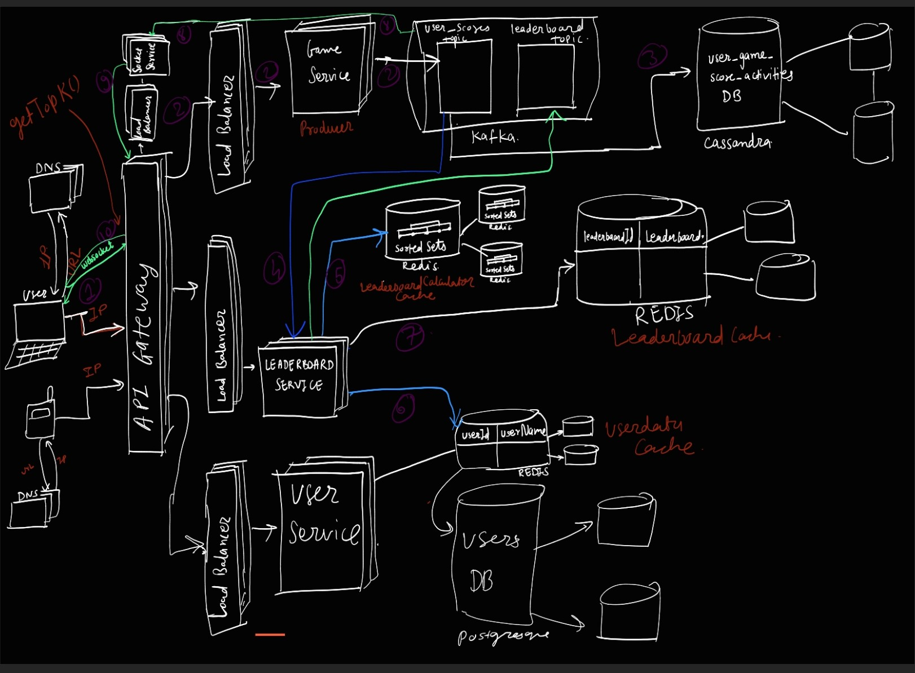
Design Overview

Slide 15
API Interfaces
PART 06

Slide 16
API Interfaces
Create Leaderboard
PUT /api/v1/leaderboards/{leaderboardId}
Admins can create and update a leaderboard. Idempotency ensured.
Returns 200 OK on success and 500 for failures.
Get Leaderboard
GET /api/v1/leaderboards/{leaderboardId}
Returns 200 OK on success and 404 for failures.
Get Top K Leaderboard
GET /api/v1/top/leaderboards/{leaderboardId}
Returns 200 OK on success and 500 for failures.

Slide 17
Schema / Data Models
PART 07

Slide 18
Schema / Data Models
ScoreCard
public record ScoreCard(String userId, int score) {
public static ScoreCard fromGameDetails(GameDetails gameDetails) {
return new ScoreCard(gameDetails.userId(), gameDetails.score());
}
}
GameDetails
public record GameDetails(String userId, int score, String gameId, String date) {
}
LeaderboardTypeEnum
public enum LeaderboardTypeEnum {
ALL_TIME, DAILY, WEEKLY, MONTHLY
}

Slide 19
Schema / Data Models
Leaderboard
public class Leaderboard {
private final String leaderboardId;
private final String leaderboardName;
private Date createdAt;
private LeaderboardTypeEnum leaderboardTypeEnum;
}
LeaderboardData
public record GameDetails(String userId, int score, String gameId, String date) {
}
ScoreCardResponseDto
public record ScoreCardResponseDto(String userId, String userName, int score) {
}

Slide 20
Schema / Data Models
LeaderboardResponseDto
public class LeaderboardResponseDto {
private final String leaderboardId;
private List<ScoreCardResponseDto> leaderboard;
}
LeaderboardRequestDto
public class LeaderboardResponseDto {
private final String leaderboardId;
private List<ScoreCardResponseDto> leaderboard;
}

Slide 21
Class Diagram
PART 08

Slide 22
Class Diagram

Slide 23
Code Overview
PART 09

Slide 24
Code Overview
LeaderboardUpdateWorker interface
Listens to the user_scores topic to calculate leaderboard.
public interface LeaderboardUpdateWorker {
void updateLeaderboard(String gameDetailString) ;
}
ThrottledLeaderboardCacheUpdateService interface
Periodically updates the leaderboard data to cache.
public interface ThrottledLeaderboardCacheUpdateService {
public void throttledLeaderboardCacheUpdater();
}
LeaderboardCalculationService interface
Interface which defines the contract for the class that has the datastructure to calculate the leaderboard.
public interface LeaderboardCalculationService {
void publishScoreToLeaderboard(GameDetails gameDetails);
List<ScoreCard> getTopKLeaderboard(int size);
}

Slide 25
Code Overview
LeaderboardSubject interface
Controller class which registers, deregisters and notifies all the observers for observer pattern
public interface LeaderboardSubject {
void attachObserver(LeaderboardDataCacheObserver observer);
void detachObserver(LeaderboardDataCacheObserver observer);
void notifyObservers(String leaderboardId, LeaderboardData leaderboardData);
}
RankingStrategy interface
Interface which defines the conflict resolution strategy for ranks
public interface RankingStrategy {
int compare(GameDetails a, GameDetails b);
}
LeaderboardDataCacheObserver interface
Interface which defines repository to provide CRUD on Leaderboard data cache
public interface LeaderboardDataCacheObserver {
Optional<LeaderboardData> getTopKLeaderboardData(String leaderboardId);
void updateLeaderboardData(String leaderboardId, LeaderboardData leaderboardData);
}

Slide 26
High Level Design
PART 10

Slide 27
High Level Design

Slide 28
High Level Design
Why not a SQL database to find top 10 ?
Very high Write QPS for the game actiivty data.
In our leaderboard case, finding the top 10 players requires aggregating data by userId and finding max scores for each user. This operation involves a full table scan on the user_score table. While a relational database may initially suffice, it may face challenges as data grows.
Imagine we have 500 million rows in our PostgreSQL database. To update the leaderboard every 500 ms, we need to run the following query:
select userId, sum(score) as sum
from user_scores
group by userId
order by sum desc
limit 10;
If this query takes more than 450 ms (reserving 50 ms for service processing and network latency), we cannot meet our goal. With this data volume and query, no relational database can handle the load efficiently, even with optimized and indexed tables, because the aggregation requires a full table scan.

Slide 29
High Level Design
Redis SortedSet
Redis SortedSets are ideal for handling a game leaderboard with high data volumes due to their efficient time complexity and built-in operations. The key operations are ZINCRBY and ZRANGE:
ZINCRBY: This command increments the score of a member in a sorted set. Its time complexity is O(log(k)), where k is the number of elements in the sorted set. This efficiency is achieved by maintaining the set in a way that allows quick updates and retrievals.
ZRANGE: This command retrieves a range of members in a sorted set, sorted by score. Its time complexity is O(log(k) + M), where k is the number of elements in the sorted set and M is the number of elements being returned. This allows for fast retrieval of top scores.
Advantages for Leaderboards:
Efficiency: The O(log(k)) complexity for both adding/incrementing scores and fetching ranges ensures operations remain fast even with large data volumes.
Real-time Updates: The incremental nature of ZINCRBY allows for real-time score updates without needing to re-scan the entire dataset.
Sorted Order: Since the set is always kept sorted by scores, fetching the top scores is straightforward and efficient.
Scalability: Redis can handle large datasets in memory, making it suitable for high-volume, real-time applications like game leaderboards.

Slide 30
High Level Design
Step 1 : The game service produces the game score event each time a game finishes to user_scores kafka topic.
Step 2 : The Cassandra sink connector, keepsa dumping the data from the user_scores kafka topic into cassandra db which serves as the primary log database for game score activities.
Step 3 : Redis consumer for the user_scores kafka topic increments the user’s score in Redis sorted set collection.
Step 4 :
A separate scheduled job asynchronously runs every configured duration (500ms in our case), we’ll request top 10 players from the Redis SortedSet.
Subsequently, we will cache this result post enriching it with userNames from userId_userNames cache in another Redis Key-Value store called leaderboard_cache, ensuring efficient O(1) lookups.
userId_userNames cache can have LFU cache eviction strategy with write back caching mechanism.

Slide 31
Future Scope
PART 11

Slide 32
Future Scope
The data from the leaderboard_cache can also be pushed to leaderboard topic, for the UI clients to update.
STOMP over Websockets to receive update in the leaderboard from the leaderboard topic.

Slide 33
Q&A
PART 12

Slide 34
Q&A

Slide 35
Appendix
PART 13

Slide 36
Appendix
https://redis.io/docs/latest/develop/data-types/sorted-sets/
https://redis.io/docs/latest/operate/oss_and_stack/management/optimization/benchmarks/
https://docs.confluent.io/kafka/overview.html
https://dynobase.dev/dynamodb-performance-latency/
https://stackoverflow.com/questions/19477821/redis-cache-vs-using-memory-directly

Slide 37
THANKS
Click here to add to the title

