Slide 1
Credit Card Customer Segmentation
Unsupervised Learning for Targeted Marketing & Risk Assessment

Slide 2
Agenda
Business Problem & Objective
Dataset Overview
Exploratory Data Analysis
Data Preprocessing & Feature Engineering
Dimensionality Reduction (PCA & t-SNE)
Model Selection — K-Means & Agglomerative Clustering
Comparative Analysis & Model Evaluation
Customer Segment Profiles
Business Recommendations & Conclusion

Slide 3
Business Problem & Objective
Credit card issuers hold rich behavioral data but often market and manage risk uniformly across all customers.
Customer Insights
Risk Management
Marketing Optimization
Identify distinct customer segments for personalized product offerings and services.
Understand spending & repayment patterns to strengthen credit risk assessment and fraud detection.
Use behavioral segments to guide sharper, more effective targeted marketing campaigns.
Objective: Build unsupervised learning models that segment credit card customers by spending and payment behavior — producing segmentation models, data visualizations, and a comparative algorithm analysis.

Slide 4
Dataset Overview
8,950 customers x 17 features
Behavioral & financial variables per customer:
Balance, purchases (one-off / installment)
Cash advance amount & frequency
Credit limit, payments, minimum payments
Tenure (months as a cardholder)
Missing values:
CREDIT_LIMIT — 1 record
MINIMUM_PAYMENTS — 313 records (3.5%)
8,950
Customers
17
Raw Features
22
Features After Engineering
12 mo
Median Tenure

Slide 5
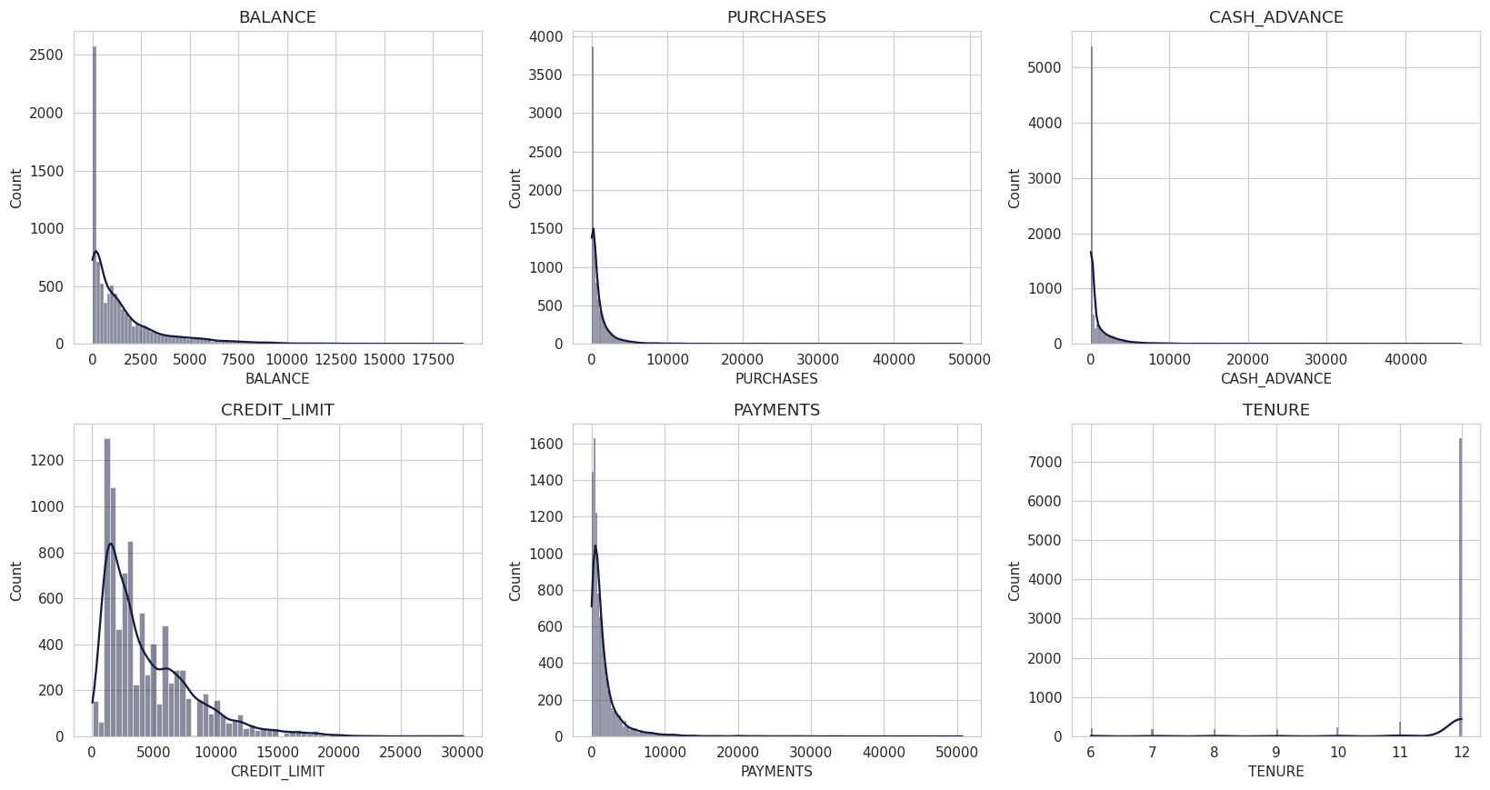
Exploratory Data Analysis — Feature Distributions
Monetary features (balance, purchases, cash advance, payments) are heavily right-skewed — a small share of customers drive very high values. Tenure is concentrated at 12 months.

Slide 6
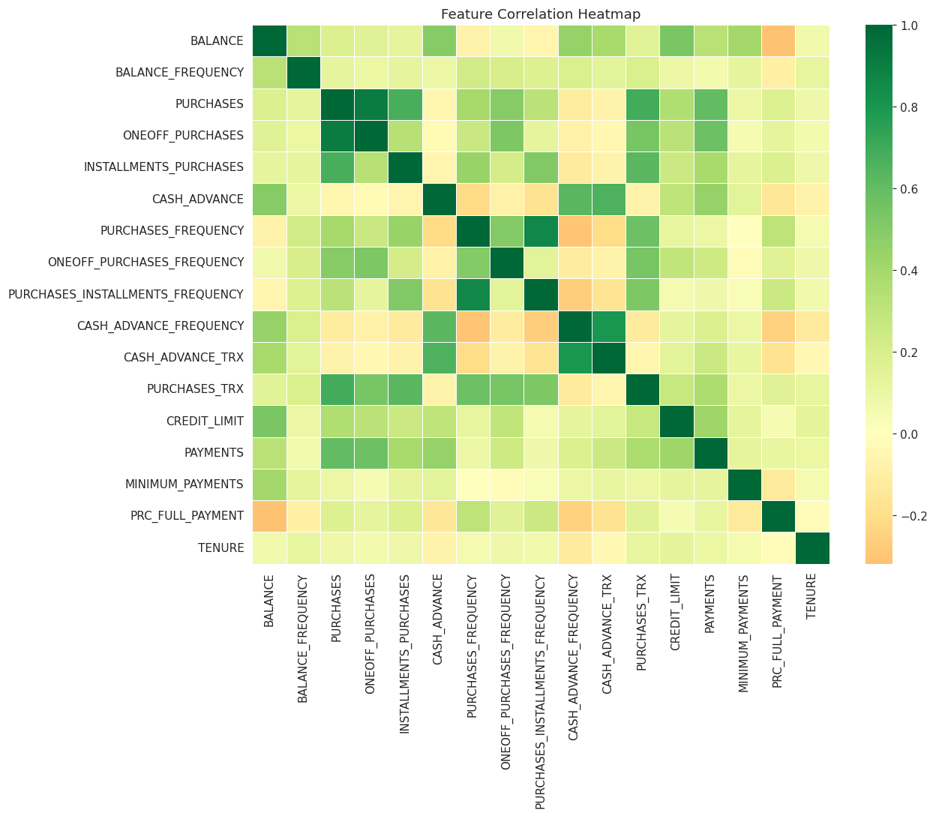
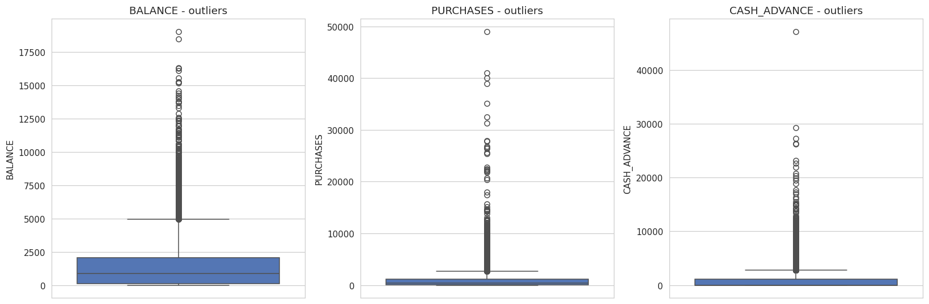
Correlation Structure & Outliers
Purchases, balance, and one-off purchases are strongly inter-correlated and show substantial high-end outliers — motivating PCA and outlier capping.

Slide 7
Data Preprocessing & Feature Engineering
Missing Value Imputation
Median imputation for CREDIT_LIMIT and MINIMUM_PAYMENTS
Feature Engineering — 5 new behavioral ratios
Monthly average purchase & cash advance (normalized by tenure)
Credit limit utilization ratio (balance / credit limit)
Payment-to-minimum-payment ratio (repayment strength)
One-off vs. installment purchase ratio (purchase style)
Outlier Handling & Scaling
Capped extreme values at the 99th percentile
Log-transformed skewed monetary columns
Standardized (z-score) all 22 features before modeling

Slide 8
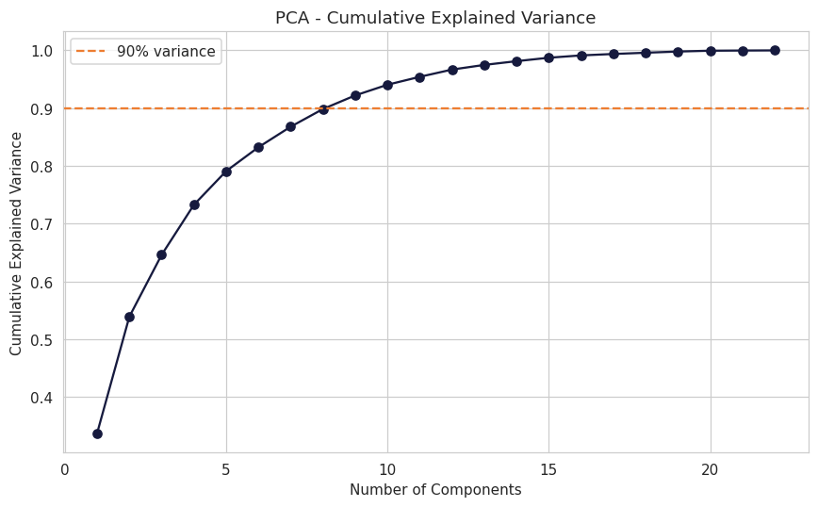
Dimensionality Reduction — PCA & t-SNE
Why reduce dimensions?
• 22 standardized features contain multicollinearity (e.g. purchases vs. one-off/installment)
• PCA: 9 components retain ~90% of total variance
• Clustering is performed on these 9 PCA components — cleaner signal, less noise
• t-SNE (2D) is used purely for visualization of cluster separation, not for clustering itself

Slide 9
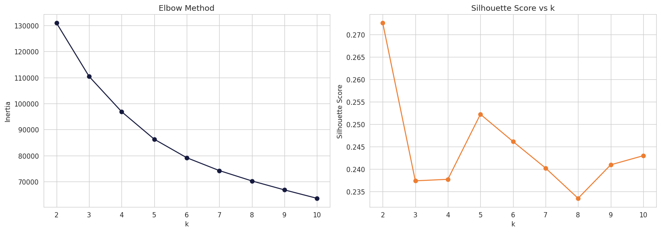
Model Selection — K-Means Clustering
Silhouette score peaks at k=2, but a 2-segment split is too coarse for differentiated marketing or risk action. k=4 is the strongest silhouette among k≥3 solutions, aligns with the elbow curve, and yields interpretable, actionable segments — selected as the final business-facing model.

Slide 10
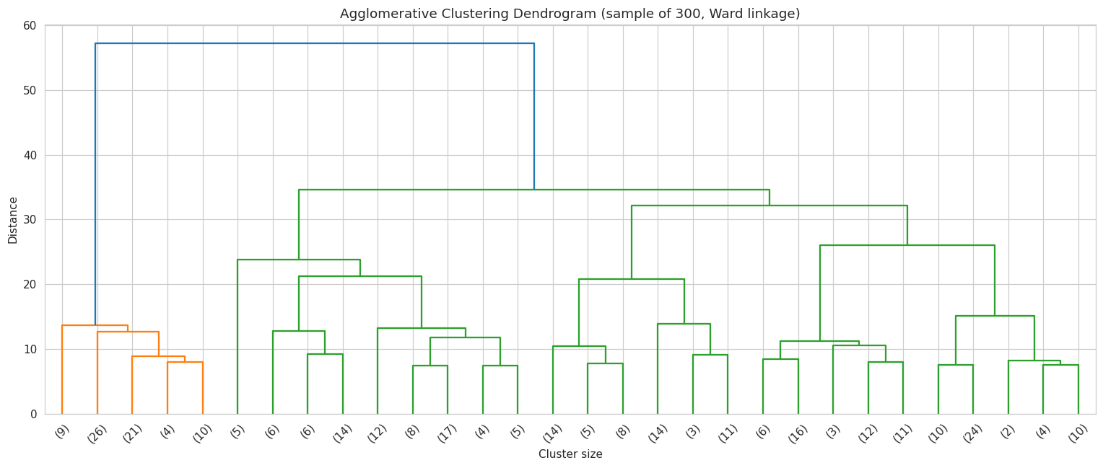
Model Selection — Agglomerative (Hierarchical) Clustering
Ward-linkage dendrogram (sampled 300 customers for legibility). k=4 is used to match K-Means for a fair, apples-to-apples comparison.

Slide 11
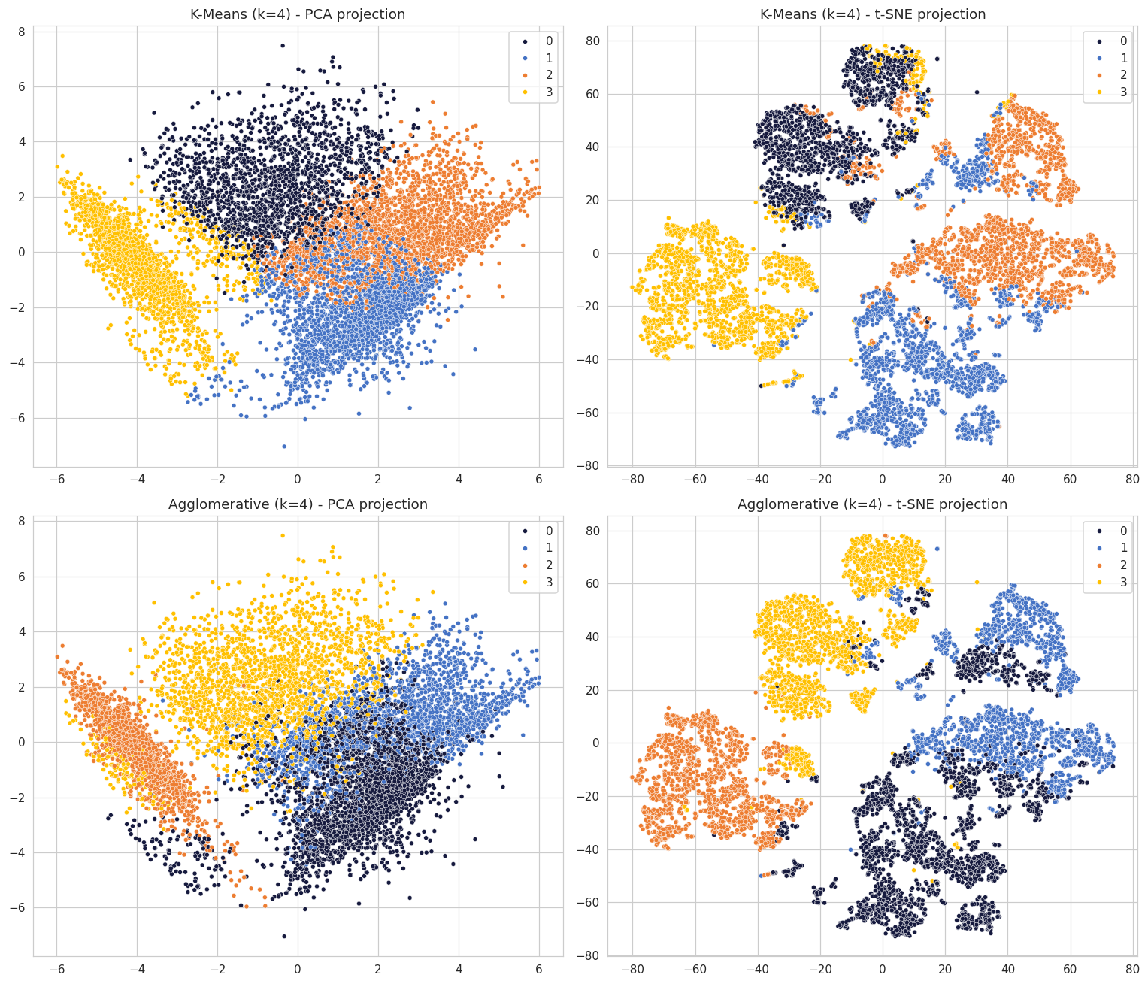
Comparative Analysis — K-Means vs. Agglomerative
Metric
K-Means (k=4)
Agglomerative (k=4)
Better
Silhouette Score ↑
0.238
0.194
K-Means
Calinski-Harabasz ↑
2,609
2,139
K-Means
Davies-Bouldin ↓
1.617
1.798
K-Means

Slide 12
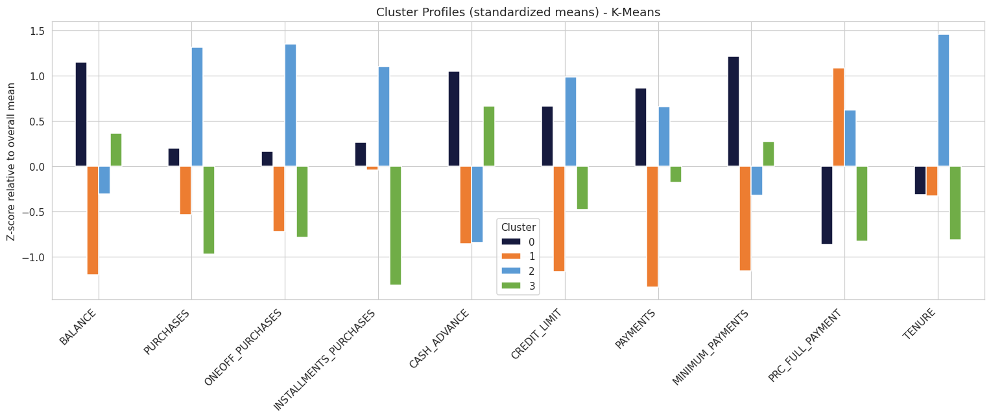
Customer Segment Profiles (K-Means, k=4)
Standardized cluster means highlight which behaviors define each segment relative to the overall customer base.

Slide 13
Segment Personas
Revolving Big Spenders
19.5%
Cautious Low-Engagement
27.8%
High balance & cash advance, moderate purchases, ~0% pay in full
Low balance, low purchases, low cash advance, highest full-payment rate
Action: Highest credit-risk group — prioritize risk monitoring & structured repayment plans
Action: Under-utilizing their card — target with purchase incentives & cashback offers
Active Transactors
27.3%
Cash-Advance Reliant
25.4%
Highest purchases (one-off & installment), high credit limit, low cash advance
High balance, near-zero purchases, high cash advance, ~0% pay in full
Action: Most profitable & loyal — retain with premium rewards & limit increases
Action: Card used mainly for cash withdrawals — flag for credit review & financial-wellness outreach

Slide 14
Business Recommendations
Risk Management
Prioritize Revolving Big Spenders & Cash-Advance Reliant segments for credit review, exposure limits, and early-warning monitoring
Targeted Marketing
Offer purchase incentives / cashback to Cautious Low-Engagement customers to raise card utilization
Reward Active Transactors with premium loyalty perks and credit limit increases to protect the most profitable segment
Customer Relationship Management
Route Cash-Advance Reliant customers into financial-wellness / structured-repayment outreach programs
Re-score segments periodically (e.g. quarterly) as spending behavior evolves

Slide 15
Conclusion & Deliverables
K-Means (k=4) selected as the final model
Higher Silhouette, Calinski-Harabasz, and lower Davies-Bouldin than Agglomerative; far more scalable for production use
Four actionable, balanced segments identified (19–28% of customers each)
Deliverables submitted:
Jupyter notebook — full EDA, preprocessing, PCA/t-SNE, clustering, evaluation
This presentation — comparative analysis & business recommendations
Interactive dashboard — explore segments and their characteristics

Slide 16
Questions ?

Slide 17
Thank You!

