Slide 1
Idea: Rule based synthesis

Slide 2
I/O
Trace
Defined Program Rules
Code
Intermediate States
Generate Condition blocks

Slide 3
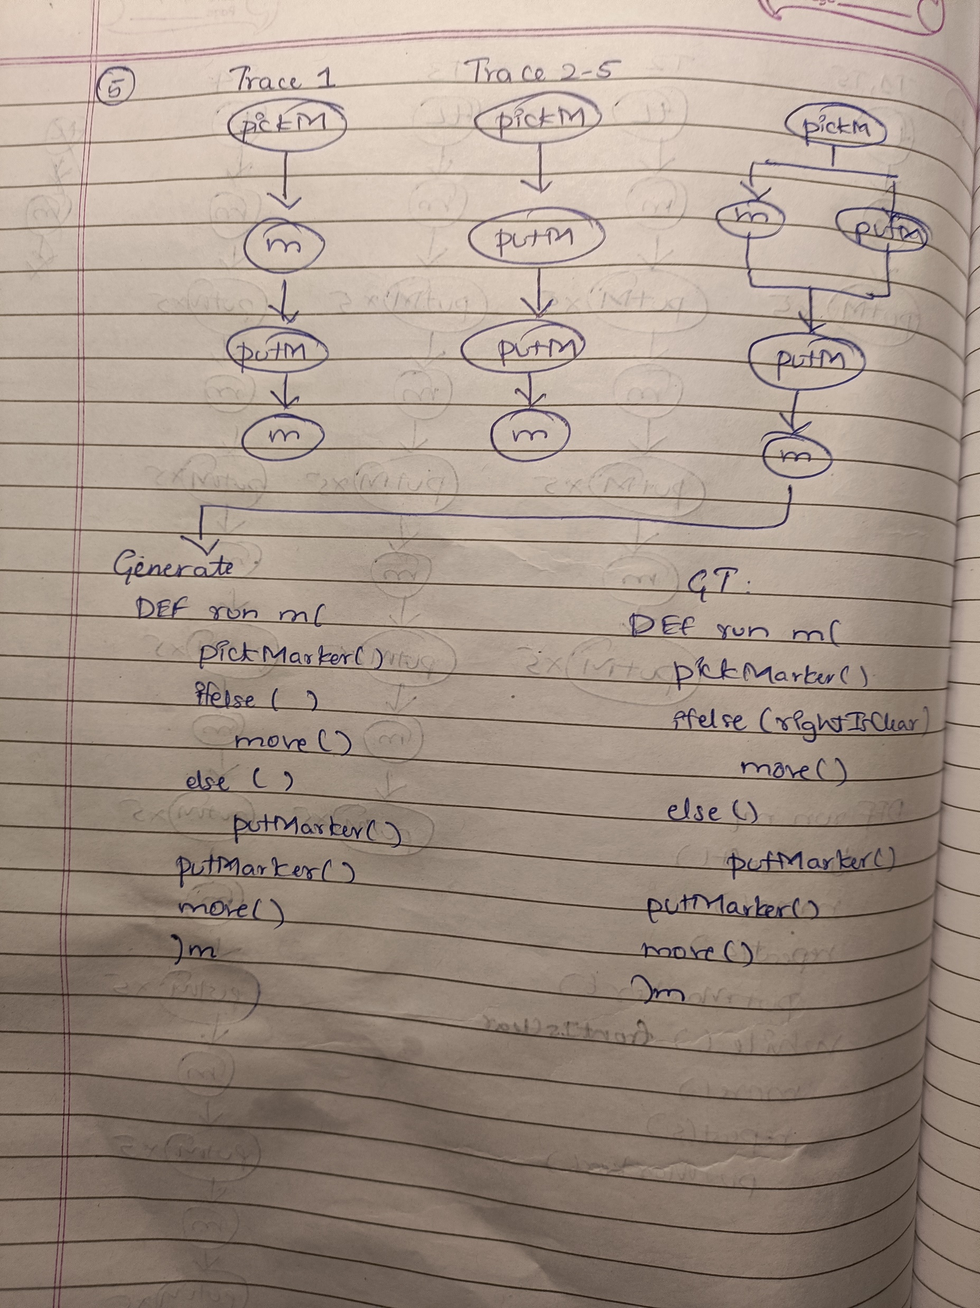
1) Create trace lists:
Collect all the traces for a dataset sample.
Create sequential lists for each unique trace.
2) Create master tree:
Keep the common tokens among all traces along a sequential path.
Create parallel paths whenever the tokens mismatch between the traces .

Slide 4
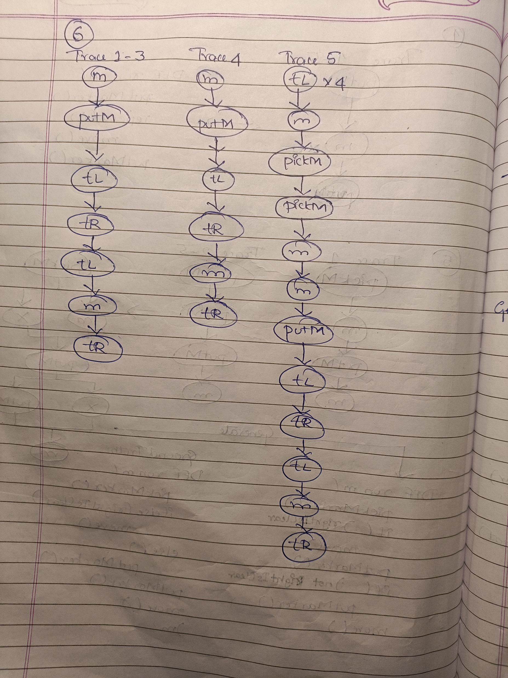
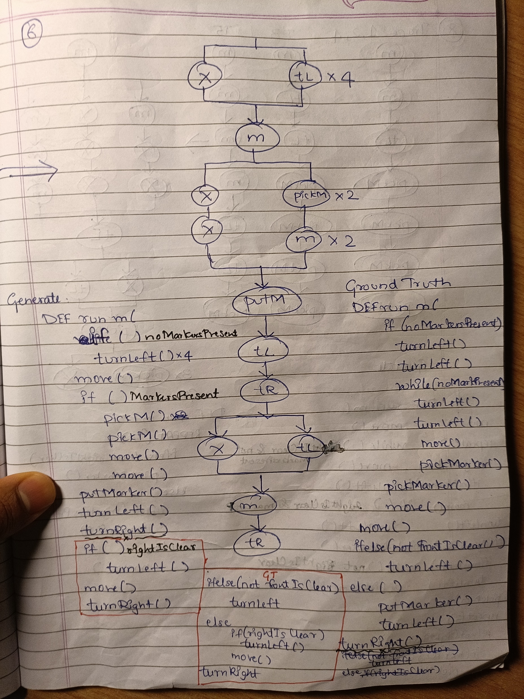

Slide 5
3) Create program template without condition blocks:
Write the tokens in the sequential path of master tree as action statements
Add control flow statements for parallel paths of master tree depending on a set of RULES

Slide 6
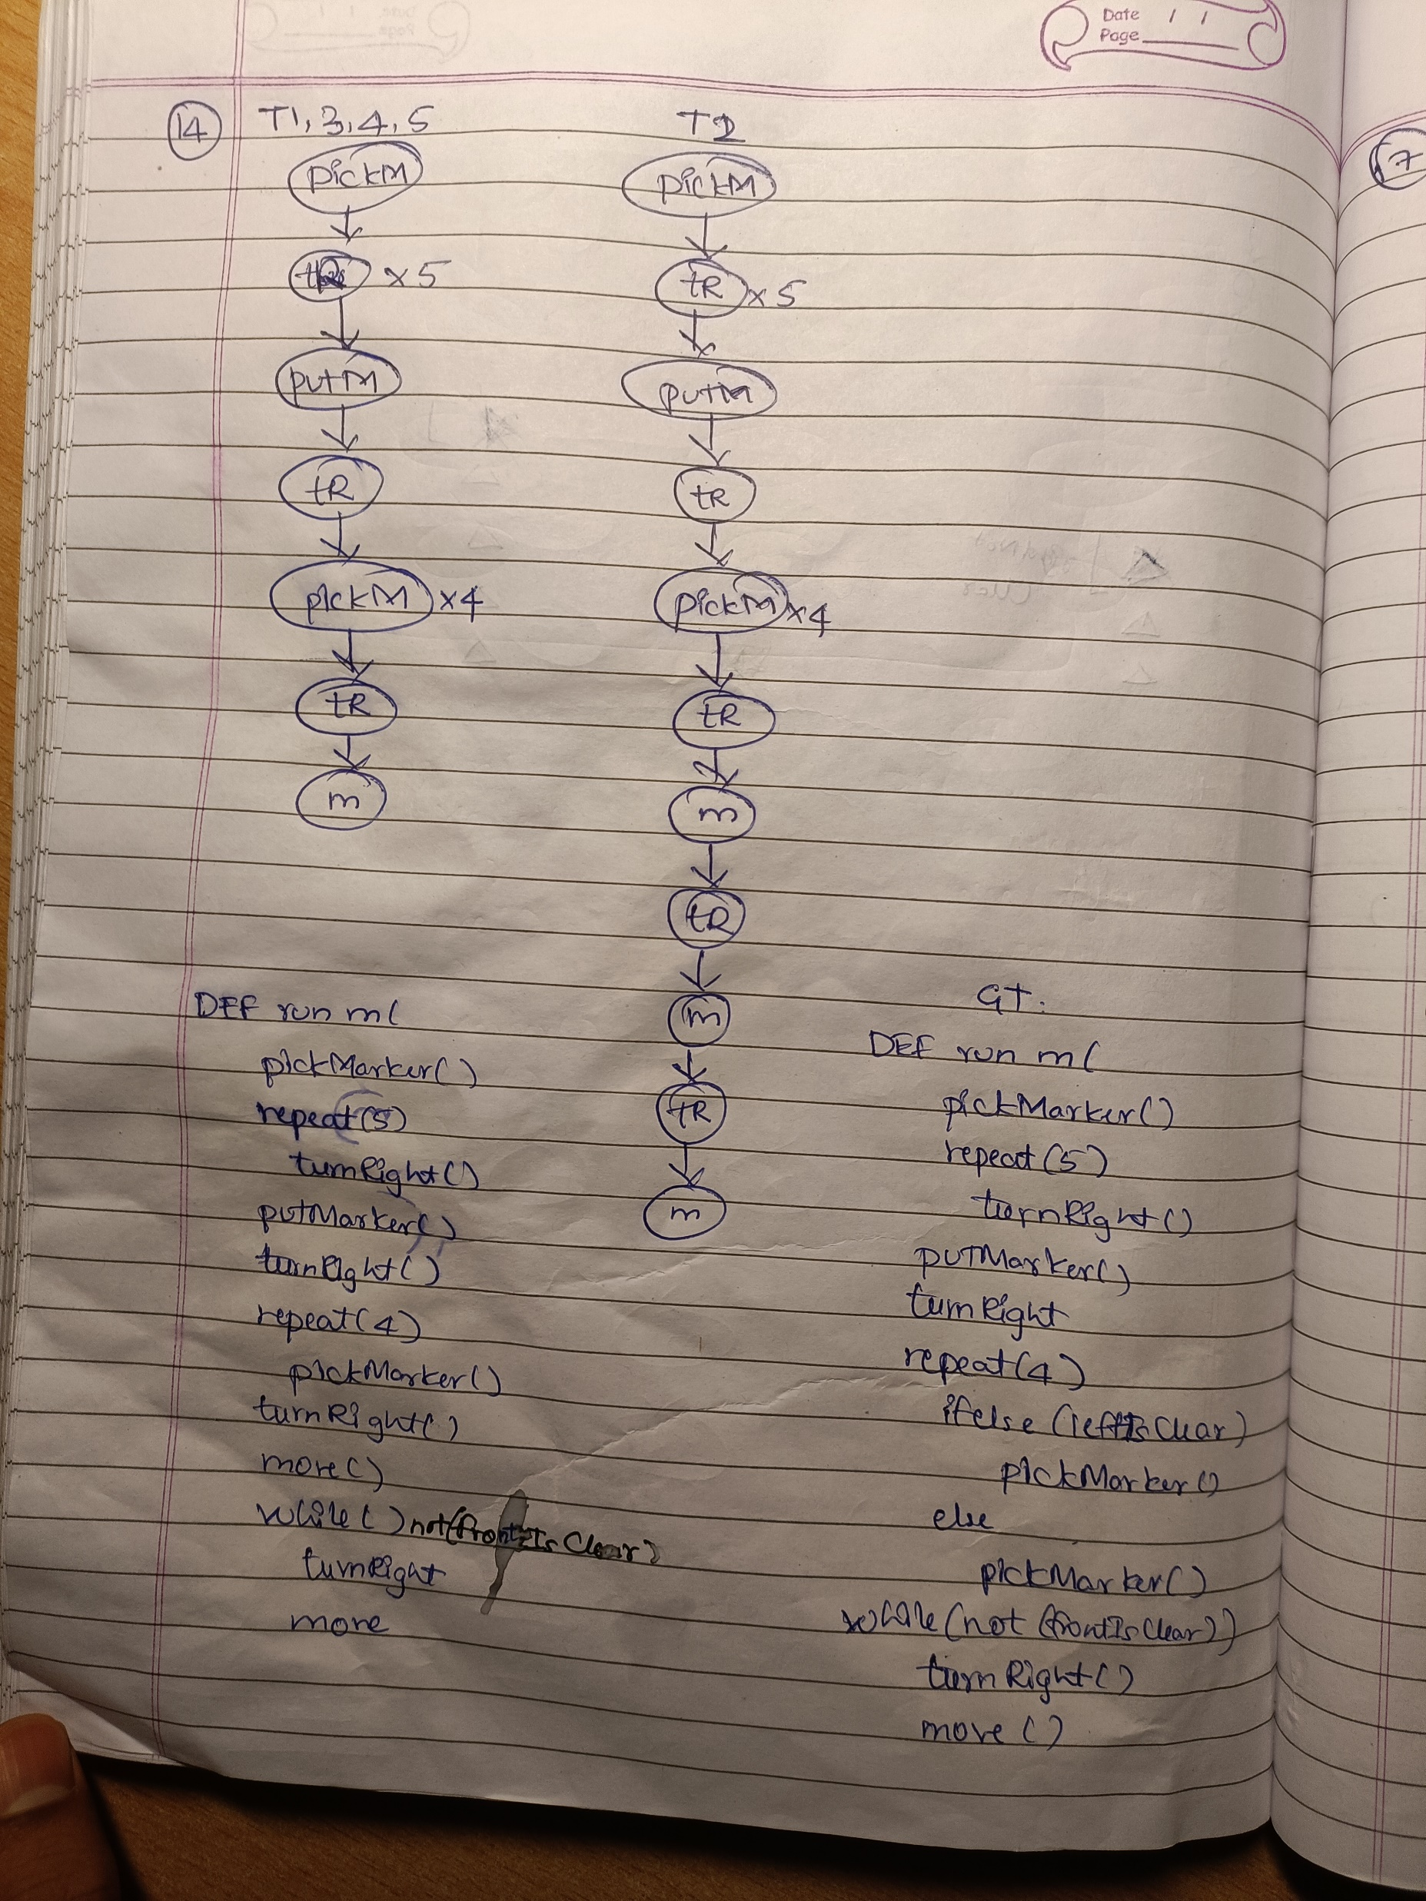
Rule 1: If there are two parallel paths; one of which contains (repeated) tokens and the other contains no token, add a WHILE loop.

Slide 7
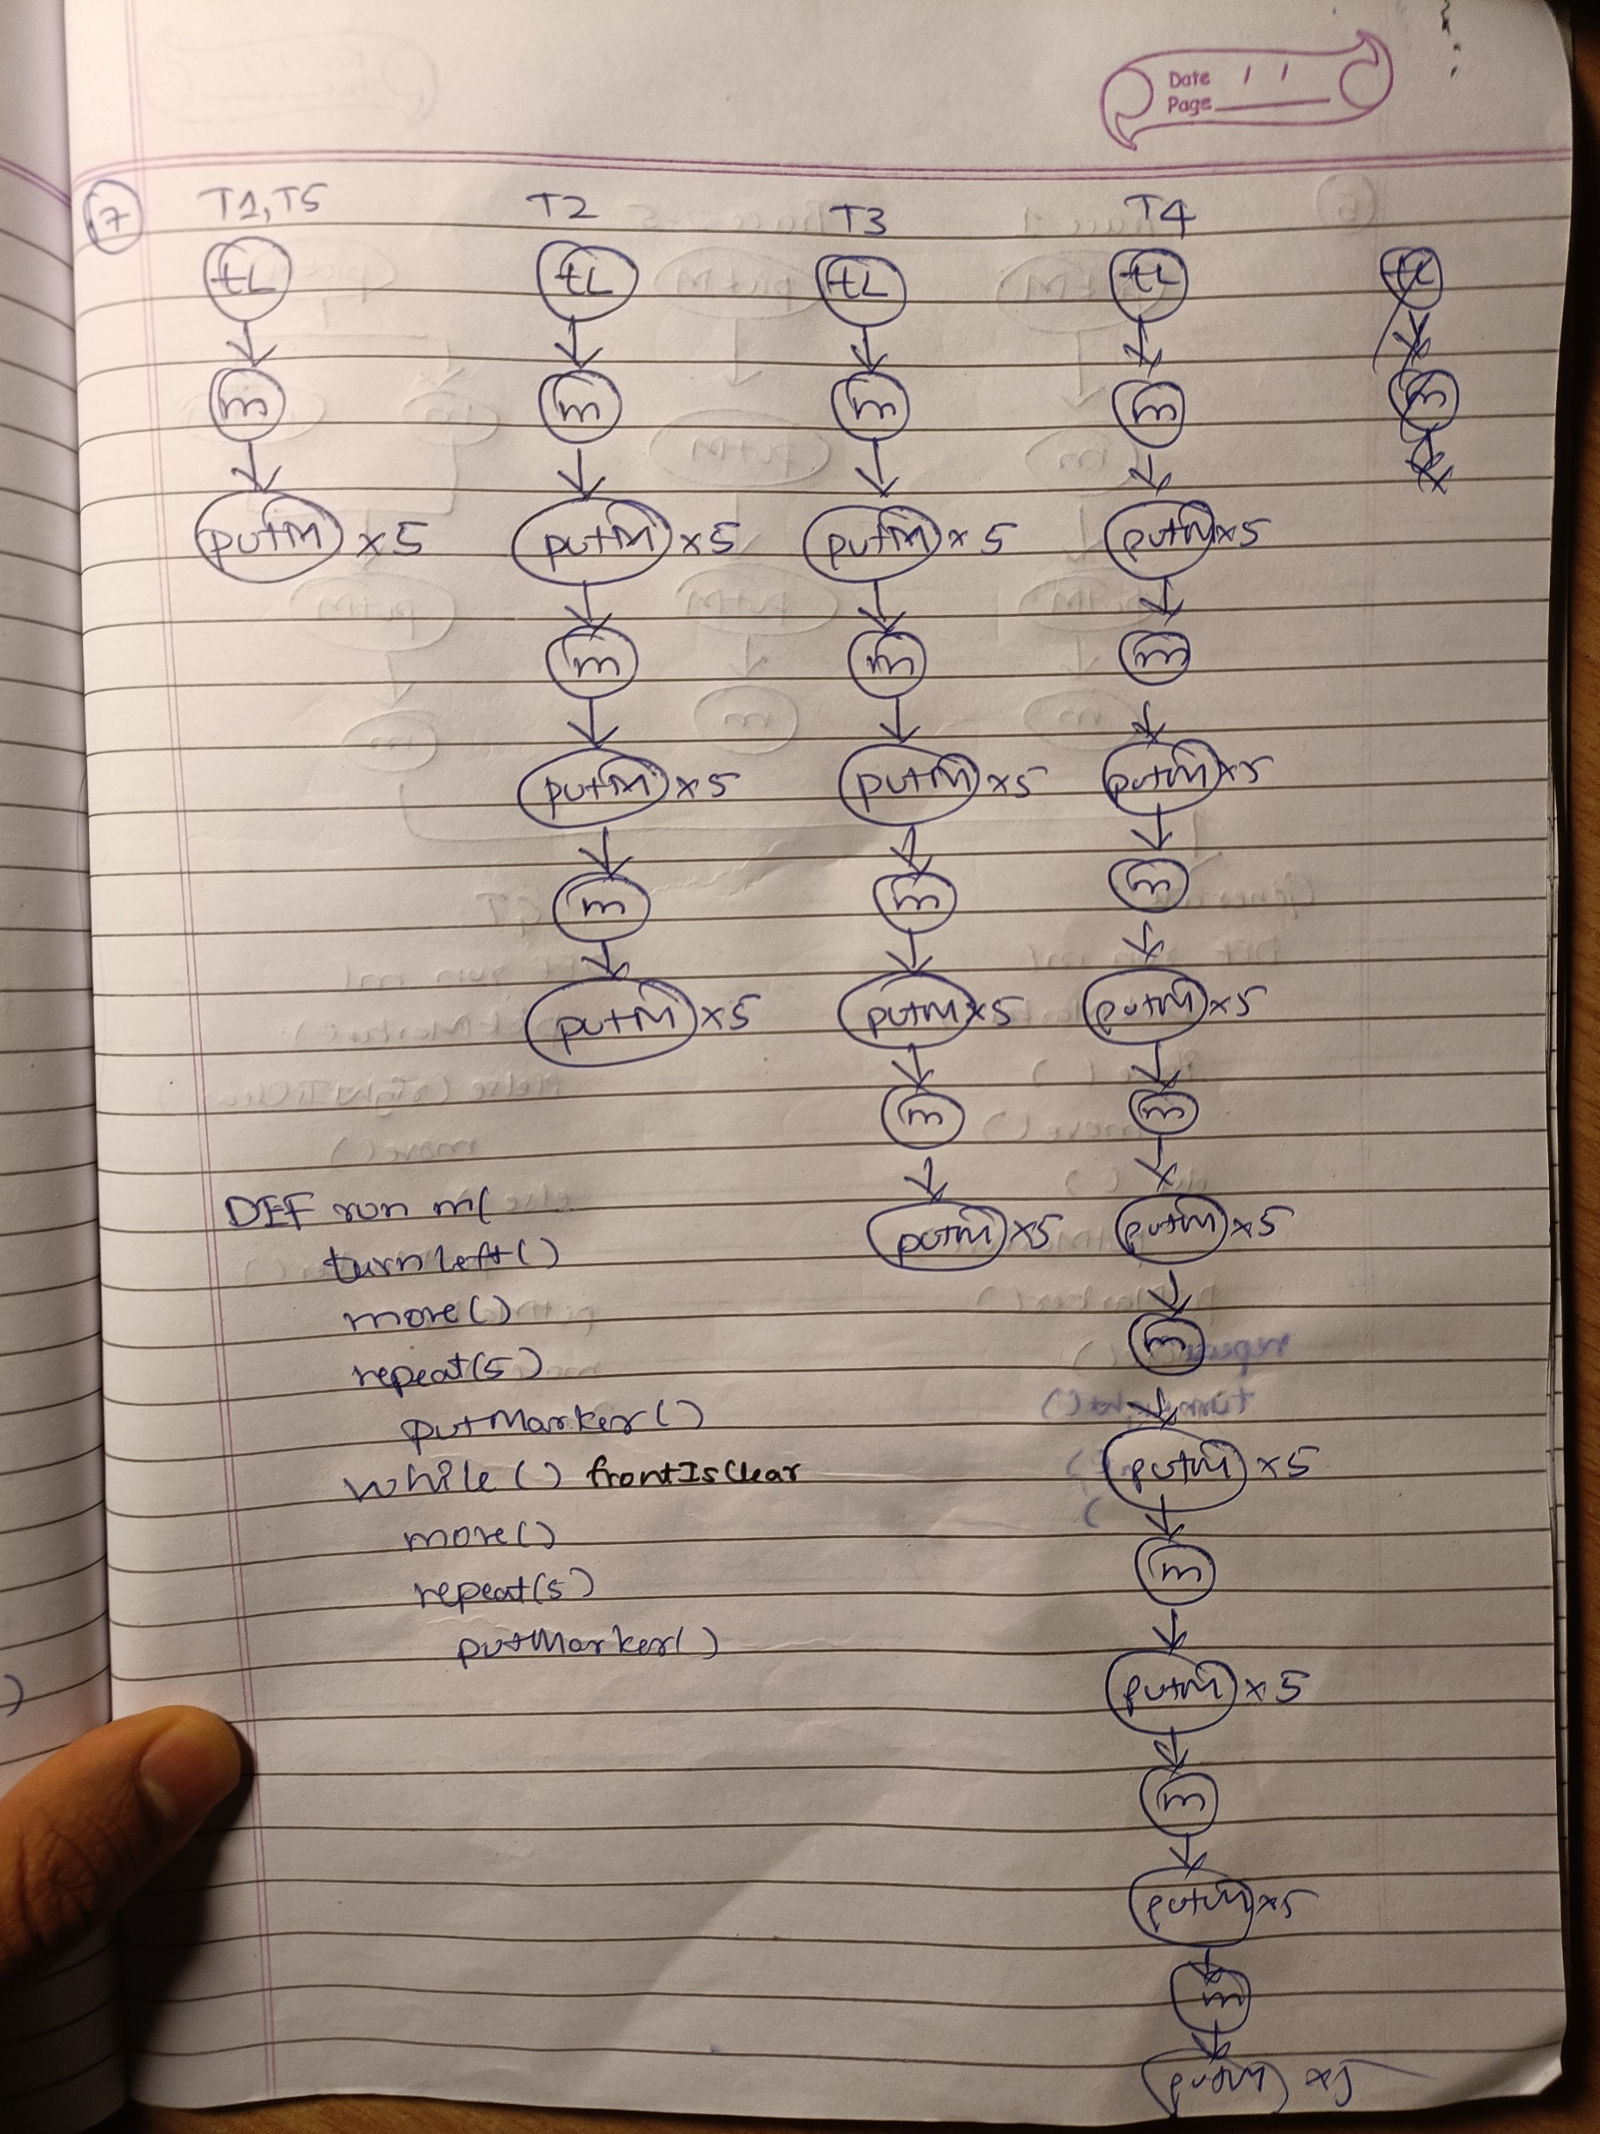

Slide 8
Rule 2: If there are two parallel paths; one of which contains (non-repeated) tokens and the other contains no token, add an IF condition.

Slide 9
Rule 3: If there are two parallel paths; both of them contain different set of tokens , add a IFELSE condition.

Slide 10
Rule 4: If two conditions evaluate to be true within a IF condition, split it into two IF conditions

Slide 11
Trace Creation Rules(Upto 2 Unique Traces)
If number of unique traces is 1, use the tokens in the trace to create program
If number of unique traces 2:
Set the longest trace as the Main trace, and the other trace as the Branch Trace
Loop through both the traces, starting from the first token
If the tokens are same, add them as single elements to a buffer program list
If the tokens are different,
Find the nearest same set of tokens.
( Preference order:
1. Nearest consecutive tokens
2. Nearest same token of Branch Trace from Main Trace
3. Nearest same token of Main Trace from Branch Trace )
Append all the tokens in between the found same token and the previous same token as double elements to the buffer program list [MainToken, NULL], [NULL, BranchToken] or [MainToken, BranchToken]

Slide 12
Program Rules applied (For 2 Unique Traces)
For single elements in the buffer program list, directly append them as action tokens to the program
For double elements in the buffer program list,
Use Rules 1-4 to create loops/conditionals

Slide 13
Results: First 100 Test Samples (with Ground Truth Traces)
Unique Traces/ Number of Samples | Semantic Accuracy | Generalization Accuracy
1 - 44 | 100% | 100%
2 - 25 | 100% | 96%
3 - 14 | -- | --
4 - 8 | -- | --
5 - 9 | -- | --
All - 100 | 69% | 68%

Slide 14
Ground Truth
DEF run m( pickMarker move
IF(not(frontIsClear)) turnRight move pickMarker
IF(frontIsClear) move
IF(rightIsClear) turnLeft putMarker turnLeft move
Generated
DEF run m( pickMarker move
IF(not(frontIsClear)) turnRight move pickMarker move
IF(rightIsClear) turnLeft putMarker turnLeft move
Failure Case
Main Trace : ['pickMarker', 'move', 'turnRight', 'move', 'pickMarker', 'move', 'turnLeft', 'putMarker', 'turnLeft', 'move']
Branch Trace : ['pickMarker', 'move', ‘NULL’ ',‘NULL’ pickMarker', 'move', ‘NULL’ , 'putMarker', 'turnLeft', 'move']
Unseen Trace : ["pickMarker", "move", "turnRight", "move", "pickMarker",”move”, 'putMarker', 'turnLeft', 'move' ]
Was always true for Seen I/O

Slide 15
Full Dataset Trace Analysis
Number of Unique Traces | Train Set | Val Set | Test Set
1 | 578381 | 1275 | 1297
2 | 262338 | 599 | 574
3 | 130421 | 297 | 311
4 | 90567 | 196 | 194
5 | 55147 | 133 | 124
 | 1116854 | 2500 | 2500

Slide 16
Advantages
If all rules are satisified, performance should be nearly as good as state of the art I/O to Trace model (~95% Top 1, ~98% Top 10 Supervised only).
If atleast rules for upto 2 unique traces are satisfied, performance should be within
70-75 % .
Does not need a training set of programs for learning.
Should be able to generalize better to different datasets as it is not dependent on training set of programs.
Shorter programs by adding repeat logic and removing redundant tL and tR statements.

Slide 17
Challenges
Multiple trace paths possible for loops/conditionals
Fixed Size Window can be used
Execution states could be better used
Rules might get complex for higher number of
unique traces
RL can be used to improve trace generation
Neural network can be used to learn conditions
(dataset neeeds to be created)

Slide 18
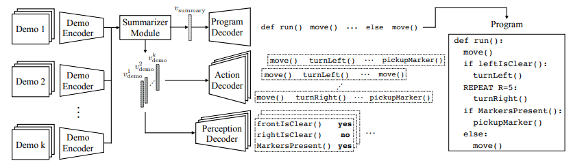
4) Learn conditions from intermediate states generated before/ after control flow statements using a neural network
Here, the perception vector prediction is formulated as a sequential multi-label binary classification problem and a binary cross entropy objective is optimized.

Slide 19
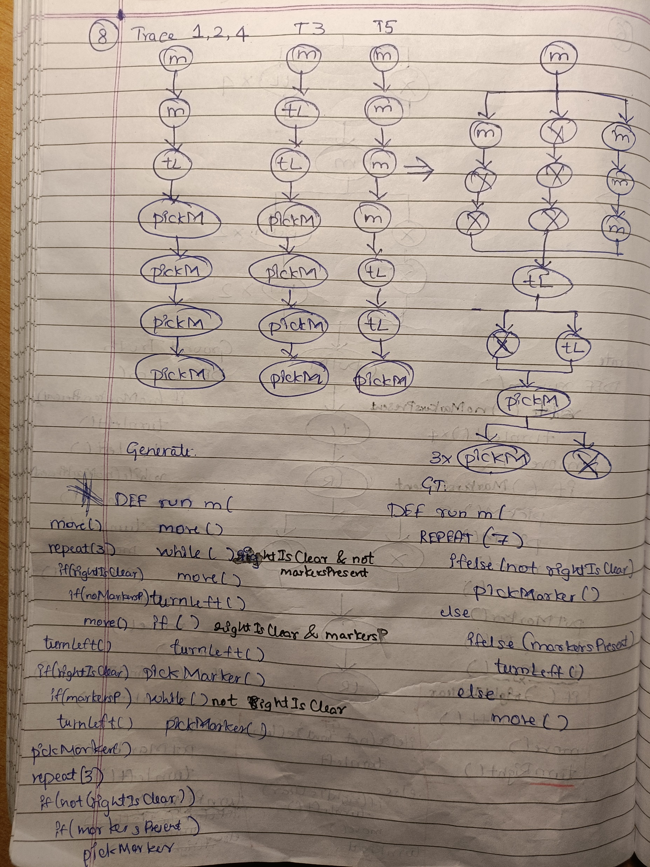
Rule 5: If there are three parallel paths; two of them contain same tokens (but unequal number of them), add a WHILE loop.
Rule 6: If two conditions evaluate to be true within a WHILE loop, split it into a REPEAT loop and two IF conditions

Slide 20
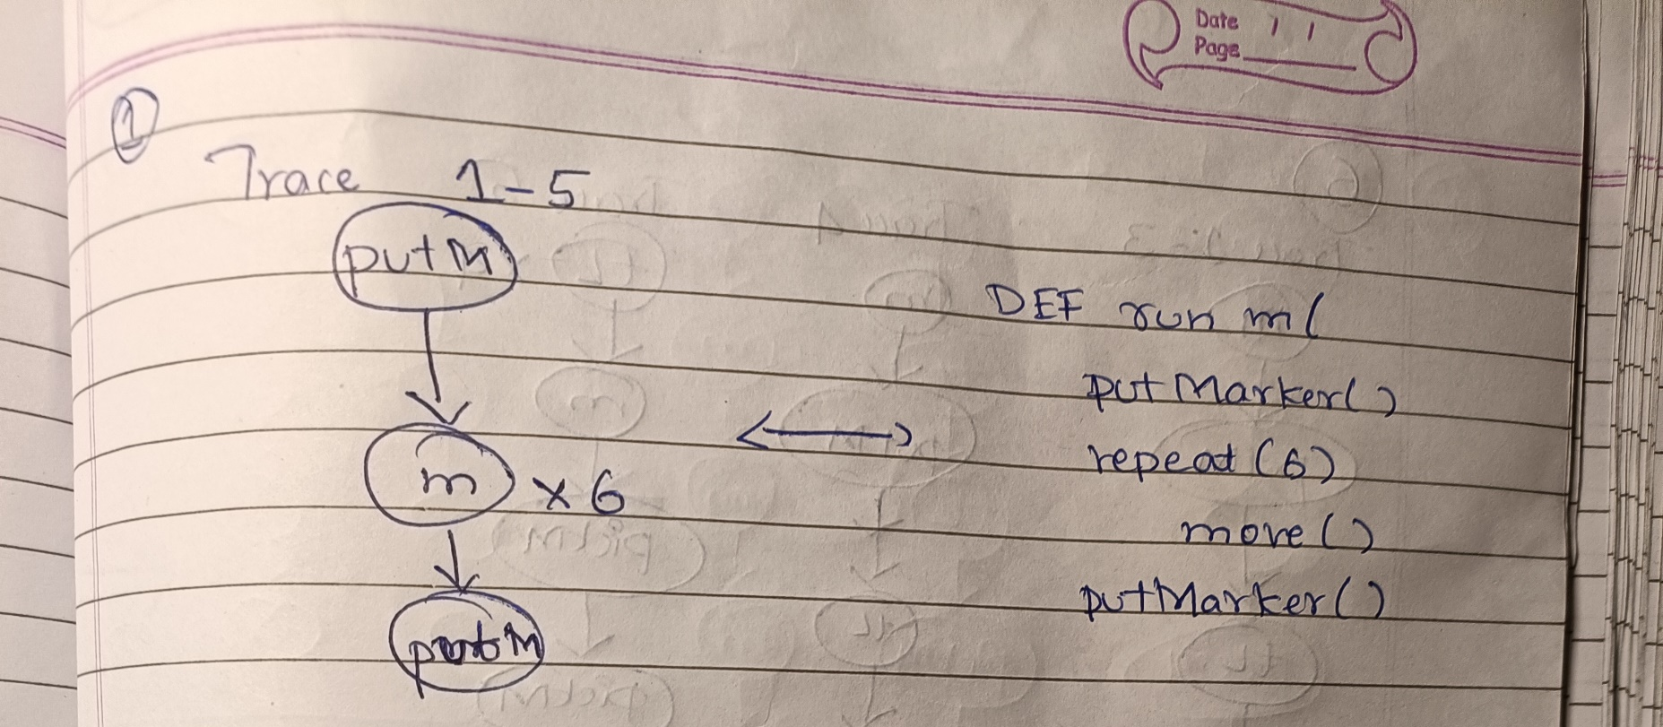
Rule 7: If there are three parallel paths; two of them contain different tokens , parse them using Rules 1 to 3.
Rule 8: If there are more than 2 consecutive same tokens in a sequential path, add a REPEAT loop.

Slide 21
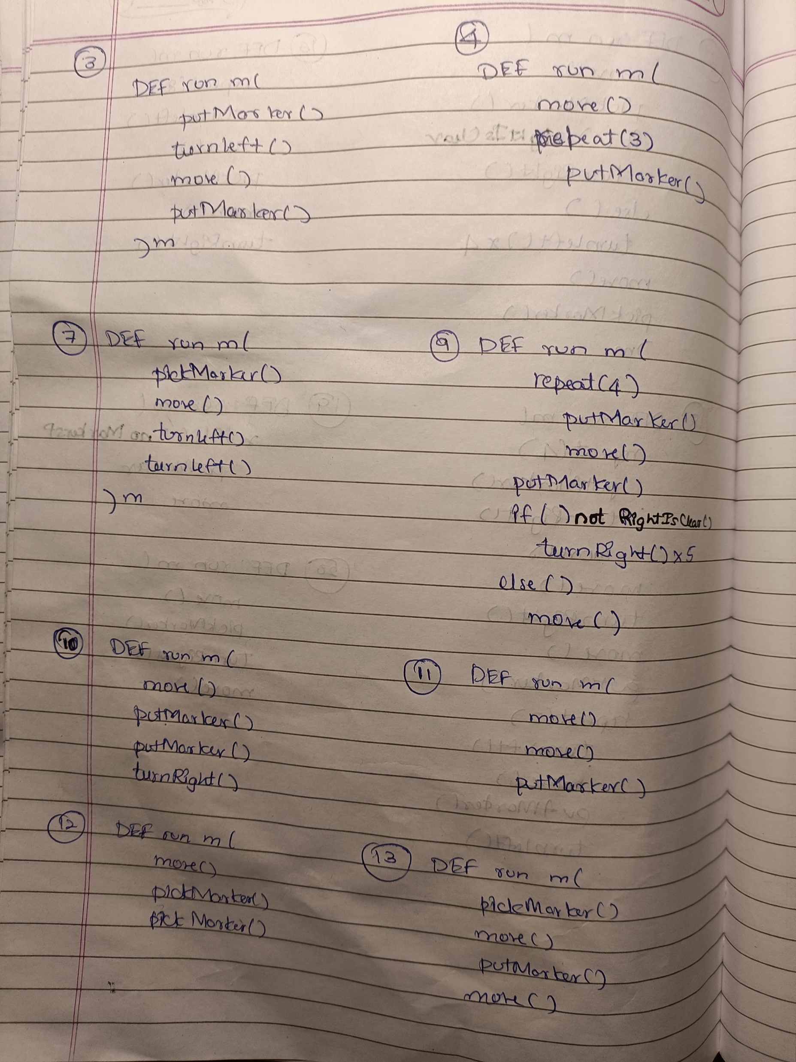
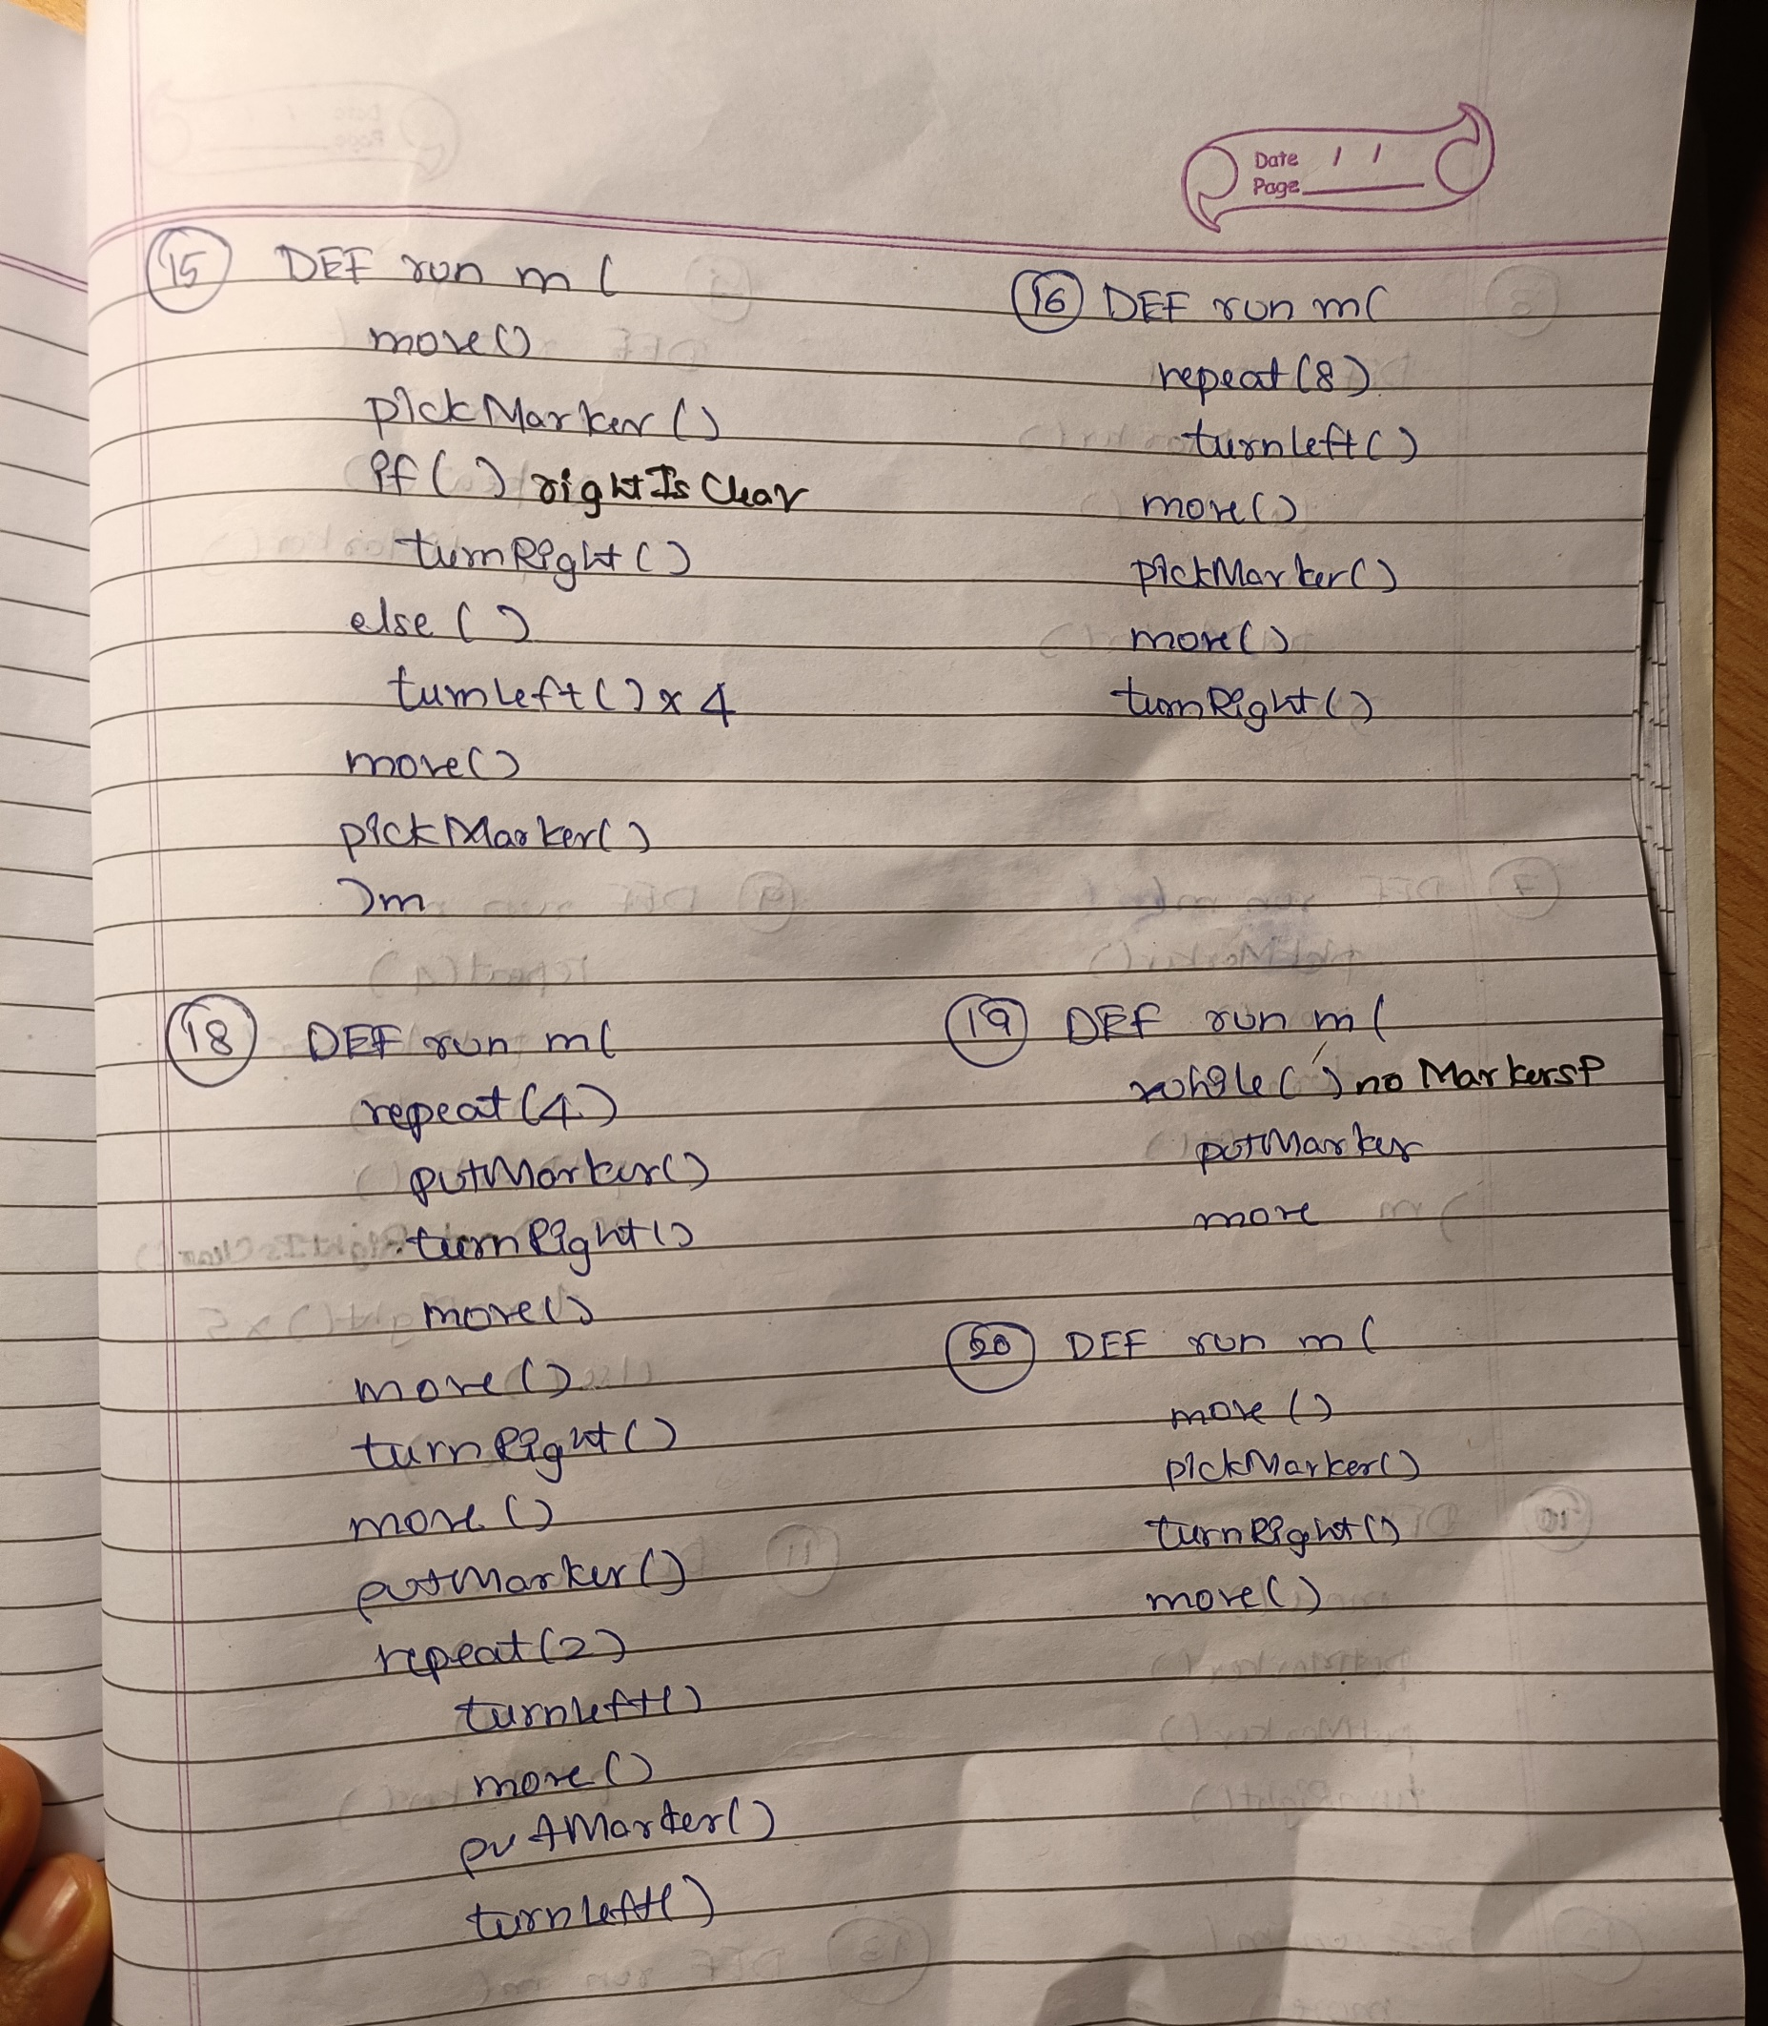
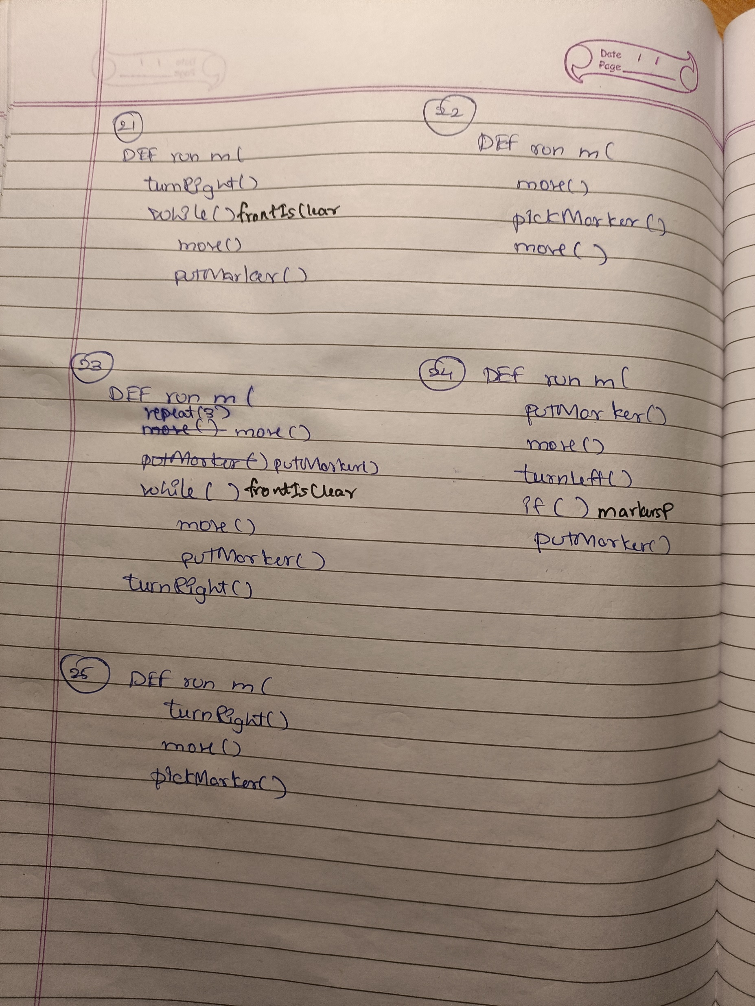
First 25 Test Samples ~ Handwritten 100%

Slide 22
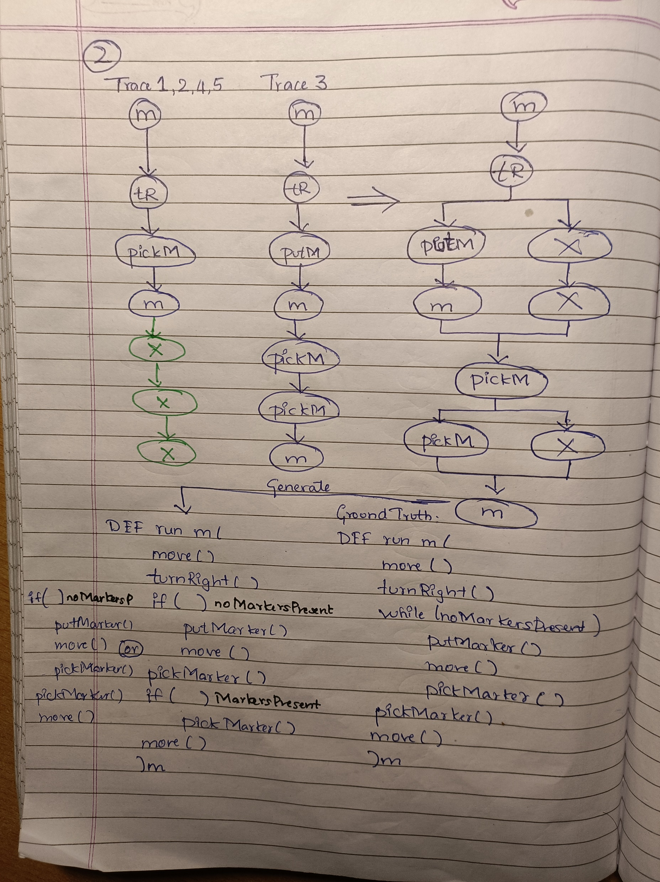
Extra

