Slide 1

CALCULATOR
MLSAKIET INTERNSHIP
Modern and sleek, conveying a refined approach to calculations.

Slide 2
Introduction & Features
Project Overview: A simple, user-friendly calculator built using HTML, CSS, and JavaScript,
designed to perform basic arithmetic operations.
Purpose:
To create a minimalistic, visually appealing calculator accessible for
various users and devices.
Key Features:
Basic Operations: Addition, Subtraction, Multiplication, Division.
Special Functions: Clear (AC), Delete (DEL), Percentage, Square Root.
Responsive Design: Optimized for desktop and mobile devices.
Theme: White and teal for a clean, modern look.

Slide 3
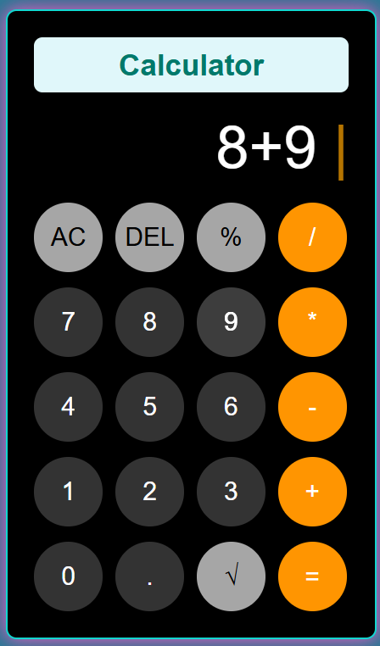
User Usability & Design
User-Friendly Layout:
Logical grouping of numbers and operations for intuitive use.
Easy-to-read display for current input and results, with responsive cursor and error handling.
Accessibility:
High contrast color scheme for visibility.
Large, clickable buttons with hover feedback for enhanced interaction.
Mobile-Friendly:
Designed to work seamlessly across devices, adapting to screen sizes.

