Slide 1
Financial Analytics &
Risk Reporting System
Automated P&L, budget vs actual, credit-risk scorecard and monthly board pack
Data Analytics track · Project 1 of 2 · Intern presentation
Notes:
Introduce yourself and the project in one sentence. Say the data is synthetic.

Slide 2
The problem: reports built by hand
Slow, inconsistent, hard to trust
1
2
3
Slow
Inconsistent
Reactive
Finance teams rebuild the P&L, variance and risk reports every month
Different definitions of the same metric in different files
Credit risk is reviewed late, without a ranked view of who is risky
Goal: one pipeline that produces trustworthy reports and a risk score every month, from a single command.

Slide 3
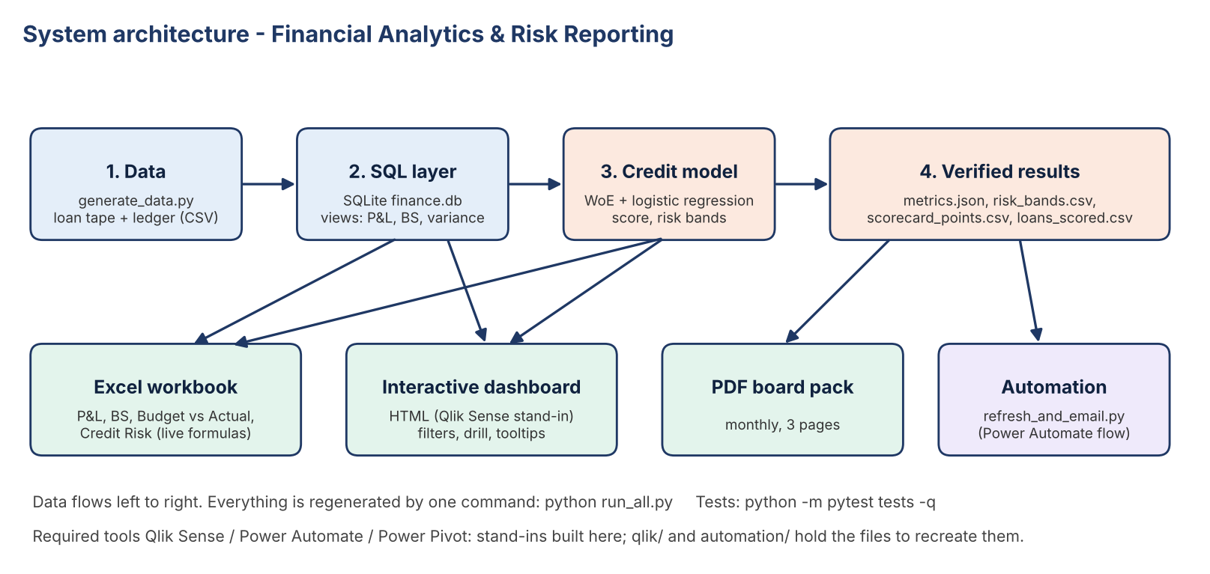
Architecture: data to decisions

Slide 4
Data: a synthetic lending company
Loan tape in Lending Club format; ledger derived from it so everything reconciles
24,447
8.6%
$341M
22
loans issued Jan 2024 – Oct 2026
default rate
originated
months of ledger and budget
Interest income = balance × rate ÷ 12 on live loans
Charge-offs and provision come from loans that default
Budget uses a planned balance and a planned 14.05% yield, so variances have real drivers

Slide 5
Finance reports: profit is rising
Net income by month, USD thousands (after 25% tax)
$339K
Oct 2026 net income
4
loss months in 2025, none since
Notes:
Open the Excel P&L sheet and Budget vs Actual sheet, change the month in B3.

Slide 6
Why interest income beat budget
Oct 2026: +$212K (+8.9%) = volume + rate
Volume: the book was slightly below plan ($202.97M vs $203.93M), costing $11K
Rate: the book yielded 15.37% vs the 14.05% planned
The insight: the beat is about pricing, not growth

Slide 7
Credit scorecard separates risk
Default rate by risk band (A = lowest risk)
0.71
0.42
AUC (test)
Gini
0.31
8.60%
KS
predicted = actual
Weight of Evidence bins → logistic regression → points (600 at 30:1 odds, +20 doubles the odds)

Slide 8
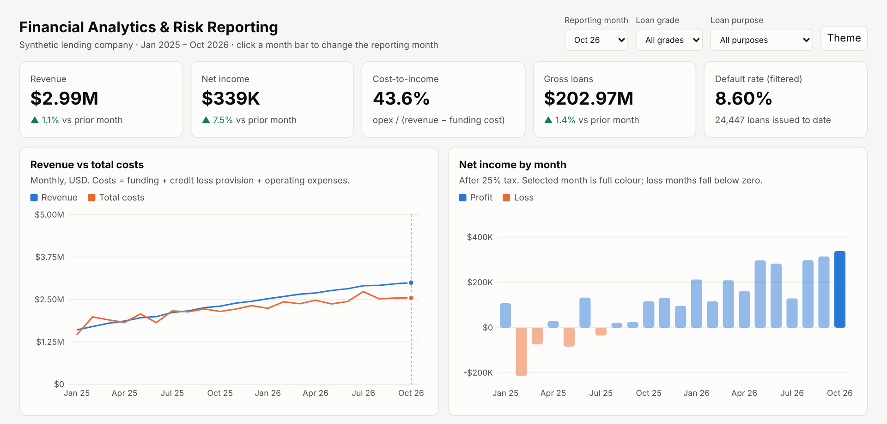
Interactive dashboard
Filters, hover tooltips, click a bar to change month, table views, light and dark

Slide 9
Testing and automation
13 automated tests, all passing
Reconciliation
Excel net income = SQL to the dollar; interest income = loan-tape calculation; balance sheet balances
1
Model quality
AUC 0.71 test vs 0.72 train (not overfit); calibrated; bands rise monotonically; no leakage features
2
Automation
One command rebuilds everything; monthly email with PDF (dry run tested; Power Automate recipe)
3

Slide 10
Challenges, limits, next steps
Challenges
Limits
Next steps
A chart that hid loss months; off-by-one row references caught by recalculation checks
Synthetic data; cash is the balancing item; random (not out-of-time) validation
Real Lending Club data; rebuild in Qlik Sense and Power Automate; out-of-time validation and drift monitoring
Thank you · Questions

