Slide 1


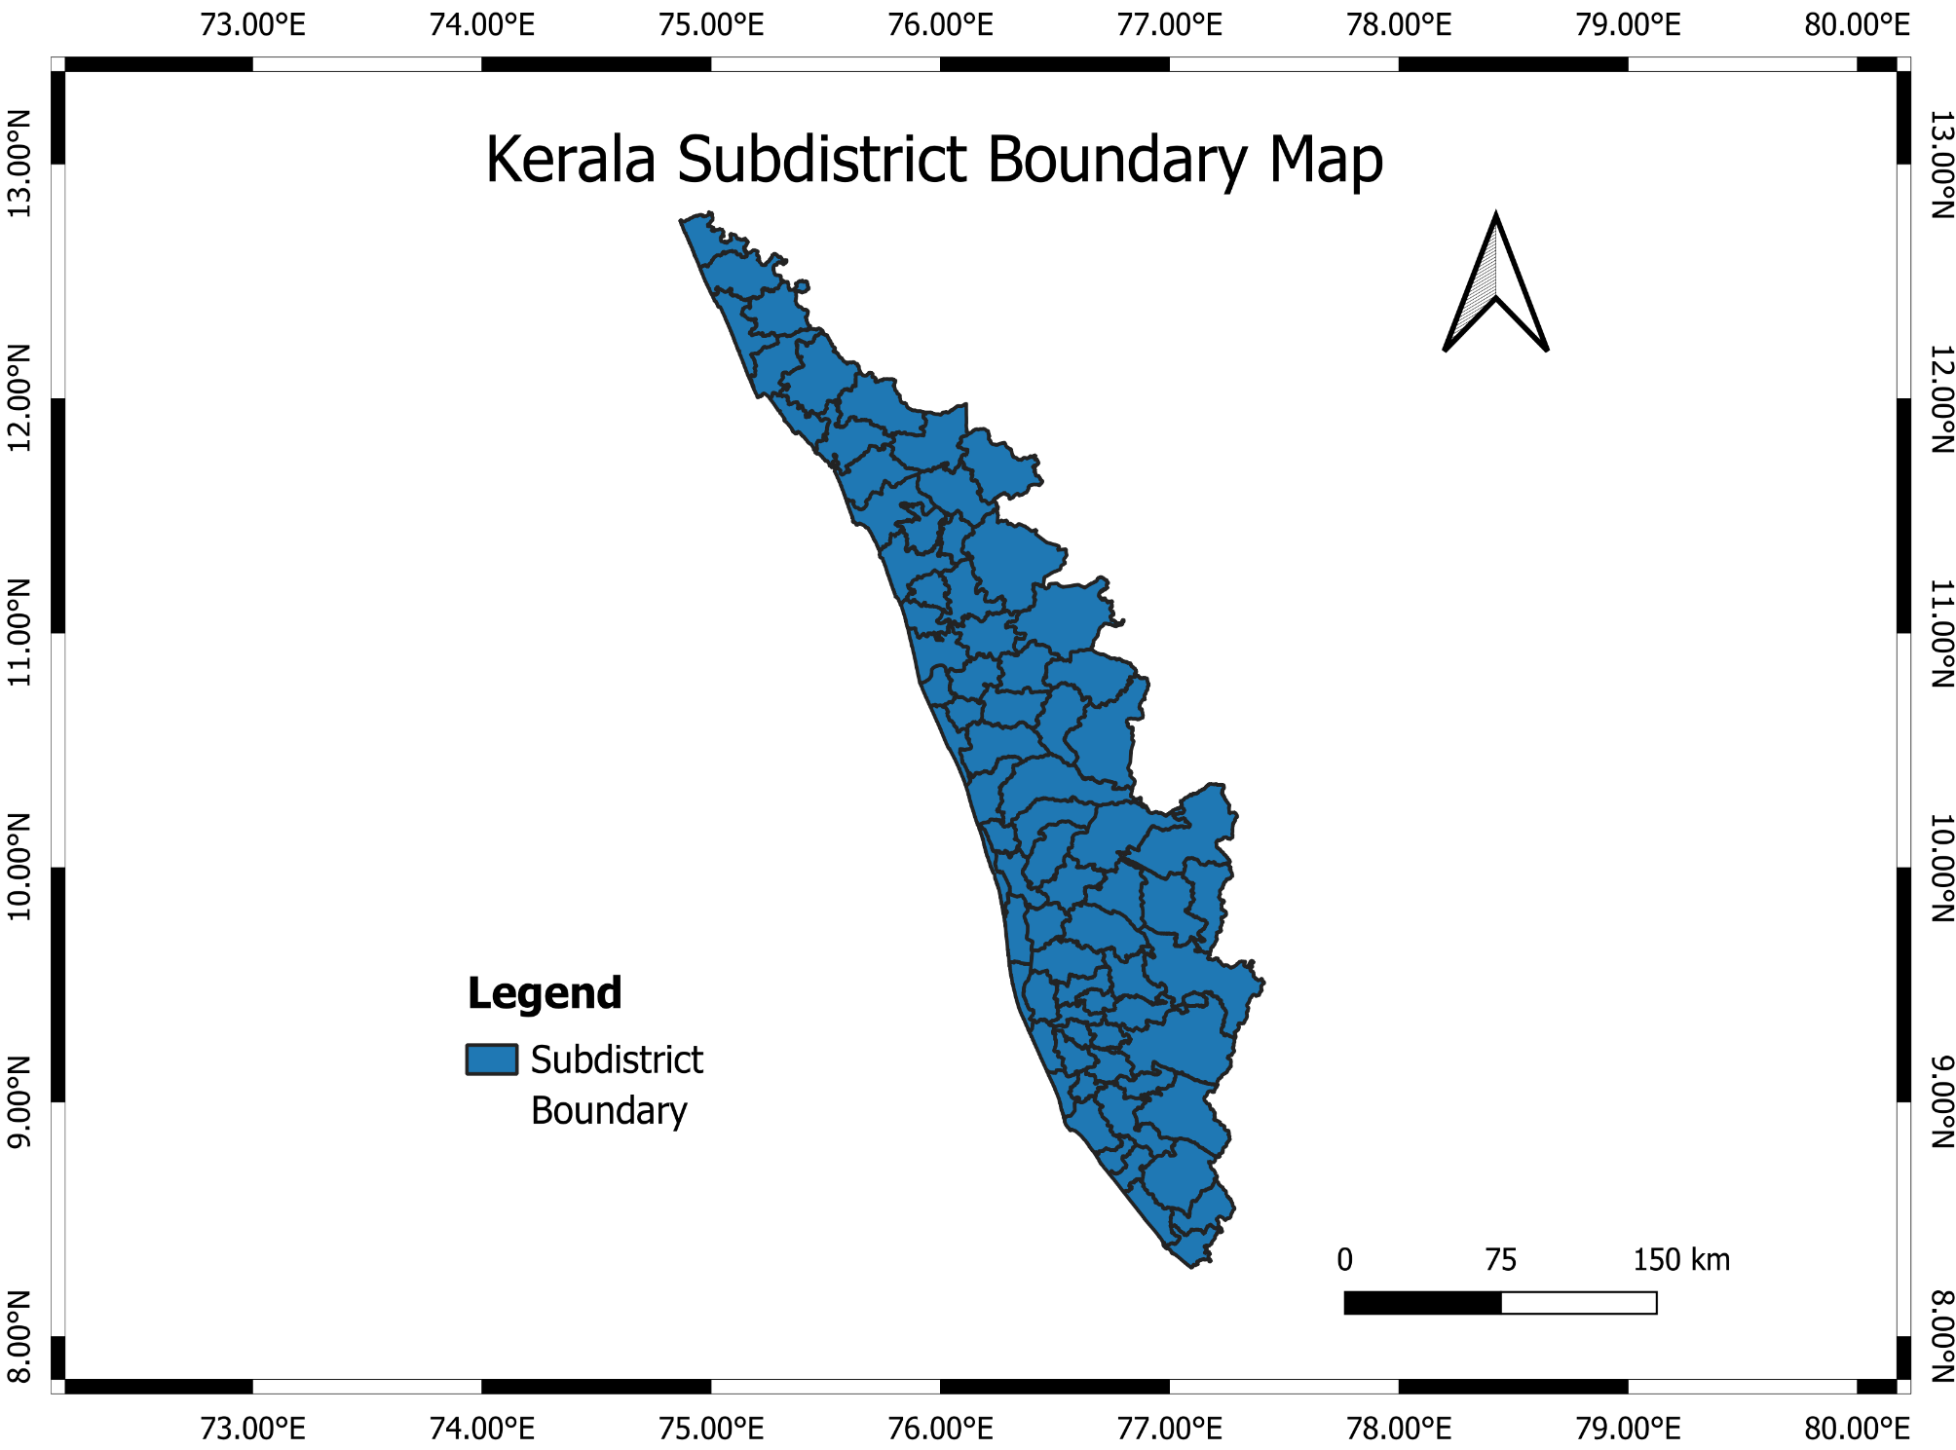
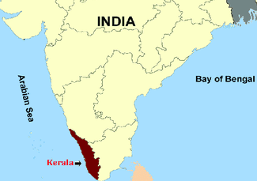
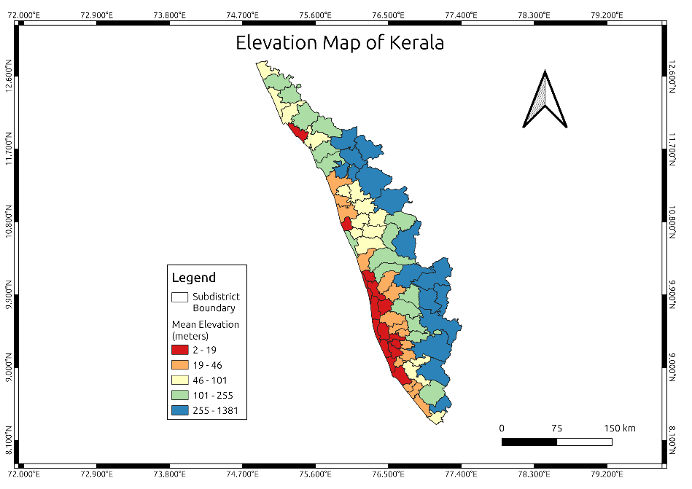
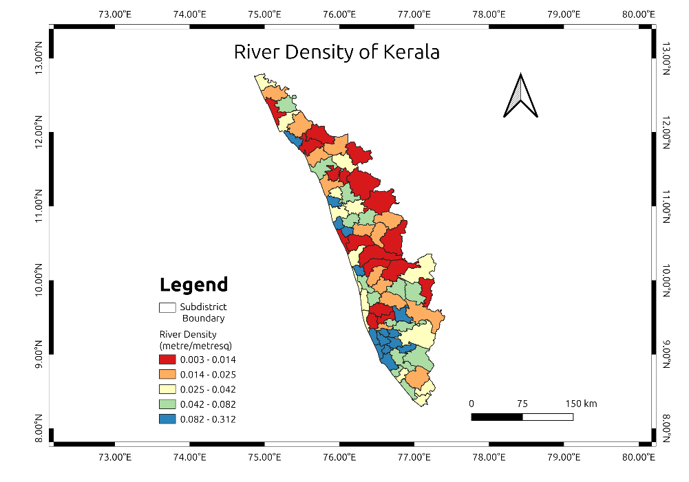
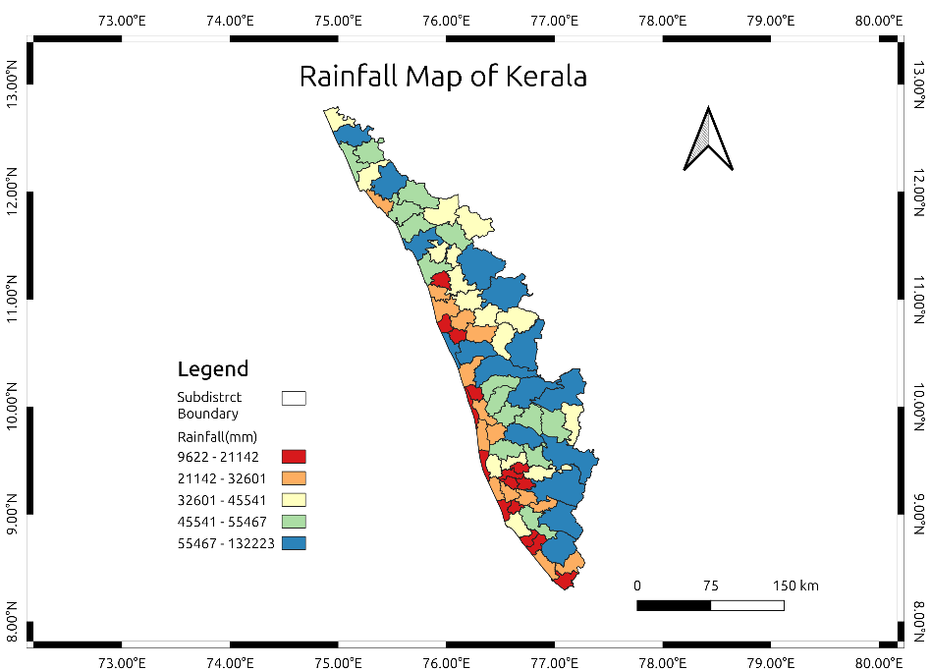
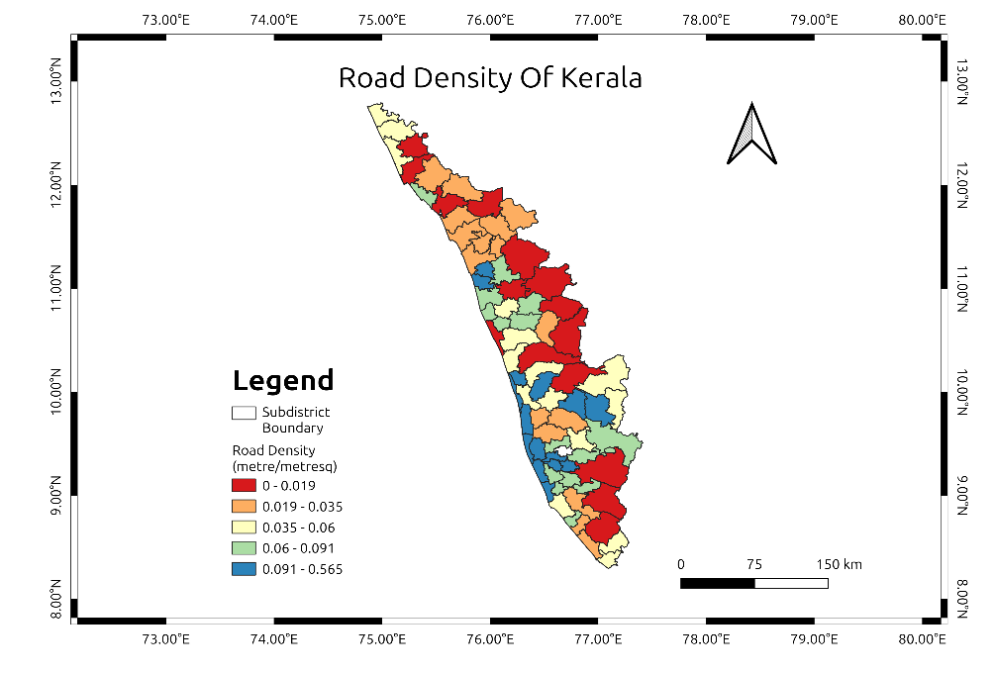
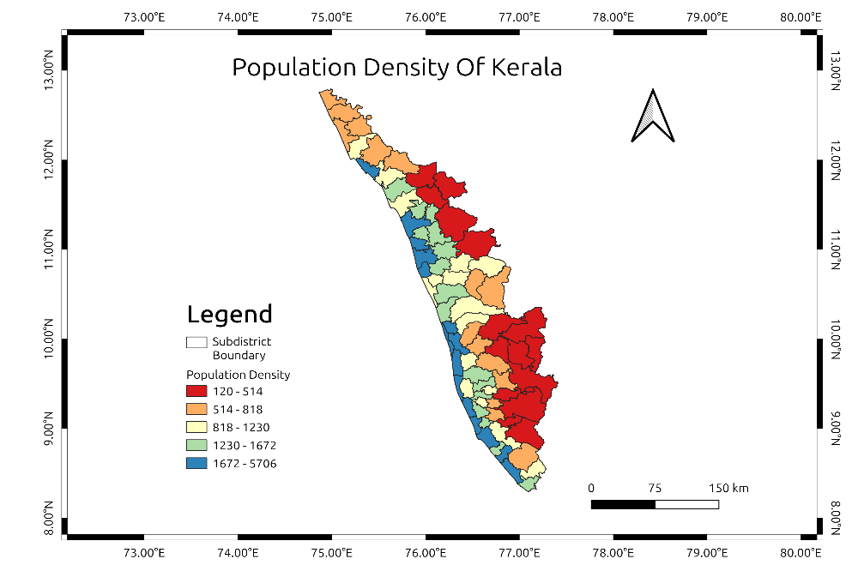
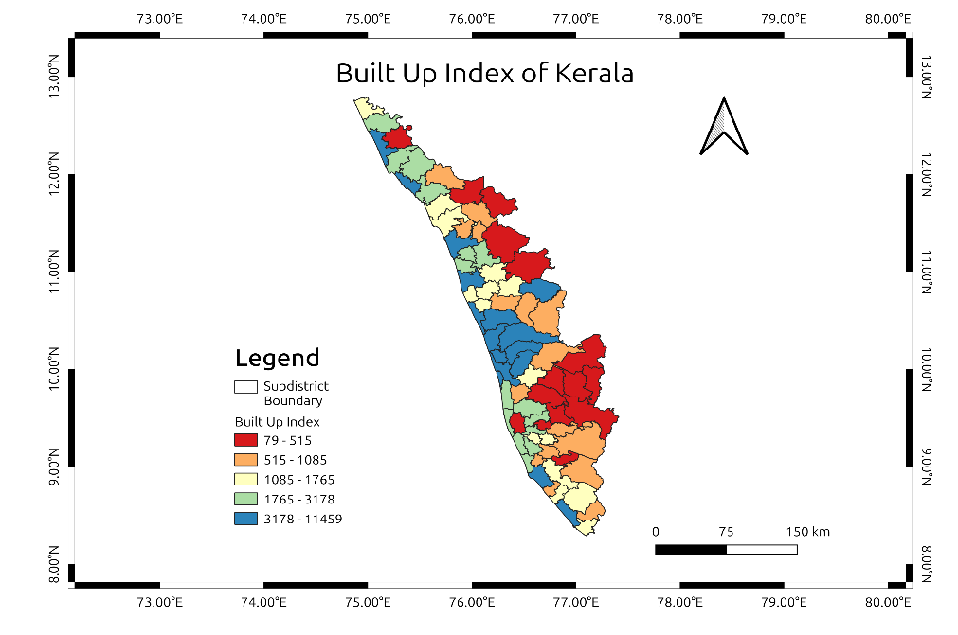
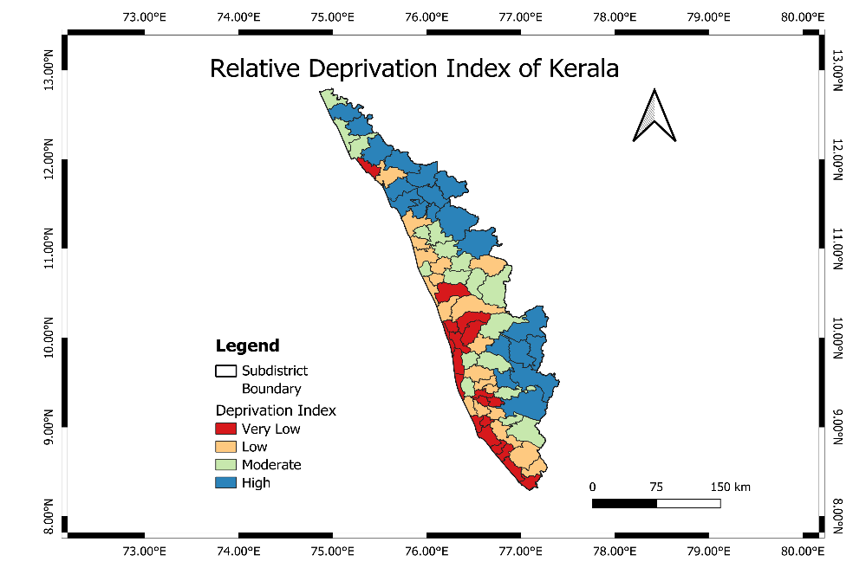
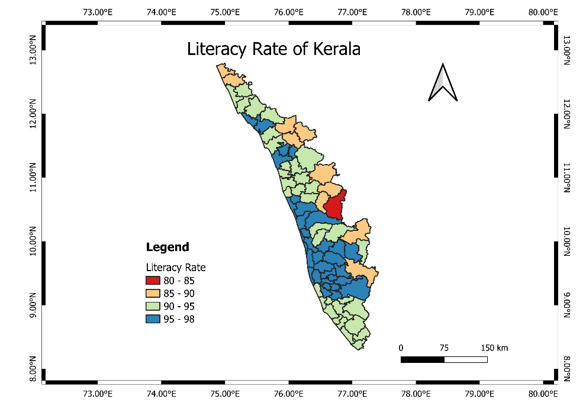
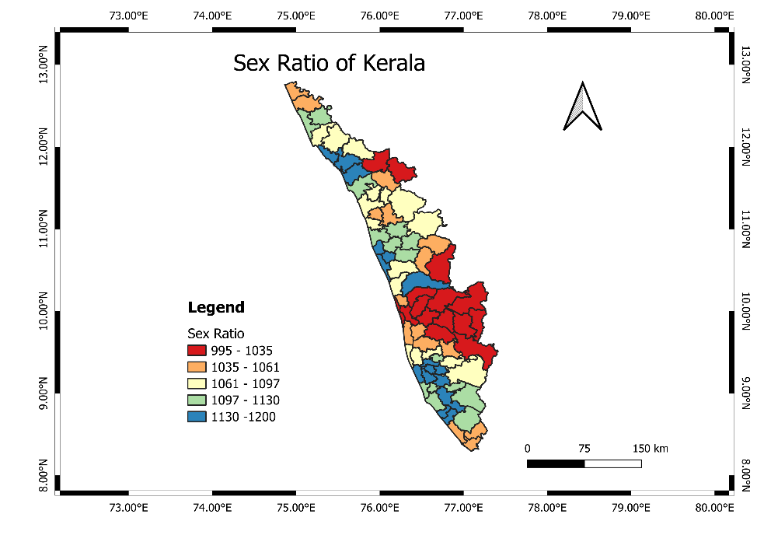
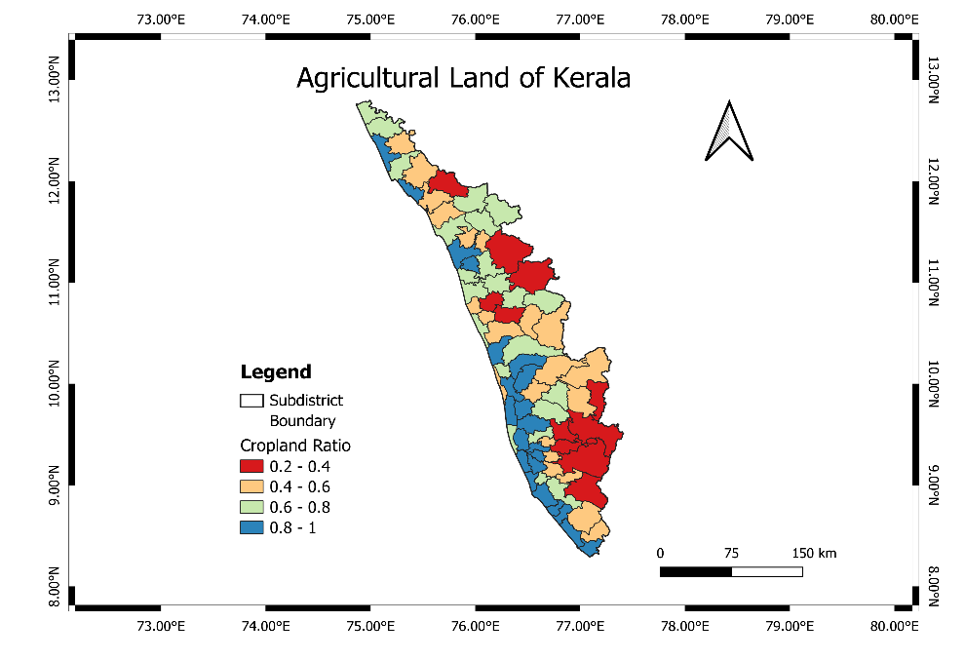
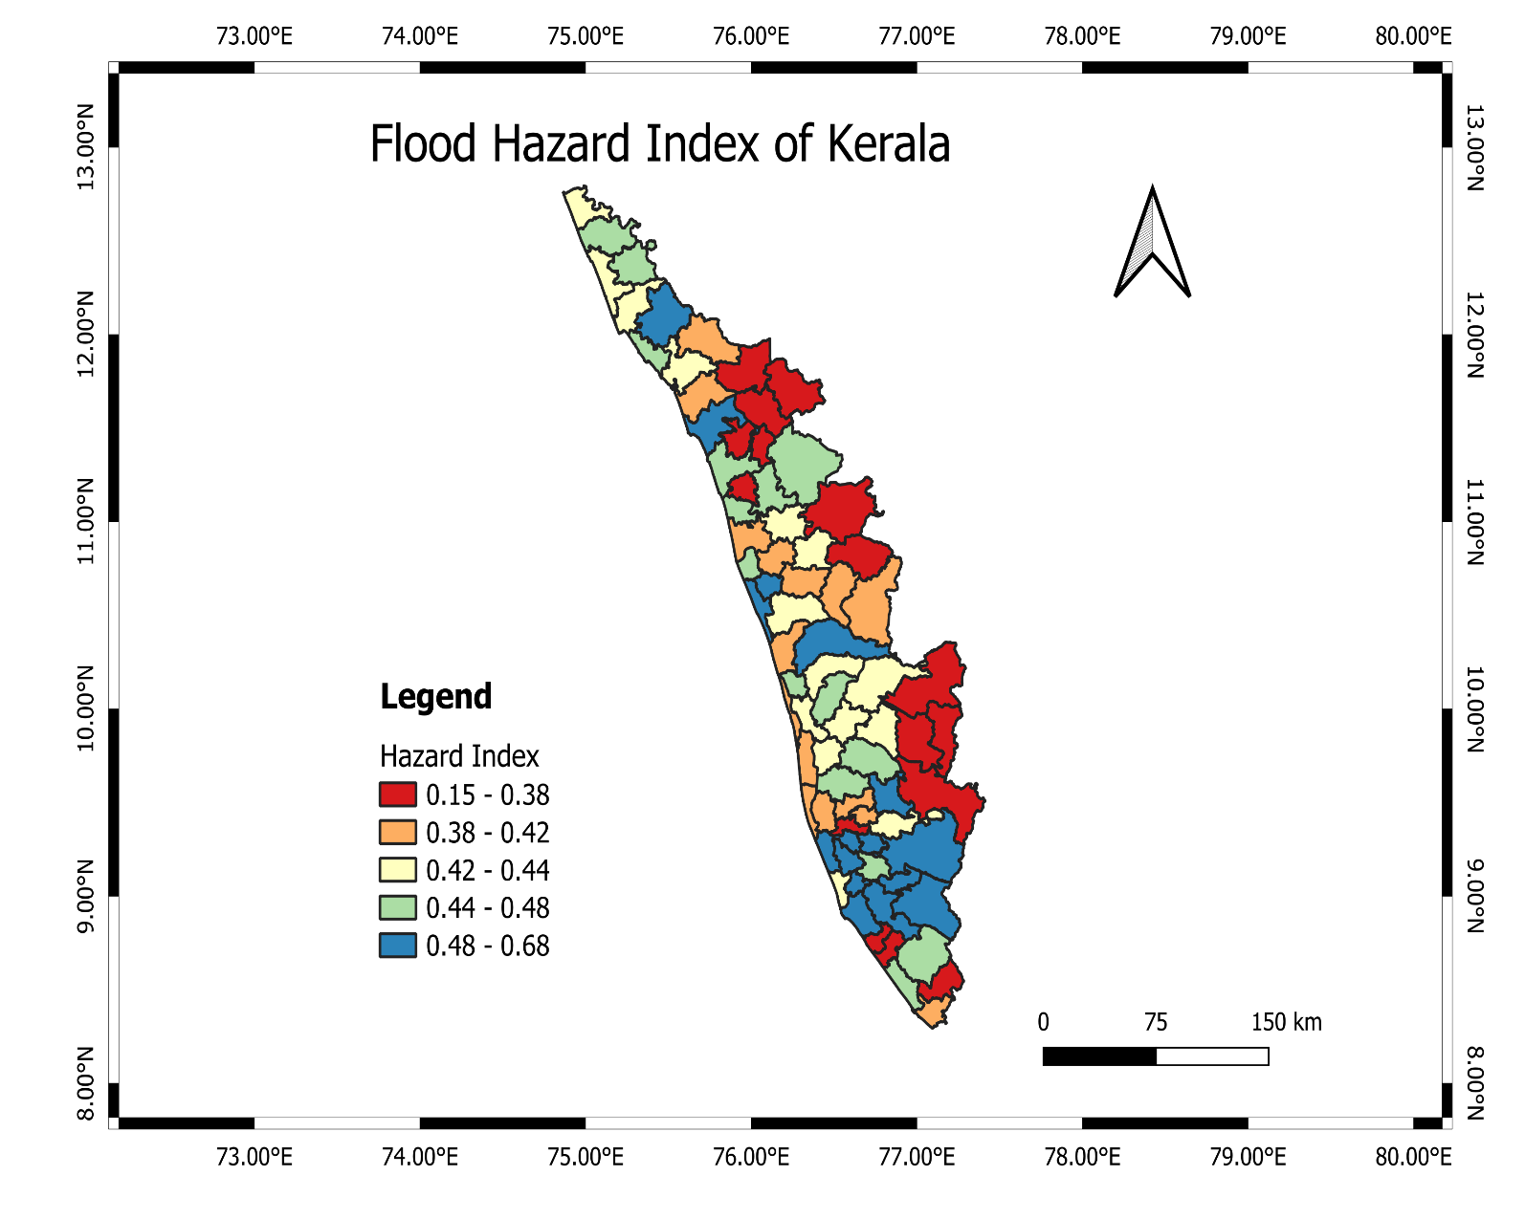
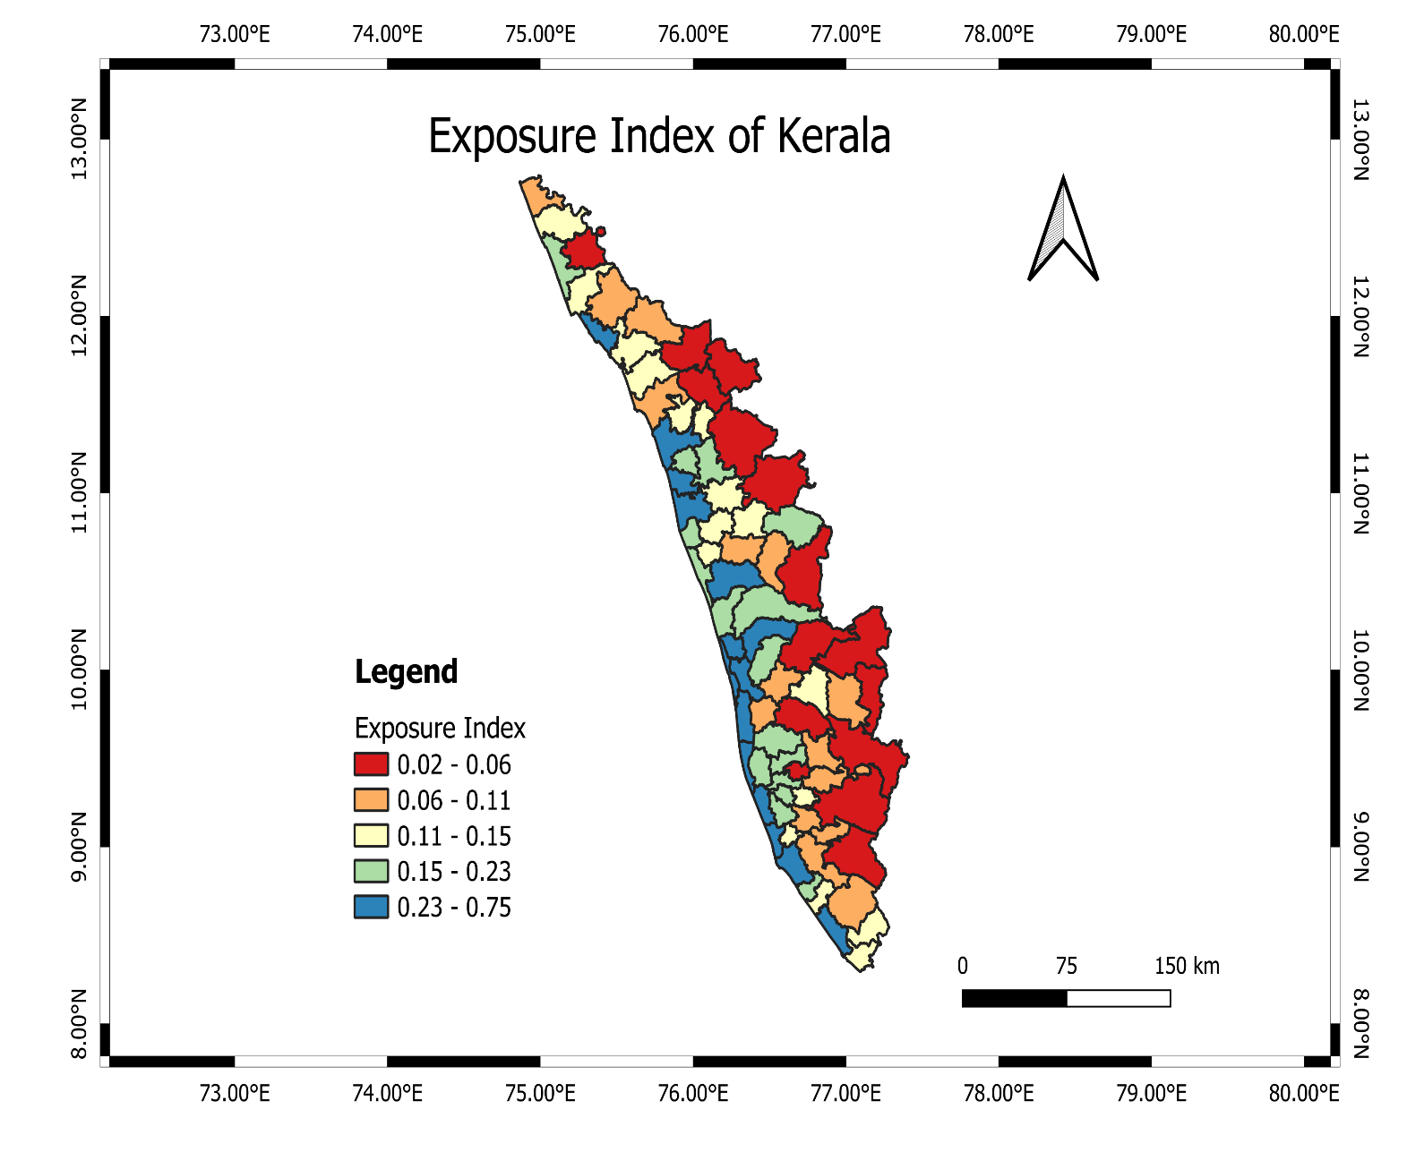
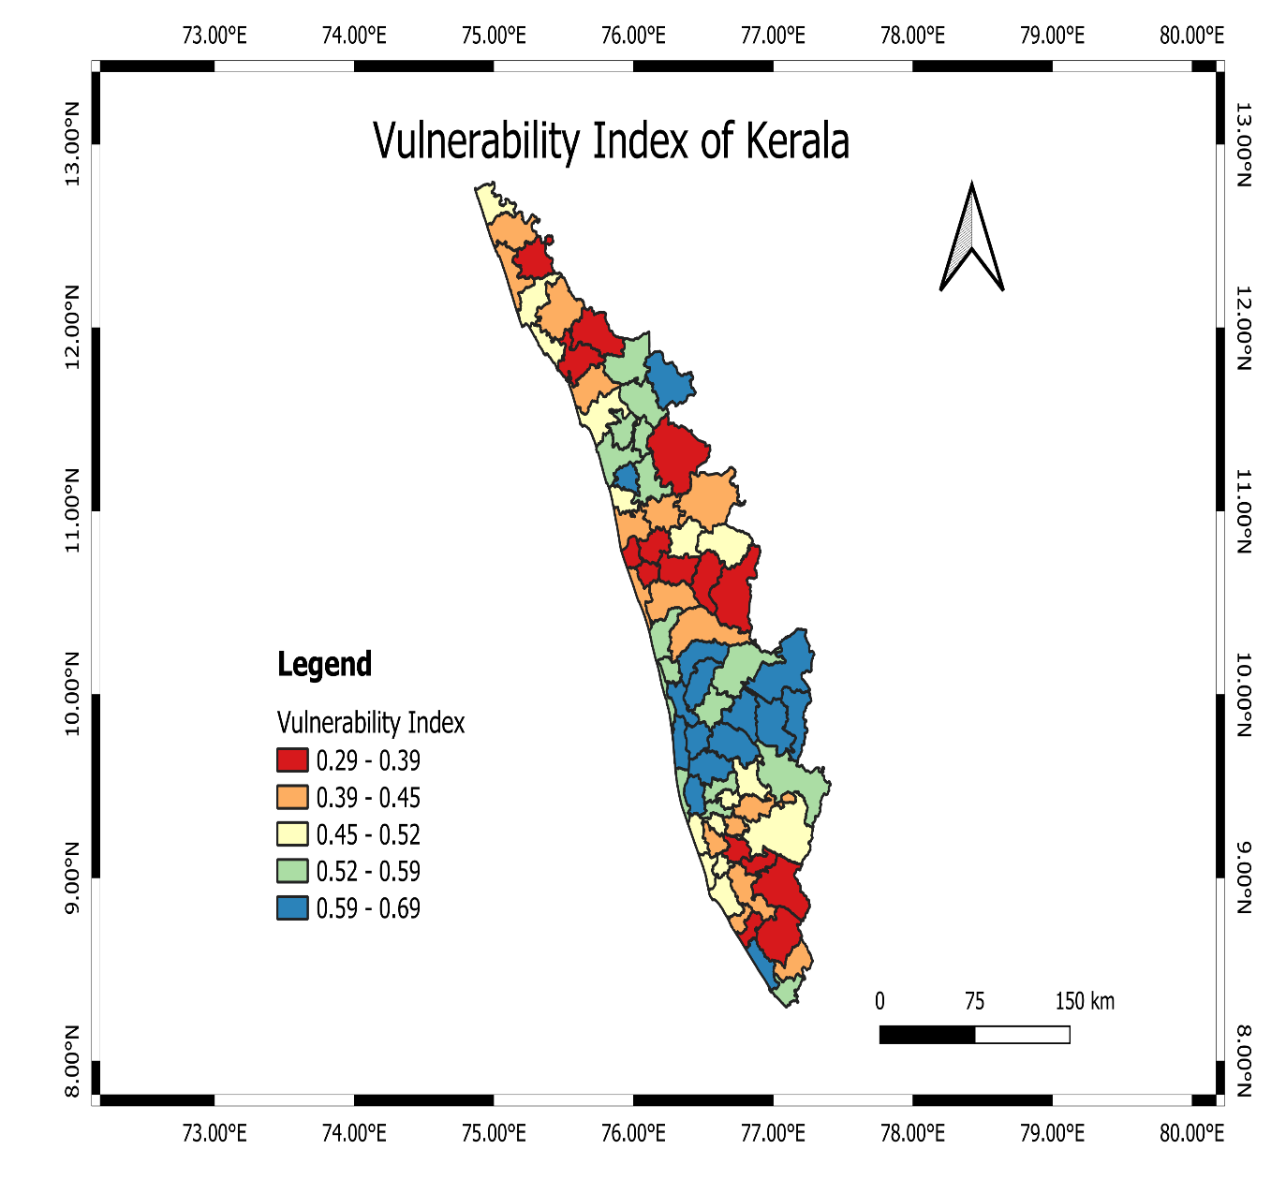
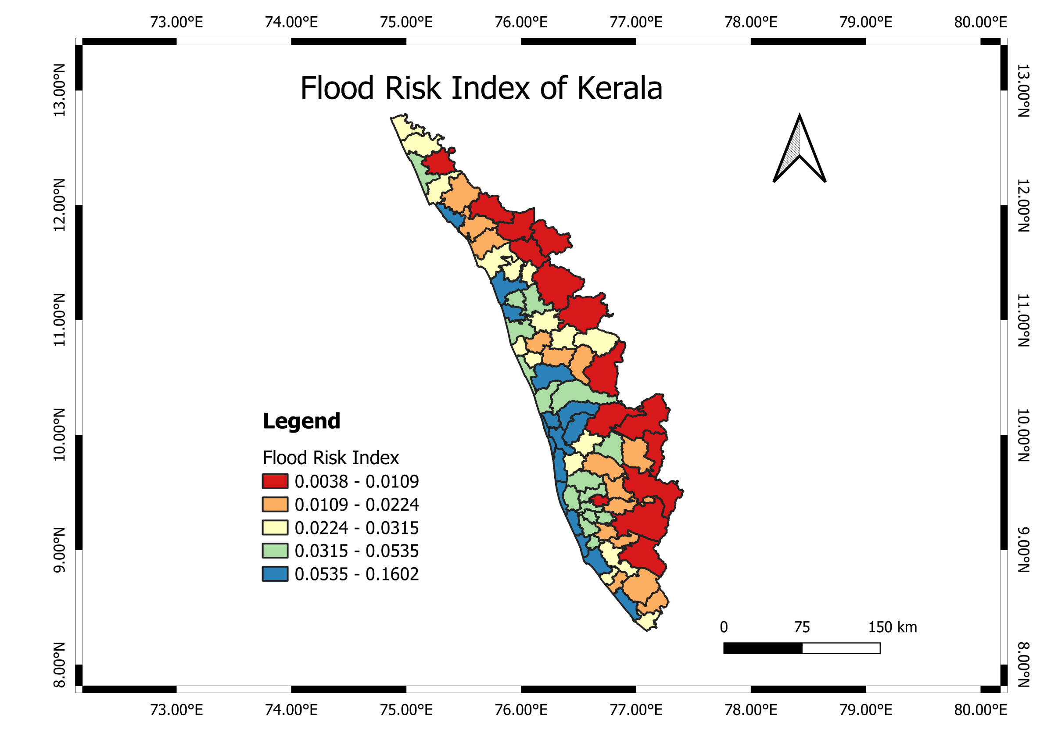
Southwestern India
8° 18ʹ to 12° 48ʹ N latitudes and 74° 02ʹ to 77° 22ʹ E longitudes
Arabian Sea in west
Western Ghats in east
Coastline of 590 km
14 districts
75 sub-districts
RISK ASSESSMENT OF FLOODS IN KERALA AT THE SUB-DISTRICT LEVEL
Aditi Gupta (200100009), B.Tech., M.E. and Akshay G (22M0788), M.Tech., C.S.E.
TD 656: Characterizing Hydro-Meteorological Hazards & Risk
1. INTRODUCTION
2. STUDY AREA
Flood Risk Assessment in Kerala
WHY?
Locating on southwest coast of India
Intense monsoon rainfall
Threat to lives and health
Biodiversity & Ecosystem Preservation
Threat to critical infrastructure
Agricultural dependency for economy
Research Gap | Literature Source
Study is limited to four districts of Kerala | Pramanick et al., 2021
Vulnerability is not considered for risk analysis | Lal et al., 2020
Only Flood Inundated Area is used for flood analysis | Joy et al., 2019
Location
Location Map of Subdistrict of Kerala (Study Area)
Demographics
2.76% of the Indian population ~ 860 people/km²
Sex Ratio of 1084 females per 1000 males
Climate
Tropical monsoon – Intense summer and rainfall
India’s 2nd highest monsoon rainfall ~ 300cm/year
Disaster Profile
Vulnerable due to seacoast and Western Ghats
Most common hazards – Flood and Landslide
A
I
M
Indicator-based risk analysis for Kerala
Flood risk map at subdistrict level
Preparedness of flood-prone areas
3. DATA AND SOURCES
Table: Indicators and their data source
Indicator(s) | Data Source
Elevation | Earth Explorer
River Density, Road Density | Diva-GIS
Rainfall | CHIRPS
Population Density, Built-Up Index, Deprivation Index, Cropland Ratio | SEDAC
Literacy Rate, Sex Ratio | Census 2011
Elevation
River Density
Rainfall
Road Density
Population Density
Built-Up Index
Deprivation Index
Literacy Rate
Sex Ratio
Cropland Ratio
4. METHODOLOGY
Maps of Indicators used for risk assessment
Identification of hazard and study area
Find potential indicators of Hazard (H), Exposure (E) and Vulnerability (V)
Data collection of indicators from varied sources
Normalisation of data
1 = high, 0 = low
Additive aggregation with equal weighting to find indices of H, E & V
Finalizing indicators by evaluating Variation Inflation Factor (VIF) < 10
Risk Assessment using
$$R=H×E×V$$
Risk Assessment using
𝑅=𝐻×𝐸×𝑉
Plotting maps and indicators-based analysis
5. RESULTS AND DISCUSSION
Hazard Index Map
Exposure Index Map
Vulnerability Index Map
D
I
S
CU
S
S
I
ON
Kochi
Kanayannur
Thiruvananthapuram
Ambalappuzha
Similarities: Along the western coast and highly populous
1. No Poverty
2. Zero Hunger
8. Decent Work and Economic Growth
11. Sustainable Cities & Communities
13. Climate Action
15. Life on Land
Sub-districts with high risk (>0.1)
SDGs to achieve for lowering risk
Steps followed for indicator-based Risk Analysis
Table: Risk indicators, their importance and correlation
Risk Indicators | Remark | Corr.
Elevation | High elevation signifies lower risk and vice-versa for low-lying areas. | H (-)
River Density | Riverbanks area faces higher floods. | H (+)
Rainfall | Identifies and maps flood-prone areas in case of high precipitation. | H (+)
Road Density | Impacts accessibility of services and serves as conduits for floodwater. | E (+)
Population Density | Indicates more potential of human casualties, effect and displacement. | E (+)
Built-Up Index | Indicate risk due to impervious surfaces and poor drainage system. | E (+)
Deprivation Index | Indicates the poverty. Poor find it difficult to recover from floods. | V (+)
Literacy Rate | Informed people (literate) make better flood mitigation decisions. | V (-)
Sex Ratio | Emotionally, women threaten their lives to save their families’ lives. | V (+)
Cropland Ratio | More crop area indicates economic prosperity and food security. | V (-)
Flood Risk Index Map
6. CONCLUSIONS AND FUTURE RECOMMENDATIONS
Conclusions
Flood risk assessment at the sub-district level in Kerala using QGIS software. An indicator-based analysis is done to map hazard, exposure and vulnerability and finally plot a risk map that can be used for the flood risk management.
Limitations and Future Recommendation
Limitation of Data: Used data was collected a decade back and the analysis is not that useful for current scenario. Data collection should be done recently.
Indicator-based study: Indicator-based approach may not capture complexity of the problem and should be complemented with other methods as well.
Weighting Methodology: Complex weighting techniques like AHP to be used.
Notes:
References:
Lecture Slides of the course TD656: Characterizing Hydro-Meteorological Hazards & Risk, taught by Prof. Parmeshwar D. Udmale of CTARA, IIT Bombay
Kerala Post Disaster Needs Assessment: Floods and Landslides - August 2018 (October 2018) - India.https://reliefweb.int/report/india/kerala-post-disaster-needs-assessment-floods-and-landslides-august-2018-october-2018
“Administrative Profile: Climate – Status of Environment Related Issues: Kerala ENVIS Centre, Ministry of Environment and Forests, Govt. Of India.” Kerenvis.nic.in, 2018, https://kerenvis.nic.in/Database/CLIMATE_829.aspx#:~:text=The%20climate%20of%20Kerala%2C%20as.

