Slide 1
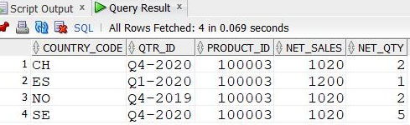
Geography wise sales report for Europe Region
Database Output
Purpose:
To determine sales based on geographical location for HAMY Biologics
Benefit:
The output will help us to track company sales, net quantities sold and geographical expansion according to sales. Also, interaction with our data in natural language feature in the report minimizes the analysis of the report. When we start typing in the text box, it gives suggestion inline For instance, once we type total sales, we get a suggestion to get results by product, by date or by Geo.

Slide 2
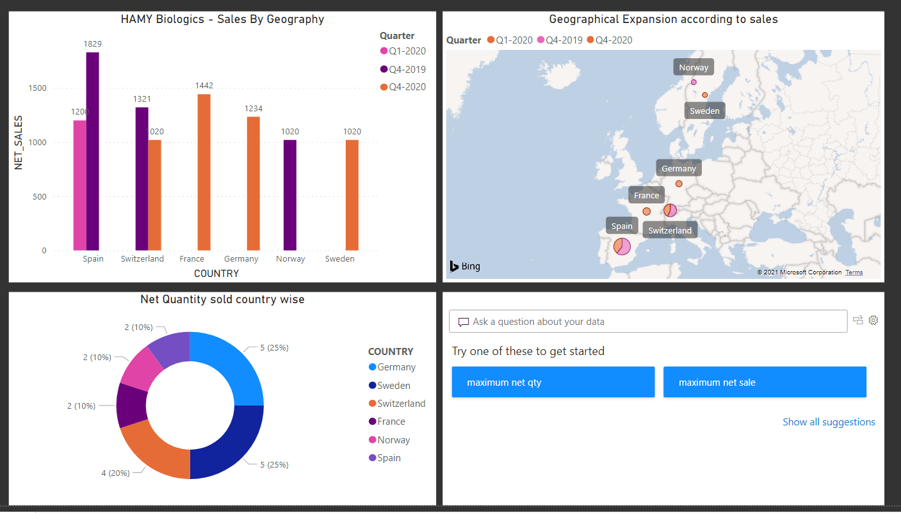
Dashboard Output:

Slide 3
Market Share Report
Database Output
Purpose:
Determine market share for all products including competitor products.
Benefit:
This will aid us in determining the success and market dominance of competitors. We've just looked at the gastroenterology industry in out dataset.

Slide 4
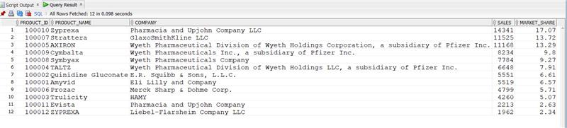
Product Wise Sales Report
Database Output
Purpose
Understand how the company’s product is performing against competitor product in that market.
Benefit
This will help us understand the performance and dominance of competitor products in the market when compared to our product.

Slide 5
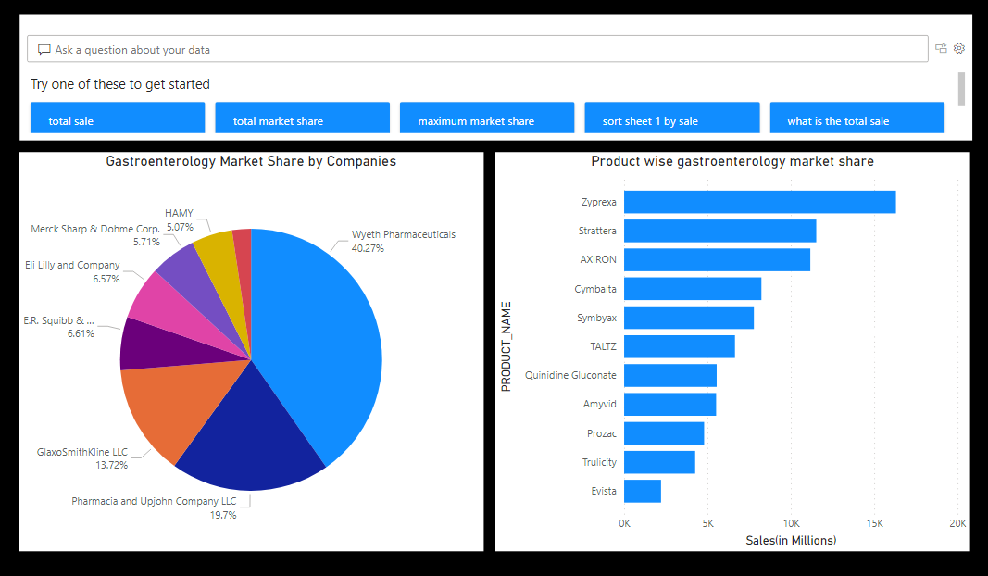
Dashboard Output:

Slide 6
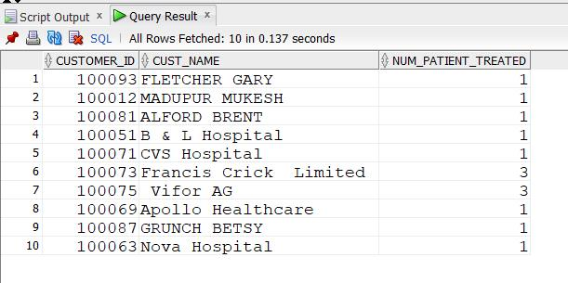
Patient Treated by HAMY Biologic product Report
Database Output
Purpose
Determine number of patients treated by the company’s product
Benefit
This will help in analyzing the density of patients being treated with a particular product

Slide 7
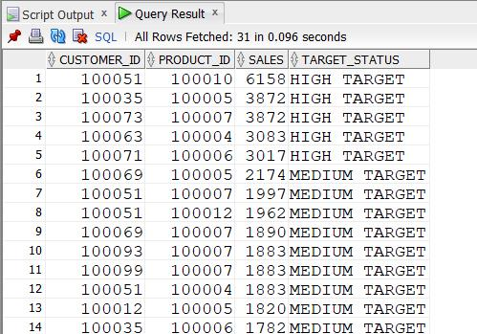
Target Customer Report
Database Output
Purpose
Determine customers prescribing high volumes of competitor products.
Benefit
This will help us in determining prospect customers for our company. These customers are already prescribing high volume of competitor product and hence our company needs to influence them to prescribe our product.

Slide 8
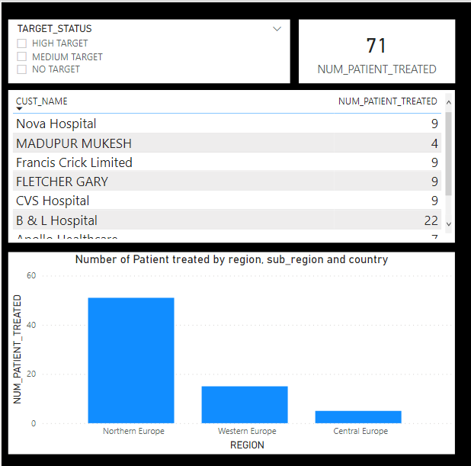
Dashboard Output:

Slide 9

Conclusion
Creating a structured database and visualization reports to interpret the data has reduced a 75% of ad-hoc requests and saved 350 working hours annually.
01
Using interactive digital dashboards to turn data into actionable insights, allowing you to spot flaws, recognize strengths, and forecast market-share and patients treated with HAMY Products.
02
Targeting customers and patient switch-in & switch-out details from HAMY products are at your fingertips, allowing you to make precise business decisions and increasing the revenue overall.
03

