Slide 1
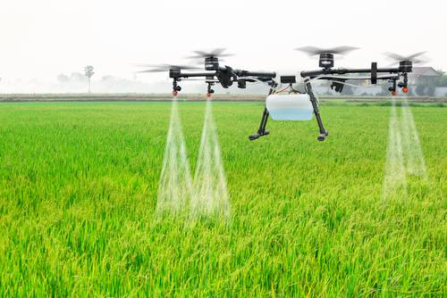
RESOURCE SHARING THROUGH CONNECTED WORLD

Slide 2
INTRODUCTION :
The economic contribution of agriculture to India's GDP is steadily declining mainly because of Urbanization.
Farmers are migrating to cities after facing many problems.
Proper Utilization of the available resources are getting reduced.

Slide 3
PROBLEM STATEMENT :
Biggest problems faced by farmers is due to lack of
availability of Manures ,fertilizers , biocides ,seeds , machineries not in terms of raising crops.
The resources of farmers are kept unused in most of agricultural steps.
So to overcome this problem, proper communication between the farmers is to be established.

Slide 4
SOFTWARE :
Android Studio IDE
Firebase real-time database

Slide 5
METHODOLOGY:
To solve this problem ,we had developed an application which will help farmers to lend their Daily-used products.This is IOT based application , which connects all the resources through internet to make use everywhere.
So this application behaves as an platform to interconnect farmers.

Slide 6
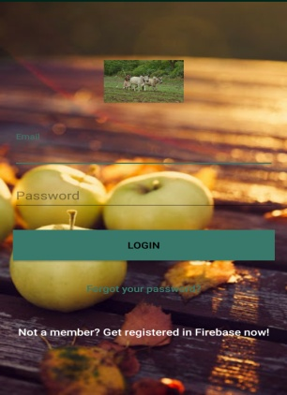
WORKING :
LOGIN AND REGISTRATION FORM
App Overview :
Initially one who wants to use the application have to create account than this app alows to login.

Slide 7
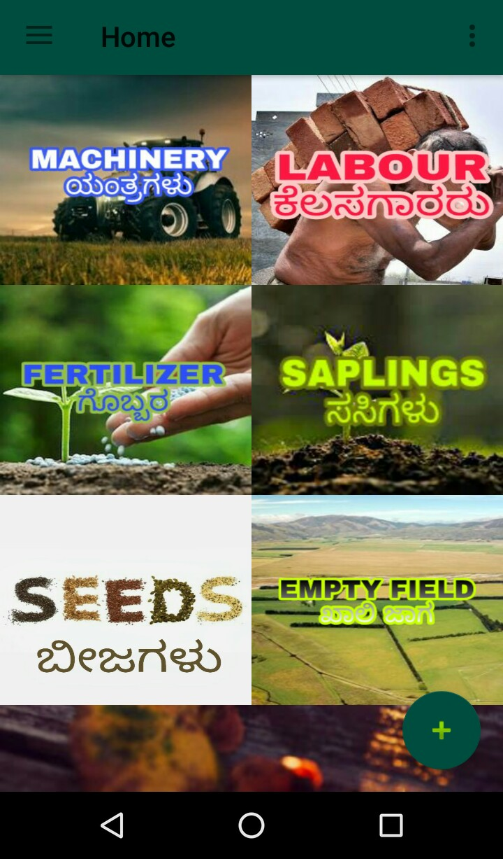
Home Page :
Click add button and
select required category
to add new field

Slide 8
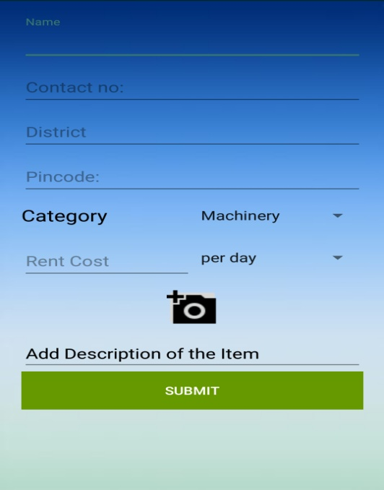
New entry Form :
Upload all the details which will be
authenticated.
Add photos ,phone number and
the cost of the resource/days.
Click on Submit
User-Data is
Stored onto firebase

Slide 9
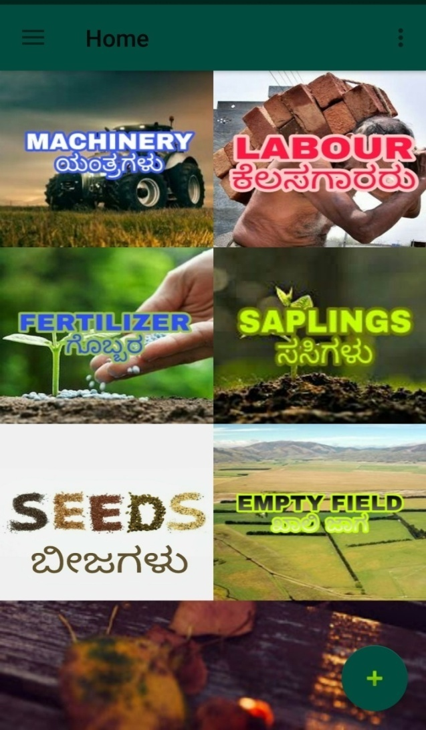
TO ACCESS RESOURCE :
Click on any of the fields
to book the required resources.

Slide 10
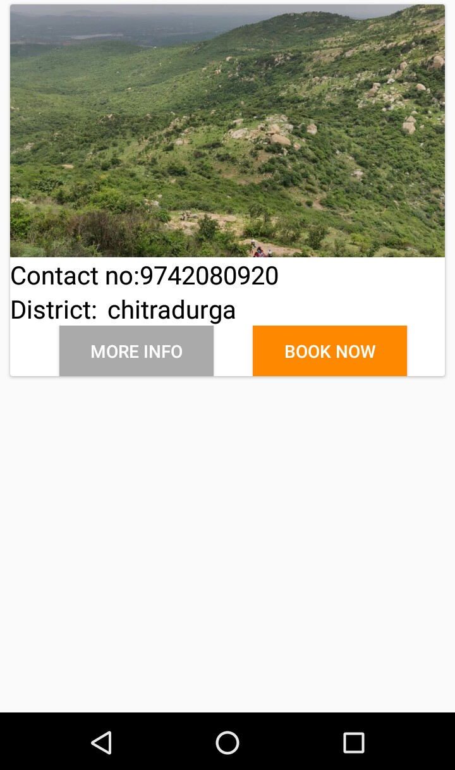
Booking :
Book now to post the
resources.
Add the details in the given boxes
Confirmation mail will be
sent to your registered email
id after booking has been confirmed.

Slide 11
THANK YOU

