Slide 1
Battle Of Neighbourhood
Bangalore City - A Perfect Area to Live

Slide 2
Introduction
Bengaluru (Bangalore) known as the IT & Start-up Capital of India is located in the state of Karnataka. This is in the southern part of India.
Everyone of us to dream to live in a prefect city with all the necessities and luxury available. So, Bangalore is one among those cities in India where people dream to live. But most of the people doesn't know much about Bangalore and its Geography, and find a problem in finding a suitable area to live which has the minimum basic necessities within a specified radius limit.

Slide 3
Business problem
Bangalore has a population of more than 1.25 Crore, and suffers a lot of traffic issues.
And living here is dream and a challenge too.So its challenging job to find a area to which u will fit into.
The main problem is that most of the people doesn't know much about Bangalore and find a problem in finding a suitable area to live which has the minimum basic necessities like Schools,Resturants,Cafes,Hospitals,Public Transport,Temples,Grocerry,Shops etc.., nearby.
So, there needs a model which provides a list of locations that has all the above mentioned necessities

Slide 4
Solution
So the solution to the above problems is to use the geoloaction of different areas and find out an area with all the necessities mentioned above.
And I hereby using the Data Science concept list out those ares that satisfy the predefined necessesities I mentioned above.

Slide 5
Target Audience
The people with a dream to live in a IT & Statup Capital of India - Bangalore. And who are in confused state of finding a good location in Banagalore that satisfies there basic recquirements.
As this would help them to find a better place of their choice in less time.

Slide 6
Data
A JSON File BBMP.GeoJSON which contains the list of different areas in the city - Bangalore and its Geoloaction,population,etc..,
File Contais JSON objects with,
Name of the area
its lattitude & longitude
population
A Foursquare API to get the details of venues of different Categories in the give geoloaction and radius limit.

Slide 7
Data….
This API used to find out different categories of venues like,
Schools
Resturants
Parks
Cafes
Hospitals
Public Transport
Temples
Grocerry
Shops etc..,

Slide 8
Methodology
The main component of the data is the different geolocation of the bangalore city.
The Lattitude & Longitude of the geolocation were taken
Foursquare API Used to get all the categories of venues in a given location within 3 KM of radius
Then a analysis is made to study the area
Calculated the net Score of the area for having the recquirements
Clusttered the areas on the basis of their score
Data Visualisation - Box Plot
Data Visualisation - Map

Slide 9
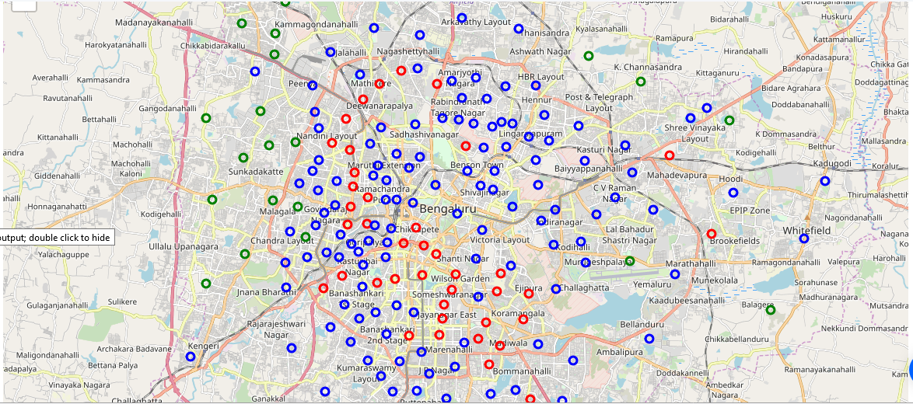
Map

Slide 10
Results
All the areas net score was calculated
It is visualised using the Box Plot & Map
Different location were mapped depending upon the score
Different Score had different colours, like
RED --> Good
BLUE --> Average
GREEN --> Poor

Slide 11
Conclusion
Many Areas had their own features leading to different Scores
Most of the areas had a average score and few had a good score
So, An individual can select the area of interest on the net score. Selecting a red coloured area on the map enables him a better living by providing all the recquirements in the radius of 3 KM.

Slide 12
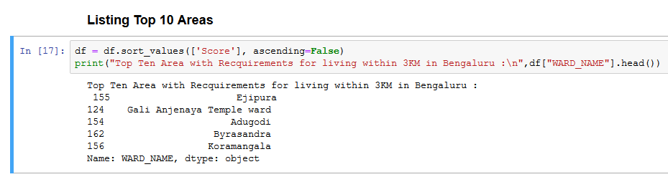
Final Result

