Slide 1

Wildfire Cause Prediction Using Machine Learning
Team 6: Akshay Govind & Varun Singh INFO 6105 – Data Science Engineering Methods and Tools Northeastern University, Spring 2026

Slide 2

Agenda
Problem Statement
Dataset Overview
Feature Engineering & Methodology
EDA Highlights
Models & Results
Conclusion & Future Work

Slide 3
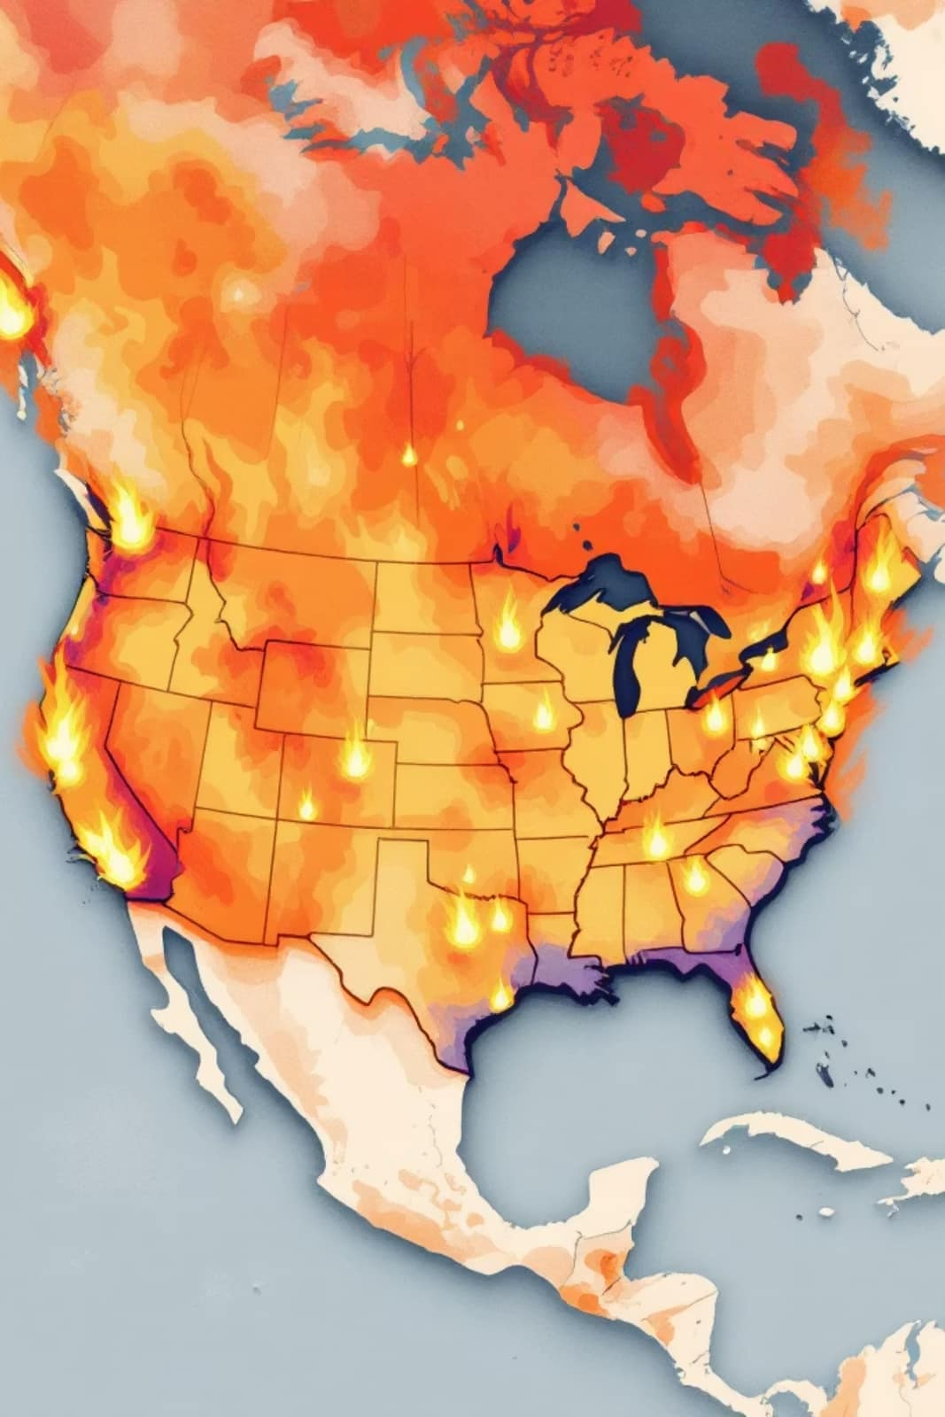
Problem Statement
The Challenge
Binary Classification
Every year, thousands of wildfires ignite across the United States. Our goal: develop a machine learning system to automatically classify whether a wildfire was caused by human activity or natural phenomena (lightning strikes).
0 = Natural (Lightning)
1 = Human (Arson, Debris Burning, Campfire, Equipment Use, etc.)
Dataset: 1.88 million wildfire records from 1992–2015

Slide 4

Dataset Overview
1.88M
Wildfire Records
USDA Forest Service database
52
US States
Coverage across all regions
1992-2015
Time Span
24 years of historical data
12
Features
After cleaning and engineering
Original 777 MB SQLite database with 39 raw columns, cleaned to 1,713,742 rows with 12 engineered features. Class imbalance: 83.8% human-caused vs 16.2% natural fires (5.2:1 ratio).

Slide 5
Feature Engineering
Fire Size
Latitude & Longitude
Acres burned
Geographic coordinates
Fire Year & Season
Region
Temporal features
West/Central/East
Is_Drought_Season
Owner_Type
Seasonal drought indicator
Federal/State/Private land
Additional features: Fire Size Class, State, Response Time, State_Fire_Rate

Slide 6





Methodology
Data Cleaning
Removed 166K unknown-cause rows, converted Julian dates, filled missing response times
Feature Engineering
Created 5 new features including season, drought indicator, region, fire rate, owner type
Train/Test Split
80/20 stratified split (1.37M train, 342K test)
Scaling
StandardScaler fit on training data only, LabelEncoder for categorical columns

Slide 7

Exploratory Data Analysis Highlights
Most Common Cause
Top Fire States
Debris Burning accounts for the largest share of human-caused wildfires
California, Georgia, and Texas lead in total fire counts
Geographic Pattern
Human-caused fires dominate the eastern US; natural fires spread across the West
Fire frequency peaks dramatically in summer months. Larger fires are slightly more likely to be natural. Geographic location is the strongest predictive signal.

Slide 8
Models Trained
Logistic Regression
LinearSVC
K-Nearest Neighbors
Baseline model with class_weight=balanced
Same settings as logistic regression
k=15, trained on 100K stratified sample
Decision Tree
Random Forest
max_depth=5 for interpretability
GridSearchCV tuned: 200 trees, max_depth=30, min_samples_leaf=1

Slide 9
Results Comparison
Model
Accuracy
F1 Score
ROC AUC
Logistic Regression
80.9%
0.8758
0.8834
SVM (LinearSVC)
80.9%
0.8756
0.8822
KNN (k=15)
90.7%
0.9452
0.9215
Decision Tree
85.8%
0.9103
0.9138
Random Forest (Best)
93.2%
0.9598
0.9579

Slide 10
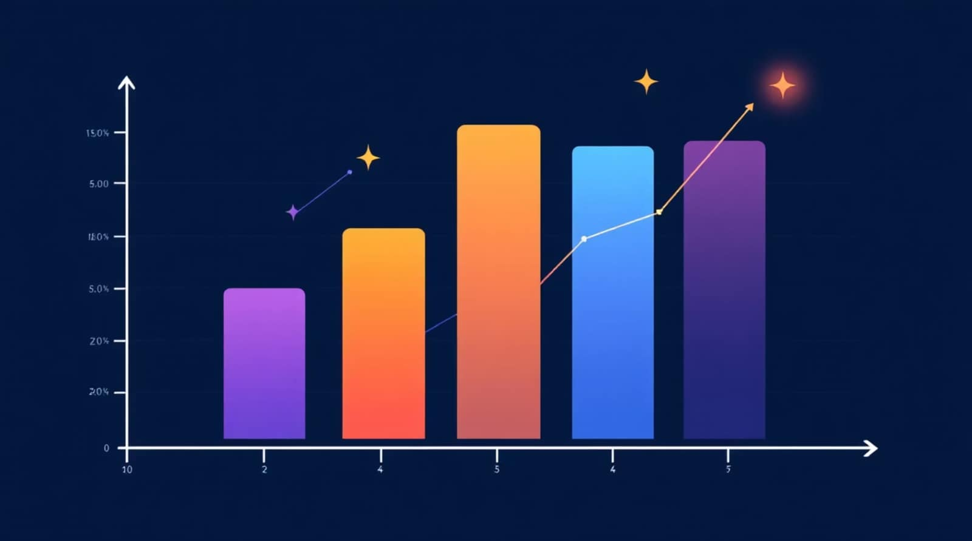
Hyperparameter Tuning & Feature Importance
GridSearchCV Results
Tested 27 hyperparameter combinations across n_estimators, max_depth, and min_samples_leaf
Best parameters: n_estimators=200, max_depth=30, min_samples_leaf=1
5-Fold CV Performance
F1 scores: [0.9585, 0.9590, 0.9592, 0.9591, 0.9590] Mean: 0.9590 | Std: 0.0003
Stable model with no overfitting
Top Features
Longitude (0.267 importance)
Latitude
Owner_Type
Is_Drought_Season
Region
Geographic features account for >50% of predictive power. Engineered features validated in top 5.

Slide 11
Conclusion & Future Work
Best Model
Linear Models Plateaued
Random Forest achieved F1=0.9598 and AUC=0.9579
F1≈0.876 — linear boundaries can't capture geographic complexity
Key Insight
Improvement Sources
Location (longitude/latitude) is more predictive than timing or fire size
Feature engineering contributed +0.08 F1; GridSearchCV confirmed optimal parameters (n_estimators=200, max_depth=30, min_samples_leaf=1); baseline RF already achieved F1=0.9597, tuning improved AUC by +0.0032
Limitations & Future Directions
No weather data (temperature, humidity, wind)
KNN limited to 100K sample due to computational constraints
Data covers only 1992–2015
Future: integrate NOAA weather data, try XGBoost/LightGBM, build multi-class classifier, deploy as real-time API

Slide 12
Thank You
Akshay Govind & Varun Singh
INFO 6105 - Northeastern University

