Slide 1

DATA ANALYIS ON UBER PICKUPS IN NEW YORK CITY

Slide 2


Outline of the presentation
WHAT’S THE DATA ABOUT ?
WHAT ARE THE FACTORS THAT DECIDE THE PICKUPS?
WHAT ARE THE TRENDS OBSERVED IN THE DATA?
CONCLUSION AND RECOMMENDATION

Slide 3
Data set information
Uber pickups data of New York
Data of 5 boroughs has been provided: Manhattan, Bronx, Staten Island, EWR and Queens
Approximately 29,000 rows and 14 columns in the dataset
Contains demographic, weather, holidays and time data

Slide 4
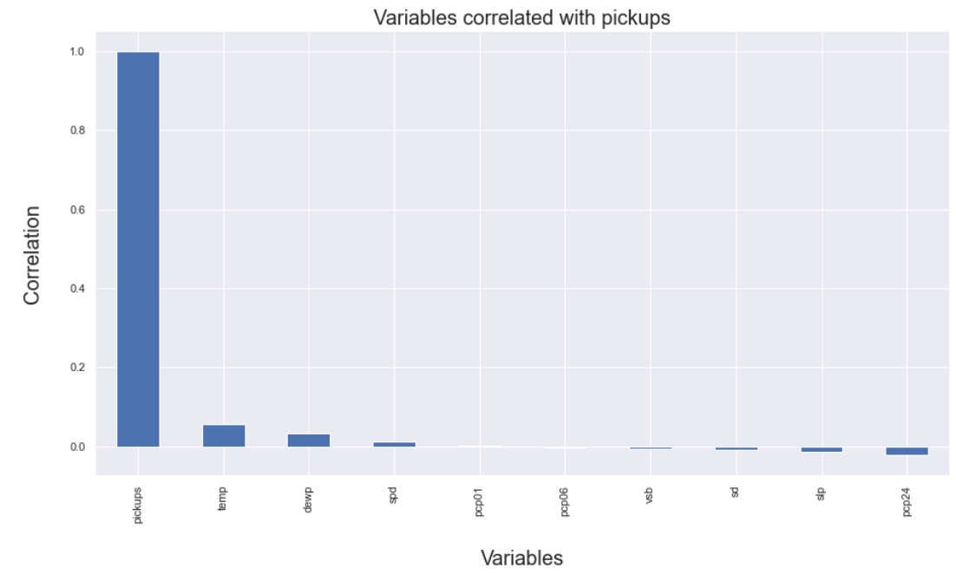
BAR CHART CORRELATION

Slide 5

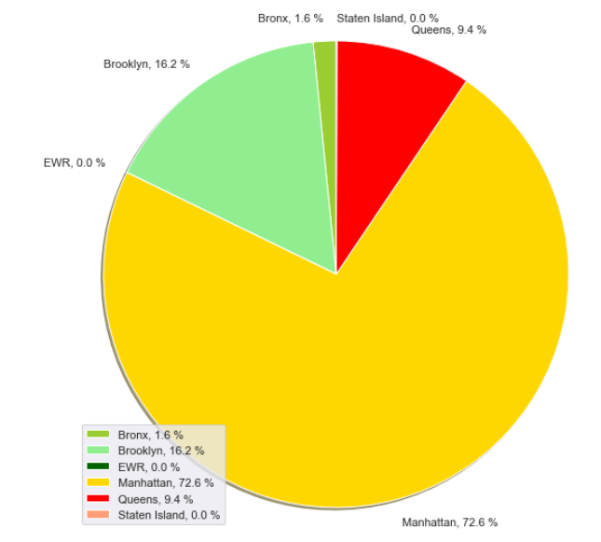
MARKET SHARE OF DIFFERENT BOROUGHS
1. Manhattan: 72.6%
2. Brooklyn: 12.6%
3. Queens: 9.4%
4. EWR: 0%
5. Staten Island: 0%

Slide 6
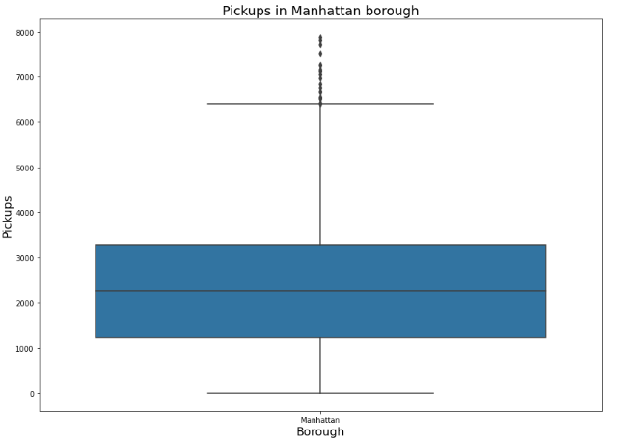
Box plot
1. Median: 2300
2. 25th percentile: 1100
3. 50th percentile : 2300
4. 75th percentile: 3200

Slide 7
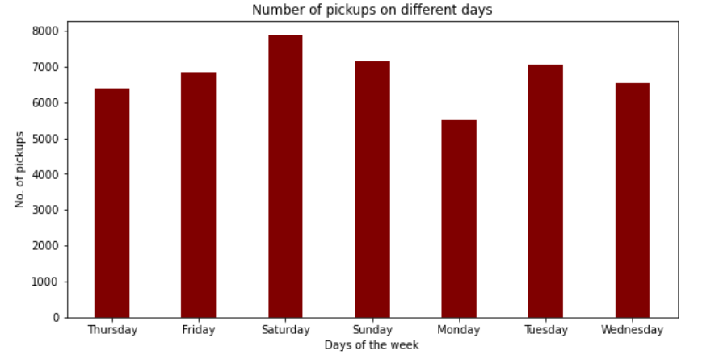
Bar chart

Slide 8
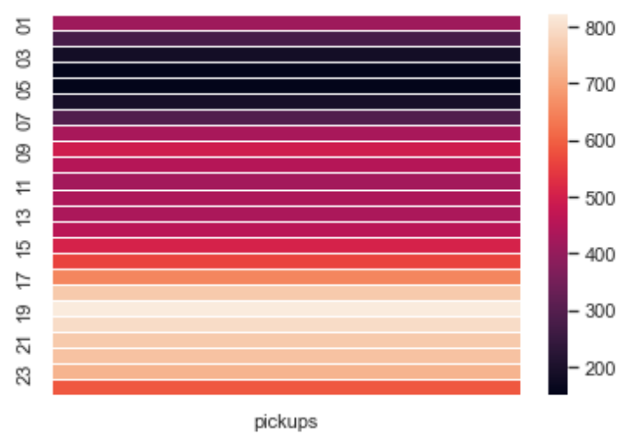
HEAT MAP

Slide 9
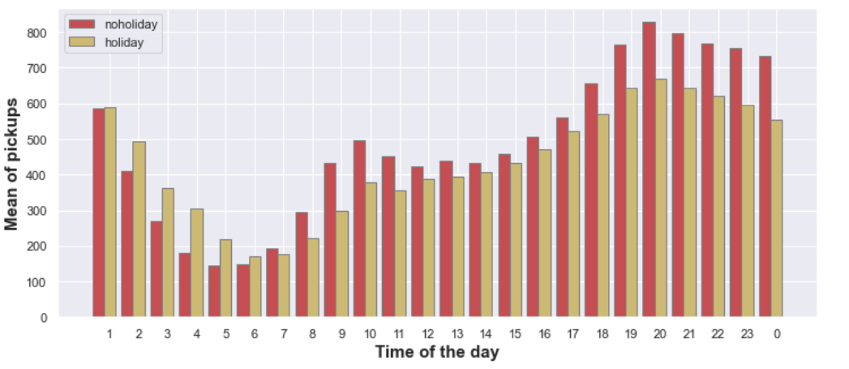
Double bar chart

Slide 10
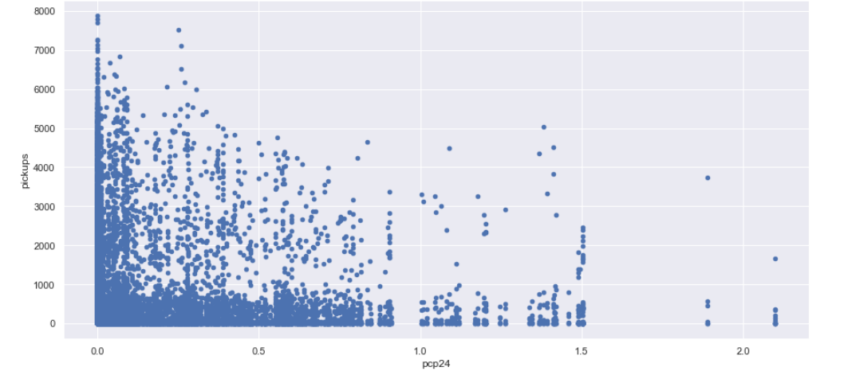
SCATTER PLOT

Slide 11
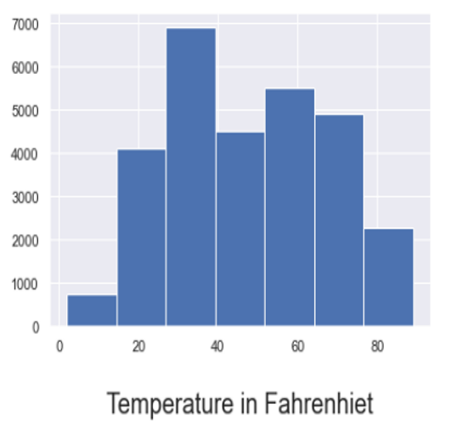
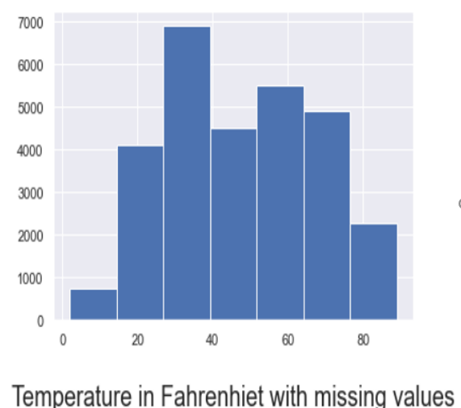
HISTOGRAM

Slide 12
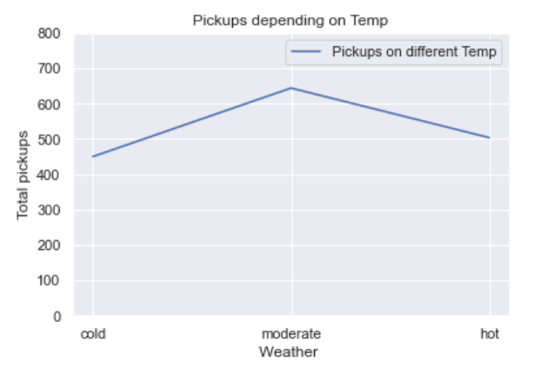
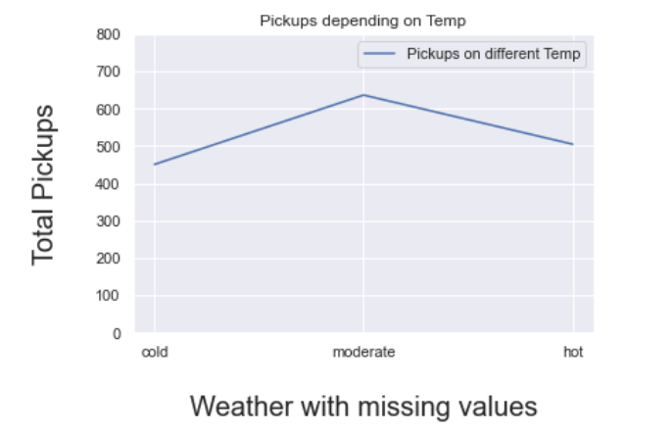
LINE PLOT

Slide 13
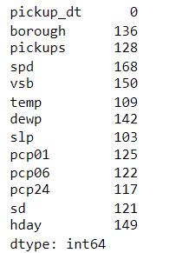
MISSING VALUES

Slide 14
CONCLUSION
In the city of New York, Manhattan had the highest market share
During the weekdays, people tend to travel more on Thursday and Friday
During the weekend, people tend to travel more on Saturday
Highest pickups are observed in the morning time from 7:00AM-11:00AM and from 3:00PM – 8:00PM in the working days
During the holiday season, we observe more pickups in the time range of 1:00AM-6:00AM than a normal day
Temperature plays a big role in deciding the number of pickups
In the city of New York, Manhattan had the highest market share
During the weekdays, people tend to travel more on Thursday and Friday
During the weekend, people tend to travel more on Saturday
Highest pickups are observed in the morning time from 7:00AM-11:00AM and from 3:00PM – 8:00PM in the working days
During the holiday season, we observe more pickups in the time range of 1:00AM-6:00AM than a normal day
Temperature plays a big role in deciding the number of pickups

Slide 15
recommendations
Week Days - Introduce concept of peak hour bonus per ride
Holidays/Weekends - Introduce concept of holiday bonus per ride
Planning ahead for any type of weather changes in the recent months
Based on the predictions of the weather changes we can start a “Weather Shield” program for increasing customer satisfaction

