Slide 1
Catching up to Anduril
Notes:
https://www.unmannedsystemstechnology.com/company/sense-aeronautics/automatic-target-recognition/

Slide 2
Career Summary
Path Planning
Navigation
Motion Control
Autonomy
Automated Target Recognition
Single Shot Detector (SSD)
Real-Time Detection Transformers (RT-DETR)
Notes:
https://www.anduril.com/mission-autonomy/

Slide 3
Path Planning
allows robots to have control over their location

Slide 4
Navigation
In most situations shortest-time = shortest-distance = shortest-energy
How to navigate in domains where this is true
Collapse euclidean space into a graph-based representation
Visibility Graphs
Naive (n^4)
Lee's Visibility Algorithm (n^2 log(n))
Ghosh-Mount Algorithm (nlog(n))

Slide 5
Postmortem

Slide 6
Motion Control
Efficiently navigate through time-energy-space constrained domains
Shortest time != shortest distance != shortest energy
Nonlinear optimization

Slide 7
Path Planning
Use Convex optimization to find good bezier curve control points
Use Mixed Integer planning to find good edges

Slide 8
Postmortem

Slide 9
Autonomy
Allows robots to conduct surveillance autonomously
Latency Graphs

Slide 10
Postmortem

Slide 11
Automated Target Recognition
allows robots to capture relevant features in their environment

Slide 12
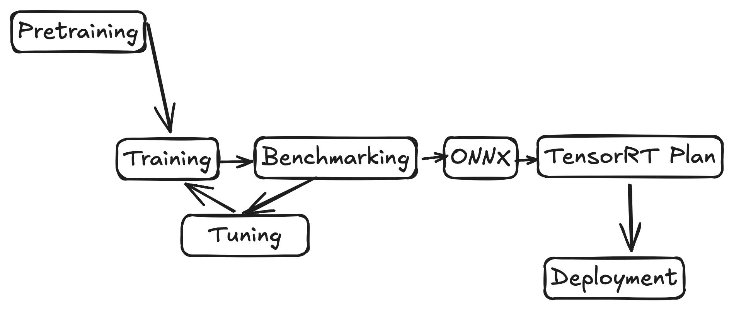
Single Shot Detector
Use convolutional filters to filter feature maps into objects
Architecture research to deployment

Slide 13
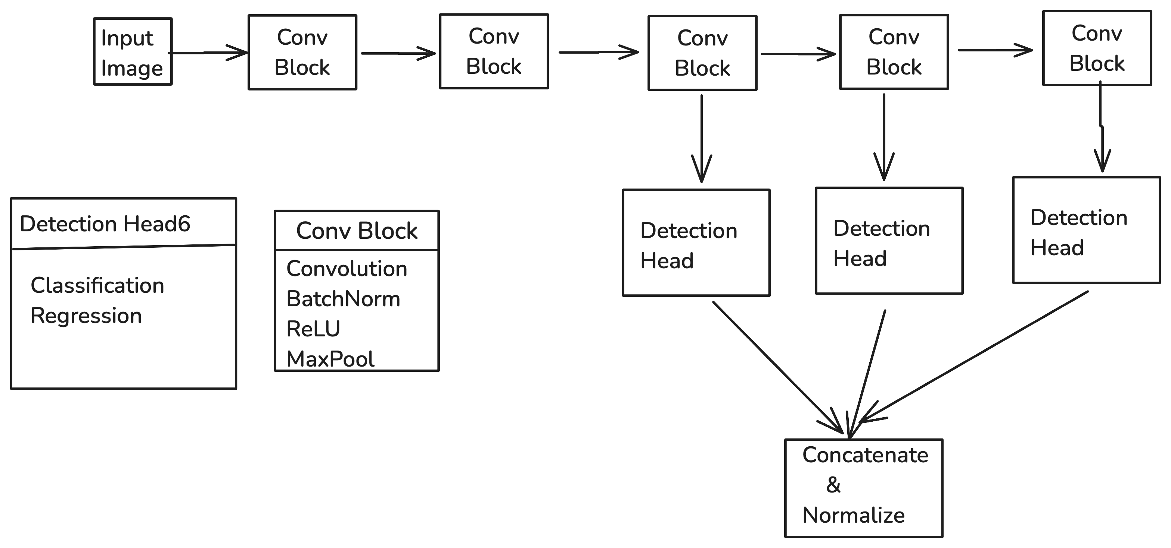

Slide 14
Postmortem

Slide 15
RT-DETR
Uses attention for translational context
Wrote dataloaders
Conducted training runs
HEY

Slide 16
Postmortem

Slide 17
Reinforcement Learning
Flappy Bird Case Study

Slide 18
Background
Mathematical framework for sequential decision making
Formally described with Markov Decision Processes (MDPs)
State Space S
Action Space A
Environment Dynamics P(S',R | S,A)
Reward function R(S' | S,A)
Trajectory: Interaction with the environment

Slide 19
Q-Learning
Use a table to store each state-action
Propagate rewards backwards each timestep
Q-tables need an entry for each state-action
Mathematically impossible in Real numbers
Practically impossible in float32
Manual feature-engineering is a popular technique

Slide 20
"Deep" Q-Networks
Automates feature engineering with neural networks
Analyze compressed state representations where actions are consistent
Credit assignment happens without trying

Slide 21
Postmortem
Should have started with replicating prior work

